Slide 1
Load Management
Lecture 14
Srinivas Narayana
http://www.cs.rutgers.edu/~sn624/553-S25

Slide 2
Distribution & its consequences
=
Internet services use replication to tackle machine failures and unavailability
So far: Data replication: consistency
But compute also requires replication
Compute replication is critical for performance
Geo-replication (e.g., failover and balance across metro regions)
Replication within a cluster (e.g., 100s of processes serving the same app within a cluster)

Slide 3
Load management
Global: How to direct user load across clusters?
Key performance considerations
Query traffic: Low latency
Data uploads: High throughput
Local: Within a cluster, how to manage the load?
Machines within a cluster are presumably similar to each other
Key: Avoiding hotspots and reducing overprovisioning

Slide 4
Global load balancing
Primary mechanism: DNS
Use IP anycast to talk to “nearest” (acc to BGP) authoritative DNS servers. Auth servers redirect user to location/server closest to them through a single DNS response.
Problem: clients rarely talk directly to auth DNS server (go through recursive resolvers). Resolvers hide client count and geo-diversity. They also cache responses.
Mitigations: estimated users and geo-diversity behind resolvers. Issue low TTL responses (adds latency)
DNS response sizes are bounded. Client will choose randomly from among responses; don’t know who is closest.

Slide 5
Virtual IP addresses per datacenter
Use a virtual IP address (VIP) to cover many real IP addresses
Hide growth, failures, maintenance in server pool from users
Use DNS with large TTL. Save latency.
Effectively decouple cluster-external from internal
Alternative: can we use IP anycast directly to get to edge?
But anycast need not be stable! BGP route flaps
Send to a different edge at any time, even in the middle of a connection

Slide 6
Frontend load balancing
Layer-4 load balancers spray connections across HTTP reverse proxies
Reverse proxy terminates TCP/TLS and re-encrypts to backends. Maintain persistent connections to backends
Terminate TCP/TLS as close to the user as possible
ECMP: easily add more L4 LBs to pool
Stabilize anycast through consistent hashing. Cannot rely on connection state shared across L4 LBs

Slide 7
Maintaining even load
Uneven load == stranded resources
Solution == spray requests across processes?

Slide 8
Problem: Statefulness
A user’s connection may have to reach the same machine (e.g., reverse proxy, or backend server)
Choosing a different reverse proxy will break TCP connections.
Having to estasblish new connections will degrade the performance advantages of reverse proxying in the first place
Backend process may have additional state: e.g., HTTP cookies, or other local execution state per connection

Slide 9
Connection tracking and consistent hashing at the L4 LB
Remembering connections by putting them in a connection tracking table: 5-tuple → backend
Not always possible
Even the load balancer forwarding a packet may change mid-connection
SYN floods and crowds may overwhelm connection tracking table
If a packet’s connection cannot be found in the connection, use a hash function h(packet) to determine the backend
Naïve choices: break connection when proxy pool changes
Need consistent hashing: even if the backends change, the backends for existing connections should be minimally disrupted

Slide 10
Maglev (L4 LB) forwarder
Multi-threaded (parallelism)
Don’t share state across threads. Each 5-tuple steered to a core.
Connection tracking table is local to the core

Slide 11
Hash table population
Each backend now uses a random (unique) permutation
Backends choose slots based on the permutation.

Slide 13
Actual packet forwarding
(1): NAT tables: map incoming connections to outgoing
Stateful; large tables
(2) Modify destination MAC address
Direct Server Return
But cannot have all machines in one L2 network
(3) Encapsulation (e.g. GRE). If a route exists, it works.
Server will decapsulate the packet and use DSR
Inflate packet size and possibly cause fragmentation

Slide 14
Disruptions on lookup table change

Slide 16
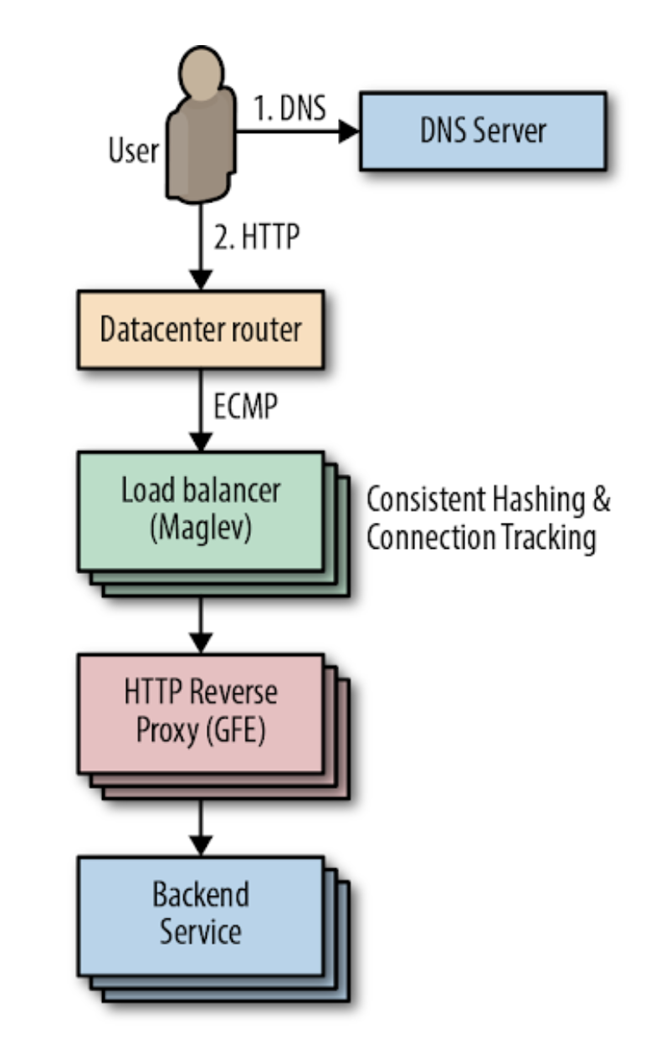
Beyond the reverse proxy
Problem 1: avoid unhealthy backends first
One strategy: Pick backend server with least outstanding requests. If too many outstanding requests, avoid those backends altogether
Problems?
Only avoids extreme overload; backend can overload even before this limit is reached
Processing time of a request may be large, doesn’t mean the server cannot take on more requests
“Lame duck” state: a backend can proactively signal that it is unhealthy to avoid new connections, while finishing processing requests in flight

Slide 17
Beyond the reverse proxy
Problem 2: choose among available healthy backends
Don’t maintain a connection to every backend: memory and CPU per connection
Establish a new (backend) connection per (user) connection? Long lived?
Connect to a subset of backends
How large?
Load variation from each reverse proxy
# backends >> #RPs
Which backends of that size?
Random subsets unevenly load-balanced
Use deterministic subsets in time-based rounds

Slide 18
Strategies to choose backends
Backend load and capacity agnostic: round robin. Insufficient
Small subsets: some clients heavier than others
Diversity in machine capacities (CPU architectures, speeds, cores)
Variation in work for each request (1000x). Hard to predict
Unpredictable performance changes (noisy neighbors, task restarts)
Assign to least loaded backend? (currently active load)
Good: move load away from loaded backends
Bad: Typically considers load without regard to available capacity
Bad: Long-lived requests
Bad: per-RP view of load
One approach: weighted (RR) splitting with load and error feedback from backends

Slide 19
Autoscaling
Sometimes, you just don’t have enough capacity
Vertical autoscaling
Horizontal autoscaling
Don’t just rely on server utilization metrics. For example, error codes returned very quickly have low CPU utilization
Creating new instances is never instant
Doesn’t always work:
Failure to do useful work but consuming resources
Overloading downstream dependencies by autoscaling upstream tier
Shared quotas across tiers: reason with dependencies carefully

Slide 20
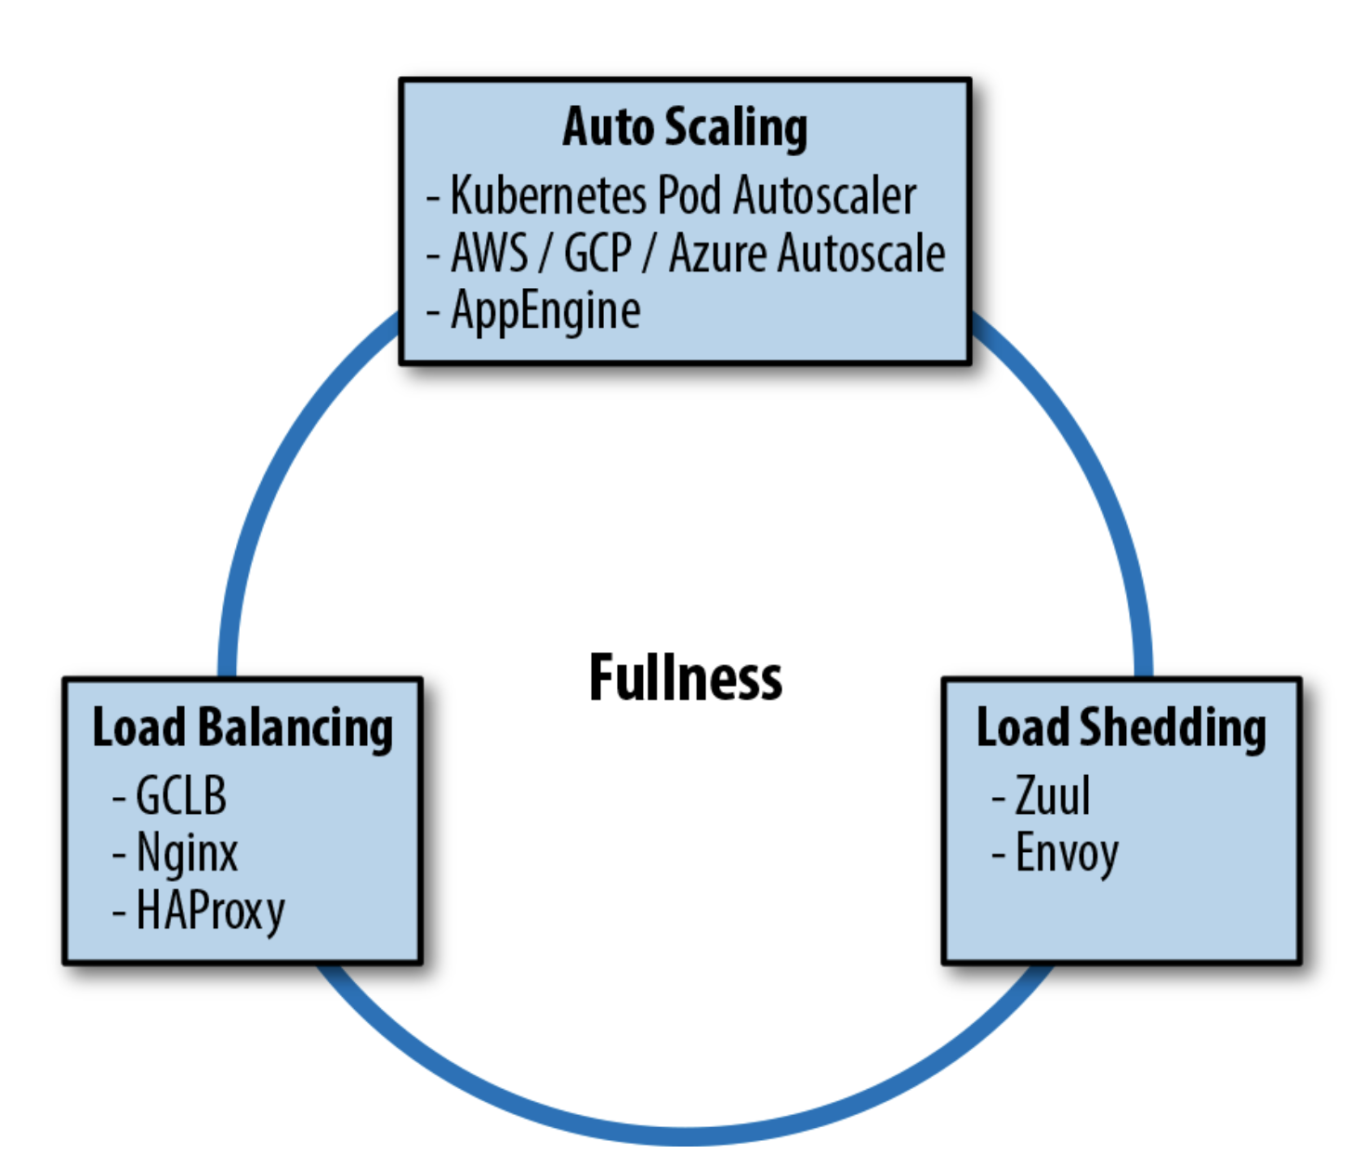
Load shedding
Return errors upon high load; process what you can
Combination of all techniques useful. But consider their interactions carefully

Slide 21
Internet Services

Slide 22
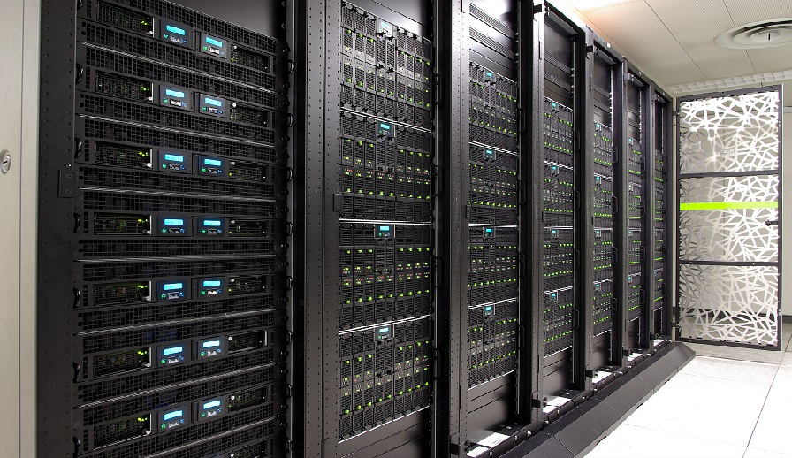
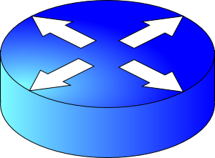
Internet Services
Delivery
Servers
Modular apps
Data Center
Infrastructure
Distributed systems

Slide 23
Operations
Monitoring, security
Release engineering, canarying
Crafting and maintaining SLOs
People and processes
Incident response, postmortems
Designing and managing cluster configurations
And many others

Slide 24
What next?
Thanks, and all the best!
Live with a deeper appreciation of Internet services
How is content delivered? How are apps designed and what architectures may I use for my own? What does my platform look like? How do I manage critical data and achieve high performance?
Put your knowledge to good use
This course: Programming homeworks; Project
Significant tech work builds on concepts from this course
Design your own Internet and data management services
Principles to organize your application
Go deeper
Research projects, independent study, theses, …

