Slide 1
Network Virtualization
Lecture 12a
Srinivas Narayana
http://www.cs.rutgers.edu/~sn624/553-S25

Slide 2
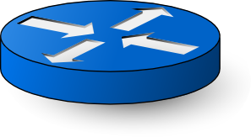
Typical network structure: Fat Trees
Spine switch
Capacities must increase as you go up the tree
Agg switch
ToR switch
…
Rack

Slide 3
Goals
Terminology:
tenant/customer and provider
Virtual NIC (vNIC): network interface exposed with SR-IOV or network namespaces
(1) Place tenant workloads on any physical machine
(2) Scale or migrate tenant workload across physical machines at any time
(3) Simplify configuration for everyone involved
Views of tenant addresses and interfaces
Tenant apps using load balancing, DNS-based IP discovery, etc.
Provider’s ability to plumb network connectivity for tenant workloads
Migration from on-premise compute cluster to shared cloud

Slide 4
Design Choice: CA’s or PA’s?
Do VMs/pods use their own “customer addresses” (CA’s) or use the infrastructure’s “provider addresses” (PA’s)?
PA’s: supporting routing is “business as usual”
But one tenant’s ports affected by other tenants on same machine
Need static allocation of ports to tenants, or dynamic port discovery
Reduced isolation, more complex configuration, app changes
CA’s: dedicated IP per VM/pod, visible to applications
Clean and backwards compatible. e.g. DNS
If VM/pod A sees its own address to be X, any VM/pod B talking to A also thinks that A has address X. A is reachable with CA address X.
However, need to design networking to route between CA’s,
Example: migrate VMs/pods across PA’s with unchanging CA

Slide 5
Networking in a multi-tenant data center
Address virtualization: VMs/pods use own addresses (CA’s)
Physical network does not know how to route CA’s
Additional software to translate CA’s between PA’s: Tunneling
Tunneling endpoint (TEP): software tun/tap interface, NIC hardware, or software switch within a hypervisor. Overlay.
TEP encapsulates and decapsulates packet headers (VXLAN, GRE)
Topology virtualization: Tenants should be able to bring own custom network topologies or assume “one big switch”
Facilitate migration into public cloud, consistent view for tenant’s monitoring and maintenance tools, etc.
Supporting service models for the network
e.g., rate limits and isolation across tenants sharing a physical machine

Slide 6
Making old software use new machines usually means making new machines behave like old ones.
(Also applies when “machines” substituted by “networks”)

Slide 7
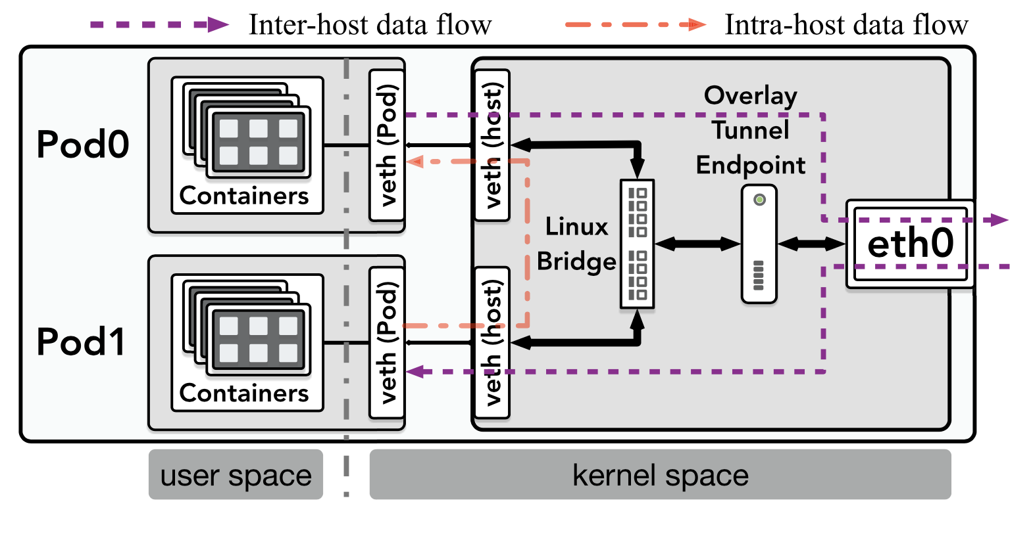
Ex: Network Virtualization in Kubernetes
Example with L2+L3 overlay

Slide 8
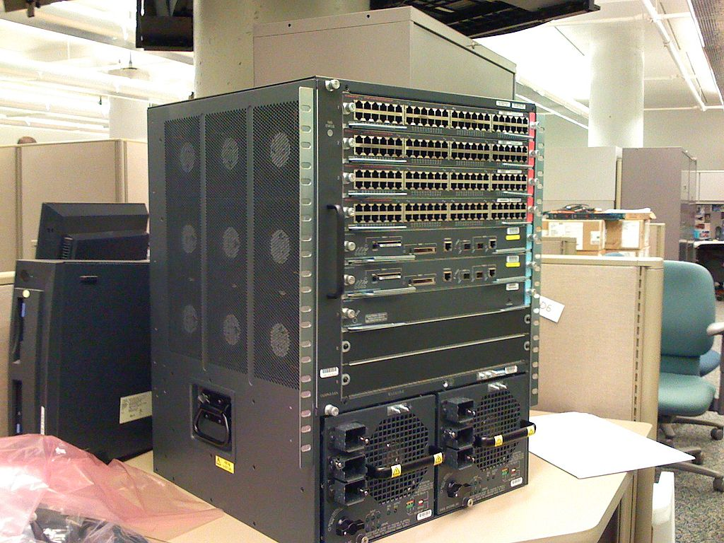
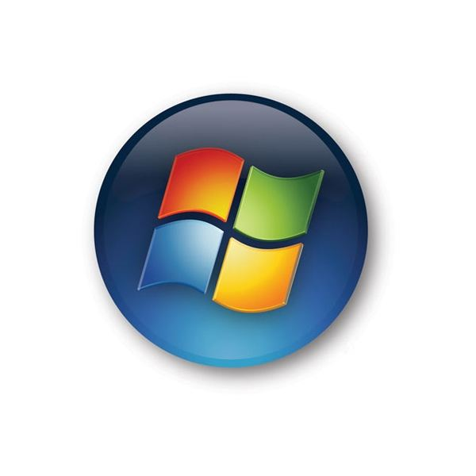
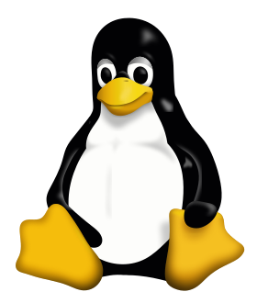
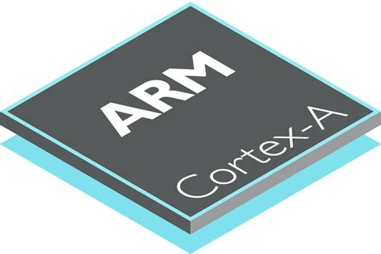
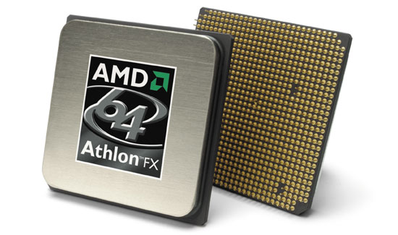
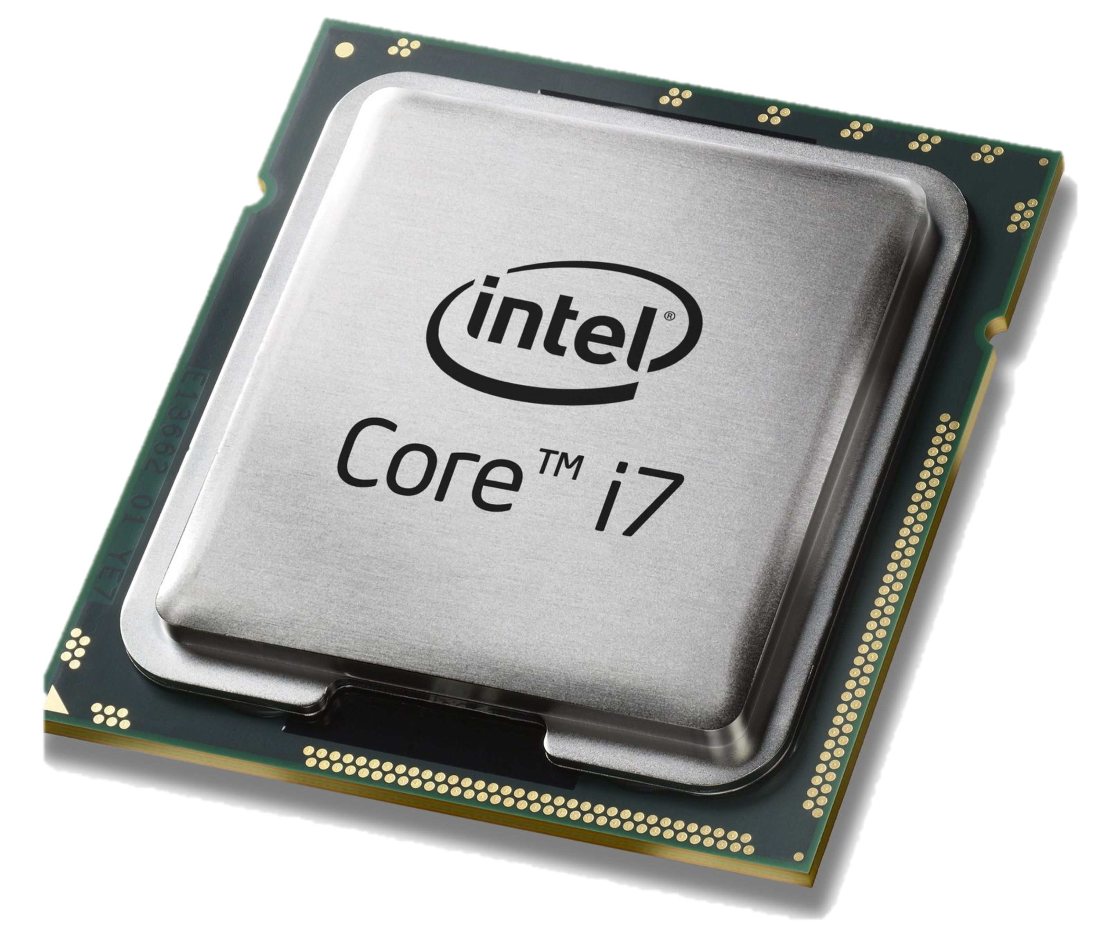
Network control is typically distributed
Traditional IP network: Management tied to distributed protocols
Ex: Set OSPF link weights to force traffic through a desired path
Ex: Non-deterministic network state after a link failure
Data and control plane controlled by vendors: proprietary interfaces
?
X

Slide 9
Traditional IP network
Control plane
Data plane
Control plane
Control plane
Data plane
Data plane
Control plane
Data plane

Slide 10
Software-defined network
Logically-centralized control plane
Data plane
Data plane
Data plane
Data plane

Slide 11
Software-Defined Networking

Slide 12
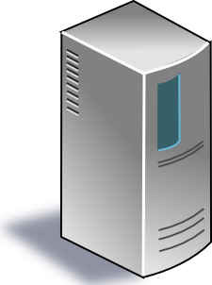
SDN (1/2): Centralized control plane
SDN controller
Control planes lifted from switches
… into a logically centralized controller
… running in a compute cluster
Data plane
Data plane
Data plane
Data plane

Slide 13
SDN (2/2): Open interface to data plane
SDN controller
Data plane
Data plane
Data plane
Data plane

Slide 14
Some immediate consequences

Slide 15
(1) Simpler switches
SDN controller
Data plane
Data plane
Data plane
Data plane
Small set of hardware instructions.

Slide 16
Data plane primitive: Match-action rules
Match arbitrary bits in the packet header
Match on any header, or new header
Match exact, a subset (ternary), or over a range
Allows any flow granularity
Actions
Forward to port(s), drop, send to controller, count,
Overwrite header with mask, push or pop, …
Forward at specific bit-rate
Prioritized list of rules
Data
Header
Match: 1000x01xx01001x
Action: fwd(port 2)
Priority: 65500

Slide 17
(2) Network programming abstractions
Application
Application
Application
Write modular apps and compose them
SDN Controller: Compiler + Run-Time
Data plane
Data plane
Data plane
Data plane

Slide 18
(3) Formal verification of network policy
Static checking
Application (specified as code)
Dynamic
checking
SDN Controller: Compiler + Run-Time
Data plane
Data plane
Data plane
Data plane

Slide 19
(4) Unified network operating system
Application
Application
Application
Network Operating System
Separate distributed system concerns from expressing intent
Data plane
Data plane
Data plane
Data plane
Persist app state
Graceful failover
Replication for perf
Consistent view

Slide 20
New technical challenges of SDN
Availability: surviving failures of the controller
Controller scalability: many routers, many events
Response time: Delays between controller and routers
Consistency: Ensuring multiple controllers behave consistently
Designing flexible router mechanisms
Compilation: translating intent to mechanisms
Verification: ensuring controller policy is faithfully implemented
Security: entire network owned if the controller is exploited
Interoperability: legacy routers; neighboring domains; …

Slide 21
Legacy?
Openflow is just a protocol. The details can change or become irrelevant, but the philosophy is longer-lasting
Programming software switches: Match-action abstraction common; programmable hardware switches common
OVS modules available for the Linux kernel
P4: protocol independence and stateful behavior in switches
In-network computing

