Slide 1
Lightweight Virtualization
Lecture 11
Srinivas Narayana
http://www.cs.rutgers.edu/~sn624/553-S25

Slide 2
Hardware for System Virtualization
Last lecture: system virtualization “without” hardware support
e.g., x86-32: Use techniques such as DBT and paravirtualization
CPU and memory hardware support much improved since the 00s!
Instruction set and architectural extensions: Intel VT-x, AMD-v
Extended page tables: Hardware support for multiple address translations
IO support through SR-IOV and IOMMUs
Paravirtualization is still useful for (further) efficiency but unnecessary for reasonably efficient basic VM functionality
VMMs built for architectures with native hardware support:
KVM/qemu, integrated with Linux
Xen was the basis of Amazon’s public cloud; KVM since ~2019
Do we always need the heavyweight hammer of full virtualization?

Slide 3
Lightweight, OS-level virtualization
First-party workloads: e.g., within a single company
Some degree of implicit trust
Consolidation and efficient resource use is more important than full isolation
Lightweight, operating-system-level virtualization: Containers
Programs use the system call interface (ideally nothing else)
No emulation, no need for special hardware support, or OS changes for e.g., paravirtualization
Containers do need OS changes for finer-grained resource abstraction and control

Slide 4
Benefits of OS-level virtualization
Application-centric view
Run any app that is portable with the same system call interface
No more management of machines & OSes; think of applications
Decouple the management of OS & hardware from applications
Roll out new hardware and OS without worrying about breaking apps
Match development, testing, and deployment environments
Convenient access points to communicate with the application
E.g., expose health information, communicate resource allocations
Relate machine telemetry to applications
No need to tease out per-app metrics from machine-level metrics
“The container is the application.”

Slide 5
Benefits of OS-level virtualization
Resource sharing across virtualized units (containers)
Shared OS kernel & utilities limit redundancy & improve consolidation
Familiar kernel resource abstractions: process scheduling, memory allocation, etc.
Container refers to two things at once:
the run-time abstraction (process, access+resource isolation, FS)
the stored software image (all software you need to run)

Slide 6
How are containers built?

Slide 7
What goes into a container?
More like process virtualization than system virtualization
No ISA virtualization; no native hardware support
Memory and IO work the same way as processes
What we call a container is a loose conglomeration of kernel-level mechanisms
Namespaces: Access isolation for global resources
Cgroups: Resource/Performance isolation of global resources
UnionFS: Improving efficiency through shared filesystem data
Access control mechanisms: capabilities, filtering (eBPF, seccomp, appArmor)

Slide 8
Namespaces
Access isolation
Show an instance of a global resource as available to all processes inside a namespace (multiplexing)
Changes visible to other processes within namespace, but invisible outside the namespace
Show different “copies” of resources associated with the kind of namespace
Network, IPC, mount, PID, …
Every process starts in init namespace, change with setns
Network: (software/hardware) network device; routing rules; port numbers. veth pair connects two network namespaces

Slide 9
Control groups
Resource/Performance isolation
Subsystem: a specific kind of resource
CPU time, memory, network bandwidth, block device access, priority, CPU and memory (numa) node assignment
Many configurable parameters per subsystem
Control group or cgroup: a set of processes
fork()-ed process inherits a bunch of parent attributes including cgroup
Hierarchy: a tree where each node is a cgroup
Many hierarchies can exist, unlike the process hierarchy
Each subsystem “mounted” onto one hierarchy
Possible to use a single hierarchy for multiple subsystems (resources)
Every process has exactly one reservation per resource

Slide 10
UnionFS: “software images too big”
Context: Data on storage typically “mounted” at some point in the virtual filesystem (/, /home/users/name, etc.)
Containers want mostly the same files, with a small number of unique modifications per container (e.g., specific library versions)
Think: common third-party packages, utilities, shared library images
Union filesystem: maintain a stack of filesystems at each mount point. Only the highest one is writable; lower layers are read-only
Inspired by similar use cases in the past: data on a read-only medium that needed a small number of updates before refreshing into a new medium (e.g., working on a CD filesystem in memory)
Write fresh to the top; copy-on-write; copy up; deletion with “whiteout”. Cache heavily
Virtual Filesystem (VFS) layer accomplishes this with minimal changes to underlying filesystem

Slide 11
Orchestrating Containers

Slide 12
Why Orchestration?
When containers are so easy to use, users will create many
Example: Instances of a microservice
Example: Co-locating latency-sensitive jobs with batch jobs
Kubernetes: an orchestrator created and evolved at Google
Today, a well-established project with a significant open-source ecosystem
Pod: a group of related containers (app and allied processes)
E.g., web service, along with logging, metrics
Node: the machine (virtual or physical) on which pod scheduled

Slide 13
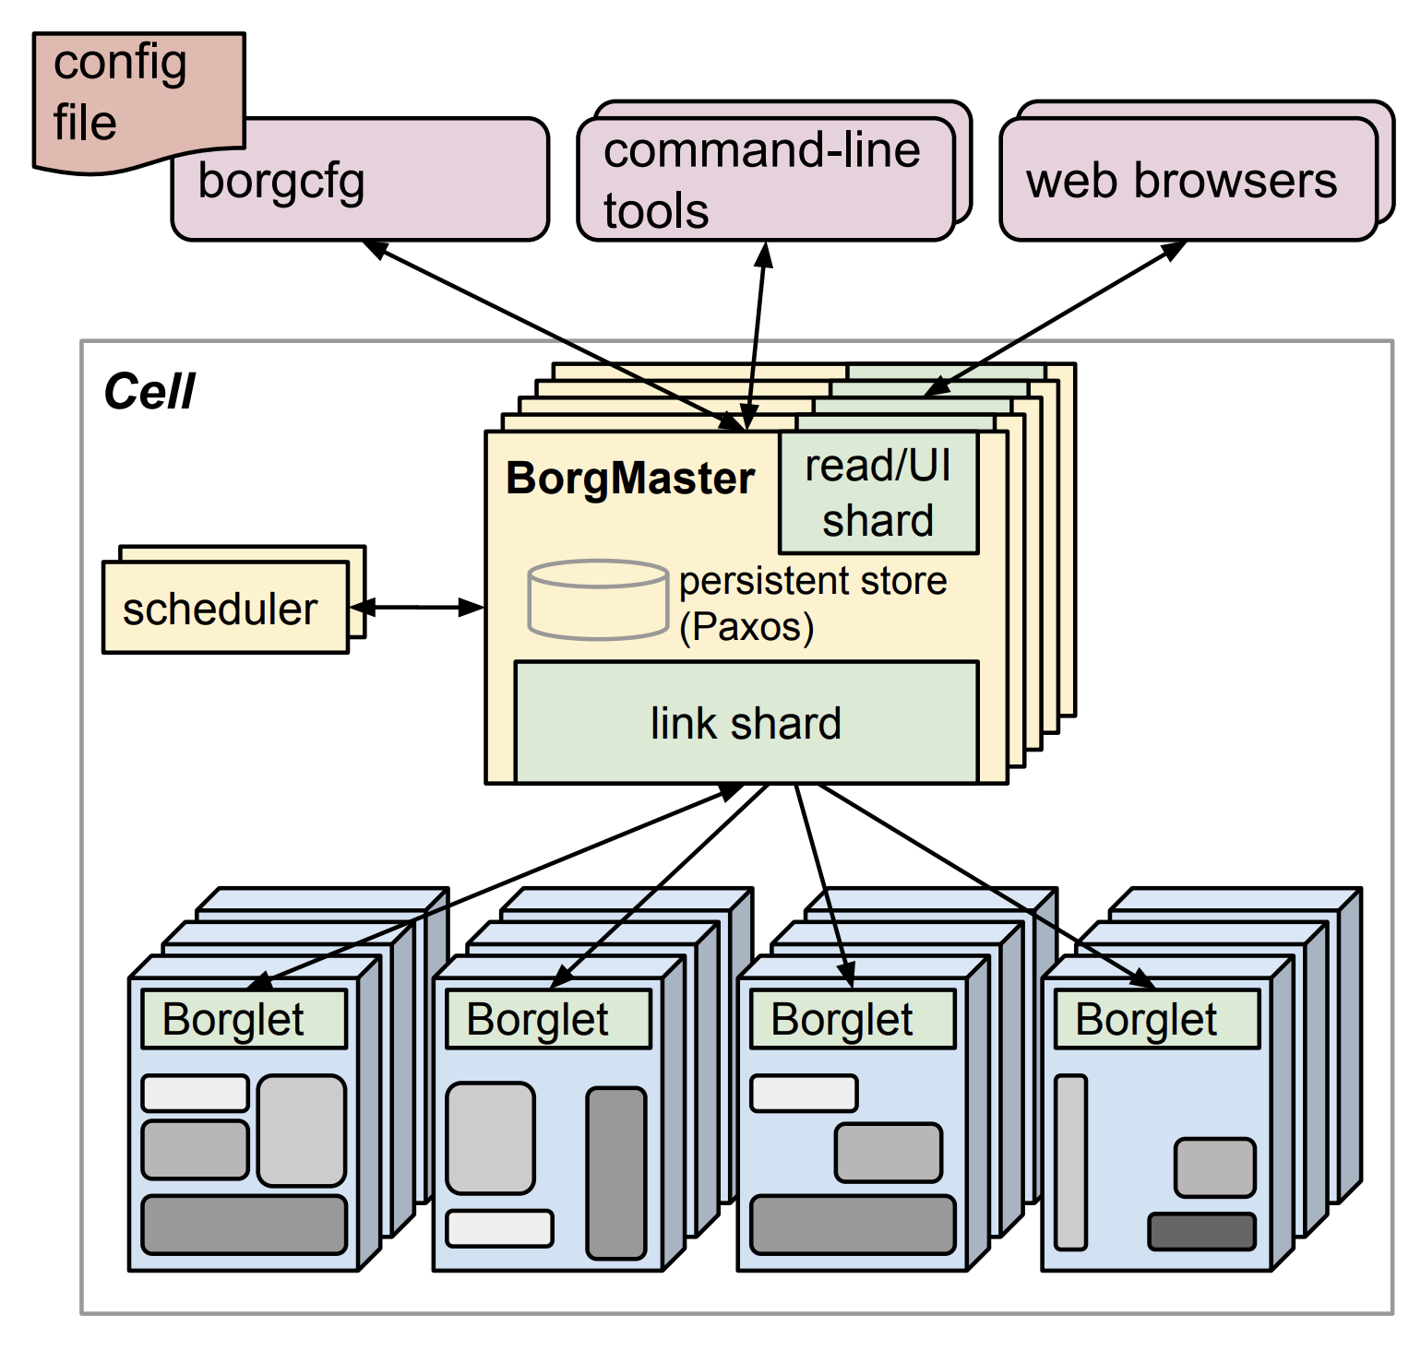
Evolution at Google: Borg
Borg: a cluster manager
Cells: units of machines managed by one controller
Borgmaster: controller
Borglet: program running locally on each machine to manage its resources
Cluster state: the controller’s view of the mapping from tasks (containers) to nodes, health, resource allocation, etc.
State is persisted in a highly-available distributed data store (e.g. Paxos)

Slide 14
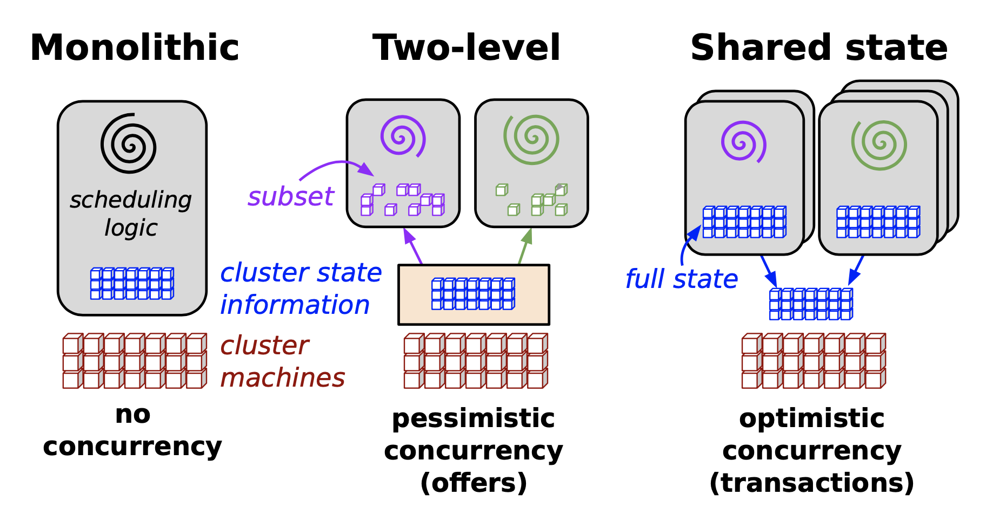
Evolution at Google: Omega
The controller needs to manage many different aspects of the cluster
Mapping from container to node
Resource allocation per container
Number of instances per container
Automatic scaling based on demand and usage
Decouple cluster state from the (one) controller
Use many controllers
Clients of the cluster state can read/write the state directly

Slide 15
Evolution at Google: Kubernetes
Manage access to the cluster state through an API server
Validation of policies, versioning, default objects, etc.
Highly-available strongly consistent distributed data store: etcd
Still use many decoupled controllers
Kubelet: manage node
https://blog.devops.dev/the-kubernetes-architecture-e1ee01ccb76d

Slide 16
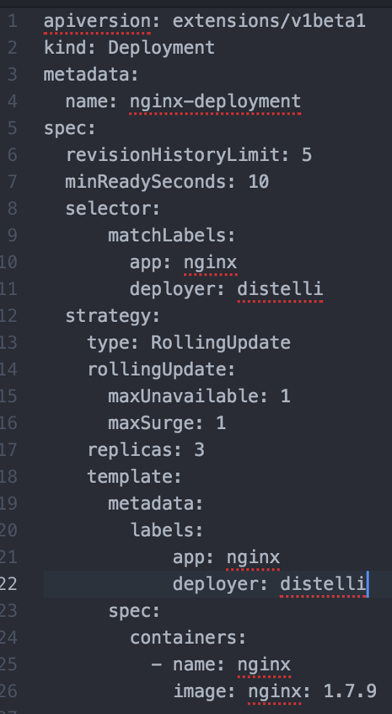
Kubernetes principles
Consistent object representations
Metadata (name, ID, version, labels)
Specification (desired state)
Status (observed state, read-only)
Reconciliation controller loop: Make the observed state (status) match the desired state (specification)
Example: number of replicas of a pod
Many modular and interacting controllers
Example: Auto-scaling and Replica controllers
A failed-then-restarted controller has direct access to the observed state; no need to maintain complex internal state machines

Slide 17
More principles
Each pod gets its own IP address
Visible to other pods and apps in the same Kubernetes cluster
Full access to all ports
This IP address need not agree with physical IP address of the node
Container Network Interface (CNI) to manage addressing & routing
Labels to group containers
Don’t just number the containers
Key-value pairs that allow operator to define any attribute,
e.g., role=frontend
Label selectors are sufficiently flexible to manage containers at time-varying granularity that is specified at operation time
e.g., a controller that only manages role=frontend pods

