Slide 1
Application Architecture
Lecture 5
Srinivas Narayana
http://www.cs.rutgers.edu/~sn624/553-S25

Slide 2
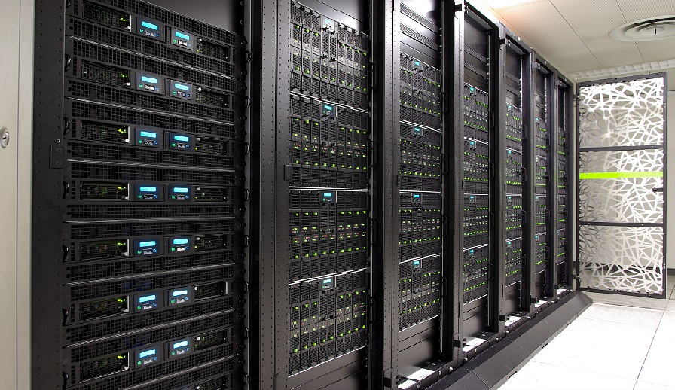
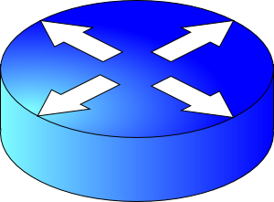
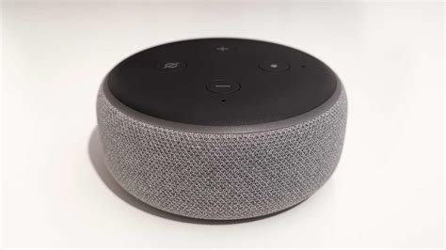
Components of an Internet Service
Routers
App compute and communication patterns
Servers
Modularized applications
Data Center
Endpoints
Storage
Interconnect: Routers

Slide 3
Offline and Online components
Services, databases, ML inference
update
User request
update
update
Online, real-time request processing
Offline processing:
Batch processing; stream events; ML training
Data, events,
etc

Slide 4
Review: Web server design
Process other requests while waiting for one to finish
process
bind(IPaddr_{B}, port_{B})
listen()
accept()
recv()/send()/..
IP_{B} + port_{B}
socket

Slide 5
Review: Parallelism
Process requests in parallel with other requests
One design: multiprocessing/multithreading (MP/MT)
process
bind(IPaddr_{B}, port_{B})
listen()
accept()
fork()
recv()/send()/..
IP_{B} + port_{B}
accept()
socket
listen()
send()
recv()
listen()
accept()
listen()
send()
recv()
send()
recv()
Great to avoid blocking (disk I/O, fastCGI, …)
more
Overhead grows with # connections
longer lived

Slide 6
Concurrency
State of the art designs combine parallelism (multiprocess/thread) with concurrency (event-driven)
Process other requests while waiting for one to finish
A different design: single process event driven (SPED)
A queue of events
accept()
process
bind(IPaddr_{B}, port_{B})
listen()
accept()
recv()/send()/..
IP_{B} + port_{B}
socket
recv()
epoll, select, kqueue, io_uring
Lightweight
Can block if any of the requests block
(asynchronous IO support can be incomplete & complex)
Avoid overheads of multiple processes and threads

Slide 7
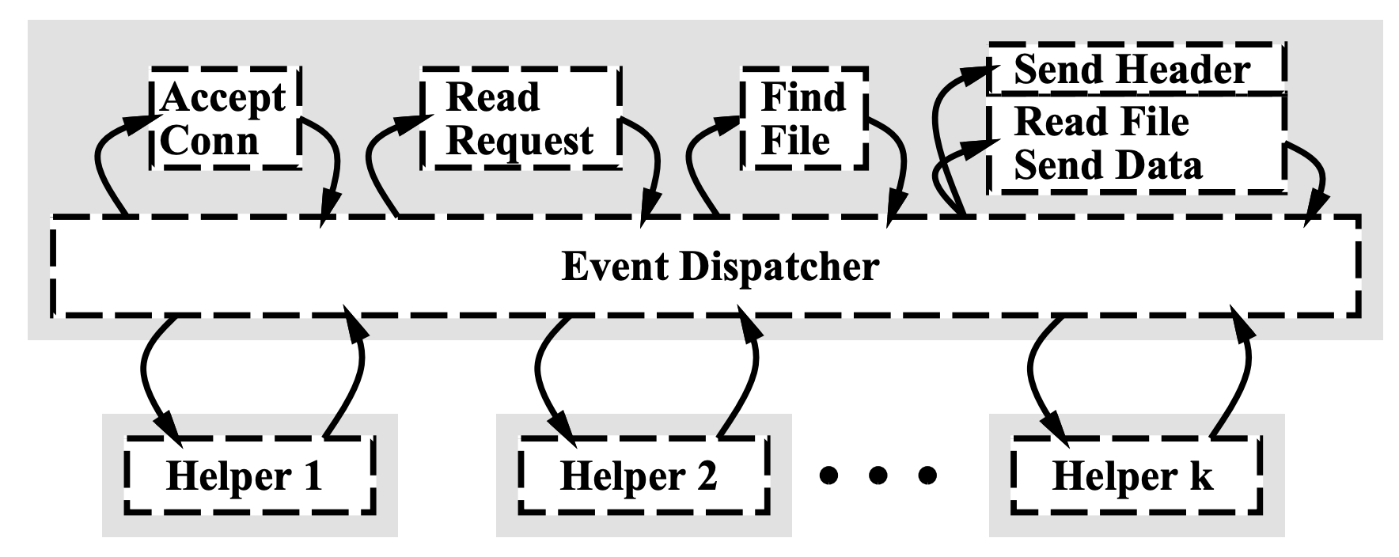
Using parallelism + concurrency
https://aosabook.org/en/v2/nginx.html
Asymmetric Multi-Process Event Driven (AMPED)
Event-driven main process
Blocking operations

Slide 8
Next: Application architecture
Partition-Aggregate
Web servers
Microservices
Map-Reduce
Communication

Slide 9
Microservice Architectural Pattern

Slide 10
Monoliths
HTTP
server
Language frameworks
CGI
Changes coupled
App
Challenges
Coordination across dev teams
Releases
Transient functions
Scaling
Troubleshooting

Slide 11
Microservices
HTTP
server
Explicit communication
Language of choice
App
Distinct from a software library:
Out of process.
Independently upgrade and deploy
App
Models must be explicitly related
Independent/de-centralized data models & storage
Loosely-coupled services

Slide 12
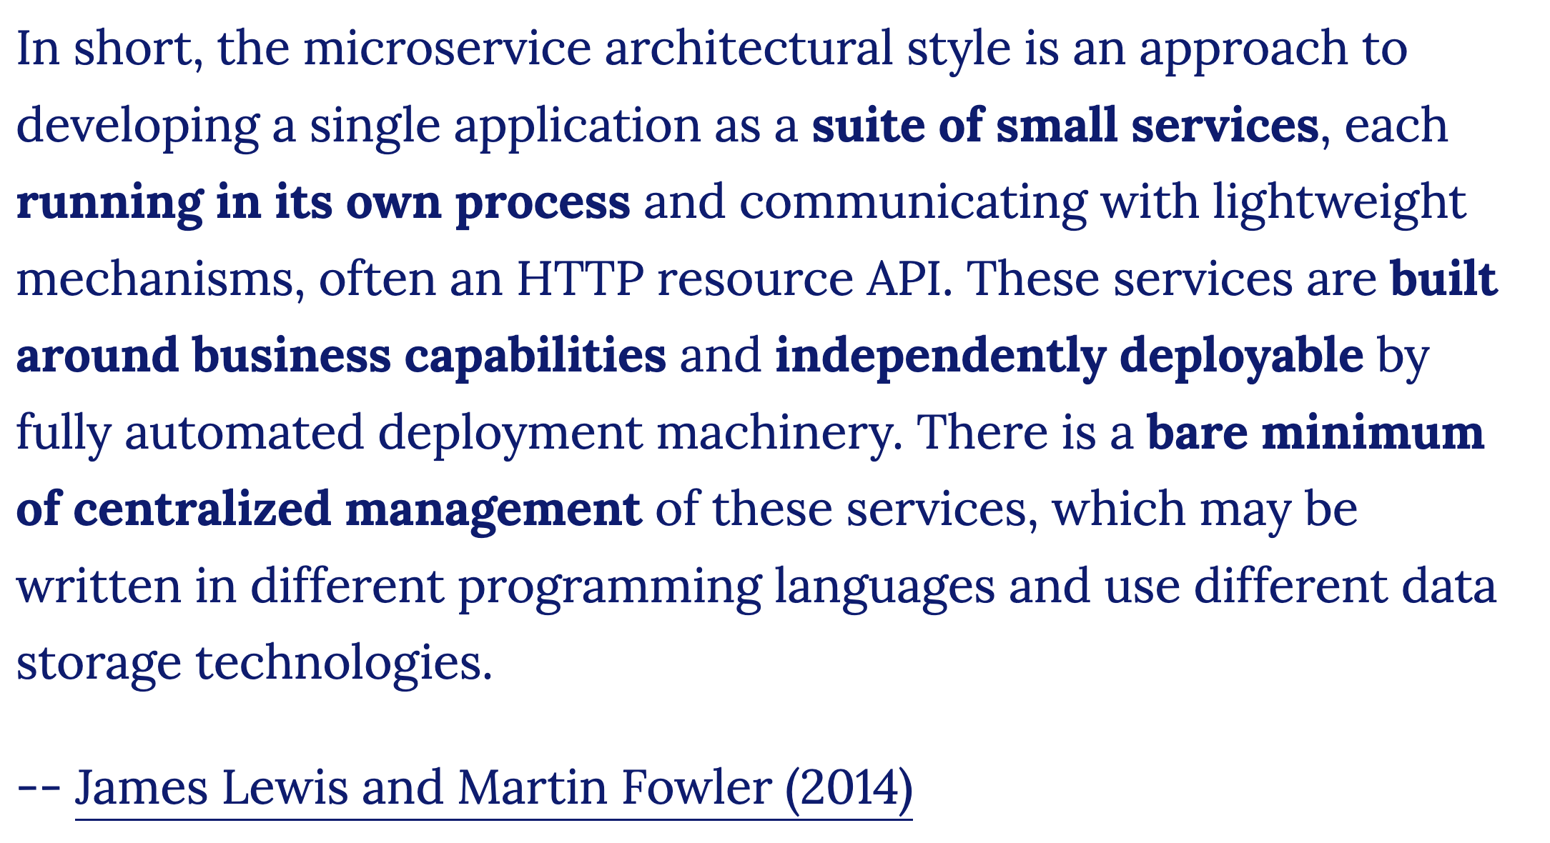
https://martinfowler.com/articles/microservices.html
https://martinfowler.com/microservices/

Slide 13
How to split?
HTTP
server
App
Business Capabilities
Boundaries of change
Lifetime of the service?
Who should know (or not)?
Changing together vs separately?
App
Heterogeneity in resource use
Refactoring common functionality

Slide 14
Salient new concerns
HTTP
server
App
Communication
No longer a function call
Design good module boundaries
App
Failures
Networks & components fail
No longer in the same process

Slide 15
Communication
Lots of waiting;
Increasing likelihood of failure
…
1 Synchronous blocking
(request-response)
App
App
Remote Procedure Call (RPC)
Serialization format (e.g., protobufs)
struct customer {
string name;
int customer_id;
..;
}
struct customer {
string name;
int customer_id;
..;
}
01101010101…
JSON
XML

Slide 16
Communication
Shared data
(async)
3 Event streaming
(asynchronous)
Not expecting a response
1 Synchronous blocking
(request-response)
App
App
2 Async Qs
Message router
Can do useful work while waiting (but still need timeouts)
2 Asynchronous request-response
callback()
“Building microservices”, Sam Newman

Slide 17
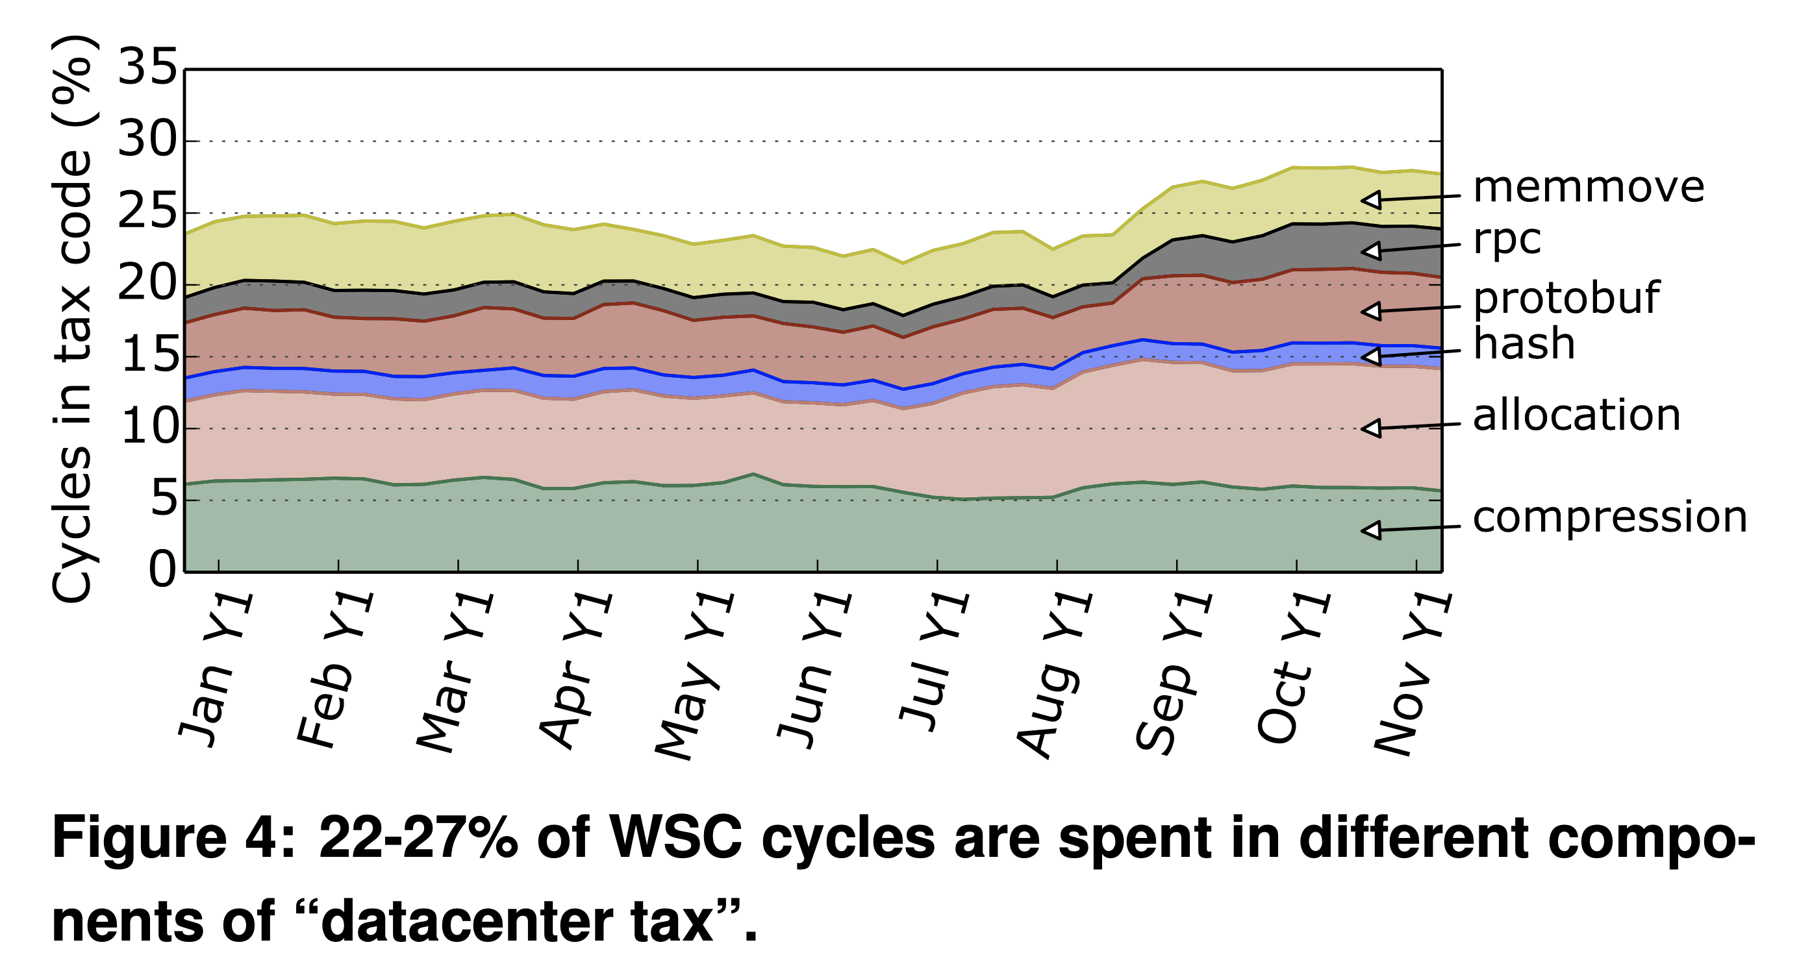
Cost of communication: Performance
Profiling a warehouse-scale computer (Google). ISCA’15.

Slide 18
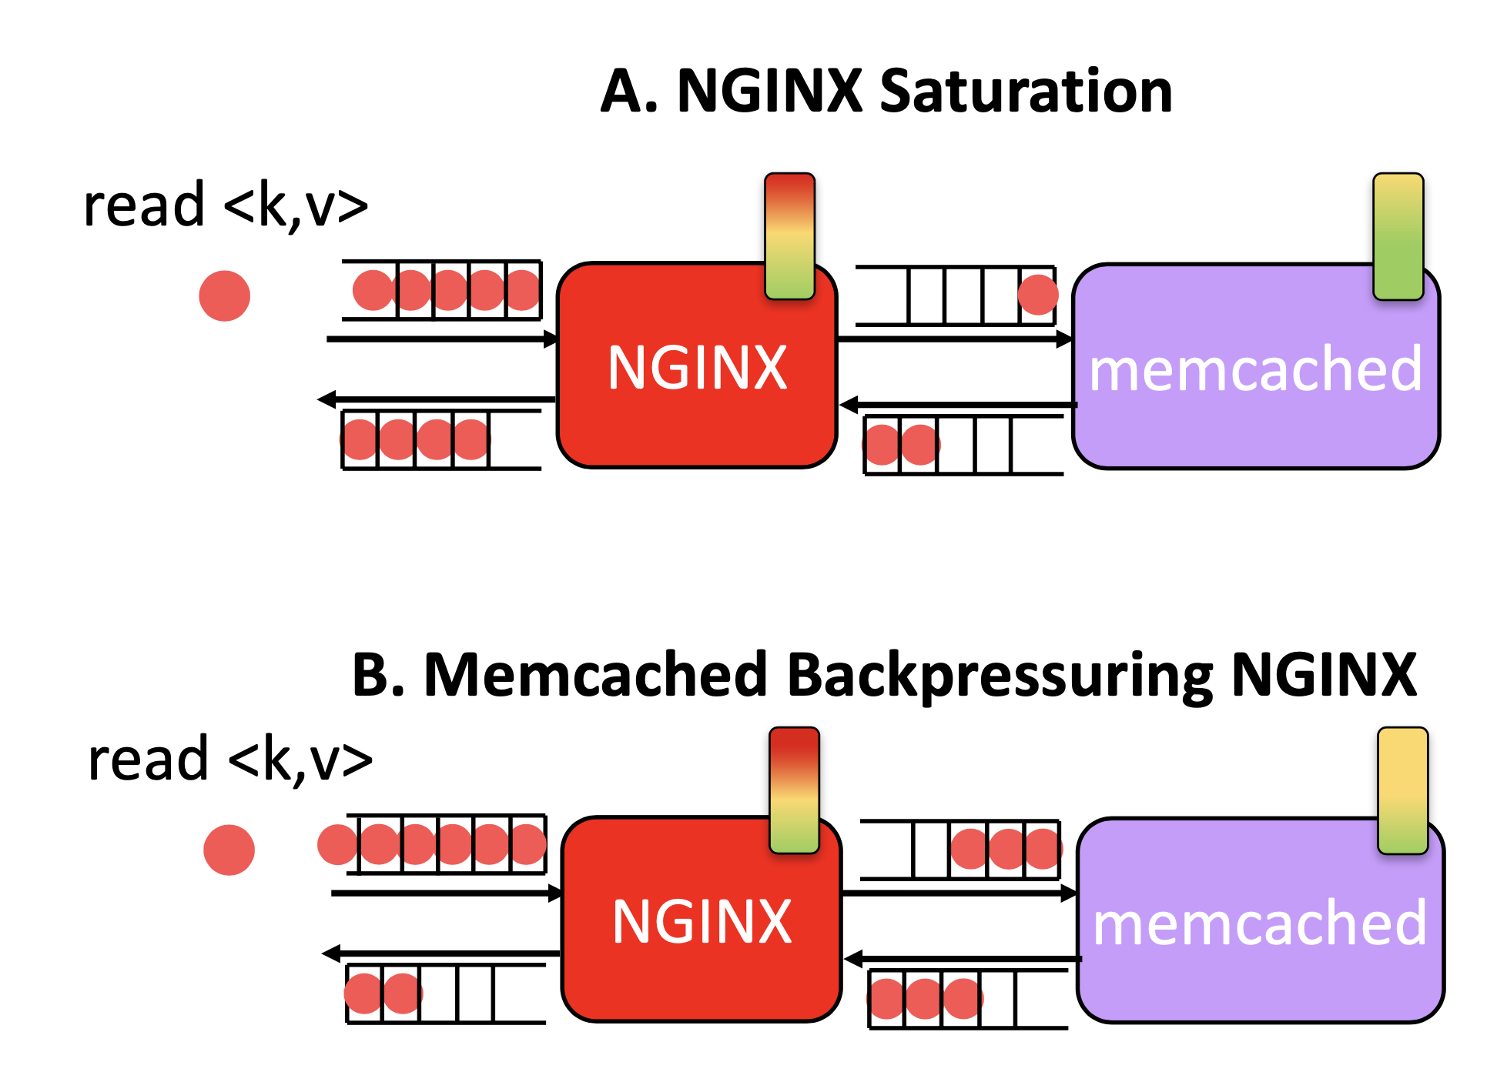
Cost of comm: Hotspot spreading
Deathstarbench. ASPLOS’19.

Slide 19
Cost of comm: high level failure handling
(Soft or hard)
App
App
Circuit breaker
Connection issue
Timeout
Timeout
Timeout
trip
Timeout
Fail immediately

Slide 20
Are microservices always ideal?
Just an architectural style. Look at solving problems first
How to evolve the splitting of components?
Refactoring microservice interfaces later isn’t easy
Interface changes need buy-in from multiple dev teams
Components should compose cleanly in the first place
How to design apps?
Monolith first, or microservices from the beginning?
Testing, Observability, Deploy automation
How significant are dev coordination overheads?
Complexity

Slide 21
Partition-Aggregate
Processing interactive search queries

Slide 22
Web search: some numbers (circa 2003)
10s of terabytes of web corpus data
Read 100s of megabytes per query
10s of billions of CPU instructions per query
Data accessed depends on the query; hard to predict
All results to be returned to users within (say) 300 milliseconds
Cannot process on a single machine within acceptable time

Slide 23
Example: Google search architecture
Web search for a planet, MICRO’03

Slide 24
Quick Review: Compute & Memory Org
Compute
(single threaded core)
Instruction pipeline
Fetch
(on hit)
Instruction pipeline
Retire
Instruction pipeline
Branch predictors
(out of order + speculative)
Registers
L1 I-cache
L1 D-cache
I-TLB
L2 cache
Memory
hierarchy
Slower but larger
L3 cache
Main memory

Slide 25
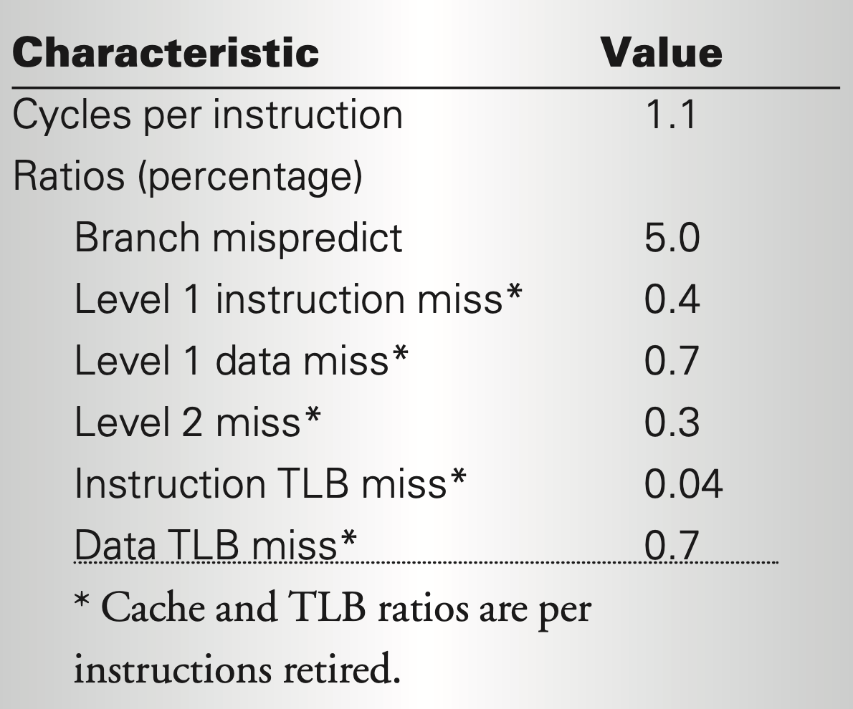
Measurements from one (index) server
Not too fast single-threaded
Data dependencies
Branches often mispredicted
Small instruction memory footprint
Data locality within a block, but not across blocks
Numbers not much better on a newer architecture
Can’t drive high single-threaded performance
Use parallelism
Web search for a planet, MICRO’03.

