Slide 1

Service Delivery Architecture
Lecture 4a
Srinivas Narayana
http://www.cs.rutgers.edu/~sn624/553-S25

Slide 2


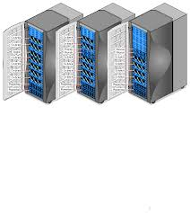

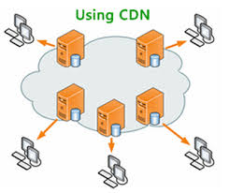
Last mile
Origin servers
“Middle” mile
CDN servers
Client

Slide 3
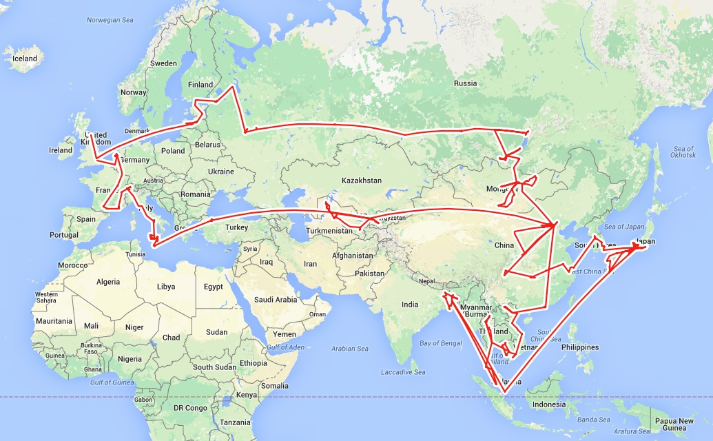
Internet
Routing

Slide 4

Distributed routing
Control plane
Traditional routing protocols: per route-change processing
(~ a few tens of seconds)
Routing
Algorithm
control
plane
data
plane
Data plane
per-packet processing
(~ tens of nanoseconds)
0111
1
3
2
values in arriving
packet header, i.e, destination IP address

Slide 5



The Internet is a large federated network
AT&T
Comcast
Verizon

Slide 6
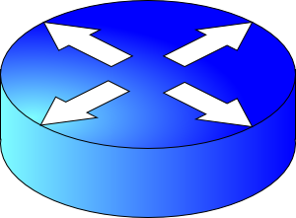
The Internet is a large federated network
Several autonomously run organizations (AS’es): No one “boss”
Organizations cooperate, but also compete
AT&T
Comcast
e.g., AT&T has little commercial interest in revealing its internal network structure to Verizon.
Verizon

Slide 7


The Internet is a large federated network
Several autonomously run organizations: No one “boss”
Organizations cooperate, but also compete
AT&T
Message exchanges must
not reveal internal network details.
Comcast
Verizon
Algorithm must work with “incomplete” information about its neighbors’ internal topology.

Slide 8
The Internet is a large federated network
Internet today: > 70,000 unique autonomous networks
Internet routers: > 800,000 forwarding table entries
AT&T
Keep messages & tables as small as possible. Don’t flood
Comcast
Verizon
Algorithm must be incremental: don’t recompute the whole table on every message exchanged.

Slide 9
Inter-domain Routing
The Internet uses Border Gateway Protocol (BGP)
All AS’es speak BGP. It is the glue that holds the Internet together
BGP is a path vector protocol
Routing protocols
Link state
protocols
Distance vector protocols
Path vector protocols
Messages?
Algorithm?
Applicable within a single AS, focus on efficiency

Slide 10
Q1. BGP Messages
Exchange paths: path vector
Routing Announcements or Advertisements
  “I am here” or “I can reach here”
  Occur over a TCP connection (BGP session) between routers
Route announcement = destination + attributes
  Destination: IP prefix
Route Attributes:
  AS-level path
  Next hop
  Several others: origin, MED, community, etc.
An AS promises to use advertised path to reach destination
Only route changes are advertised after BGP session established
No internal link or topology
“I am here.”
Dst: 128.1.2.0/24
AS path: X
1b
“I can reach X”
Dst: 128.1.2.0/24
AS path: AS2, X
AS 2
1a
1c
2b
1d
2a
2c
X
2d

Slide 11
Q1. Next Hop
Next hop conceptually denotes the first router interface that begins the AS-level path
  The meaning of this attribute is context-dependent
In an announcement arriving from a different AS (eBGP), next hop is the router in the next AS which sent the announcement
  Example: Next Hop of the eBGP announcement reaching 1c is 2a
1b
2b
1a
1c
2a
2c
X
1d
2d
AS 1
eBGP announcement:
AS2, X
AS 2

Slide 12
Q1. Next Hop
Suppose router 1c receives a path advertisement
Router 1c will propagate the announcement inside the AS using iBGP
The next hop of this (iBGP) announcement is set to 1c
  In particular, the next hop is an AS1 internal address
1b
2b
1a
1c
2a
2c
X
1d
2d
AS 1
eBGP announcement:
AS2, X
AS 2

Slide 13
Q2. The algorithm
A BGP router does not consider every routing advertisement it receives by default to make routing decisions
  An import policy determines whether a route is even considered a candidate
Once imported, the router performs route selection
A BGP router does not propagate its chosen path to a destination to all other AS’es by default
  An export policy determines whether a (chosen) path can be advertised to other AS’es and routers
Programmed by network operator
Policy considerations make BGP paths very different from “the most efficient” paths

Slide 14
Policies in BGP
Announcement
Import policy
Route selection
Export policy

Slide 15
Policy arises from business relationships
Customer-provider relationships:
  E.g., Rutgers is a customer of AT&T
Peer-peer relationships:
  E.g., Verizon is a peer of AT&T
Business relationships depend on where connectivity occurs
  “Where”, also called a “point of presence” (PoP)
  e.g., customers at one PoP but peers at another
  Internet-eXchange Points (IXPs) are large PoPs where ISPs come together to connect with each other (often for free)

Slide 16
BGP Export Policy
legend:
provider
B
network
X
W
A
customer
C
network:
Y
Suppose an ISP only wants to route traffic to/from its customer networks (does not want to carry transit traffic between other ISPs)
A,B,C are provider networks
X,W,Y are customers (of provider networks)
X is dual-homed: attached to two networks
policy to enforce: X does not want to route from B to C via X
  So, X will not announce to B a route to C

Slide 17
BGP Export Policy
legend:
provider
B
network
X
W
A
customer
C
network:
Y
Suppose an ISP only wants to route traffic to/from its customer networks (does not want to carry transit traffic between other ISPs)
A announces path Aw to B and to C
B will not announce BAw to C:
  B gets no “revenue” for routing CBAw, since none of C, A, w are B’s customers
C will route CAw (not using B) to get to w

Slide 18
Impact of BGP export policies
Based on your location on the Internet,
Some paths aren’t visible or usable, even if they physically exist
Many efficient paths could be eliminated from actual use
Focus on financial incentives, not efficient end-to-end paths

Slide 19


Thumb rules for export policy
Export customer-learned routes to the rest of the Internet
  Financially attractive if the Internet uses your AS to get to a customer
  OK to export customer-learned route to a provider since the customer must be reachable from the rest of the Internet
Do not export a provider-learned route to another provider
  Don’t lose money on both sides
Do not export peer-learned route to another peer
  The resources of your AS are used but no financial gains from free “transit” service
OK to export provider-learned route to a customer
  Customer must be able to reach the rest of the Internet
  Also financially attractive

Slide 20
BGP Import Policy
Remove common misconfigurations or problematic routes
Loops
Too-specific prefixes (e.g., anything longer than /24)

Slide 21
BGP Import Policy
legend:
provider
B
network
X
W
A
customer
C
network:
Y
Suppose an ISP wants to minimize costs by avoiding routing through its providers when possible.
Suppose C announces path Cy to x
Further, y announces a direct path (“y”) to x
Then x may choose not to import the path Cy to y since it has a peer path (“y”) towards y

Slide 22
Q2. BGP Route Selection
When a router imports more than one route to a destination IP prefix, it selects route based on:
  local preference value attribute (import policy decision -- set by network admin)
  shortest AS-PATH
  closest NEXT-HOP router
  Several additional criteria: You can read up on the full, complex, list of criteria, e.g., at https://www.cisco.com/c/en/us/support/docs/ip/border-gateway-protocol-bgp/13753-25.html

Slide 23
Example of route selection
NA
EU
Suppose AS A and B are connected to each other both in North America (NA) and in Europe (EU)
A source in NA wants to reach a destination in EU
There are two paths available
  Assume same local preference
  Same AS path length
Closest next hop-router: choose path via B1 rather than B2
Dst-EU
A1
A2
AS A
B1
B2
Src-NA
AS B

Slide 24

Example of route selection
NA
EU
Choosing closest next-hop results in early exit routing
  Try to exit the local AS as early as possible
  Also called hot potato routing
Reduce resource use within local AS
  potentially at the expense of another AS
A potential reason for inefficiency
Dst-EU
A1
A2
AS A
B1
B2
Src-NA
AS B

Slide 25
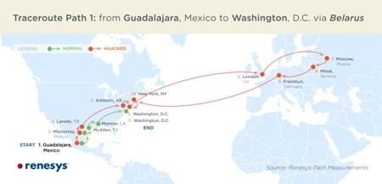
BGP Path Selection
Approaches to bring flexibility:
Flexible control logic for path selection
(Google, Facebook)
Detour/overlay routing (Akamai)
Local preference, shortest AS path, closest NEXT HOP, etc.
Not capacity aware
Not performance aware
Not aware of the length of the path (in # routers)
  The protocol does not even incorporate precise perf/capacity info
Financial incentive, not end-to-end performance, heavily determines peering and capacity
Only a single path per destination
Can be slow to converge
Vulnerable to bugs and malice

Slide 26
Application Architecture
Lecture 4b
Srinivas Narayana
http://www.cs.rutgers.edu/~sn624/553-S25

Slide 27





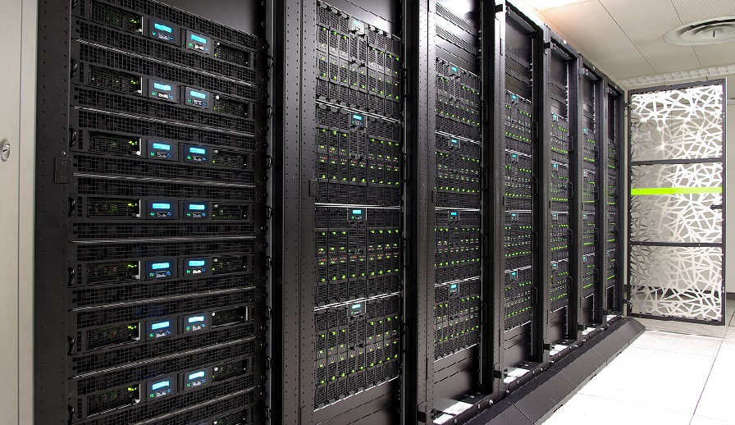



Components of an Internet Service
Routers
App compute and communication patterns
Servers
Modularized applications
Data Center
Endpoints
Storage
Interconnect: Routers

Slide 28





Web Servers
Often the first app point where a user request lands
Parse HTTP request
process
bind(IPaddr_{B}, port_{B})
listen()
accept()
recv()/send()/..
IP_{B} + port_{B}
(many other headers!)
socket
Find a file, run a script, …
HTTP/1.1 200 OK
Content-Type: text/html
Send response header
Read file, send() data

Slide 29

Overloaded with functionality
Often the first app point where a user request lands
Find a file, run a script, …
process
bind(IPaddr_{B}, port_{B})
listen()
accept()
recv()/send()/..
IP_{B} + port_{B}
Scripting:
Python/PHP/nodejs
fastCGI
socket
Reverse proxy
Caching
Compression
Access control
TLS
Media streaming
Image transforms

Slide 30


How does one design a web server?
Process connections one at a time?
accept()
close()
process
bind(IPaddr_{B}, port_{B})
listen()
accept()
recv()/send()/..
IP_{B} + port_{B}
socket
listen()
send/recv()
listen()
Many other requests waiting in the meanwhile
Powerful server doing nothing most of the time

Slide 31

How does one design a web server?
Process other requests while waiting for one to finish
process
bind(IPaddr_{B}, port_{B})
listen()
accept()
recv()/send()/..
IP_{B} + port_{B}
socket

Slide 32
Parallelism
Process requests in parallel with other requests
One design: multiprocessing/multithreading (MP/MT)
process
bind(IPaddr_{B}, port_{B})
listen()
accept()
fork()
recv()/send()/..
IP_{B} + port_{B}
accept()
socket
listen()
send()
recv()
listen()
accept()
listen()
send()
recv()
send()
recv()
Great to avoid blocking (disk I/O, fastCGI, …)
more
Overhead grows with # connections
longer lived

