Slide 1

Internet Services

Slide 2
Introduction
Lecture 1
Srinivas Narayana
http://www.cs.rutgers.edu/~sn624/553-S25

Slide 3







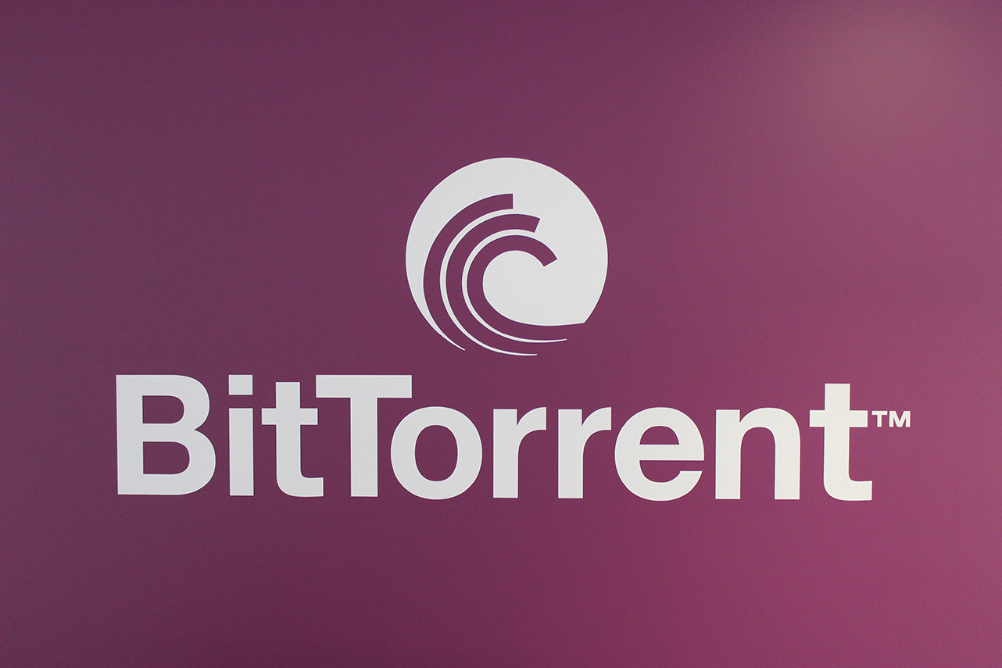







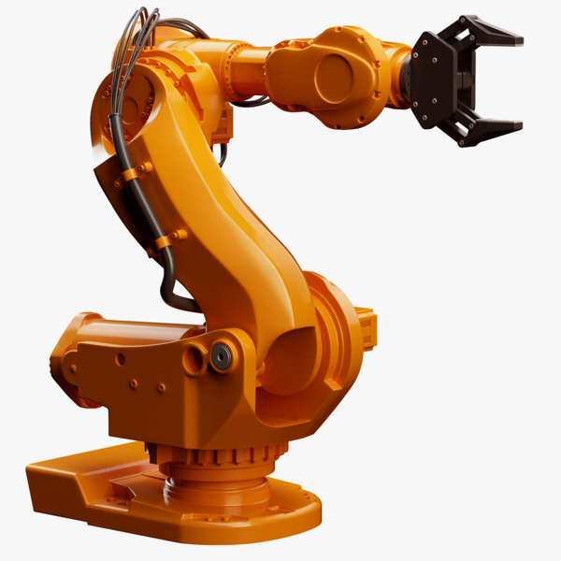

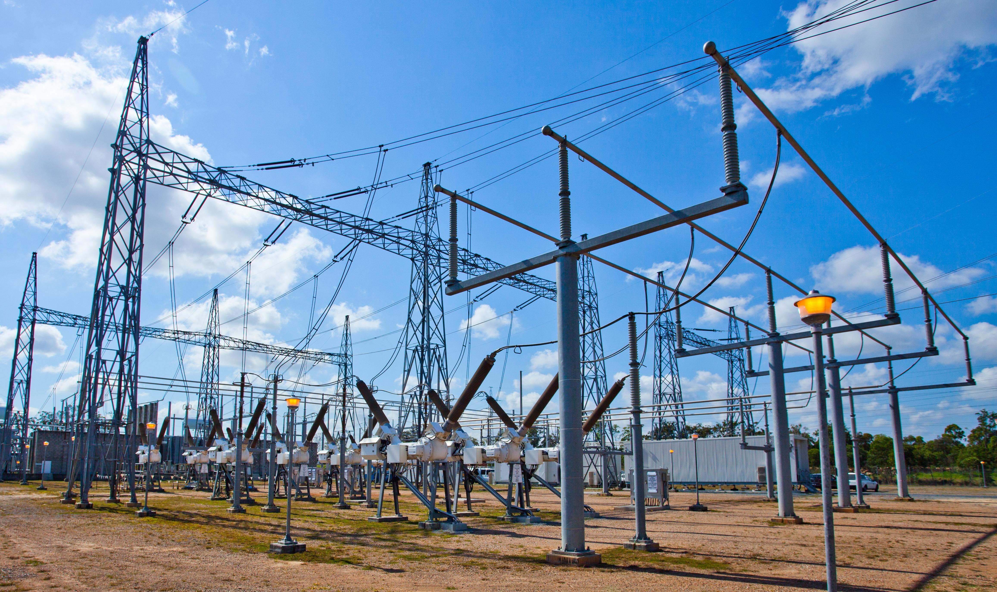

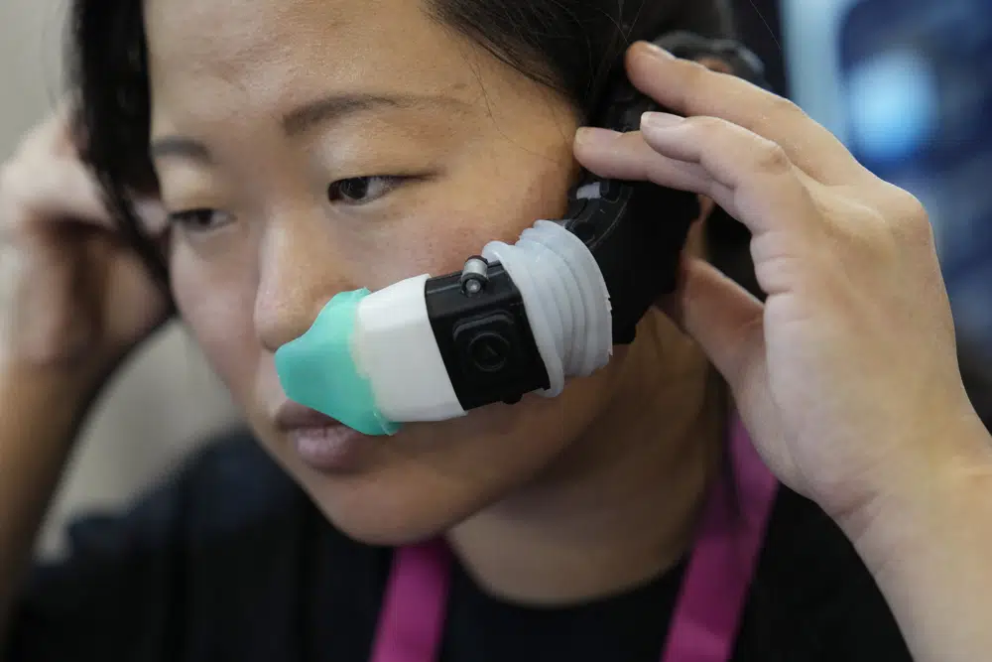
Our life on the Internet

Slide 4
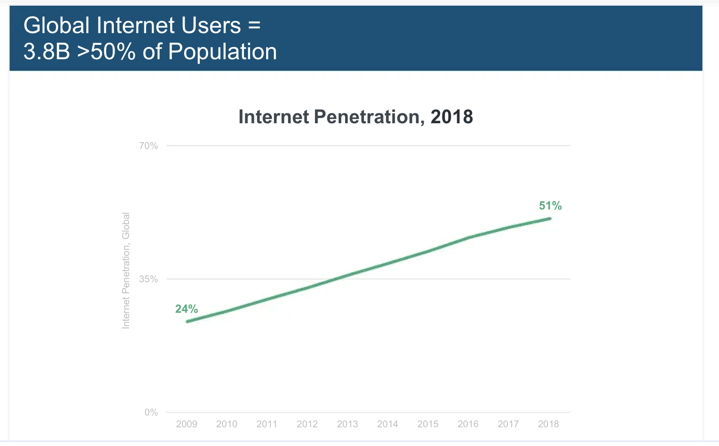
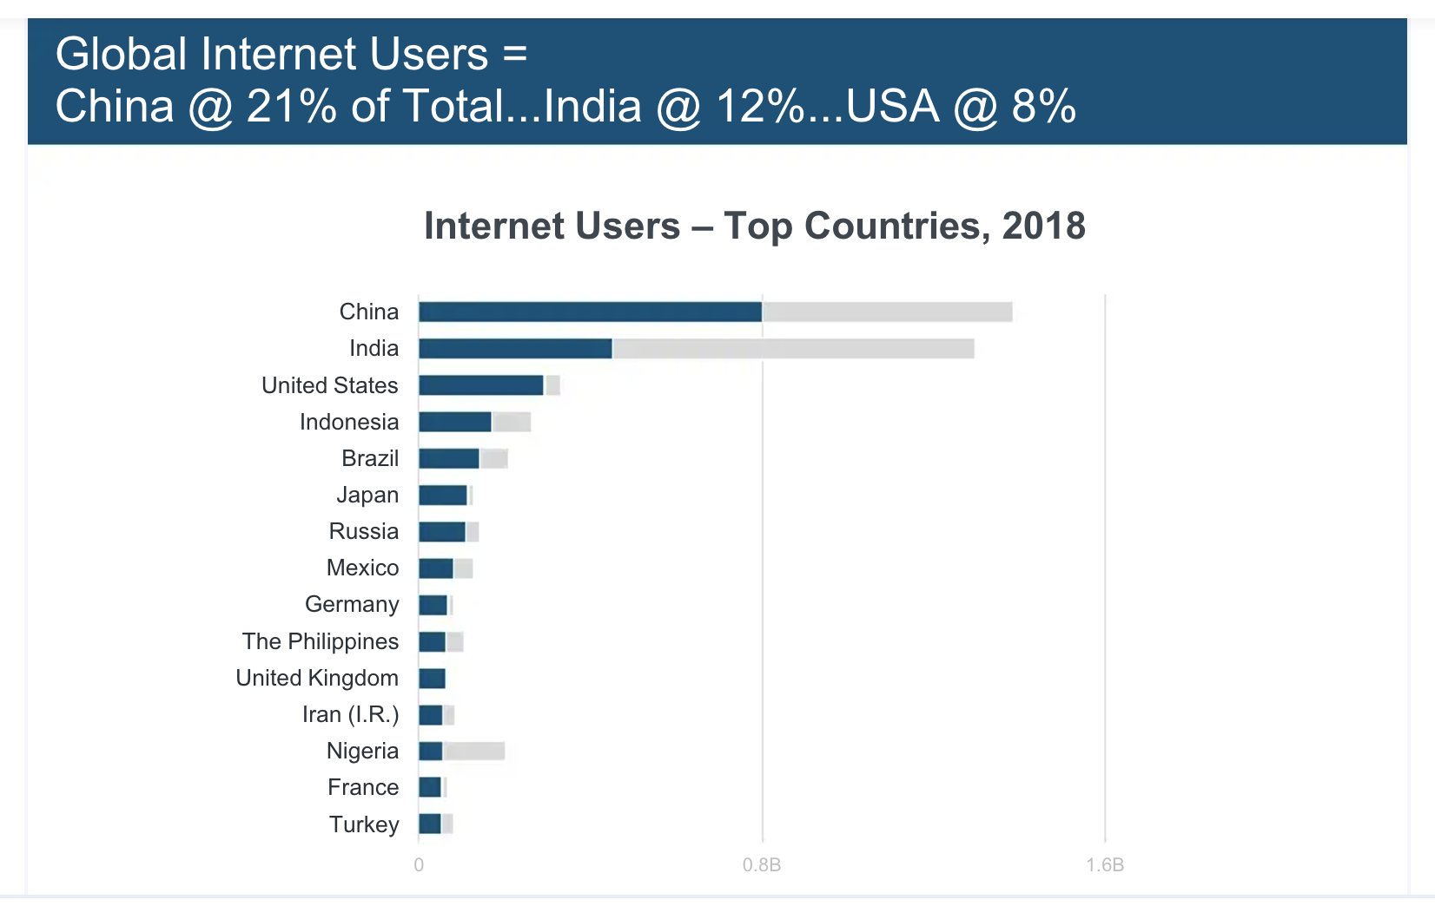
Internet users are everywhere
Source: Mary Meekers, 2019 Internet trends

Slide 5
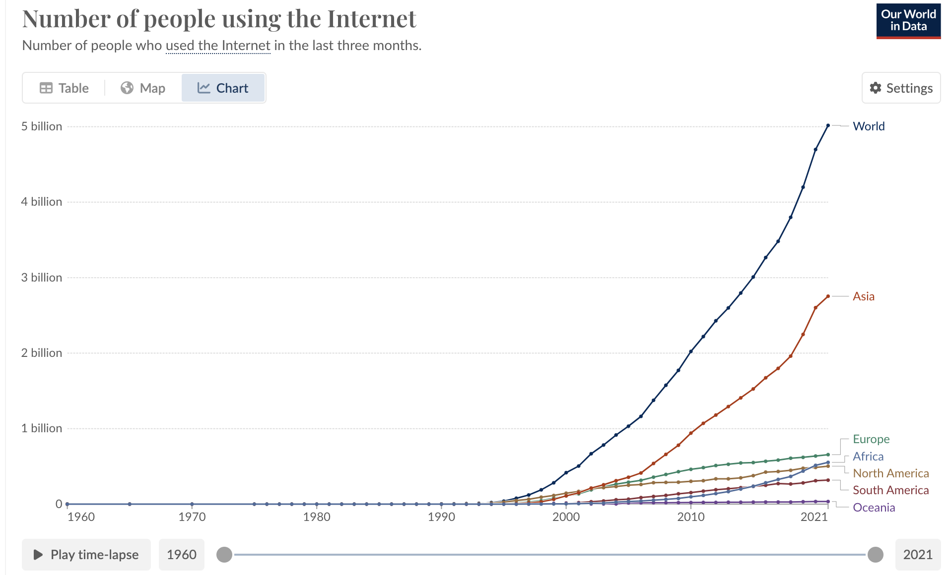
Internet users
https://ourworldindata.org/grapher/number-of-internet-users

Slide 6
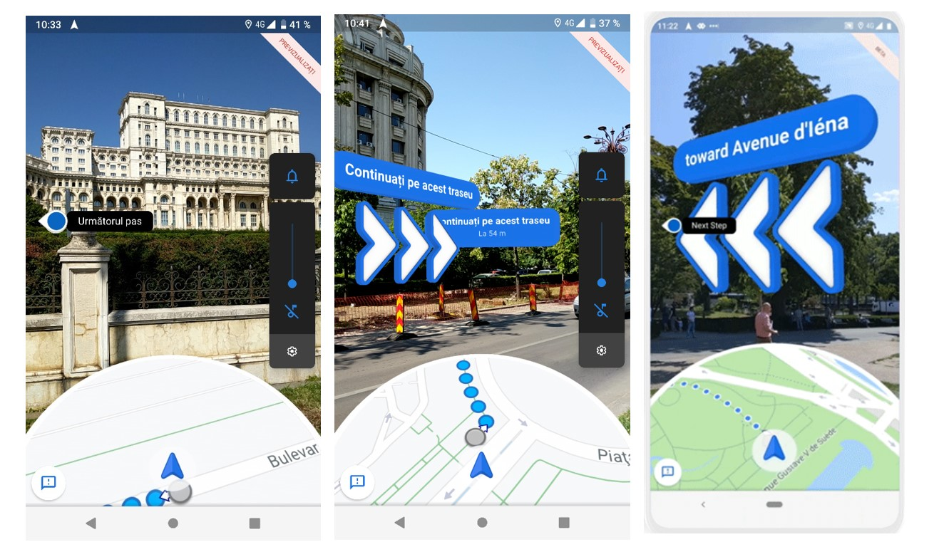

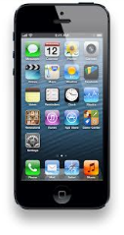













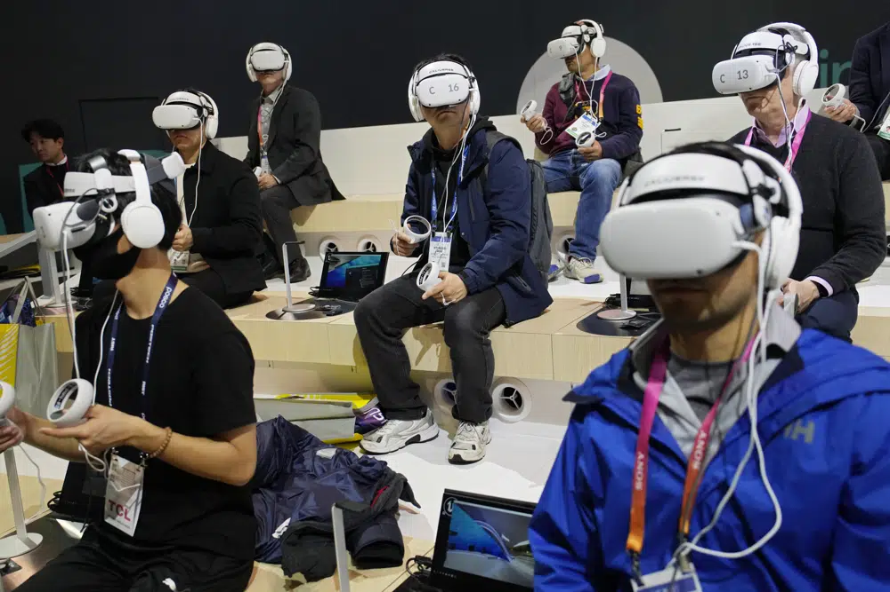

Evolution of Internet services
2010-2020
2020--
1992
1996
2000
2004
2008
ftp
Web
email
chat
Games
IM
Yahoo!
news
Blog
Search
Music
itunes
Games
search
Wikipedia
Craiglist
Youtube
Multimodal media
User-generated content
Text-heavy
Augment physical world
Replace phy world

Slide 7
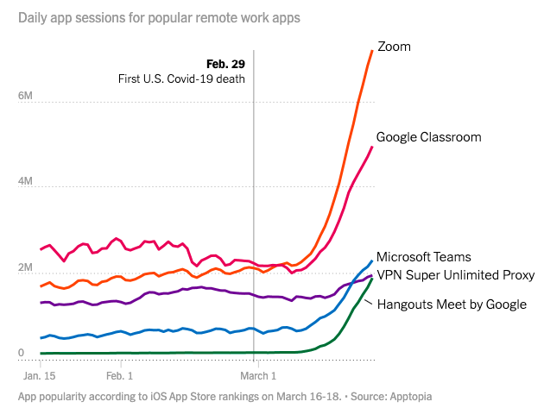
Pandemic shifts: how we worked
Data shows number of daily sessions in the US over a period in 2020. Source: nytimes

Slide 8
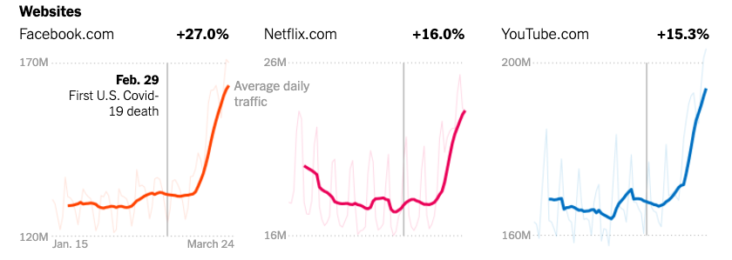
… and played
Data shows number of daily sessions in the US over a period in 2020. Source: nytimes

Slide 9
Internet Services
Understand how modern Internet services designed
Learn fundamental concepts in application, system, and network design that make them possible
Practice your knowledge

Slide 10
What is an Internet service made of?
Applications, systems, interconnecting network, abstractions.

Slide 11





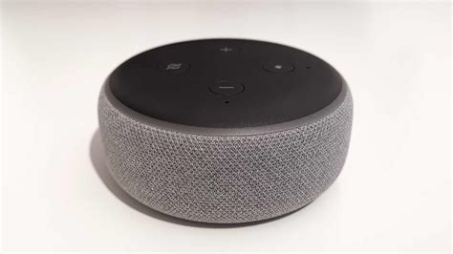
Components of an Internet Service
Routers
Endpoints

Slide 12
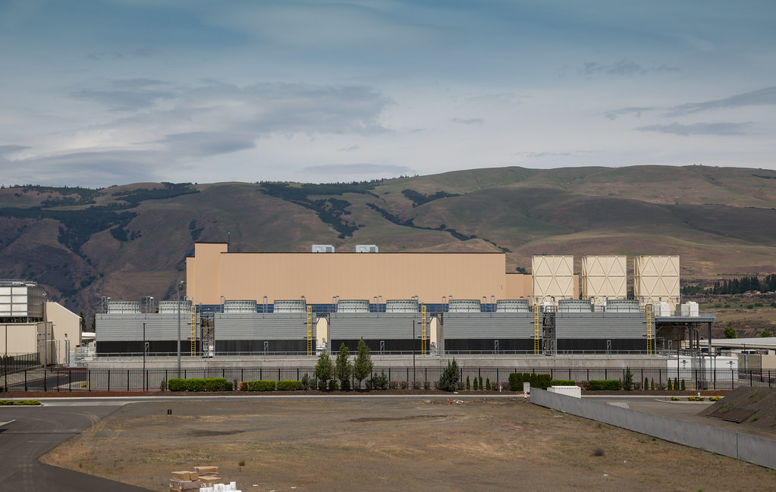
Components of an Internet Service
Routers
Data Center
Endpoints

Slide 13
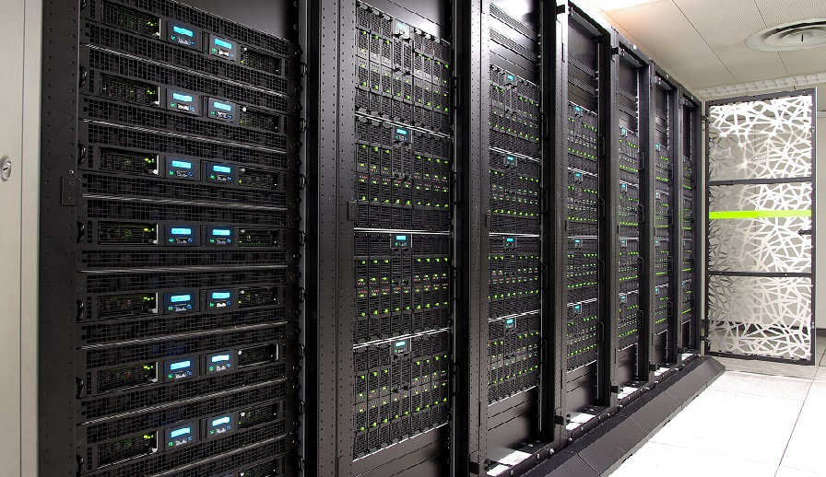
Components of an Internet Service
Routers
Data Center
Endpoints

Slide 14


Components of an Internet Service
Routers
Server
Data Center
Endpoints

Slide 15


Components of an Internet Service
Routers
App compute and communication patterns
Servers
Modular apps
Data Center
Endpoints
Storage
Interconnect: Routers

Slide 16


Components of an Internet Service
Routers
App
Data Center
Container
Monitoring
Policies
Virtual Machine
Performance
Endpoints
OS & Net Stack
Availability

Slide 17
Components of an Internet Service
Routers
AT&T
Data Center
Comcast
Verizon
Name resolution
Endpoints
Internet Routing
Content delivery

Slide 18
Core technical disciplines (incomplete)
*app abstractions
Computer Networks
Operating Systems
*prog languages
*algorithms
Distributed Systems
*security
Internet Services

Slide 19
Why should you study Internet services?
Intellectual merits
  Interdisciplinary problems, many principles
Real world utility
  Low barriers: anyone can do something useful
Pragmatic
  Many job opportunities, timely
Distinct from other coursework at Rutgers
  OS, distributed systems, databases, networks

Slide 20
Course Content Overview

Slide 21

(1) Internet Arch & Service Delivery
Protocols
App
Transport
Network
Content delivery

Slide 22
(2) Application architecture
Microservices
Server architecture
Partition-Aggregate
Bulk data processing

Slide 23



(3) Infrastructure
Public Cloud
SDN,
Service mesh
App
Containerization
Container
Virtual switching
Orchestration
Virtual Machine
OS & Net Stack
Service communication
(RPCs, qs, …)

Slide 24
(4) Distributed System Design
Coordination services
Distributed storage
Distributed consensus
Load management

Slide 25

(5) Operations
Monitoring
Tracing, logs, metrics
Access control
Scaling
In-band network telemetry
Network stack monitoring
Incident management

Slide 26
Course Logistics

Slide 27
About this class
Faculty Instructor: Srinivas Narayana
  http://www.cs.rutgers.edu/~sn624
  sn624@rutgers.edu
  Office hours: by appointment
  Lecture Wed 8:30 – 11:30 in Busch HLL 116
Canvas and Discord
Class info: http://www.cs.rutgers.edu/~sn624/553-S25/
Teaching Assistant: Bhavana Vannarth Shobhana
  bvs17@cs.rutgers.edu

Slide 28
Class philosophy
We want you to learn and to be successful
Significant technical reading & programming
  Build necessary skills for future tech careers (industry or academic)
Be proactive: interact, ask, support
  Attend lectures and discuss class material regularly
  Use class Discord
Happy to provide the necessary background materials
  Ask me or your TA

Slide 29
Course grade components
Quizzes (32%)
Programming homework (28%)
Course project (32%)
Class participation (8%)
Absolute grading; no curve

Slide 30
In-class quizzes (32%)
Every lecture starting 2/12
Answer questions from the last lecture and assigned reading
  Requires significant engagement with the technical readings
  5—10 hours per reading
Typical length: 20 minutes
We only consider the 8 highest grades (drop lowest 3)

Slide 31
In-class quizzes (32%)
Open book, but paper-based materials only
Unlimited quantity: research article, textbook, lecture prints, your notes
No tablet, laptop, smart watch, cell phone use
No collaboration or Internet use
No make-up quizzes

Slide 32
You’ll spend significant time reading
This course has an assigned technical reading per week
  Technical blog posts, accessible survey articles, deep technical papers
Knowing how to read well technically is worth your time
  Grad students: reading and writing technical papers
  Developers: reading RFCs, protocol specifications, other technical specs
  Implementing any cutting-edge technology requires reading
Staying broadly technically educated (and employable)
It’s worth reflecting on how to read effectively

Slide 33
There is no magic
Reading effectively takes a lot of time and effort
I’ve been reading technical articles for 14+ years now
  And I still sometimes spend 5+ hours or more
You will get more effective and better over time
A few tricks

Slide 34
(1) Three pass approach for papers
First pass: title, category, context, assumptions, correctness, contribution
Second pass: get into the technical ideas, figures and graphs. Explain the new technical idea or design to someone else
Third pass: starting from assumptions and problem statement, reconstruct solution on your own with proof or argument for why it works and why it is the right approach (other approaches?)
How to read a paper? -- Keshav Srinivasan

Slide 35
(2) Look for concrete, simple examples
Good articles often use good examples to explain their ideas
If the article does not show examples, construct and work through your own
Constructing a good example itself often clarifies the technical problems and innovations in the solution
Discussing with your peers can be substantially helpful

Slide 36
(3) Identify reusable principles
What do you want to take away from the reading?
System design or algorithmic techniques
Existence of a new problem space
A class of technical solution approaches
New techniques for empirical evaluation or measurement
Reading something worthy changes how you think about the world from that point

Slide 37
Programming homework (28%)
2—3 over the term; tentative submission dates on syllabus
Work on your own; released and handed in on Canvas
C/C++ programming language, Python, shell
Test and run on class VM (access instructions to be provided)

Slide 38
Programming homeworks (28%)
Please follow all instructions carefully and exactly
You will lose significant points if:
  We are unable to run your code with the stated commands
  We do not receive your submission in a timely fashion

Slide 39
Programming homeworks (28%)
You can collaborate with others freely, however all submitted code must be your own work
Do not blindly lift code from stack overflow, GitHub, chatGPT, etc.
Incorporate learning from other sources and produce your own solutions
Mandatory to state collaboration & references at the beginning of submitted program

Slide 40
Course project (32%)
A team of up to 3; work on this through April
Aligned with the course topics
“Significant” programming component
  Measured by complexity and the size of the source code
  Talk to me to ensure this (next: project specification)

Slide 41
Course project (32%)
A small open-ended research problem
Adding new features to an existing open-source codebase
Reproducing empirical evaluations and benchmarks from a paper you read
Re-implementing an existing technique on a different system
Building a tool that makes further technical work or research possible or easier

Slide 42
Course project (32%)
I will send out some possible ideas
Welcome & encouraged to work on something you find exciting
Form teams, brainstorm ideas with each other and me early
I will help you succeed technically: don’t struggle alone
3 concrete deliverables: project specification, source code, technical report

Slide 43
Project specification
1—2 pages, tentatively due 04/02
Specific, measurable, realistic technical goal
Existing prior work and why your goal or approach is novel
Brief description of technical idea and solution approach
  What needs to be built? How will you build it?
Key performance metrics, qualitative and quantitative, you will evaluate your system on
Technical and other risks

Slide 44
Source code
Due end of the semester (tentatively 05/05)
Host source code on a public repository e.g., on GitHub
Provide clear documentation (README) with commands and requirements to run your system
Provide scripts and commands to reproduce your empirical evaluation results

Slide 45
Technical report
5—10 pages, due end of the semester (tentatively 5/05)
  Latex template to be provided
  One PDF per team submitted on Canvas
Clearly and fully describe all the technical details:
Implementation of the solution
How you evaluated the system: metrics, workloads, executions
Why did you observe the numerical results you found?
Optional: presentations or demonstrations of the system
Assessed for clarity, comprehensiveness, technical design, scientific accuracy

Slide 46
Course project (32%)
Don’t “just implement” something, also measure and explain it
Highly coveted technical skills:
  Identifying good performance indicators, representative workloads and configurations
  Measuring them accurately
  Explaining them clearly with more detailed measurements
Rigorously evaluating a system may take as long as implementing it

Slide 47
Course project (32%)
Do not blindly lift code from other sources
When you use existing software libraries, state the nature and scope of their use clearly in your project spec and report
Do not blindly lift text (e.g., for project report) from other sources
Please cite references for specific statements and be thorough

Slide 48
Course participation (8%)
You are welcome to discuss and collaborate extensively
  Get to know each other, and me
Meaningful class questions and technical discussion
Insightful Discord/email questions or answers or follow-up discussion
Discussion with me after the lecture or outside
Supporting and helping each other grow in any way
  e.g., sharing useful materials on class Discord

Slide 49
Course participation (8%)
Class participation is a consistent and meaningful activity
  Assessed throughout the semester
  Not a one-time event or a checkbox
  Intention to learn and support, not just a grade
I’m happy to get to know you professionally and engage in technical discussions
  If you require professional support from me later (e.g., recommendation letters), it’s a great way for me to know you better

Slide 50
Course Policies

Slide 51
Collaboration and Integrity policies
This course welcomes discussion and collaboration
Do
  Ask questions on Discord or e-mail
  Discuss projects and readings with me and with each other
  Read references (textbooks, papers, Internet posts) widely
  Acknowledge each other and all the references
Report collaborations on programming homework & the project
  Include who you talked to, references (including on the web) you consulted
  Be as accurate and complete as possible

Slide 52
Policy on AI
Specific use with specific attribution
Use it to resolve specific questions and concerns
  You are not permitted to use it to produce the entire solution for homework or your project
List all your prompts and the service you used
  And discuss how you fix the output

Slide 53
GenAI is experimental
Do not become a victim of hallucination
AI makes mistakes: you must learn how to identify problems and fix them
  You still need to know what you’re doing
  Learn and understand the fundamentals well
Use AI as an assist, not to drive your entire solution
Like anything else on the Internet, you need to think critically

Slide 54
Collaboration and Integrity policies
All your written (coded) work must be your (team’s) own
  Understand the problem deeply and produce your own solutions
Do not
  blindly lift or incorporate other student solutions
  look at other people’s code or solutions
  copy solution code from the web (e.g., other people’s GitHub projects)
  use generative AI to produce a full solution
  post programming homeworks or quizzes (questions or solutions) on GitHub, Chegg, CourseHero, etc.

Slide 55
Rutgers takes academic dishonesty very seriously.
Violation of academic integrity at the graduate level is especially serious. Consequences include suspension and expulsion.
We will run plagiarism detection tools on all submitted materials.
If you are ever in doubt, ask me first.

Slide 56
Late policy
Don’t be late
If you must be late, inform us in advance
If you cannot inform us in advance (e.g., medical), provide official medical note of absence through the University
Unexcused late submissions will result in losing significant fraction of points

Slide 57
24/7 Grading Policy
You may not dispute a grade or request a regrade before 24 hours or after 7 days of receiving it
Please contact us if you have a legitimate re-grading request:
  After 24 hours of receiving the grade: Please take the time to review your case before contacting me
  Before 7 days have elapsed: we don’t want to forget what the quiz/homework was all about.

Slide 58
Help, Accommodations, etc.
I’ll make every effort to accommodate reasonable requests that support your learning better
sn624@cs.rutgers.edu
I am committed to help you succeed in this course.

Slide 59
Next steps
Sign up for class Discord: link on canvas home page
Warm up on C/C++ programming this week
  e.g., linked lists, basic TCP and UDP socket programming
Next two lectures (1/29, 2/05) online: Video lectures to be posted on the syllabus page
First quiz on 2/12: covering the first three lectures
  Thereafter every week
Meet each other and form project teams

