Slide 1
Fast Packet Processing
Lecture 11
Srinivas Narayana
http://www.cs.rutgers.edu/~sn624/553-S23
Some slides were adapted from those of Gianni Antichi

Slide 2
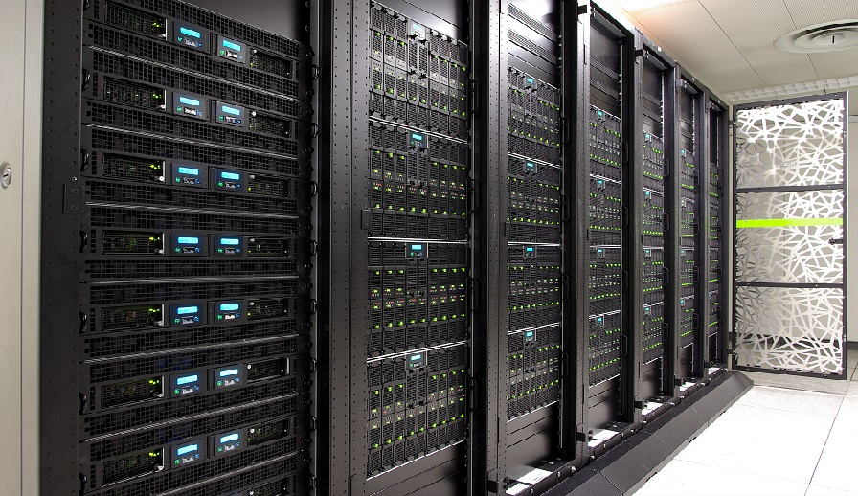
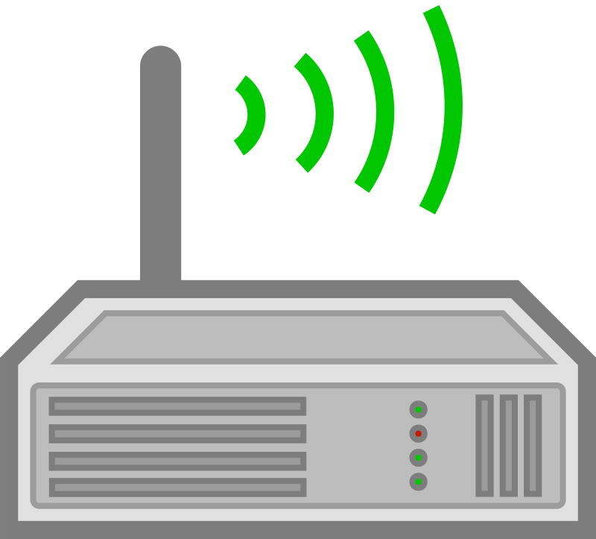
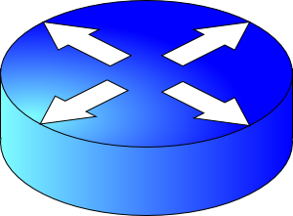
Context: Networking for Internet services
App
Transport
Network
Interconnect
Data center transport
Fast packet processing

Slide 3
Packet processing on Linux

Slide 4
Modern NICs and architectures can also do direct cache access (DCA)
Notes:
Source: https://blog.packagecloud.io/eng/2016/10/11/monitoring-tuning-linux-networking-stack-receiving-data-illustrated/

Slide 5
Interrupt mitigation
Interrupt processing at high rate and priority prevents any other part of the system from progressing (receive livelock).
Mitigations:
(1) Interrupt coalescing:
Wait (at NIC) for more packets or a timeout until interrupting
(2) Polling to schedule work across different sources of processing
Avoid preemption
(3) CPU or packet quotas on polling to ensure other parts of the system (user space app) can progress
Re-enable interrupts if there is less work than allotted quota

Slide 6
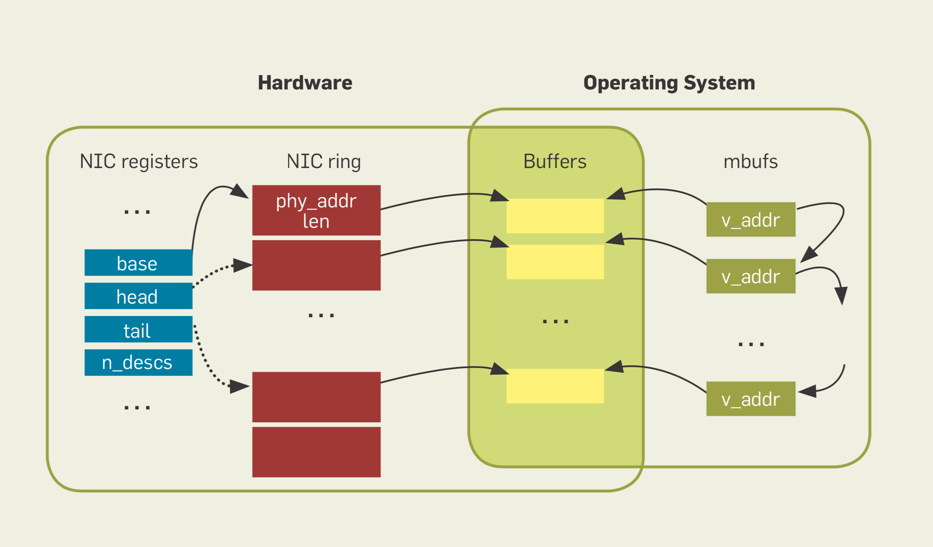
Revisiting network I/O APIs: The netmap framework. CACM’12
Notes:
Source: Revisiting network i/o aPis: The netmap framework. Communications of the ACM 2012

Slide 7
Allocate packet data structures in memory (sk_buff, mbufs, …)
(Optional) receive packet steering
Notes:
Source: https://blog.packagecloud.io/eng/2016/10/11/monitoring-tuning-linux-networking-stack-receiving-data-illustrated/
Linux kernel 3.13. Things have changed a bit since 4.15 with Edward Cree’s batching patch set. https://lwn.net/Articles/763056/

Slide 8
Socket buffers
Allocate in arbitrary chunks (multiples of 64 bytes)
Support arbitrary packet sizes, fragments, deferred processing
*next
*next
*next
*prev
*prev
*prev
buffer
skb
skb
skb
…
*head
*data
*tail
*end
…
headroom
pkt data
tailroom

Slide 9
Other things that happen afterward
Netfilter: tracking TCP connection state, firewalling, NAT, …
IP protocol processing: routing
Transport processing (UDP/TCP protocol layer)
Some stateless, per-packet work can be done by the NIC:
TSO: TCP segmentation offload
LRO: Large Receive Offload (also applicable in software)
IP checksum
Ethernet CRC computation

Slide 10
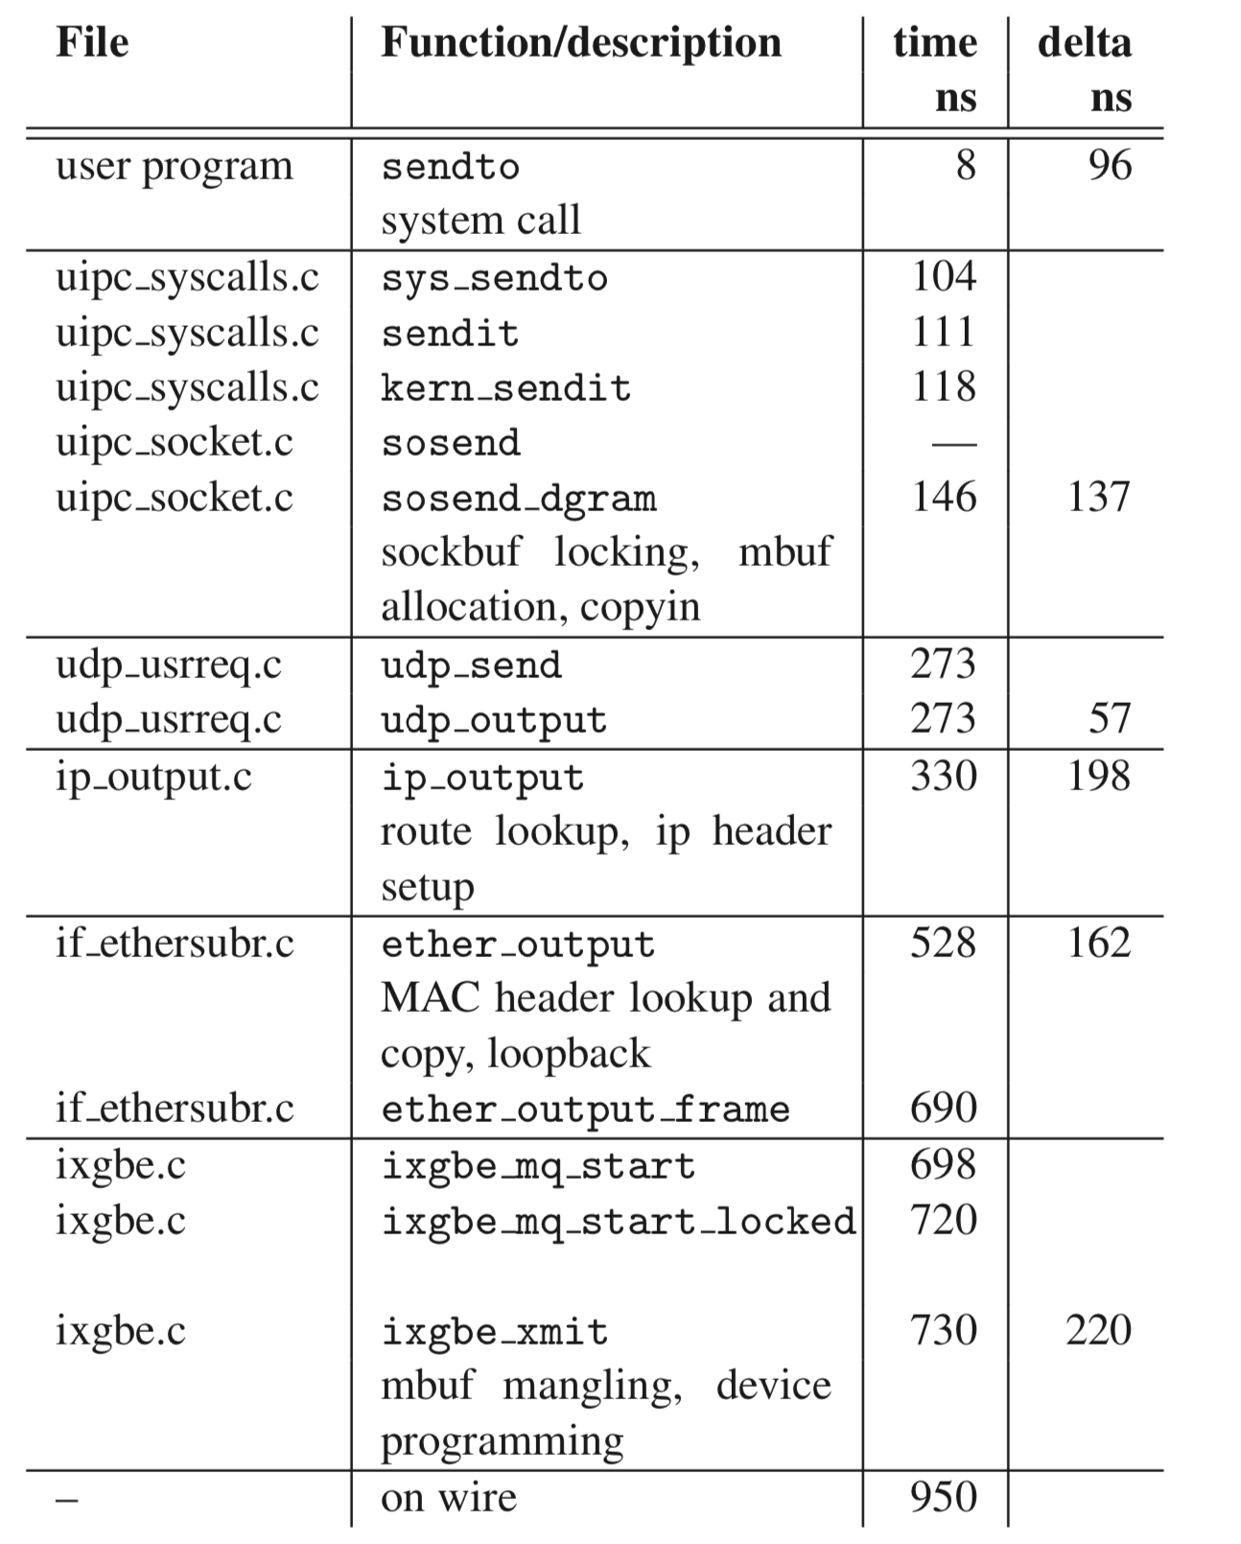
FreeBSD sendto() code path
Overheads are sprinkled throughout the packet processing stack.
Netmap ATC12.

Slide 11
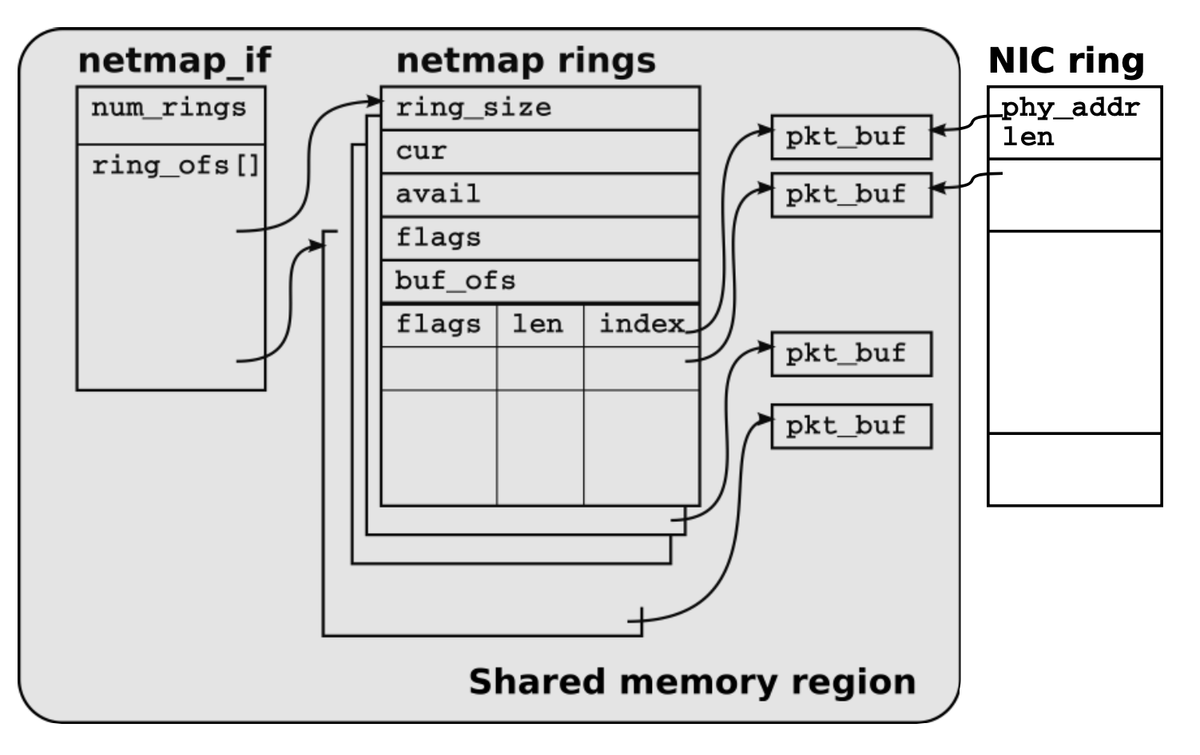
(1) Shared memory: avoid per-byte costs
Remove user-kernel data copies
Other systems use similar ideas:
Finish processing entirely within the kernel (e.g., click-kernel, eBPF)
Expose kernel buffers directly to user space (PF_RING)

Slide 12
(2) Data representation: pre-allocated fixed size buffers and rings
Avoid per-byte costs by pre-allocating chunks of a fixed size (max packet size)
No allocation and freeing mbuf/sk_buff at run time

Slide 13
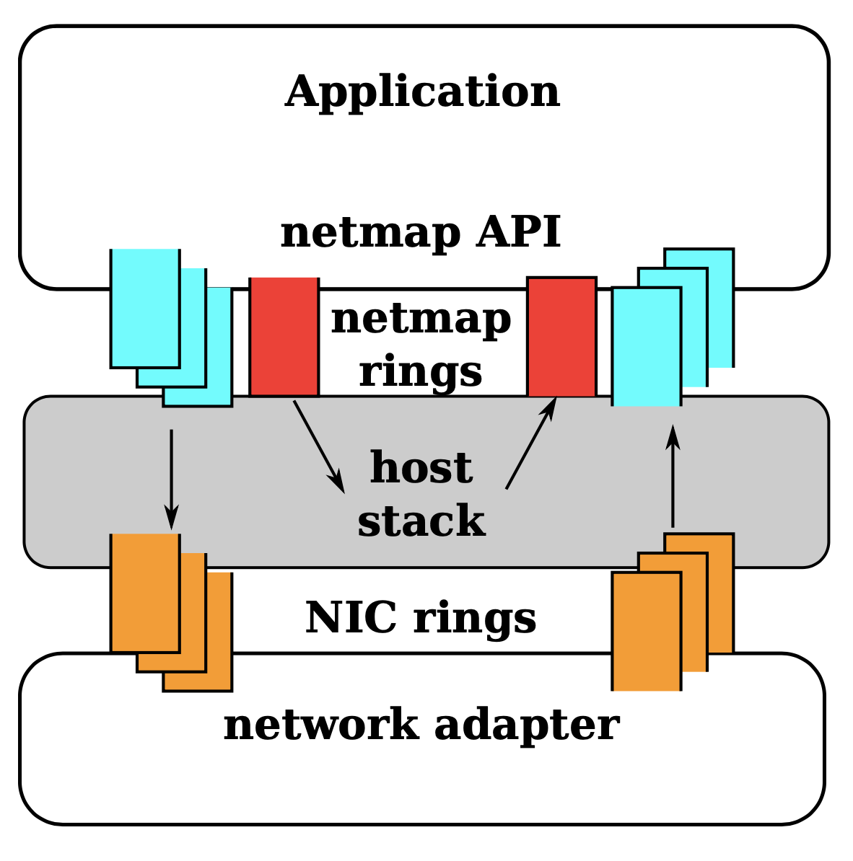
(3) NIC/netmap ring separation
Validate netmap ring inputs provided by applications
System call still needed to copy netmap ring descriptor to NIC ring descriptor (per-packet operation)
Some systems avoid even this (DPDK, PF-RING, Solarflare openonload) by having apps directly program NIC rings (security & fault implications)

Slide 14
(4) Amortize system calls by batching
Notify the kernel about packets written for transmission or available for receiption

Slide 15
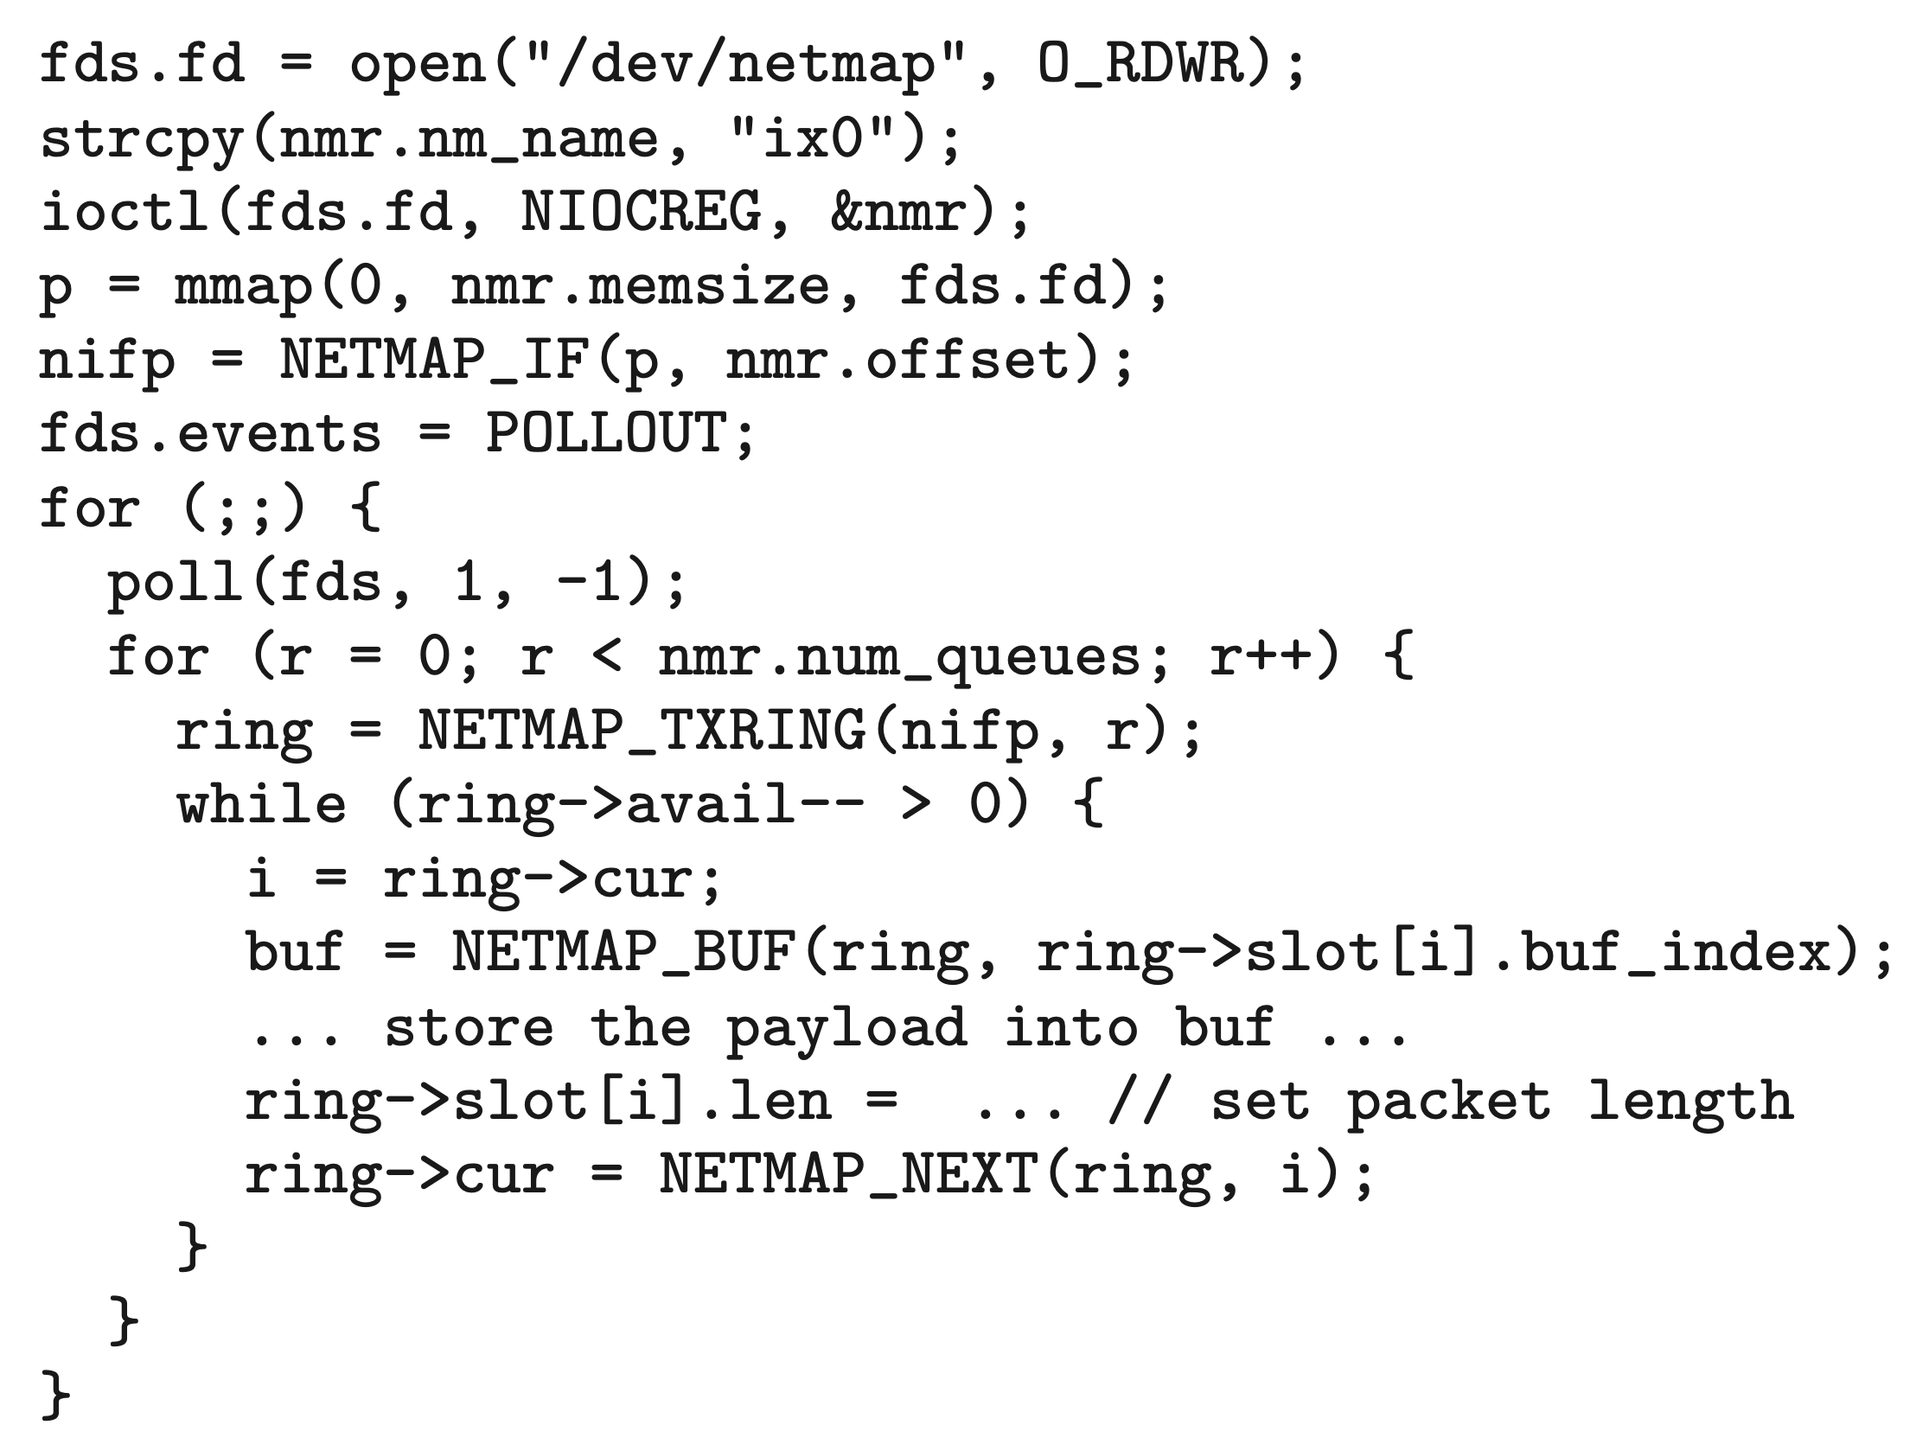
Pkt gen
Associate shared buffers with fd’s
Poll file descriptor
Walk through the netmap ring to identify available packet buffers. Write and notify
Poll automatically synchronizes rings. No more system calls needed

Slide 16
DPDK basic forwarding

Slide 17
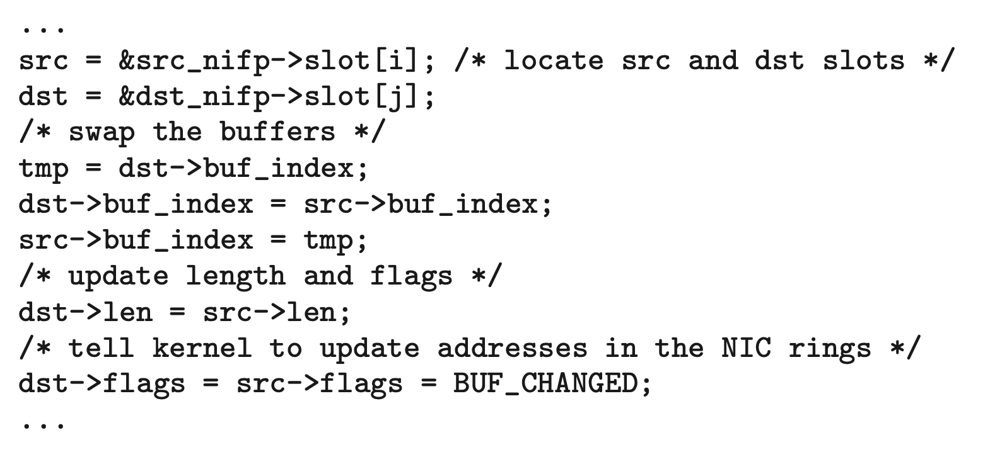
Forwarding between two interfaces
Move descriptors, no data copies

Slide 18
Performance (pkt gen throughput)
Vary clock rate to make the workload CPU bound

Slide 19
Varying packet size

Slide 20
Performance with batching

Slide 21
Outlook: fast packet processing
Get rid of software if you can
Application-kernel API change: application must be modified
Device drivers must often be modified
Utilities in the host networking stack?
Libpcap, Netfilter, Routing, Socket lookup/packet demuxing?
Multitenancy: serious implications to weakening fault isolation
Can we get isolation with efficiency?

