Slide 1

Data Center Transport
Lecture 10
Srinivas Narayana
http://www.cs.rutgers.edu/~sn624/553-S23
Parts of this lecture were heavily adapted from slides by Mohammad Alizadeh

Slide 2
DC Transport Requirements
High throughput, low latency, burst tolerance

Slide 3


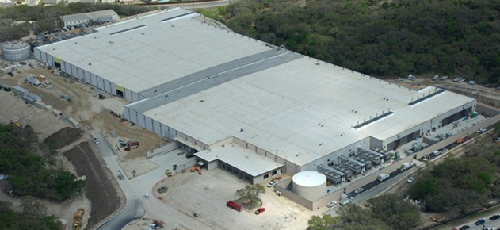


Transport
inside the DC
100Kbps–100Mbps links
~100ms latency
INTERNET
Fabric
10–100Gbps links
~10–100μs latency
Servers

Slide 4
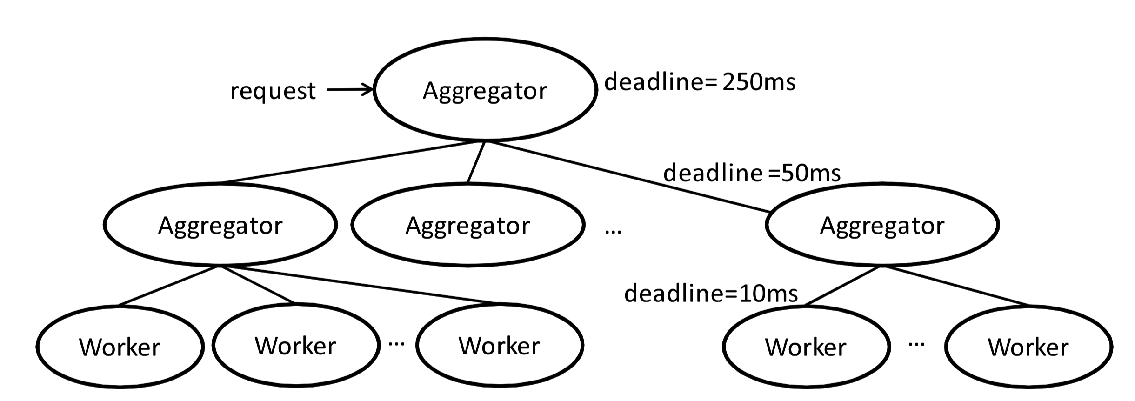
Transport
inside the DC
INTERNET
Fabric
Interconnect for distributed compute workloads
Servers
web
app
cache
data-base
map-reduce
HPC
monitoring
Notes:
Specifically, while some of the traffic in data center networks is sent across the Internet, the majority of data center traffic is between the servers within the data center and never leaves the data center.

Slide 5



Data center workloads
Coexistence creates some performance impairments...
Mice and Elephants
Short messages
(e.g., query, coordination)
Large flows
(e.g., data update, backup)
Low Latency
High Throughput
Source with B bytes to send
Delay D
Completion time D + B/R
Rate R

Slide 6


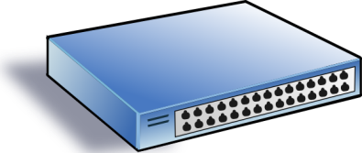

(1) Incast
Synchronized fan-in congestion
Worker 1
Aggregator
Worker 2
Worker 3
RTO_{min} = 300 ms
Worker 4
TCP timeout
Vasudevan et al. (SIGCOMM’09)

Slide 7
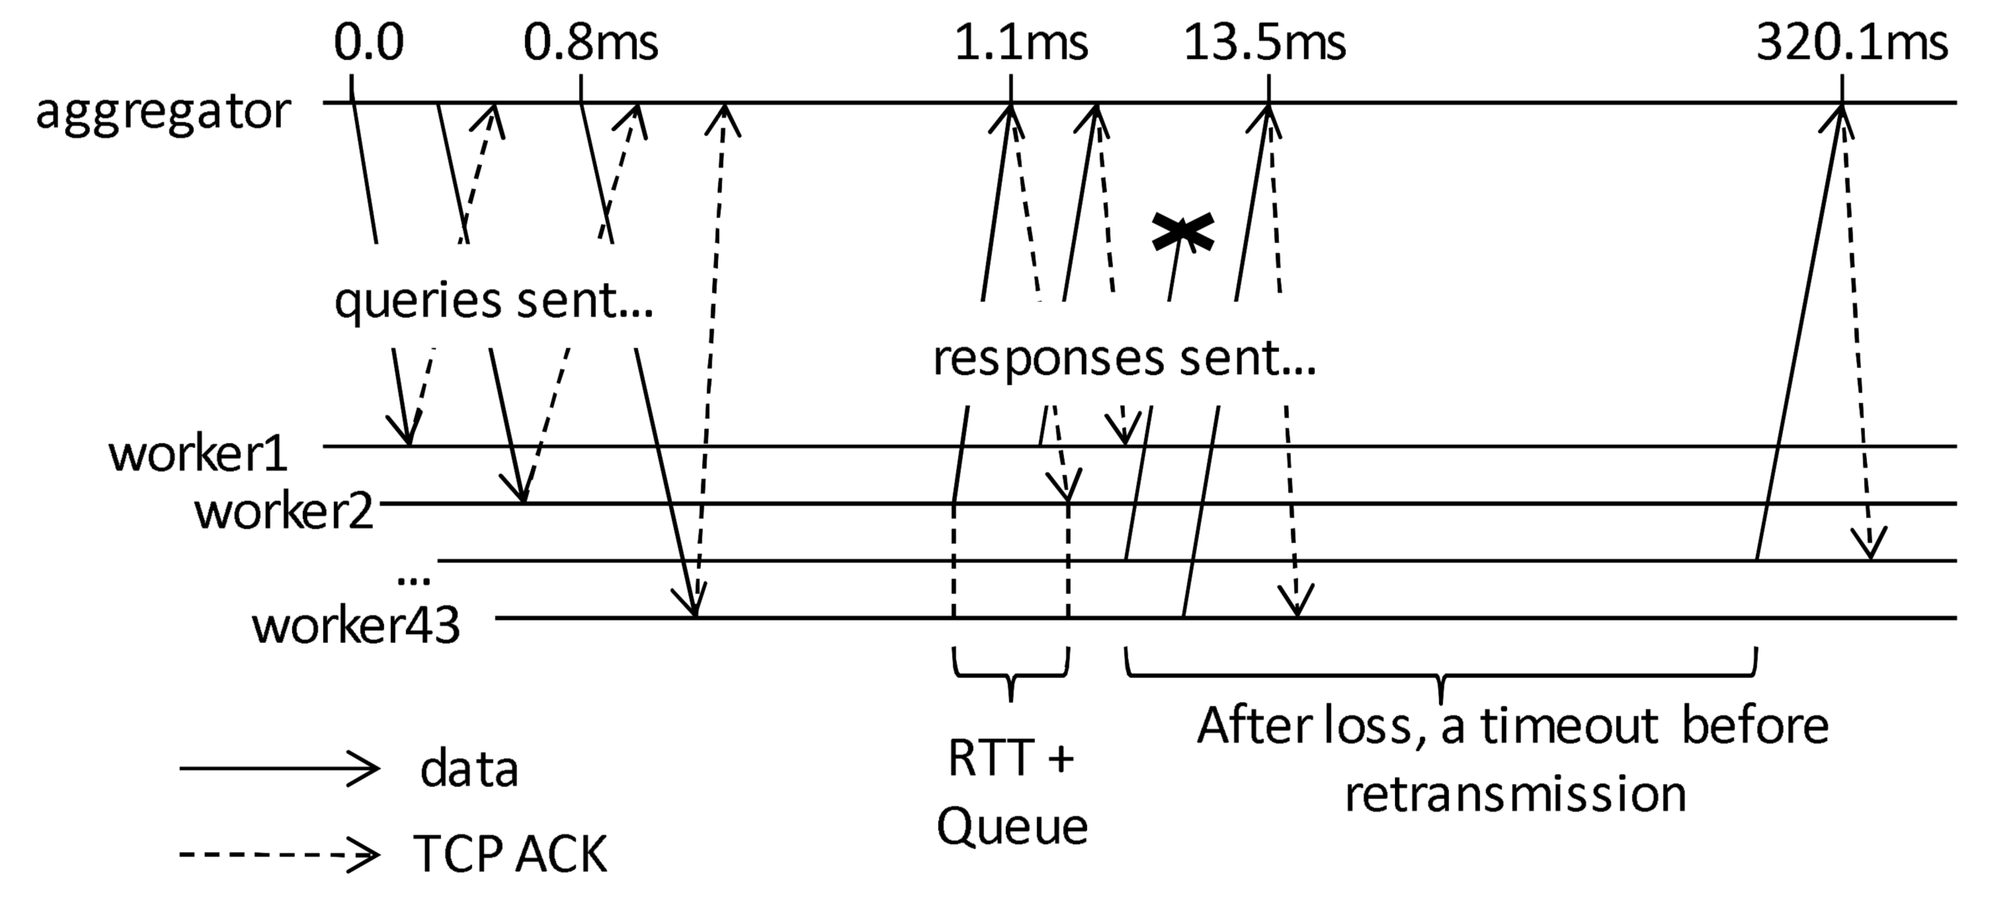
Trace of a real incast event
One option: reduce RTO to mitigate this

Slide 8
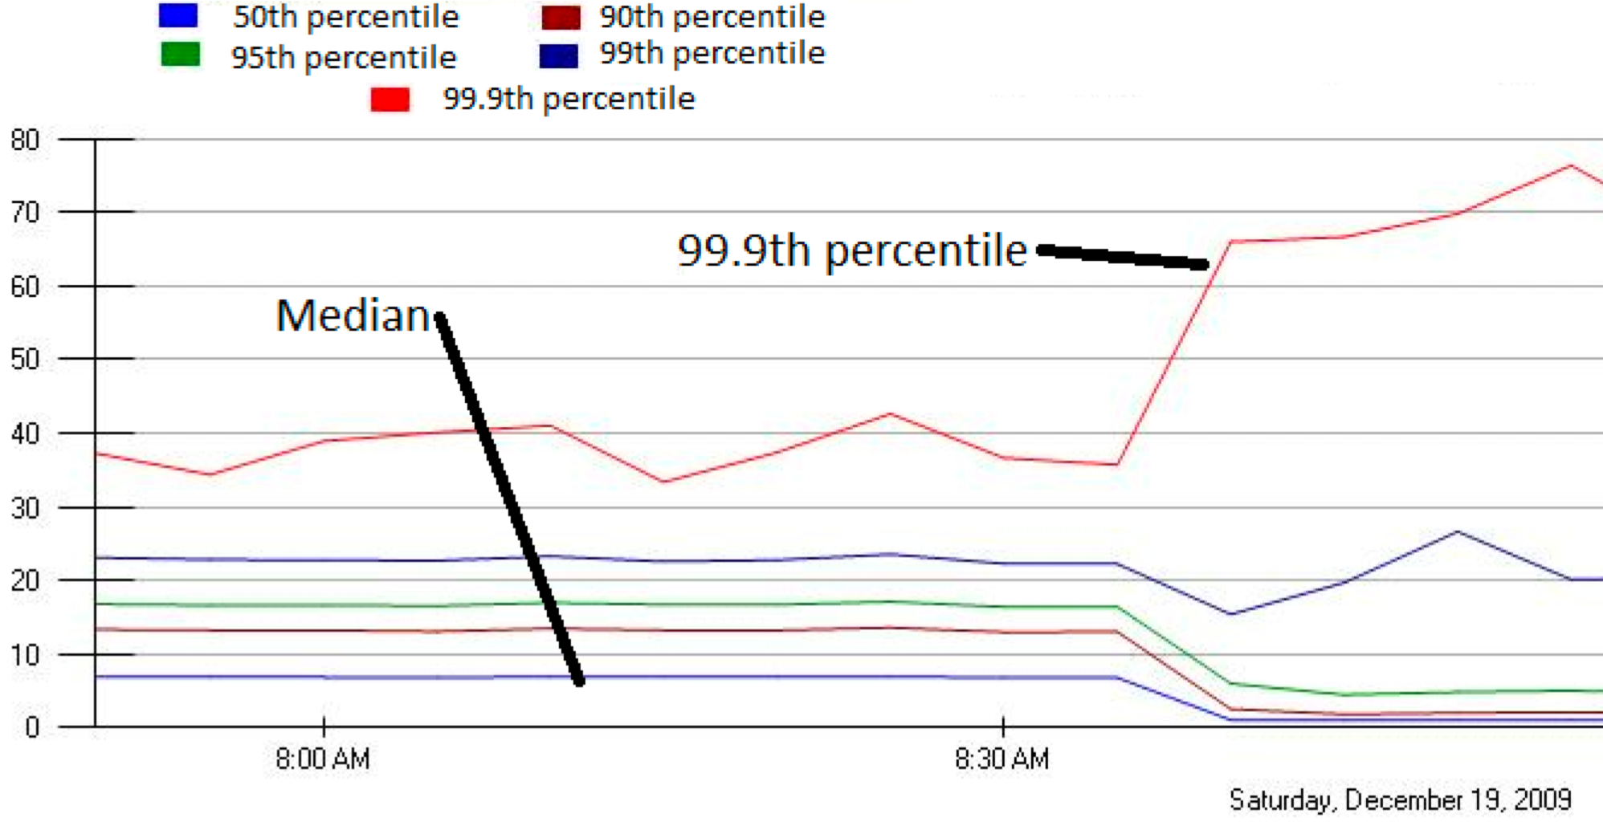
Another option: Jittering to avoid sync
MLA Query Completion Time (ms)
Jittering switched off around 8:30 am.
Jittering trades off median for high percentiles
Notes:
1. Incast really happens – see this actual screenshot from production tool
2. People care, they’ve solved it at application by jittering.
3. They care about the 99.9th percentile, 1-1000 customers

Slide 9

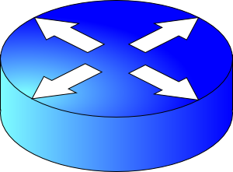



(2) Head of line blocking: Queue buildup
Mouse flow: Requires low latency
High delay
Packet drops
Resource contention occurs in the core of the network
Congestion control will react, but may be too little & too late:
  Congestion control can’t prevent packet drops “now”
  Congestion control won’t prevent high-sending-rate flows from inflicting large delays or recurring drops
Elephant flow: Requires high throughput
FIFO queue
Head of the line blocking

Slide 10
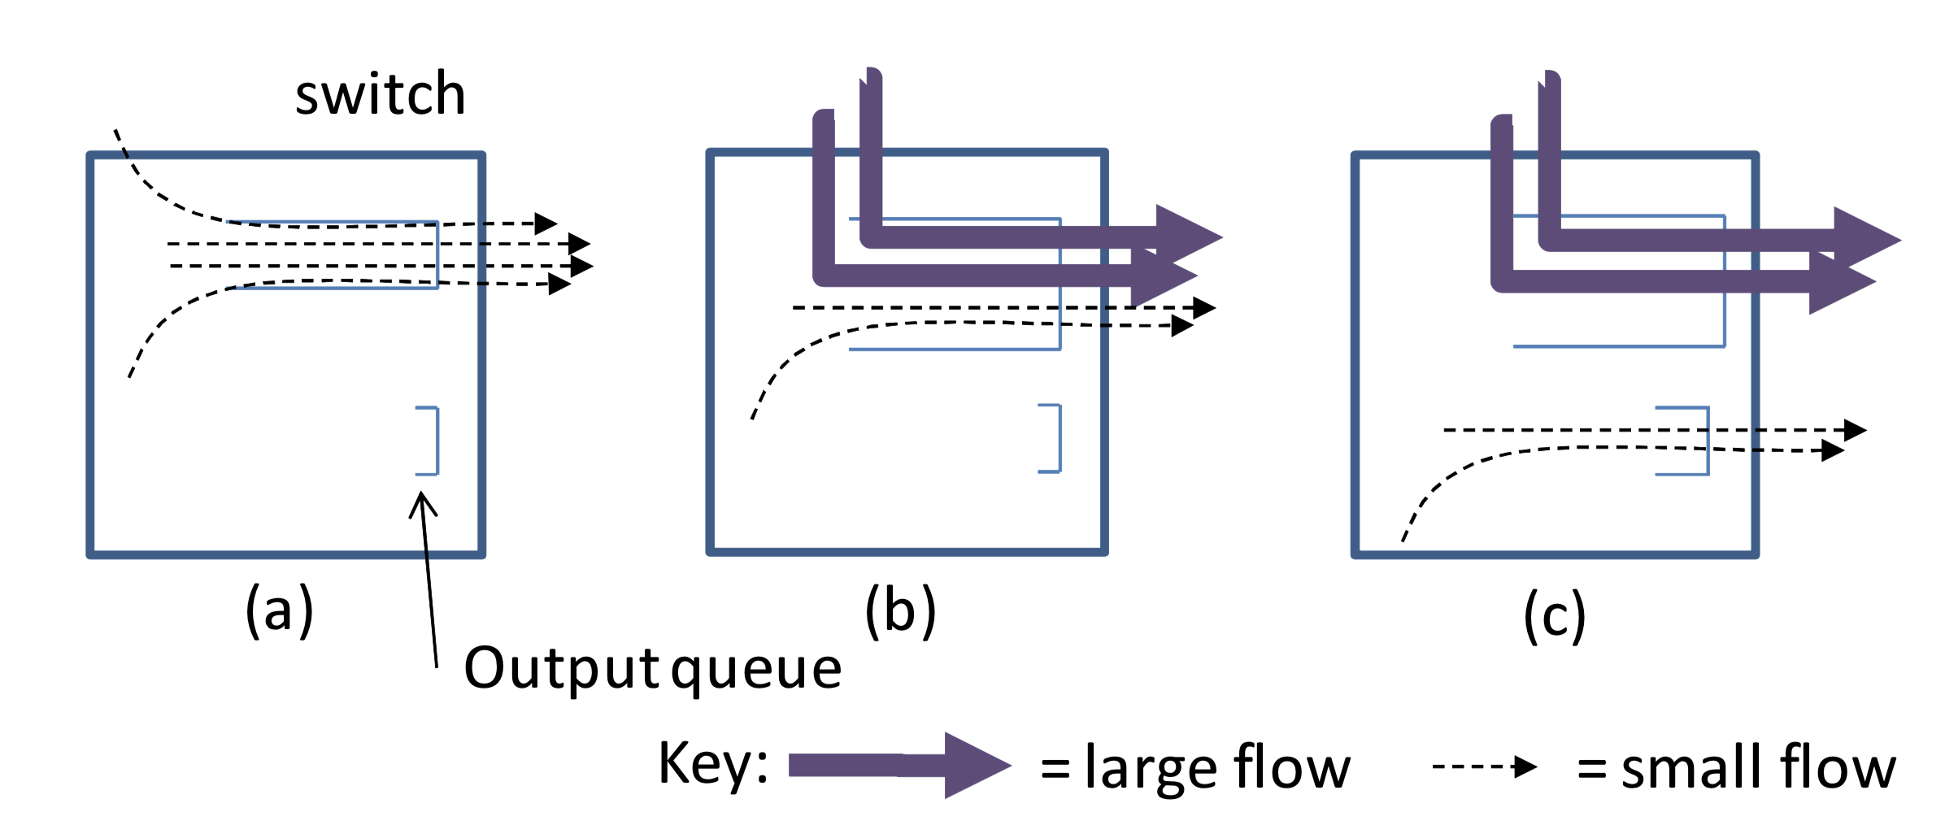
(2) HOL Blocking on a switch port
Queue buildup on a port increases delays for all flows using that port (head of the line blocking)
Reducing RTO doesn’t help latency when there are no drops

Slide 11
(3) Shared memory buffering
Where should the packets not currently serviced wait?
Input-queued vs. output-queued (preferable design)
Buffer management: how to put packets into the buffer
Scheduling: how to schedule packets leaving the buffer
Shared memory buffer
Input port
Output port
Static buffer allocation
Input port
Switching fabric
Output port
…
…
…
Dynamic buffer allocation
(statistical multiplexing)
Input port
Output port

Slide 12
(3) Buffer Pressure
Shared memory buffering means that queues building up on a different port can also impact flows.

Slide 13
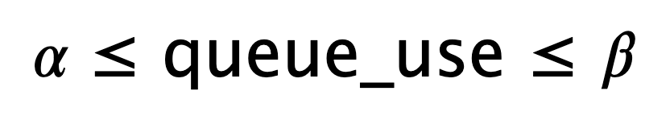
Need to keep queues small.
Use delay-based CC?
Keep just a few packets in queues by observing delays
Adjust window such that only a few packets are in queue
RTT estimates need to be very accurate and precise
  Difficult in low-RTT data centers.
  Challenges: Software queueing & scheduling delays. Timer tick res

Slide 14
Data Center TCP (DCTCP)
Design of the congestion control algorithm

Slide 15
Review: TCP congestion control
Keep some in-flight (un-ACK’ed) packets: congestion window
Adjust window based on several algorithms: TCP New Reno:
  Startup: slow start
  Steady state: AIMD
  Loss: fast retransmission, fast recovery
Main question for this lecture:
  (How) should this design change for data centers?

Slide 16
Behavior of Additive Increase
Say MSS = 1 KByte
Default ssthresh = 64KB = 64 MSS
Packet drops/
RTO
Loss occurs at cwnd = 54K
Loss occurs at cwnd = 40K
54 MSS
Additive increase
Set ssthresh to
27 MSS
Additive increase
Congestion Window
Set ssthresh to
20 MSS
Slow start
Slow start
Slow
start
1K
Time

Slide 17
Additive Increase/Multiplicative Decrease
Say MSS = 1 KByte
Default ssthresh = 64KB = 64 MSS
Triple duplicate ACK
Perceived loss occurs at cwnd = 80K
Switch to additive increase at cwnd = ssthresh = 64K
New ACK
RTO
Multiplicative decrease
In-flight data
Additive increase
Additive increase
RTO: window drops all the way to 1 MSS
Slow start
(2) Set inflight = ssthresh = 40K
Fast retransmit: (1) retransmit dup-ACKed segment
Fast recovery keeps inflight stable until new ACK
1K
Time

Slide 18
Explicit Congestion Notification
Sender 1
Additive Increase:
W → W+1 per round-trip time
Multiplicative Decrease:
W → W/2 per drop or ECN mark
ECN Mark (1 bit)
Receiver
Window Size (Rate)
Time
Queue size > K, mark the packet.
Sender 2
Example of Active Queue Management
ECN = Explicit Congestion Notification
(RED, PI, etc.)
Notes:
DCTCP is based on the existing Explicit Congestion Notification framework in TCP.
----- Meeting Notes (3/7/12 12:24) -----
Remember to mention "SAWTOOTH"

Slide 19
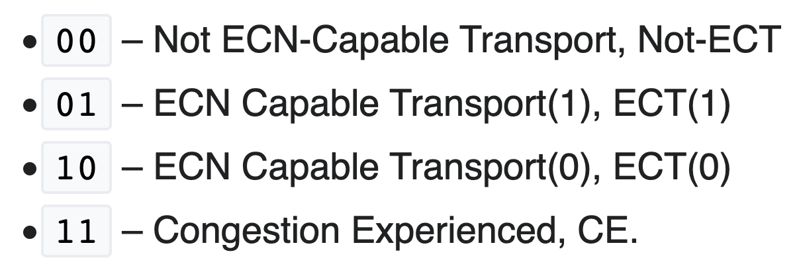
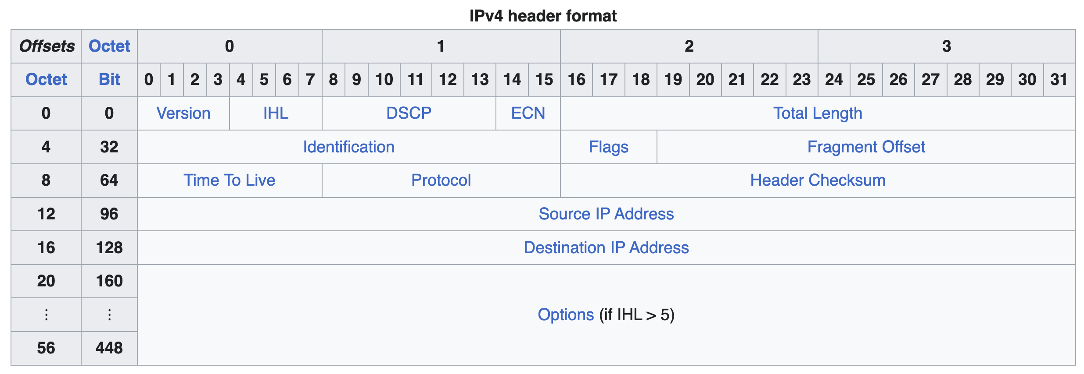
ECN set on the IP header by routers
Dropped if TCP sender is not ECN enabled

Slide 20
Explicit Congestion Notification
Sender 1
Additive Increase:
W → W+1 per round-trip time
Multiplicative Decrease:
W → W/2 per drop or ECN mark
ECN Mark (1 bit)
Receiver
Window Size (Rate)
Time
Receiver’s ACK echoes mark in TCP header
Sender 2
ECN = Explicit Congestion Notification
Notes:
DCTCP is based on the existing Explicit Congestion Notification framework in TCP.
----- Meeting Notes (3/7/12 12:24) -----
Remember to mention "SAWTOOTH"

Slide 21
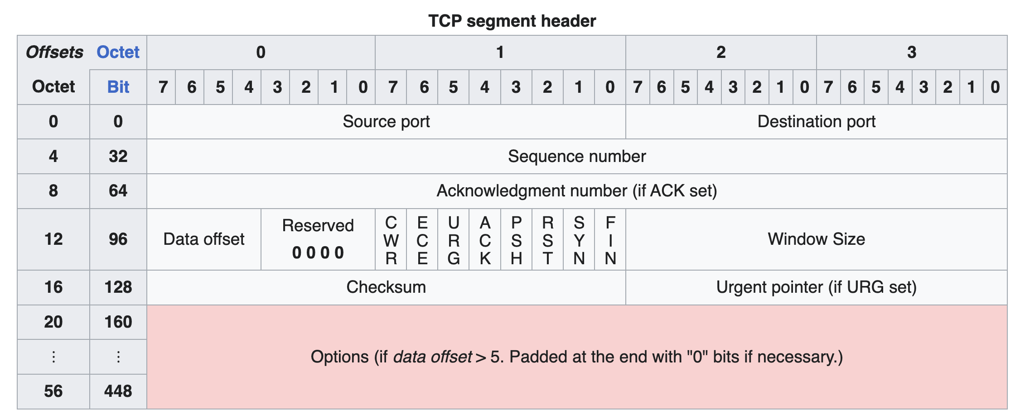
ECN on the TCP header

Slide 22
DCTCP: Main idea
Extract multi-bit feedback from single-bit stream of ECN marks
  Reduce window size based on fraction of marked packets

Slide 23
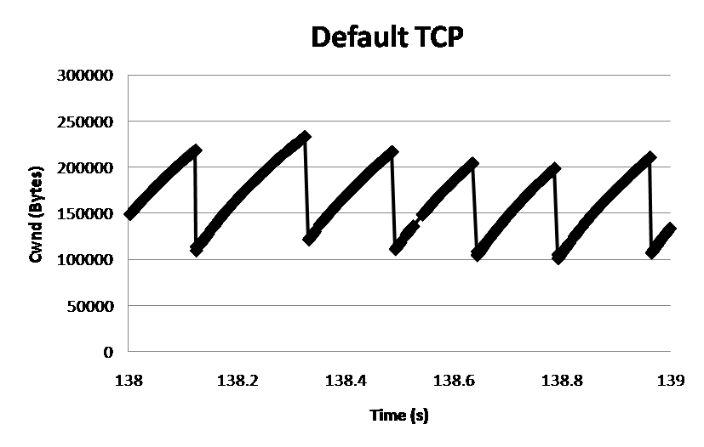
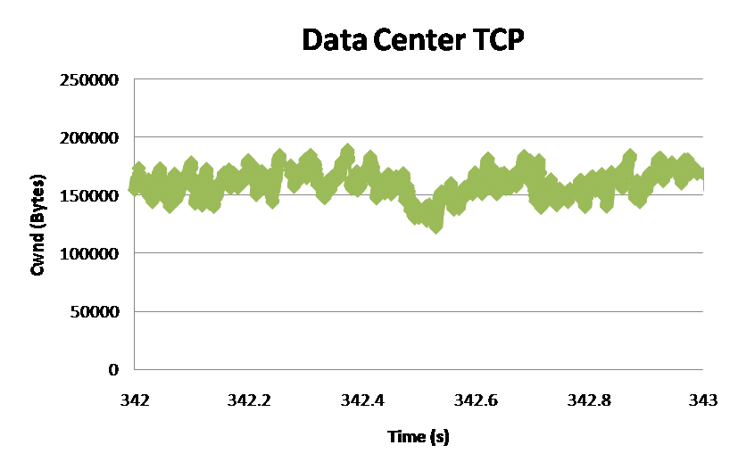
DCTCP: Main idea
ECN Marks | TCP | DCTCP
1 0 1 1 1 1 0 1 1 1 | Cut window by 50% | Cut window by 40%
0 0 0 0 0 0 0 0 0 1 | Cut window by 50% | Cut window by 5%
TCP
DCTCP
Window Size (Bytes)
Window Size (Bytes)
Time (sec)
Time (sec)
Notes:
Start with: “How can we extract multi-bit information from single-bit stream of ECN marks?”
- Standard deviation: TCP (33.6KB), DCTCP (11.5KB)

Slide 24
DCTCP algorithm
B
K
Don’t
Mark
Mark
Switch side:
  Mark packets when Queue Length > K.
  Sender side:
  Maintain running average of fraction of packets marked (α).
  Adaptive window decreases:
    Note: decrease factor between 1 and 2.
Reacting to and controlling queue size distribution
Notes:
very simple marking mechanism
not all the tunings other aqms have
on the source side, the source is tryign to estimate the fraction of packets getting marked
using the obs that there is a stream of ecn marks coming back – more info in the stream than in any single bit
trying to maintain smooth rate variations to operate well even when using shallow buffers, and only a few flows (no stat mux)
F over the last RTT. In TCP there is always a way to get the next RTT from the window size. Comes from the self-clocking of TCP.
Only changing the decrease. Simplest version – makes a lot of sense. So generic could apply it to any algorithm – CTCP, CUBIC – how to cut its window leaving increase part to what it already does. Have to be careful here.

Slide 25
Delayed ACKs
Not every packet is ACKnowledged by receiver
Too many ACKs: increase packet processing load
  Typical policy: ACK every m packets, or after sender has paused transmitting for a delayed ACK timeout
How to allow the sender to see the full stream of ECN marks?

Slide 26
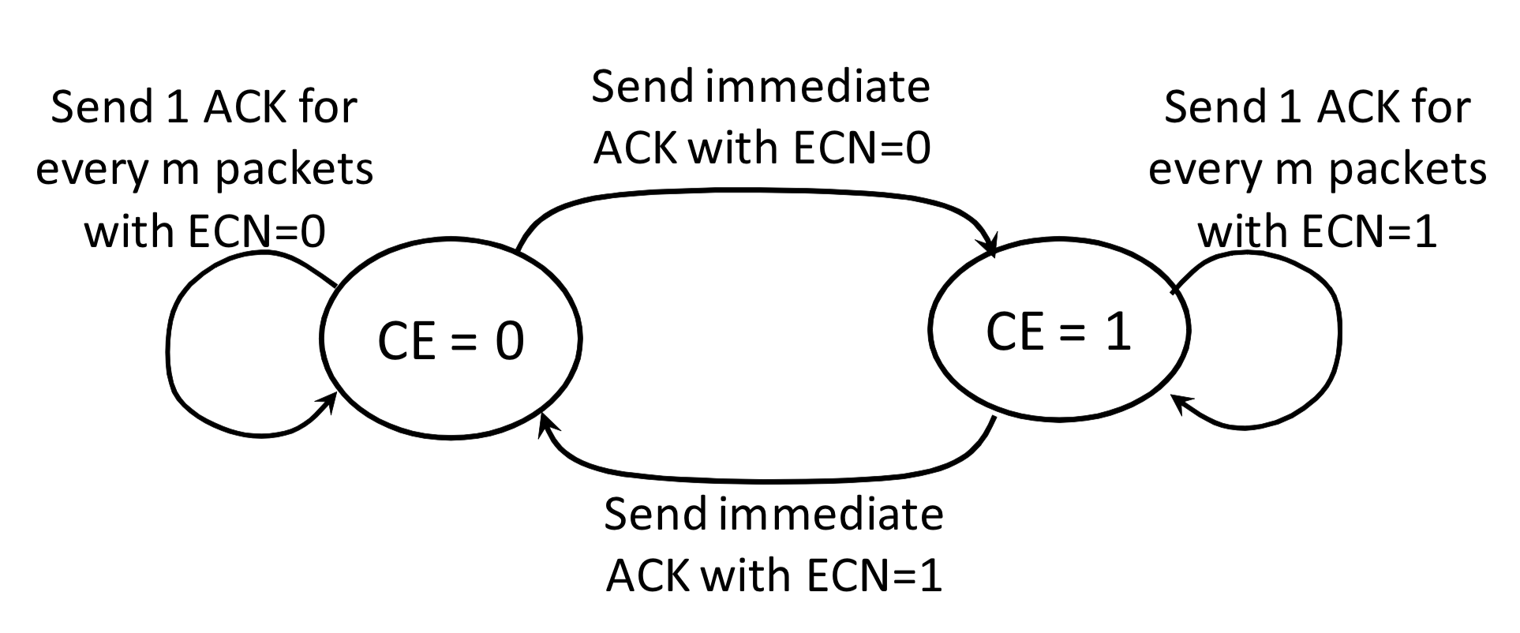
Efficient and “lossless” ACK generation

Slide 27
DCTCP vs TCP
Experiment: 2 flows (Win 7 stack), Broadcom 1Gbps Switch
Buffer is mostly empty
(KBytes)
DCTCP mitigates Incast by creating a
large buffer headroom
ECN Marking Thresh = 30KB

Slide 28
Why it works
Low Latency
  Small buffer occupancies → low queuing delay
2. High Throughput
  ECN averaging → smooth rate adjustments, low variance
3. High Burst Tolerance
  Large buffer headroom → bursts fit
  Aggressive marking → sources react before packets are dropped

Slide 29
Setting parameters: A bit of analysis
B
K
How much buffering does DCTCP need for 100% throughput?
Need to quantify queue size oscillations (stability).
Packets sent in this
RTT are marked
Window Size
W*+1
W*
(W*+1)(1-α/2)
Time

Slide 30
Setting parameters: A bit of analysis
B
K
How small can queues be without loss of throughput?
Need to quantify queue size oscillations (Stability).
for TCP:
K > C x RTT
K > (1/7) C x RTT

Slide 31
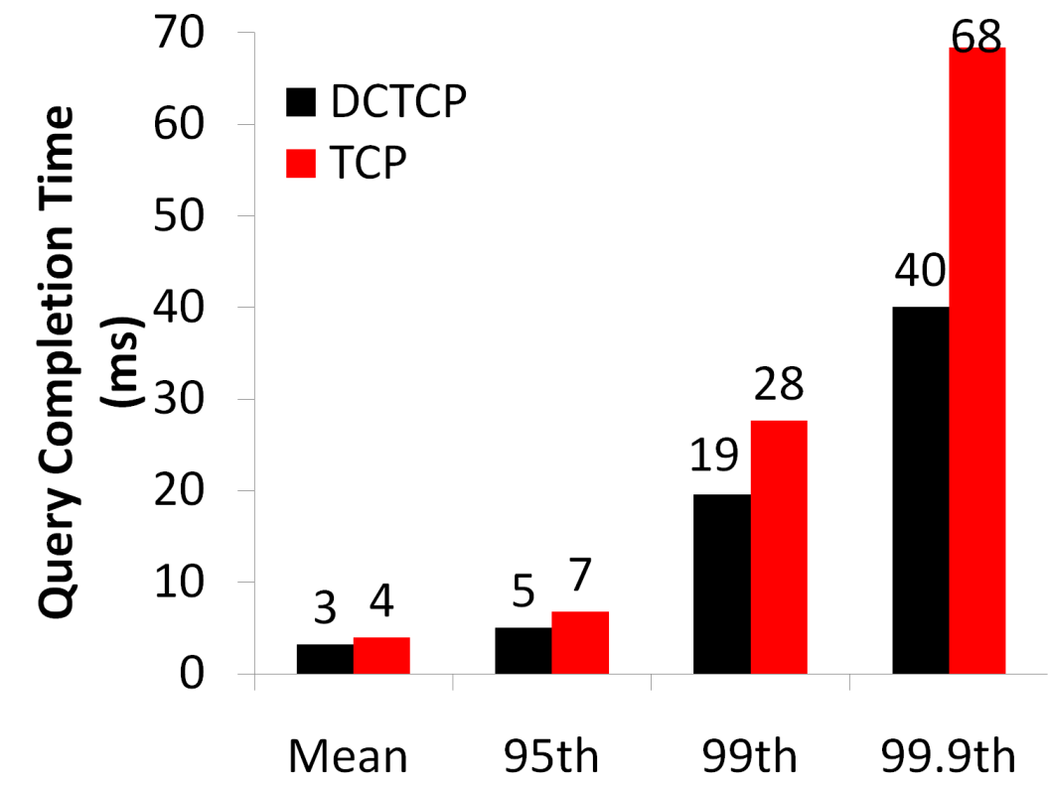
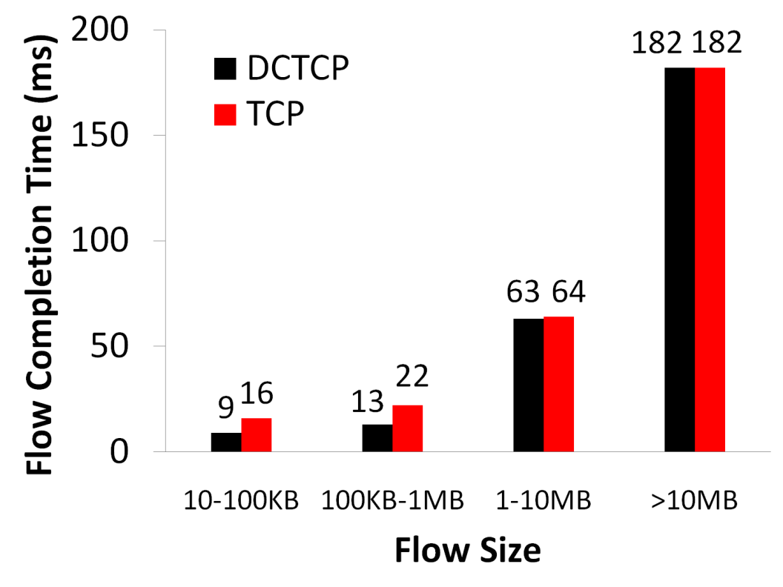
Bing benchmark (baseline)
Background Flows
Query Flows
Notes:
To transition to scaled traffic: people always want to get more out of their network.

Slide 32
Convergence time
DCTCP takes at most ~40% more RTTs than TCP
  “Analysis of DCTCP”, SIGMETRICS 2011
Intuition: DCTCP makes smaller adjustments than TCP, but makes them much more frequently
TCP
DCTCP
Notes:
In the first part of the talk, we established that what we need from DCTCP is to maintain small queues, without loss of throughput
Now in the case of TCP, the question of how much buffering is needed for high throughput has been studied and is known in the literature as the buffer sizing problem.
… and I’ll show you how to get low var…

Slide 33
CC evaluation: many aspects to consider
Throughput, delays, flow completion times
Fairness, convergence times
Specific impairments:
  incast (many to one, all to all)
  Queue buildup
  Buffer pressure
  Collateral damage from incast
Multi-hop versus single-hop bottlenecks
Comparison against existing TCPs ad AQMs
How deployable: app awareness, hardware compatibility, …

Slide 34
CC Deployment Concerns
Life isn’t easy in the fast lane

Slide 35
Practical deployment concerns in DCs
Coexistence with legacy protocols like TCP Cubic
  Application code can’t be upgraded in one shot
Minimum window size matters during heavy incast events
  e.g., 2 packets versus 1 packet: no reactive scheme can work if buffers are so small that drop in one RTT
Enabling appropriate options at senders, receivers, and routers
  Non “ECN-capable” flagged packets will be dropped when Q > K
  … including the SYN packets of any connection
Receive-side buffer tuning
  Reacting to increasing buffer demands at the endpoints takes time
  Static: Usually, receive buffer must be at least BDP; also influenced significantly by queueing

