Slide 1

Data Center Networking
Lecture 9
Srinivas Narayana
http://www.cs.rutgers.edu/~sn624/553-S23
Parts of this lecture were heavily adapted from slides by Mohammad Alizadeh and Changhoon Kim

Slide 2

What are data centers?
Large facilities with ~100K servers
  Compute, storage, and networking working in concert
  “Warehouse-Scale Computers”

Slide 3




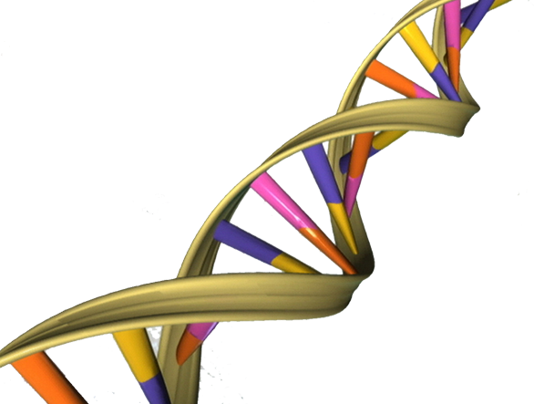


Types of Data Centers
Specialized data centers built for one or a few big apps
  Social networking: Facebook, Insta
  Web Search: Google, Bing
“Cloud” data centers
  Amazon EC2, Microsoft Azure
  Google App Engine

Slide 4
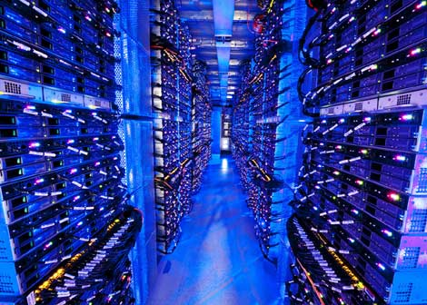
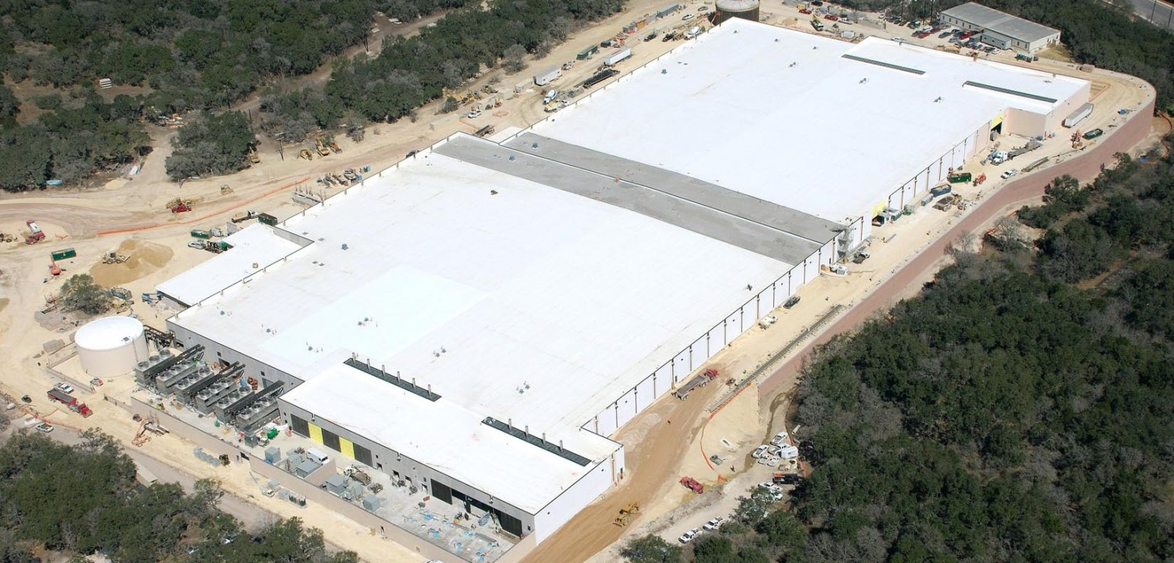
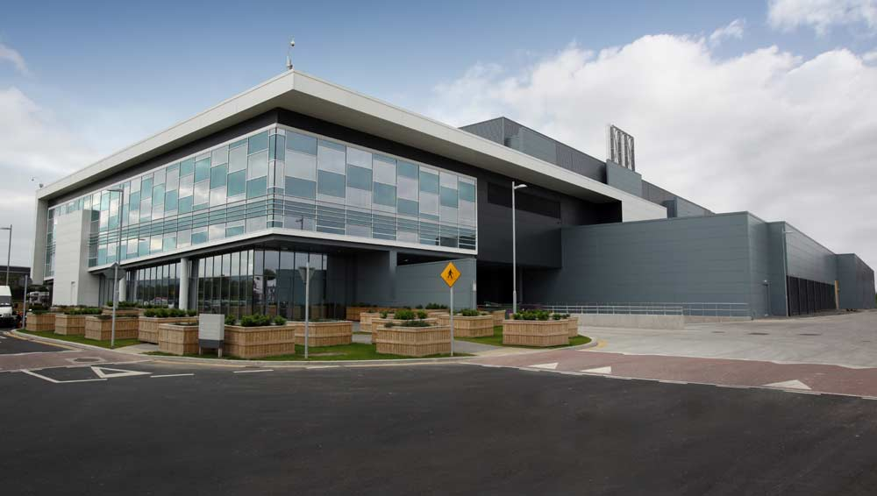
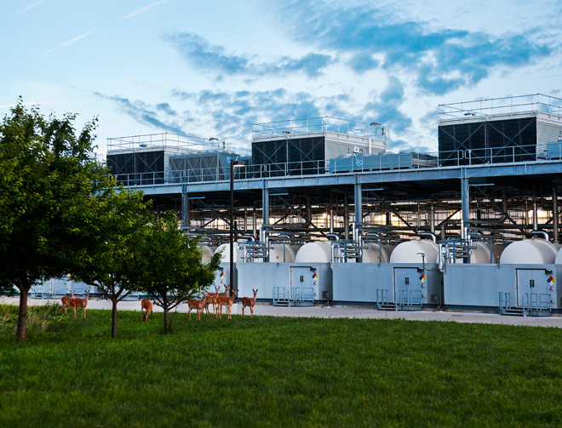
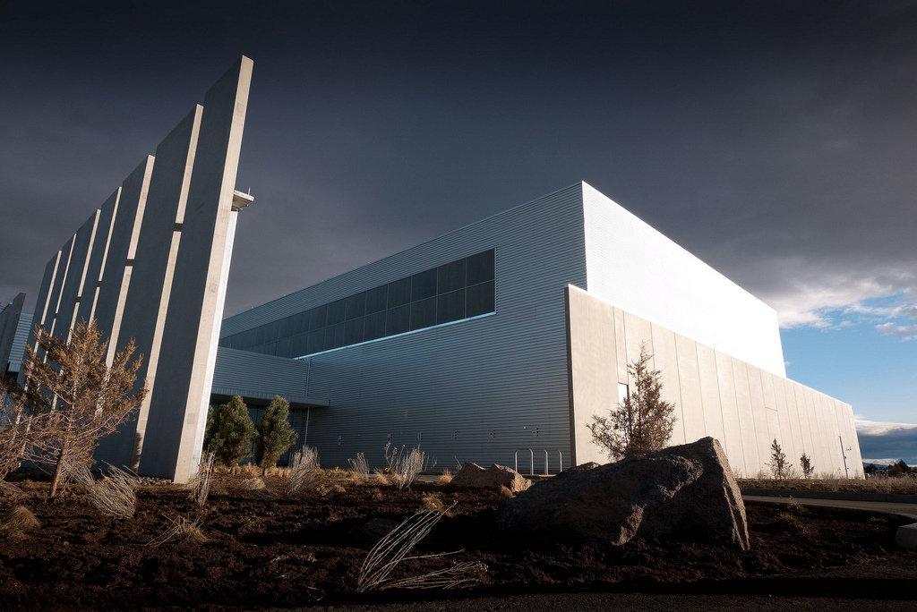
Data Centers with 100,000+ Servers
Microsoft
Microsoft
Google
Facebook

Slide 5
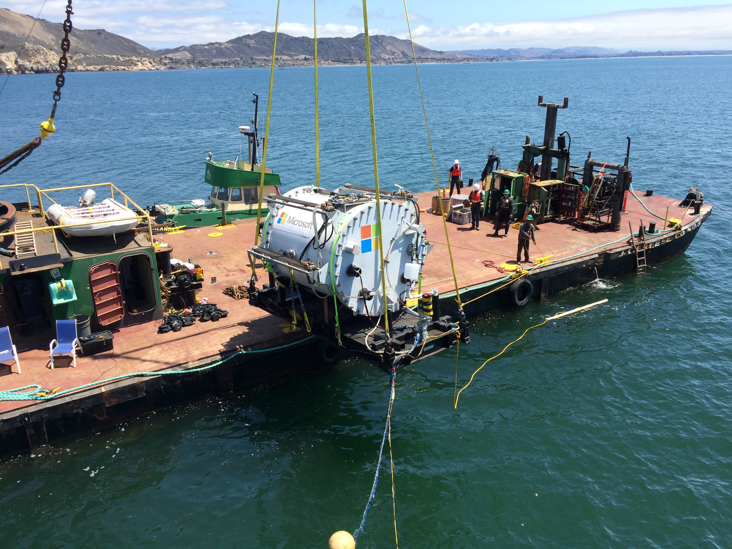
Notes:
https://www.nytimes.com/2016/02/01/technology/microsoft-plumbs-oceans-depths-to-test-underwater-data-center.html?_r=0

Slide 6



Scale of mega-data centers (circa 2016)
Each DC hosts ~100K servers
100s of Petabytes of storage
100s of Terabits/s of Bandwidth
(more than core of Internet)
10-100MW of power
(1-2% of global energy consumption)
Cost upwards of $1--4 billion per (mega) data center
100s of millions of users per data center app
100 billion searches per month
1.15 billion users

Slide 7
Datacenter traffic growth
Source: “Jupiter Rising: A Decade of Clos Topologies and Centralized Control in Google’s Datacenter Network”, SIGCOMM 2015.

Slide 8
How a data center looks on the inside

Slide 9
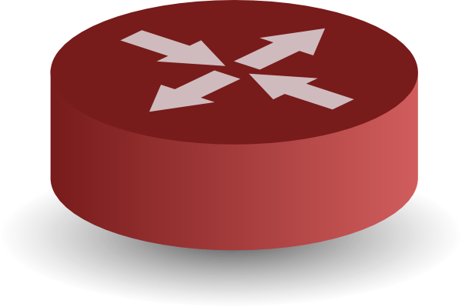
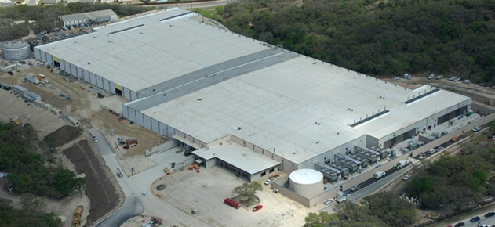


INTERNET
Fabric
Servers

Slide 10
Review: Basics of data center topology
Servers arranged into racks
  Some people call the individual server in a rack a blade
  Each slot also called a pizza box or 1U (“1 unit”)
Switch interconnecting all servers at the top of the rack
  Forms the edge of the network
  You’ll see the name Top-Of-Rack (ToR) switch
ToR switches are interconnected by the rest of the network fabric

Slide 11
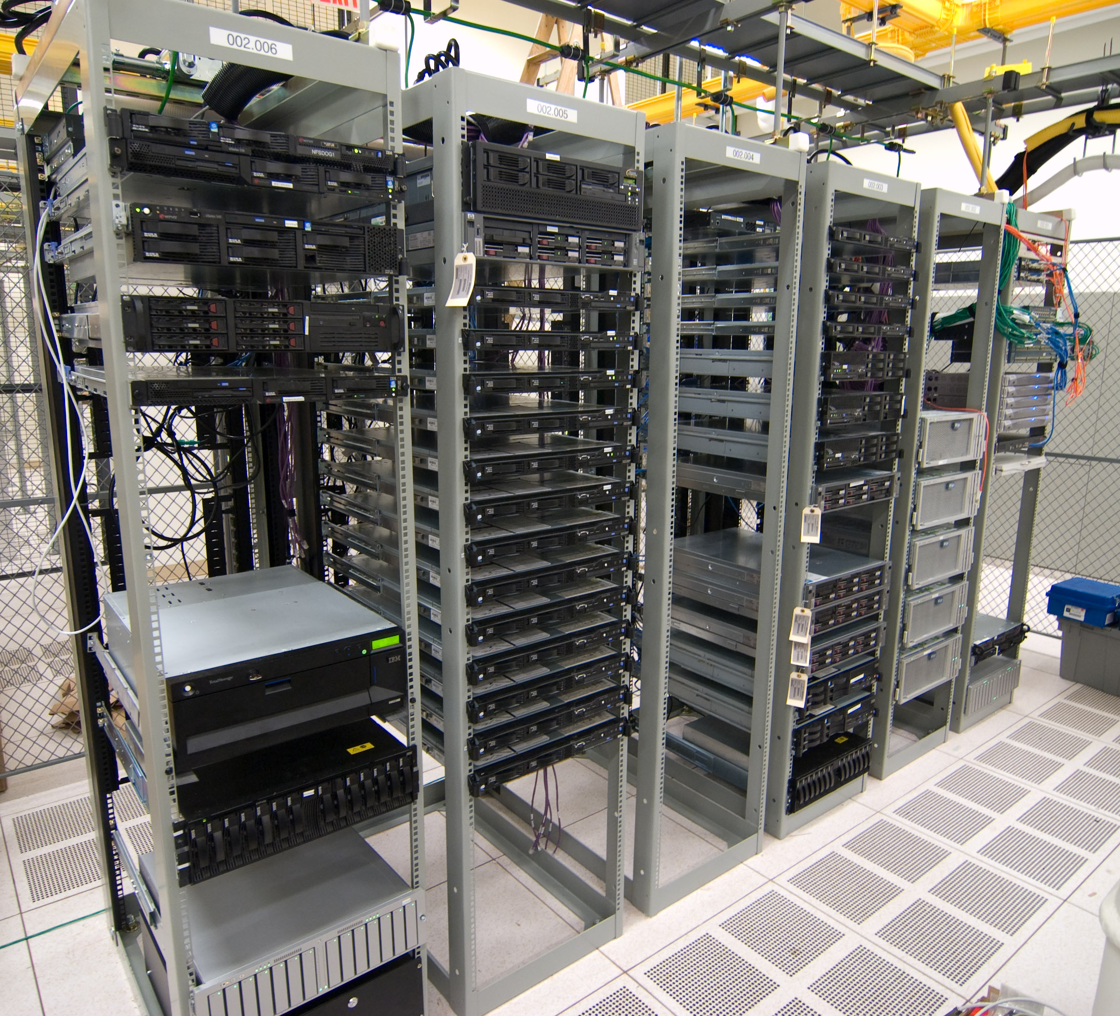
Half-filled rack
Cabling from servers to the switch
Power, network backplane running on top

Slide 12
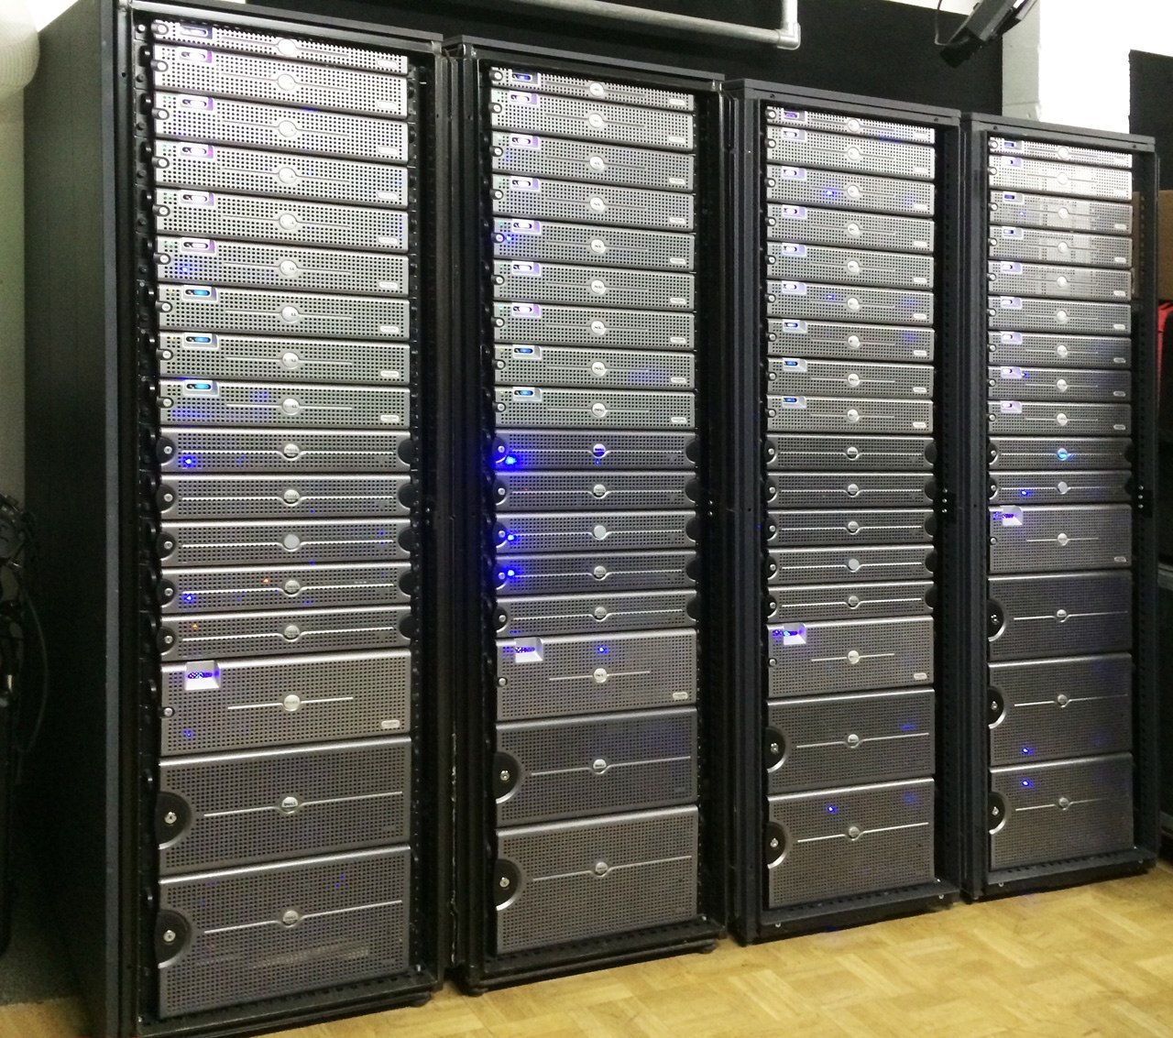
Fully filled rack
With this kind of density, you need effective cooling
Different kinds of cooling possible.
  “Free” cooling with external air, pumped refrigerants, etc.

Slide 13
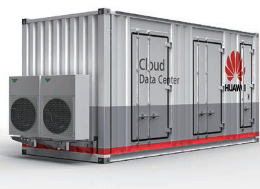
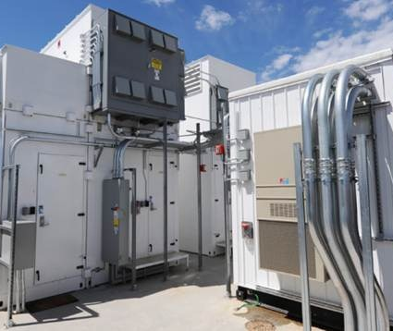
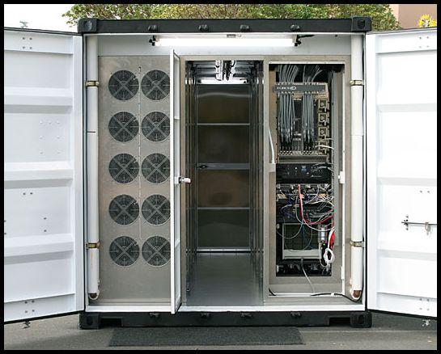
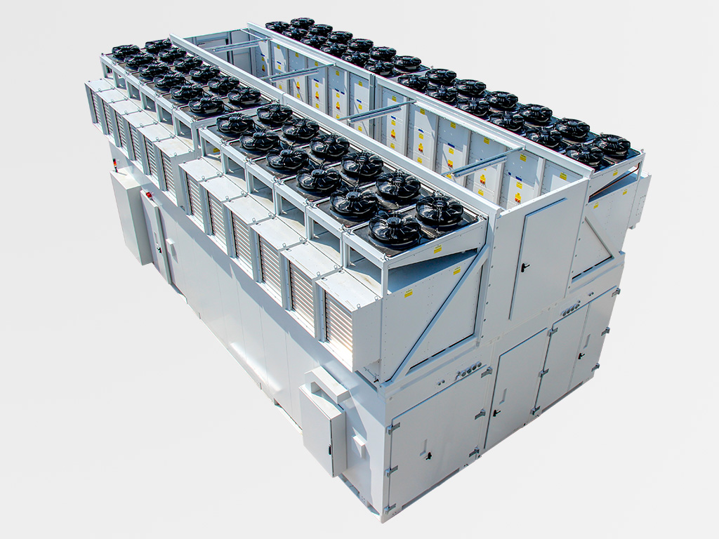
Container data centers

Slide 14
What’s different about DCNs?
Single administrative domain
  Change all endpoints and switches if you want
  Limited interfaces with the outside world
Unique network properties
  Tiny round trip times (microseconds)
  Massive multipath topologies
  Shallow-buffered switches
Latency and tail-latency critical
  Tail latency: high %-ile (e.g., 99.9) of a latency distribution
  Network is a backplane for large-scale parallel computation
Together, serious implications for the application, transport, network, link layer designs one can use

Slide 15
Goal: Support cloud app requirements
On-demand
  Use resources when you need it; pay-as-you-go
  Elastic: Scale up & down based on demand
Multi-tenancy
  Multiple independent users share infrastructure
  Security and resource isolation
  SLOs on performance & reliability
Dynamic Management
  Resiliency: isolate failure of servers and storage
  Workload movement: move work to other locations

Slide 16





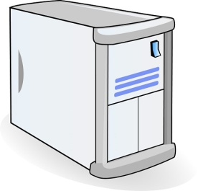

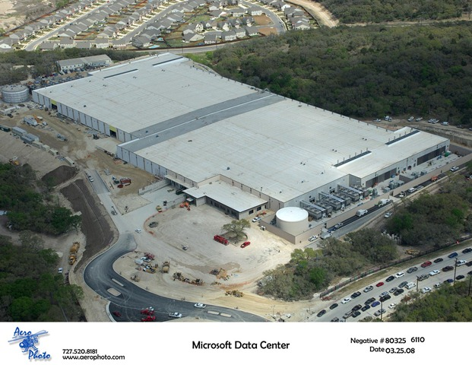


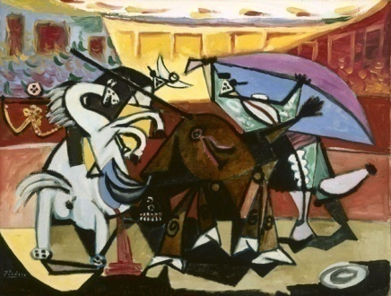






Example: Web Search
TLA
1.
Picasso
Art is…
Deadline = 250ms
2. Art is a lie…
…..
3.
Partition/Aggregate App Structure
Picasso
MLA
………
1. Art is a lie…
1.
MLA
Deadline = 50ms
2.
2. The chief…
Strict deadlines
Tail Latency Matters
…..
…..
3.
3.
“Everything you can imagine is real.”
“Computers are useless.
They can only give you answers.”
“It is your work in life that is the ultimate seduction.“
“Bad artists copy.
Good artists steal.”
“I'd like to live as a poor man
with lots of money.“
“Art is a lie that makes us
realize the truth.
“The chief enemy of creativity is good sense.“
“Inspiration does exist,
but it must find you working.”
Deadline = 10ms
Worker Nodes
Notes:
After the animation, say “this follows what we call the partition/aggregate application structure.
I’ve described this in the context of search, but it’s actually quite general
- “the foundation of many large-scale web applications.”

Slide 17
Challenges in DCNs

Slide 18
Data center costs
Amortized Cost* | Component | Sub-Components
~45% | Servers | CPU, memory, disk
~25% | Power infrastructure | UPS, cooling, power distribution
~15% | Power draw | Electrical utility costs
~15% | Network | Switches, links, transit
The Cost of a Cloud: Research Problems in Data Center Networks. Sigcomm CCR 2009. Greenberg, Hamilton, Maltz, Patel.
  *3 yr amortization for servers, 15 yr for infrastructure, 5% cost of money
Notes:
Source: http://web.cse.ohio-state.edu/icdcs2009/Keynote_files/greenberg-keynote.pdf

Slide 19
Server costs
30% server utilization considered “good” in data centers
Application demands uneven across the resources
  Each server has CPU, memory, disk: most applications exhaust one resource, stranding the others
Long provisioning timescales
  New servers purchased quarterly at best
Uncertainty in demand
  Demand for a new service can spike quickly
Risk management
  Not having spare servers to meet demand brings failure just when success is at hand
Notes:
Source: Albert Greenberg keynote, ICDCS 2009

Slide 20
Goal: Agility: any service, any server
Turn the servers into a single large pool
Dynamically expand and contract service footprint as needed
Place workloads where server resources are available
Easier to maintain availability
  If one rack goes down, machines from another still available
Want to view DCN as a pool of compute connected by one big high-speed fabric

Slide 21

Steps to achieving Agility
Workload (compute) management
  Means for rapidly installing a service’s code on a server
  Virtual machines, disk images, containers
Storage management
  Means for a server to access persistent data
  Distributed global filesystems (e.g., HDFS, blob stores)
Network and Routing management
  Communicate efficiently with other servers, regardless of where they are in the data center
??

Slide 22
Achieving agility requires DCN to have…
Massive bisection bandwidth
  Bandwidth between any two “halves” of the network across a cut
  Topologies, addressing, routing (Multiple paths ➔ Load balancing)
Ultra-Low latency (<10 microseconds)
  The right transport? Switch scheduling/buffer management?
  Schedule packets or control transmission rates?
  Centralized or distributed control?
Effective Resource Management (across servers & switches)
  Multi-tenant performance isolation
  App-aware packet or flow scheduling

Slide 23
Conventional DC network
Internet
CR
CR
DC-Layer 3
. . .
AR
AR
AR
AR
DC-Layer 2
S
S
Key
CR = Core Router (L3)
AR = Access Router (L3)
S = Ethernet Switch (L2)
A = Rack of app. servers
S
S
S
S
. . .
A
A
…
A
A
A
…
A
~ 1,000 servers/pod == IP subnet
Source: “Data Center: Load balancing Data Center Services”, Cisco 2004

Slide 24
Layer 2 vs. Layer 3
Ethernet switching (layer 2)
  Fixed IP addresses and auto-configuration (plug & play)
  Seamless mobility, migration, and failover
  Broadcast limits scale (ARP)
  Spanning Tree Protocol: no multipath routing
IP routing (layer 3)
  Scalability through hierarchical addressing
  Multipath routing through equal-cost multipath
  More complex configuration
  Can’t migrate w/o changing IP address

Slide 25
Conventional DC Network Problems
CR
CR
~ 200:1
AR
AR
AR
AR
S
S
S
S
~ 40:1
S
S
S
S
. . .
S
S
S
S
~ 5:1
A
A
…
A
A
A
…
A
A
A
…
A
A
A
…
A
Dependence on high-cost proprietary routers
Extremely limited server-to-server capacity

Slide 26
Conventional DC Network Problems
CR
CR
~ 200:1
AR
AR
AR
AR
S
S
S
S
S
S
S
S
S
S
S
S
A
…
A
A
…
A
A
A
…
A
A
A
…
A
A
A
A
IP subnet (VLAN) #1
IP subnet (VLAN) #2
Resource fragmentation, significantly lowering server utilization and cost-efficiency
Notes:
Green host from the green IP subnet / VLAN#2 cannot respond to the request from the machine in the IP subnet / VLAN#1! This means that special rules must be installed on the switches to route VLAN 2 data within the sub-tree under the second pair of AR’s in this network.

Slide 27
Conventional DC Network Problems
CR
CR
~ 200:1
AR
AR
AR
AR
Complicated manual
L2/L3 re-configuration
S
S
S
S
S
S
S
S
S
S
S
S
A
…
A
A
…
A
A
A
…
A
A
A
…
A
A
A
A
IP subnet (VLAN) #1
IP subnet (VLAN) #2
Resource fragmentation, significantly lowering server utilization and cost-efficiency

Slide 28
Building a high-speed
switching fabric

Slide 29
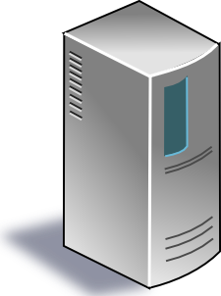
Interconnecting fabric is key to agility
Network Fabric

Slide 30
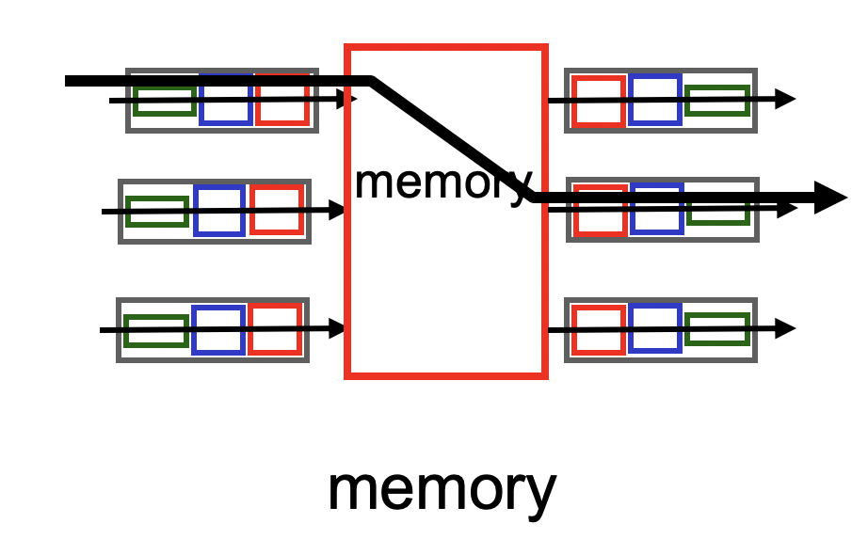
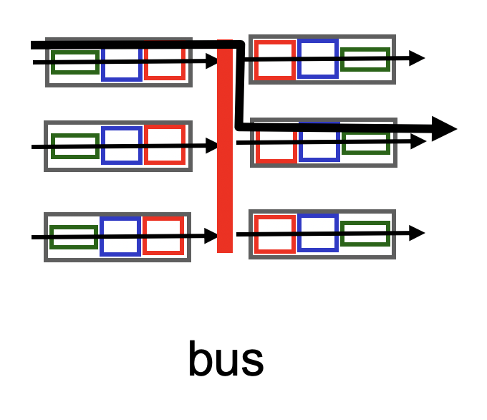
A single (n X m)-port switching fabric
Different designs of switching fabric possible
Assume n ingress ports and m egress ports, half duplex links

Slide 31
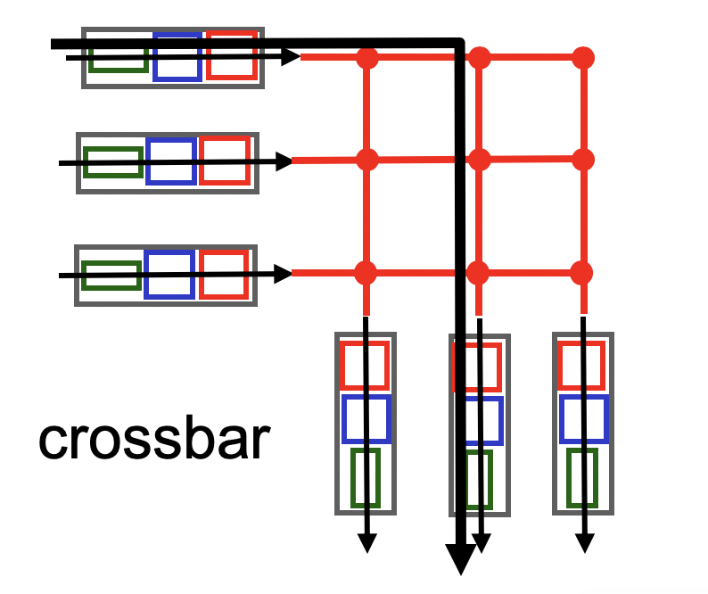
A single (n X m)-port switching fabric
Electrical/mechanical/electronic crossover
We are OK with any design such that:
Any port can connect to any other directly if all other ports free
Nonblocking: if input port x and output port y are both free, they should be able to connect
  Regardless of other ports being connected.
  If not satisfied, switch is blocking.

Slide 32
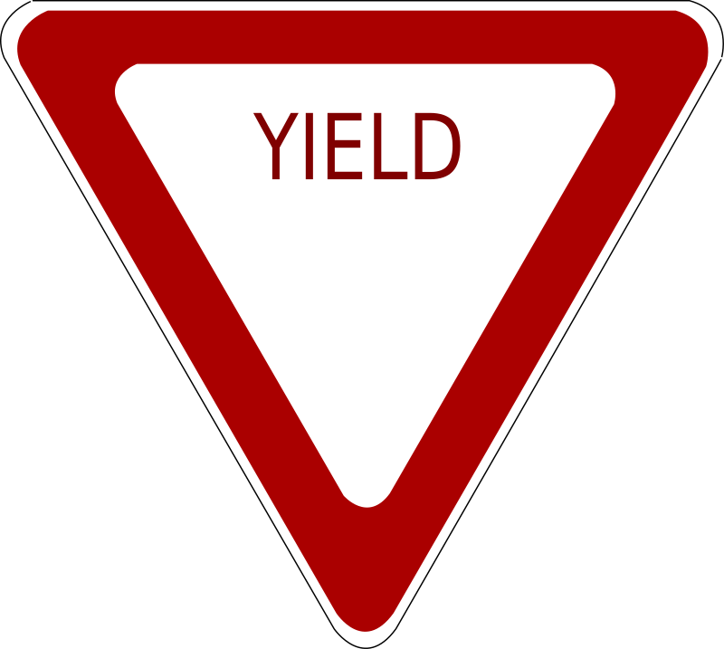
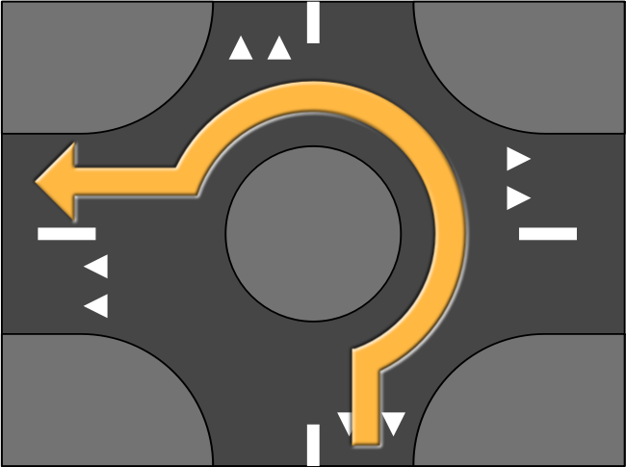
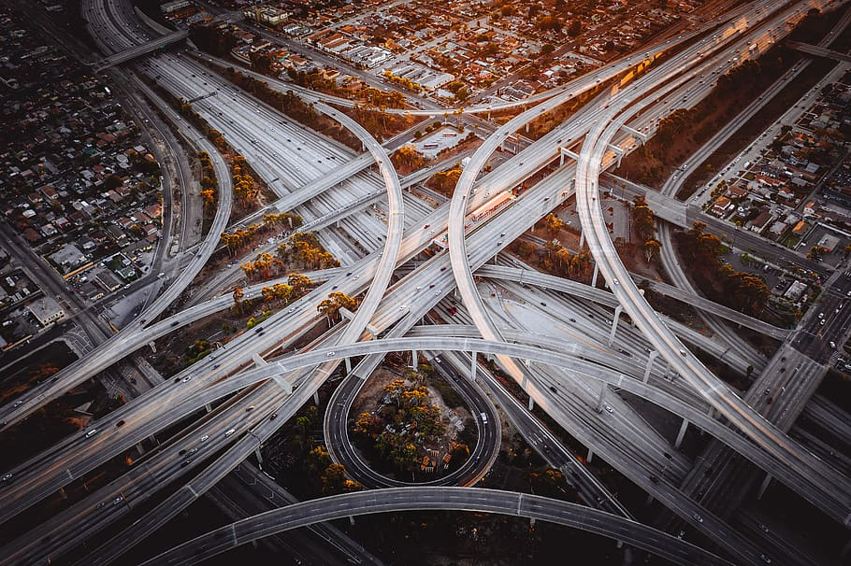

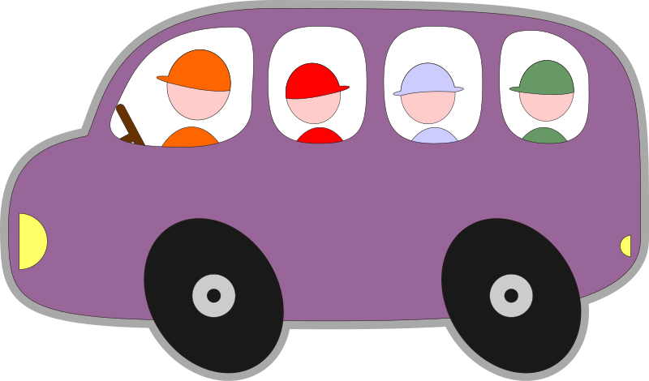
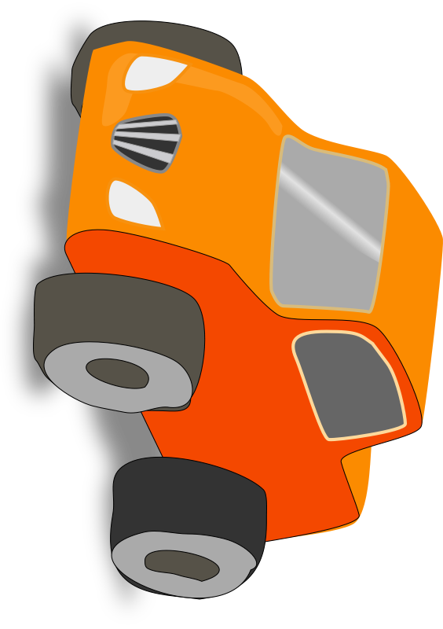
Nonblocking designs are nontrivial

Slide 33
High port density + nonblocking == hard!
Low-cost nonblocking crossbars are feasible for small # ports
However, it is costly to be nonblocking with a large number of ports
If each crossover is as fast as each input port,
  Number of crossover points == n * m
  Cost grows quadratically on the number of input ports
Else, crossover must transition faster than the port
  … so that you can keep the number of crossovers small

Slide 34
Nonblocking switches with many ports
Key principle: Every fast nonblocking switch with a large number of ports is built out of many fast nonblocking switches with a small number of ports.
How to build large nonblocking switches?
  The subject of interconnection networks from the telephony era

Slide 35
3-stage Clos network (r*n X r*n ports)
n X m
r X r
m X n
…
…
…
…
…
…
n X m
r X r
m X n
…
…
…
…
…
…
n X m
r X r
m X n
…
…
…
r switches n X m
m switches r X r
r switches m X n

Slide 36
How Clos networks become nonblocking
if m > 2n – 2, then the Clos network is strict-sense nonblocking.
That is, any new demand between any pair of free (input, output) ports can be satisfied without re-routing any of the existing demands.

Slide 37
Need at most (n-1)+(n-1) middle stage
n X m
r X r
m X n
…
…
…
…
…
…
At most n-1 existing demands
n X m
r X r
m X n
…
…
…
…
…
…
n X m
r X r
m X n
…
…
…
r switches n X m
m switches r X r
r switches m X n

Slide 38
Surprising result about Clos networks
if m >= n, then the Clos network is rearrangeably nonblocking
That is, any new demand between any pair of free (input, output) ports can be satisfied by suitably re-routing existing demands.
It is easy to see that m >= n is necessary
  The surprising part is that m >= n is sufficient

Slide 39
Rearrangeably nonblocking Clos built with identical switches
n X n
n X n
n X n
…
…
…
…
…
…
n X n
n X n
n X n
…
…
…
…
…
…
n X n
n X n
n X n
…
…
…
n switches n X n
n switches n X n
n switches n X n

Slide 40
Modern data center network topologies are just folded Clos topologies.
VL2: a scalable and flexible data center network (sigcomm’09)

Slide 41
How does one design a Clos DCN?
Switches are usually n X n with full-duplex links
Fold the 3-stage Clos into 2-stages
Share physical resources between ingress and egress stages
Share ports and links across the two “sides” of the middle stage

Slide 42
ToR/aggregation layer
Spine layer
ToR/aggregation layer
n/2 X n/2
n X n
n/2 X n/2
…
…
…
…
…
…
From/to hosts
n/2 X n/2
n X n
n/2 X n/2
…
…
…
…
…
…
n/2 X n/2
n X n
n/2 X n/2
…
…
…
n X n full duplex
n/2 switches n X n full duplex
n X n full duplex

Slide 43
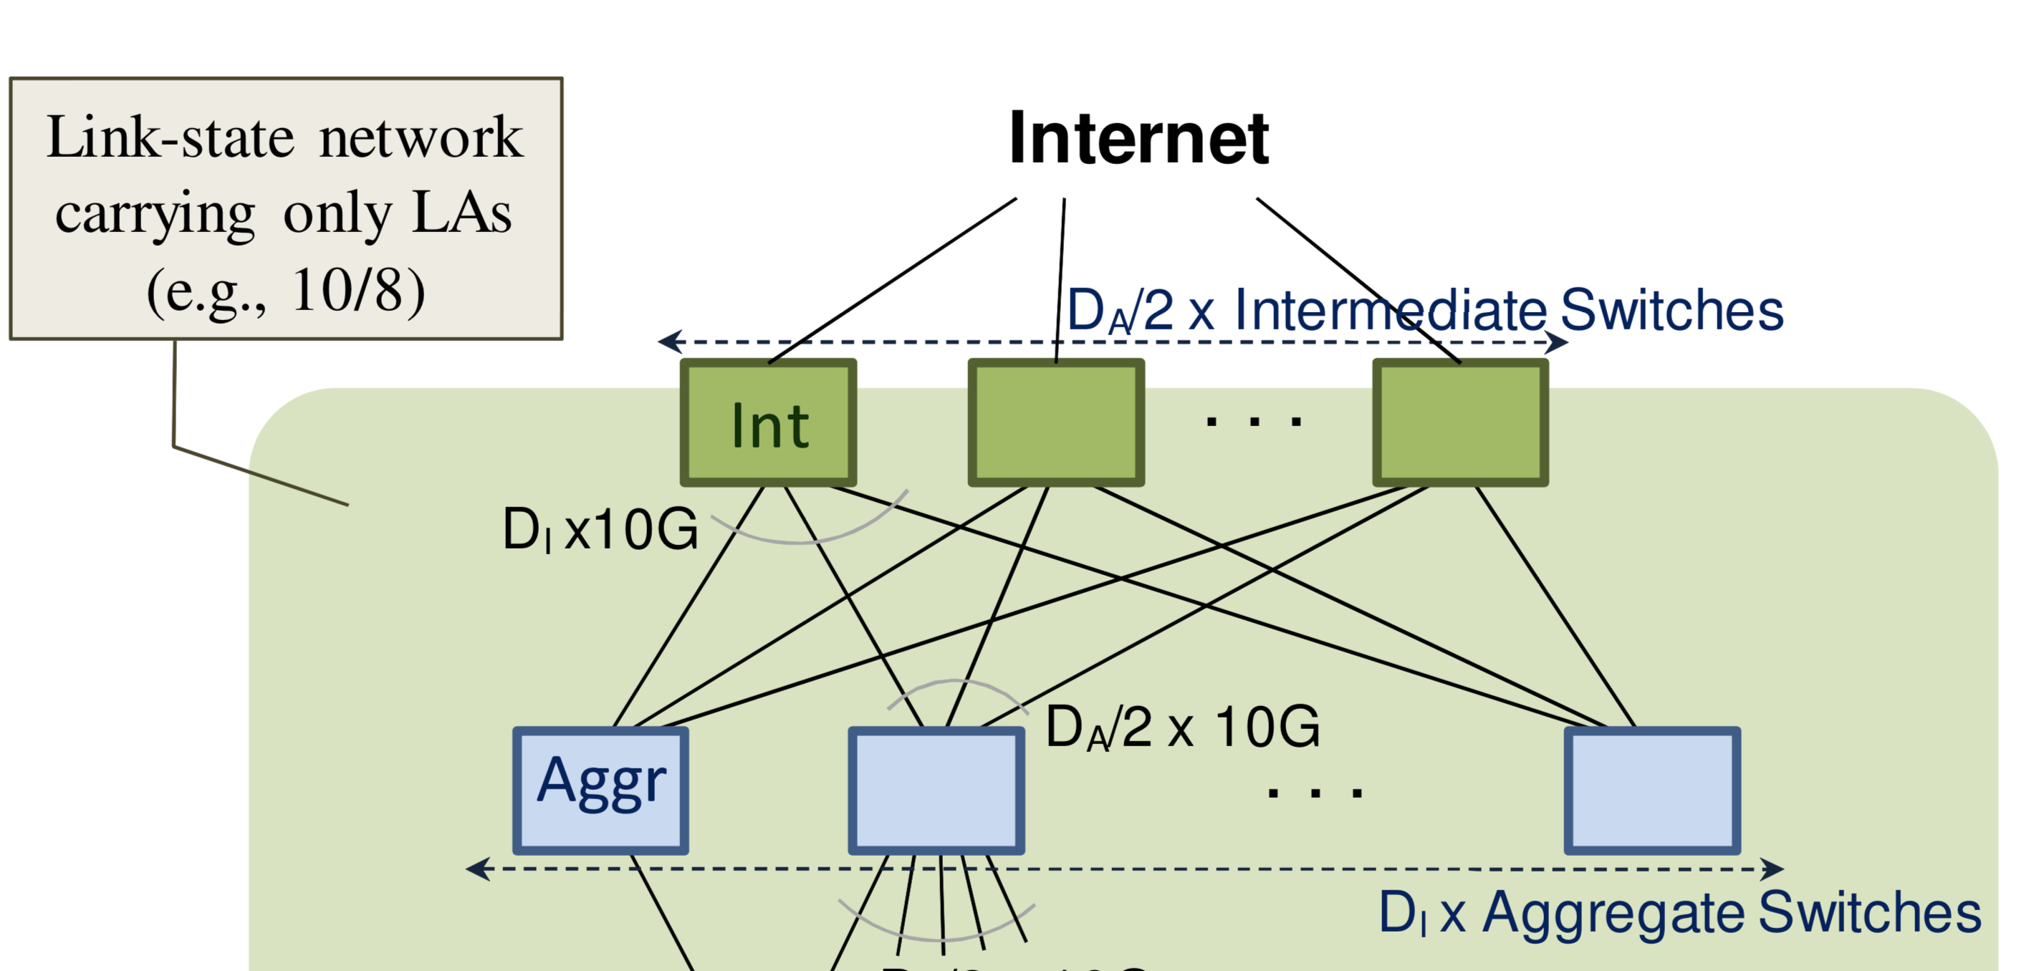
Consequences of using folded Clos
2-stage high throughput data center topology
All can use the same switches! (port density and link rates)

Slide 44
What about routing?
We said that the Clos topology above is rearrangeably nonblocking.
So, how to rearrange existing demands when a new packet arrives, so that it can get across as quickly as possible?
How to do it without “interference” to (ie: rerouting) other pkts?
VL2: We don’t need to rearrange anything.

Slide 45
Valiant Load Balancing (VLB)
Designed to move data quickly for shuffling in parallel computing
Setting: Connectivity is sparse (“hypercube” topology): log n links per node in a network with n nodes
Key idea: pick a random node to redirect a message to from the source, then follow the shortest path to the destination from there
Guarantee: With high probability, the message reaches its destination very quickly (log n steps)
  Practically, this means there is very less queueing in the network

Slide 46
VLB in data center networks
VLB is more general than data center networks or Clos
  It is a form of oblivious routing
  e.g., no need to measure traffic patterns before choosing routes
  Extremely simple to implement: no global state
VLB is handy in folded Clos topologies due to the numerous options to pick the first-hop from ToR switch
  Balance load across many paths
Very beneficial in practice
  Performance isolation: other flows don’t matter
  High capacity (“bisection bandwidth”) between two ToR ports

Slide 47
VLB requirements: Hose model
The guarantees of VLB + Clos only hold under the hose model:
  Demands for any one ToR port (send or receive) must not exceed its bandwidth.
Very hard to enforce especially on the receiver side without sender-side rate limits.
VL2 uses TCP convergence as a way of ensuring that aggregate ToR port demand is within its bandwidth

Slide 48
Requirements for VLB to work well
TLA
VLB + Clos provides high capacity if no ToR port demands more than its bandwidth (hose model)
MLA
………
MLA
A bunch of results arrive at MLAs and TLAs in a short period.
Demand may exceed ToR port bandwidth!
Worker Nodes

Slide 49
Enforcing the hose model
Hose model is hard to enforce especially on the receiver side without sender-side rate limits
VL2 uses TCP’s convergence to bottleneck link rate as a loose method to enforce that the demand for port bandwidth is met by the available capacity.
Input port
Output port
Input port
Switching fabric
Output port
…
…
Input port
Output port

