Slide 1

Network Virtualization
Lecture 6
Srinivas Narayana
http://www.cs.rutgers.edu/~sn624/553-S23

Slide 2
Building Blocks of Containers

Slide 3
What goes into a container?
Not a natively hardware-supported abstraction like privilege rings, which enable OSes (and virtual machines)
Instead, use software mechanisms built into OS kernels
Containers: a loose conglomeration of kernel-level mechanisms
  Access isolation of global resources (namespaces)
  Resource/Performance isolation of global resources (control groups)
  Sharing data on filesystem for efficiency (union filesystems)
    (need to add on isolation of unique data)
  Security mechanisms: appArmor, capabilities
Kludgy, but essential since hard to get it right from scratch

Slide 4
Namespaces
Access isolation
Show an instance of a global resource as available to all processes inside a namespace
Changes visible to other processes within namespace
  But invisible outside the namespace
Show different “copies” of resources associated with the kind of namespace
  Network, IPC, mount, PID, …
Every process starts in init namespace, change with setns
Network: (software/hardware) network device; routing rules; port numbers. veth pair connects two network namespaces

Slide 5
Control groups
Resource/Performance isolation
Subsystem: a specific kind of resource
  CPU time, memory, network bandwidth, block device access, priority, CPU and memory (numa) node assignment. Many configurable parameters per subsystem
Control group or cgroup: a set of processes
  If fork(), inherit a bunch of attributes including parent’s cgroup
Hierarchy: a tree where each node is a cgroup
  Many hierarchies can exist, unlike process hierarchy
Each subsystem “mounted” onto one hierarchy
  Possible to use a single hierarchy for multiple subsystems (resources)
Every process has exactly one reservation per resource

Slide 6
Union FS: “container images too big”
Directory structures on disk are typically “mounted” at some point in the virtual filesystem (/, /home/users/name, etc.)
Processes in containers want mostly the same files, with a small number of modifications per process or container
  Think: common third-party packages and shared library images
  (while supporting the need for distinct libraries/versions across containers)
  Similar use cases in the past: data on a read-only medium which needed a small number of updates and refresh into new medium
Union filesystem: maintain a stack of filesystems at each mount point. Only the latest one is writable. Lower layers are read-only.
Write fresh to the top. Update by copy up. Deletion requires a special mechanism to record a file that isn’t there (whiteout). Cache heavily.
Virtual Filesystem layer accomplishes this with minimal changes to underlying filesystem.

Slide 7
Orchestrating Containers

Slide 8
Components you need?
The machines (nodes), pods (container-ish), images
Controllers and mechanization (“choreography”)
  Provisioning pods and nodes with desired resources (kube-scheduler + kubelet)
  Replicating according to system metrics or demand (autoscaling controller)
  Detecting and reacting to failures (replicaSet controller)
Maintaining the cluster’s desired and observed state
  Persistent data store (etcd; consensus protocol -- RAFT)
  How should everyone see and access this? api server (versioning, etc.)
Desired state: declaratively specified. Label selectors to group.
  … even when we say kubectl do this and that
Naming and connecting to remote entities
  Pods shouldn’t have to know physical addresses; IP address management for applications connecting from within container network namespaces
  Routing between nodes; within a node from/to a pod on the node
  Container Network Interface

Slide 9
Network Virtualization

Slide 10
Virtualizing Networking on a Single Machine

Slide 11
How to virtualize I/O?
How device I/O works in general:
  Registers. Interrupts and polling. Shared memory. DMA.
Full virtualization: trap and emulate any I/O data operation
  e.g., moving each byte of guest data through VMM memory is too expensive (not a “zero copy” solution)
Xen’s initial approach (SOSP’03)
  Descriptor rings: async I/O over memory shared between hypervisor & guest
Hypervisor responsibilities for virtualization:
  Validate data pages pointed from guest-enqueued descriptors
  Remap data pages (avoid time-of-check to time-of-use), even if not copy
  (incoming) find which VM to signal? Send event notification to guest OS
Hypervisor intervention to check every descriptor is bad for perf

Slide 12
Direct I/O
Key idea: enable memory protections in hardware
  Processors have a memory management unit (MMU) for segmentation and paging related memory protections
IOMMU: a hardware page table to translate and validate addresses for I/O accesses through DMA (on processor)
Device features to also support:
  Separate interrupts going to each guest (rather than shared across guests or with hypervisor)
  Separate address space identifier (“tagged” page table) per guest
  Sensitive registers on device cannot be controlled directly by guest
  Must classify incoming packets at NIC to the appropriate guest’s memory region
  But do all this while allowing device to maintain all this info

Slide 13
Single Root I/O virtualization (SR-IOV)
PCIe capability: expose a single physical device (“physical function”) as multiple virtual devices (“virtual functions”), dedicated to each guest OS
Layer-2 switching to classify packets to each guest’s VF
  Corresponding IOMMU, interrupts invoked
Mainly performance-critical registers replicated per VF
Share “insensitive” per-device resources across guests
  MAC/PHY logic, packet classification logic
Sensitive configuration or register access mediated through a driver component in domain0

Slide 14
Single-Root IO Virtualization (SR-IOV)
Exposing device as dedicated device provides several benefits
Configure, monitor, view using “typical” tools (iproute2, wireshark, …)
VFs are now “Virtual NICs” (vNICs) with their own MAC address, IP Address, ingress/egress forwarding rules, etc.
  Decoupled from corresponding physical device parameters

Slide 15
How about virtualizing networking across a shared compute cluster?
A detour…

Slide 16
Software/hardware layering at hosts
Application: useful user-level functions
Communication functions broken up and “stacked”
Transport: provide guarantees to apps
Each layer depends on the one below it.
Each layer supports the one above it.
The interfaces between layers are well-defined and standardized.
Network: best-effort global pkt delivery
Link: best-effort local pkt delivery

Slide 17
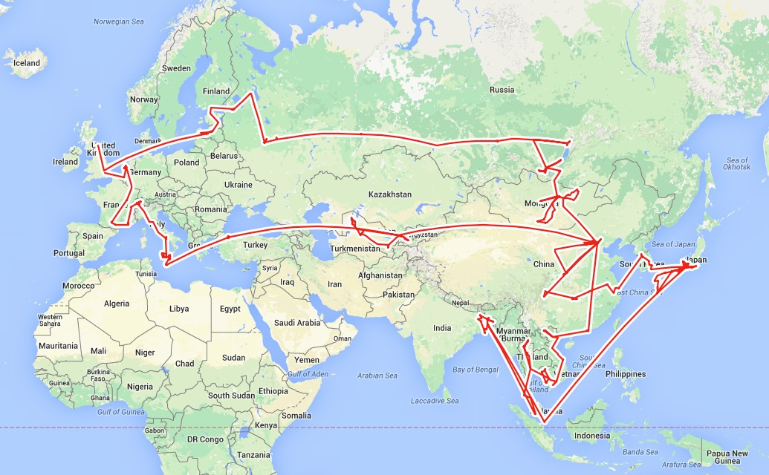
Routing

Slide 18
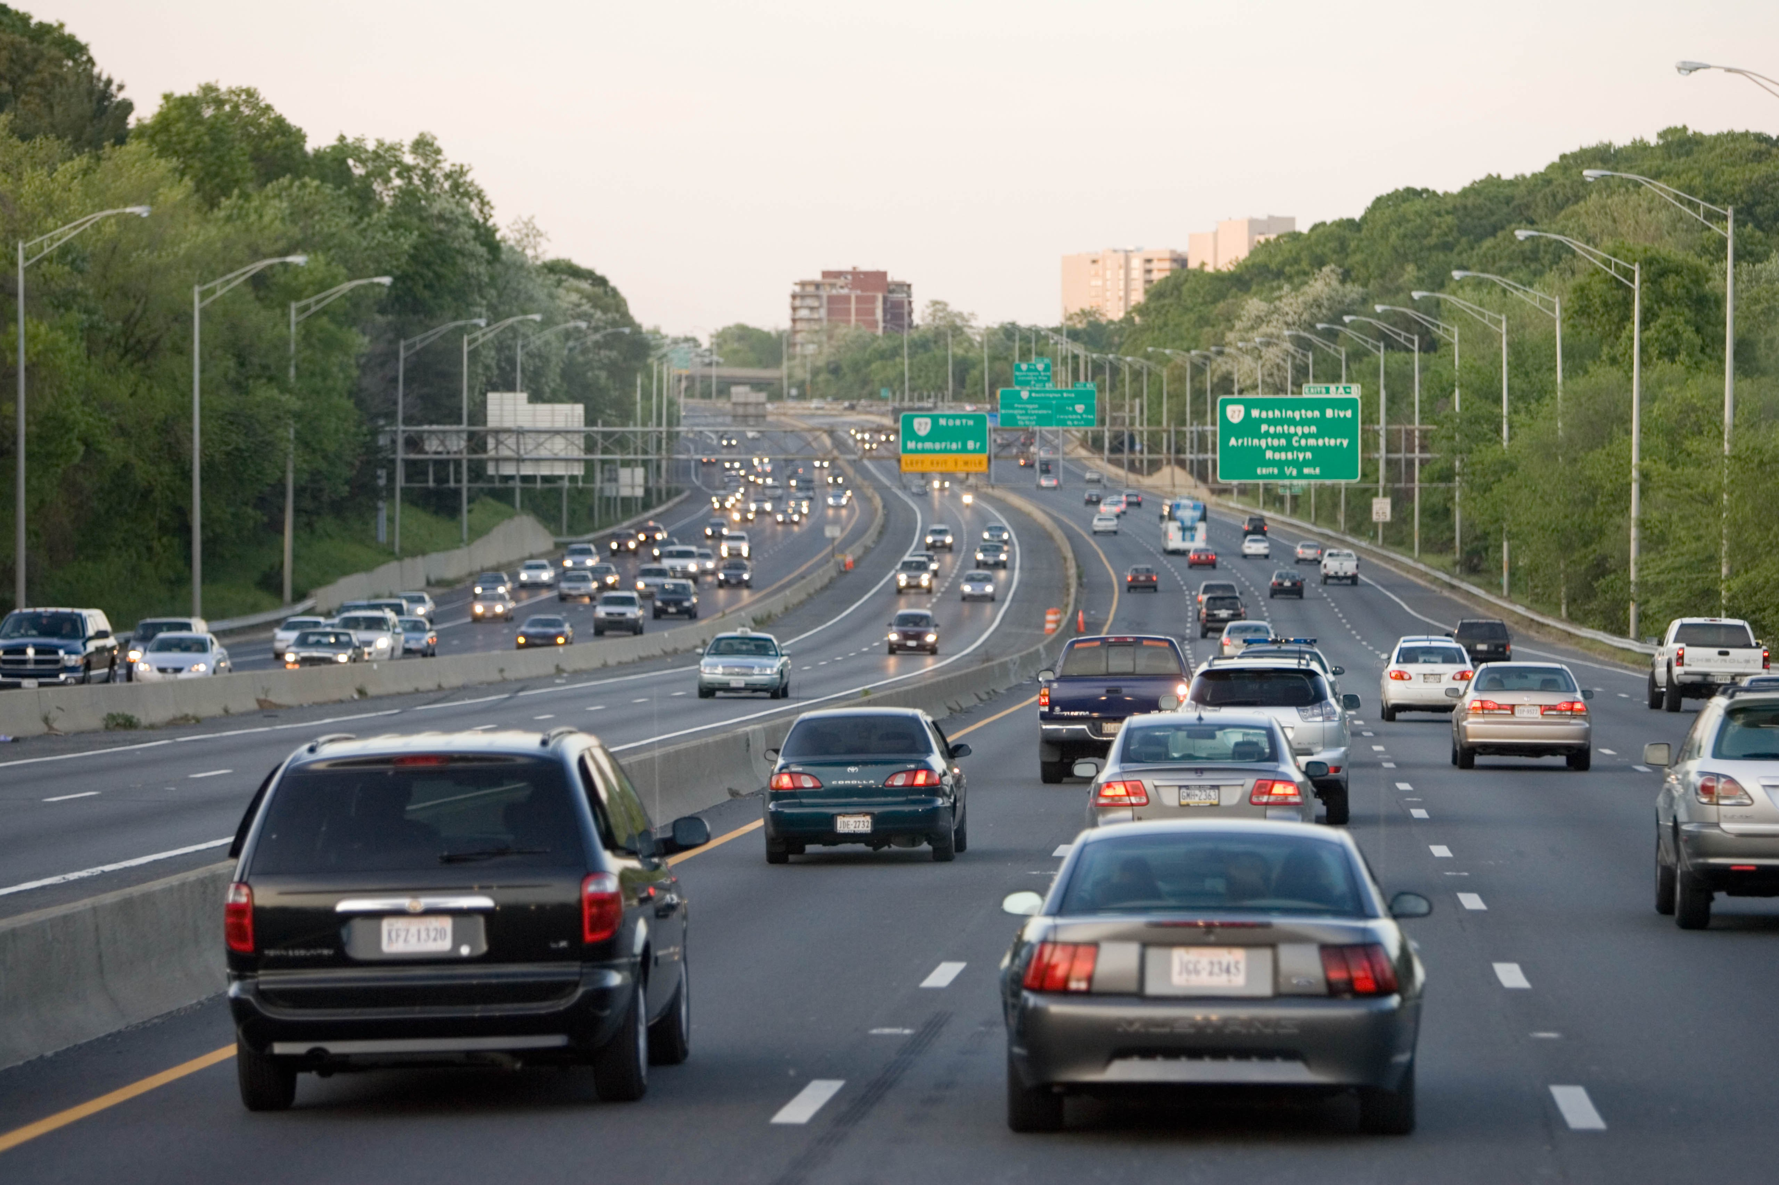
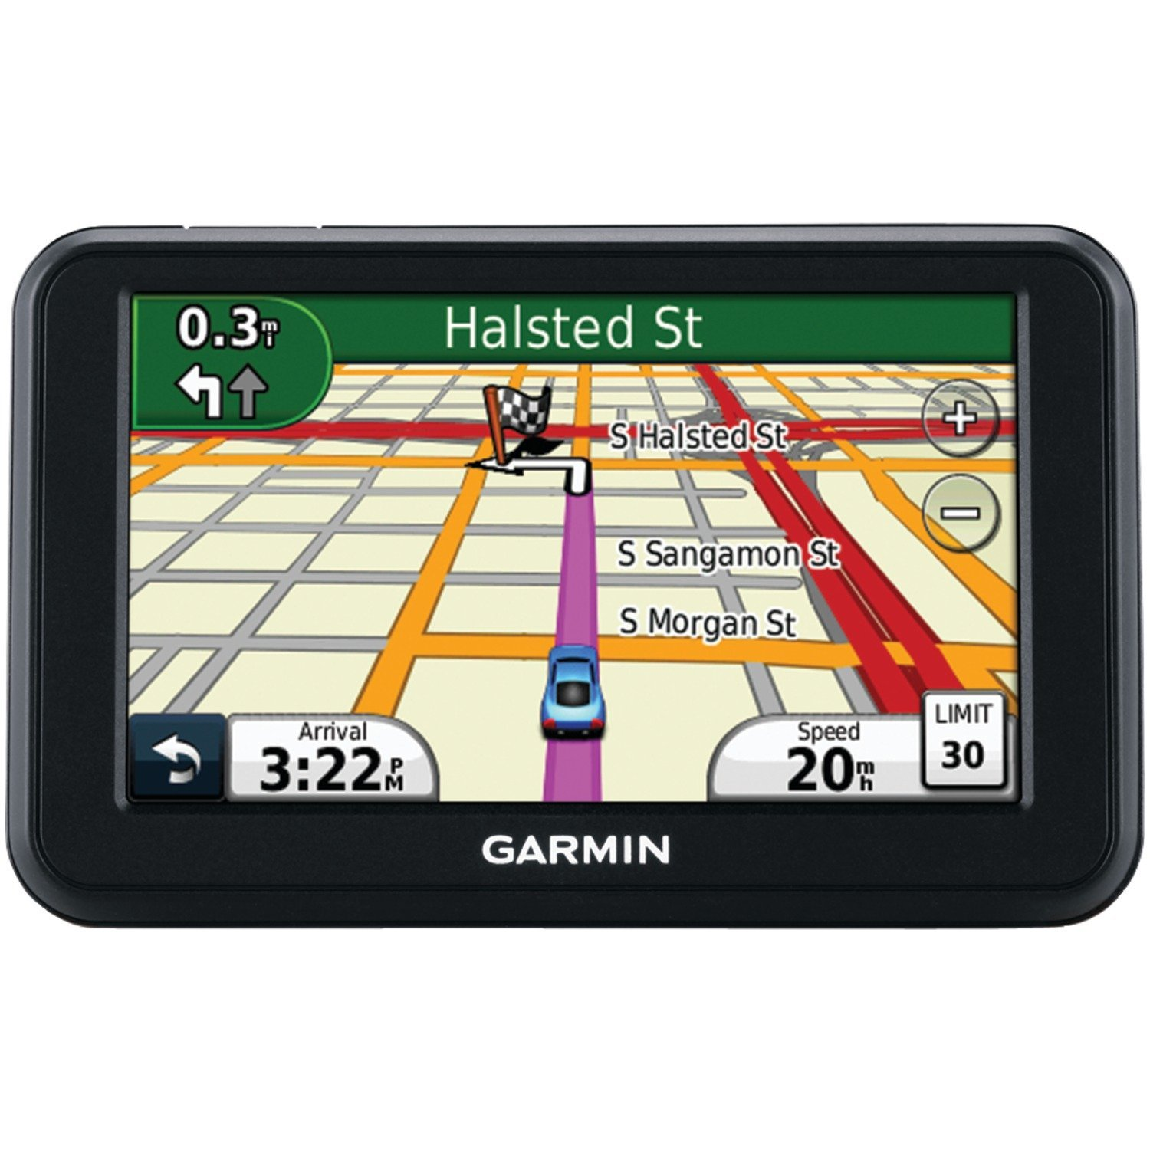

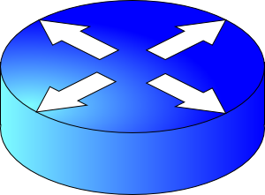
Two key network-layer functions
Forwarding: move packets from router’s input to appropriate router output
Routing: determine route taken by packets from source to destination
  routing algorithms
The network layer solves the routing problem.
Analogy: taking a road trip
Forwarding: process of getting through single exit
Routing: process of planning trip from source to destination
network
layer
runs
everywhere

Slide 19
Distributed Routing

Slide 20
Control/Data Planes
Data plane = Forwarding
local, per-router function
determines how datagram arriving on router input port is forwarded to router output port
Control plane = Routing
network-wide logic
determines how datagram is routed along end-to-end path from source to destination endpoint
two control-plane approaches:
  Distributed routing algorithm running on each router
  Centralized routing algorithm running on a (logically) centralized machine
values in arriving
packet header
0111
1
3
2

Slide 21

Distributed routing
Control plane
Traditional routing protocols: per route-change processing
(~ a few tens of seconds)
Routing
Algorithm
control
plane
data
plane
Data plane
per-packet processing
(~ tens of nanoseconds)
0111
1
3
2
values in arriving
packet header, i.e, destination IP address

Slide 22


What should routing optimize?
Efficiency goals: “good” paths
  Low latency, low cost, high bandwidth, etc.
  Often translates to shortest path on a suitably modeled graph!
  Edges: link metrics. Nodes: routers.
Internet rationale: keep it distributed: avoid failures; scaling.
Two questions: (1) what messages? (2) what algorithm?
  What is the algorithm computing? – is already known (shortest path)
  Link state and distance vector protocols
  Applicable when

Slide 23


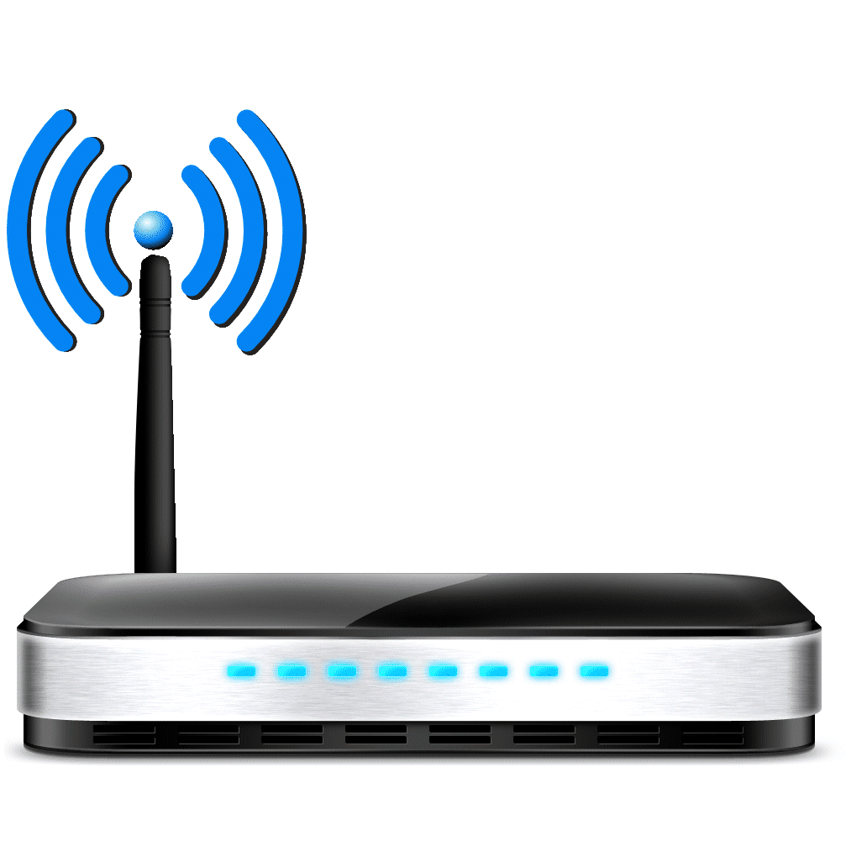

The Internet is a large federated network
AT&T
Comcast
Verizon

Slide 24
The Internet is a large federated network
Several autonomously run organizations (AS’es): No one “boss”
Organizations cooperate, but also compete
AT&T
Comcast
e.g., AT&T has little commercial interest in revealing its internal network structure to Verizon.
Verizon

Slide 25
The Internet is a large federated network
Several autonomously run organizations: No one “boss”
Organizations cooperate, but also compete
AT&T
Message exchanges must
not reveal internal network details.
Comcast
Verizon
Algorithm must work with “incomplete” information about its neighbors’ internal topology.

Slide 26
The Internet is a large federated network
Internet today: > 70,000 unique autonomous networks
Internet routers: > 800,000 forwarding table entries
AT&T
Keep messages & tables as small as possible. Don’t flood
Comcast
Verizon
Algorithm must be incremental: don’t recompute the whole table on every message exchanged.

Slide 27
Inter-domain Routing
The Internet uses Border Gateway Protocol (BGP)
All AS’es speak BGP. It is the glue that holds the Internet together
BGP is a path vector protocol
Routing protocols
Link state
protocols
Distance vector protocols
Path vector protocols
Messages?
Algorithm?
Applicable within a single AS

Slide 28
(1) BGP Messages
Loop detection is easy
(no “count to infinity”)
Exchange paths: path vector
Routing Announcements or Advertisements
  “I am here” or “I can reach here”
  Occur over a TCP connection (BGP session) between routers
Route announcement = destination + attributes
  Destination: IP prefix
Route Attributes:
  AS-level path
  Next hop
  Several others: origin, MED, community, etc.
An AS promises to use advertised path to reach destination
Only route changes are advertised after BGP session established
No link metrics, distances!
“I am here.”
Dst: 128.1.2.0/24
AS path: X
1b
“I can reach X”
Dst: 128.1.2.0/24
AS path: AS2, X
AS 2
1a
1c
2b
1d
2a
2c
X
2d

Slide 29
(2) BGP algorithm
A BGP router does not consider every routing advertisement it receives by default to make routing decisions!
  An import policy determines whether a route is even considered a candidate
Once imported, the router performs route selection
A BGP router does not propagate its chosen path to a destination to all other AS’es by default!
  An export policy determines whether a (chosen) path can be advertised to other AS’es and routers
Programmed by network operator
Business policy considerations drive BGP.
NOT efficiency considerations.

Slide 30
Policy arises from business relationships
Customer-provider relationships:
  E.g., Rutgers is a customer of AT&T
Peer-peer relationships:
  E.g., Verizon is a peer of AT&T
Business relationships depend on where connectivity occurs
  “Where”, also called a “point of presence” (PoP)
  e.g., customers at one PoP but peers at another
  Internet-eXchange Points (IXPs) are large PoPs where ISPs come together to connect with each other (often for free)

Slide 31
BGP Export Policy
legend:
provider
B
network
X
W
A
customer
C
network:
Y
Suppose an ISP only wants to route traffic to/from its customer networks (does not want to carry transit traffic between other ISPs)
A,B,C are provider networks
X,W,Y are customers (of provider networks)
X is dual-homed: attached to two networks
policy to enforce: X does not want to route from B to C via X
  So, X will not announce to B a route to C

Slide 32
BGP Export Policy
legend:
provider
B
network
X
W
A
customer
C
network:
Y
Suppose an ISP only wants to route traffic to/from its customer networks (does not want to carry transit traffic between other ISPs)
A announces path Aw to B and to C
B will not announce BAw to C:
  B gets no “revenue” for routing CBAw, since none of C, A, w are B’s customers
C will route CAw (not using B) to get to w

Slide 33
BGP Import Policy
legend:
provider
B
network
X
W
A
customer
C
network:
Y
Suppose an ISP wants to minimize costs by avoiding routing through its providers when possible.
Suppose C announces path Cy to x
Further, y announces a direct path (“y”) to x
Then x may choose not to import the path Cy to y since it has a peer path (“y”) towards y

Slide 34
Q2. BGP Route Selection
When a router imports more than one route to a destination IP prefix, it selects route based on:
  local preference value attribute (import policy decision -- set by network admin)
  shortest AS-PATH
  closest NEXT-HOP router
  Several additional criteria: You can read up on the full, complex, list of criteria, e.g., at https://www.cisco.com/c/en/us/support/docs/ip/border-gateway-protocol-bgp/13753-25.html

Slide 35
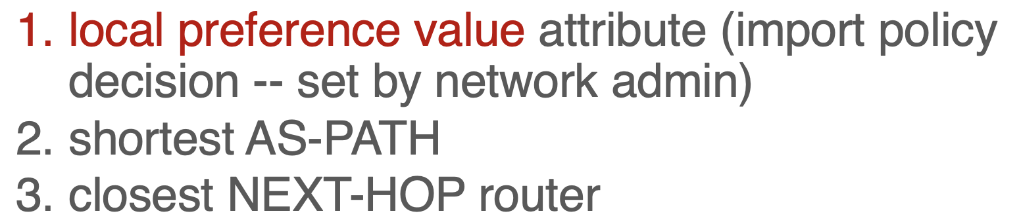
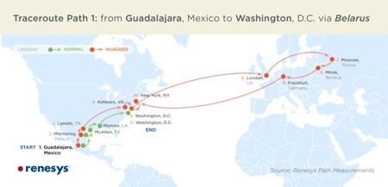
Problems with BGP
Approaches to bring flexibility:
Flexible control logic for path selection
(Google, Facebook)
Detour/overlay routing (Akamai)
Not designed for efficiency
Only a single path per destination
Slow to converge after a change
Vulnerable to bugs & malice
Nothing to do with path length, delay, or available capacity.

Slide 36
So far: layer-3. But “layer-2” exists too
Switch: move packets based on link layer addresses
Provide an illusion of a single link connecting many endpoints
  Without every endpoint necessarily hearing every other endpoint
Learning switch: zero configuration or control plane.
  All endpoints in the same IP network
  Flood packets when dest MAC address unknown
  Use source MAC of incoming packets and associate with the incoming switch port: use later for forwarding
Works even if endpoints move, so long as they are in the same IP prefix

Slide 37
Centralized Routing

Slide 38
Control & Data Planes inside a router
Traditionally:
Individual routing algorithm components in each and every router interact in the control plane
Control plane
per route-change processing
(~ a few seconds)
Routing
Algorithm
control
plane
data
plane
Data plane
per-packet processing
(~ tens of nanoseconds)
0111
1
3
2
values in arriving
packet header

Slide 39
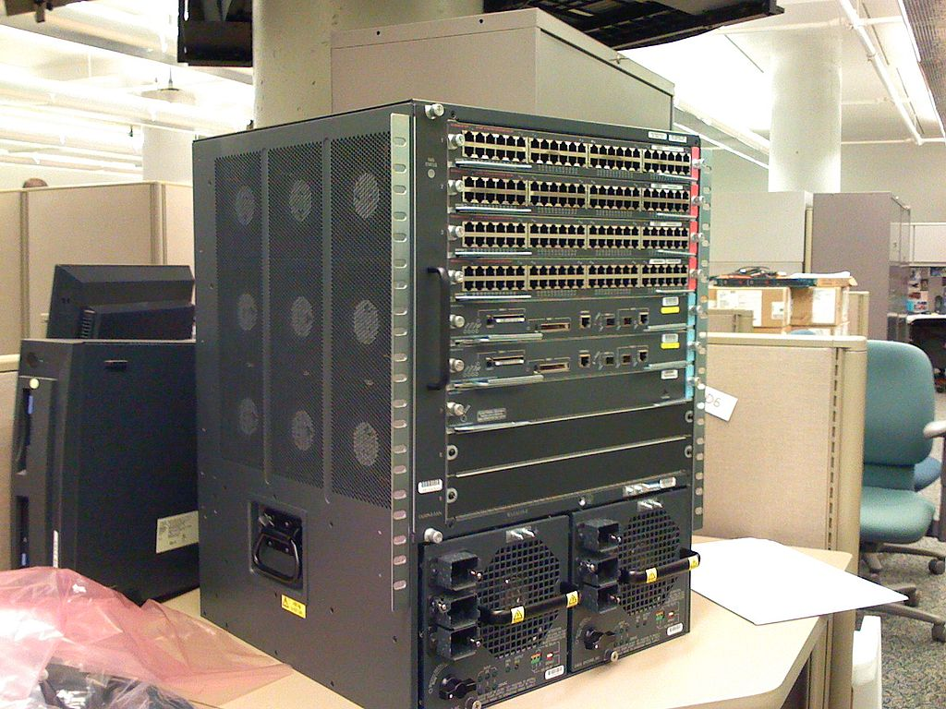


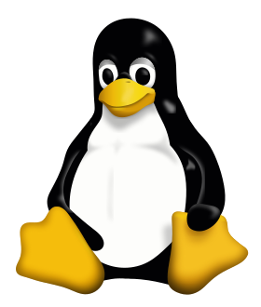

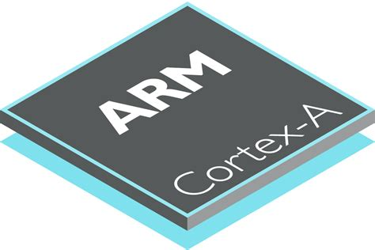
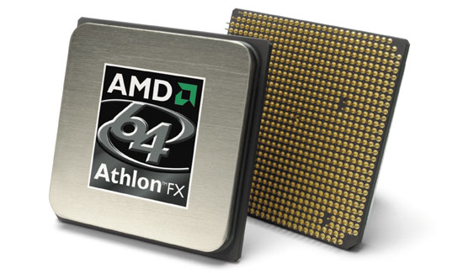
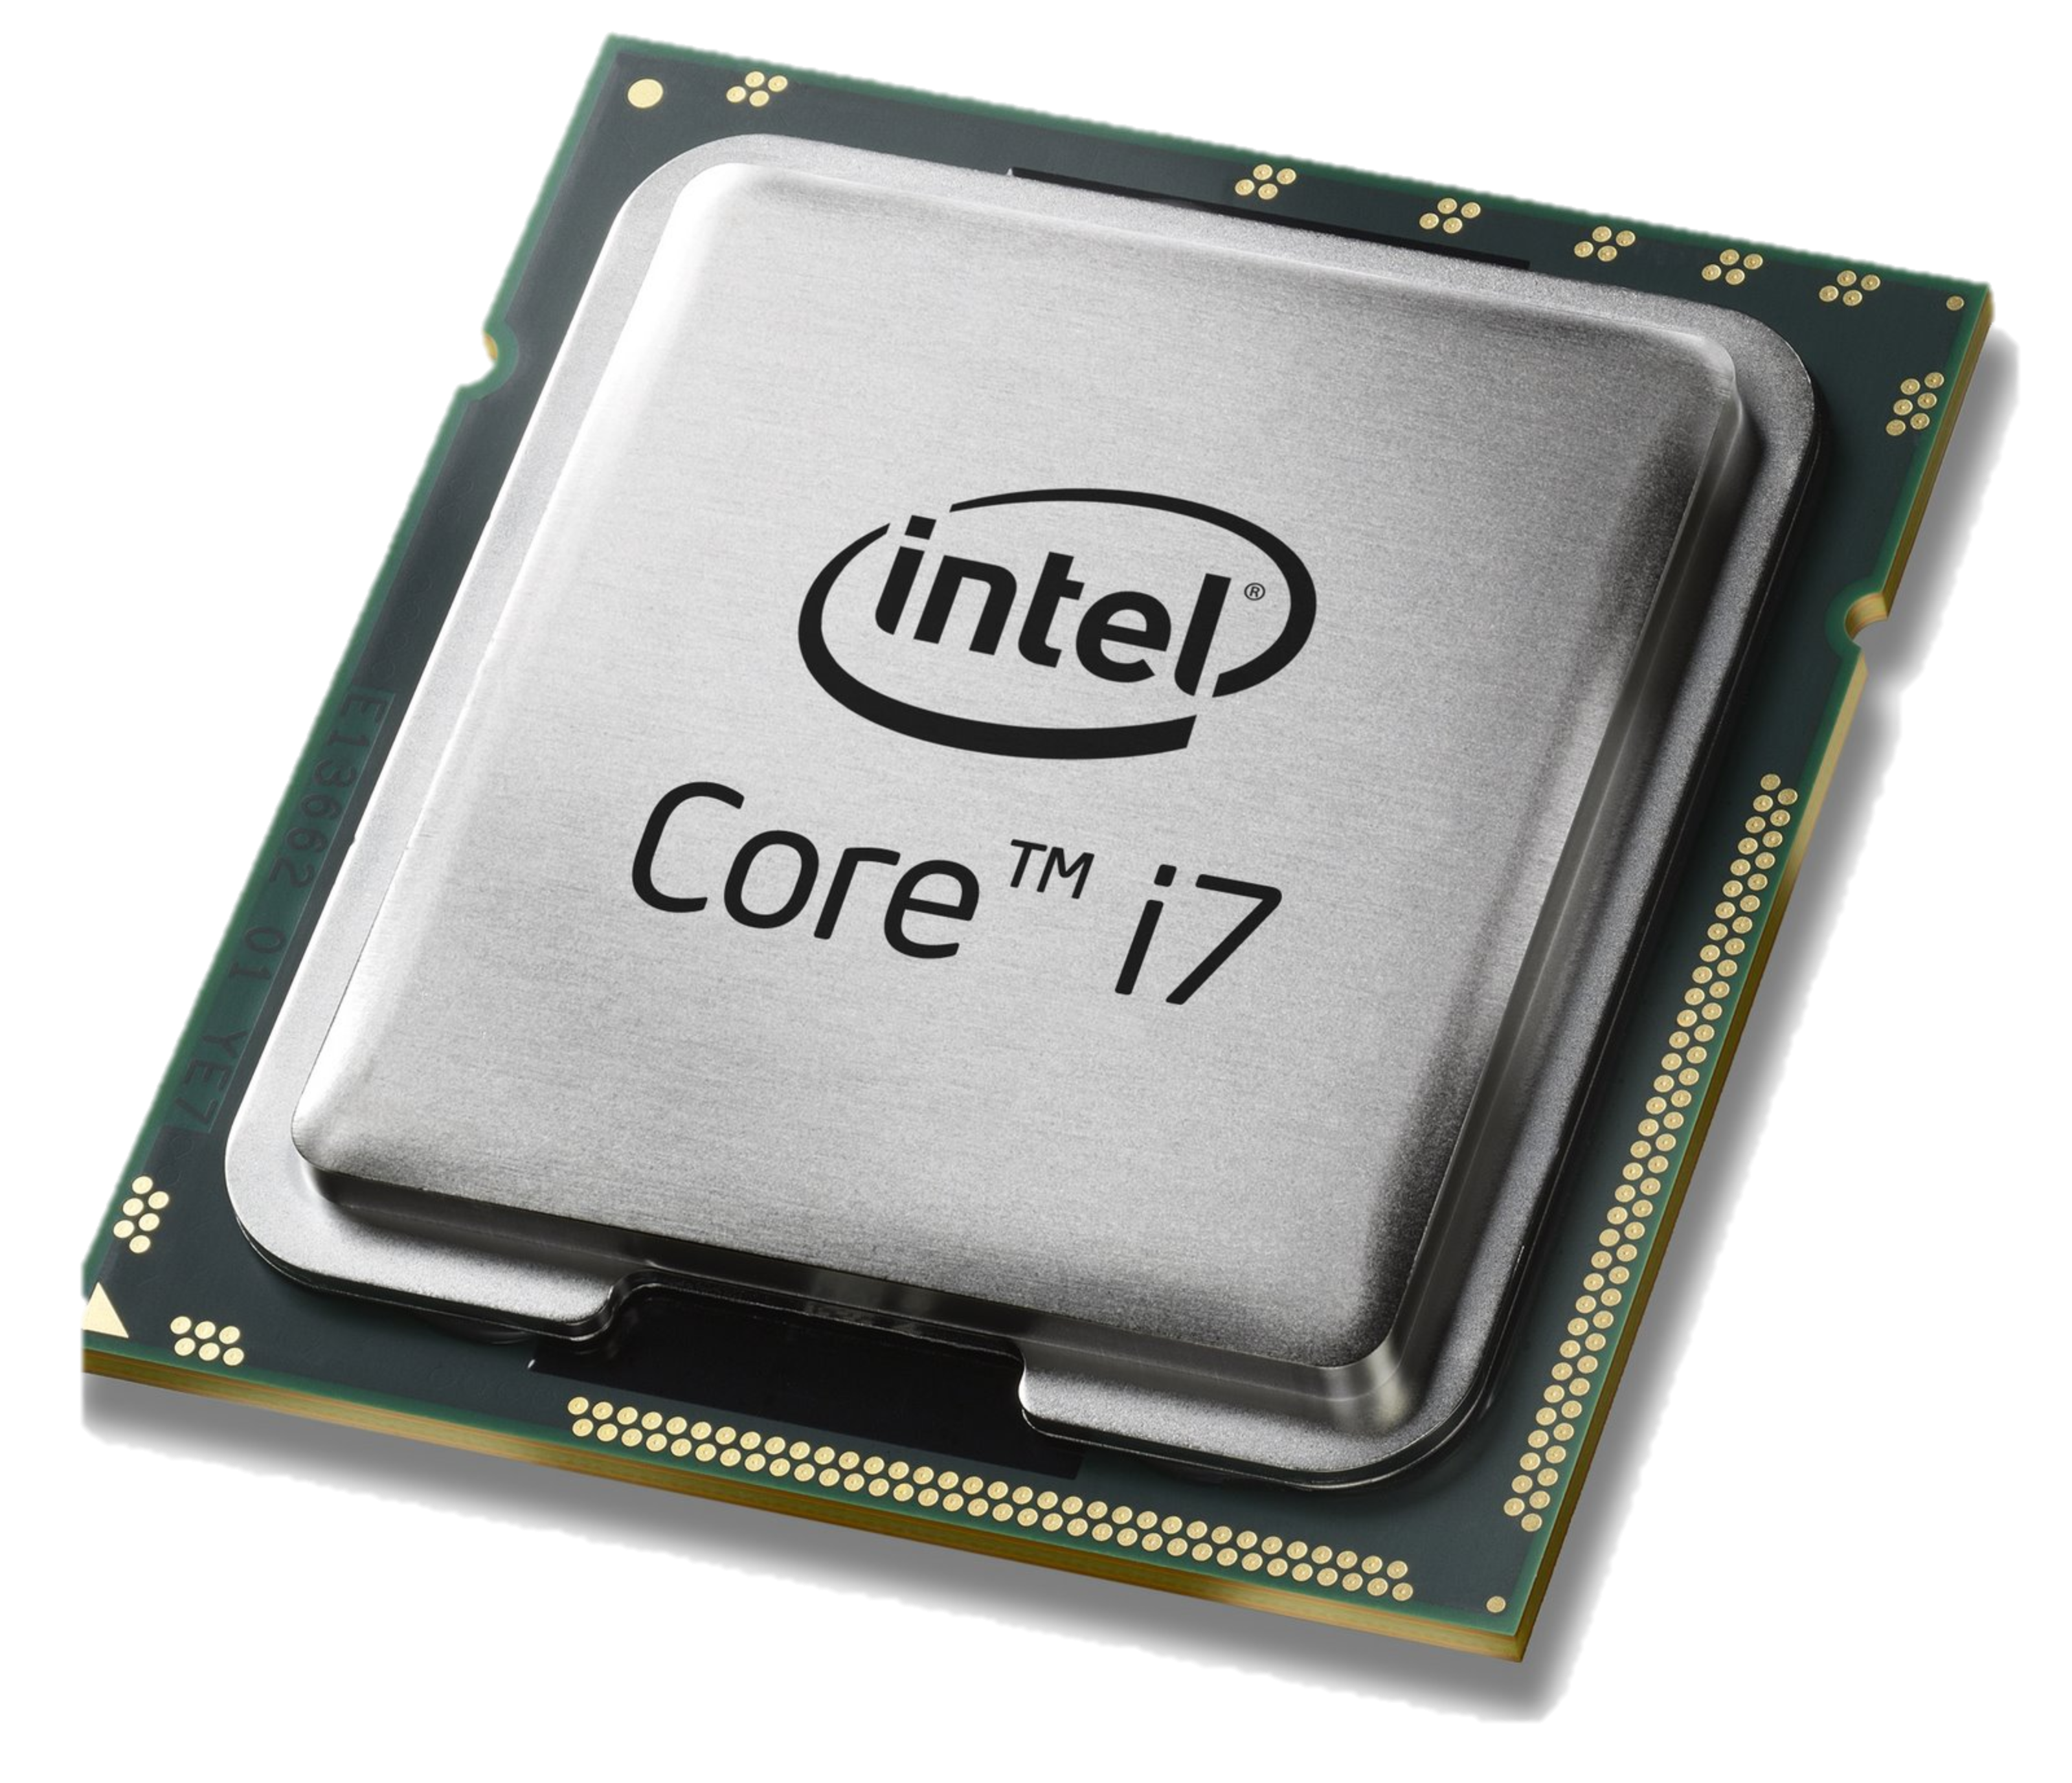
Problems with traditional control planes
Management decisions tied to distributed protocols
  Ex: Set OSPF link weights to force traffic through desired path
  Ex: Non-deterministic network state after a link failure
Data and control plane controlled by vendors: proprietary interfaces
?
X

Slide 40
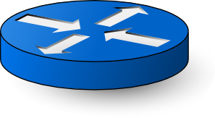
Traditional IP network
Control plane
Data plane
Control plane
Control plane
Data plane
Data plane
Control plane
Data plane

Slide 41
Software-defined network
Logically-centralized control plane
Data plane
Data plane
Data plane
Data plane

Slide 42
Software-Defined Networking

Slide 43
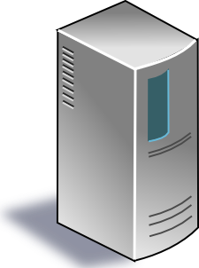
SDN (1/2): Centralized control plane
SDN controller
Control planes lifted from switches
… into a logically centralized controller
… running in a compute cluster
Data plane
Data plane
Data plane
Data plane

Slide 44


SDN (2/2): Open interface to data plane
SDN controller
Data plane
Data plane
Data plane
Data plane

Slide 45
Some immediate consequences

Slide 46
(1) Simpler switches
SDN controller
Data plane
Data plane
Data plane
Data plane
Small set of hardware instructions.

Slide 47
Data plane primitive: Match-action rules
Match arbitrary bits in the packet header
  Match on any header, or new header
  Match exact, a subset (ternary), or over a range
  Allows any flow granularity
Actions
  Forward to port(s), drop, send to controller, count,
  Overwrite header with mask, push or pop, …
  Forward at specific bit-rate
Prioritized list of rules
Data
Header
Match: 1000x01xx01001x
Action: fwd(port 2)
Priority: 65500

Slide 48
(2) Network programming abstractions
Application
Application
Application
Write modular apps and compose them
SDN Controller: Compiler + Run-Time
Data plane
Data plane
Data plane
Data plane

Slide 49
(3) Formal verification of Network Policy
Static checking
Application (specified as code)
Dynamic
checking
SDN Controller: Compiler + Run-Time
Data plane
Data plane
Data plane
Data plane

Slide 50
(4) Unified network operating system
Application
Application
Application
Network Operating System
Separate distributed system concerns from expressing intent
Data plane
Data plane
Data plane
Data plane
Persist app state
Graceful failover
Replication for perf
Consistent view

Slide 51
Technical challenges of SDN
Availability: surviving failures of the controller & data plane
Controller scalability: many routers, many events
  Response time: Delays between controller and routers
Consistency: Ensuring multiple controllers behave consistently
Designing flexible router mechanisms
Compilation: translating intent to mechanisms
Verification: ensuring controller policy is faithfully implemented
Security: entire network owned if the controller is exploited
Interoperability: legacy routers? neighboring domains?
  Developing interfaces that are portable across hardware vendors

Slide 52
Virtualizing Networking in a Shared Cluster

Slide 53
Networking in a multi-tenant cloud
L2 and L3 networking: basics
A typical public cloud network topology: Tree upon ToRs
Problems: Many tenants, time-varying demands.
  Want homogeneity across data center on use of compute capacity
  Where to provision VMs?
  How to migrate VMs or scale the number of VMs?
Ideas: VMs get their own network addresses
  network address virtualization
Ideas: tenants should be able to use custom topologies
  Needed “in practice” rather than “in principle”. But important to do.

Slide 54
How cloud network looks to tenant
Control abstraction: pipeline of lookup tables.
  Example: L2, ACL, L2.
  Example: L2, L3, ACL
Packet abstraction: send to IP addresses of your own
  Processed through switch/router topology
  Data plane behavior defined through control plane configuration
Design of NVP: (nicira virtualization platform):
  Push all interesting data plane behaviors to the edge (hypervisor, OVS)
  The core of the network (switches/routers) just moves data using tunnel headers

Slide 55
Datapath design
(1) Topology virtualization: Implement tenant control plane policies faithfully
  Compute match-action forwarding rules inside a pipeline of logical data paths. Plumb them to each other carefully.
(2) Address virtualization: Get hypervisors to tunnel to each other based on forwarding outcomes from tenant’s logical data paths
  Separate protocol to communicate the hypervisor’s provider-address, hosted VM identifiers, and logical port identifiers for each VM to the controller
  Eventually send packet to the local virtual NIC of the VM
Use caching heavily to avoid many table lookups

Slide 56
Controller design
Declarative design: language to specify tuples of rules/relations
  No need to implement a state machine to transition rule sets
  Use a compiler to emit correct, up to date logical datapaths (tuples)
Shared-nothing parallelism to scale
  Different logical datapaths easily distributed
  “Template” rules output from logical datapaths may be independently specialized to specific hypervisors and VMs
Controller availability maintained using standard leader election mechanisms
Control and data paths fail independently
  Existing OVS hypervisor rules can process packets even if controller fails
  Fast failover through precomputed failover installed in the data path

Slide 57
Making old software use new networks usually means making new networks behave like old ones.

