Slide 1

Application Architecture
Lecture 4
Srinivas Narayana
http://www.cs.rutgers.edu/~sn624/553-S23

Slide 2




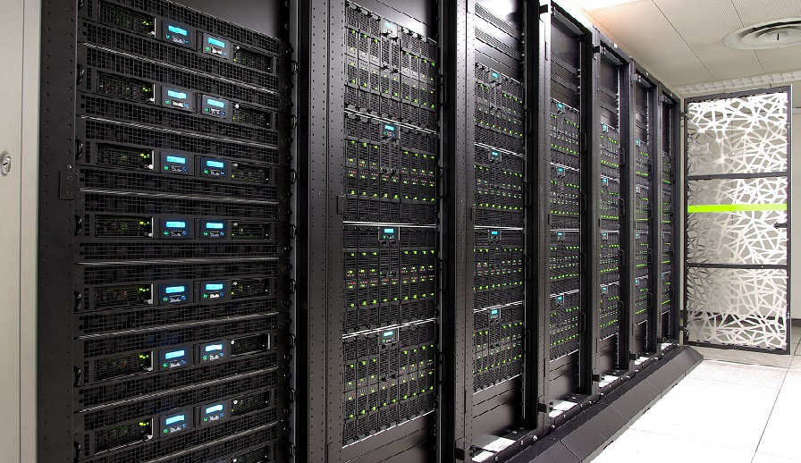

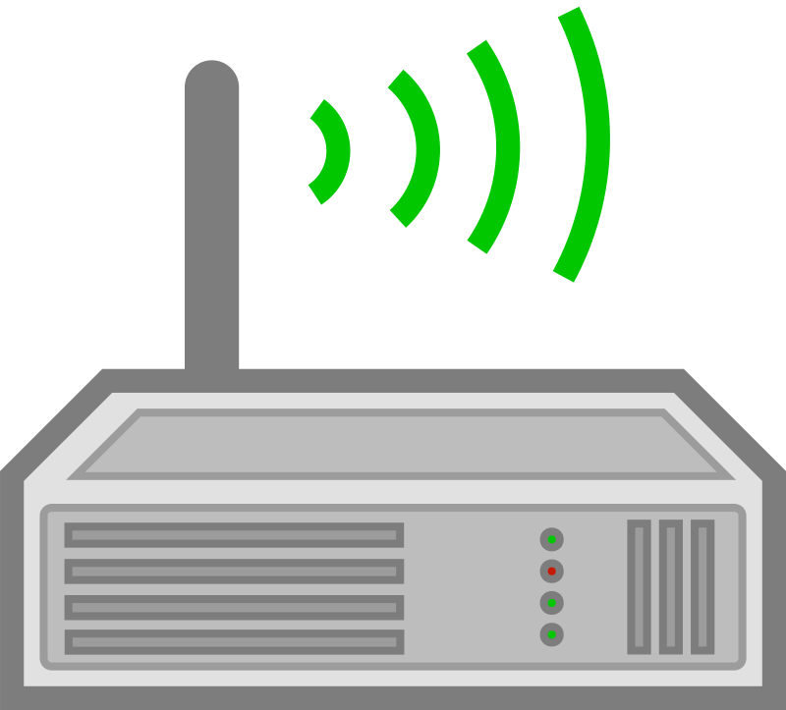

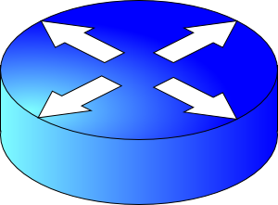
Application architecture
Partition-Aggregate
Web servers
Microservices
Data preprocessing (MR)
RPCs and MQs
Storage (noSQL)

Slide 3



Monoliths
HTTP
server
Language frameworks
CGI
Changes coupled
App
Releases, transient functions, etc.
Coordination overheads
Scaling, troubleshooting incidents, …

Slide 4
Microservices
HTTP
server
Language of choice
App
Distinct from a software library.
Out of process.
Independently upgrade and deploy
App
Independent data models
Must be explicitly related

Slide 5

How to split?
HTTP
server
App
Business Capabilities
Churn Boundaries
Fleeting?
Who should know (or not)?
Changing together?
App
Heterogeneity in resource use
Disparate data views
Refactoring common functionality

Slide 6
Salient new concerns!
HTTP
server
App
Communication
App
Failures

Slide 7

Communication
Lots of waiting.
Increasing failures.
…
Synchronous blocking
(request-response)
App
App
Remote Procedure Call (RPC)
Serialization format (e.g., protobufs)
struct customer {
string name;
int customer_id;
..;
}
struct customer {
string name;
int customer_id;
..;
}
01101010101…
JSON
XML

Slide 8



Communication
Shared data
Event streaming
Synchronous blocking
(request-response)
App
App
Message broker
Can do useful work while waiting (but still need timeouts)
Asynchronous request-response
callback()
“Building microservices”, Sam Newman

Slide 9
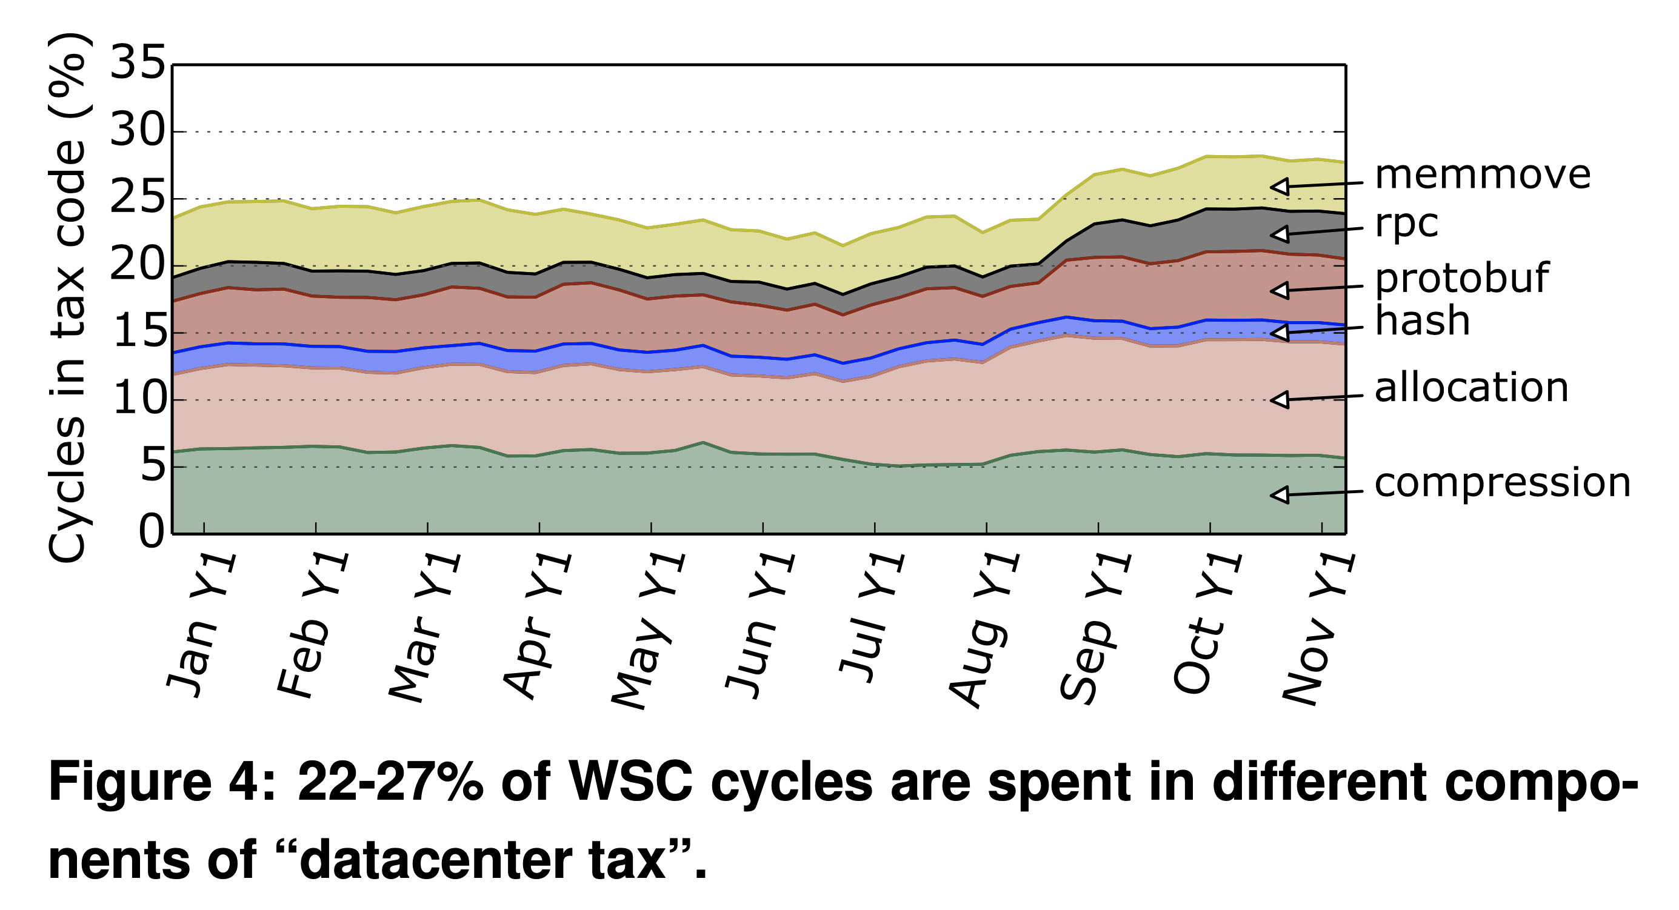
Cost of communication: Performance
Profiling a warehouse-scale computer (Google). ISCA’15.

Slide 10
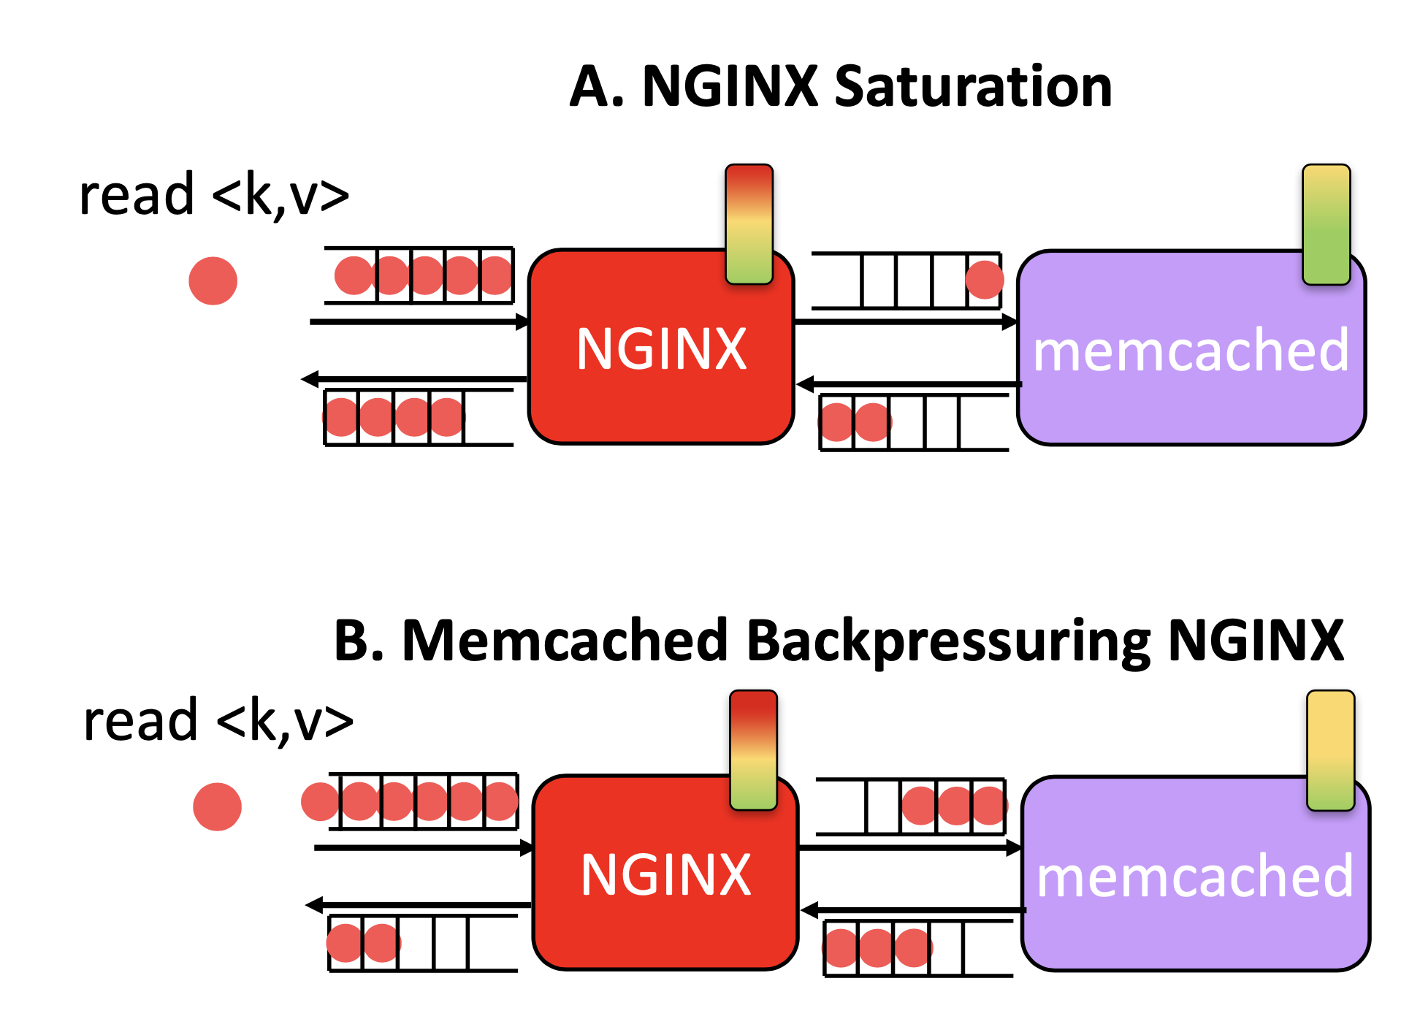
Cost of comm: Hotspot spreading
Deathstarbench. ASPLOS’19.

Slide 11


Cost of comm: high level failure handling
(Soft or hard)
App
App
Circuit breaker
Connection issue
Timeout
Timeout
Timeout
trip
Timeout
Fail immediately

Slide 12
Microservices aren’t always good
Just a technology. Look at problems first
Observability
Deployment automation
Integration: refactoring service boundaries is hard
How significant are dev coordination overheads?
Complexity

Slide 13
Partition-Aggregate
Processing interactive search queries

Slide 14
Web search: some numbers (circa 2003)
10s of terabytes of web corpus data
  Read 100s of megabytes per query
10s of billions of CPU instructions per query
Data accessed depends on the query; hard to predict
Cannot process on a single machine within acceptable time

Slide 15
Quick Review: Compute & Memory Org
Compute
(single threaded core)
Instruction pipeline
Fetch
(on hit)
Instruction pipeline
Retire
Instruction pipeline
Branch predictors
(out of order + speculative)
Registers
L1 I-cache
L1 D-cache
I-TLB
L2 cache
Memory
hierarchy
Slower but larger
L3 cache
Main memory

Slide 16
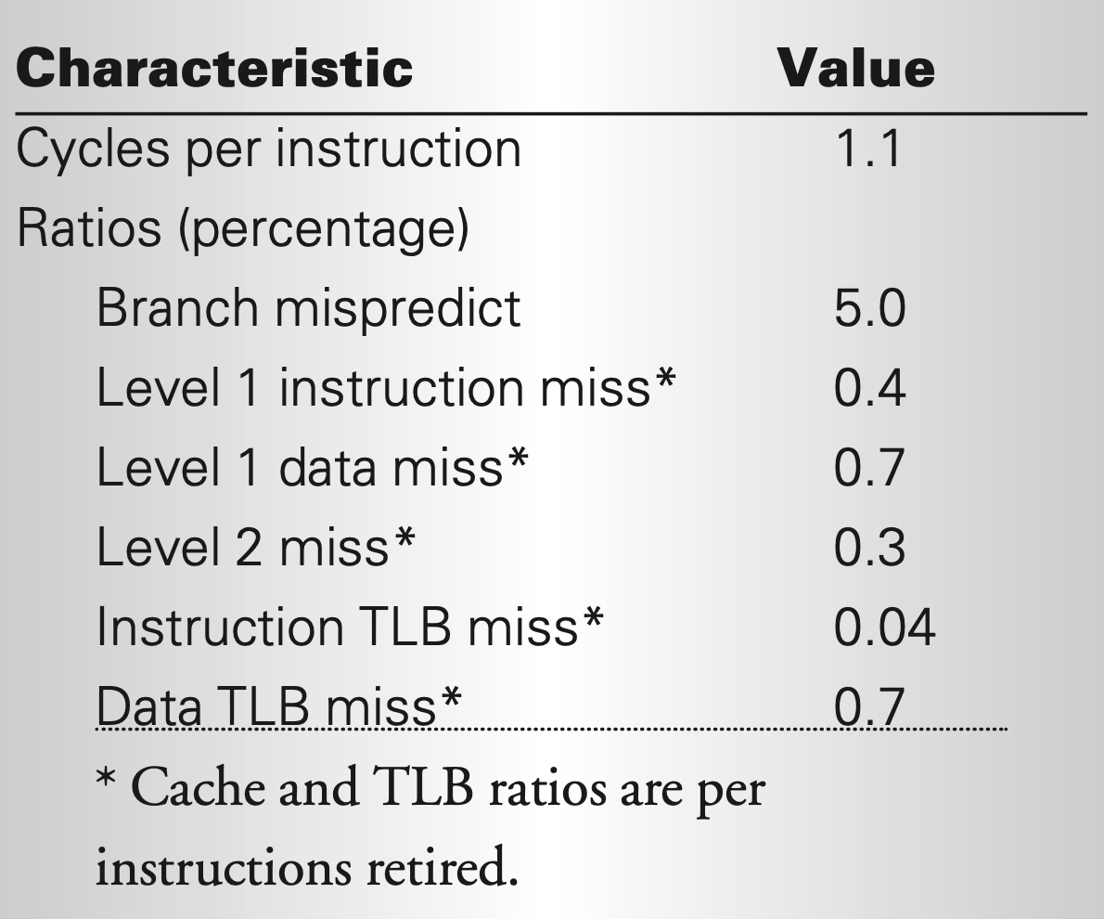
Measurements from one (index) server
Not too fast single-threaded
  Data dependencies
  Branches often mispredicted
Small instruction memory footprint
Data locality within a block, but not across blocks
Can’t drive high single threaded performance
Use parallelism
Web search for a planet, MICRO’03.

Slide 17

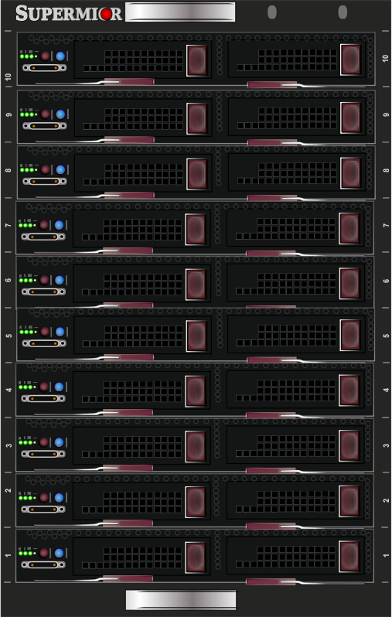

How to use parallelism?
Fast core
Fast core
Few fast cores with high-speed interconnect
Or more slow cores?
Cost per query processed?
Power efficiency?
Fast core
Fast core
Slow core
Slow core
Slow core
Slow core
Slow core
Slow core
(hyperthreaded or on-chip multicore)
Slow core
Slow core
Slow core
Server rack

Slide 18


Data parallelism
Significant parts of computation are independent over shards of data
  Fast interconnects not as critical
  Stateless, no coordination within a request
Different requests are independent
  Use parallelism across requests
  Shard itself can be replicated for throughput
Need lower latency?
Compensate slow cores with smaller shard (add more shards)
Turn throughput into latency advantage
1
2
3
a
b
4
5
6
a
4
4
b
4

Slide 19
Google search
Index servers
Doc servers
GWS
LB
user
DNS
GFE
Partition
Pick one
Word → Doc
Aggregate
All-up SLO (300 ms)
(Doc, word) → Snippet
Partition
Aggregate

Slide 20
Internet architecture: Review
Routing

Slide 21
Software/hardware organization at hosts
Application: useful user-level functions
Communication functions broken up and “stacked”
Transport: provide guarantees to apps
Each layer depends on the one below it.
Each layer supports the one above it.
The interfaces between layers are well-defined and standardized.
Network: best-effort global pkt delivery
Link: best-effort local pkt delivery

Slide 22
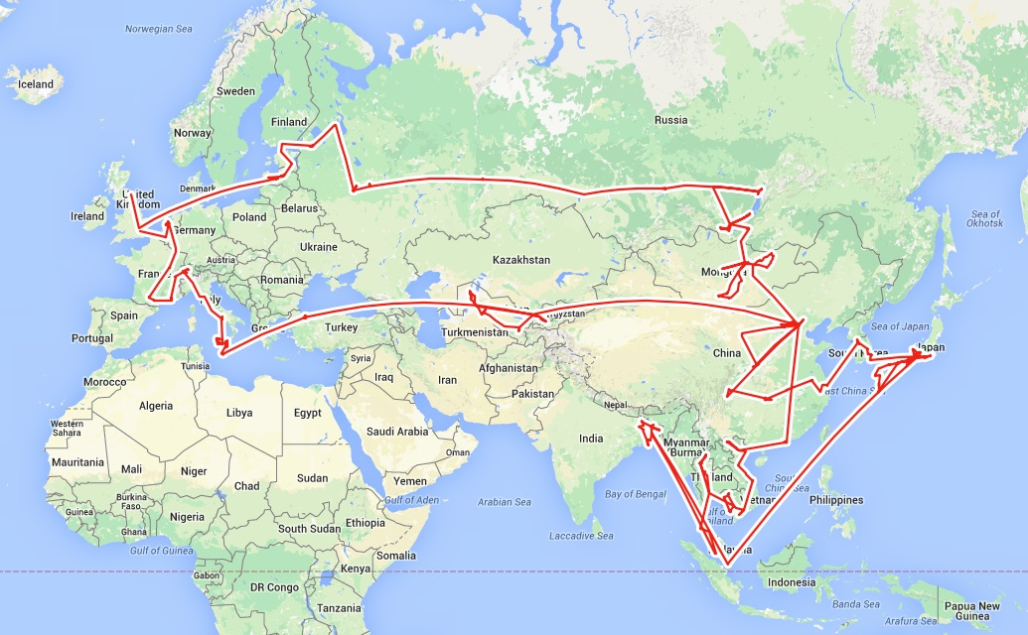
Routing

Slide 23
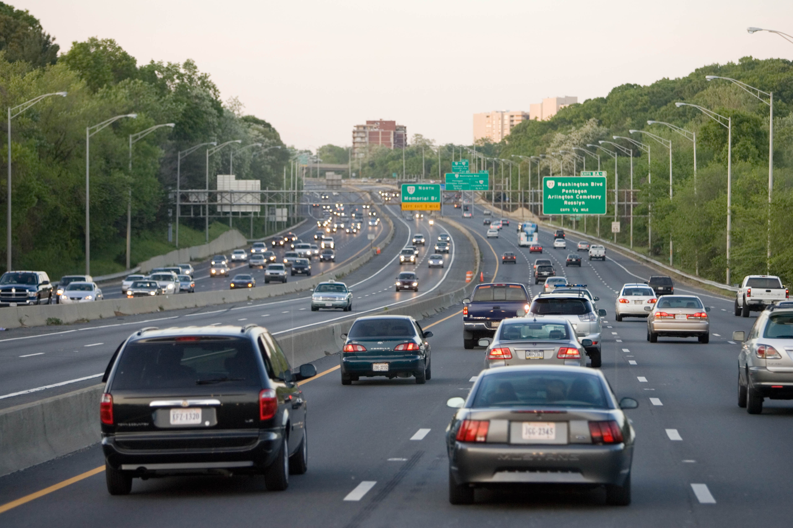
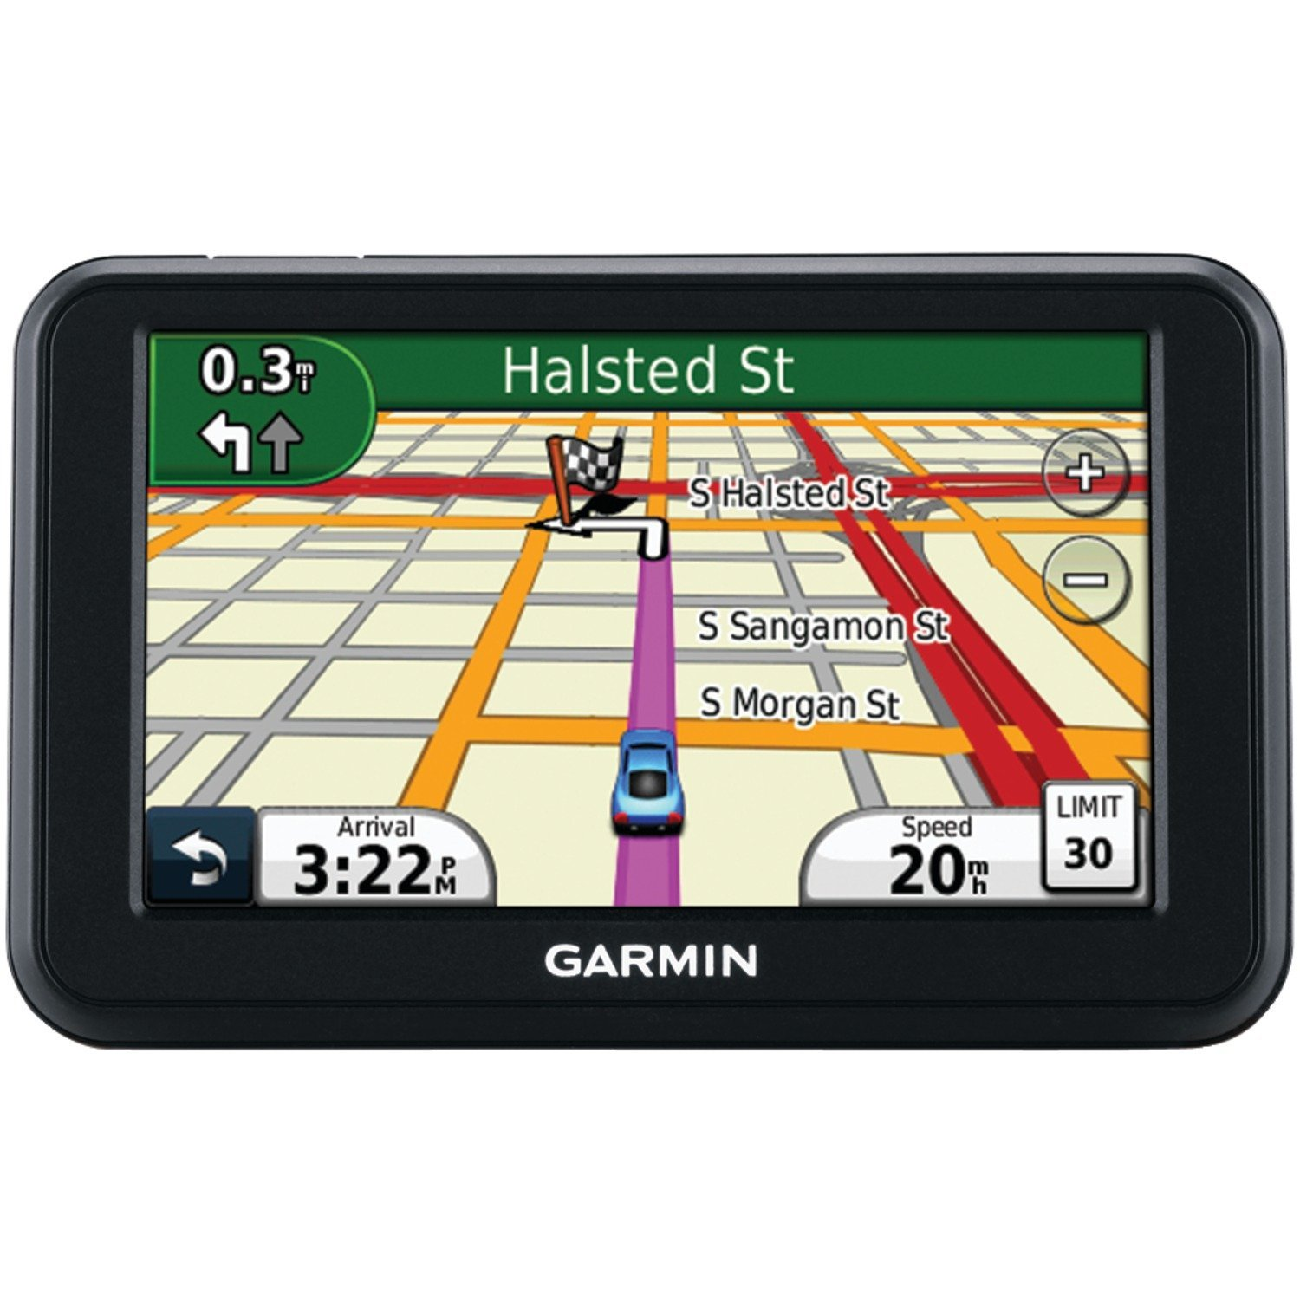

Two key network-layer functions
Forwarding: move packets from router’s input to appropriate router output
Routing: determine route taken by packets from source to destination
  routing algorithms
The network layer solves the routing problem.
Analogy: taking a road trip
Forwarding: process of getting through single exit
Routing: process of planning trip from source to destination
network
layer
runs
everywhere

Slide 24
Control/Data Planes
Data plane = Forwarding
local, per-router function
determines how datagram arriving on router input port is forwarded to router output port
Control plane = Routing
network-wide logic
determines how datagram is routed along end-to-end path from source to destination endpoint
two control-plane approaches:
  Distributed routing algorithm running on each router
  Centralized routing algorithm running on a (logically) centralized machine
values in arriving
packet header
0111
1
3
2

Slide 25

Distributed routing
Control plane
Traditional routing protocols: per route-change processing
(~ a few tens of seconds)
Routing
Algorithm
control
plane
data
plane
Data plane
per-packet processing
(~ tens of nanoseconds)
0111
1
3
2
values in arriving
packet header, i.e, destination IP address

Slide 26


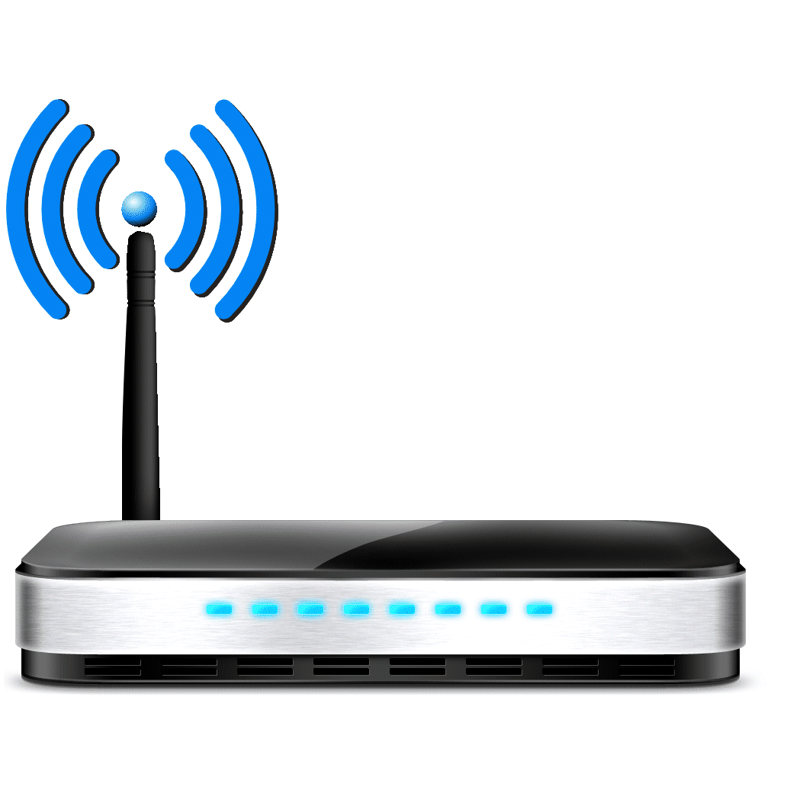

The Internet is a large federated network
AT&T
Comcast
Verizon

Slide 27
The Internet is a large federated network
Several autonomously run organizations (AS’es): No one “boss”
Organizations cooperate, but also compete
AT&T
Comcast
e.g., AT&T has little commercial interest in revealing its internal network structure to Verizon.
Verizon

Slide 28

The Internet is a large federated network
Several autonomously run organizations: No one “boss”
Organizations cooperate, but also compete
AT&T
Message exchanges must
not reveal internal network details.
Comcast
Verizon
Algorithm must work with “incomplete” information about its neighbors’ internal topology.

Slide 29
The Internet is a large federated network
Internet today: > 70,000 unique autonomous networks
Internet routers: > 800,000 forwarding table entries
AT&T
Keep messages & tables as small as possible. Don’t flood
Comcast
Verizon
Algorithm must be incremental: don’t recompute the whole table on every message exchanged.

Slide 30
Inter-domain Routing
The Internet uses Border Gateway Protocol (BGP)
All AS’es speak BGP. It is the glue that holds the Internet together
BGP is a path vector protocol
Routing protocols
Link state
protocols
Distance vector protocols
Path vector protocols
Messages?
Algorithm?
Applicable within a single AS

Slide 31
(1) BGP Messages
Loop detection is easy
(no “count to infinity”)
Exchange paths: path vector
Routing Announcements or Advertisements
  “I am here” or “I can reach here”
  Occur over a TCP connection (BGP session) between routers
Route announcement = destination + attributes
  Destination: IP prefix
Route Attributes:
  AS-level path
  Next hop
  Several others: origin, MED, community, etc.
An AS promises to use advertised path to reach destination
Only route changes are advertised after BGP session established
No link metrics, distances!
“I am here.”
Dst: 128.1.2.0/24
AS path: X
1b
“I can reach X”
Dst: 128.1.2.0/24
AS path: AS2, X
AS 2
1a
1c
2b
1d
2a
2c
X
2d

Slide 32
(2) BGP algorithm
A BGP router does not consider every routing advertisement it receives by default to make routing decisions!
  An import policy determines whether a route is even considered a candidate
Once imported, the router performs route selection
A BGP router does not propagate its chosen path to a destination to all other AS’es by default!
  An export policy determines whether a (chosen) path can be advertised to other AS’es and routers
Programmed by network operator
Business policy considerations drive BGP.
NOT efficiency considerations.

Slide 33
Policy arises from business relationships
Customer-provider relationships:
  E.g., Rutgers is a customer of AT&T
Peer-peer relationships:
  E.g., Verizon is a peer of AT&T
Business relationships depend on where connectivity occurs
  “Where”, also called a “point of presence” (PoP)
  e.g., customers at one PoP but peers at another
  Internet-eXchange Points (IXPs) are large PoPs where ISPs come together to connect with each other (often for free)

Slide 34
BGP Export Policy
legend:
provider
B
network
X
W
A
customer
C
network:
Y
Suppose an ISP only wants to route traffic to/from its customer networks (does not want to carry transit traffic between other ISPs)
A,B,C are provider networks
X,W,Y are customers (of provider networks)
X is dual-homed: attached to two networks
policy to enforce: X does not want to route from B to C via X
  So, X will not announce to B a route to C

Slide 35
BGP Export Policy
legend:
provider
B
network
X
W
A
customer
C
network:
Y
Suppose an ISP only wants to route traffic to/from its customer networks (does not want to carry transit traffic between other ISPs)
A announces path Aw to B and to C
B will not announce BAw to C:
  B gets no “revenue” for routing CBAw, since none of C, A, w are B’s customers
C will route CAw (not using B) to get to w

Slide 36
BGP Import Policy
legend:
provider
B
network
X
W
A
customer
C
network:
Y
Suppose an ISP wants to minimize costs by avoiding routing through its providers when possible.
Suppose C announces path Cy to x
Further, y announces a direct path (“y”) to x
Then x may choose not to import the path Cy to y since it has a peer path (“y”) towards y

Slide 37
Q2. BGP Route Selection
When a router imports more than one route to a destination IP prefix, it selects route based on:
  local preference value attribute (import policy decision -- set by network admin)
  shortest AS-PATH
  closest NEXT-HOP router
  Several additional criteria: You can read up on the full, complex, list of criteria, e.g., at https://www.cisco.com/c/en/us/support/docs/ip/border-gateway-protocol-bgp/13753-25.html

Slide 38
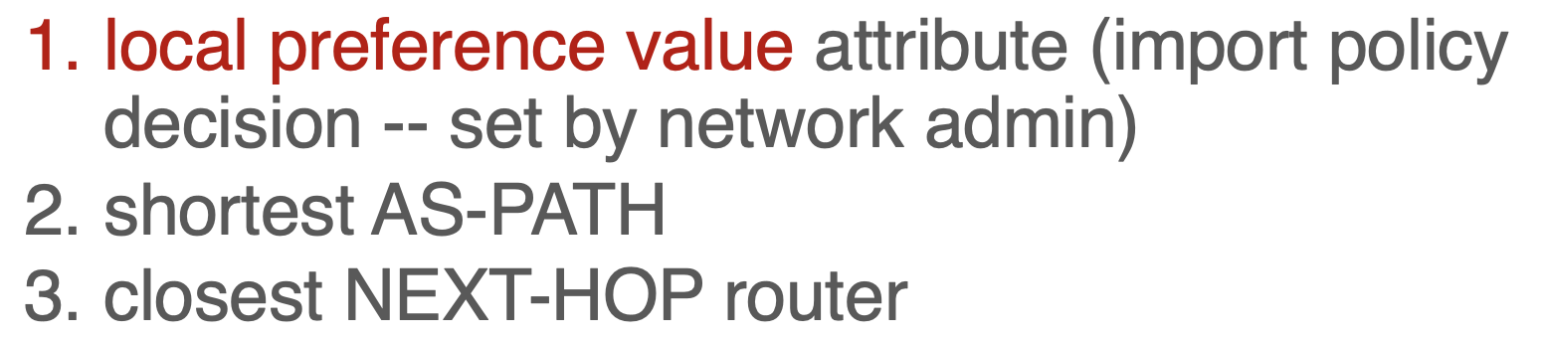
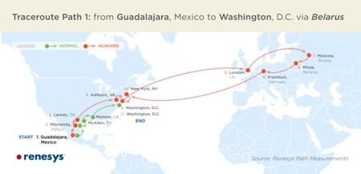
Problems with BGP
Approaches to bring flexibility:
Flexible control logic for path selection
(Google, Facebook)
Detour/overlay routing (Akamai)
Not designed for efficiency
Only a single path per destination
Slow to converge after a change
Vulnerable to bugs & malice
Nothing to do with path length, delay, or available capacity.

