Slide 1
Internet Architecture
A review
Lecture 3
Srinivas Narayana
http://www.cs.rutgers.edu/~sn624/553-S23

Slide 2
Software/hardware organization at hosts
Application: useful user-level functions
Communication functions broken up and “stacked”
Transport: provide guarantees to apps
Each layer depends on the one below it.
Each layer supports the one above it.
The interfaces between layers are well-defined and standardized.
Network: best-effort global pkt delivery
Link: best-effort local pkt delivery

Slide 3
Software/hardware organization at hosts
Application: useful user-level functions
Demultiplexing
Reliability
Congestion control
Transport: provide guarantees to apps
Network: best-effort global pkt delivery
Link: best-effort local pkt delivery

Slide 4
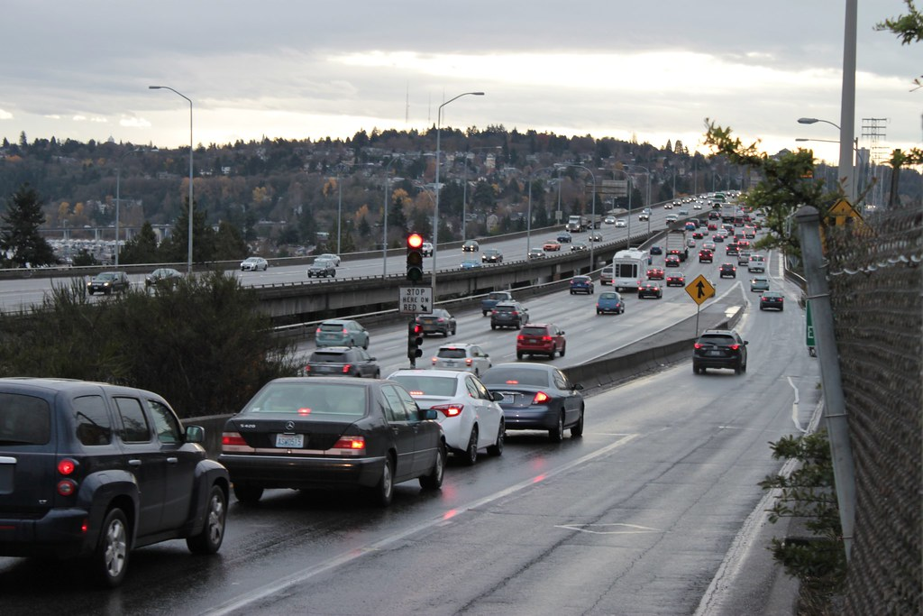
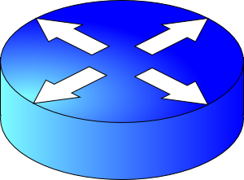
(3) How much data to keep in flight?
Avoid overwhelming network resources: Congestion control
Internet: every endpoint makes its own decisions!
Distributed algorithm: no central authority
Goal 1: efficiency (use available capacity)
Goal 2: fairness (distribute capacity equitably)
H
C
Feedback Control

Slide 5
Finding the right congestion window
There is an unknown bottleneck link rate that the sender must match
If sender sends more than the bottleneck link rate:
packet loss, delays, etc.
If sender sends less than the bottleneck link rate:
all packets get through; successful ACKs
Congestion window (cwnd): amount of data in flight

Slide 6
Quickly finding a rate: TCP slow start
L
N
T
Payload
Initially cwnd = 1 MSS
MSS is “maximum segment size”
Upon receiving an ACK of each MSS, increase the cwnd by 1 MSS
Effectively, double cwnd every RTT
Initial rate is slow but ramps up exponentially fast
On loss (RTO), restart from cwnd := 1 MSS
Host A
Host B
MSS
one segment
RTT
two segments
four segments
time

Slide 7
Behavior of slow start
Packet drops/
RTO
Congestion Window
Slow start
Slow start
Slow start
1 MSS
Time

Slide 8
Slow start has problems
Congestion window increases too rapidly
Example: suppose the “right” window size cwnd is 17
cwnd would go from 16 to 32 and then dropping down to 1
Result: massive packet drops
Congestion window decreases too rapidly
Suppose the right cwnd is 31, and there is a loss when cwnd is 32
Slow start will resume all the way back from cwnd 1
Result: unnecessarily low speed of sending data
Instead, perform finer adjustments of cwnd: congestion avoidance

Slide 9
TCP New Reno: Additive Increase
Remember the recent past to find a good estimate of link rate
The last good cwnd without packet drop is a good indicator
TCP New Reno calls this the slow start threshold (ssthresh)
Increase cwnd by 1 MSS every RTT after cwnd hits ssthresh
Effect: increase window additively per RTT
Host A
Host B
say ssthresh=4
four segments
RTT
five segments
RTT
six segments
RTT
seven segments
…
time

Slide 10
TCP New Reno: Additive increase
Start with ssthresh = 64K bytes (TCP default)
Do slow start until ssthresh
Once the threshold is passed, do additive increase
Add one MSS to cwnd for each cwnd worth data ACK’ed
For each MSS ACK’ed, cwnd = cwnd + (MSS * MSS) / cwnd
Upon a TCP timeout (RTO),
Set cwnd = 1 MSS
Set ssthresh = max(2 * MSS, 0.5 * cwnd)
i.e., the next linear increase will start at half the current cwnd

Slide 11
Behavior of Additive Increase
AI is slow.
Persistent connections
Large window sizes
Different laws to evolve congestion window
Say MSS = 1 KByte
Default ssthresh = 64KB = 64 MSS
Packet drops/
RTO
Loss occurs at cwnd = 54K
Loss occurs at cwnd = 40K
54 MSS
Additive increase
Set ssthresh to
27 MSS
Additive increase
Congestion Window
Set ssthresh to
20 MSS
Slow start
Slow start
Slow
start
1K
Time

Slide 12
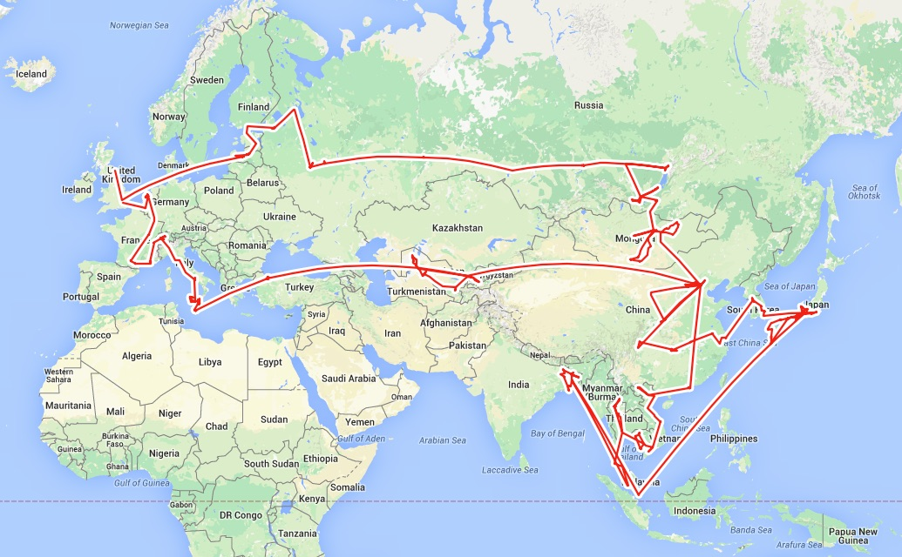
Routing

Slide 13
Google
google.com
Applications
Applications
User
Socket
Transport
Kernel
Transport
Demultiplexing
Reliability
Congestion control
Network
Network
Link layer
Link layer

Slide 14
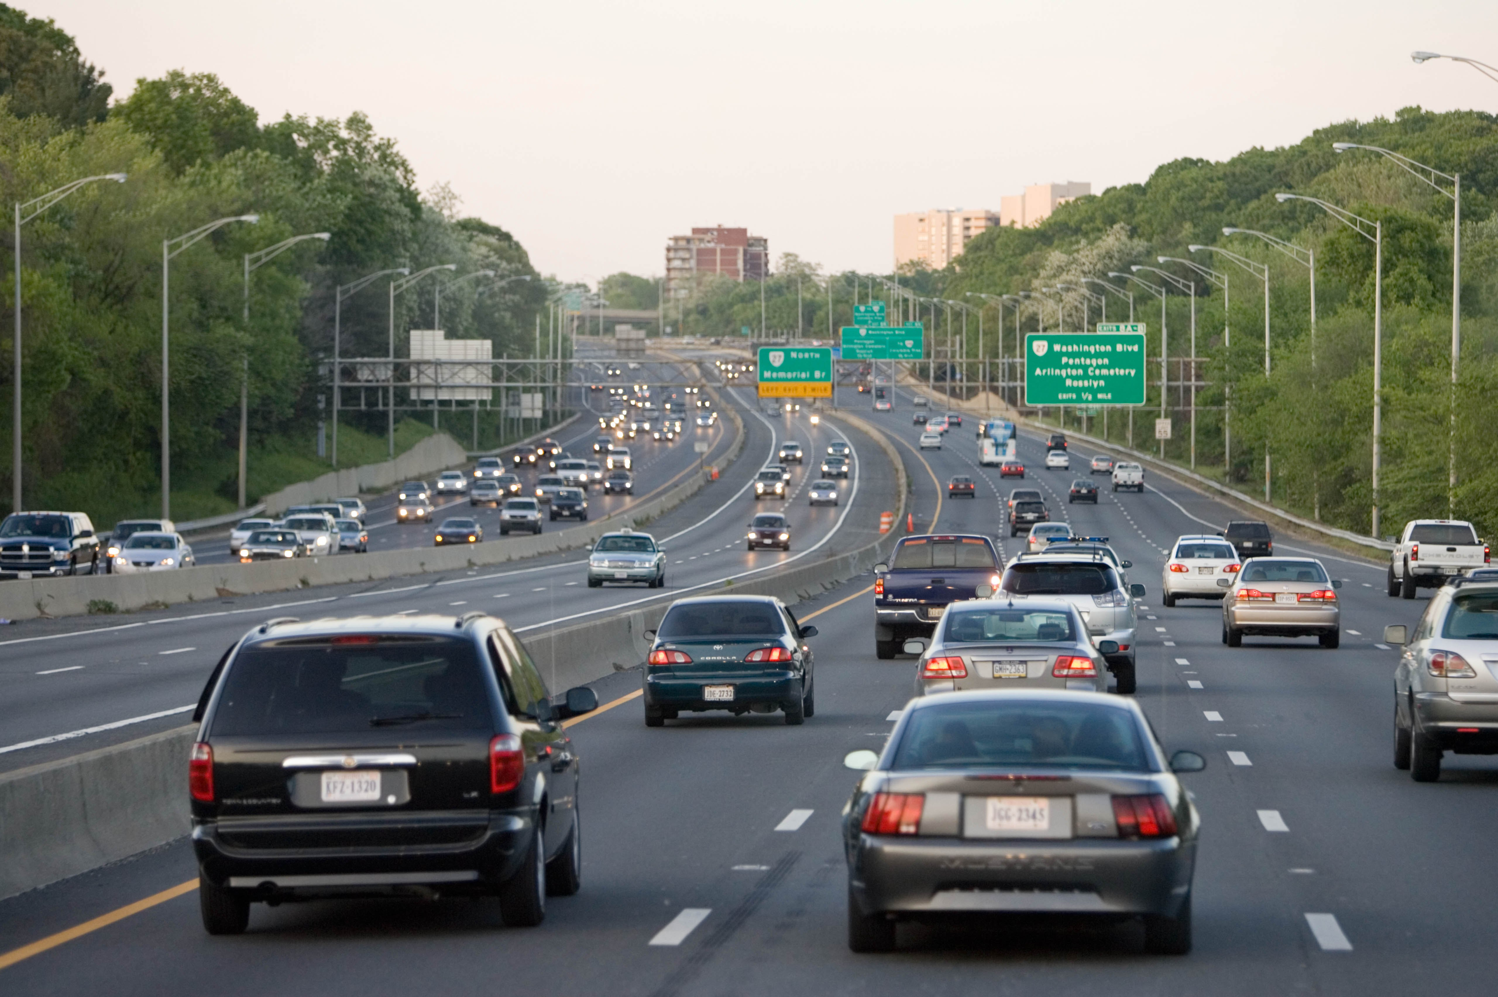
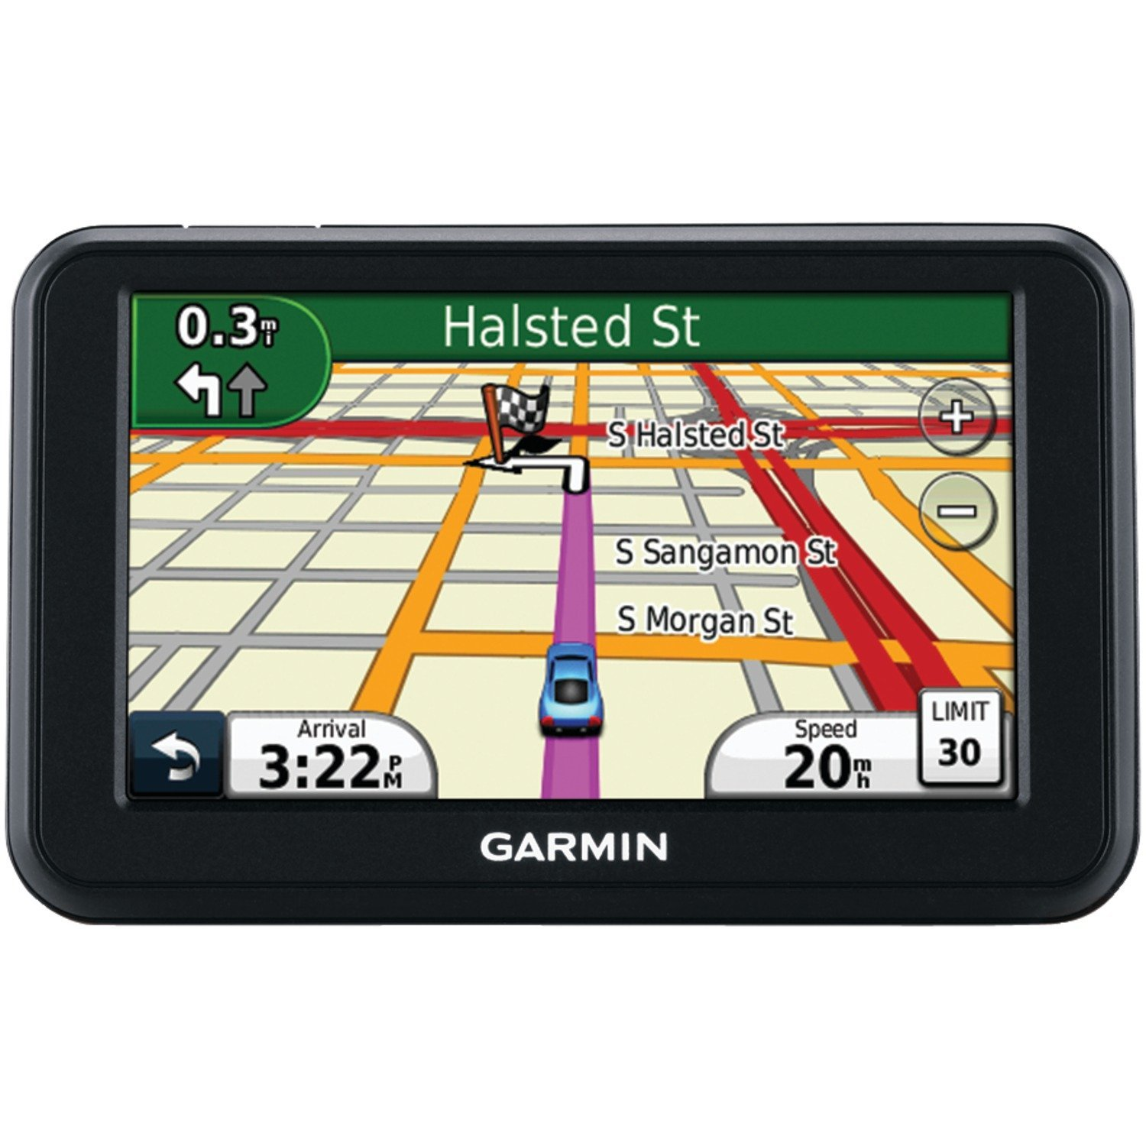
Two key network-layer functions
Forwarding: move packets from router’s input to appropriate router output
Routing: determine route taken by packets from source to destination
routing algorithms
The network layer solves the routing problem.
Analogy: taking a road trip
Forwarding: process of getting through single exit
Routing: process of planning trip from source to destination
network
layer
runs
everywhere

Slide 15
Control/Data Planes
Data plane = Forwarding
local, per-router function
determines how datagram arriving on router input port is forwarded to router output port
Control plane = Routing
network-wide logic
determines how datagram is routed along end-to-end path from source to destination endpoint
two control-plane approaches:
Distributed routing algorithm running on each router
Centralized routing algorithm running on a (logically) centralized machine
values in arriving
packet header
0111
1
3
2

Slide 16
Application architecture
Web servers

Slide 17
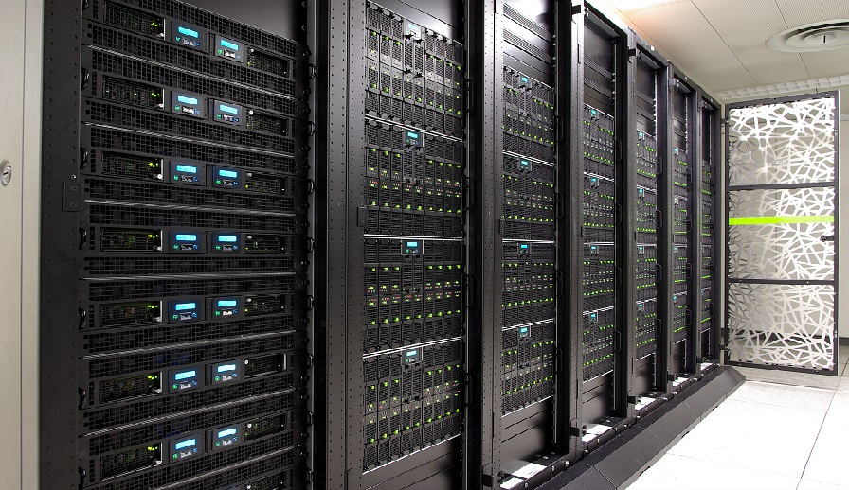
Components of an Internet Service
Routers
App compute and communication patterns
Servers
Modularized applications
Data Center
Endpoints
Storage
Interconnect: Routers

Slide 18
Web server
Often the first app point where a user request lands
Parse HTTP request
process
bind(IPaddr_{B}, port_{B})
listen()
accept()
recv()/send()/..
IP_{B} + port_{B}
(many other headers!)
socket
Find a file, run a script, …
HTTP/1.1 200 OK
Content-Type: text/html
Send response header
Read file, send() data

Slide 19
Overloaded with functionality
Often the first app point where a user request lands
Find a file, run a script, …
process
bind(IPaddr_{B}, port_{B})
listen()
accept()
recv()/send()/..
IP_{B} + port_{B}
Scripting:
Python/PHP/nodejs
fastCGI
socket
Reverse proxy
Caching
Compression
Access control
TLS
Media streaming
Image filtering

Slide 20
How does one design a web server?
Process connections one at a time?
accept()
close()
process
bind(IPaddr_{B}, port_{B})
listen()
accept()
recv()/send()/..
IP_{B} + port_{B}
socket
listen()
send/recv()
listen()
Many other requests waiting in the meanwhile
Powerful server doing nothing most of the time

Slide 21
How does one design a web server?
Process other requests while waiting for one to finish
process
bind(IPaddr_{B}, port_{B})
listen()
accept()
recv()/send()/..
IP_{B} + port_{B}
socket

Slide 22
Parallelism
Process other requests while waiting for one to finish
A first design: multiprocessing/threading
process
bind(IPaddr_{B}, port_{B})
listen()
accept()
fork()
recv()/send()/..
IP_{B} + port_{B}
accept()
socket
listen()
send()
recv()
listen()
accept()
listen()
send()
recv()
send()
recv()
Great to avoid blocking (disk I/O, fastCGI, …)
more
Overhead grows with # connections
longer lived

Slide 23
Concurrency
Process other requests while waiting for one to finish
A better design: event driven
A queue of events
accept()
process
bind(IPaddr_{B}, port_{B})
listen()
accept()
recv()/send()/..
IP_{B} + port_{B}
socket
recv()
epoll, select, kqueue, etc.
Lightweight
State of the art designs combine parallelism (multiprocess/thread) with concurrency (event-driven)
Can block if any of the requests block

