Slide 1

Internet and Web Architecture
A review
Lecture 2
Srinivas Narayana
http://www.cs.rutgers.edu/~sn624/553-S23

Slide 2
Outline
Name resolution
The HTTP protocol
Socket abstraction
Underlying transport concerns: reliability, basic congestion control
Internet routing: IP address organization, BGP, and concerns
CDN reading : Tom Leighton, Akamai full detailed study
Relevant points from Google, FB, Microsoft edge and peering papers
HTTP/TCP interaction?

Slide 3
Software/hardware organization at hosts
Application: useful user-level functions
Communication functions broken up and “stacked”
Transport: provide guarantees to apps
Each layer depends on the one below it.
Each layer supports the one above it.
The interfaces between layers are well-defined and standardized.
Network: best-effort global pkt delivery
Link: best-effort local pkt delivery

Slide 4


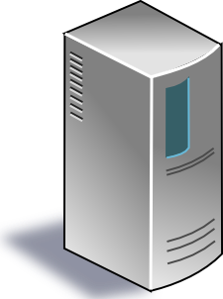


Applications
Applications
Packet starts as an
app “payload”
Transport
Packet takes on headers (metadata) at each layer
Transport
Network
Network
Link layer
Link layer
The Internet

Slide 5
Name Resolution

Slide 6
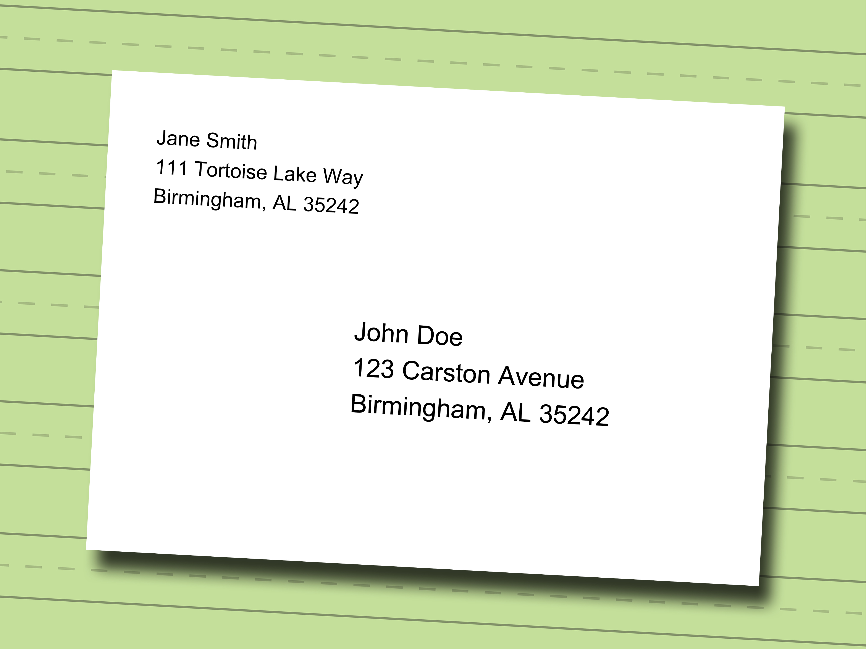

Google
google.com
Machines communicate using IP addresses and ports
IP addresses: ~12 digits (IPv4) or more
Ports: fixed based on application (e.g., 80: web)
Need a way to turn human-readable addresses into Internet addresses.
Ask someone
Ask everyone
Tell everyone
Directory service
Query broadcast
Information flooding
Asking “someone” could involve asking many machines…

Slide 7
Domain Name Service
DOMAIN NAME | IP ADDRESS
spotify.com | 98.138.253.109
cs.rutgers.edu | 128.6.4.2
www.google.com | 74.125.225.243
www.princeton.edu | 128.112.132.86
<Client IP, CPort, DNS server IP, 53>
QUERY cs.rutgers.edu
<DNS server, 53, Client IP, Cport>
RESPONSE 128.6.4.2
Key idea: Implement a server that looks up a table.
Will this scale?
  Every new (changed) host needs to be (re)entered in this table
  Performance: can the server serve billions of Internet users?
  Failure: what if the server or the database crashes?
  Security: What if someone “takes over” this server?

Slide 8
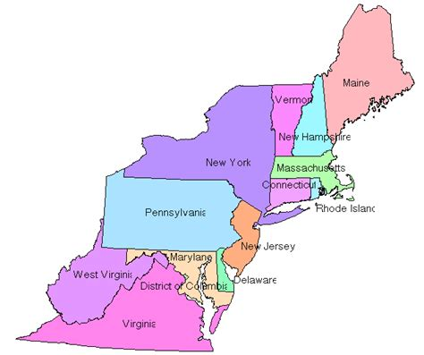
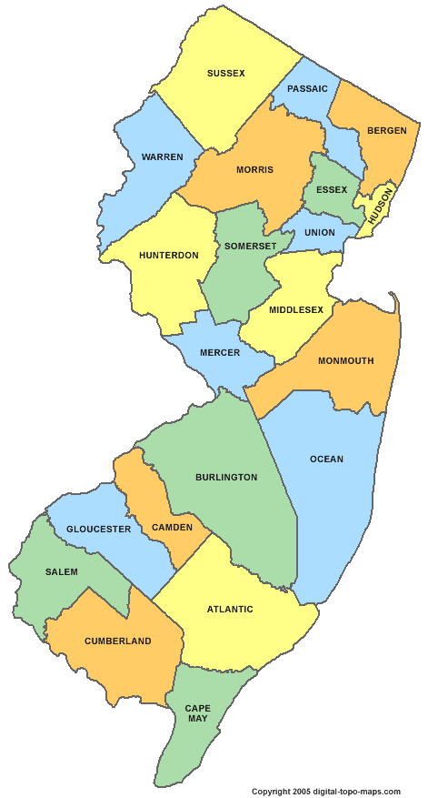

Distributed and hierarchical database
Root DNS Servers
Top-level domain (TLD) servers
com DNS servers
org DNS servers
edu DNS servers
google.com
DNS servers
wnyc.org
DNS servers
rutgers.edu
DNS servers
umass.edu
DNS servers
amazon.com
DNS servers
cs.rutgers.edu
DNS server
Authoritative name server
Hierarchy
Replication
Indirection
RFC 1034

Slide 9
DNS name resolution
root DNS server
2
Host at cs.rutgers.edu wants IP address for gaia.cs.umass.edu
Local DNS server
Root DNS server
TLD DNS server
Authoritative DNS server
3
.edu DNS server
4
5
local DNS server
dns.rutgers.edu
7
6
1
8
umass.edu DNS server
dns.umass.edu
requesting host
cs.rutgers.edu
gaia.cs.umass.edu

Slide 10

DNS caching
root DNS server
2
Once (any) name server learns a name to IP address mapping, it caches the mapping
Cache entries timeout (disappear) after some time
TLD servers typically cached in local name servers
In practice, root name servers aren’t visited often!
Caching is pervasive in DNS
3
.edu DNS server
4
5
local DNS server
dns.rutgers.edu
7
6
1
8
umass.edu DNS server
dns.umass.edu
requesting host
cs.rutgers.edu
gaia.cs.umass.edu

Slide 11
Example DNS interactions
dig <domain-name>
dig +trace <domain-name>
dig @<dns-server> <domain-name>

Slide 12
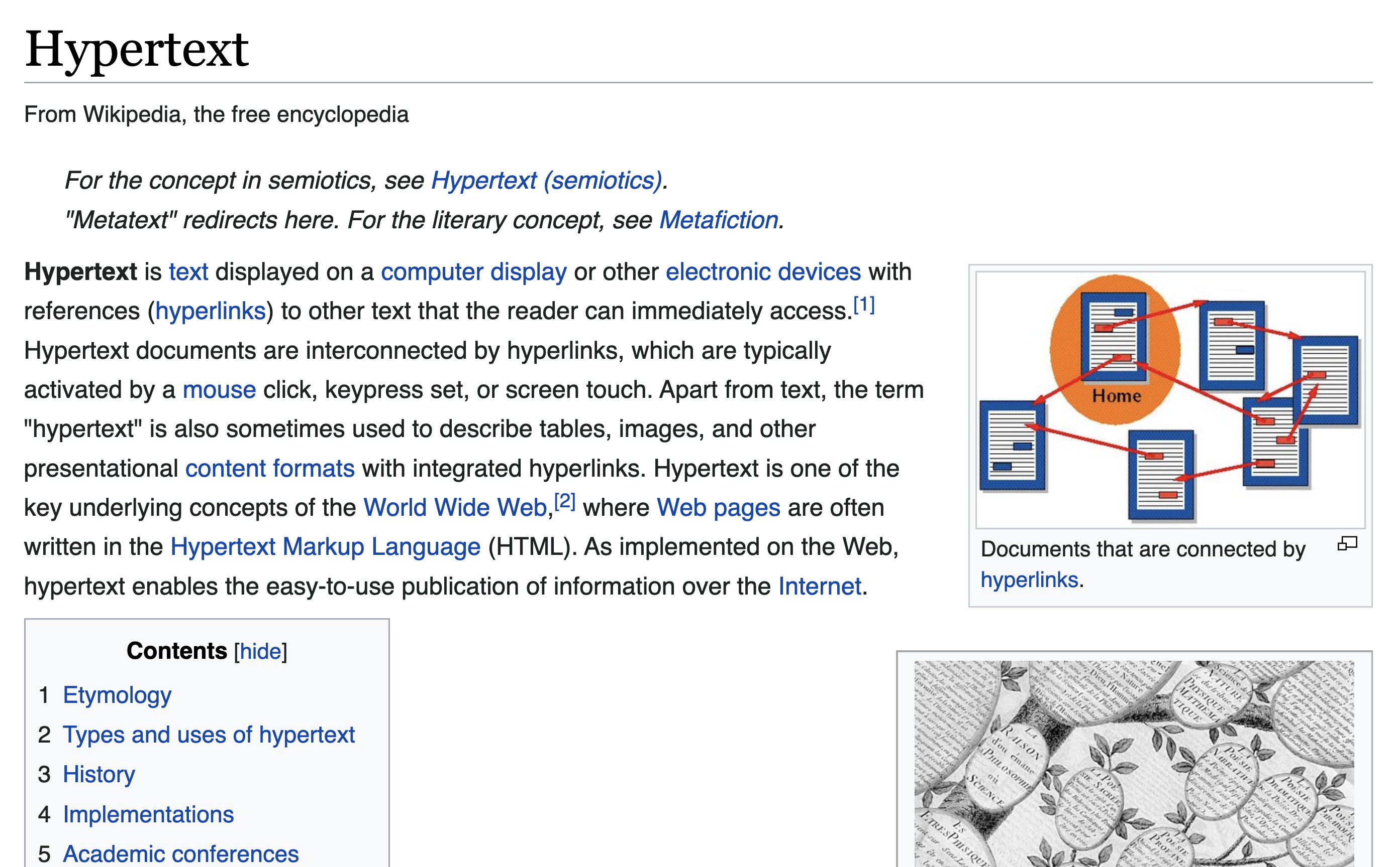
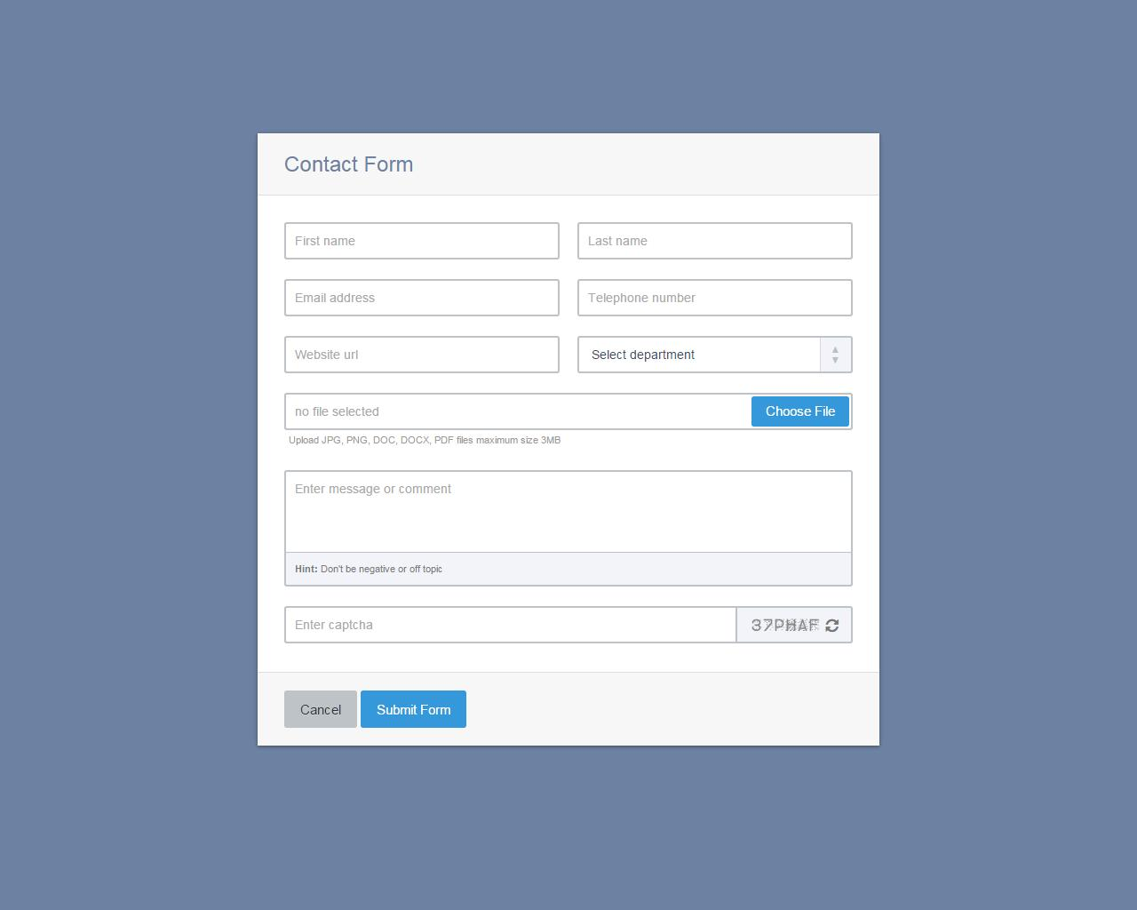
Google
google.com
The web is a specific application protocol running over a network: HyperText Transfer Protocol (HTTP)
Each object addressable by a name (URL)
Named objects can be static (image, video)
… or the result of a dynamic app process
Objects

Slide 13
Web interactions
Hostname | IP address
Google.com | 10.0.1.2
DNS server
I want to browse google.com
Host name
Server IP Address
(HTTP application typically associated with port 80)
clientIP, clientPort, server IP Address, 80
HTTP request
HTTP response
HTTP messages

Slide 14
Example HTTP interactions
wget google.com (or) curl google.com
telnet example.com 80
  GET / HTTP/1.1
  Host: example.com
(followed by two enter’s)
Exercise: try
  telnet google.com 80
  telnet web.mit.edu 80

Slide 15

Remembering users: cookies
client
server
Cookie is typically opaque to client.
Cookie file
http request msg + auth
server
creates ID
1678 for user
Netflix: 436
Amazon: 1678
http response +
Set-cookie: 1678
entry in backend
database
Cookie file
http request (no auth)
cookie: 1678
Netflix: 436
cookie-
specific
action
access
Amazon: 1678
Personalized http response
one week later:
access
Cookie file
http request (no auth)
cookie: 1678
cookie-
specific
action
Netflix: 436
Amazon: 1678
Personalized http response

Slide 16

Improving performance: Web caching
Network administrators (e.g., Rutgers) may run web caches to remember popular web objects
Hit: cache returns object
Miss: obtain object from originating web server (origin server) and return to client
  Also cache the object locally
Reduce response time
Reduce traffic requirements (and $$) on an organization’s network connections
Clients
Return cached object!
Web Server
(also called origin server in this context)
GET foo.html
GET foo.html
The Internet
Web cache
Store foo.html
on receiving response
Rutgers

Slide 17
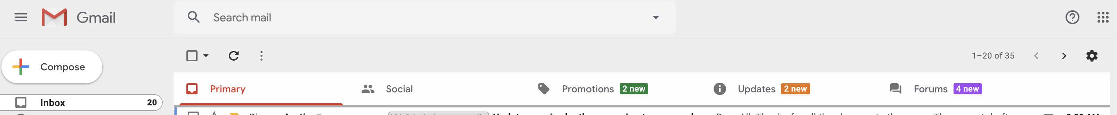
Not all content is effectively cacheable
Personalized content
Interactive processing
  e.g., forms, shopping carts, ajax, etc.
Long tail of (obscure) content

Slide 18
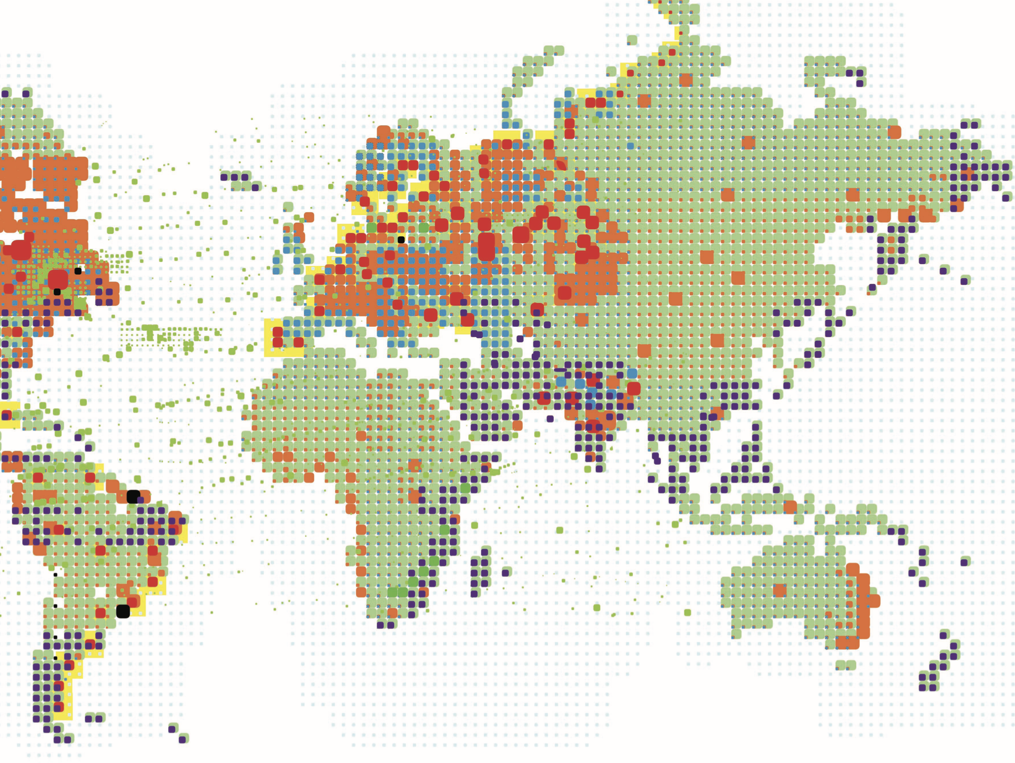
Content Distribution Networks (CDNs)
A global network of web caches
Provisioned by ISPs and network operators
Or content providers, like Netflix, Google, etc.
Uses
Reduce traffic on a network’s Internet connection, e.g., Rutgers
Improve response time for users: CDN nodes are closer to users than origin servers (servers holding original content)
Reduce bandwidth requirements on content provider
Reduce $$ to maintain origin servers

Slide 19
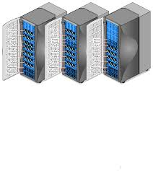
Without CDN
DOMAIN NAME | IP ADDRESS
www.yahoo.com | 98.138.253.109
cs.rutgers.edu | 128.6.4.2
www.google.com | 74.125.225.243
www.princeton.edu | 128.112.132.86
DNS
Clients distributed all over the world
Cluster of Rutgers CS origin servers (located in NJ, USA)
128.6.4.2
Problems:
Huge bandwidth requirements for Rutgers
Large propagation delays to reach users

Slide 20
Where the CDN comes in
Distribute content of the origin server over geographically distributed CDN servers
But how will users get to these CDN servers?
Use DNS!
  DNS provides an additional layer of indirection
  Instead of returning IP address, return another DNS server (NS record)
  The second DNS server (run by the CDN) returns IP address to client
The CDN runs its own DNS servers (CDN name servers)
  Custom logic to send users to the “closest” CDN web server

Slide 21
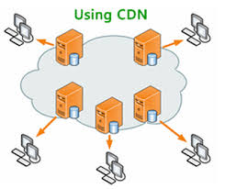
With CDN
DOMAIN NAME | IP ADDRESS
www.yahoo.com | 98.138.253.109
cs.rutgers.edu | 124.8.9.8 (NS record pointing to CDN name server)
www.google.com | 74.125.225.243
DNS reply
CDN Name Server (124.8.9.8)
NS record delegates the choice of IP address to the CDN name server.
Custom logic to map ONE domain name to one of many IP addresses!
DOMAIN NAME | IP ADDRESS
Cs.Rutgers.edu | 12.1.2.3
Cs.Rutgers.edu | 12.1.2.4
Cs.Rutgers.edu | 12.1.2.5
Cs.Rutgers.edu | 12.1.2.6
Popular CDNs:
CloudFlare
Akamai
Level3
…
12.1.2.3
CDN servers
12.1.2.4
12.1.2.6
12.1.2.5
128.6.4.2
Origin server
Most requests go to CDN servers (caches).
CDN servers may request object from origin
Few client requests go directly to origin server
Client

Slide 22
Seeing a CDN in action
dig web.mit.edu (or) dig +trace web.mit.edu
telnet web.mit.edu 80

Slide 23
Application-OS interface

Slide 24

Google
google.com
Applications
Applications
User
Socket
Transport
Kernel
Transport
Network
Network
Link layer
Example: connected socket (TCP)
Link layer

Slide 25




Google
google.com
bind(IPaddr_{B}, port_{B})
listen()
accept()
recv()
process
process
IP_{B} + port_{B}
socket
socket
IP_{A} + port_{A}
connect(
IP_{B}, port_{B})
send()

Slide 26
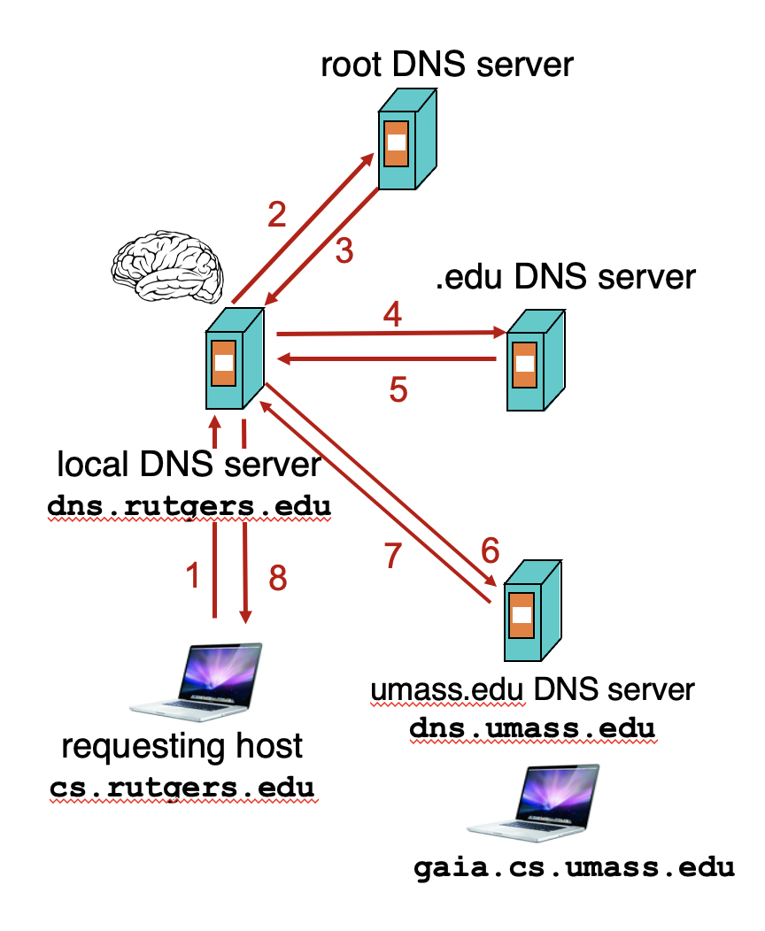
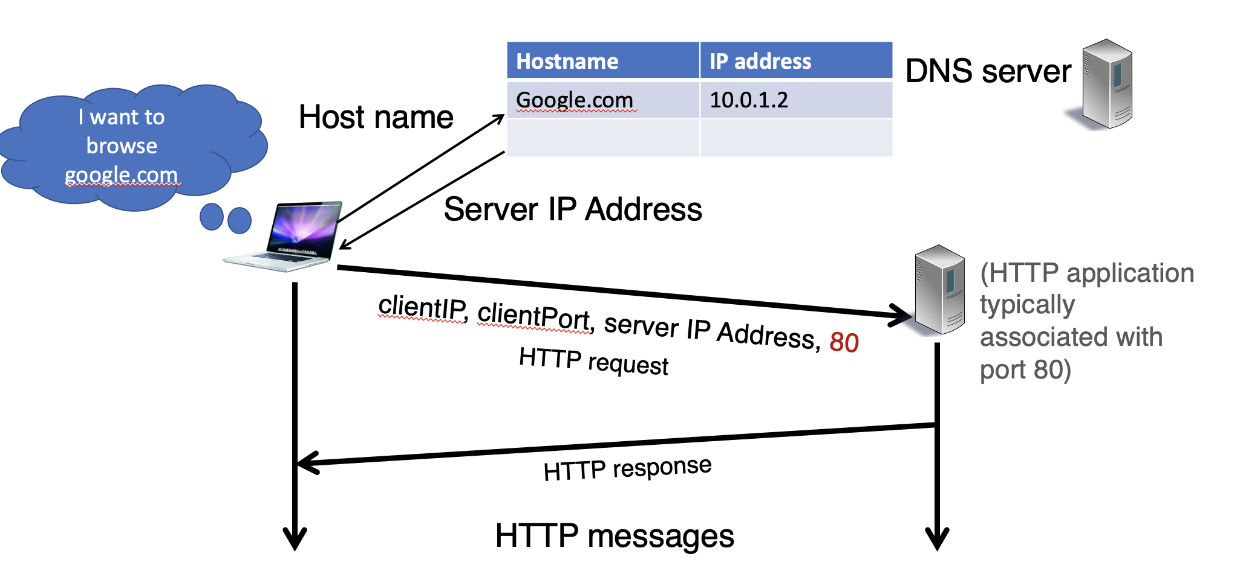
Google
google.com
bind(IPaddr_{B}, port_{B})
listen()
accept()
recv()
connect(
IP_{B}, port_{B})
send()

Slide 27
Google
google.com
Applications
Applications
User
Socket
Transport
Kernel
Transport
Network
Network
Link layer
Link layer

Slide 28
Transport

Slide 29


(1) (De)multiplexing
Connection lookup: The operating system does a lookup using these data to determine the right socket and app.
Machine 1
Port 1
Machine 1
IP addr 1
Port 2
…
Src port, Dst port
Denotes an attachment point with the network.
…
…
…
Src IP, Dst IP,
Tp Protocol
…
Port 65535
Machine 1
IP addr 2
UDP or TCP listening:
(dst IP, dst port, TCP)
socket()
Ports
Each IP address comes with a full copy of its own ports.
TCP established:
(dst IP, dst port, src IP, src port, TCP)
Machine

Slide 30
TCP sockets of different types
Listening (bound but unconnected)
# On server side
ls = socket(AF_INET, SOCK_STREAM)
ls.bind(serv_ip, serv_port)
ls.listen() # no accept() yet
Connected (Established)
# On server side
cs, addr = ls.accept()
# On client side
connect(serv_ip, serv_port)
accept() creates a new socket with the
4-tuple (established) mapping
(dst IP, dst port)
➔
Socket (ss)
(src IP, dst IP, src port, dst port)
➔
Socket (cs NOT ls)
Enables new connections to be demultiplexed correctly
Enables established connections to be demultiplexed correctly

Slide 31
(2) Reliability: Stop and Wait. 3 Ideas
ACKs: Sender sends a single packet, then waits for an ACK to know the packet was successfully received. Then the sender transmits the next packet.
RTO: If ACK is not received until a timeout, sender retransmits the packet
Seq: Disambiguate duplicate vs. fresh packets using sequence numbers that change on “adjacent” packets
Sender
Receiver
SEQ 0
ACK 0
RTT
SEQ 1
RTO
Retransmit

Slide 32
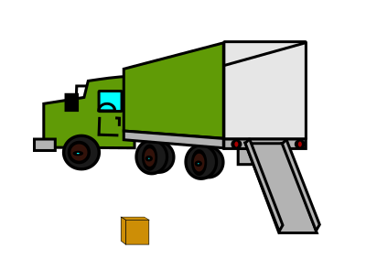
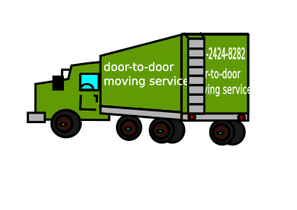


Sending one packet per RTT makes the data transfer rate limited by the time between the endpoints, rather than the bandwidth.
Ensure you got the (one) box safely; make N trips
Ensure you get N boxes safely; make just 1 trip!
Keep many packets in flight

Slide 33
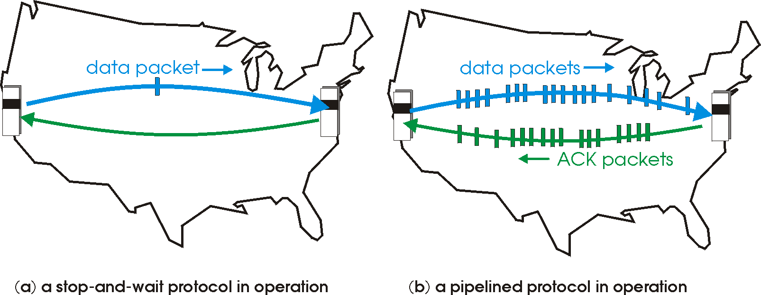
Pipelined reliability
Data in flight: data that has been sent, but sender hasn’t yet received ACKs from the receiver
  Note: can refer to packets in flight or bytes in flight
New packets sent at the same time as older ones still in flight
New packets sent at the same time as ACKs are returning
More data moving in same time!
Improves throughput
  Rate of data transfer

Slide 34
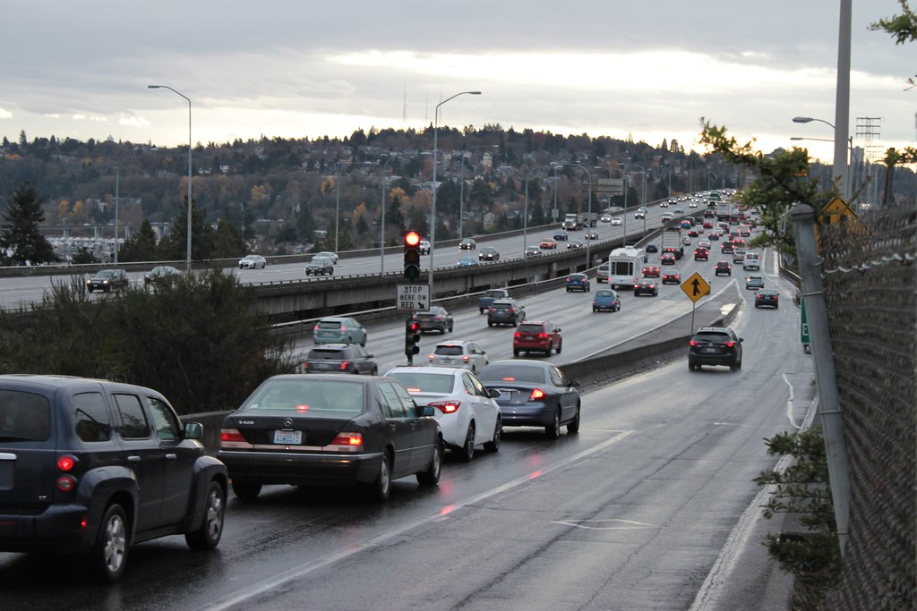


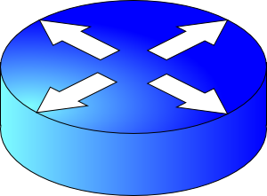




(3) How much data to keep in flight?
Avoid overwhelming network resources: Congestion control
Internet: every endpoint makes its own decisions!
  Distributed algorithm: no central authority
  Goal 1: efficiency (use available capacity)
  Goal 2: fairness (distribute capacity equitably)
H
C
Feedback Control

Slide 35
Finding the right congestion window
There is an unknown bottleneck link rate that the sender must match
If sender sends more than the bottleneck link rate:
  packet loss, delays, etc.
If sender sends less than the bottleneck link rate:
  all packets get through; successful ACKs
Congestion window (cwnd): amount of data in flight

Slide 36

Quickly finding a rate: TCP slow start
L
N
T
Payload
Initially cwnd = 1 MSS
  MSS is “maximum segment size”
Upon receiving an ACK of each MSS, increase the cwnd by 1 MSS
Effectively, double cwnd every RTT
Initial rate is slow but ramps up exponentially fast
On loss (RTO), restart from cwnd := 1 MSS
Host A
Host B
MSS
one segment
RTT
two segments
four segments
time

Slide 37
Behavior of slow start
Packet drops/
RTO
Congestion Window
Slow start
Slow start
Slow start
1 MSS
Time

Slide 38
Slow start has problems
Congestion window increases too rapidly
  Example: suppose the “right” window size cwnd is 17
  cwnd would go from 16 to 32 and then dropping down to 1
  Result: massive packet drops
Congestion window decreases too rapidly
  Suppose the right cwnd is 31, and there is a loss when cwnd is 32
  Slow start will resume all the way back from cwnd 1
  Result: unnecessarily low speed of sending data
Instead, perform finer adjustments of cwnd: congestion avoidance

Slide 39
TCP New Reno: Additive Increase
Remember the recent past to find a good estimate of link rate
The last good cwnd without packet drop is a good indicator
  TCP New Reno calls this the slow start threshold (ssthresh)
Increase cwnd by 1 MSS every RTT after cwnd hits ssthresh
  Effect: increase window additively per RTT
Host A
Host B
say ssthresh=4
four segments
RTT
five segments
RTT
six segments
RTT
seven segments
…
time

Slide 40
TCP New Reno: Additive increase
Start with ssthresh = 64K bytes (TCP default)
Do slow start until ssthresh
Once the threshold is passed, do additive increase
  Add one MSS to cwnd for each cwnd worth data ACK’ed
  For each MSS ACK’ed, cwnd = cwnd + (MSS * MSS) / cwnd
Upon a TCP timeout (RTO),
  Set cwnd = 1 MSS
  Set ssthresh = max(2 * MSS, 0.5 * cwnd)
  i.e., the next linear increase will start at half the current cwnd

Slide 41
Behavior of Additive Increase
Say MSS = 1 KByte
Default ssthresh = 64KB = 64 MSS
Packet drops/
RTO
Loss occurs at cwnd = 54K
Loss occurs at cwnd = 40K
54 MSS
Additive increase
Set ssthresh to
27 MSS
Additive increase
Congestion Window
Set ssthresh to
20 MSS
Slow start
Slow start
Slow
start
1K
Time

Slide 42
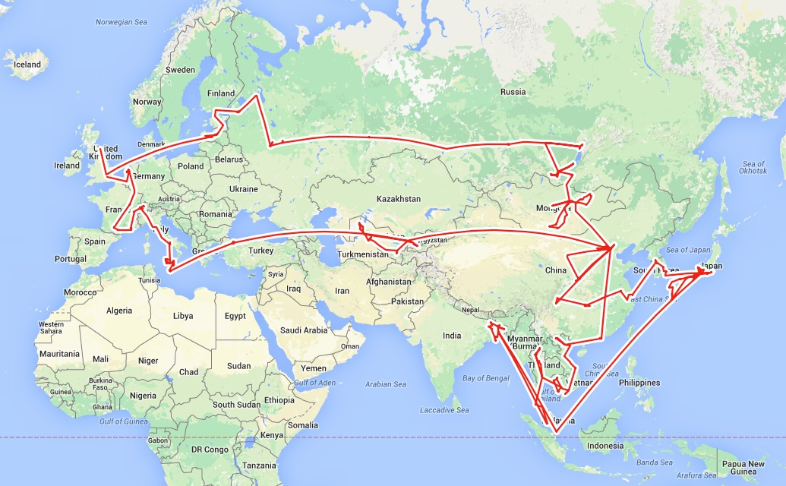
Routing

Slide 43
Google
google.com
Applications
Applications
User
Socket
Transport
Kernel
Transport
Demultiplexing
Reliability
Congestion control
Network
Network
Link layer
Link layer

Slide 44
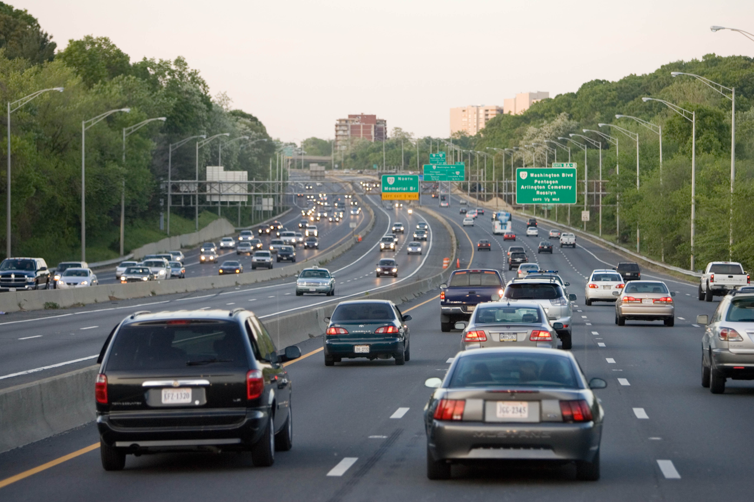
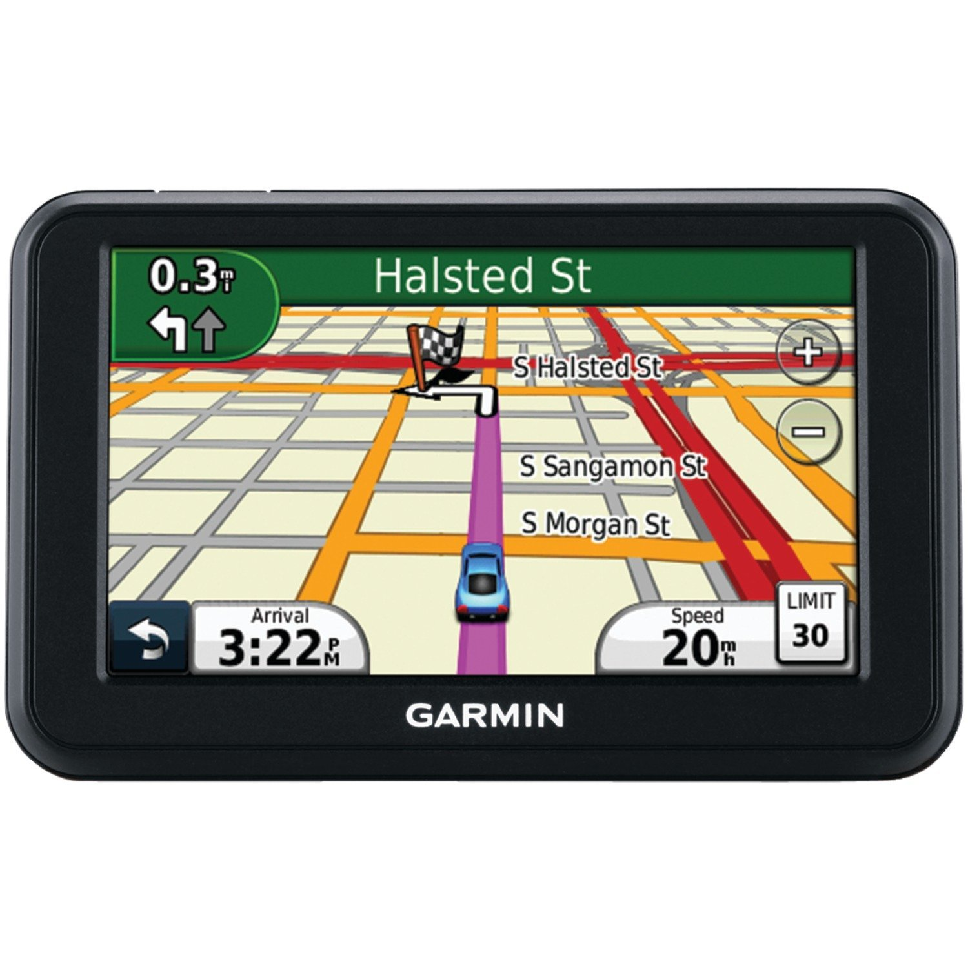
Two key network-layer functions
Forwarding: move packets from router’s input to appropriate router output
Routing: determine route taken by packets from source to destination
  routing algorithms
The network layer solves the routing problem.
Analogy: taking a road trip
Forwarding: process of getting through single exit
Routing: process of planning trip from source to destination
network
layer
runs
everywhere

Slide 45
Control/Data Planes
Data plane = Forwarding
local, per-router function
determines how datagram arriving on router input port is forwarded to router output port
Control plane = Routing
network-wide logic
determines how datagram is routed along end-to-end path from source to destination endpoint
two control-plane approaches:
  Distributed routing algorithm running on each router
  Centralized routing algorithm running on a (logically) centralized machine
values in arriving
packet header
0111
1
3
2

Slide 46

Distributed routing
Control plane
Traditional routing protocols: per route-change processing
(~ a few tens of seconds)
Routing
Algorithm
control
plane
data
plane
Data plane
per-packet processing
(~ tens of nanoseconds)
0111
1
3
2
values in arriving
packet header, i.e, destination IP address

Slide 47


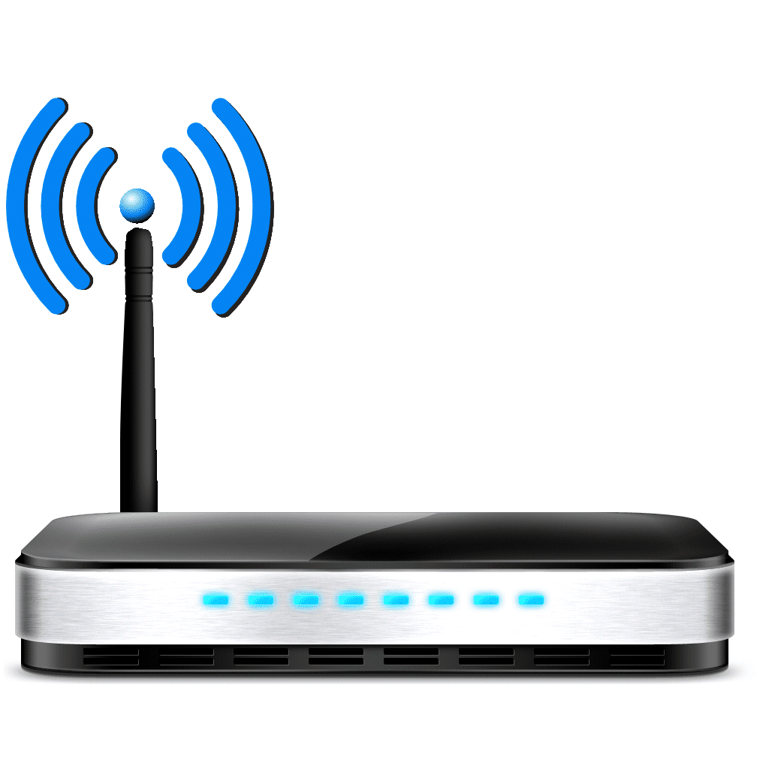

The Internet is a large federated network
AT&T
Comcast
Verizon

Slide 48
The Internet is a large federated network
Several autonomously run organizations (AS’es): No one “boss”
Organizations cooperate, but also compete
AT&T
Comcast
e.g., AT&T has little commercial interest in revealing its internal network structure to Verizon.
Verizon

Slide 49

The Internet is a large federated network
Several autonomously run organizations: No one “boss”
Organizations cooperate, but also compete
AT&T
Message exchanges must
not reveal internal network details.
Comcast
Verizon
Algorithm must work with “incomplete” information about its neighbors’ internal topology.

Slide 50
The Internet is a large federated network
Internet today: > 70,000 unique autonomous networks
Internet routers: > 800,000 forwarding table entries
AT&T
Keep messages & tables as small as possible. Don’t flood
Comcast
Verizon
Algorithm must be incremental: don’t recompute the whole table on every message exchanged.

Slide 51
Inter-domain Routing
The Internet uses Border Gateway Protocol (BGP)
All AS’es speak BGP. It is the glue that holds the Internet together
BGP is a path vector protocol
Routing protocols
Link state
protocols
Distance vector protocols
Path vector protocols
Messages?
Algorithm?
Applicable within a single AS

Slide 52
(1) BGP Messages
Loop detection is easy
(no “count to infinity”)
Exchange paths: path vector
Routing Announcements or Advertisements
  “I am here” or “I can reach here”
  Occur over a TCP connection (BGP session) between routers
Route announcement = destination + attributes
  Destination: IP prefix
Route Attributes:
  AS-level path
  Next hop
  Several others: origin, MED, community, etc.
An AS promises to use advertised path to reach destination
Only route changes are advertised after BGP session established
No link metrics, distances!
“I am here.”
Dst: 128.1.2.0/24
AS path: X
1b
“I can reach X”
Dst: 128.1.2.0/24
AS path: AS2, X
AS 2
1a
1c
2b
1d
2a
2c
X
2d

Slide 53
(2) BGP algorithm
A BGP router does not consider every routing advertisement it receives by default to make routing decisions!
  An import policy determines whether a route is even considered a candidate
Once imported, the router performs route selection
A BGP router does not propagate its chosen path to a destination to all other AS’es by default!
  An export policy determines whether a (chosen) path can be advertised to other AS’es and routers
Programmed by network operator
Business policy considerations drive BGP.
NOT efficiency considerations.

Slide 54
Policy arises from business relationships
Customer-provider relationships:
  E.g., Rutgers is a customer of AT&T
Peer-peer relationships:
  E.g., Verizon is a peer of AT&T
Business relationships depend on where connectivity occurs
  “Where”, also called a “point of presence” (PoP)
  e.g., customers at one PoP but peers at another
  Internet-eXchange Points (IXPs) are large PoPs where ISPs come together to connect with each other (often for free)

Slide 55
BGP Export Policy
legend:
provider
B
network
X
W
A
customer
C
network:
Y
Suppose an ISP only wants to route traffic to/from its customer networks (does not want to carry transit traffic between other ISPs)
A,B,C are provider networks
X,W,Y are customers (of provider networks)
X is dual-homed: attached to two networks
policy to enforce: X does not want to route from B to C via X
  So, X will not announce to B a route to C

Slide 56
BGP Export Policy
legend:
provider
B
network
X
W
A
customer
C
network:
Y
Suppose an ISP only wants to route traffic to/from its customer networks (does not want to carry transit traffic between other ISPs)
A announces path Aw to B and to C
B will not announce BAw to C:
  B gets no “revenue” for routing CBAw, since none of C, A, w are B’s customers
C will route CAw (not using B) to get to w

Slide 57
BGP Import Policy
legend:
provider
B
network
X
W
A
customer
C
network:
Y
Suppose an ISP wants to minimize costs by avoiding routing through its providers when possible.
Suppose C announces path Cy to x
Further, y announces a direct path (“y”) to x
Then x may choose not to import the path Cy to y since it has a peer path (“y”) towards y

Slide 58
Q2. BGP Route Selection
When a router imports more than one route to a destination IP prefix, it selects route based on:
  local preference value attribute (import policy decision -- set by network admin)
  shortest AS-PATH
  closest NEXT-HOP router
  Several additional criteria: You can read up on the full, complex, list of criteria, e.g., at https://www.cisco.com/c/en/us/support/docs/ip/border-gateway-protocol-bgp/13753-25.html

Slide 59
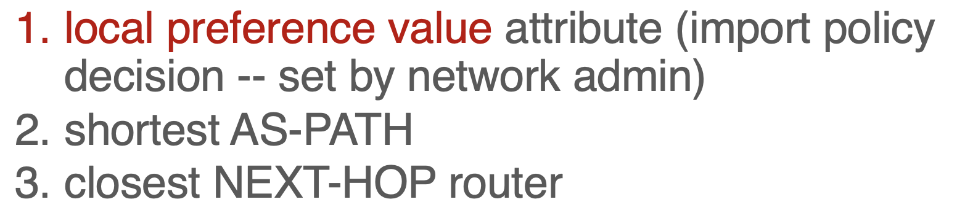
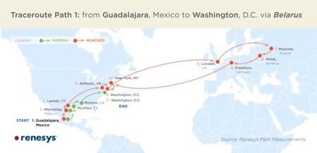
Problems with BGP
Not designed for efficiency
Only a single path per destination
Slow to converge after a change
Vulnerable to bugs & malice
Nothing to do with path length, delay, or available capacity.

