Slide 1
Network

Slide 2
Hardware Router overview
Input port
Output port
Input port
Switching fabric
Output port
…
…
Input port
Output port
Line Termination
Parsing
Lookup & Modification
Buffering & Scheduling
Line Termination
(Match-Action)
(Traffic Management)

Slide 3
Nonblocking designs are nontrivial
Two aspects: topology and routing

Slide 4
3-stage Clos network (r*n X r*n ports)
n X m
r X r
m X n
…
…
…
…
…
…
n X m
r X r
m X n
…
…
…
…
…
…
n X m
r X r
m X n
…
…
…
r switches n X m
m switches r X r
r switches m X n

Slide 5
Rearrangeably nonblocking Clos built with identical switches: n²Xn² using 3n nXn
n X n
n X n
n X n
…
…
…
VLB
…
…
…
n X n
n X n
n X n
…
…
…
…
…
…
n X n
n X n
n X n
…
…
…
n switches n X n
n switches n X n
n switches n X n

Slide 6
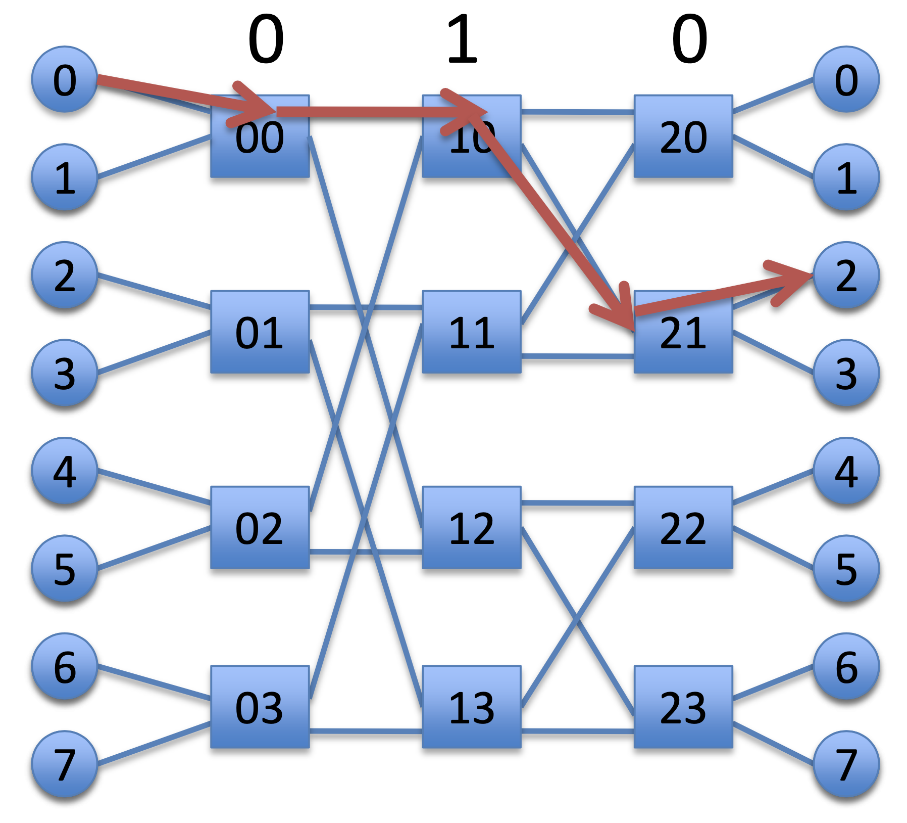
Increasing # ports: Butterfly Networks
Can we reduce internal # ports for a given external # ports?
K-ary L-butterfly:
Use L*K KxK port switches to build K^{L}XK^{L} port switch
Figure: K = 2, L = 3
Produce n³Xn³ switch from 3n nXn switches
Clos: n²Xn²
Routing is deterministic
Tradeoff: more blocking
https://ece757.ece.wisc.edu/lect09-interconnects-2-topology.pdf

Slide 7
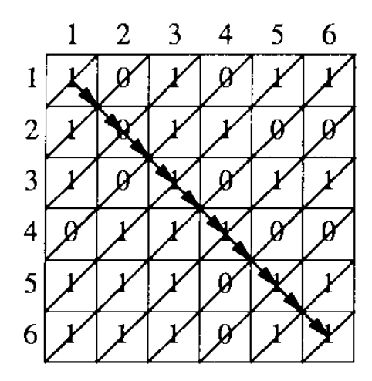
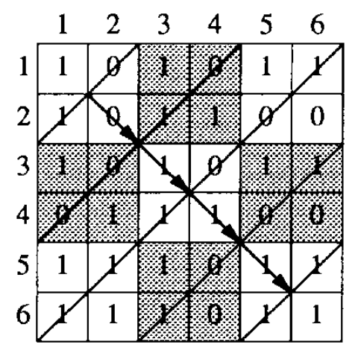
(4) MGR: Crossbars & Matching
MGR uses a nonblocking crossbar across 15 ports
Strategies to match incoming demands & output ports quickly
Greedy (simple), wavefront, group
Try to address fairness across ports

Slide 8
(4) RMT: Memory switching fabric
RMT uses memory as the fabric to hold packet headers and payloads between any two interfaces
Key challenge: simultaneous access to memory (N memory ports)
In the late 90s and early 2000s, there was considerable research on building high-speed packet buffers
Today: shared memory switches & routers (shared ➔ across ports)
Fast memory can be clocked at 1 GHz
Fundamental tradeoff: faster memories are not very dense
Can’t make the memory too large; can’t hold too any packets
Workaround: exploit memory access patterns: e.g., each queue is FIFO
Traffic manager implements scheduling & buffer management

Slide 9
(5) Traffic Manager
Where should the packets not currently serviced wait?
Two designs: Input-queued vs. output-queued
Output queueing avoids HOL blocking exhibited by input queueing.
Suppose port 1 wants to send to both 2 and 3 but port 2 busy
Packets from p1 towards p3 need not be delayed

Slide 10
(5) Traffic Manager
Queueing represents output port contention
A single output port can be represented by multiple queues
e.g., to implement weighted fair queueing
Each queue is just a linked list in the shared memory
Maximum flexibility in queue sizes, but pointer overhead
Separate memory to maintain per-queue heads and tails

Slide 11
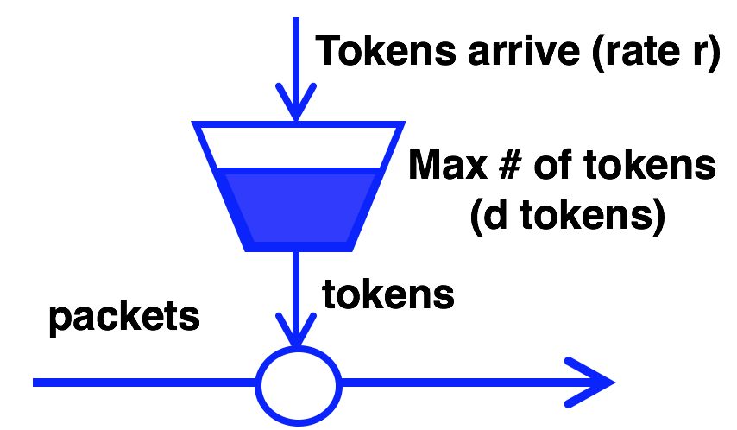
(5) Traffic Manager: Scheduling policies
How to dequeue packets in output port buffer? packet scheduling algorithms
Fair queueing across ports or flows
Strict prioritization of some ports over others
Rate limiting per port
Possible to make it flexible: PIFOs

Slide 12
(5) Traffic Manager: Buffer Management
Q: how to enqueue packets into buffer?
If buffer is full, which packet should be dropped?
Typical buffer management: Tail-drop
Want fairness: if queue 1 has too many buffered pkts, don’t tail-drop q2
Share memory by partitioning (carving memory out) across queues
Want efficiency: if q1 has no pkts, q2 should be able to use (nearly) all buffer memory
One possibility: static thresholds for buffer occupancy per port
Can be made fair or efficient but not both

Slide 13
(5) Demand-aware buffer management
DT: “Dynamic Queue Length Thresholds for Shared-Memory Packet Switches”, Choudhury and Hahne
Compute a critical (dynamic) queue length threshold T
Port blocked from adding packets if

Slide 14
(6) Egress line termination
Combine headers with payload for transmission
Must incorporate effect of header modifications
Also called deparsing or serialization
Multicast: egress-specific packet processing
Ex: different source MAC address for each output port
Multicast makes almost everything inside the switch (interconnect, lookups, queueing) more complex

Slide 15
Note: three kinds of router hardware data plane programmability
Packet header formats, i.e., the packet parser
Example: Go from IPv4 -> IPv6
Custom packet format to carry financial info at high speed on a point-to-point link
Table formats, actions, sizes, i.e., the match-action tables
Change which fields in the packet can be processed by a table
Control the table sizes, i.e., # entries, and hence the memory resource footprint according to use case.

Slide 16
Note: three kinds of router hardware data plane programmability
Packet scheduling, i.e., the traffic manager
Flexible classification of packets
Flexible assignment of ordering and timing of when packets are transmitted from an outgoing link

Slide 17
… which is distinct from control plane programmability
The control plane must compute the packet-processing rules put into the memory on the router ASIC
Example: packet with IPv4 destination 10.0.0.1 must go out of port 4
Data plane programmability refers to the flexibility in the allowed set of packet headers, tables, and actions themselves, not the actual rules.
Example: There is a table that matches on IPv4 destination addr whose action is to determine the output port

Slide 18
Software Data Plane

Slide 19
Why software?
Applications run in software. Get packets to/from apps quickly
Software routers:
virtualization and cloud (e.g., openvSwitch)
Middleboxes (network functions)
Network Address Translation, mobile processing nodes (packet gateways, radio controllers, …), tunneling gateways (IPsec/SSL VPN), traffic analysis & security (IDS, firewalls, spam), CDNs/caches, video accelerators, …

Slide 20
Packet processing on Linux
Receive path

Slide 21
How is data received in software?
Have CPU poll the network interface card (NIC) memory to copy data
Interrupt from the NIC (“data is available”), then CPU reads memory
Direct Memory Access (DMA): NIC moves data to memory
Reduce or remove CPU from the “data moving” loop
Large data or scattered data

Slide 22
Modern NICs and architectures can also do direct cache access (DCA)
Notes:
Source: https://blog.packagecloud.io/eng/2016/10/11/monitoring-tuning-linux-networking-stack-receiving-data-illustrated/

Slide 23
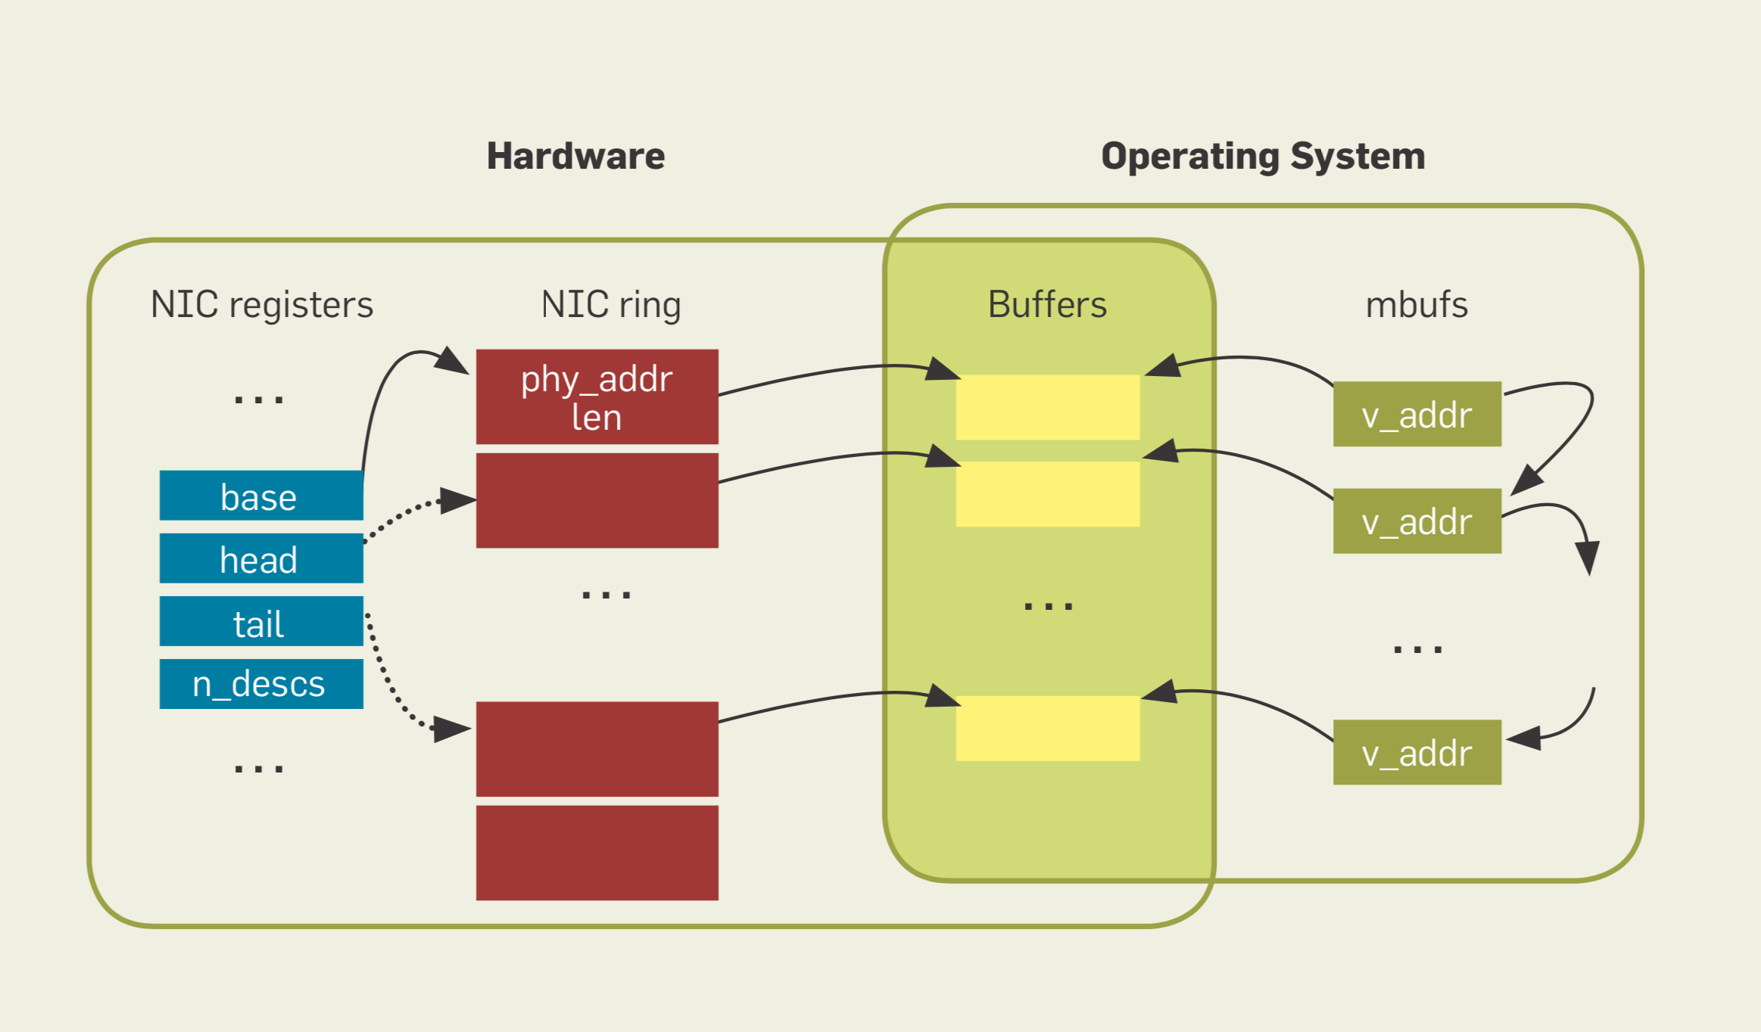
Revisiting network I/O APIs: The netmap framework. CACM’12
Notes:
Source: Revisiting network i/o aPis: The netmap framework. Communications of the ACM 2012

Slide 24
Interrupt mitigation
Interrupt processing at high rate and priority prevents any other part of the system from progressing (receive livelock).
Mitigations:
(1) Interrupt coalescing:
Wait (at NIC) for more packets or a timeout until interrupting
(2) Polling to schedule the work, avoiding preemption
(3) CPU or packet quotas on polling to ensure other parts of the system (e.g. user space app) can progress
Re-enable interrupts if there is less work than allotted quota

Slide 25
RSS
aRFS
Allocate packet data structures in memory (sk_buff, mbufs, …)
Optionally, steer packet to core running the application
Notes:
Source: https://blog.packagecloud.io/eng/2016/10/11/monitoring-tuning-linux-networking-stack-receiving-data-illustrated/
Linux kernel 3.13. Things have changed a bit since 4.15 with Edward Cree’s batching patch set. https://lwn.net/Articles/763056/

