Slide 1

Network

Slide 2
Life of a packet in a hardware router
Input port
Output port
Input port
Switching fabric
Output port
…
…
Input port
Output port
Line Termination
Parsing
Lookup & Modification
Buffering & Scheduling
Line Termination
(Match-Action)
(Traffic Management)

Slide 3
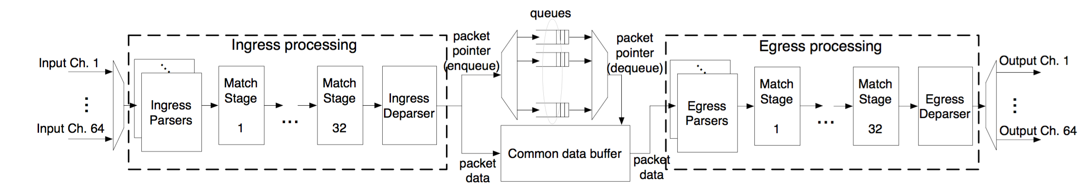
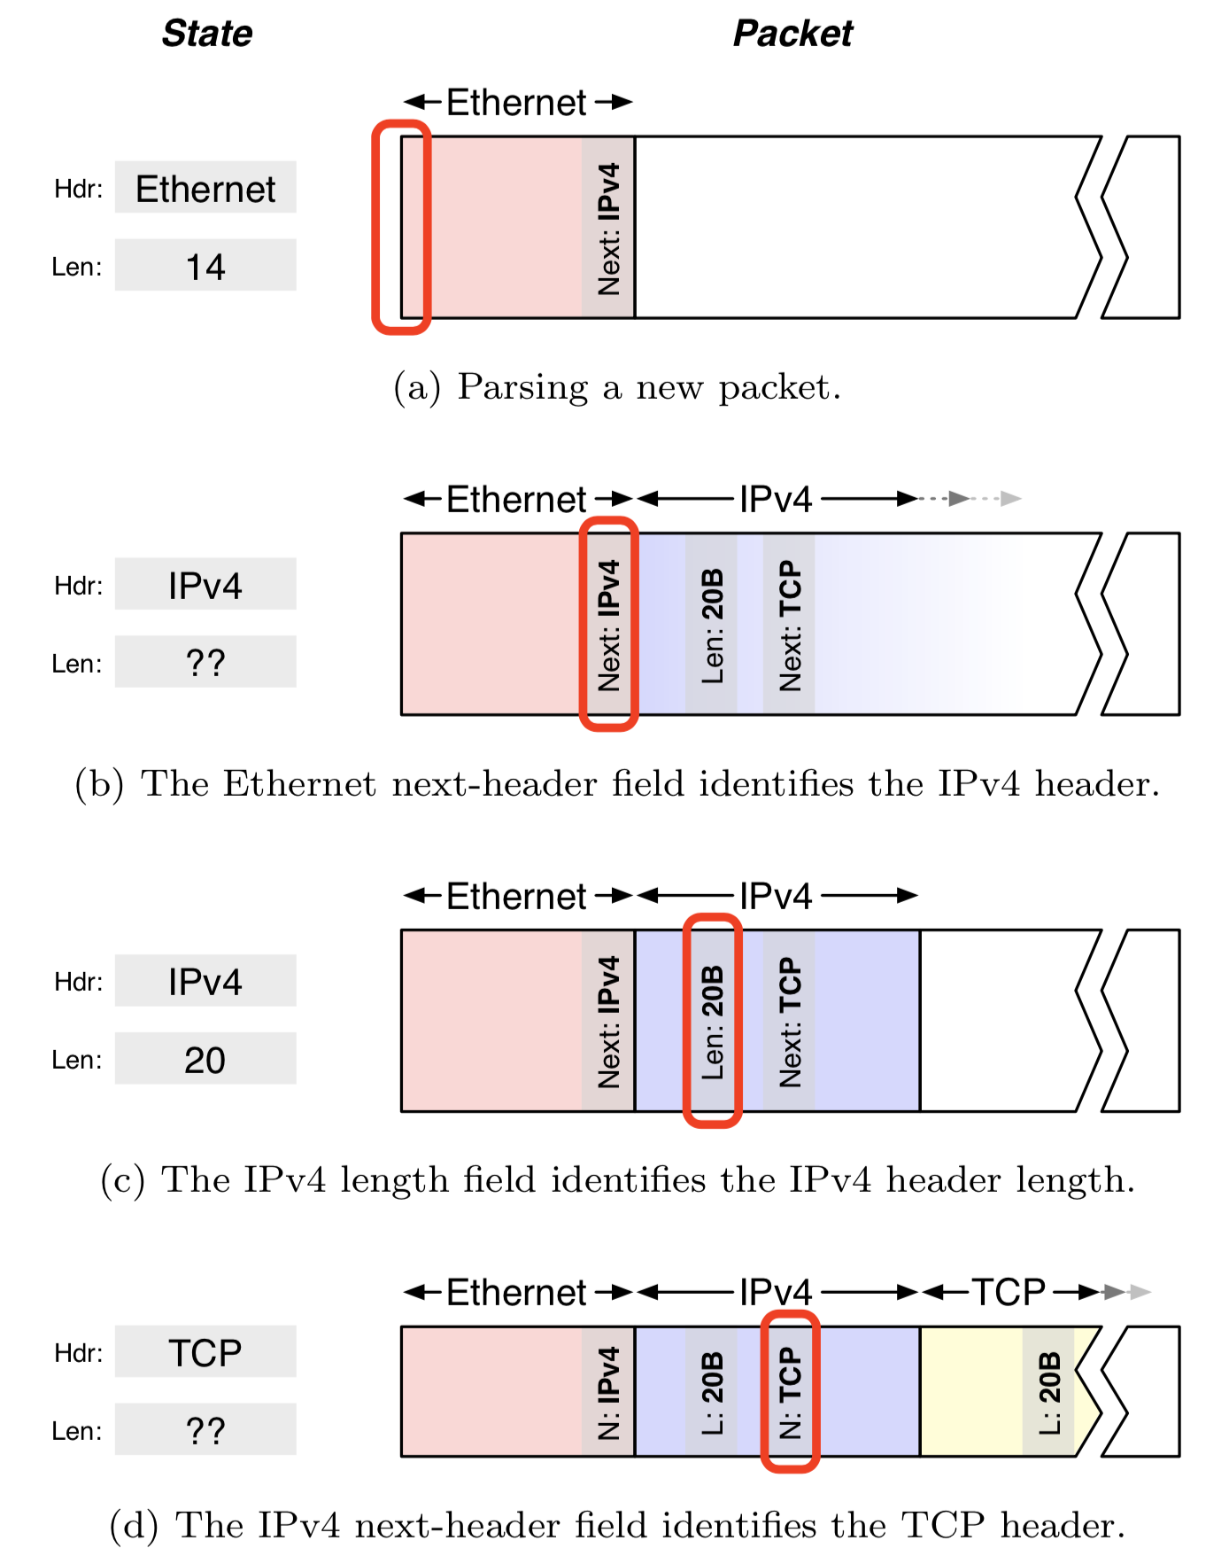
Pipelined Parallelism
“SRAM port”
SRAM bank
address
Packet
Header
Vector
data row

Slide 4
RMT: Match-Action Table memory design
Match and Action units supplied with the Packet Header Vector
Each stage accesses its own memory containing tables
RMT uses a crossbar to pick PHV fields for matching against contents of SRAM/TCAM banks
  Flexible key generation for lookup
Distinction from fixed-function:
  User-programmed fields stored in table
  PHVs include user-programmed fields
  Table match keys chosen by users
PHV
+
xbar
Mem banks

Slide 5
RMT: Match-Action Table memory design
Entry looked up in the memory (SRAM/TCAM) contains a pointer to the instruction (action) for that entry
Instructions implemented through programmable ALUs
  More general ALUs than fixed-function hardware devices
Feasible since compute components “cheap” inside a router
VLIW: operate on multiple headers simultaneously
Entry also contains pointers to:
  Action data (e.g., output port),
  statistics (counters), if needed
ALUs
PHV

Slide 6
Achieving reconfigurable match-action
Separately configurable and addressable memory blocks is the key to using tables flexibly. Independent block level access
L2
PHV
L2
L2
L2
L2
L2
VS.
T1
T1
T2
T3
Cost: 14% extra area (& power) for fatter wires
Fixed-function matching
Flexible match function
Each table in a match-action stage may use a different crossbar configuration to extract a different set of fields from the PHV
Different memory banks can contain entries for different tables (e.g., IPv4 matching, virtualization, …)

Slide 7
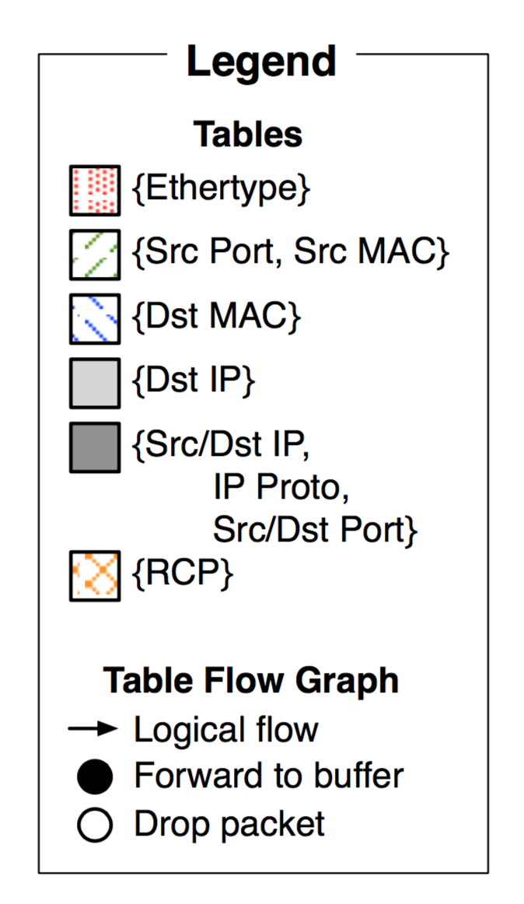
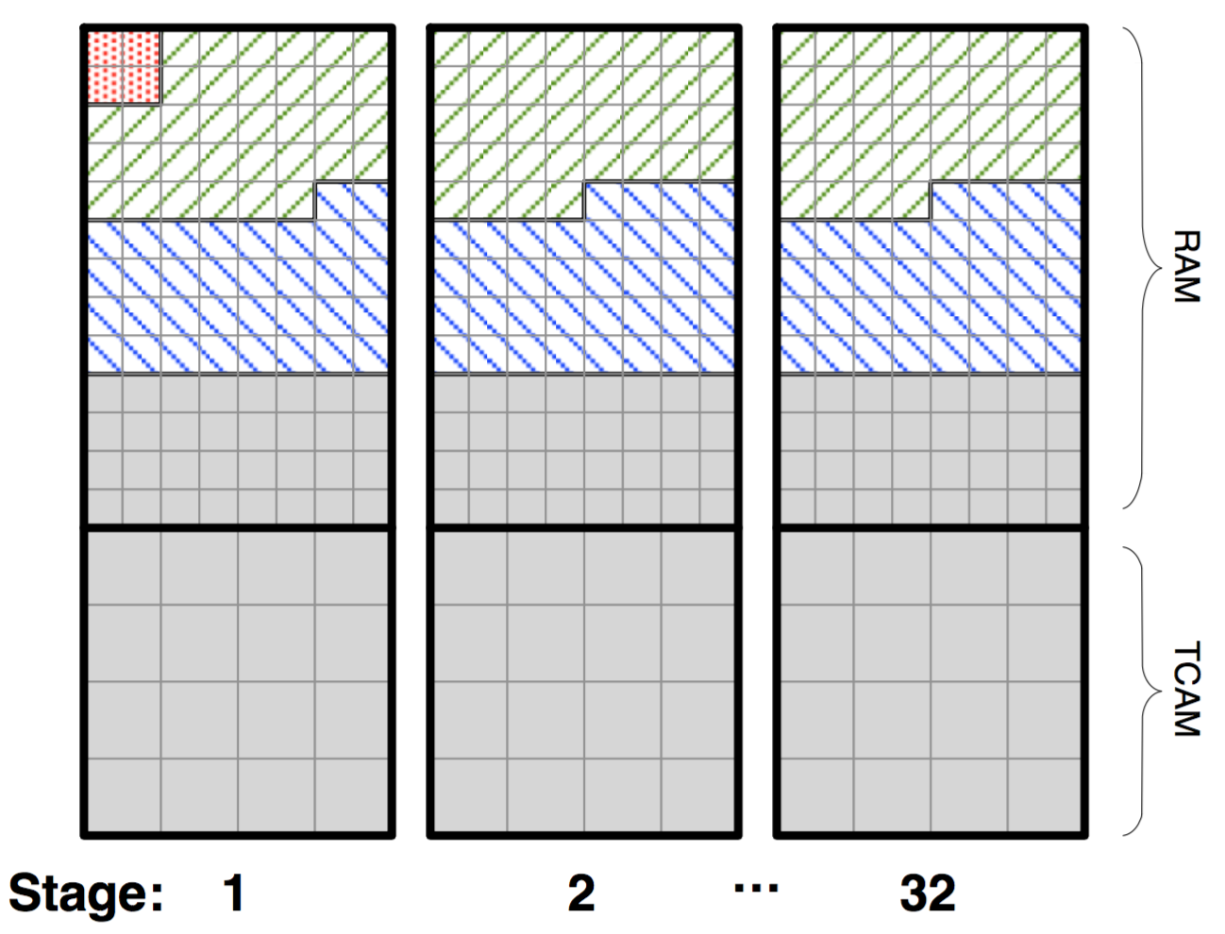
Memory layout and use matters
Flexible partitioning of memory across SRAM and TCAM
Fixed size memory blocks: internal fragmentation
Deterministic access times
  All of it is SRAM or TCAM
Interesting compiler concerns
  “Packing” tables
  Within & across pipeline stage

Slide 8

Who programs the rules? Control plane
Control plane
per route-change processing
(~ a few seconds)
Routing
Algorithm
control
plane
data
plane
Data plane
per-packet processing
(~ tens of nanoseconds)
0111
1
3
2
values in arriving
packet header

Slide 9
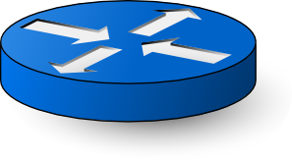
Distributed control planes
Control plane
Data plane
Control plane
Control plane
Data plane
Data plane
Control plane
Data plane

Slide 10
Software-defined network (SDN)
Logically-centralized control plane
Data plane
Data plane
Data plane
Data plane

Slide 11
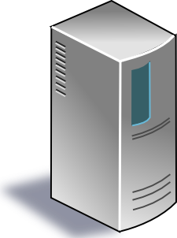
SDN (1/2): Centralized control plane
SDN controller
Control planes lifted from switches
into a logically centralized controller
Data plane
Data plane
Data plane
Data plane

Slide 12


SDN (2/2): Open interface to data plane
SDN controller
Data plane
Data plane
Data plane
Data plane

Slide 13
Packet after route lookup
What we have after lookup and modifications:
  One or more output ports, or a decision to drop
  packet headers, possibly modified from ingress
Goal: reconstitute the headers with payload and send the packet out of one or more output ports
Move the packet (header) to output through the switching fabric

Slide 14
Building a high-speed
switching fabric

Slide 15
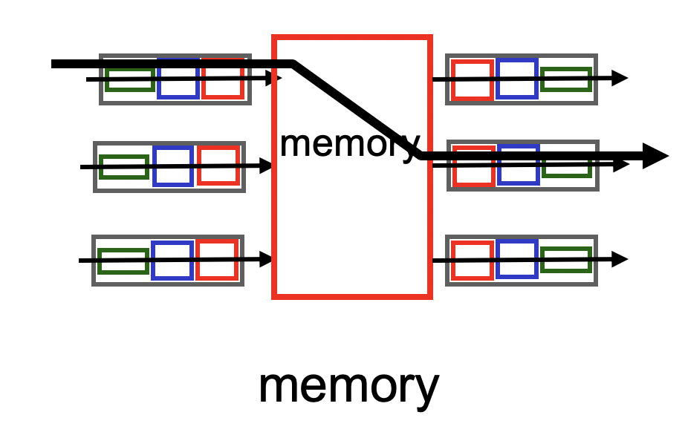
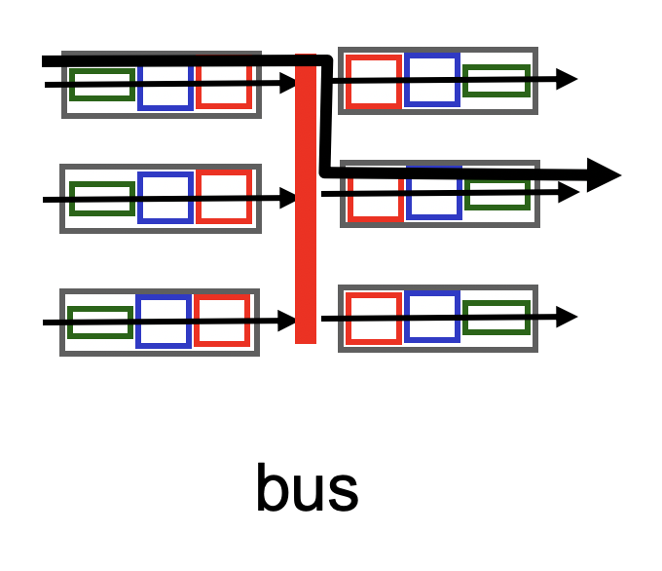
A single (n X m)-port switching fabric
Different designs of switching fabric possible
Assume n ingress ports and m egress ports, half duplex links

Slide 16
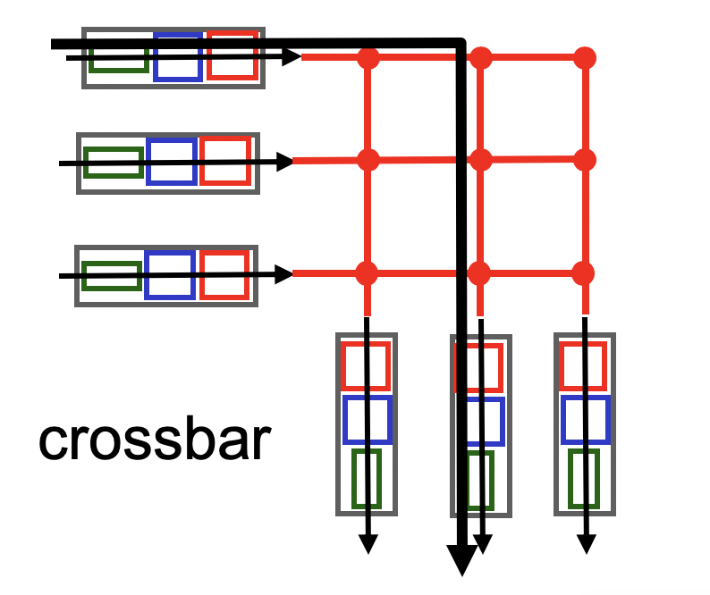
A single (n X m)-port switching fabric
Electrical/mechanical/electronic crossover
We want a design such that:
Any port can connect to any other directly if all other ports free
Nonblocking: if input port x and output port y are both free, they should be able to connect
  Regardless of other ports being connected.
  If not satisfied, switch is blocking.

Slide 17
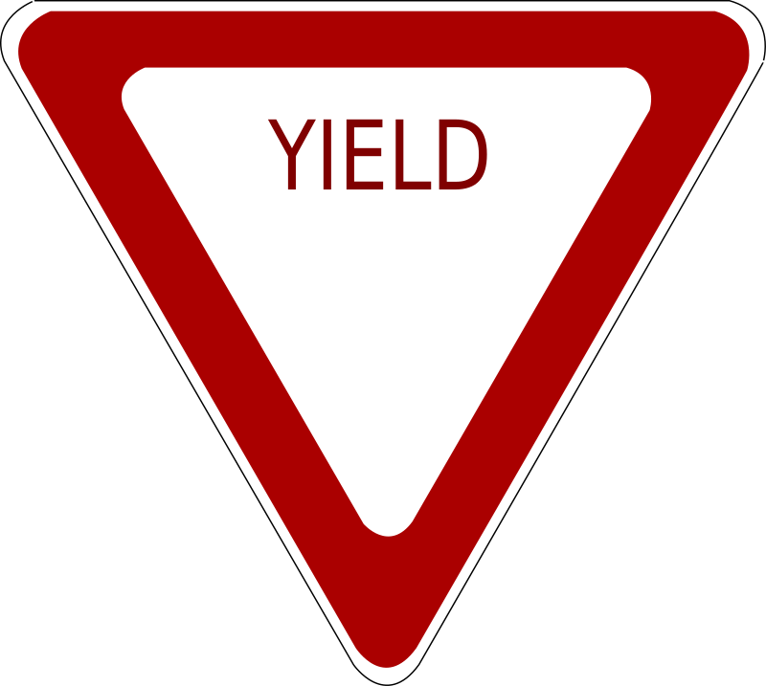
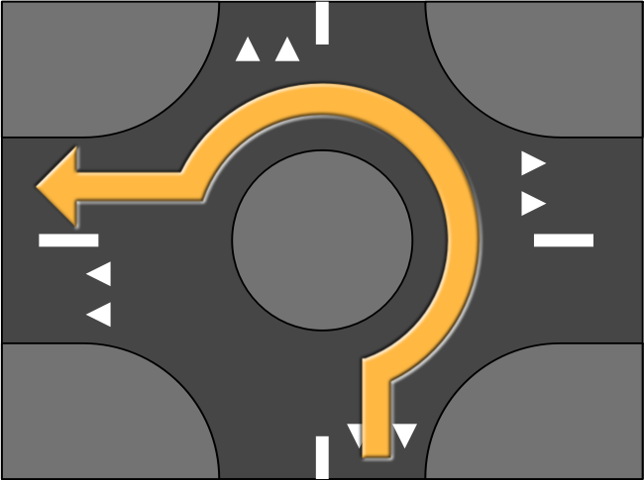




Nonblocking designs are nontrivial
Two aspects: topology and routing

Slide 18
High port density + nonblocking == hard!
Low-cost nonblocking crossbars are feasible for small # ports
However, it is costly to be nonblocking with many ports
If each crossover is as fast as each input port,
  Number of crossover points == n * m
  Cost grows quadratically on the number of input ports
Else, crossover must transition faster than the port
  … so that you can keep the number of crossovers small

Slide 19
Nonblocking switches with many ports
Key principle: Build a fast, nonblocking switch with many ports using many fast, nonblocking switches with a small number of ports.
How to build large nonblocking switches?
  The subject of interconnection networks
  https://en.wikipedia.org/wiki/Multistage_interconnection_networks

Slide 20
3-stage Clos network (r*n X r*n ports)
n X m
r X r
m X n
…
…
…
…
…
…
n X m
r X r
m X n
…
…
…
…
…
…
n X m
r X r
m X n
…
…
…
r switches n X m
m switches r X r
r switches m X n

Slide 21
How Clos networks become nonblocking
Adjacent layers of Clos are fully connected with each other
if m > 2n – 2, then the Clos network is strict-sense nonblocking
  Cost: you need more output ports than input ports
That is, any new demand between any pair of free (input, output) ports can be satisfied without re-routing any of the existing demands.

Slide 22
Need at most (n-1)+(n-1) middle stage
n X m
r X r
m X n
…
…
…
…
…
…
At most n-1 existing demands
n X m
r X r
m X n
…
…
…
…
…
…
n X m
r X r
m X n
…
…
…
r switches n X m
m switches r X r
r switches m X n

Slide 23
Surprising result about Clos networks
if m >= n, then the Clos network is rearrangeably nonblocking
Any new demand between a pair of free (input, output) ports can be satisfied by suitably re-arranging existing demands.
  Re-arranging == re-routing
It is easy to see that m >= n is necessary
  The surprising part is that m >= n is sufficient
  Intuition: matching in a fully connected bipartite graph

Slide 24
Rearrangeably nonblocking Clos built with identical switches: n²Xn² using 3n nXn
n X n
n X n
n X n
…
…
…
…
…
…
n X n
n X n
n X n
…
…
…
…
…
…
n X n
n X n
n X n
…
…
…
n switches n X n
n switches n X n
n switches n X n

Slide 25
What about re-routing?
How to rearrange existing demands when a new packet arrives, so that it can get across as quickly as possible?
Ideally, do it without “interference” to (i.e.: rerouting) other pkts
  In general, it is not possible. Packets must wait, adding to delays.
But, doable with high probability based on the input traffic workload: if packets are “randomly shuffled” across output ports
Valiant Load Balancing

Slide 26
Valiant Load Balancing (VLB)
Suppose you had many paths to get to a destination
Key idea: pick a random node to redirect a message to from the source, then follow a deterministically-chosen shortest path to the destination from there
Guarantee: With high probability, the message reaches its destination “very quickly” without blocking (log n steps in a n-hypercube)
Practically, this means close to zero queueing delays in switch
Randomized algorithms can be powerful.

Slide 27
VLB and Clos
VLB is more general than Clos
  It is a form of oblivious routing
  e.g., no need to measure traffic patterns before choosing routes
  Extremely simple to implement: no global state
VLB is handy in Clos topologies due to the numerous options to pick the intermediate layer switch
  Balance load across many paths
Very beneficial in practice
  “Performance isolation:” other port – port flows don’t matter
  High capacity (“bisection bandwidth”) between two ports

