Slide 1

Network

Slide 2



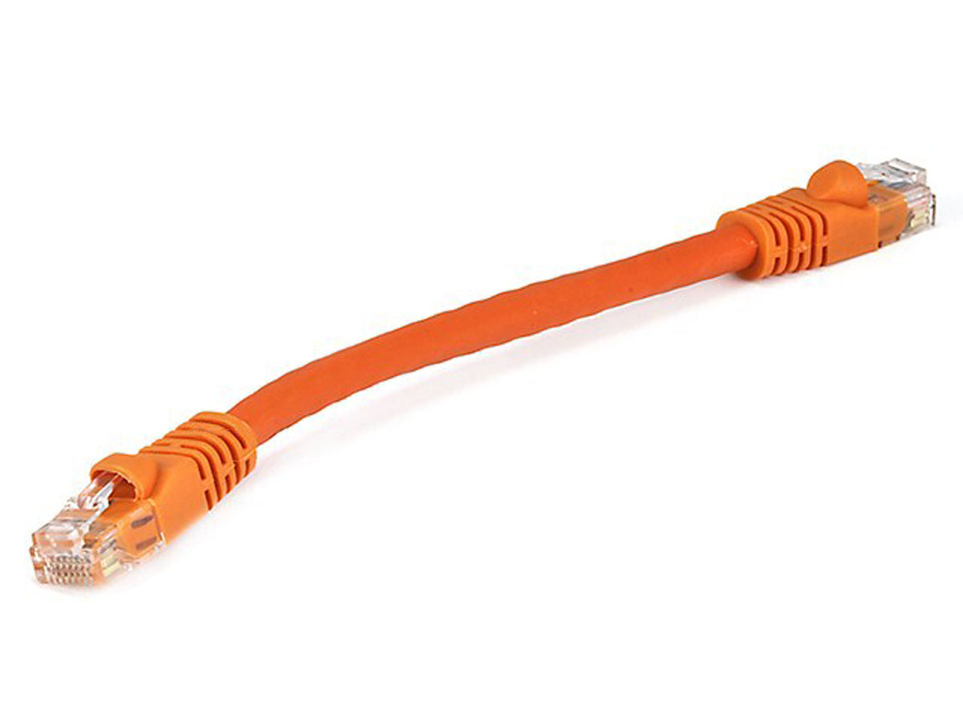
What’s in a router?
Queuing delay
Bottleneck queue
(max size B)
Link rate
Flows
Packet-switched core network

Slide 3

Control & Data Planes inside a router
Control plane
per route-change processing
(~ a few seconds)
Routing
Algorithm
control
plane
data
plane
Data plane
per-packet processing
(~ tens of nanoseconds)
0111
1
3
2
values in arriving
packet header

Slide 4
Hardware Router overview
Input port
Output port
Input port
Switching fabric
Output port
…
…
Input port
Output port
Line Termination
Parsing
Lookup & Modification
Buffering & Scheduling
Line Termination
(Match-Action)
(Traffic Management)

Slide 5
Study 2 designs
Historically evolving, multiple concurrent router designs
2 exemplars:
  MGR: router from the late 1990s (50Gbit/s router, Partridge et al)
  RMT: router from the late 2010s

Slide 6
Life of a Packet

Slide 7
(2) Packet parsing
Dividing a sentence into its grammatical parts:
  “I ate an apple”
  Sentence := Subject (I) Verb (ate) Object (an apple)
  Object:= Article (an) Noun (apple)
Packet parsing: dividing sequence of bits into header fields
  1100100101011
  ➔ ethernet destination (1100) | source (1001) | ethertype (01) | …
  Unlike parsing English, parsing packets is quite mechanical
  Series of extractions and branches to assign fields to packet bits
Parsing could be implemented in software (MGR) or hardware (RMT)

Slide 8
(2) Packet parsing
A key principle: Separate header and payload data paths
  Router functionality is “header-heavy” but “payload-light”
  Don’t move the payload around too much
  Conserve bandwidth & resources for data moved inside the router
Header goes on as input to route lookup/packet modification
Payload sits on a buffer until router knows what to do with pkt
  Buffer could be on the ingress line card (MGR) or a buffer shared between line cards (RMT)

Slide 9
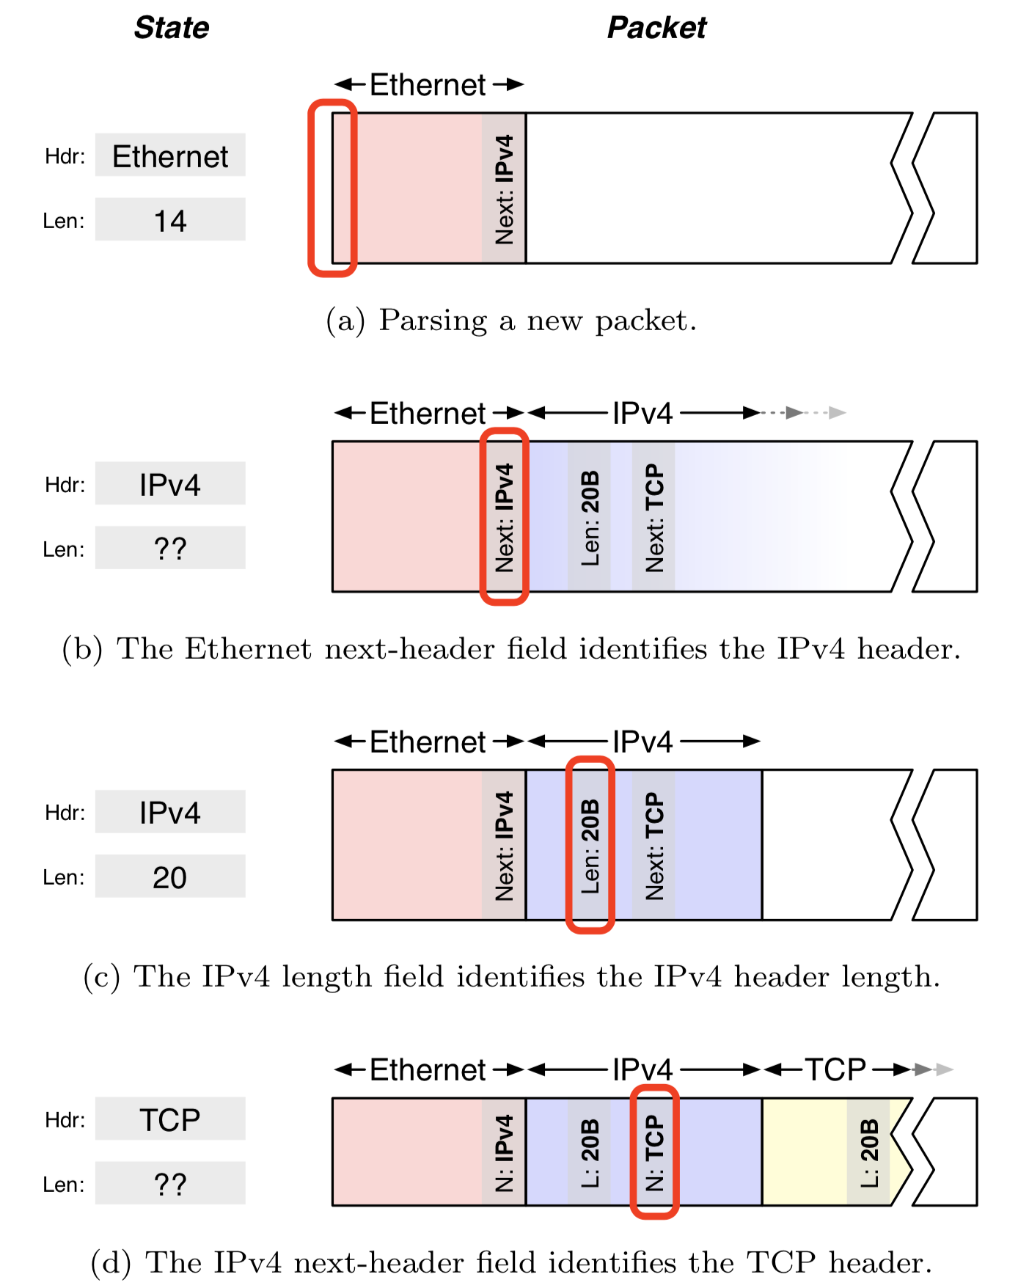
Parsing state machine
Parsing is an inherently sequential process
Previous header determines the next header type
Current header length determines the start of the next header
Parser state: tracks the current header and its length
  Help jump to the next state
Source: Design principles for packet parsers, Gibb et al.

Slide 10
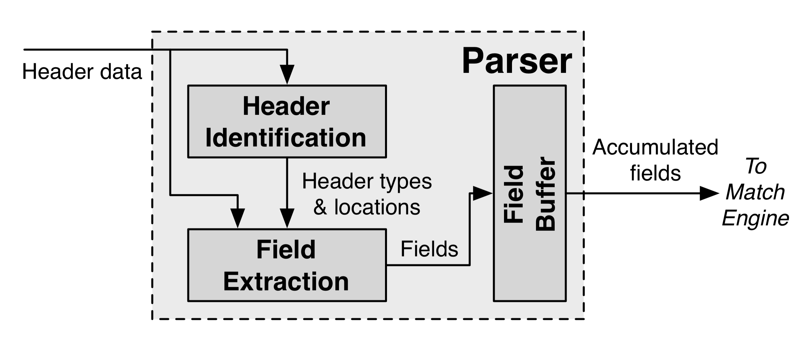
A hardware (fixed function) parser
Two steps:
Header identification: Identify sequence of headers
Extract fields from identified headers to send to matching components of tables
Design digital circuits with a high clock rate?

Slide 11
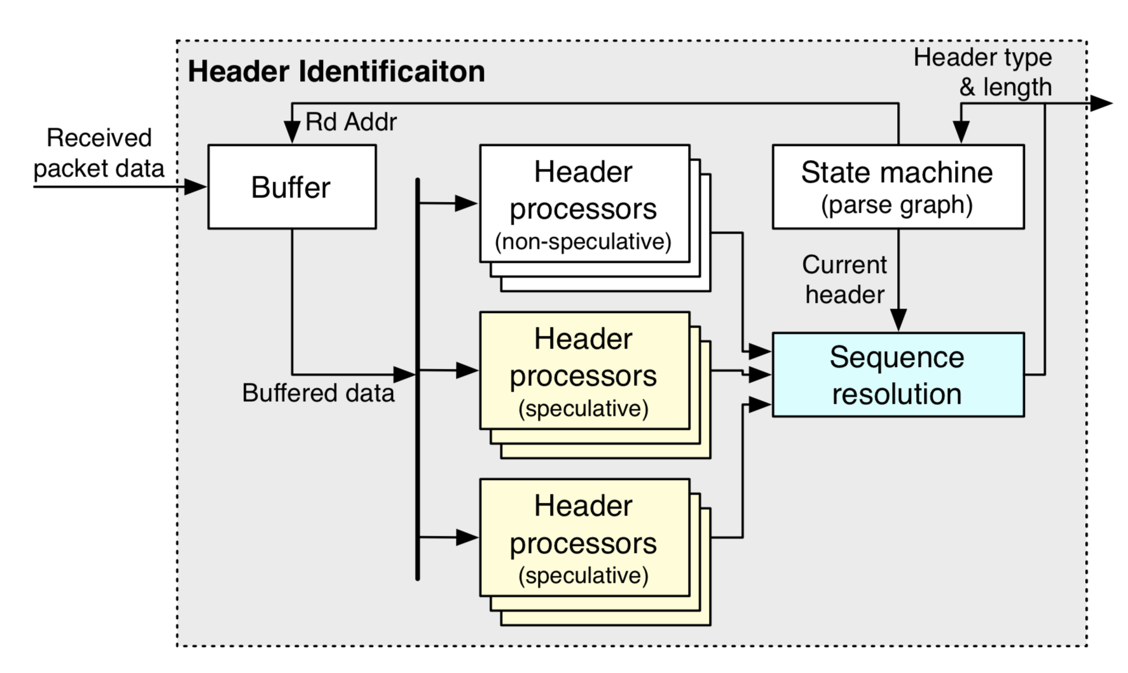
(Fixed function) header identification
Identify headers through fixed-function header processors
Simple design: extract one header per clock cycle
Speculate to extract multiple headers/cycle
Sequence resolution picks one

Slide 12
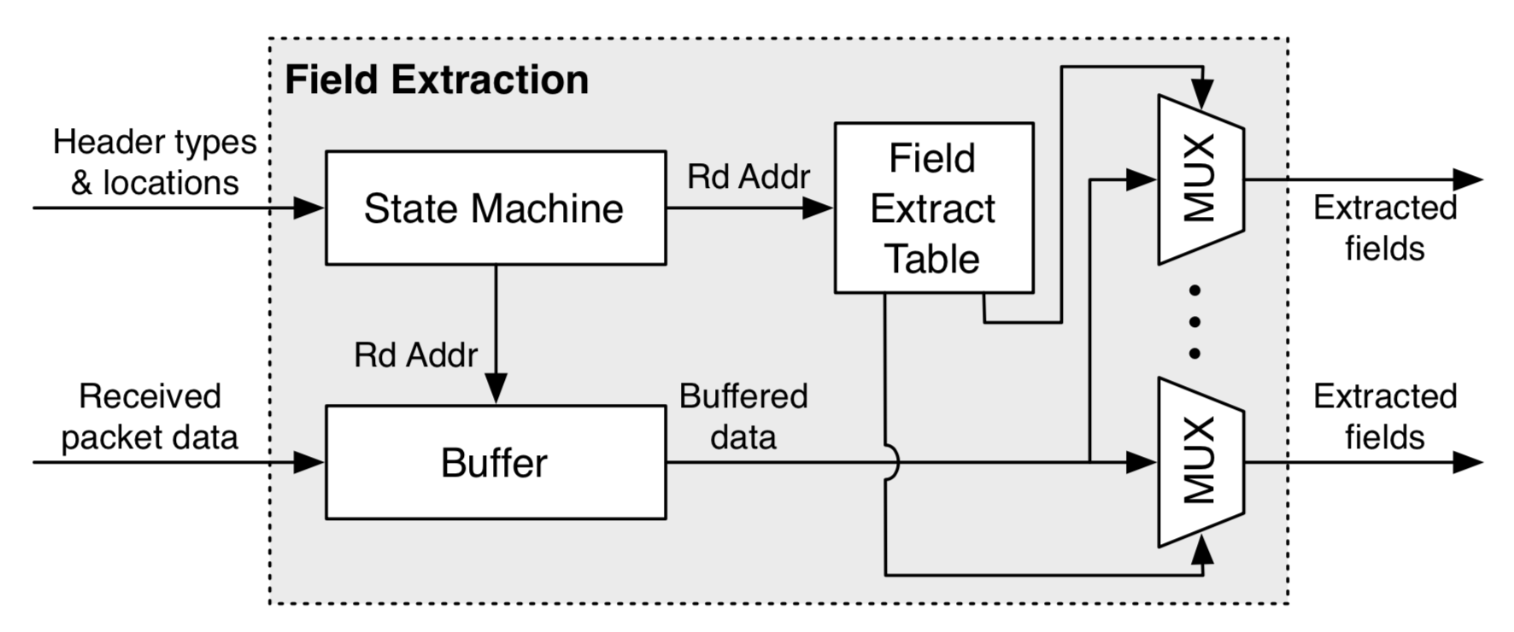
(Fixed function) field extraction
Extract fields using fixed offsets into the packet, depending on parser state
Field-extraction table is hard-coded for specific fields and protocols
  E.g., IPv4 length: always at bytes 3 & 4

Slide 13
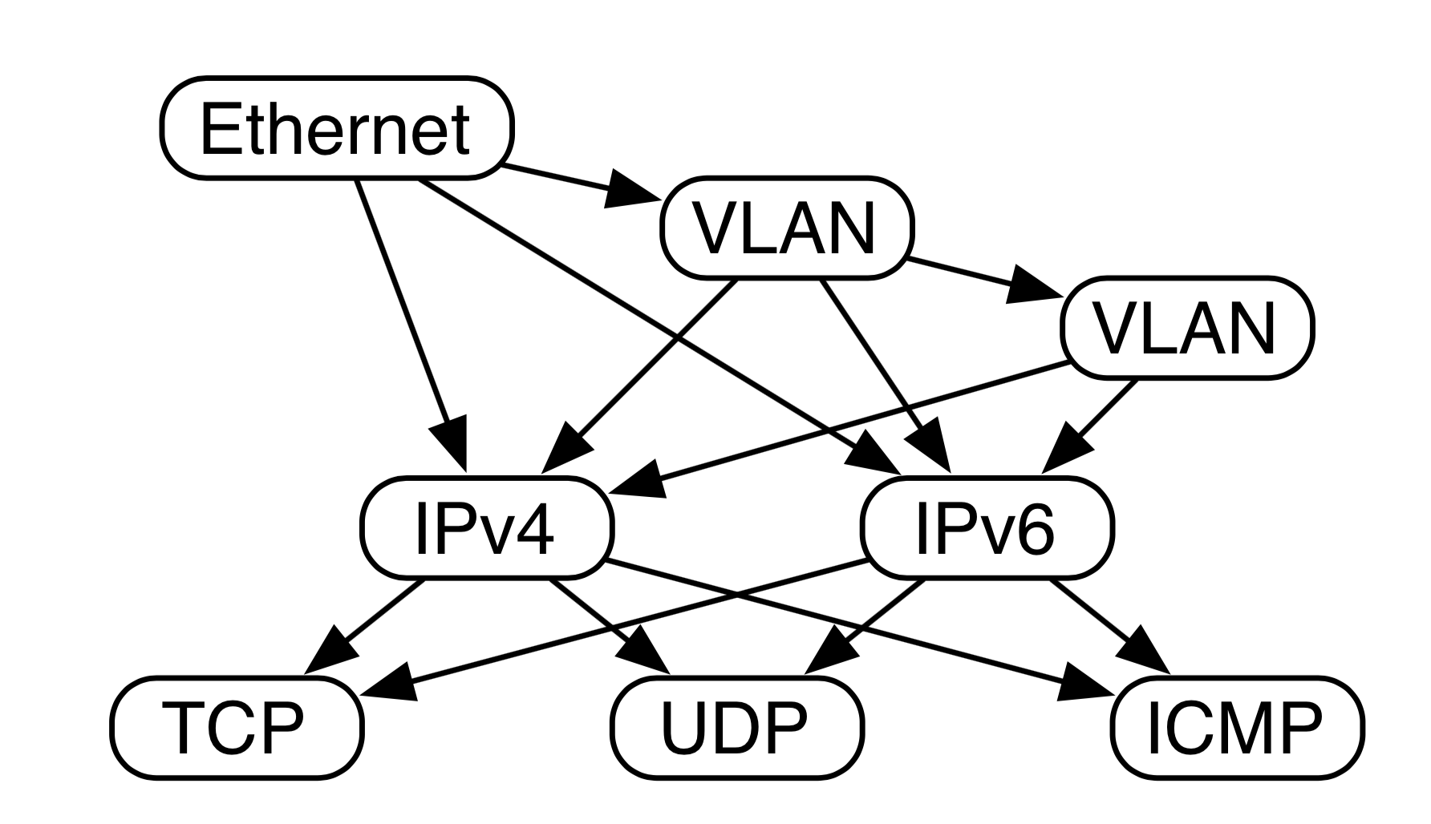
RMT makes parsing programmable
Parse graph: Representation of all valid header sequences you expect

Slide 14
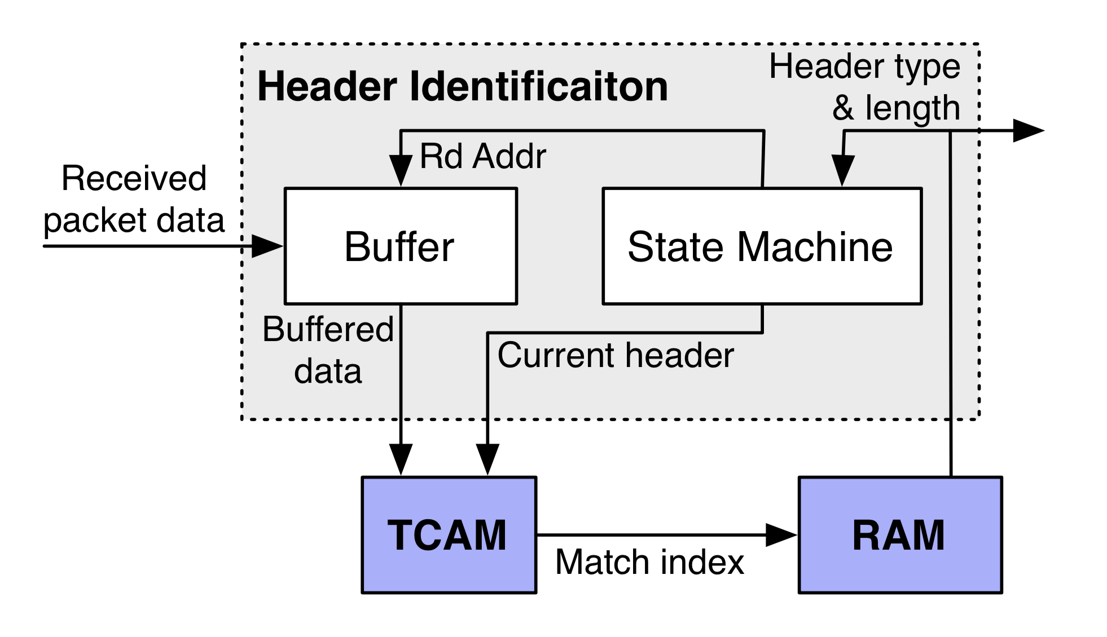
Programmable parser
Reprogrammable TCAM allows us to identify headers based on the protocol parse graph
Reprogrammable SRAM contains the protocol-dependent field extractions:
  e.g., IPv4, byte 8 → TTL, 12—15 → IPv4 source address, etc.
  Extracting the next header & length is a special case of generic field extractions for each protocol

Slide 15
Output of programmable parser
Vector of extracted packet fields and labels. Example:
  Ethernet -> src: 1010..; dst: 0101…; ethertype: IPv4
  IPv4 -> version: …; …
  … <other headers>
Termed the packet header vector (PHV)
Fed into the packet lookup and modification engines

Slide 16
(3) Packet Lookup & Modification
The main job of a router is to forward packets to the correct output port(s)
Typically done by looking up a table of entries that were pre-computed by the control plane
Look-up tables with a range of sizes (# entries), widths (headers)
Packets may also need to be modified
  RFC 1812 TTL decrement, recompute IP checksum, MAC rewrite, …
  Virtualized public cloud: encap/decap headers
Outcome: a (set of) output ports + (possibly modified) headers

Slide 17
Typical table structures
Sequence of tables: L2, L3, ACL
Ethernet (L2) headers to forward packets within one IP network
IP (L3) headers to forward packets across IP networks
Access control lists (ACL) to implement firewalls & other policies
Different kinds of lookups possible:
  Exact match
  Longest prefix match
  Wildcard match

Slide 18
Packet lookup in MGR
A forwarding engine card separate from line cards
  Scale forwarding and interface capacity separately
Software: Use Alpha 21164 (a 415MHz generic processor)
Programmed in assembly to do route lookup and other processing.
Many optimizations to improve performance
  Need for such optimizations continues today for software

Slide 19
MGR Software lookup performance
Separate fast path from slow path (optimize the common case)
  ARP lookup, fragmentation, error handling
Try to fit all code into the processor instruction cache
Heavily use caching for table entries across different memories in a hierarchy
  Traffic locality: a small fast memory can service “most” traffic
Two copies of table in external memory to support downtime-less updates to the forwarding table
However, can’t guarantee deterministic throughput for packets
  Packet might access slower memories in the memory hierarchy

Slide 20
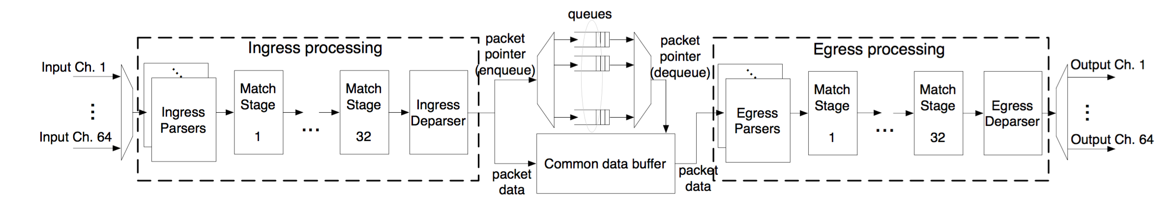
Packet lookup in RMT: Pipelined parallelism
Different functionalities (ex: L2, L3) in different table stages
Highly parallel over packets: admit 1 packet/cycle
Pipeline circuitry clocked at a high rate: ex: RMT@1 GHz
Deterministic throughput

Slide 21
Traditional pipelined hardware: fixed-function (Multiple Match-Action Tables)
L2 Table
IPv4 Table
IPv6 Table
ACL Table
L2 Hdr Actions
v4 Hdr Actions
v6 Hdr Actions
ACL Actions
Fixed Parser
Fixed Header Processing Pipeline

Slide 22
MMT isn’t enough!
Operators want new protocols and services
Virtualization and the cloud
  VMs have their own address space (e.g., 10.0.x.x)
  Physical networks route traffic using a different set of addresses (e.g., 128.6.x.x)
  Keep them separate so you can place VMs wherever you can
  Need: dedicated new packet headers to use for forwarding within the “core” fabric of the network
    E.g., VXLAN, NVGRE
Research experimentation and domain-specific headers
  E.g., finance; university campuses; network feedback signals

Slide 23
MMT isn’t enough!
Want to use table memory flexibly
  Different environments need tables of different shapes and sizes
Enterprises: ACL-heavy (“students can see information sent to other students from professors, but cannot see info from professors to printers”)
Tier-1 ISP like ATT: L3-heavy (~1 million Internet IPv4 prefixes)
Static table sizes don’t work well
  Can’t use another table’s memory, even if it is empty
  Heterogenous devices to support different scenarios: complexity
  Even device for a specific market may have insufficient resources

Slide 24
MMT isn’t enough!
All of this might be supported if switch hardware can be upgraded as often as software in general (e.g., on smartphone)
Unfortunately, the reality is very far from it:
Each device generation hardware upgrade: 3--5 years
  New ASIC design, verification, fabrication, testing
Even software upgrades take time:
  Features requested by other customers stand in the way of releasing new feature that one customer wants

Slide 25
RMT: Protocol Independent Switch Arch
Stages of Match-Action Tables
To egress pipeline
Memory
ALU
Programmable
Parser
(Gibb et al, ANCS’13)
Programmable Match-Action Pipeline
(RMT, SIGCOMM’13)
Programmable
scheduler
(PIFO, SIGCOMM’16)

Slide 26
A primer on high-speed memories
Computers have different kinds of memory
  Fastest caches (L1, L2, …) made of SRAM
  Fast main memory made of DRAM
  Storage (HDD) made of magnetic disks, tape, SSDs, and so on
  Translation Lookaside Buffer (TLB) with CAM/TCAM
Today’s high-speed routers use SRAM and TCAM
  Static Random Access Memory for exact match
  Ternary Content Addressable Memory for wildcard ACL match (also longest prefix match)

Slide 27
SRAM principles of operation
SRAM bank
Memory is organized into banks
Each bank can be independently accessed through an address
Data in the memory row at the address can be read/written each clock cycle
Banks of larger sizes are denser (fewer wires to run), but you can only read/write one data row per bank per clock cycle (reduced parallelism)
Looking up (ex: IPv4 dst) involves computing address(es) & reading mem
address
data row
address
address

Slide 28
TCAM principles of operation
TCAM bank
Banks are accessed using content, not addresses (CAM)
Contents of the memory are ternary: values can be 0, 1, or x (don’t care)
Incoming keys are matched against TCAM, with any bit accepted at the location of the wildcard bits
Ternary logic is power- and area-hungry relative to SRAM
0101
data row
0xx1
content
content

