Slide 1

Transport

Slide 2



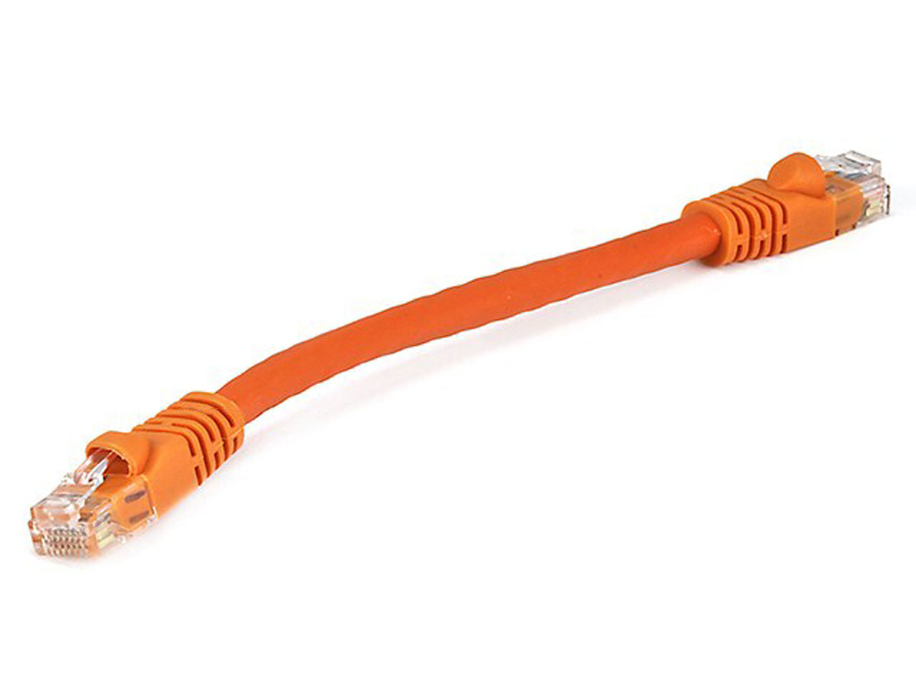
Packet scheduling
Queuing delay
Bottleneck queue
(max size B)
Link rate
Flows
Packet-switched core network

Slide 3
Packet Scheduling Algorithms
Which packet to send next? (order)
When to send the next packet? (timing)

Slide 4
Providing Isolation through Rate Limiting
Used to isolate flows from each other by giving each a fixed data rate through a link
Three commonly used terms:
(long term) average rate: how many pkts can be sent per unit time (in the long run)
  crucial question: what is the interval length? 100 packets per sec or 6000 packets per min have same average, but instantaneous behaviors can be very different
peak rate: e.g., 6000 pkts per min (ppm) avg.; 1500 ppm peak rate
(max.) burst size: max number of pkts sent consecutively (with no intervening idle)

Slide 5
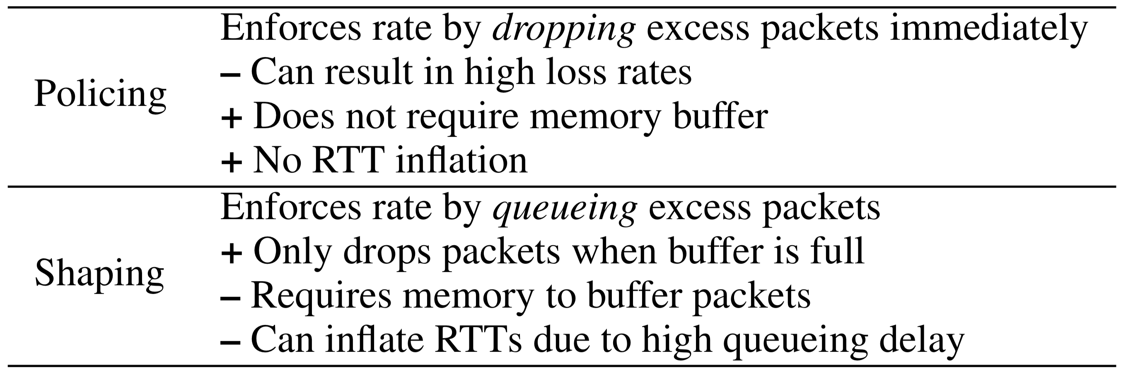
Shaping and Policing

Slide 6
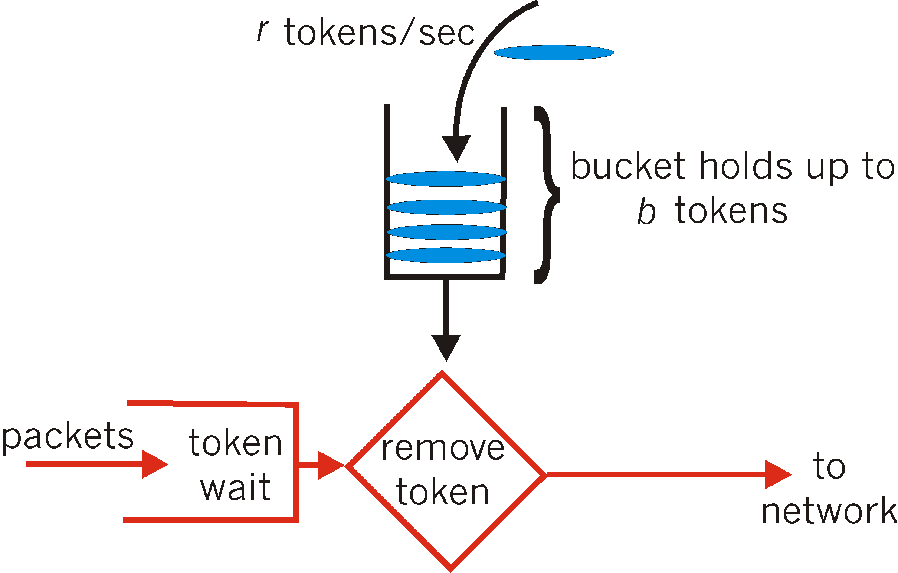
Token Bucket
token bucket: limit input flow to specified burst size and average rate
Tokens generated at rate r tokens/sec, put into bucket
Bucket can hold b tokens. Tokens are not added if bucket is full
A packet can be transmitted successfully if a token is available
  Packet “picks up” the token as it leaves the router
Over interval of time t:
number of packets that leave the token
bucket is less than or equal to (r * t + b)
Average rate r
Burst size b

Slide 7
Purpose of the bucket
Suppose each flow starts with a “full” bucket (b tokens)
Bucket of tokens enables small bursts to go through unscathed
Short flows (bursts) can exceed rate limit r, since they can use up the reserve in the bucket
Long flows will fit into the rate limit r over their lifetime, since they cannot exceed the average token-filling rate r after using up the reserve

Slide 8
Token Bucket Shaper vs. Policer
Shaper: there is a bucket for tokens and a packet buffer hold packets waiting for tokens
  Packets will be delayed if the buffer can hold the packet
  Dropped when the buffer is full
A token bucket policer doesn’t contain the packet buffer:
  a packet arriving while the bucket is empty is dropped right away

Slide 9
Token Buckets are simple to implement
Assume byte-based rates. Each time a packet from a flow arrives, refill tokens according to gap in time and bucket size
    tokens += r * time since last packet of flow
    tokens = min(tokens, b)
Need enough tokens to dequeue a packet: tokens >= pkt_size
When a packet departs, remove tokens: tokens -= pkt_size
Small per-flow state: r, b, timestamp, current # of tokens
  Used to build more complex metering like TR-TCM (RFC 2698)

Slide 10
The Internet uses token bucket policers at several bottleneck links.

Slide 11
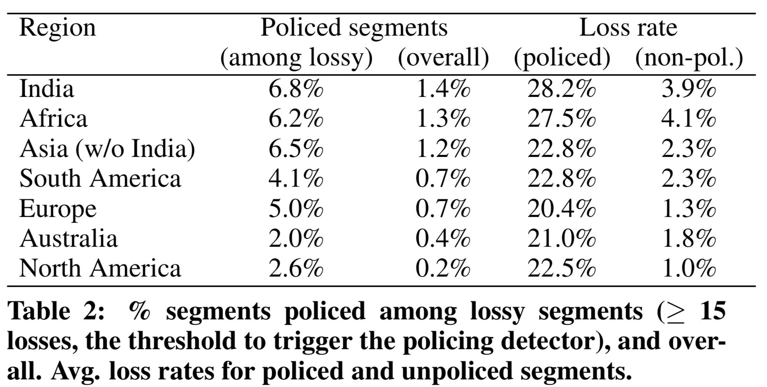
Impact of Token Bucket Policers
Flach et al., An Internet-Wide Analysis of Traffic Policing, SIGCOMM 2016

Slide 12
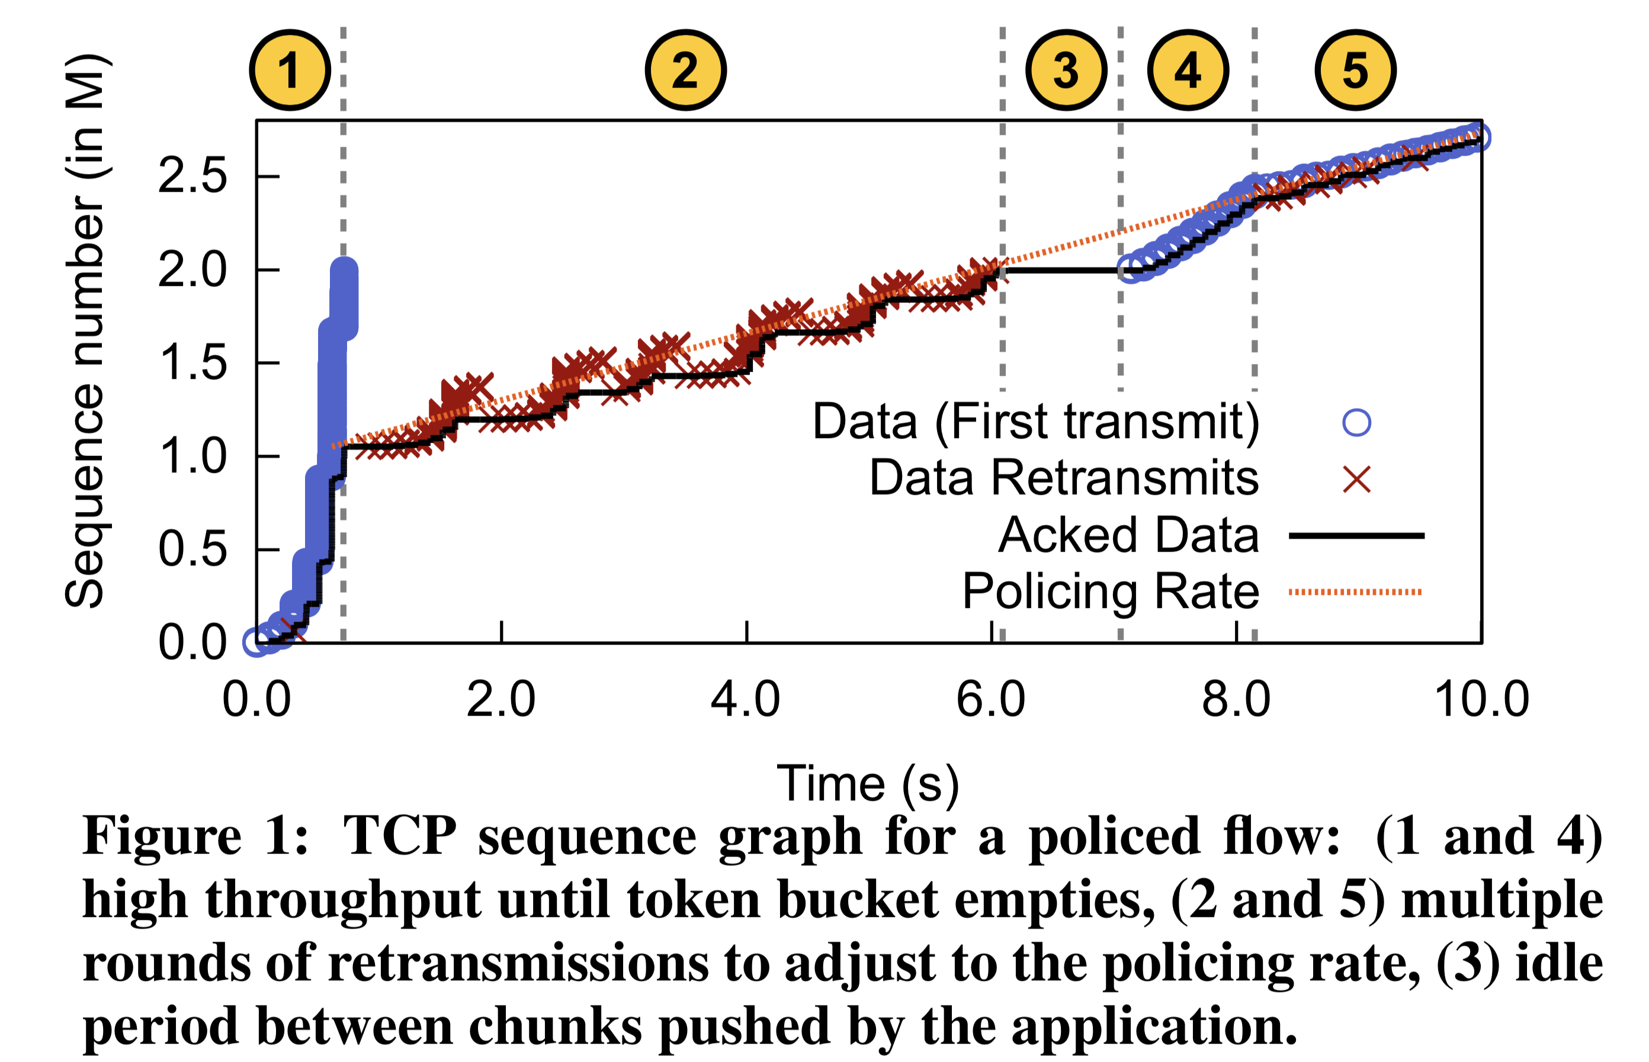
Impact on TCP

Slide 13
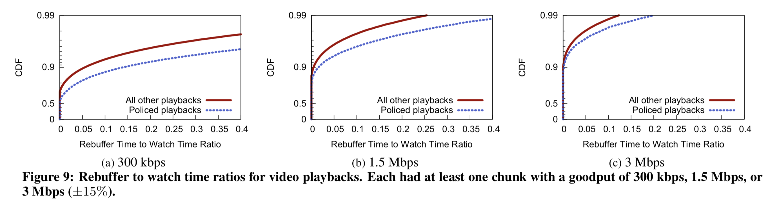
Policing losses impact applications
Video rebuffer rate: rebuffer time / overall watch time
Flach et al., An Internet-Wide Analysis of Traffic Policing, SIGCOMM 2016

Slide 14
Transport topics we didn’t consider
Multipath transport
Network utility maximization

Slide 15
Network Data Plane

Slide 16
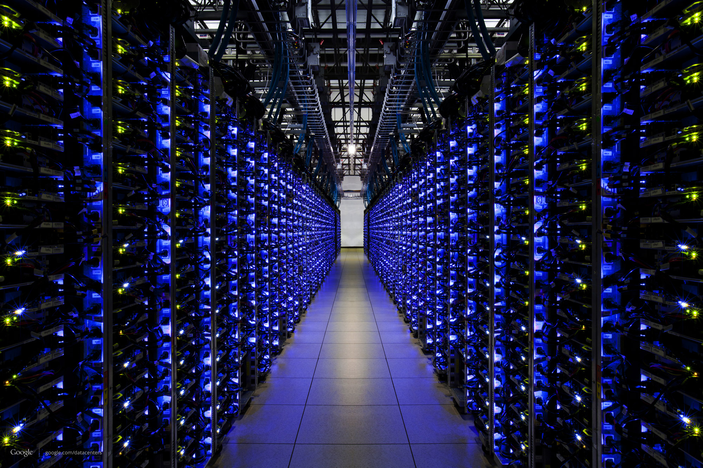


The Internet
Applications
Applications
Packet starts as an
app “payload”
Transport
Packet takes on headers (metadata) at each layer
Transport
Network
Network
Link layer
Link layer
The Internet

Slide 17
Applications
Applications
Transport
Transport
Network
Network
Network
Network
Link layer
Link layer
Link layer
Link layer

Slide 18

Control & Data Planes inside a router
Traditionally, Distributed Control:
Individual routing algorithm components in every router interact in the control plane
Control plane
per route-change processing
(~ a few seconds)
Routing
Algorithm
control
plane
data
plane
Data plane
per-packet processing
(~ tens of nanoseconds)
0111
1
3
2
values in arriving
packet header

Slide 19
Router Design: Requirements

Slide 20
1. Speed: move packets quickly
(1) Inherently
parallel workload; speed up through hardware parallelism
(2) Physical communication technologies (e.g., optical) not bound by semiconductor speed

Slide 21

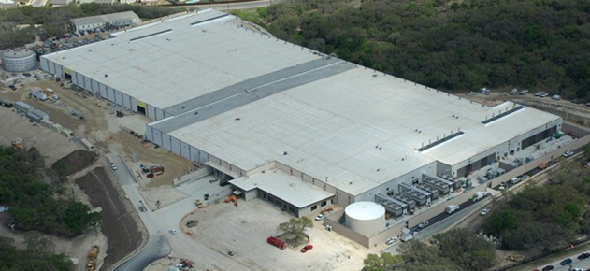


2. High port density, low power & area
INTERNET
Fabric
Servers

Slide 22
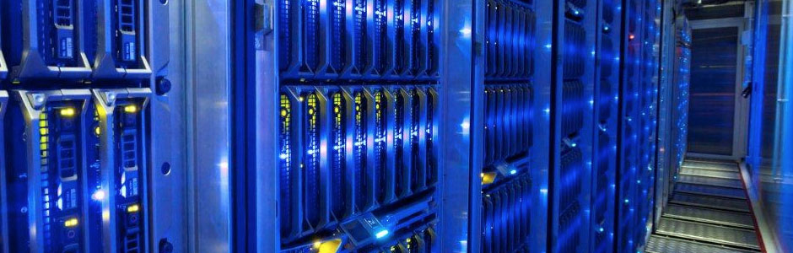
3. Make routers follow top-level intent
Cloud era: special challenges
  Scale: don’t want to configure manually
  Multiple kinds of addressing
  Telemetry
Expressiveness:
  Routing with global/centralized goals
  Functions beyond simple forwarding:
    access control, in-network computing, perf debugging, …
  Scheduling policy
Focus on programmability and observability

Slide 23
3.5 Standard router specifications
RFC 1812: Forward pkts using a table lookup, but also …
Update TTL (time-to-live IP header field): ttl -= 1
Update IP checksum (TTL updated)
IP to link-layer translation across networks (e.g., ARP for dst)
Rewrite link layer source address
Special processing (IP options): source route, record route, …
Handle IPv4 packet fragmentation
Handle multicast packets
Maintain QoS assurances

Slide 24
What’s in a router?
Queuing delay
Bottleneck queue
(max size B)
Link rate
Flows
Packet-switched core network

Slide 25
Overview of router functionality
Historically evolving, multiple concurrent router designs
2 exemplars:
  MGR: router from the late 1990s (50Gbit/s router, Partridge et al)
  RMT: router from the late 2010s
Many things in common. Some functions implemented:
  Packet receive/transmit from/to physical interfaces
  Packet and header parsing
  Packet lookup and modification: ingress & egress processing
  High-speed switching fabric to connect interfaces
  Traffic management: Scheduling & Buffer Management

Slide 26
Life of a Packet

Slide 27
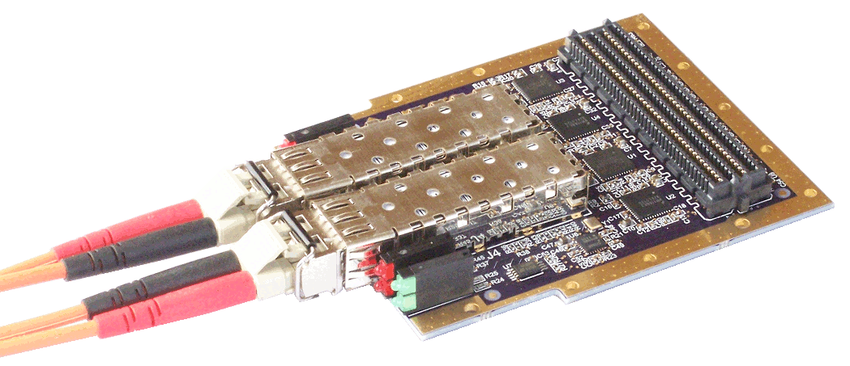
(1) Receive data at line cards
Circuitry to interface with physical medium: copper, optical, …
  SerDes/IO modules: serialize/deserialize data from the wire
Network interfaces keep getting faster
  More parallelism, but stay the same size; Moore’s law is alive for now
  Link technologies still getting faster: optical & wireless
Multiple network interfaces on a single “line card”
  Component detachable from the rest of the switch
  Ex: upgrade multiple 10 Gbit/s interfaces to 40 Gbit/s in one shot

Slide 28
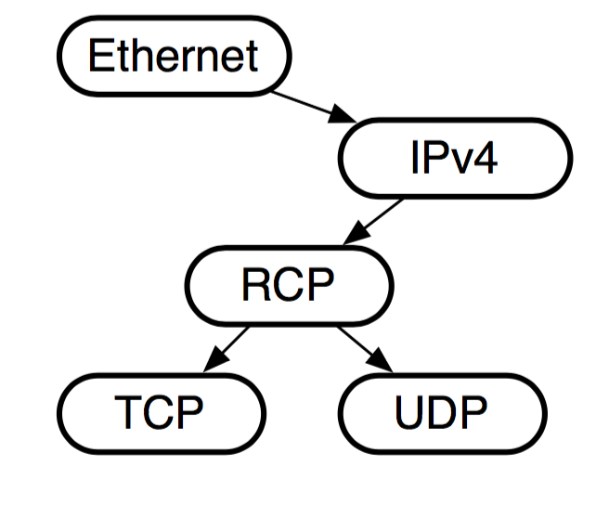
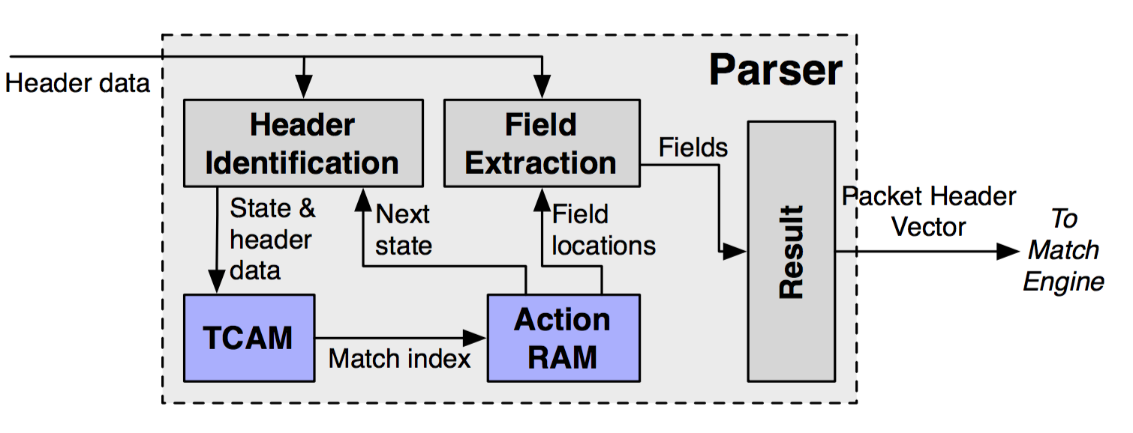
(2) Packet parsing
Extract header fields: extraction & branching, sometimes “loop”
Example: extract Ethernet headers to know src/dst hw addresses
Example: determine transport protocol based on IP proto field
Example: encapsulation, e.g., IPv6 in IPv4
Outcome: assignment of header fields to bits from packet
MGR: software, RMT: hardware (programmable)

Slide 29
(2) Packet parsing
A key principle: Separate header and payload data paths
  Router functionality is “header-heavy” but “payload-light”
  Don’t move the payload around too much
  Conserve bandwidth & resources for data moved around inside the router
Header goes on as input to route lookup/packet modification
Payload sits on a buffer until router knows what to do with pkt
  Buffer could be on the ingress line card (MGR) or a buffer shared between line cards (RMT)

