Slide 1
Transport

Slide 2
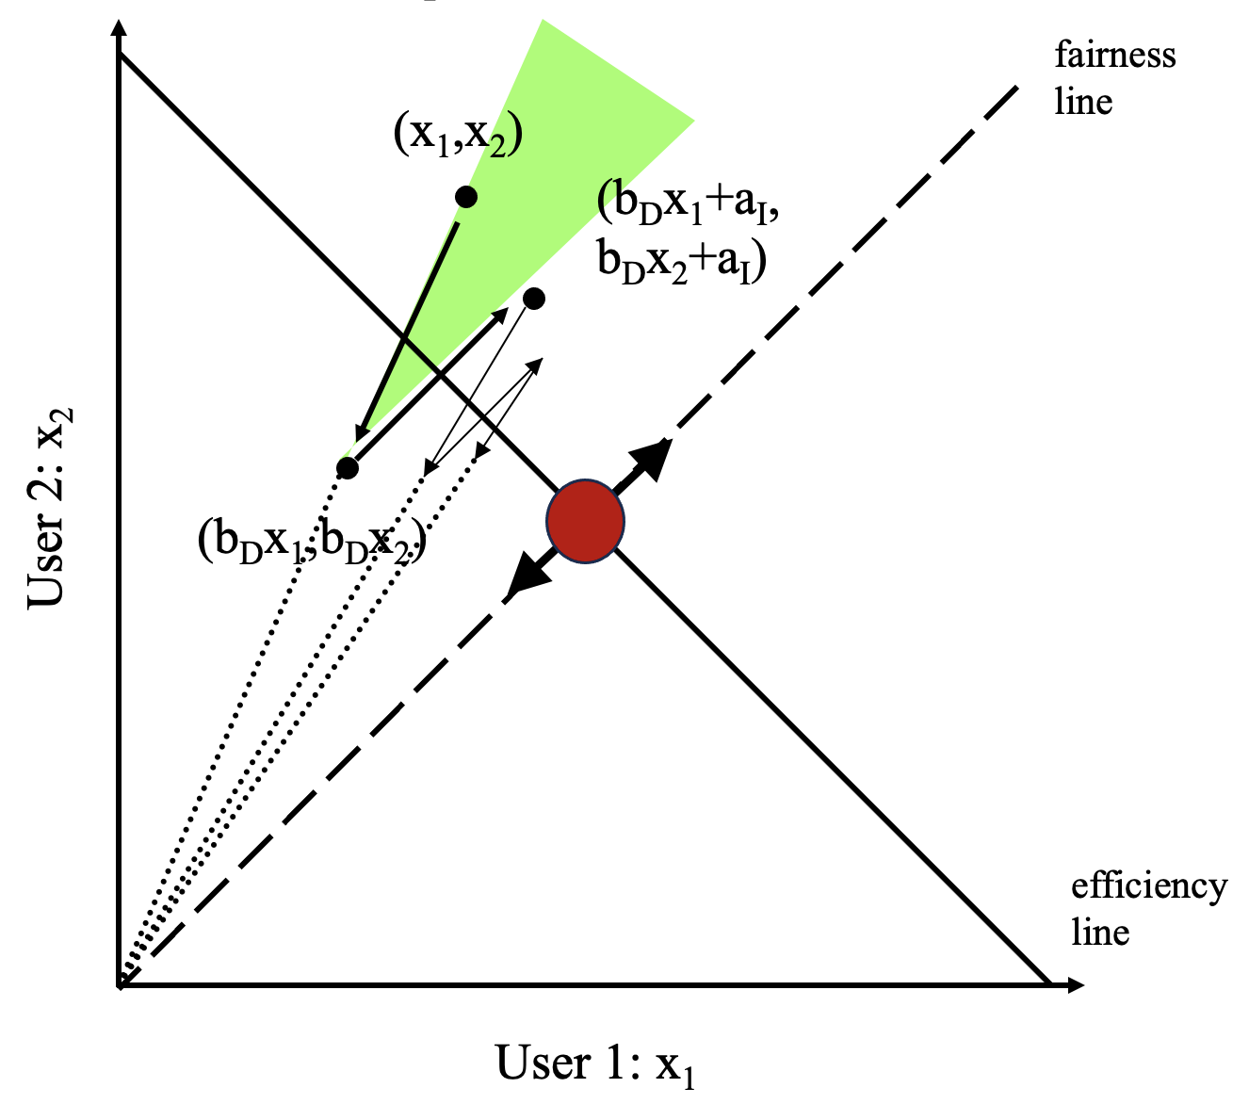
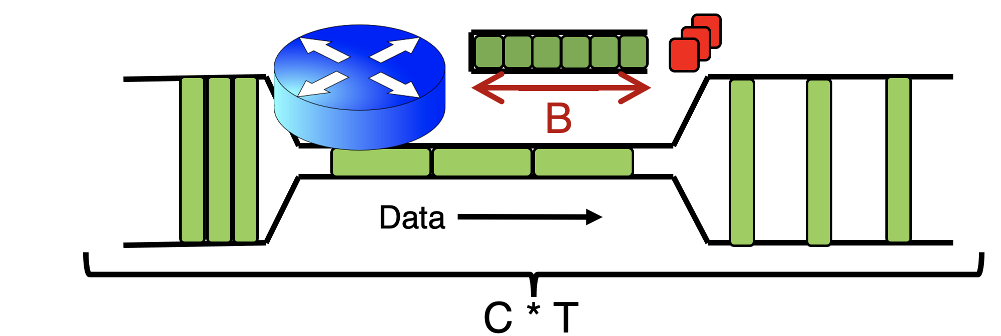
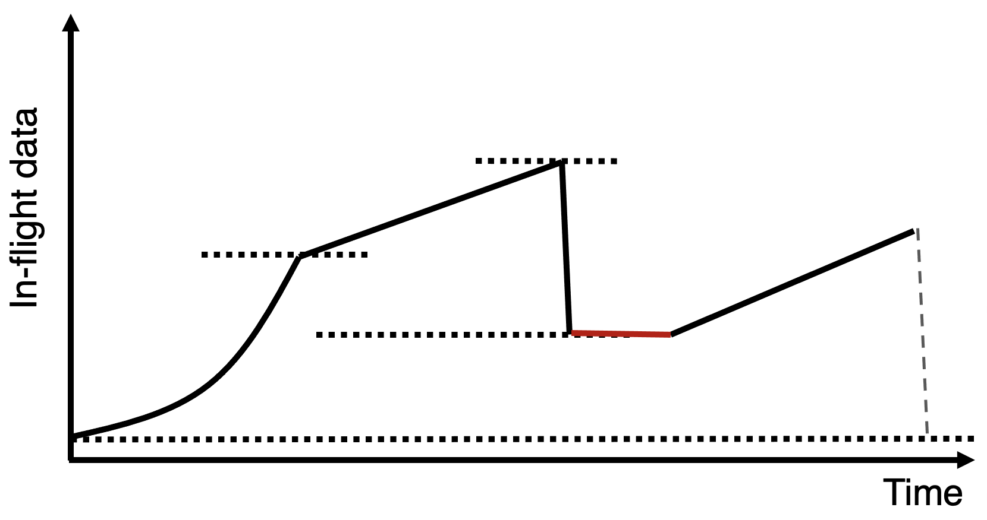
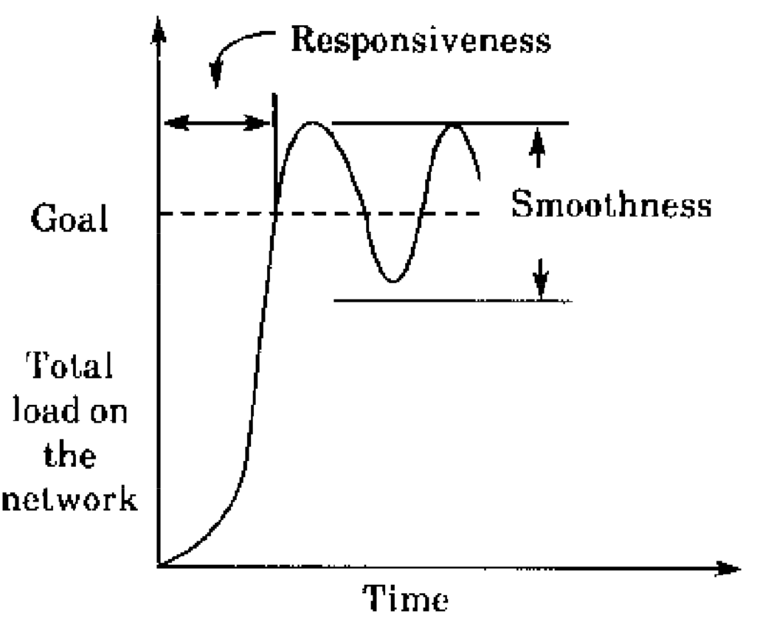

Slide 3
Simple models are useful
Chiu and Jain’s model isn’t indicative of all TCP/AIMD behavior
But it’s “realistic” enough
Stands the test of time: many more sources, much higher bandwidth, …
Models should be simple
For us to work with
For others to understand
But they don’t have to mimic the “real” thing in every way
A real, complex model is likely useless, but a realistic, simple model might teach us something

Slide 4
Modeling TCP throughput
Given network characteristics, how quickly can TCP (New Reno) send data?
Mathis et al., “Macroscopic behavior of TCP congestion avoidance”

Slide 5
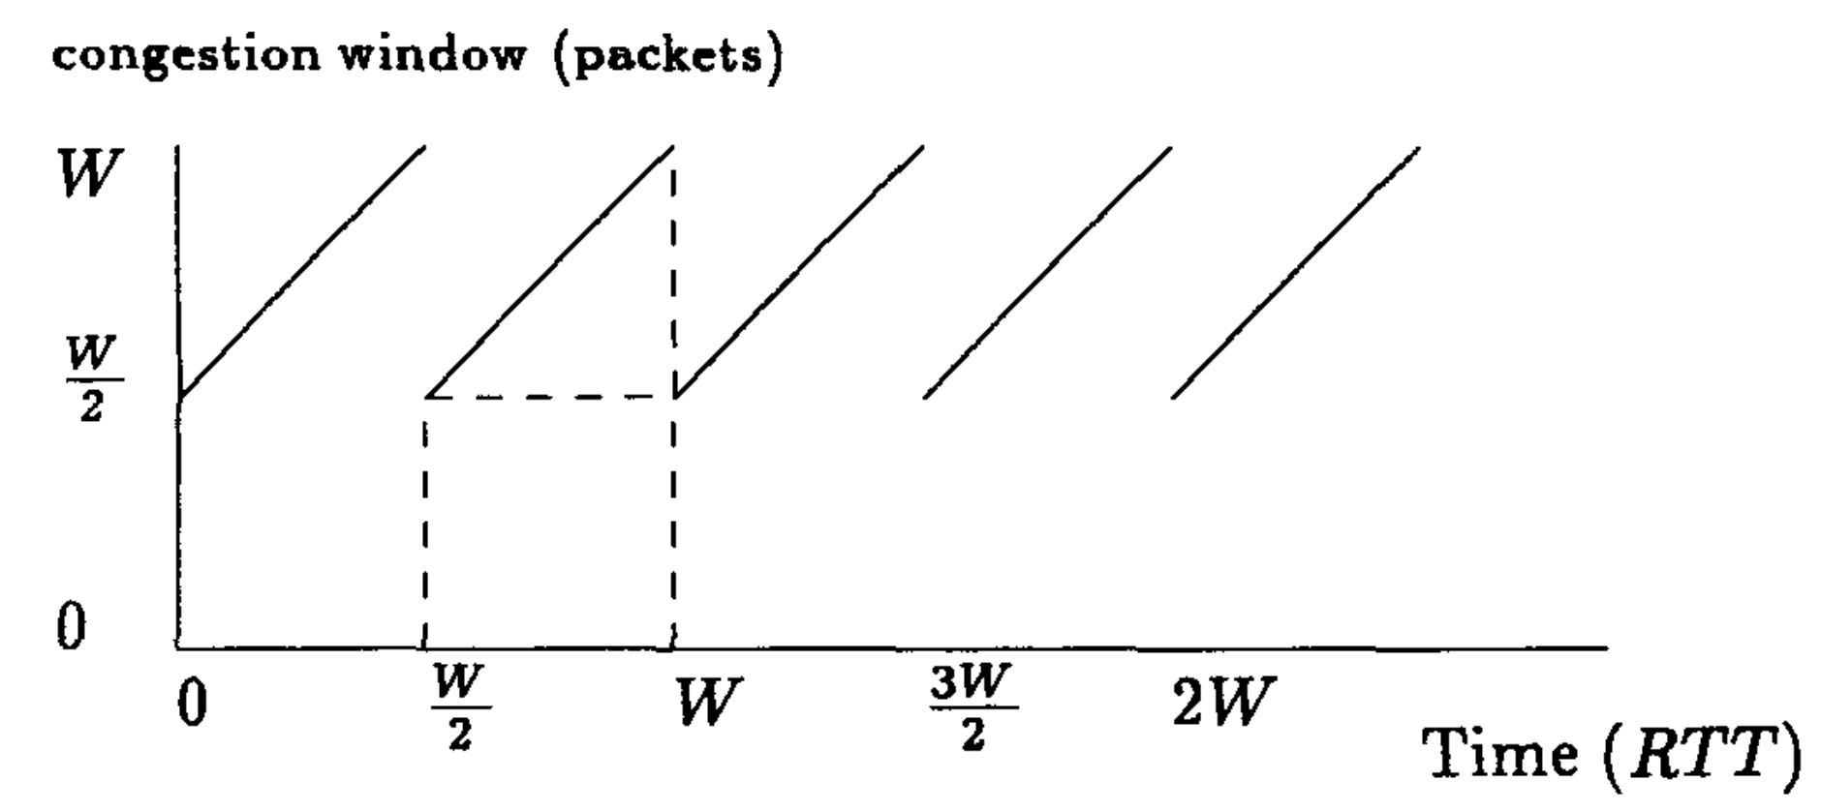
Steady AIMD
(Mathis equation)
Mathis et al., “Macroscopic behavior of TCP congestion avoidance”

Slide 6
Estimating TCP AIMD throughput
Assumptions
Single flow, repeating AIMD
Loss occurs exactly in the last RTT before window reduction
Exactly one packet lost
Assume RTT constant (ignore queueing delay change)
Relationship between W₁, W₂?
How many pkts sent over T?
Relationship p and # pkts?
Window
Packet drop probability p
W₂
W₁
T
Time

Slide 7
Implications
Throughput has a 1/sqrt(p) dependence on packet loss rate
Getting full bottleneck throughput requires loss rate 1/(BDP)²
RTT unfairness
Flows with a smaller RTT get better throughput (ramp up faster)
Engineering implications:
Split TCP (CDNs, data center frontends, …)
Special considerations for long-distance connections

Slide 8
Widely Deployed TCPs

Slide 9
Data Center TCP
Alizadeh et al.

Slide 10
Context
Regular TCP: window evolution with all signals measured end to end
Data centers: hardware under single administrative control
Could network switches do better?
What if switches provided better feedback than loss?

Slide 11
Explicit Congestion Notification
Sender 1
Additive Increase:
W → W+1 per round-trip time
Multiplicative Decrease:
W → W/2 per drop or ECN mark
ECN Mark (1 bit)
Receiver
Window Size (Rate)
Time
Queue size > K, mark the packet.
Sender 2
Example of Active Queue Management
ECN = Explicit Congestion Notification
(RED, PI, etc.)
Notes:
DCTCP is based on the existing Explicit Congestion Notification framework in TCP.
----- Meeting Notes (3/7/12 12:24) -----
Remember to mention "SAWTOOTH"

Slide 12
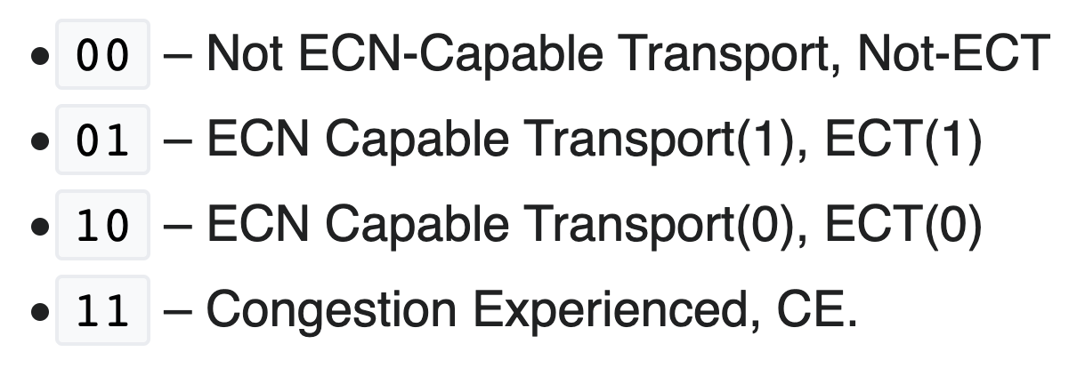
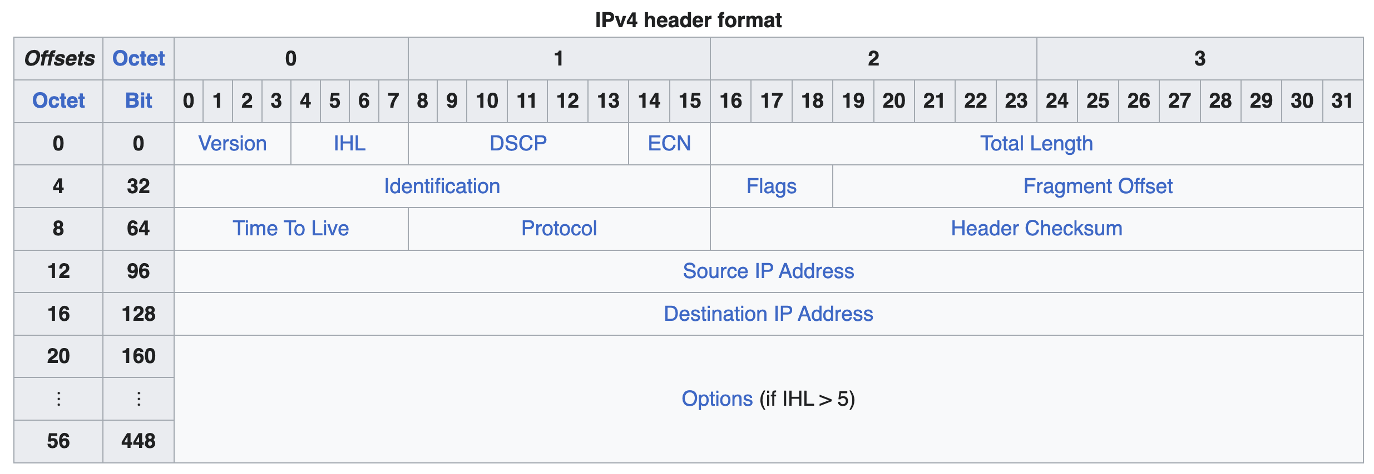
ECN set on the IP header by routers
Dropped by router if TCP sender is not ECN enabled

Slide 13
Explicit Congestion Notification
Sender 1
Additive Increase:
W → W+1 per round-trip time
Multiplicative Decrease:
W → W/2 per drop or ECN mark
ECN Mark (1 bit)
Receiver
Window Size (Rate)
Time
Receiver’s ACK echoes mark in TCP header
Sender 2
ECN = Explicit Congestion Notification
Notes:
DCTCP is based on the existing Explicit Congestion Notification framework in TCP.
----- Meeting Notes (3/7/12 12:24) -----
Remember to mention "SAWTOOTH"

Slide 14
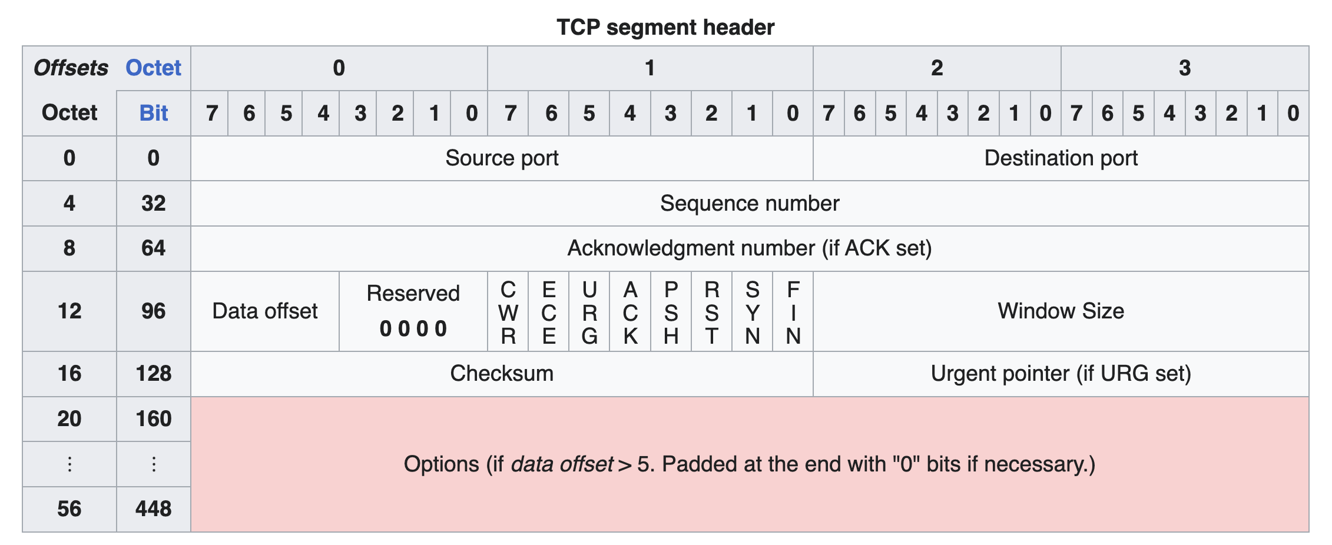
ECN on the TCP header

Slide 15
DCTCP: Main idea
Extract multi-bit feedback from single-bit stream of ECN marks
Reduce window size based on fraction of marked packets

Slide 16
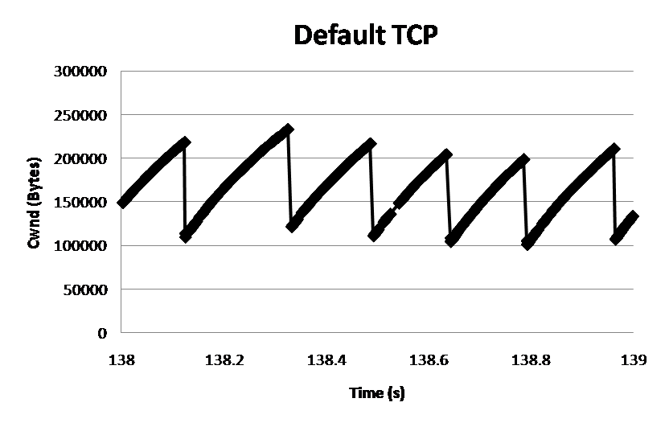
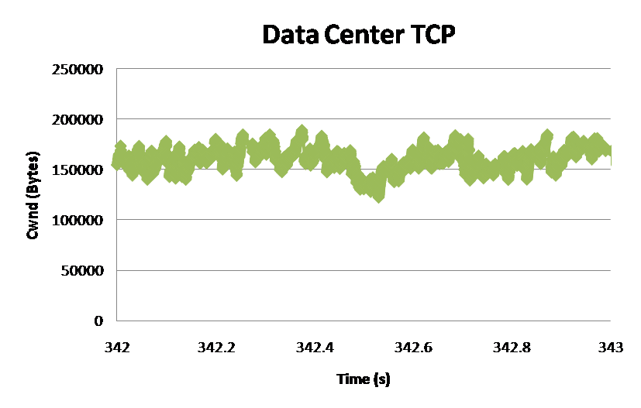
DCTCP: Main idea
ECN Marks | TCP | DCTCP
1 0 1 1 1 1 0 1 1 1 | Cut window by 50% | Cut window by 40%
0 0 0 0 0 0 0 0 0 1 | Cut window by 50% | Cut window by 5%
TCP
DCTCP
Window Size (Bytes)
Window Size (Bytes)
Time (sec)
Time (sec)
Notes:
Start with: “How can we extract multi-bit information from single-bit stream of ECN marks?”
- Standard deviation: TCP (33.6KB), DCTCP (11.5KB)

Slide 17
DCTCP algorithm
B
K
Don’t
Mark
Mark
Router side:
Mark packets when Queue Length > K.
Sender side:
Maintain running average of fraction of packets marked (α).
Adaptive window decreases:
Note: decrease factor between 1 and 2.
Reacting to and controlling queue size distribution,
specifically, the region above K.
Notes:
very simple marking mechanism
not all the tunings other aqms have
on the source side, the source is tryign to estimate the fraction of packets getting marked
using the obs that there is a stream of ecn marks coming back – more info in the stream than in any single bit
trying to maintain smooth rate variations to operate well even when using shallow buffers, and only a few flows (no stat mux)
F over the last RTT. In TCP there is always a way to get the next RTT from the window size. Comes from the self-clocking of TCP.
Only changing the decrease. Simplest version – makes a lot of sense. So generic could apply it to any algorithm – CTCP, CUBIC – how to cut its window leaving increase part to what it already does. Have to be careful here.

Slide 18
Setting protocol parameters
When should router start marking? K:
Mark too late: higher queueing delay (and maybe loss)
Mark too early: queues too small, lose throughput
Want min queue size > 0 even when TCP windows drop
What is the ideal buffer size for DCTCP?
Regular TCP: Bandwidth-delay product
Want buffer > max queue size

Slide 19
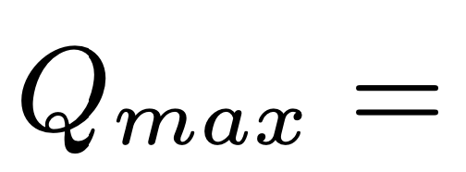
Use model to set parameters
Packets sent in this
RTT are marked
Window Size
W*+1
W*
(W*+1)(1-α/2)
Time

Slide 20
TCP Cubic

Slide 21
Support faster window growth
Max probing
Steady state operation
W_{max}

Slide 22
TCP BBR
Cardwell et al., Google

Slide 23
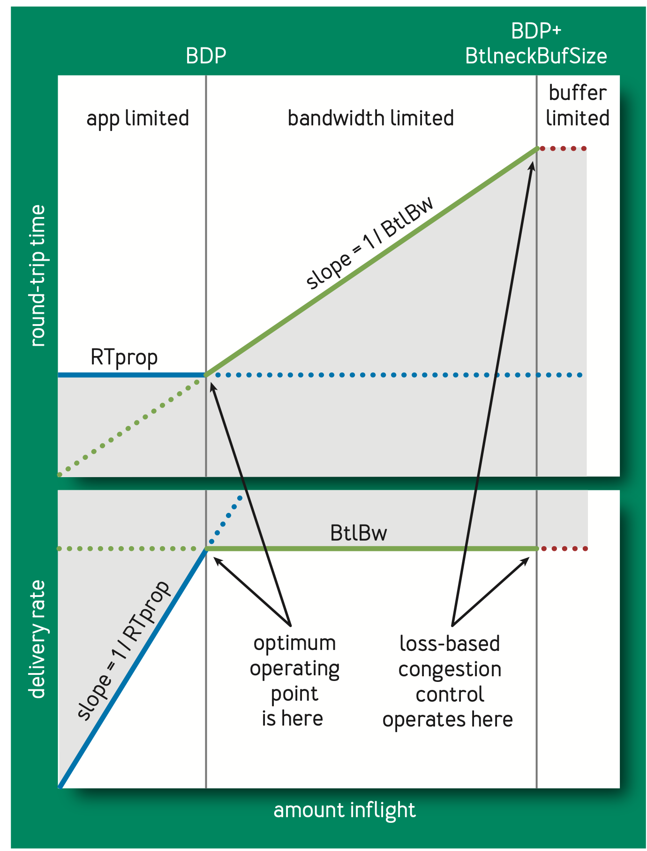
Principle of Operation
Find optimal operating point in terms of bottleneck bandwidth and delays
Cannot simultaneously probe bottleneck bandwidth and propagation delay
➔ Occasionally drop window to estimate propagation RTT

Slide 24
Endpoint algorithms alone are insufficient

Slide 25
The approach that the Internet takes to allocate resources in the network core is to use a
distributed algorithm (congestion control)
running at endpoints.
This allows the Internet to scale to a large # of endpoints.
However, it also places trust in endpoints.

Slide 26
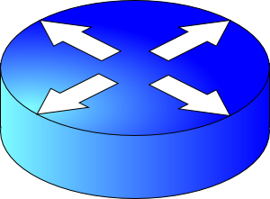
Uncooperative, buggy, malicious endpoints
What if an endpoint is buggy, or malicious?
We’d like the network core to do something better than best-effort

Slide 27
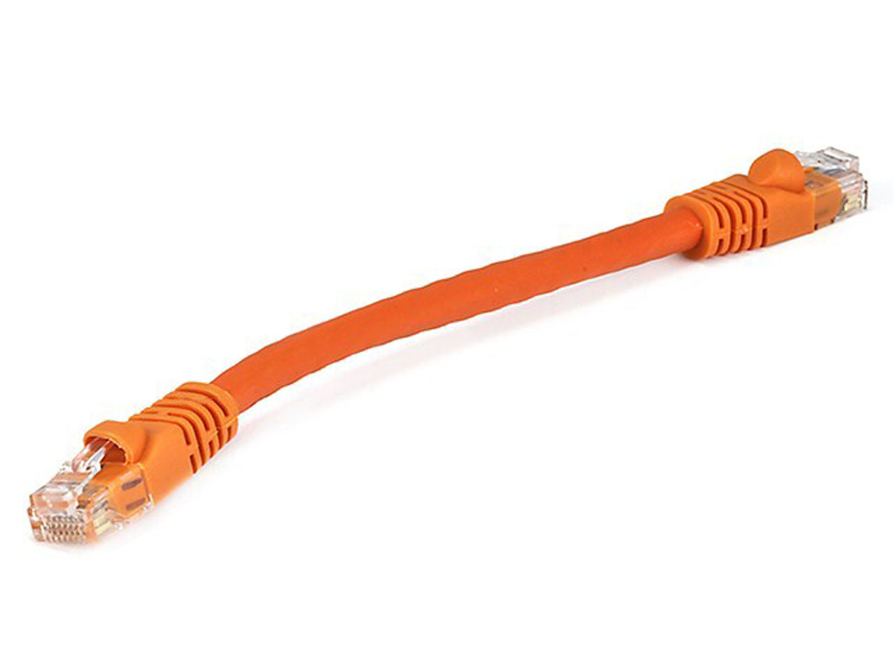
Simplified model of bottleneck link
Queuing delay
Bottleneck queue
(max size B)
Link rate
Flows
Packet-switched core network

Slide 28
FIFO scheduling + Tail-drop buffer mgmt
Buffer size
2
1
b
2
a
1
a
b
Dropped packets

Slide 29
FIFO scheduling + Tail-drop buffer mgmt
6
Head of the line blocking (HOL)
5
4
Buffer size
3
2
1
6
a
4
3
2
5
1
a
b
b
Dropped packets

Slide 30
Next RTT: ACK-clocking makes it worse
13
12
11
10
Buffer size
9
8
7
13
12
11
10
9
8
7
b
b
c
ACK signals sender: prior packet left the network => resource available!
Dropped packets

Slide 31
Network can be monopolized by bad endpoints
ACK clocking synchronizes senders to when resource is available
Conversely, packet losses desynchronize the sender
Contending packet arrivals may not be random enough
e.g., Blue flow can’t capture buffer space for a few round-trips
Can observe this effect when many TCP flows compete
Some TCP flows can never get off the ground
A FIFO tail-drop queue incentivizes sources to misbehave

Slide 32
Packet scheduling disciplines @ routers
Significantly influences how packets are treated regardless of the endpoint’s transmissions
Implementations of Quality of Service (QoS) within large networks
Implications for net neutrality debates
Intellectually interesting and influential question
Important connections to job scheduling in systems
Just like in life, how you schedule work is highly impactful

Slide 33
Relationship: scheduling & transport
Packet scheduling is dealing with things transport has already put into the network
Transport requires a few round-trip times to react; scheduling does something “immediately”
If you could schedule transmission out of the endpoint, you could get them to zoom through the network without waiting anywhere in queues
In modern clusters, goal of transport is to often act as if a centralized scheduler directly chose the packet to transmit from the endpoint (leaving other packets waiting at the endpoint)

