Slide 1
Computer Networks

Slide 2
A collection of computers exchanging information

Slide 3
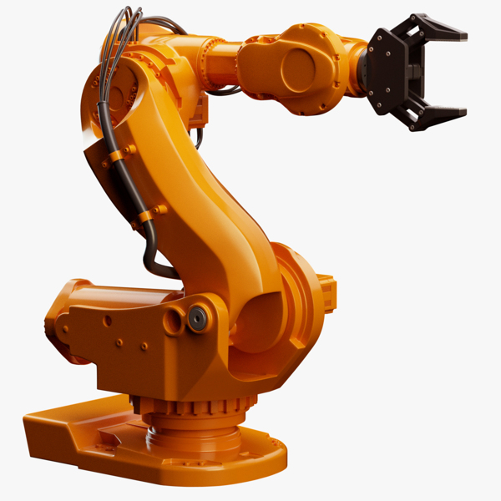
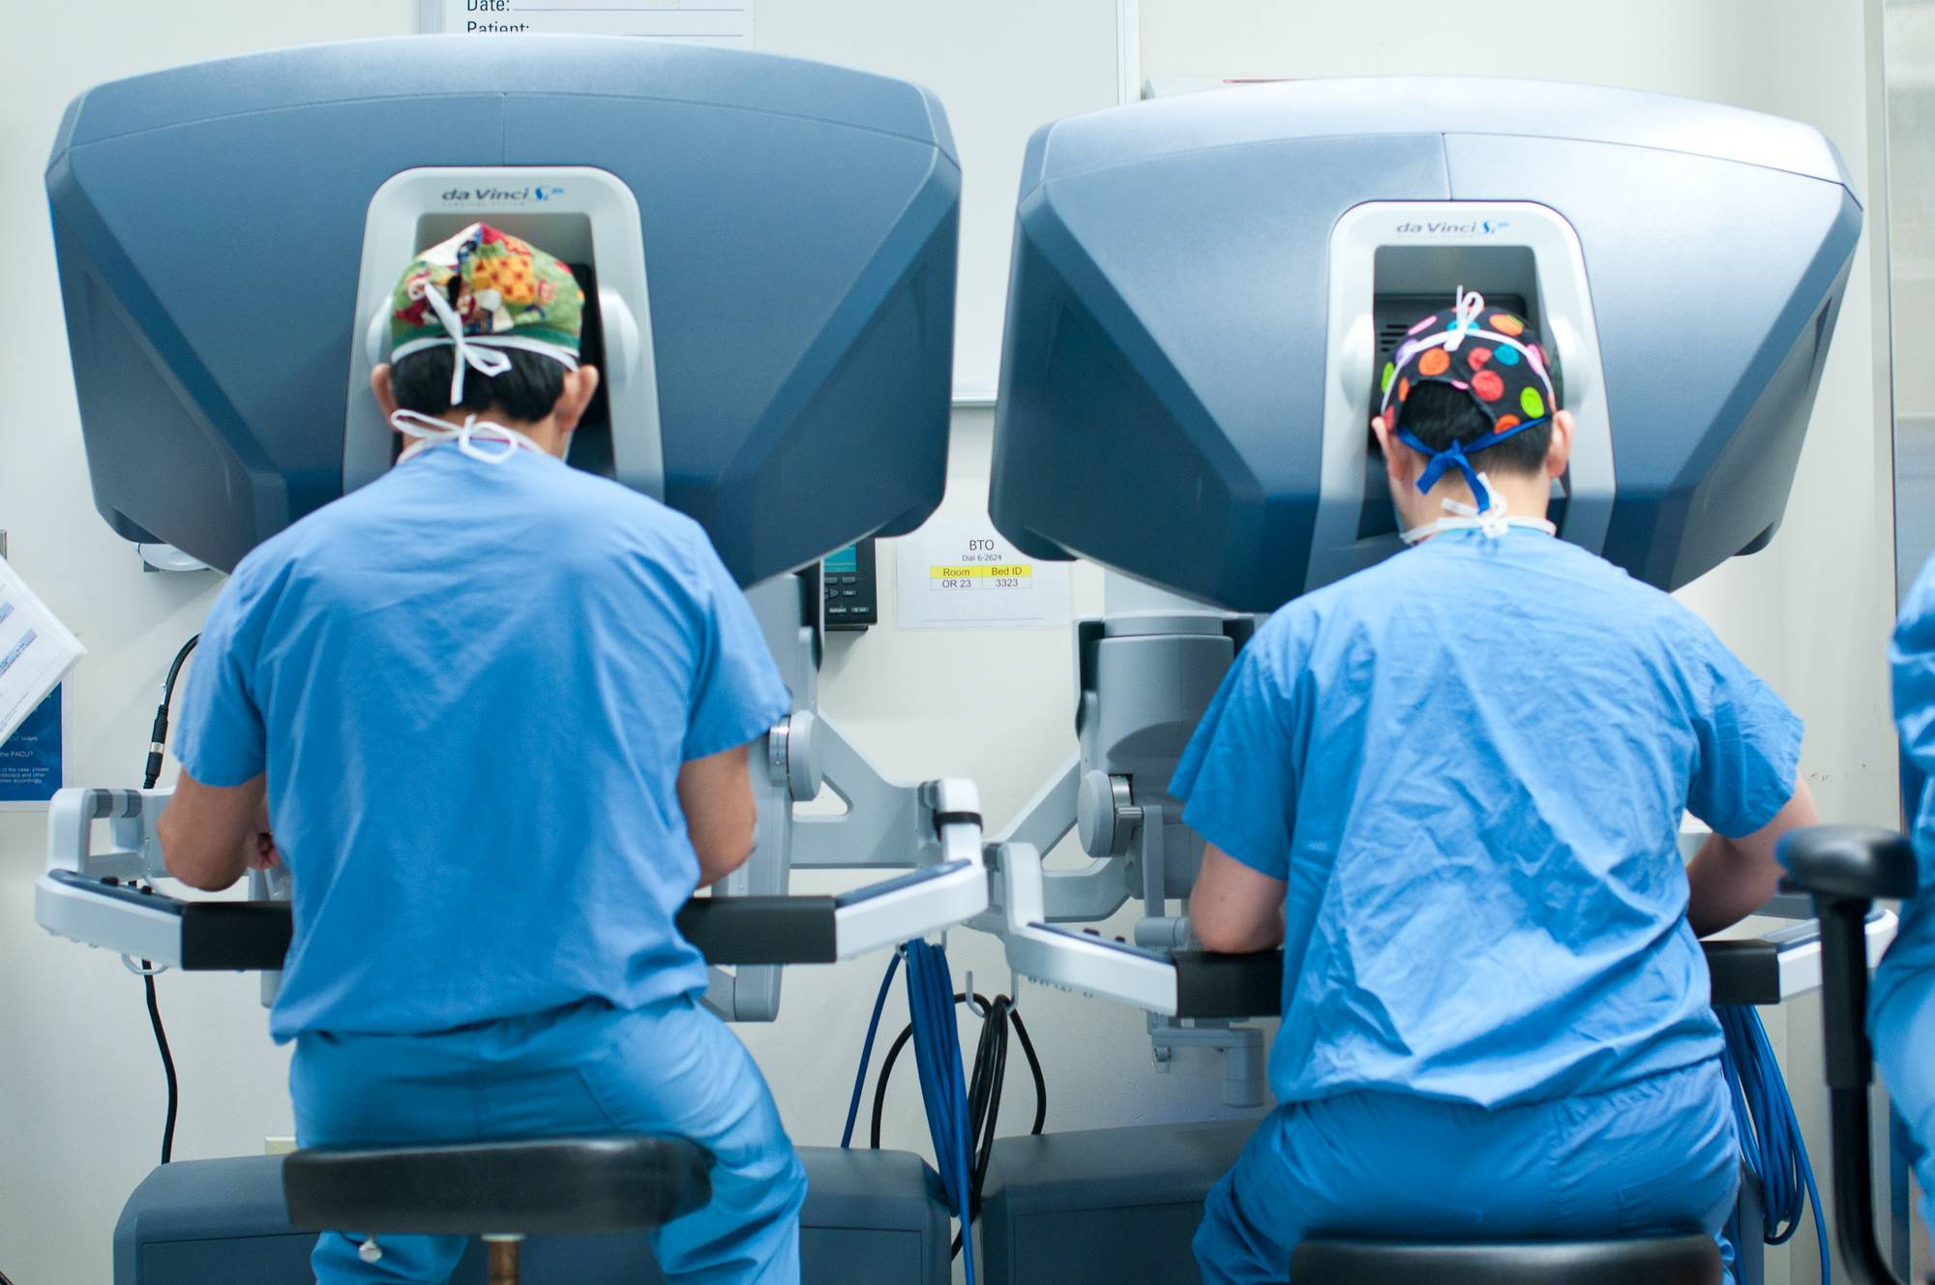
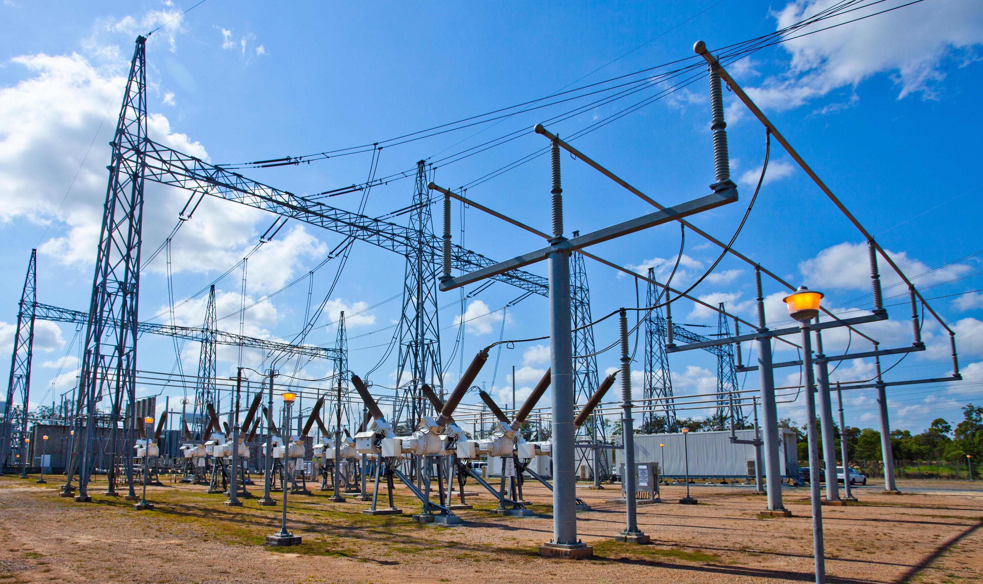
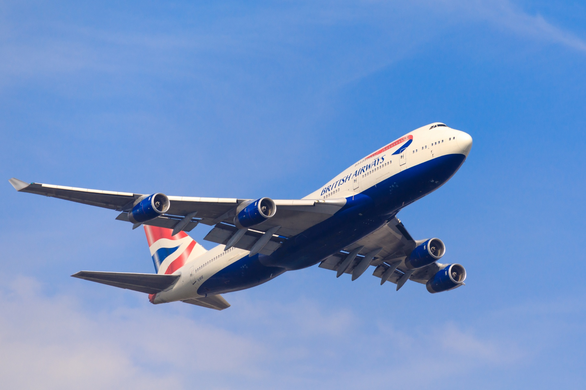
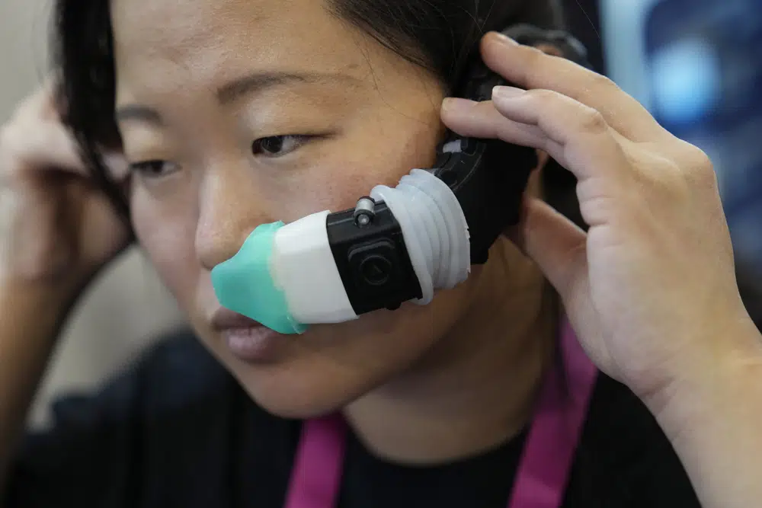
The Internet

Slide 4
Why is that useful?
Communicating with other human beings
Processing vast quantities of data
Learning what’s going on in the world
Education
Transacting and doing business
Entertaining ourselves
Living sanely in an isolated world
Moving and operating in the physical world

Slide 5
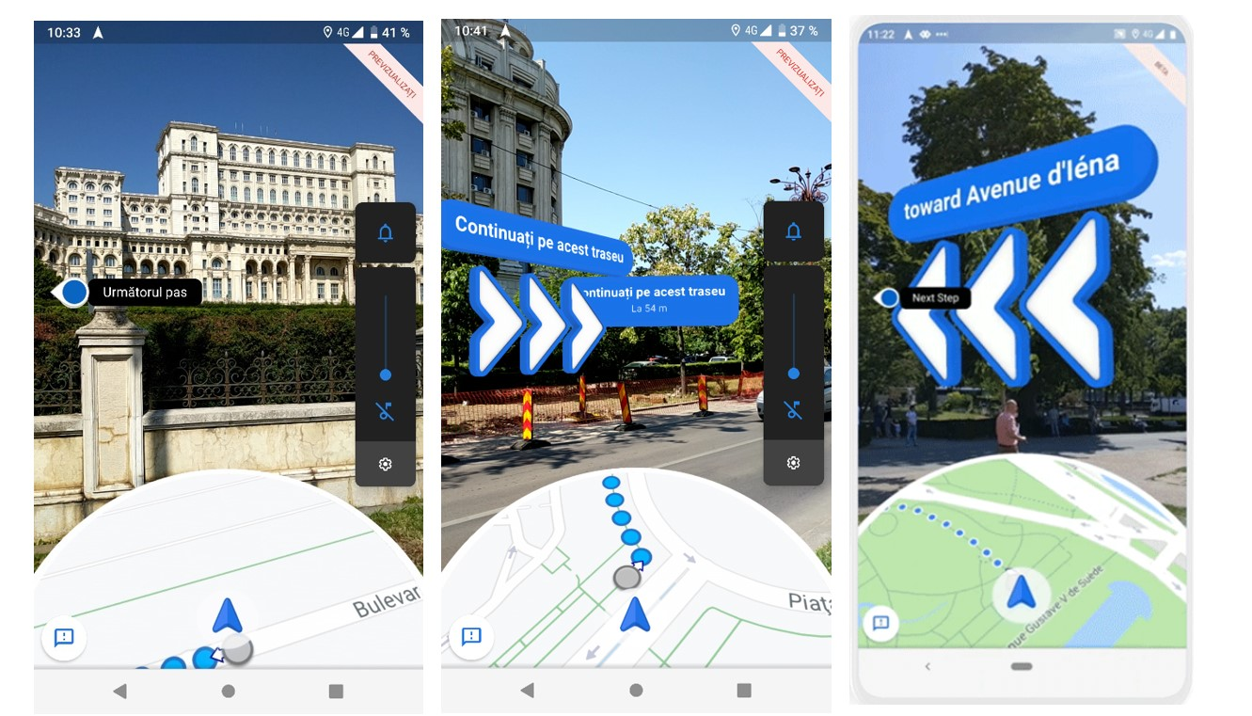
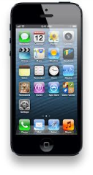
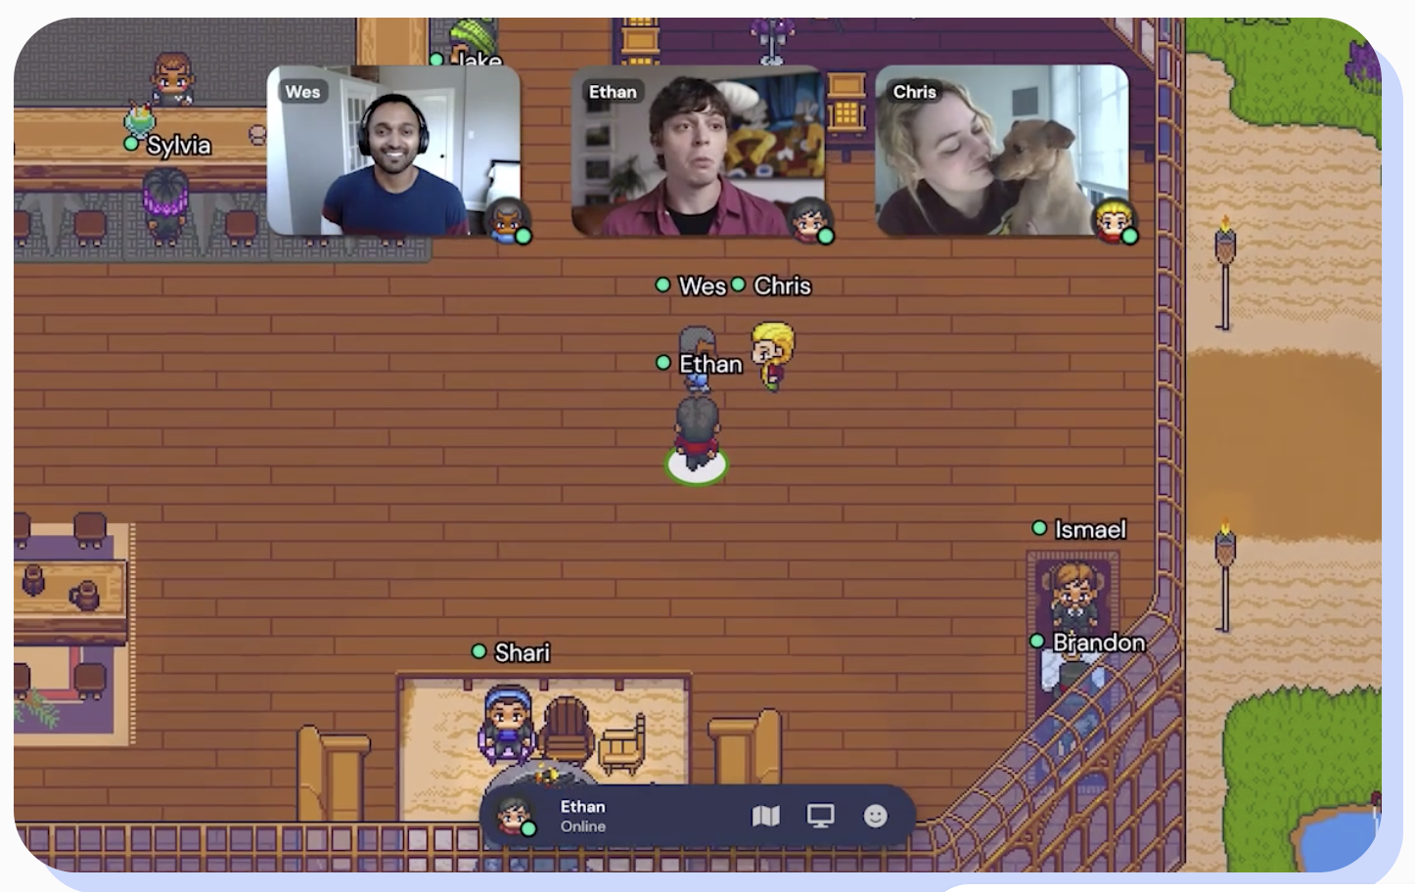
Evolution of Internet applications
2010-2020
2020--
1992
1996
2000
2004
2008
ftp
Web
email
chat
Games
IM
Yahoo!
news
Blog
Search
Music
itunes
Games
search
Wikipedia
Craiglist
Youtube
Text-heavy
Multimodal media
Augment physical world
Replace phy world

Slide 6
There’s a science to communication
What language should machines speak?
How to partition functionality? “Who” should do “what”?
How to make communication effective?
Achieve better scale, performance, resource efficiency
Evolve to address new needs over time
How to grow organically? include more communicating parties
Make it easy for humans to build and manage?
How to make communication worthy of societal trust?

Slide 7
Computer Networks
Principles and algorithms by which communication software & hardware are organized
Design of foundational artifacts of the Internet
and other modern networks
Readings and programming assignments

Slide 8
There are different kinds of computers and networks

Slide 9
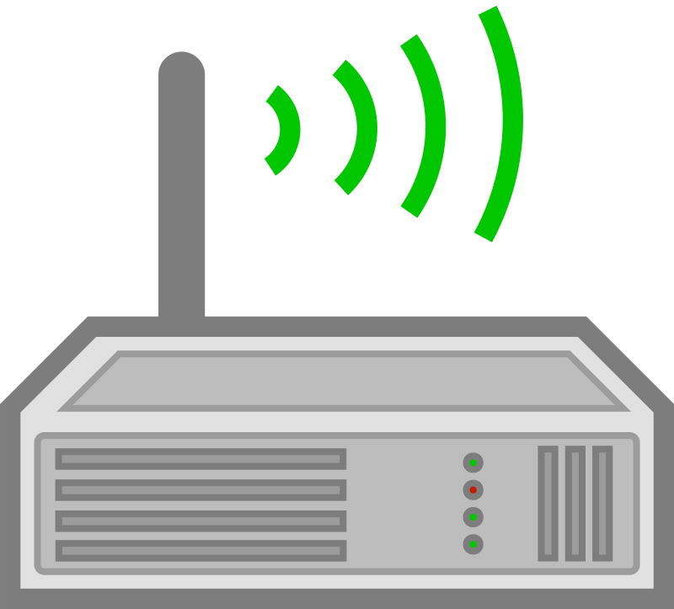
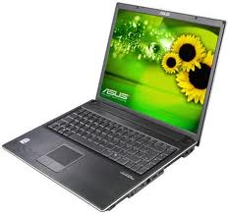
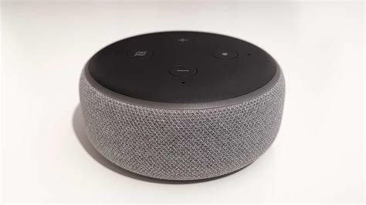
Your experience of the Internet
links
Routers
Endpoints

Slide 10
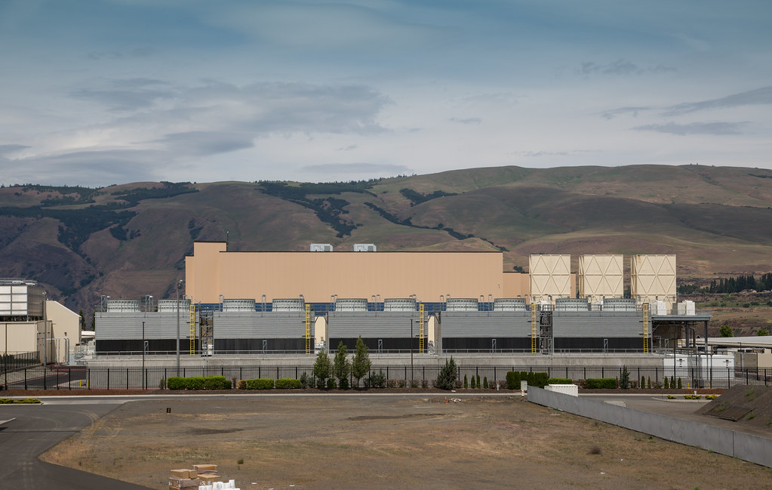
Your experience of the Internet
links
Routers
Data Center
Endpoints

Slide 11
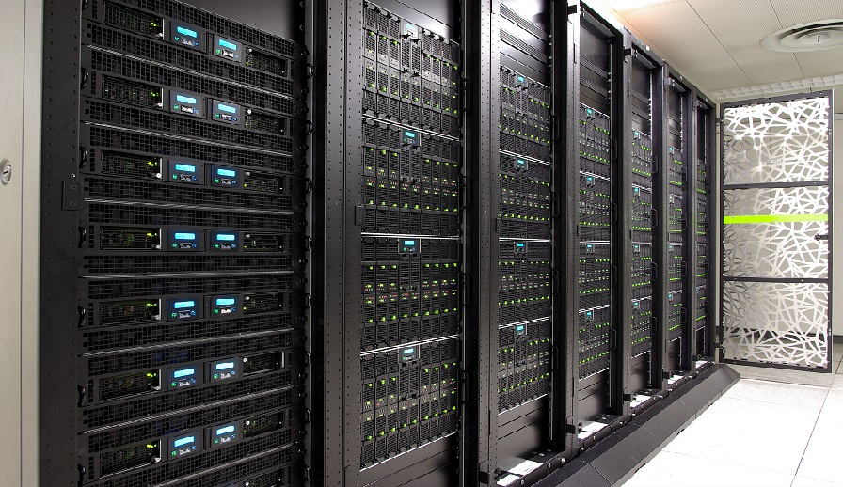
Your experience of the Internet
links
Routers
Data Center
Endpoints

Slide 12
Your experience of the Internet
links
Routers
Server
Data Center
Endpoints

Slide 13
Your experience of the Internet
links
Routers
Servers
Data Center
Endpoints

Slide 14
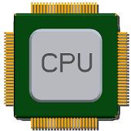
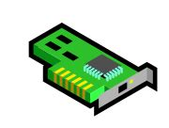
Your experience of the Internet
Routers
AT&T
Data Center
Comcast
Verizon
Endpoints

Slide 15
Course content overview

Slide 16
(1) Internet architecture
Protocols
App
Transport
Network
Decomposition of functionality

Slide 17
(2) The transport layer
Protocols
App
Transport
Network
Basic guarantees
Design principles of widely deployed TCP protocols
Packet scheduling

Slide 18
(3) Network data plane
Protocols
App
Transport
Network
Modern router architectures
High-speed software
packet processing
Network functions

Slide 19
(4) Network control plane
Protocols
App
Transport
Network
Interconnection (BGP)
Routing
Software-defined networking

Slide 20
(5) Verification
Protocols
App
Transport
Network
Data plane verification
Control plane verification

Slide 21
Concrete tools and takeaways
Understanding, configuring, and implementing transport (TCP)
Writing SDN data and control plane programs (P4)
Experience with real distributed routing protocols (BGP)
Writing fast, verified packet-processing code (eBPF)

Slide 22
Why might all this be useful to you?
Intellectually rewarding
Principles in designing distributed computer systems
Pragmatic
Modern software requires an understanding of networking
Real world utility
Many programs you use today designed by programmers like you
Academic impact
Still an evolving discipline with many open problems (and awards)
Fun, profit, impact, altruism

Slide 23
Logistics

Slide 24
About us
Faculty instructor: Srinivas Narayana
http://www.cs.rutgers.edu/~sn624
sn624@rutgers.edu
Teaching Assistant: Bala Murali Komanduri
Office hours TBA
Canvas and Piazza
Busch campus SEC 202 on Wed 8:30—11:30

Slide 25
Class philosophy
We want you to learn and to be successful
Significant technical reading & programming
Build necessary skills for future tech careers (industry or academic)
Be proactive: interact, ask, support
Attend lectures and office hours regularly to discuss material
Use Piazza
Happy to help you acquire necessary background
Ask me for support materials

Slide 26
Grade components
Programming assignments (60%)
Quizzes (40%)

Slide 27
Quizzes (40%)
4 in-class quizzes, held during lecture
Exact dates to be announced
tentatively, weeks 4, 7, 11, 14
45 minutes to 1 hour each
Cover lectures and readings
Open book, but paper-based materials only
No sharing, Internet access, mobile use during exam

Slide 28
Readings
6—7 technical papers to read deeply over the term
Knowing how to read well technically is worth your time
Grad students: reading and writing technical papers
Developers: reading RFCs, protocol specifications, other technical specs
Development: implementing new system technology requires reading
Staying broadly technically educated and employable!
It’s worth reflecting on how to read effectively

Slide 29
There is no magic
Reading effectively takes a lot of time and effort
I’ve been reading technical articles for 13+ years now
And I still sometimes spend 5+ hours or even an entire day
You will get more effective and better over time
A few tricks

Slide 30
(1) Three pass approach for papers
First pass: title, category, context, assumptions, correctness, contribution
Second pass: get into the technical ideas, figures and graphs. Explain the new technical idea or design to someone else
Third pass: starting from assumptions and problem statement, reconstruct solution on your own with proof or argument for why it works and why it is the right approach (other approaches?)
How to read a paper? -- Keshav Srinivasan

Slide 31
(2) Look for concrete, simple examples
Good articles often use good examples to explain their ideas
If the article does not show examples, construct and work through your own
Constructing a good example itself often clarifies the technical problems and innovations in the solution

Slide 32
(3) Identify reusable principles
What do you want to take away from the reading?
System design or algorithmic techniques
Existence of a new problem space
A class of technical solution approaches
New techniques for empirical evaluation or measurement
Reading something worthy changes how you think about the world from that point

Slide 33
Programming assignments (60%)
4, released and handed in over Canvas
TCP, P4, BGP, eBPF
Sizable, substantial programming
C language, and some domain-specific languages (P4, BGP)
Solo or teams of 2

Slide 34
Programming assignments
We’ll give you access to a Linux VM with sudo privileges
Assignments Due roughly every 3 weeks
Tentatively, Mondays after lectures 5, 8, 11, 14

Slide 35
Programming assignments
Please follow all instructions carefully and exactly
You will lose significant points if:
We are unable to compile or run your code
We do not receive your submission in a timely fashion

Slide 36
Programming assignments
You can talk to others, however all submitted code must be your own
Do not blindly lift code from stack overflow, GitHub, chatGPT, …
Do not post solutions on GitHub or elsewhere
Incorporate learning from other sources and produce your own solutions
Mandatory to state collaboration & references in an attached report

Slide 37
Collaboration and Integrity policies
This course welcomes discussion and collaboration
Do
Ask questions on Piazza
Discuss projects and readings with me and with each other
Read references (textbooks, papers, Internet posts) widely
Acknowledge each other and all the references
Use collaboration prompts on programming homeworks; project
Include who you talked to, references (including on the web) you consulted
Be as accurate and complete as possible

Slide 38
Collaboration and Integrity policies
All your written (coded) work must be your (team’s) own
Understand the problem deeply and produce your own solutions
Do not
blindly lift or incorporate other solutions
look at other people’s code or solutions
copy code from the web (e.g., other people’s GitHub projects)
use generative AI (e.g. chatGPT)
post programming homeworks or quizzes (questions or solutions) on GitHub, Chegg, CourseHero, etc.

Slide 39
Rutgers takes academic dishonesty very seriously.
Violation of academic integrity at the graduate level is especially serious. Consequences include suspension and expulsion.
We will run plagiarism detection tools on all submitted materials.
If you are ever in doubt, ask me first.

Slide 40
Late policy
Don’t be late
If you must be late, inform us in advance
If you cannot inform us in advance (e.g., medical), provide official medical note of absence through the University
Unexcused late submissions will result in losing significant fraction of points

Slide 41
24/7 Grading Policy
You may not dispute a grade or request a regrade before 24 hours or after 7 days of receiving it
Please contact us if you have a legitimate regrading request:
After 24 hours of receiving the grade: Please take the time to review your case before contacting me
Before 7 days have elapsed: we don’t want to forget what the quiz/project was all about.

Slide 42
Help, Accommodations, etc.
I’ll make every effort to accommodate reasonable requests that support your learning better
sn624@cs.rutgers.edu
I am committed to help you succeed in this course.

Slide 43
Next steps
Look out for canvas page, sign up for piazza (link TBD)
Lecture and recording will be posted online
Warm up on C programming
Meet each other to form teams for programming

