Slide 1

Re-Configurable Match-Action Tables (RMT)
Lecture 16, Computer Networks (198:552)
Fall 2019
Notes:
Slide material heavily adapted courtesy of Albert Greenberg, Changhoon Kim, Mohammad Alizadeh.

Slide 2
Fixed-function pipeline (MMT)
L2 Table
IPv4 Table
IPv6 Table
ACL Table
L2 Hdr Actions
v4 Hdr Actions
v6 Hdr Actions
ACL Actions
Fixed Parser
Fixed Header Processing Pipeline

Slide 3
Need for flexible packet forwarding
Modify the set of packet fields
  Network virtualization: new tunneling formats
  Support for new flags
  Disabling existing fields
Use tables more flexibly
  Different environments require tables of different shapes and sizes
  Enterprises: ACL-heavy
  Core: IPv4-heavy
  Resource wastage: can’t use another table’s hardware

Slide 4
Why OpenFlow isn’t enough
In the beginning, OpenFlow was simple: Match-Action
  Single rule table on a fixed set of fields (12 fields in OF 1.0)
Needed new encapsulation formats, different versions of protocols, additional measurement-related headers
Number of headers ballooned to 41 in OF 1.4 specification!
  With multiple stages of heterogenous tables

Slide 5
Protocol Independent Switch Arch. (PISA)
Match+Action
Stage
Memory
ALU
Programmable
Parser
Programmable Match-Action Pipeline

Slide 6
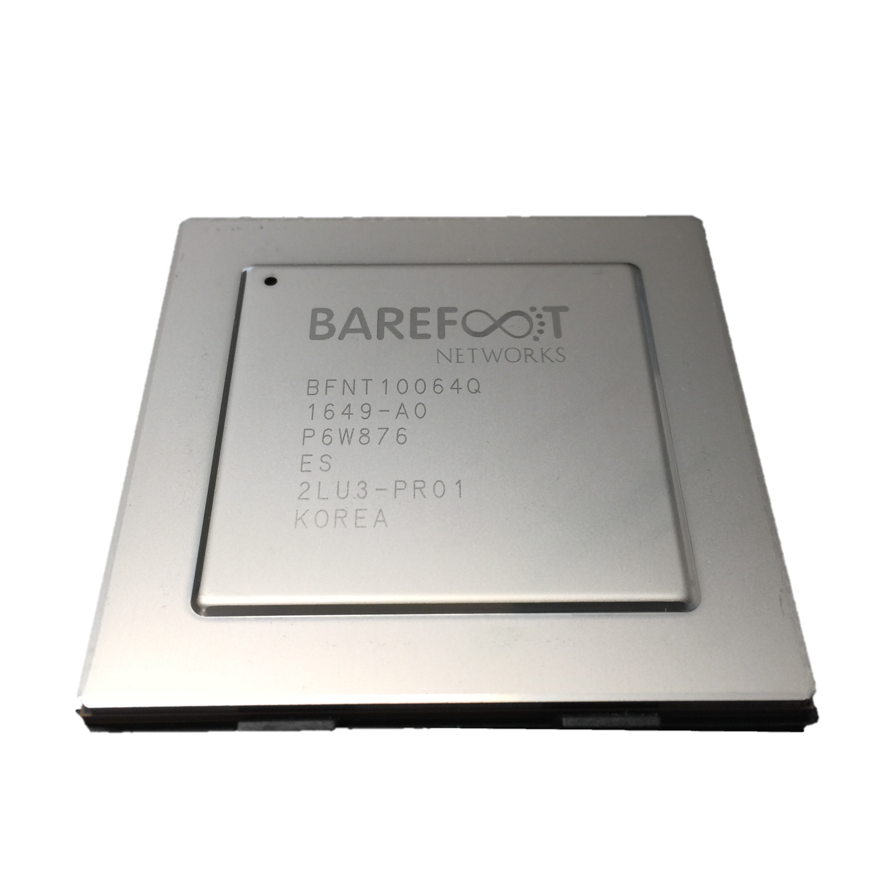
Comparison
 | P4 Programmable “Tofino” | Fixed Function
L2/L3 Throughput | 6.4Tb/s | 6.4Tb/s
Number of 100G Ports | 64 | 64
Availability | Yes | Yes
Max Forwarding Rate | 5.1B packets per sec | 4.2B packets per sec
Max 25G/10G Ports | 256/258 | 128/130
Programmability | Yes (P4) | No
Typical System Power draw | 4.2W per port | 5.3W per port
Large Scale NAT | Yes (100k) | No
Large scale stateful ACL | Yes (100k) | No
Large Scale Tunnels | Yes (192k) | No
Packet Buffer | Unified | Segmented
Segment Rtg/Bare Metal | Yes/Yes | No/No
LAG/ECMP Hash Algorithm | Full entropy, programmable | Hash seed, reduced entropy
ECMP | 256 way | 128 way
Telemetry and Analytics | Line-rate per flow stats | Sflow (Sampled)
Latency | Under 400 ns | 450 ns
Otherwise, both systems
are identical:
  # of Ports
  CPU
  Power Supplies
Source: Nick McKeown “SDN 3.0”, ONF connect 2019

Slide 7
Basic features of the RMT design
Programmable packet parser
Pipelined structure
  Multiple, identical pipeline stages
  Clocked at a high rate (1 GHz)
Match and action logic are separate
  And separate from statistics (counters) memory
Can keep state on the switch in stage-local memory

Slide 8
Consequences

Slide 9
Better abstractions
Parser Program
Header and Data Declarations
Tables and Control Flow
parser parse_ethernet {
extract(ethernet);
return switch(ethernet.ethertype) {
0x8100 : parse_vlan_tag;
0x0800 : parse_ipv4;
0x8847 : parse_mpls;
default: ingress;
}
header_type ethernet_t { … }
header_type l2_metadata_t { … }
header ethernet_t ethernet;
header vlan_tag_t vlan_tag[2];
metadata l2_metadata_t l2_meta;
table port_table { … }
control ingress {
apply(port_table);
if (l2_meta.vlan_tags == 0) {
process_assign_vlan();
}
}
Memory
ALU
Programmable
Parser
Programmable Match-Action Pipeline

Slide 10
Better abstractions
Developers can write programs for networking with a reasonably general “mental model” of what the switch looks like.
… without attending to specifics like here are the specific header fields on a specific table.
… similar to the sequential model of computing we’re all familiar with (Von Neumann architecture)

Slide 11
Better tools
Enable compilers to translate abstractions to actual hardware
  Algorithms to allocate resources
  Implemented once, implemented well
Enable formal verification of behaviors existing in the network
  Think of the network program is a contract between the control and the data plane
Brings network software one step closer to “real” software

Slide 12
Reduced complexity
Network operators can remove the features they don’t need
  And the associated bugs
  Avoid wasting time waiting for switch vendors to fix those bugs
Network operators can add the features they need
  New ideas and software are owned by the operators
  … rather than switch vendors
More innovation in networking!

Slide 13
Telemetry
Debugging correctness and performance issues in a live network is challenging
  Packets not going where they’re supposed to
  Packets experiencing significant queueing or drops
Measuring networks effectively requires collecting a lot of data
  Recall number of packets every second even on a single 10 Gbit/s network
Flexible packet formats allow you to put useful information directly on the original packet
  In-band Network Telemetry (INT)

Slide 14
Today, basic information is hard to find
“I visited Switch 1 @780ns,
Switch 9 @1.3µs, Switch 12 @2.4µs”
1
“Which path did my packet take?”
# | Rule
1
2
3
…
75 | 192.168.0/24
…
“In Switch 1, I followed rules 75 and 250. In Switch 9, I followed rules 3 and 80. ”
2
“Which rules did my packet follow?”
Notes:
INT slides taken from material by Nick McKeown/Changhoon Kim.

Slide 15
3
“How long did my packet queue at each switch?”
“Delay: 100ns, 200ns, 19740ns”
Queue
4
“Who did my packet share the queue with?”
Time
Notes:
INT slides taken from material by Nick McKeown/Changhoon Kim.

Slide 16
3
“How long did my packet queue at each switch?”
“Delay: 100ns, 200ns, 19740ns”
Aggressor flow!
Queue
4
“Who did my packet share the queue with?”
Time
Notes:
INT slides taken from material by Nick McKeown/Changhoon Kim.

Slide 17
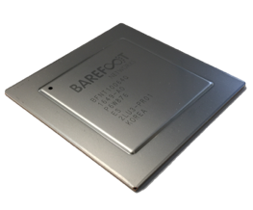
Today, basic information is hard to find
1
“Which path did my packet take?”
“Which rules did my packet follow?”
“How long did it queue at each switch?”
“Who did it share the queues with?”
2
3
4
With P4 + INT we can answer all four questions for the first time. At full line rate. Without generating additional packets.
Notes:
INT slides taken from material by Nick McKeown/Changhoon Kim.

Slide 18
INT: In-band Network Telemetry
SwitchID, Arrival Time,
Queue Delay, Matched Rules, …
Original Packet
Log, Analyze
Replay and Visualize
Notes:
INT slides taken from material by Nick McKeown/Changhoon Kim.

Slide 19
Technical Innovations of RMT

Slide 20
Two key innovations
Flexible packet parser
  Useful to introduce new fields into packets
Ability to allocate table memories flexibly
  Use fields of your choice
  Free to choose depth and width of tables
  Run multiple tables per stage
  Or one table across multiple stages

Slide 21
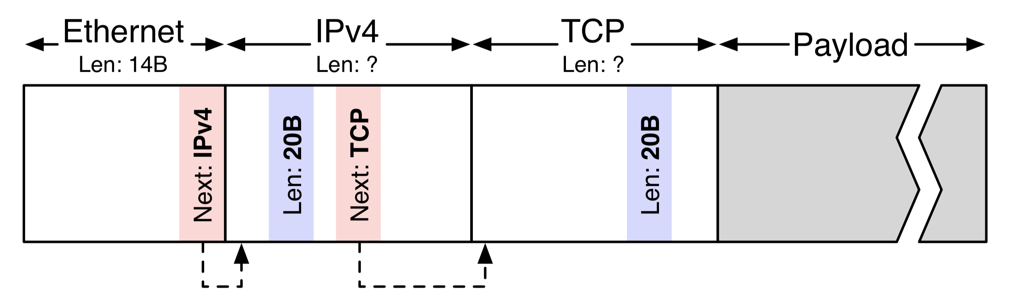
Parsing packets
Source: Design principles for packet parsers, Gibb et al.

Slide 22
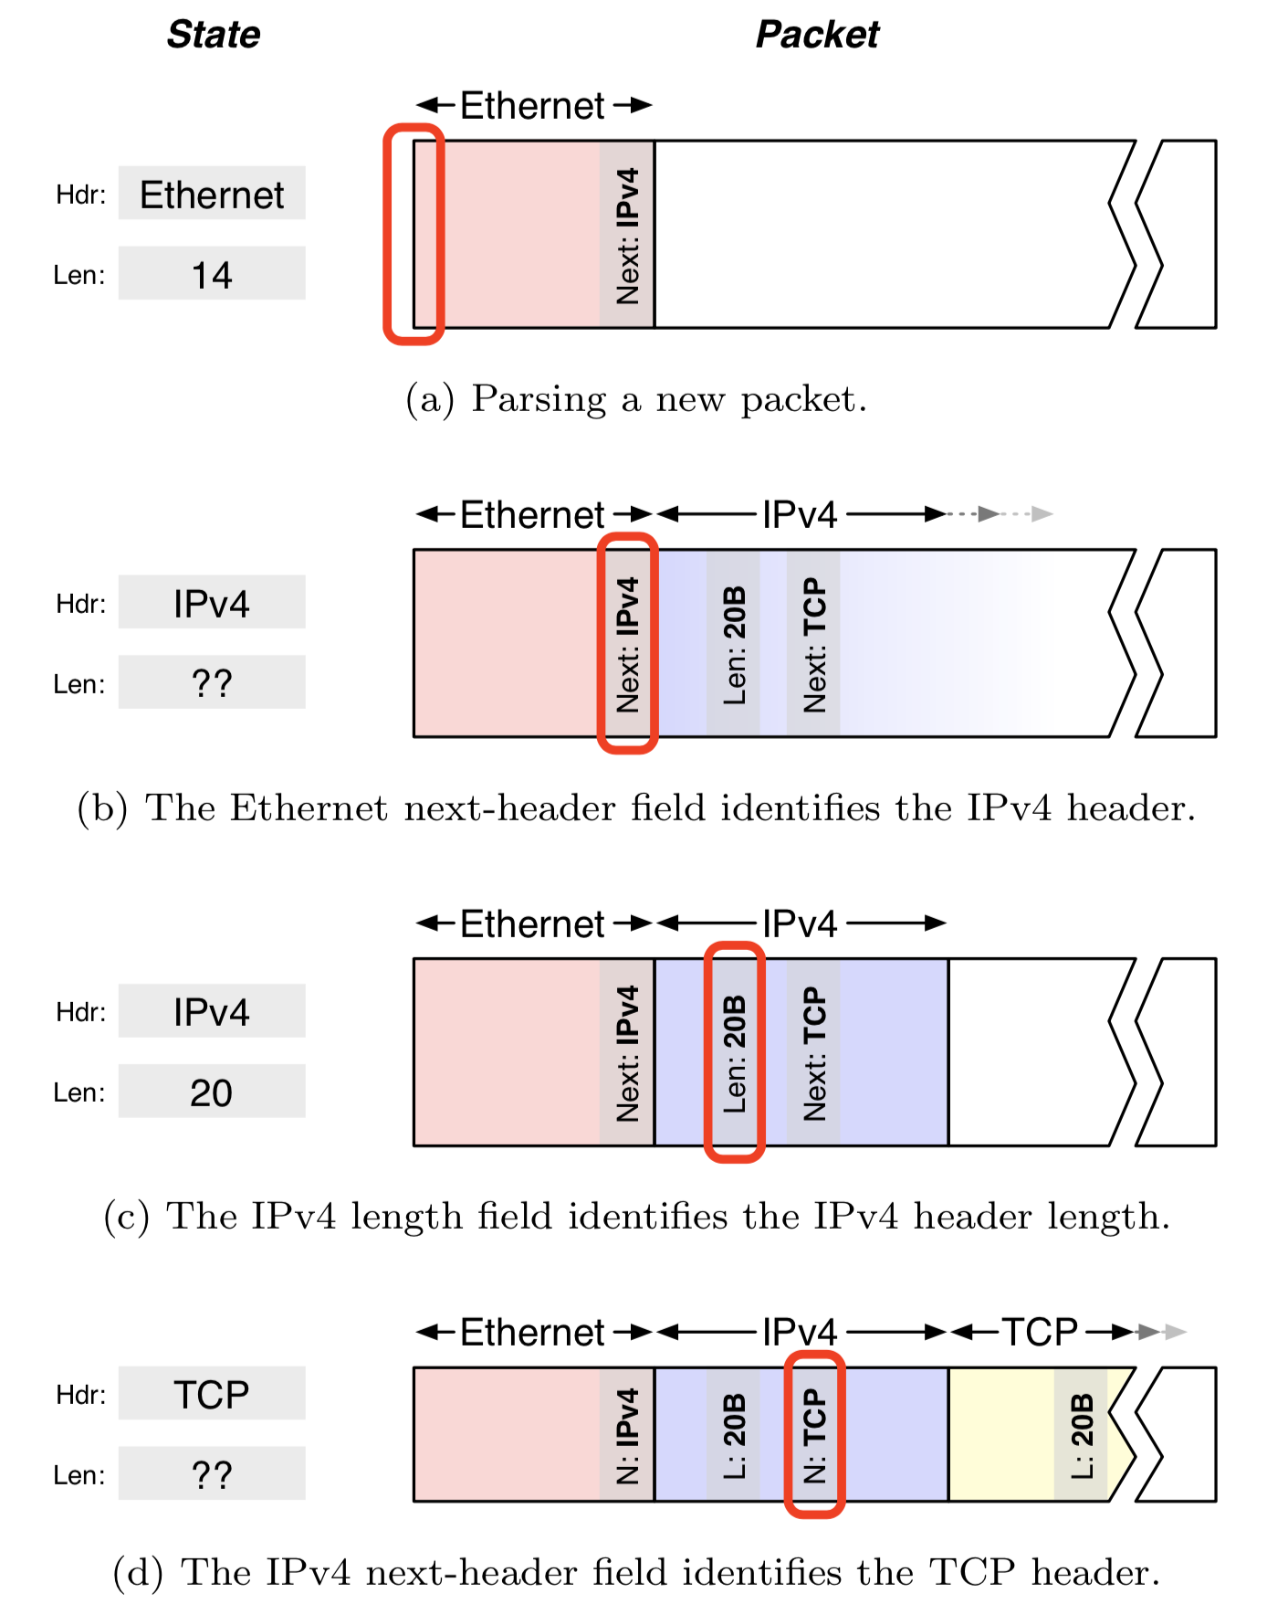
Parsing state machine
Inherently sequential process
  Previous header determines the next header type
  Current header length determines the start of the next header
Parser state: tracks the current header and its length
  Help jump to the next state

Slide 23
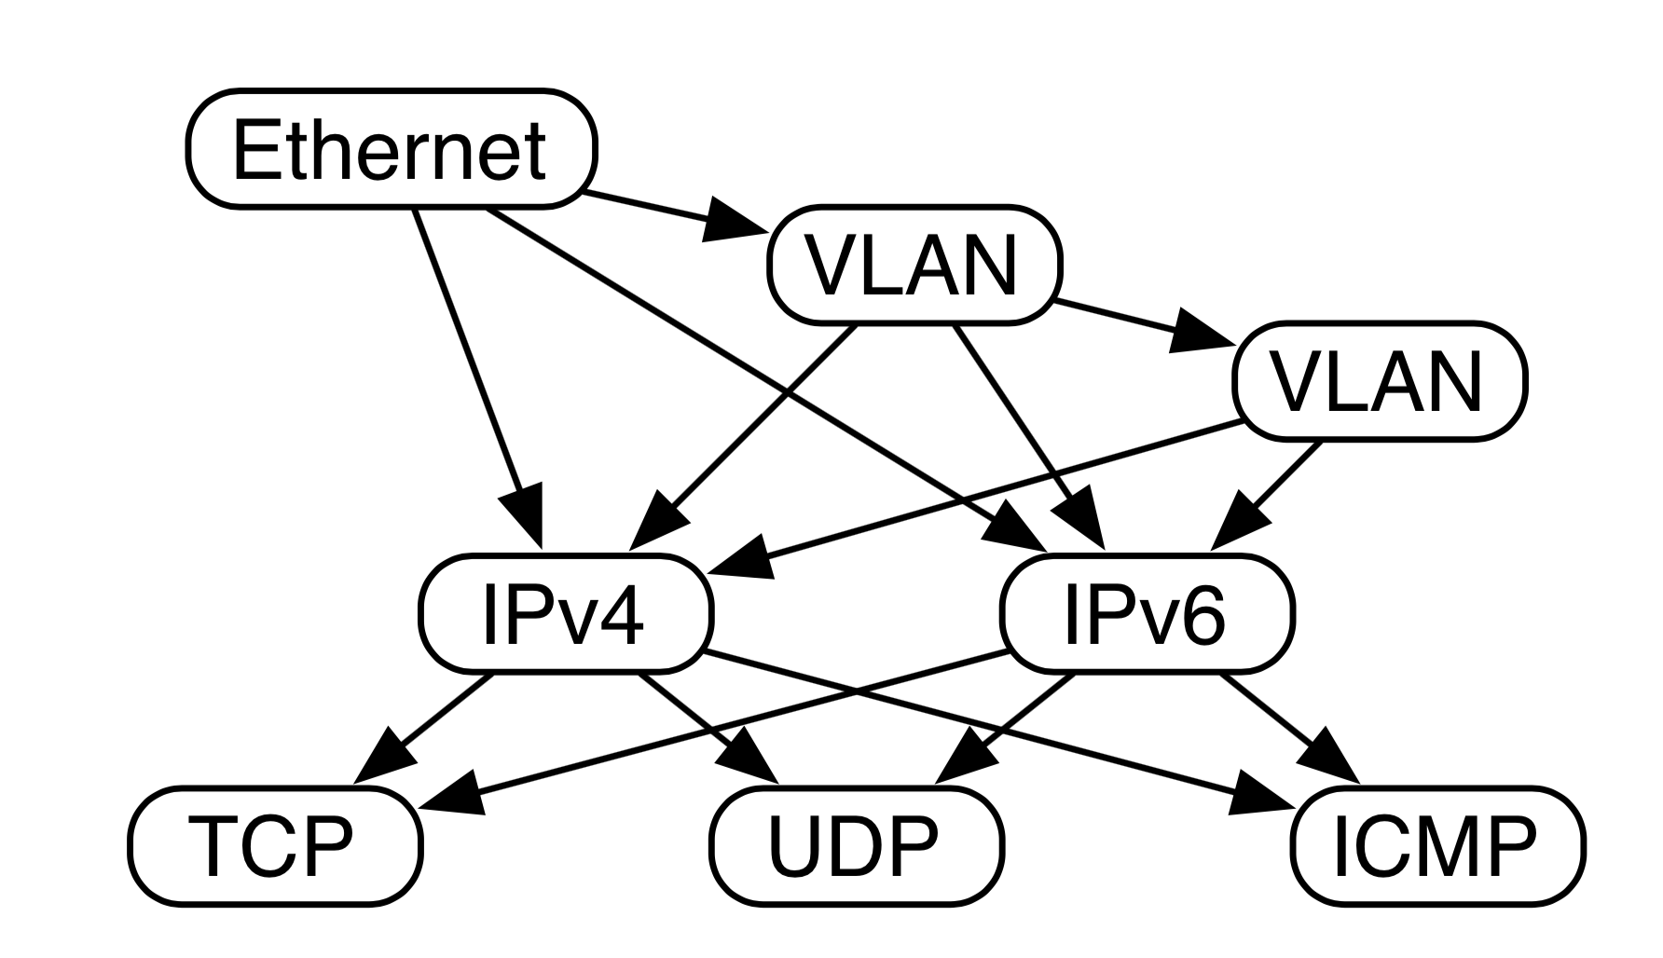
Goal: encode fields from parse graph
Representation of all valid header sequences

Slide 24
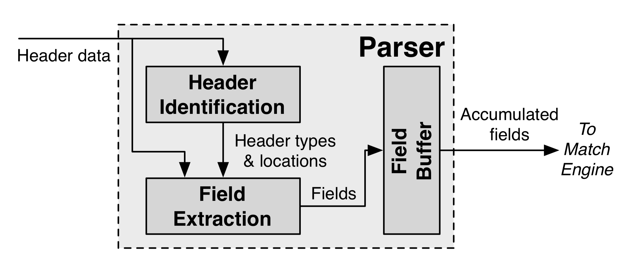
A hardware (fixed) packet parser
Two steps
Identify sequence of headers
Extract fields from identified headers

Slide 25
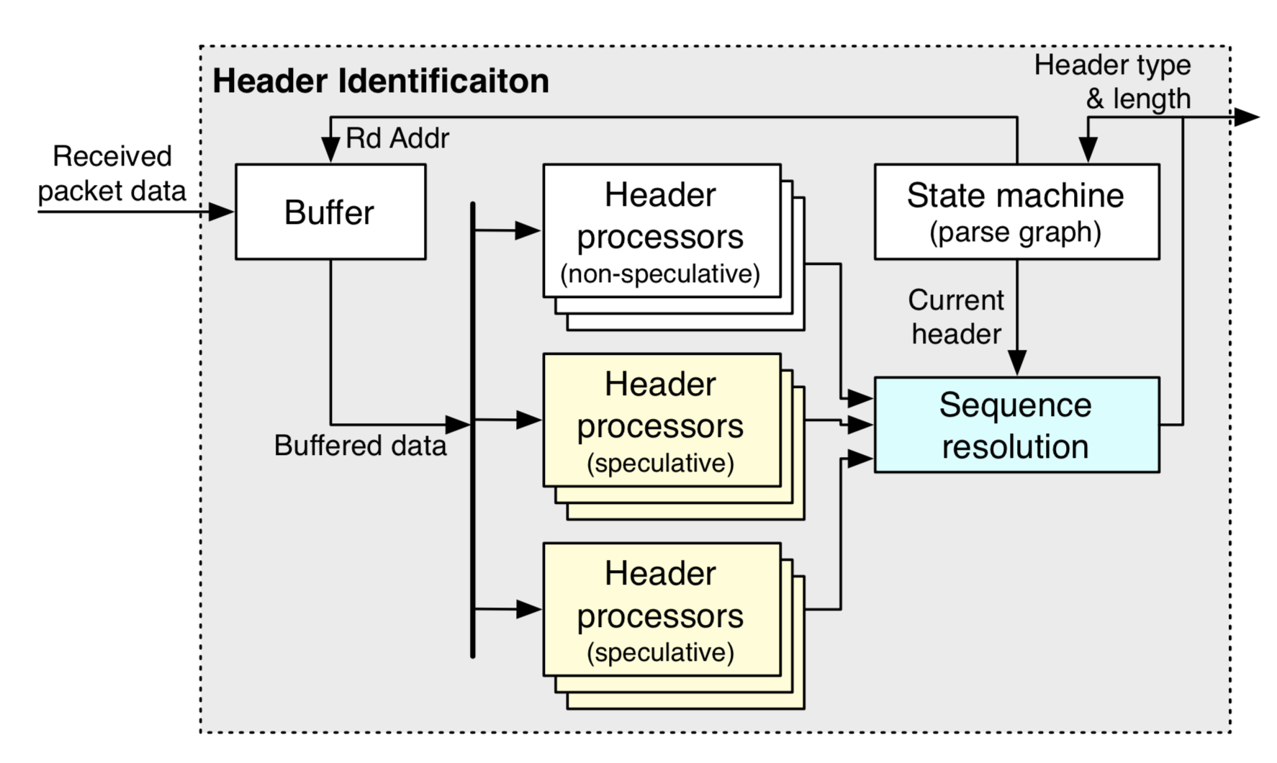
Header identification
Identify headers through fixed-function header processors
Simple design: extract one header per cycle
Speculate to extract multiple headers/cycle
  Seq.res. picks one

Slide 26
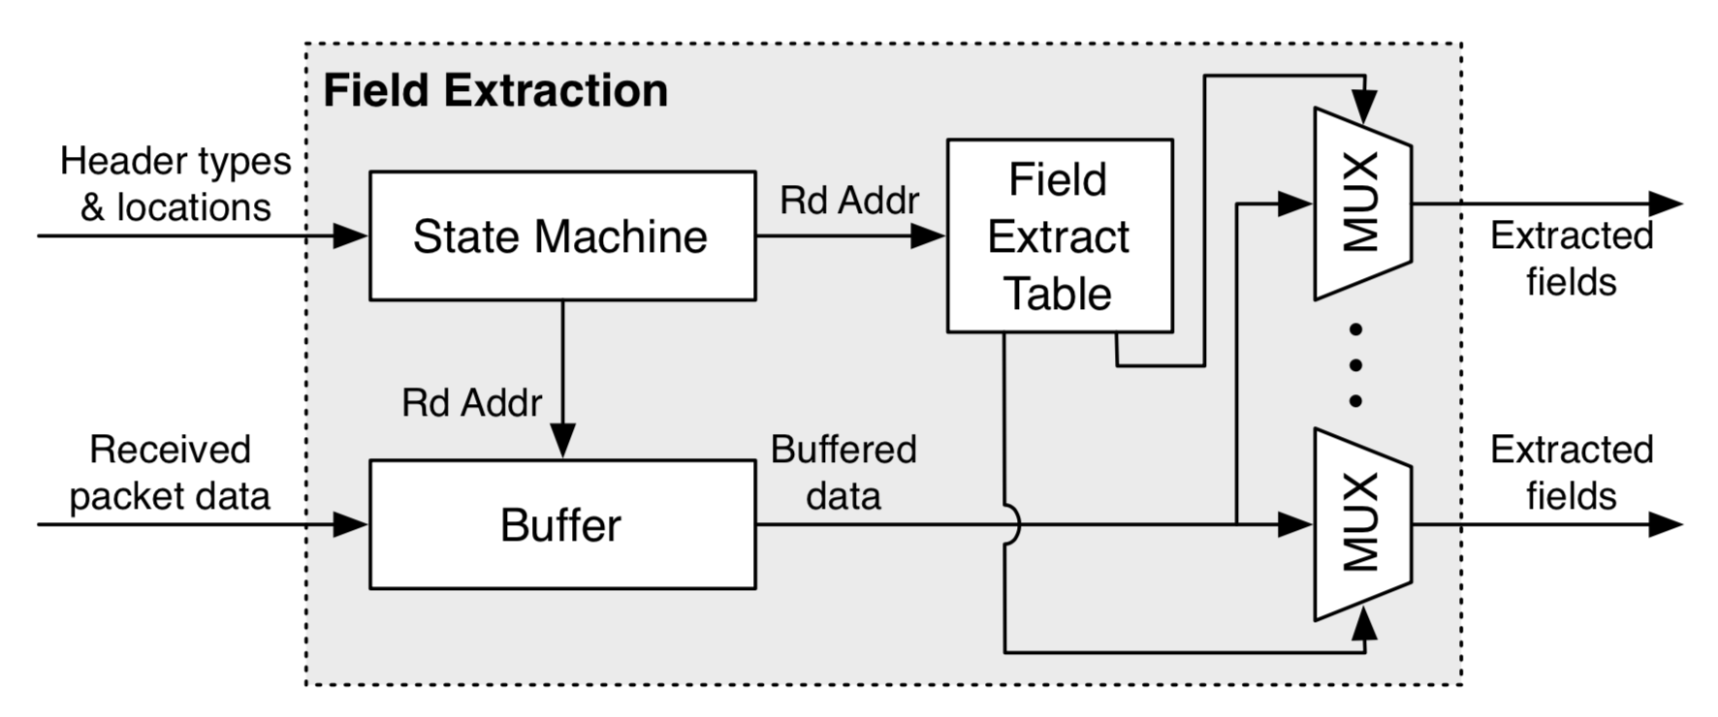
Field extraction
Extract fields using fixed offsets into the packet, depending on parser state
Field-extract table hard-coded for specific fields

Slide 27
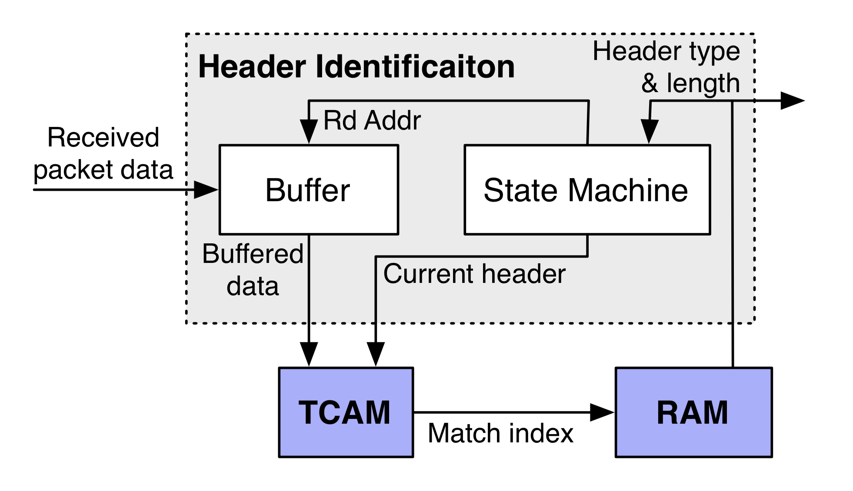
Programmable parser
Morph header processor into TCAM
Content-addressable memory allows us to find matches in one clock cycle, rather than fixed-function header processor
Field extraction data goes into the RAM

Slide 28
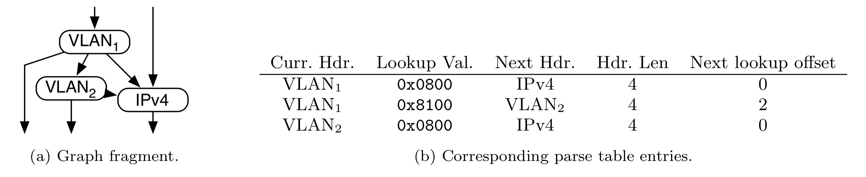
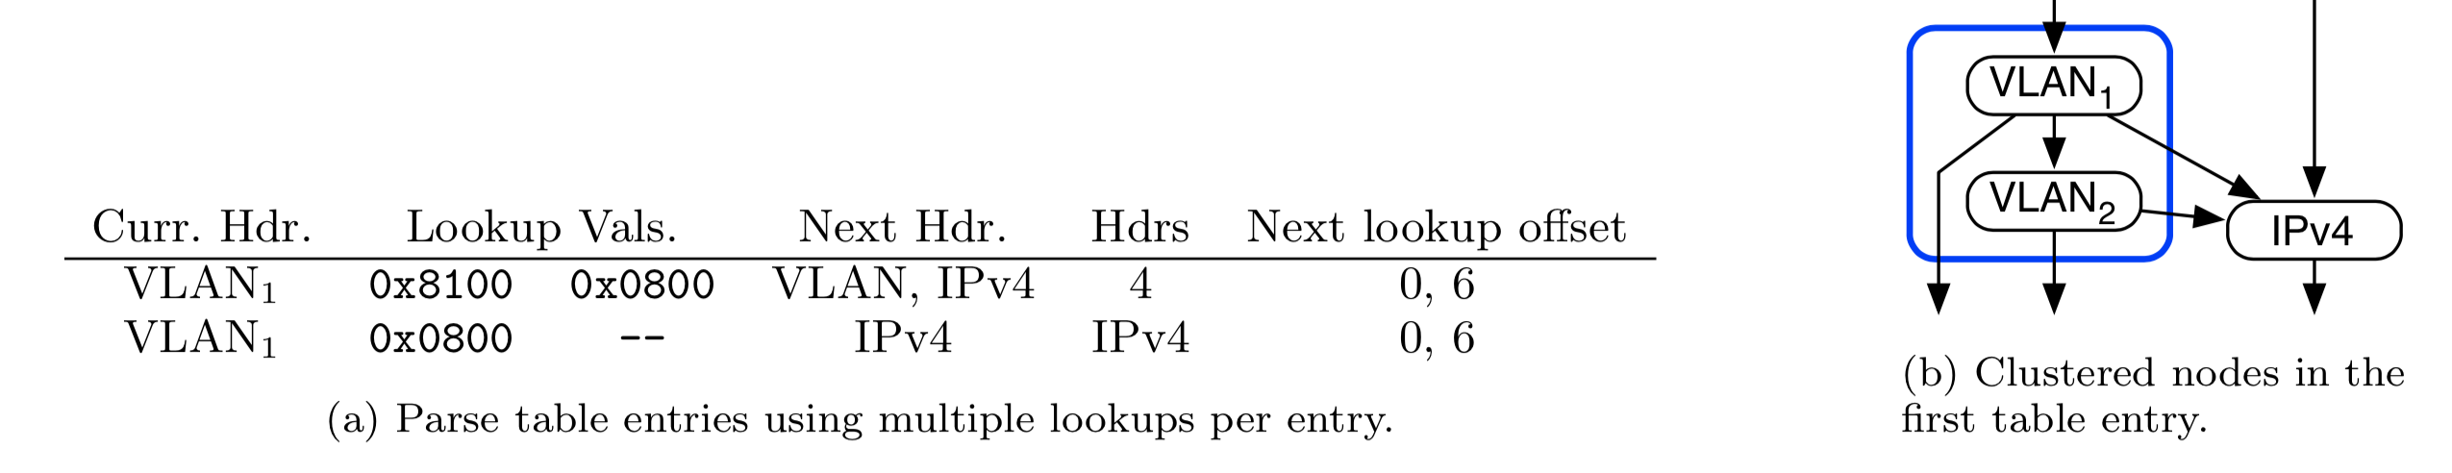
Optimize parsing by clustering states
Consequence: increase parser throughput significantly (Tofino: 400 Gbit/s)

Slide 29
Match-Action Table memory design
Match and Action units supplied with the Packet Header Vector
Each pipeline stage accesses its own local memory
VLIW: modify each component of PHV if needed
PHV

Slide 30
Match-Action Table memory design
Hardware realization: separately configurable memory blocks
➔ Key to table flexibility
SRAM
Exact match
Action memory
Statistics
L2
Fixed
match function
VS.
PHV
Flexible match function
TCAM
wildcard match
Faster than trie
14% extra area (& power) for fatter wires

Slide 31
Match-Action Table memory design
Hardware realization: separately configurable memory blocks
➔ Key to table flexibility
SRAM
Exact match
Action memory
Statistics
L2
Match RAM blocks also contain
pointers to action memory and instructions
VS.
PHV
TCAM
wildcard match
Faster than trie

Slide 32
Summary of RMT
Reconfigurability works
  Flexible logic is cheap (1—2% of chip area)
  Memory is more expensive, but overheads are worth the cost
Better abstractions and tools arise due to reconfigurability
RMT has inspired a lot of further work
  Compilers, verification, testing
  Architecting other hardware platforms (e.g., NICs)
  Better monitoring of networks
  Possibility of “zero touch” networking

