Slide 1
CPU Virtualization:
Scheduling

Slide 2
Review of Concepts: Scheduling
Workloads: arrival_time run_time
Schedulers: FIFO SJF STCF RR
Metrics (efficiency): turnaround_time response_time
Q3
A
Fair sharing schedulers
Q2
B
A: 100
B: 50
C: 250
Choose randomly in proportion to tickets
Q1
Lottery
Q0
C
D
MLFQ

Slide 3
Stride Scheduling
Can we make lottery scheduling more “deterministic”?
Goal: Make each process run deterministically in proportion to its tickets
Suppose tickets A: 100, B: 50, C: 250
Define a stride: (large number, say 10000)/#tickets
A: 100, B: 200, C: 40
Every time process runs, increment a counter, pass, by the stride
Pick process with the minimum pass to schedule

Slide 4
Stride Scheduling example
Pass(A) Pass(B) Pass(C) Who runs?
stride=100 200 40
0 0 0
A
100 0 0
B
100 200 0
C
100 200 40
C
100 200 80
C
100 200 120
A

Slide 5
Problems with stride scheduling
Simple enough, but…
Global state can be bad (across processes)
Troublesome to provide fair share for new processes
Suppose process D enters after 5 runs of stride scheduler
What should its pass value be?
Lottery: every scheduler run is likely to choose process proportional to its fair share
If the process needs to change its priority (tickets), how to reinterpret its pass value?

Slide 6
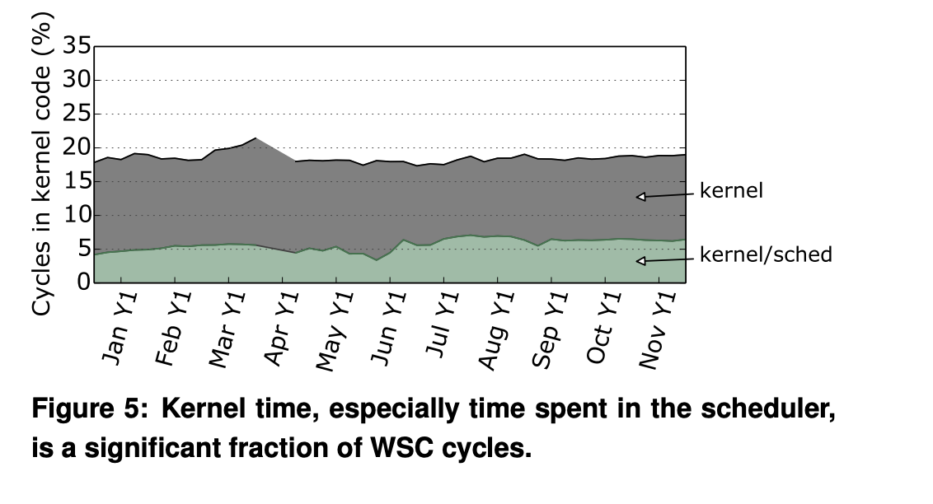
Completely Fair Scheduling
Goal: scheduling many 1000s of processes efficiently

Slide 7
Completely Fair Scheduler
On Linux, in use since 2.6.23, has O(log N) runtime
Move from MLFQ to Weighted Fair Queuing
First major OS to use a fair scheduling algorithm
Processes ordered by the amount of CPU time they use
Gets rid of queues and linked lists in favor of a red-black tree of processes

Slide 8
Key ideas of CFS
Maintain a counter of cumulative execution time
Virtual runtime, like the “pass” in stride scheduling
Schedule process with least virtual runtime. Use R-B trees
Left-most process has always used the least time
Scheduled next
Add the process back to the tree
Rebalance the tree
17
15
25
38
22
27
Precise vruntime (nanoseconds)

Slide 9
Key ideas of CFS
Don’t use a fixed time slice per run
Instead of stride, divide up a “time over which scheduler should be fair” into slices according to number of runnable processes
sched_latency
Like the “large number” we used to compute the stride previously
But what if there are too many processes?
Spend more time context switching than executing processes
min_granularity
Even if process time slice is not a multiple of the timer, can track vruntime precisely using the actual execution time

Slide 10
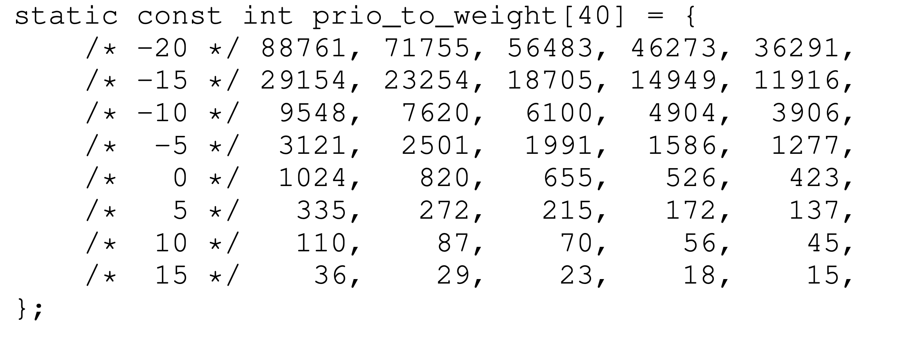
Nice levels to set priorities
ps ax -eo pid,ni,rtprio,cmd
Nice value between -20 to 20. Equivalent of tickets

Slide 11
Multi-Core Scheduling

Slide 12
Multiprocessor Scheduling
The rise of the multicore processor is the source of multiprocessor-scheduling proliferation.
Multicore: Multiple CPU cores are packed onto a single chip.
Adding more CPUs does not make that single application run faster.
Rewrite application to run in parallel, using threads.
How to schedule jobs on Multiple CPUs?

Slide 13
Single CPU with cache
CPU
Cache
Small, fast memories
Hold copies of popular data that is found in the main memory.
Utilize temporal and spatial locality
Cache
Memory
Main Memory
Holds all the data
Access to main memory is slower than cache.
By keeping data in cache, the system can make slow memory appear to be a fast one

Slide 14
Cache Coherence
Consistency of shared resource data stored in multiple caches.
0. Two CPUs with caches sharing memory
CPU 0
CPU 1
Cache
Cache
Bus
Memory
0
1
2
3
Initial D value is 0

Slide 15
Cache Coherence
Consistency of shared resource data stored in multiple caches.
0. Two CPUs with caches sharing memory
1. CPU0 reads a data at address 1.
CPU 0
CPU 1
CPU 0
CPU 1
Cache
Cache
Cache
Cache
Bus
Bus
Memory
Memory
0
1
2
3
0
1
2
3

Slide 16
Cache Coherence
Consistency of shared resource data stored in multiple caches.
CPU 0
CPU 1
Cache
Cache
Bus
Memory
0
1
2
3

Slide 17
Cache Coherence
Consistency of shared resource data stored in multiple caches.
3. CPU1 re-reads the value at address A
CPU 0
CPU 1
CPU 0
CPU 1
Cache
Cache
Cache
Cache
Bus
Bus
Memory
Memory
0
1
2
3
0
1
2
3
Data Inconsistency Problem!

Slide 18
Cache Coherence: one solution
Bus snooping
Each cache pays attention to memory updates by observing the bus.
When a CPU sees an update for a data item it holds in its cache, it will notice the change and either invalidate its copy or update it.
When accessing shared data across CPUs, mutual exclusion primitives should be used to guarantee correctness

Slide 19
Don’t forget synchronization
1 typedef struct __Node_t {
2 int value;
3 struct __Node_t *next;
4 } Node_t;
5
6 int List_Pop() {
7 Node_t *tmp = head; // remember old head ...
8 int value = head->value; // ... and its value
9 head = head->next; // advance head to next pointer
10 free(tmp); // free old head
11 return value; // return value at head
12 }

Slide 20
Don’t forget synchronization
1 typedef struct __Node_t {
2 int value;
3 struct __Node_t *next;
4 } Node_t;
5
int List_Pop() {
lock(&m)
8 Node_t *tmp = head; // remember old head ...
9 int value = head->value; // ... and its value
10 head = head->next; // advance head to next pointer
free(tmp); // free old head
unlock(&m)
12 return value; // return value at head
13 }

Slide 21
Cache Affinity
Keep a process on the same CPU if at all possible
A process builds up a fair bit of state in the cache of a CPU.
The next time the process run, it will run faster if some of its state is already present in the cache on that CPU.
A multiprocessor scheduler should consider cache affinity when making its scheduling decision.

Slide 22
Cache Affinity
Put all jobs that need to be scheduled into a single queue.
Each CPU simply picks the next job from the globally shared queue. Simple.
Cons:
Some form of locking has to be inserted
Lack of scalability
Cache affinity

Slide 23
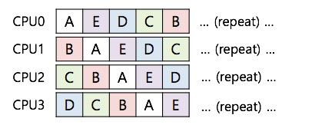
Cache Affinity?
No cache affinity ☹

Slide 24
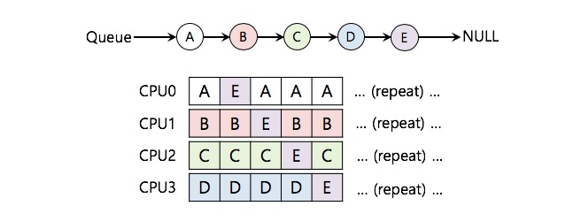
Scheduling with cache affinity

Slide 25
Scheduling with cache affinity
Preserving affinity for most
Jobs A through D are not moved across processors.
Only job E Migrating from CPU to CPU.
Implementing such a scheme can be complex.

Slide 26
Multi-queue Multiprocessor Scheduling (MQMS)
MQMS consists of multiple scheduling queues.
Each queue will follow a particular scheduling discipline.
When a job enters the system, it is placed on exactly one scheduling queue.
Avoid the problems of information sharing and synchronization.

Slide 27
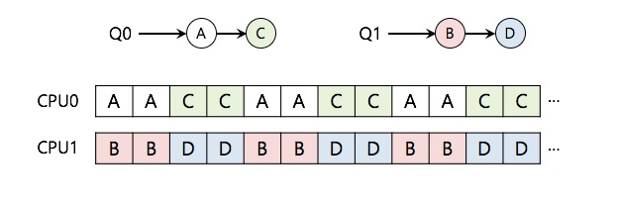
Multi-queue Multiprocessor Scheduling (MQMS)
With round robin, the system might produce a schedule that looks like this:
MQMS provides more scalability and cache affinity.

Slide 28
Problem with MQMS?
Load Imbalance
Need ways to balance load across cores over time by migrating processes across cores

Slide 29
Summary
Understand goals (metrics) and workload, then design scheduler around that
General purpose schedulers need to support processes with different goals
Past behavior is good predictor of future behavior
Random algorithms (lottery scheduling) can be simple to implement and avoid corner cases.
Multiprocessor scheduling: incorporate cache affinity & contention

Slide 30
Memory Virtualization

Slide 31
Questions answered
What is in the address space of a process (review)?
What are the different ways that that OS can virtualize memory?
Time sharing, static relocation, dynamic relocation (base, base + bounds, segmentation)
What hardware support is needed for dynamic relocation?

Slide 32
More Virtualization
1st part of course:Virtualization
Virtual CPU: illusion of private CPU registers
Virtual RAM: illusion of private memory

Slide 33
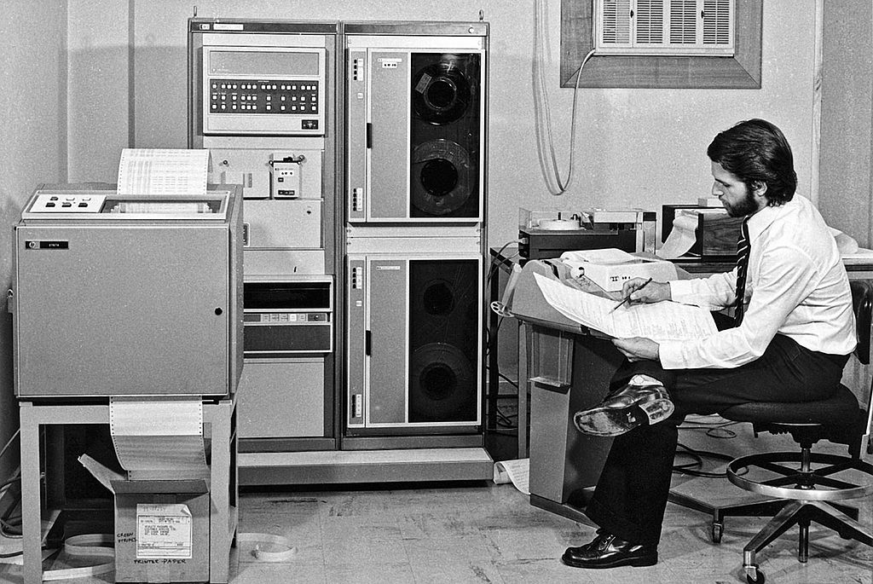
Memory Virtualization – Then (1974)
Albrecht (an astronomer) sits with pencil paper working on code in front of a HP bulky computer, with one processor and a breathtaking 16 kilobytes of magnetic-core memory and 1 Processor
Developed virtual memory system to handle files on tape that were larger than the available memory on his Hewlett Packard 2116 microcomputer

Slide 34
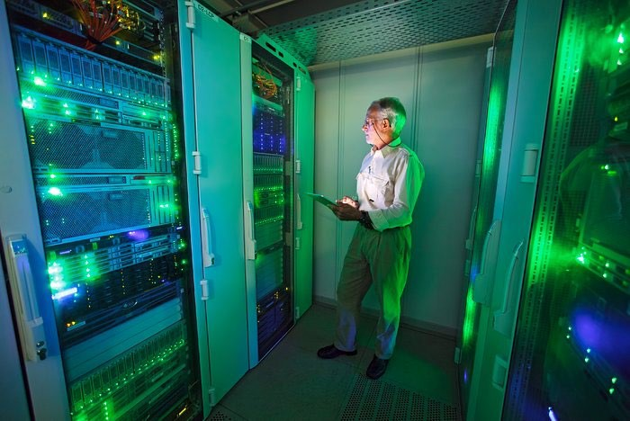
Memory Virtualization – recently (2013)
Albrecht (an astronomer, circa 2013) in front of a datacenter system with 40 processor cores, 138 terabytes of storage capacity and 83 gigabytes of RAM
5 million times more memory!

Slide 35
Motivation for Virtualization
Uniprogramming: One process runs at a time
0
OS
Code
Heap
Stack
Physical Memory
User Process
Address Space
2^{n}-1
Disadvantages:
Only one process runs at a time
Process can destroy OS

Slide 36
Goals of Mem Virtualization
Transparency
Processes are not aware that memory is shared
Works regardless of number and/or location of processes
Protection
Cannot corrupt OS or other processes
Privacy: Cannot read data of other processes
Efficiency
Do not waste memory resources (minimize fragmentation)
Sharing
Cooperating processes can share portions of address space

Slide 37
Abstraction: Address Space
Address space: Each process has set of addresses that map to bytes
Problem:
Code
Heap
Stack
0
How can OS provide illusion of private address space to each process?
Review:What is in an address space?
Address space has static and dynamic components
Static: Code and some global variables
Dynamic: Stack and Heap
2^{n}-1

Slide 38
Motivation for Dynamic Memory
Why do processes need dynamic allocation of memory?
Do not know amount of memory needed at compile time
Must be pessimistic when allocate memory statically
Allocate enough for worst possible case; Storage is used inefficiently
Recursive procedures
Do not know how many times procedure will be nested
Complex data structures: lists and trees
struct my_t *p = (struct my_t *)malloc(sizeof(struct my_t));
Two types of dynamic allocation
Stack
Heap

Slide 39
Where Are stacks Used?
OS uses stack for procedure call frames (local variables and parameters)
main () {
int A = 0; foo (A);
printf(“A: %d\n”, A);
}
void foo (int Z) {
int A = 2; Z = 5;
printf(“A: %d Z: %d\n”, A, Z);
}

Slide 40
Heap Organization
Definition: Allocate from any random location: malloc(), new()
Heap memory consists of allocated areas and free areas (holes)
Order of allocation and free is unpredictable
Advantage
Works for all data structures
Disadvantages
16 bytes
Free
Alloc
Free
Alloc
A
24 bytes
Allocation can be slow
End up with small chunks of free space - fragmentation
Where to allocate 12 bytes? 16 bytes? 24 bytes??
12bytes 16 bytes
B
What is OS’s role in managing heap?
OS gives big chunk of free memory to process; library manages individual allocations

Slide 41
Quiz: Match that Address Location
int x;
int main(int argc, char *argv[]) { int y;
int *z = malloc(sizeof(int)););
}
main? x?
y? z?
*z?
Possible locations: static data, code, stack, heap
What if no static data location?
Address | Location
x | Static data → Code
main | Code
y | Stack
z | Stack
*z | Heap

Slide 42
Memory Accesses
#include <stdio.h> #include <stdlib.h>
int main(int argc, char *argv[]) { int x;
x = x + 3;
}
0x10:
0x13:
0x19:
movl0x8(%rbp), %edi addl $0x3, %edi movl%edi, 0x8(%rbp)
otool -tv demo1.o
(or objdump on Linux)
%rbp is the base pointer:
points to base of current stack frame

Slide 43
How to Virtualize Memory?
Problem: How to run multiple processes simultaneously?
Addresses are “hardcoded” into process binaries.
➔ How to avoid collisions?
Possible Solutions for Mechanisms (covered today):
Time Sharing
Static Relocation
Base
Base+Bounds
Segmentation

Slide 44
1) Time Sharing of Memory
Try similar approach to how OS virtualizes CPU
Observation:
OS gives illusion of many virtual CPUs by saving CPU registers to memory
when a process isn’t running
Could give illusion of many virtual memories by saving memory to disk when process isn’t running

Slide 50
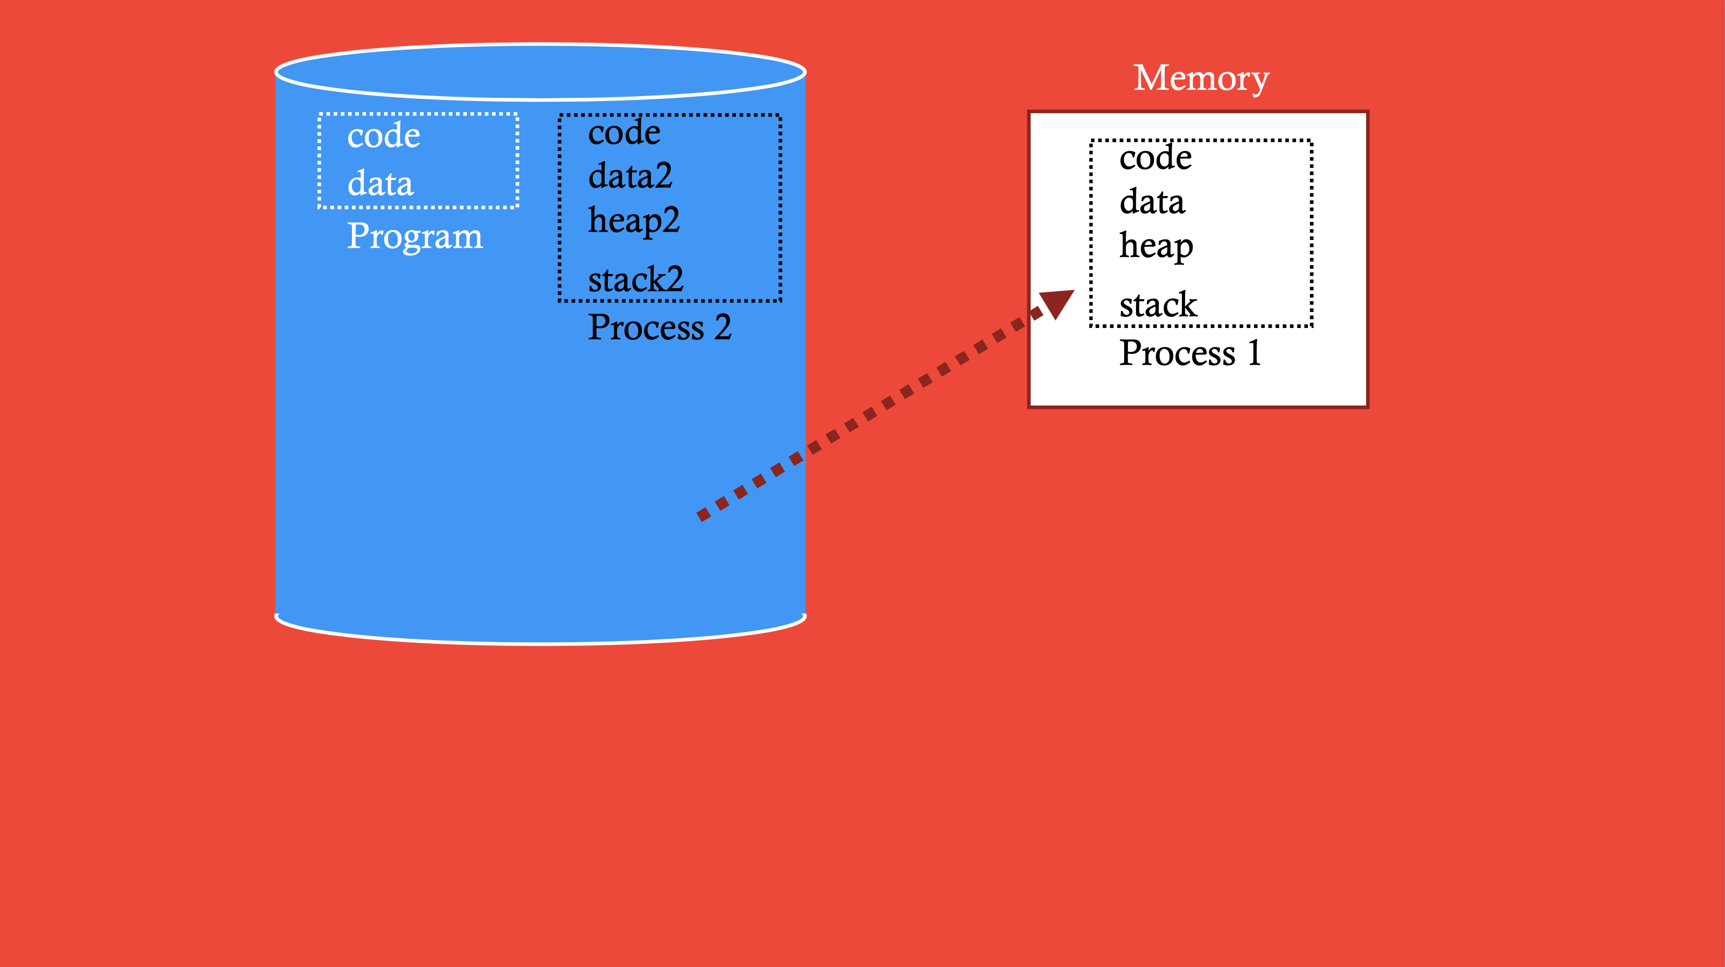

Slide 52
Problems with Time Sharing Memory
Problem: Ridiculously poor performance
Better Alternative: space sharing
At same time, space of memory is divided across processes
Remainder of solutions all use space sharing

Slide 53
2) Static Relocation
Idea: OS rewrites each program before loading it as a process in memory
Each rewrite for different process uses different addresses and pointers
Change jumps, loads of static data
0x1010: movl 0x8(%rbp), %edi 0x1013: addl $0x3, %edi 0x1019: movl %edi, 0x8(%rbp)
rewrite
0x10:
0x13:
0x19:
movl 0x8(%rbp), %edi addl $0x3, %edi
movl %edi, 0x8(%rbp)
0x3010: movl 0x8(%rbp), %edi 0x3013: addl $0x3, %edi 0x3019: movl %edi, 0x8(%rbp)
rewrite

Slide 54
Static: Layout in Memory
(free)
Program Code
Heap
(free)
stack
(free)
Program Code
Heap
(free)
stack
(free)
0x1010: movl 0x8(%rbp), %edi 0x1013: addl $0x3, %edi 0x1019: movl %edi, 0x8(%rbp)
4 KB
process 1
8 KB
12 KB
0x3010: movl 0x8(%rbp), %edi 0x3013: addl $0x3, %edi 0x3019: movl %edi, 0x8(%rbp)
process 2
16 KB

Slide 55
Static Relocation: Disadvantages
No protection
Process can destroy OS or other processes
Possible to create addresses on the fly, and read/write
No privacy
Cannot move address space after it has been placed
May not be able to allocate new process

Slide 56
3) Dynamic Relocation
Goal: Protect processes from one another
Requires hardware support
Memory Management Unit (MMU)
MMU dynamically changes process address at every memory reference
Process generates logical or virtual addresses (in their address space)
Memory hardware uses physical or real addresses
Process runs here
OS can control MMU
CPU
MMU
Memory
Physical address
Logical address

Slide 57
Hardware Support for Dynamic Relocation
Two operating modes
Privileged (protected, kernel) mode: OS runs
When enter OS (trap, system calls, interrupts, exceptions)
Allows certain instructions to be executed
Can manipulate contents of MMU
Allows OS to access all of physical memory
User mode: User processes run
Perform translation of logical address to physical address
Minimal MMU contains base register for translation
base: start location for address space

Slide 58
Implementation of Dynamic Relocation: BASE REG
Translation on every memory access of user process
MMU adds base register to logical address to form physical address
MMU
32 bits
1 bit
registers
base
mode
logical address
physical address
mode
=
user?
no
yes
+
base

