Slide 1

DASH, Transport Intro
Lecture 9
http://www.cs.rutgers.edu/~sn624/352-S22
Srinivas Narayana

Slide 2



Quick recap of concepts
Video Bitrate
Bits played out per second
(can vary over video’s lifetime)
App layer
variable
network
delay
Buffer at the client to hold frames initially until playout delay t_{p}
Choosing t_{p} is hard! Don’t know buffer fill rate apriori
Adaptive bit-rate selection
Constant bitrate video
transmitted @ server
Cumulative data
Reality
Ideal @ client
time

Slide 3
Dynamic Adaptive Streaming over HTTP (DASH)

Slide 4
Streaming multimedia with DASH
Dynamic Adaptive Streaming over HTTP
  Used by Netflix and most popular video streaming services
Adaptive: Perform video bit rate adaptation
  It can be done on the client, or the server (with client feedback)
Dynamic: Retrieve a single video from multiple sources
The DASH video server is just a standard HTTP server
  Provides video/audio content in multiple formats and encodings
Leverage existing web-based infrastructure
  DNS
  CDNs!

Slide 5
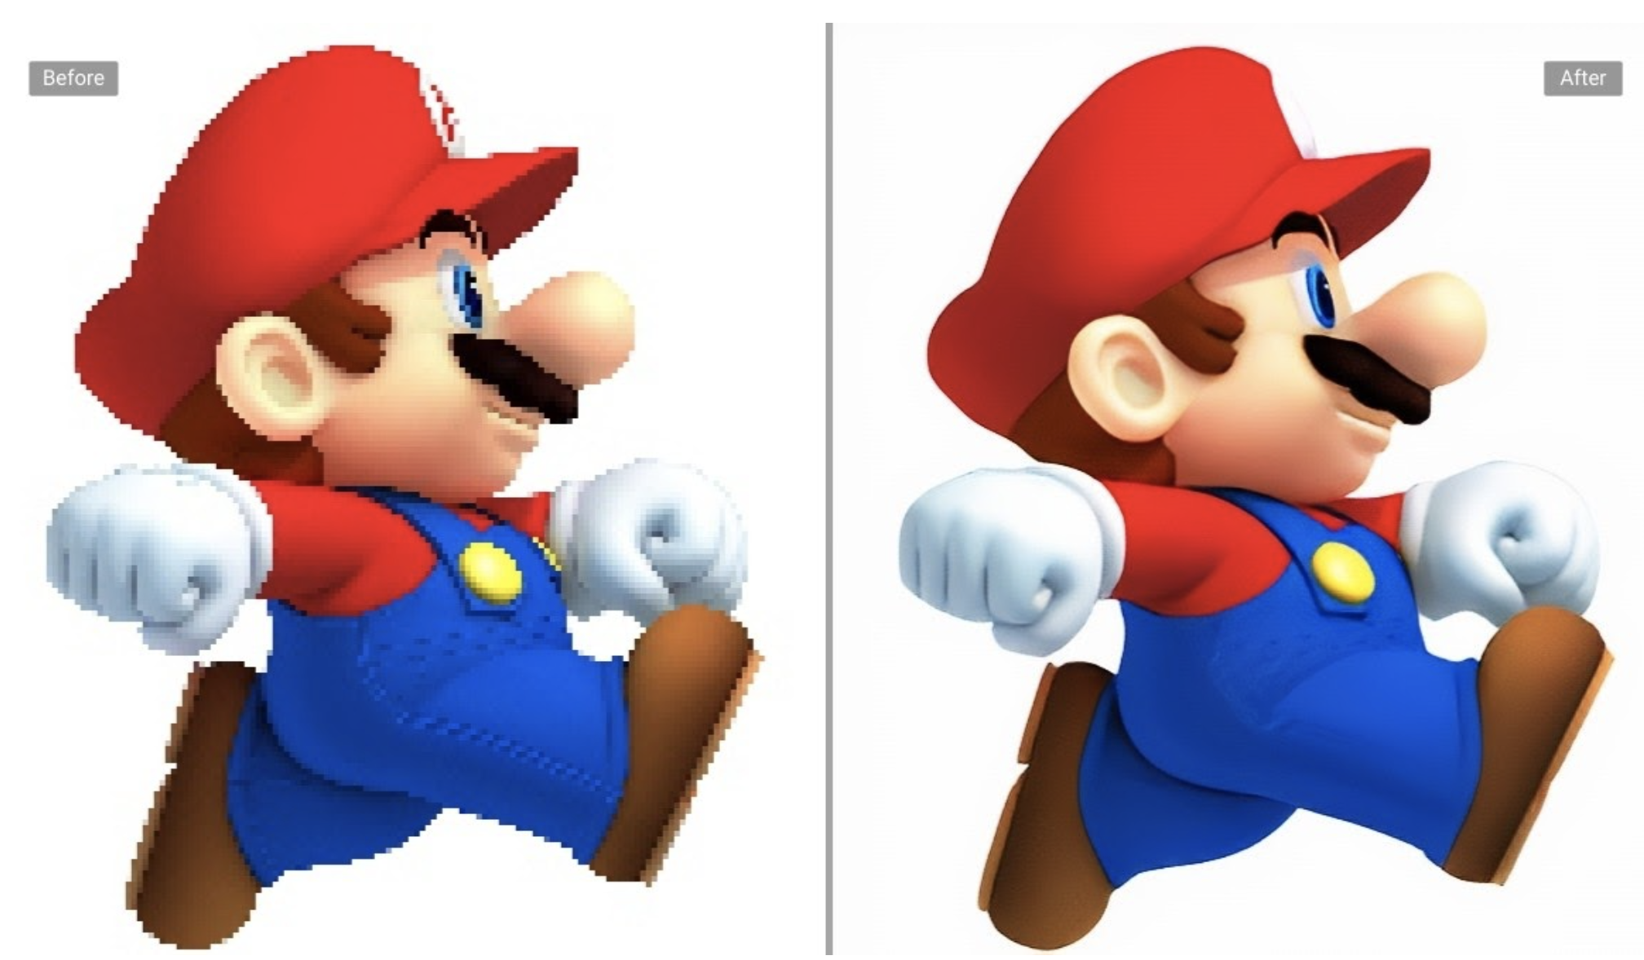
DASH: Key ideas
Web Browser
Or Video Client
Content (video, audio, transcript, etc.) divided into segments (time)
Algorithms to determine and request varying attributes (e.g., bitrate, language) for each segment
Goal: ensure good quality of service, match user prefs, etc.
HTTP
client
Media
player
Issue requests on time. Pick attributes for each segment of content
Media Presentation
Description (manifest)
Video
Server
Audio
Transcripts

Slide 6
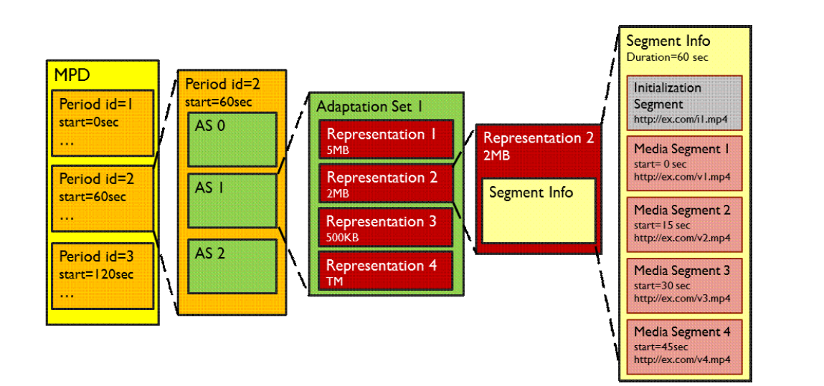
What does the manifest contain?
Functionally equivalent: RSes of given AS
Functionally different: different ASes
Adaptation set: functionally equivalent content
Representations: codecs, bit rates, etc.
Periods:
Durations of content
Multiple segments per representation
URL available for each segment
Byte ranges per segment (HTTP header for a range request)
Source: Stockhammer, MMSys.
https://www.w3.org/2010/11/web-and-tv/papers/webtv2_submission_64.pdf

Slide 7
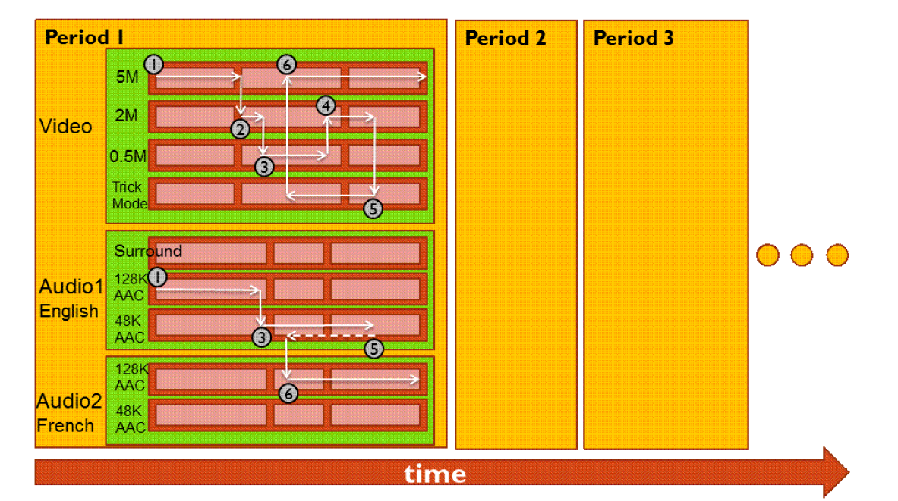
Dynamic changes in stream quality

Slide 8

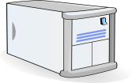
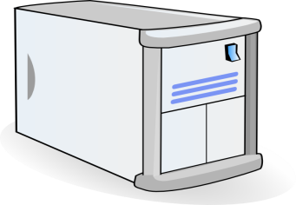

Dynamic changes in stream location
Just an HTTP request for an HTTP object
CDN DNS points user to best CDN server
2. HTTP reply containing html to construct the web page, manifest, with URLs for video content
3. HTTP GET request
for URLs
CDN servers caching the video
Internet
YouTube origin servers
Subtle: DNS granularity is per (sub)domain.
Content from different (sub)domains can go to different CDN servers or origin
  1. HTTP GET request for video URL
4. HTTP reply
with cached resources at those URLs
User

Slide 9
DASH reference player
https://reference.dashif.org/dash.js/latest/samples/dash-if-reference-player/index.html

Slide 10
DASH Summary
Piggyback video on HTTP: widely used
Enables independent HTTP requests per segment
  Choose dynamic quality & preferences over time
  Independent HTTP byte ranges
Works well with CDNs
  Fetch segments from locations other than the origin server
  Fetch different segments from possibly different locations
More resources on DASH
  https://www.w3.org/2010/11/web-and-tv/papers/webtv2_submission_64.pdf
  https://www.youtube.com/watch?v=xgowGnH5kUE

Slide 11
Application Layer: Wrap-up
Name resolution, the web, mail, video
Protocols built over the socket() abstraction
Simple designs go a long way
  Plain text protocols, header-based evolution, …
Infrastructure for functionality, performance, …
  Mail servers, CDNs, proxies, …
Fit your apps to run on browsers: run almost anywhere (e.g. video)
Apps are ultimately what users and most engineers care about
BUT: if you don’t understand what’s under the hood, you risk bad design and poor performance for your Internet-facing applications
App layer
App layer

Slide 12
Server Selection
File → server mapping done in at least three ways
Dynamic DNS resolution
  DNS returns different IP addresses for a given DNS name
HTTP redirect
  Use HTTP status code 3xx [with new URL]
  Web browser does a GET from the new site
IP anycast
  Use BGP to announce the same IP address from different locations
  Client reaches “nearest” location according to inter-domain routing

Slide 13
Transport

Slide 14
Transport
Application
HTTPS
FTP
HTTP
SMTP
DNS
Transport
TCP
UDP
Tp layer
Network
IP
Host-to-Net
X.25
…
802.11
ATM

Slide 15

Transport services and protocols
application
transport
network
data link
physical
Provide a communication abstraction between application processes
Transport protocols run @ endpoints
  send side: transport breaks app messages into segments, passes to network layer
  recv side: reassembles segments into messages, passes to app layer
Multiple transport protocols available to apps
  Very popular in the Internet: TCP and UDP
application
transport
network
data link
physical

Slide 16






Transport vs. network layer
Household analogy:
3 kids sending letters to 3 kids
endpoints = houses
processes = kids
app messages = letters in envelopes
transport protocol = Alice and Bob who de/mux to in-house siblings
network-layer protocol = postal service
Network layer: abstraction to communicate between endpoints. Network layer provides best effort packet delivery to a remote endpoint.
Transport layer: communication abstraction between processes. Delivers packets to the process.
Alice
Bob

Slide 17
Identifying a single conversation
Application connections are identified by 4-tuple:
Source IP address
Source port
Destination IP address
Destination port
In this analogy,
Source address: the address of the first house
Source port: name of a kid in the first house
Destination address: the address of the second house
Destination port: name of a kid in the second house

Slide 18
Transport vs. network layer
Hotel analogy:
Hotel residents order food to their rooms from a restaurant using a delivery service.
processes = residents of rooms and restaurant chefs
app messages = food packages
endpoint = the hotel / restaurant
transport protocol = local hotel staff who bring the food to the different rooms
network-layer protocol = food delivery service
Network layer: abstraction to communicate between endpoints. Network layer provides best effort packet delivery to a remote endpoint.
Transport layer: communication abstraction between processes. Delivers packets to the process.

Slide 19
Identifying a single conversation
Application connections are identified by 4-tuple:
Source IP address
Source port
Destination IP address
Destination port
In this analogy,
Source address: the address of the restaurant
Source port: the chef preparing the specific order
Destination address: the address of the hotel
Destination port: room number in the hotel

Slide 20
Demultiplexing Packets

Slide 21
Two popular transports
Transmission Control Protocol (TCP)
Connection-based: the application remembers the other process talking to it.
Suitable for longer-term, contextual data transfers, like HTTP, file transfers, etc.
Guarantees: reliability, ordering, congestion control
User Datagram Protocol (UDP)
Connectionless: app doesn’t remember the last process or source that talked to it.
Suitable for single req/resp flows, like DNS.
Guarantees: basic error detection

Slide 22



Demultiplexing
Machine 1
Applications
Port 1
Machine 1
IP addr 1
Port 2
…
Denotes an attachment point with the network.
Transport
…
…
…
…
Network
Port 65535
Machine 1
IP addr 2
Link layer
socket()
Ports
Each IP address comes with a full copy of its own ports.
Machine

Slide 23
Demultiplexing
Machine 1
Port 1
Machine 1
IP addr 1
Port 2
…
Denotes an attachment point with the network.
Transport
…
…
…
…
Network
Port 65535
Machine 1
IP addr 2
socket()
Ports
Each IP address comes with a full copy of its own ports.
Machine

Slide 24
Demultiplexing
Machine 1
Port 1
Machine 1
IP addr 1
Port 2
…
Denotes an attachment point with the network.
Src port, Dst port
…
…
…
…
Src IP, Dst IP,
Tp Protocol
Port 65535
Machine 1
IP addr 2
socket()
Ports
Each IP address comes with a full copy of its own ports.
Machine

Slide 25



Demultiplexing
Connection lookup: The operating system does a lookup using these data to determine the right socket and app.
Machine 1
Port 1
Machine 1
IP addr 1
Port 2
…
Denotes an attachment point with the network.
Src port, Dst port
…
…
…
…
Src IP, Dst IP,
Tp Protocol
Port 65535
Machine 1
IP addr 2
socket()
Ports
Each IP address comes with a full copy of its own ports.
Machine

Slide 26
Demultiplexing
Connection lookup: The operating system does a lookup using these data to determine the right socket and app.
Machine 1
Port 1
Machine 1
IP addr 1
Port 2
…
TCP sockets:
(src IP, dst IP, src port, dst port)
➔
Socket ID
Denotes an attachment point with the network.
…
…
…
…
Port 65535
Machine 1
IP addr 2
socket()
Ports
Each IP address comes with a full copy of its own ports.
Machine

Slide 27
Demultiplexing
Connection lookup: The operating system does a lookup using these data to determine the right socket and app.
Machine 1
Port 1
Machine 1
IP addr 1
Port 2
…
TCP sockets:
(src IP, dst IP, src port, dst port)
➔
Socket ID
Denotes an attachment point with the network.
…
…
Port 44262
…
Port 65535
Machine 1
IP addr 2
socket()
Ports
Each IP address comes with a full copy of its own ports.
Machine

Slide 28
Demultiplexing
Connection lookup: The operating system does a lookup using these data to determine the right socket and app.
Machine 1
Port 1
Machine 1
IP addr 1
Port 2
…
TCP sockets:
(src IP, dst IP, src port, dst port)
➔
Socket ID
UDP sockets:
(dst IP, dst port)
➔
Socket ID
Denotes an attachment point with the network.
…
…
…
…
Port 65535
Machine 1
IP addr 2
Connectionless: the socket is shared across all sources!
socket()
Ports
Each IP address comes with a full copy of its own ports.
Machine

Slide 29
Demultiplexing
Connection lookup: The operating system does a lookup using these data to determine the right socket and app.
Machine 1
Port 1
Machine 1
IP addr 1
Port 2
…
TCP sockets** Some caveats!
(src IP, dst IP, src port, dst port)
➔
Socket ID
UDP sockets:
(dst IP, dst port)
➔
Socket ID
Denotes an attachment point with the network.
…
…
…
…
Port 65535
Machine 1
IP addr 2
Connectionless: the socket is shared across all sources!
socket()
Ports
Each IP address comes with a full copy of its own ports.
Machine

Slide 30
TCP sockets of different types
Listening (bound but unconnected)
# On server side
ss = socket(AF_INET, SOCK_STREAM)
ss.bind(serv_ip, serv_port)
ss.listen() # no accept() yet
Connected (Established)
# On server side
csockid, addr = ss.accept()
# On client side
cs.connect(serv_ip, serv_port)
(src IP, dst IP, src port, dst port)
➔
Socket (csockid NOT ss)

Slide 31
TCP sockets of different types
Listening (bound but unconnected)
# On server side
ss = socket(AF_INET, SOCK_STREAM)
ss.bind(serv_ip, serv_port)
ss.listen() # no accept() yet
Connected (Established)
# On server side
csockid, addr = ss.accept()
# On client side
cs.connect(serv_ip, serv_port)
accept() creates a new socket with the
4-tuple (established) mapping
(dst IP, dst port)
➔
Socket (ss)
(src IP, dst IP, src port, dst port)
➔
Socket (csockid NOT ss)
Enables new connections to be demultiplexed correctly
Enables existing connections to be demultiplexed correctly

Slide 32
TCP demultiplexing
When a TCP packet comes in, the operating system:
Looks up table of existing connections using 4-tuple
  If success, send to corresponding (established) socket
If fail (no table entry), look up table of listening connections using just (dst IP, dst port)
  If success, send to corresponding (listening) socket
If fail again (no table entry), send error to client
  Connection refused

Slide 33
UDP demultiplexing
When a UDP packet comes in, the operating system:
Looks up table of listening UDP sockets using (dst IP, dst port)
  If success, send packet to corresponding socket
  There are no “established” UDP sockets
If fail (no table entry), send error to client
  Port unreachable

Slide 34
Listing sockets and connections
List all sockets with ss
Create and observe UDP sockets with iperf
Observe a TCP listening socket with iperf (or your own server!)

