Slide 1

The Application Layer:
Video Streaming
Lecture 8
http://www.cs.rutgers.edu/~sn624/352-S22
Srinivas Narayana

Slide 2



Quick recap of concepts
Video representation:
Pixels in Frames
App layer
Spatial coding
Temporal coding
Codec
Simple Mail Transfer Protocol (SMTP)
Mail access protocols
POP, IMAP, HTTP
Sender’s mail server
Recipient’s mail server
SMTP
Sender’s user agent
SMTP
Recipient’s user agent
??

Slide 3
Video codecs: terminology
Video bit rate: effective number of bits per second of the video after encoding
Higher bit rate == higher perceptual quality
CBR: (constant bit rate): fixed bit-rate video
VBR: (variable bit rate): different parts of the video have different bit rates, e.g., changes in color, motion, etc.
  For VBR, we talk about average bit-rate over video’s duration
https://blog.video.ibm.com/streaming-video-tips/what-is-video-encoding-codecs-compression-techniques/

Slide 4
Networking multimedia: 3 types
On-demand streamed video/audio
  Can begin playout before downloading the entire file
  Ful video/audio stored at the server: able to transmit faster than audio/video will be rendered (with storing/buffering at client)
  e.g., Spotify, YouTube, Netflix
Conversational voice or video over IP
  interactive human-to-human communication limits delay tolerance
  e.g., Zoom, Google Stadia
Live streamed audio, video
  e.g, sporting event on sky sports
  Can buffer a little, but must be close to the “live edge” of content

Slide 5
On-demand Video Streaming

Slide 6
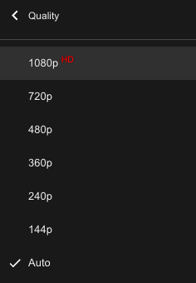
Streaming (stored) video
Media is prerecorded at different qualities
  Available in storage at the server
Client downloads an initial portion and starts viewing
  The rest is downloaded as time progresses
  No need for user to wait for entire content to be downloaded!
Can change the quality of the content and where it’s fetched mid-stream
  More on this soon

Slide 7


Streaming stored video
Constant bit rate video
Cumulative data (e.g. bytes)
Client
e.g., your phone
2. video
sent
video
recorded (e.g., 30 frames/sec)
3. video received,
played out at client
(30 frames/sec)
network delay
(fixed in this example)
time
streaming: at this time, client
playing out early part of video,
while server still sending later
part of video
Server
e.g. Netflix

Slide 8

Streaming stored video: challenges
Continuous playout constraint: once client playout begins, playback must match the original timing of the video (why?)
But network delays are variable!
Clients have a client-side buffer of downloaded video to absorb variation in network conditions
Client interactivity: pause, fast-forward, rewind, jump through video

Slide 9
Scenario 1: Constant bit-rate video
constant bit
rate video
transmission
client video
reception
constant bit
rate video
playout at client
Cumulative data
variable
network
delay
buffered
video
client playout
delay
time
Client-side buffering with playout delay:
compensate for network-added delays and variations in the delay

Slide 10
Scenario 2: Small playout delay
constant bit
rate video
transmission
client video
reception
constant bit
rate video
playout at client
Cumulative data
variable
network
delay
buffered
video
client playout
delay
time
Playout delay that’s too small can cause stalls
There’s nothing in the buffer to show to the user

Slide 11

Client-side buffering, playout
buffer fill level, B(t)
variable fill
rate, x(t)
playout rate,
e.g., CBR r
video server
Client’s
buffer, size B_{max}
client
Most video is broken up in time into multiple segments
Client downloads video segment by segment
For example: a segment might be 4 seconds worth of video.

Slide 12
Client-side buffering, playout
buffer fill level, B(t)
variable fill
rate, x(t)
playout rate,
e.g., CBR r
video server
Client’s
buffer, size B_{max}
client
1. Initial fill of buffer until playout begins at t_{p}
2. playout begins at t_{p}
3. buffer fill level varies over time as fill rate x(t) varies (assume playout rate r is constant for now)

Slide 13
Client-side buffering, playout
buffer fill level, B(t)
variable fill
rate, x(t)
playout rate,
e.g., CBR r
video server
Client’s
buffer, size B_{max}
playout buffering: average fill rate (x), playout rate (r):
x < r: buffer eventually empties for a sufficiently long video. Stall and rebuffering
x > r: buffer will not empty, provided the initial playout delay is large enough to absorb variability in x(t)
  initial playout delay tradeoff: buffer starvation less likely with larger delay, but also incur a larger delay until the user begins watching

Slide 14
Client-side buffering, playout
buffer fill level, B(t)
variable fill
rate, x(t)
playout rate,
e.g., CBR r
video server
Client’s
buffer, size B_{max}
playout buffering: average fill rate (x), playout rate (r):
is x < r or x > r for a given network connection?
It is hard to predict this in general!
  Best effort network suffers long queues, paths with low bandwidth, …
How to set playout rate r?
  Too low a bit-rate r: video has poorer quality than needed
  Too high a bit-rate r: buffer might empty out. Stall/rebuffering!

Slide 15
Adaptive bit–rate video
Motivation: Want to provide high quality video experience, without stalls
Observations:
  Videos come in different qualities (average bit rates)
  Versions of the video for different quality levels readily available
  Different segments of video can be downloaded separately
Adapt bit rate per segment through collaboration between the video client (e.g., your browser) and the server (e.g., @ Netflix)
Adaptive bit-rate (ABR) video: change the bit-rate (quality) of next video segment based on network and client conditions
A typical strategy: Buffer-based rate adaptation

Slide 16
Buffer-based bit-rate adaptation
Key idea: If there is a large stored buffer of video, optimize aggressively for video quality, i.e., high bit rates
Else (i.e., buffer has low occupancy), avoid stalls by being conservative and ask for a lower quality (bit-rate)
  Hope: lower bandwidth requirement of a lower quality stream is satisfiable more easily

Slide 17
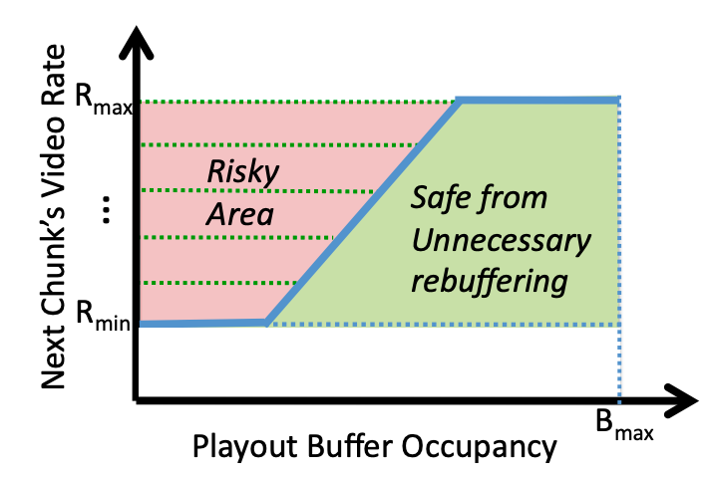
Buffer-based bit-rate adaptation
A highly effective method to provide high video quality despite variable and intermittently poor
network conditions.
Used by Netflix.
http://yuba.stanford.edu/~nickm/papers/sigcomm2014-video.pdf
A Buffer-Based Approach to Rate Adaptation

Slide 18
Dynamic Adaptive Streaming over HTTP (DASH)

Slide 19
Streaming multimedia with DASH
Dynamic Adaptive Streaming over HTTP
  Used by Netflix and most popular video streaming services
Adaptive: Perform video bit rate adaptation
  It can be done on the client, or the server (with client feedback)
Dynamic: Retrieve a single video from multiple sources
The DASH video server is just a standard HTTP server
  Provides video/audio content in multiple formats and encodings
Leverage existing web-based infrastructure
  DNS
  CDNs!

Slide 20
DASH: Key ideas
Web Browser
Or Video Client
Content (video, audio, transcript, etc.) divided into segments (time)
Algorithms to determine and request varying attributes (e.g., bitrate, language) for each segment
Goal: ensure good quality of service, match user prefs, etc.
HTTP
client
Media
player
Issue requests on time. Pick attributes for each segment of content
Media Presentation
Description (manifest)
Video
Server
Audio
Transcripts

Slide 21
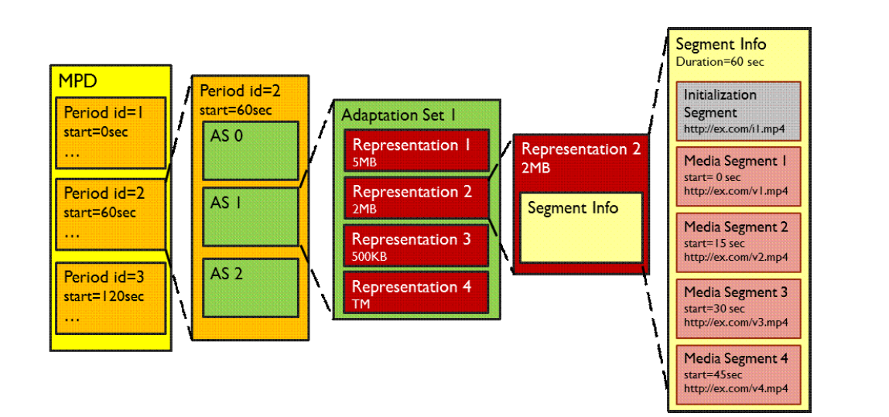
What does the manifest contain?
Periods:
Durations of content
Adaptation set: functionally equivalent content
Representations: codecs, bit rates, etc.
Multiple segments per representation
URL available for each segment
Byte ranges per segment (HTTP header for a range request)
Source: Stockhammer, MMSys.
https://www.w3.org/2010/11/web-and-tv/papers/webtv2_submission_64.pdf

Slide 22
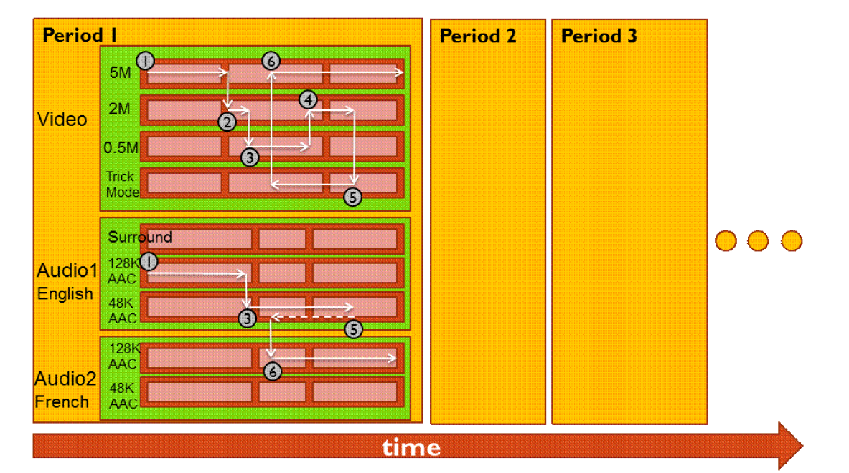
Dynamic changes in stream quality

Slide 23

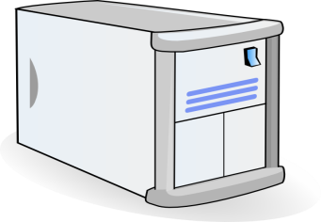


Get stream from anywhere!
Just an HTTP request for an HTTP object
2. HTTP reply containing html to construct the web page, manifest, with URsL for video content
3. HTTP GET request
for URLs
CDN servers caching the video
YouTube origin servers
Internet
  1. HTTP GET request for video URL
4. HTTP reply
with cached resources at those URLs
User

Slide 24
DASH reference player
https://reference.dashif.org/dash.js/latest/samples/dash-if-reference-player/index.html

Slide 25
DASH Summary
Piggyback video on HTTP: widely used
Enables independent HTTP requests per segment
  Choose dynamic quality & preferences over time
  Independent HTTP byte ranges
Works well with CDNs
  Fetch segments from locations other than the origin server
  Fetch different segments from possibly different locations
More resources on DASH
  https://www.w3.org/2010/11/web-and-tv/papers/webtv2_submission_64.pdf
  https://www.youtube.com/watch?v=xgowGnH5kUE

Slide 26
Server Selection
File → server mapping done in at least three ways
Dynamic DNS resolution
  DNS returns different IP addresses for a given DNS name
HTTP redirect
  Use HTTP status code 3xx [with new URL]
  Web browser does a GET from the new site
IP anycast
  Use BGP to announce the same IP address from different locations
  Client reaches “nearest” location according to inter-domain routing

