Slide 1

The Application Layer:
HTTP, SMTP
Lecture 6
http://www.cs.rutgers.edu/~sn624/352-S22
Srinivas Narayana

Slide 2



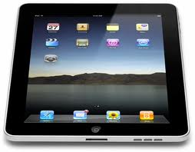

Quick recap of concepts
HyperText Transfer Protocol (HTTP)
HTTP is a client/server application
App layer
Methods: GET/POST/…
Headers
User-agent/server/…
Response codes: 200, 404, etc.
Persistence
Cookies
Connection
initiation
Set-cookie: XXX
Caching
e.g., proxy server
RTT
Cookie: XXX
HTTP req
RTT
HTTP resp
Cookie file

Slide 3
Web caches
Web caches: Machines that remember web responses for a network
Why cache web responses?
Reduce response time for client requests
Reduce traffic on an institution’s access link
Last lecture: Caches implemented in the form of a proxy server

Slide 4
Content Distribution Networks (CDNs)
A global network of web caches
Provisioned by ISPs and network operators
Or content providers, like Netflix, Google, etc.
Uses (overlaps with uses of web caching in general)
Reduce traffic on a network’s Internet connection, e.g., Rutgers
Improve response time for users: CDN nodes are closer to most users than origin servers
Reduce bandwidth requirements on content provider
Reduce $$ to maintain origin servers

Slide 5
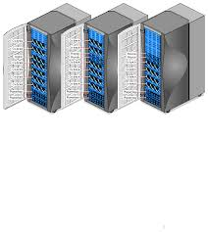
Without CDN
DOMAIN NAME | IP ADDRESS
www.yahoo.com | 98.138.253.109
cs.rutgers.edu | 128.6.4.2
www.google.com | 74.125.225.243
www.princeton.edu | 128.112.132.86
DNS
Clients distributed all over the world
Cluster of Rutgers CS origin servers (located in NJ, USA)
128.6.4.2
Problems:
Huge bandwidth requirements for Rutgers
Large propagation delays to reach users

Slide 6
Where the CDN comes in
Distribute content of the origin server over geographically distributed CDN servers
But how will users get to these CDN servers?
Use DNS!
  DNS provides an additional layer of indirection
  Instead of returning IP address, return another DNS server (NS record)
  The second DNS server (run by the CDN) returns IP address to client
The CDN runs its own DNS servers (CDN name servers)
  Custom logic to send users to the “closest” CDN web server

Slide 7
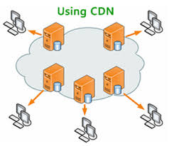
With CDN
DOMAIN NAME | IP ADDRESS
www.yahoo.com | 98.138.253.109
cs.rutgers.edu | 124.8.9.8 (NS record pointing to CDN name server)
www.google.com | 74.125.225.243
DNS reply
CDN Name Server (124.8.9.8)
NS record delegates the choice of IP address to the CDN name server.
Custom logic to map ONE domain name to one of many IP addresses!
DOMAIN NAME | IP ADDRESS
Cs.Rutgers.edu | 12.1.2.3
Cs.Rutgers.edu | 12.1.2.4
Cs.Rutgers.edu | 12.1.2.5
Cs.Rutgers.edu | 12.1.2.6
Popular CDNs:
CloudFlare
Akamai
Level3
…
12.1.2.3
CDN servers
12.1.2.4
12.1.2.6
12.1.2.5
128.6.4.2
Origin server
Most requests go to CDN servers (caches).
CDN servers may request object from origin
Few client requests go directly to origin server
Client

Slide 8
Summary of HTTP
Request/response protocol
ASCII-based human-readable message structures
Improve performance using connection persistence, caching, and CDN
Enhanced stateful functionality using cookies
Simple, highly-customizable protocol
  Just add headers
Protocol that forms of the basis of the web we enjoy today!

Slide 10
Simple Mail Transfer Protocol

Slide 11
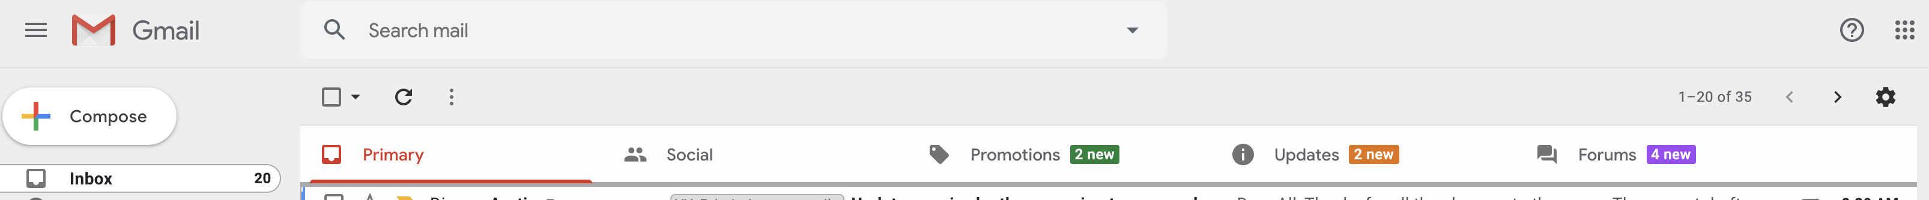
We’re all familiar with email.
How does it work?

Slide 12
Electronic Mail
outgoing
message queue
user mailbox
Three major components:
User agents
  a.k.a. “mail reader”
  e.g., Applemail, Outlook
  Web-based user agents (ex: gmail)
user
agent
mail
server
user
agent
SMTP
mail
server
user
agent
SMTP
SMTP
mail
server
user
agent
user
agent
user
agent

Slide 13
Electronic Mail: Mail servers
Mail Servers
Mailbox contains incoming messages for user
Message queue of outgoing (to be sent) mail messages
Sender’s mail server makes connection to Receiver’s mail server
  IP address, port 25
SMTP protocol: client/server protocol
Used to send messages
Client: sending user agent or sending mail server
server: receiving mail server
user
agent
mail
server
user
agent
SMTP
mail
server
user
agent
SMTP
SMTP
mail
server
user
agent
user
agent
user
agent

Slide 14
Scenario: Alice sends message to Bob
1) Alice (alice@rutgers.edu) uses UA to compose message to bob@nyu.edu
2) Alice’s UA sends message to her mail server; message placed in outgoing message queue
3) Client side of SMTP opens TCP connection with Bob’s mail server
4) SMTP client sends Alice’s message over the TCP connection
5) Bob’s mail server places the message in Bob’s incoming mailbox
6) Sometime later, Bob invokes his user agent to read message
1
mail
server
mail
server
user
agent
user
agent
Alice
2
Bob
3
4
6
5
A set of durable files on the machine. Persisted on disk.
Rutgers mail server
NYU mail server

Slide 15
Observations on these exchanges
Mail servers are the “infrastructure” for email functionality
  Receiving the email on behalf of Bob, should Bob’s machine be turned off
  Retrying the delivery of the email to Bob on behalf of Alice, should Bob’s mail server be unavailable in the first attempt
The same machine can act as client or server based on context
  Rutgers’s mail server is the server when Alice sends the mail
  It is the client when it sends mail to Bob’s mail server
SMTP is push-based: info is pushed from client to server
  Contrast to HTTP or DNS where info is pulled from the server

Slide 16
Sample SMTP interaction
telnet <mail-server> 25
HELO <sender-domain>
MAIL FROM: <name>@<sender-domain>
RCPT TO: <user>@<mail-server-domain>
DATA
Put data in, then [enter].[enter] Don’t forget the “.”
You can add mail headers (later) to make your email look good

Slide 17
MAIL command response codes
220: Service ready
250: Request command complete
354: Start mail input
421: Service not available
500: Unrecognized command

Slide 18
Mail message format (stored on server)
SMTP text message exchange standardized in RFC 822
Header lines, e.g.,
  To:
  From:
  Subject:
  These are different from SMTP commands!
  (these would still be under “DATA”)
body
  the “message”.
  ASCII characters only
header
blank
line
body

Slide 19
Message format: multimedia extensions
MIME: multimedia mail extension, RFC 2045, 2056
additional headers in DATA header declare MIME content type
A message can have many parts
From: alice@crepes.fr
To: bob@hamburger.edu
Subject: Picture of yummy crepe.
MIME-Version: 1.0
Content-Transfer-Encoding: base64
Content-Type: image/jpeg
base64 encoded data .....
.........................
......base64 encoded data
MIME version
method used
to encode data
multimedia data
type, subtype,
parameter declaration
encoded data

Slide 20
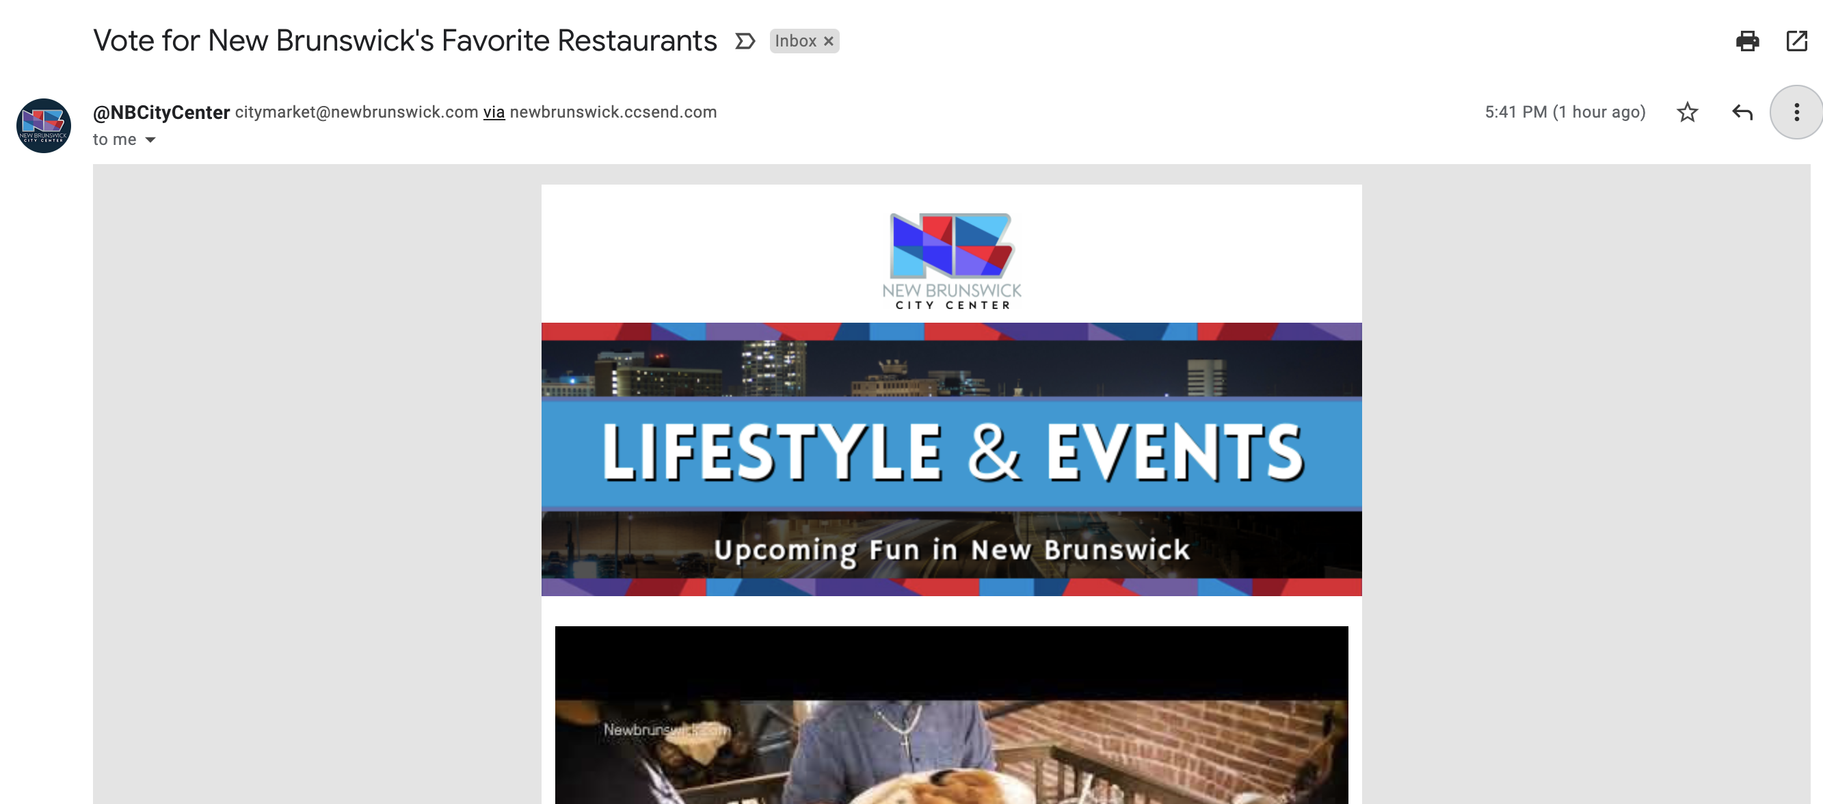
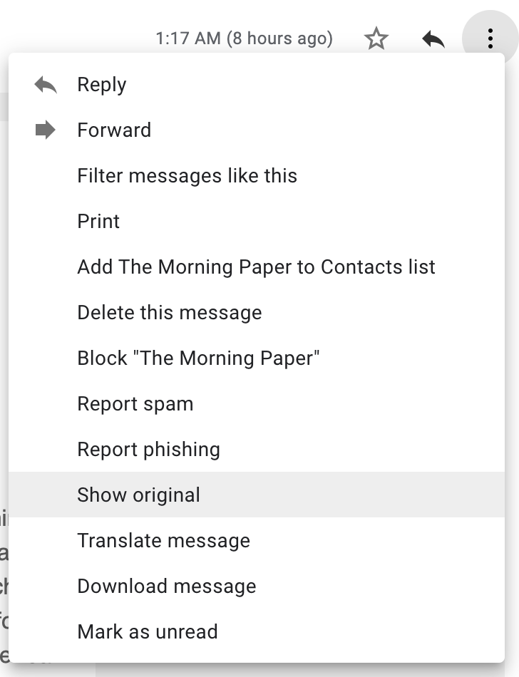

Slide 21
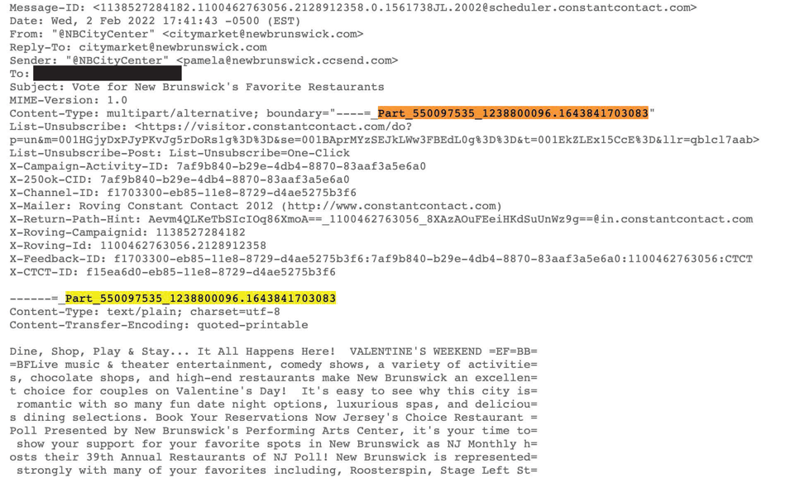

Slide 22
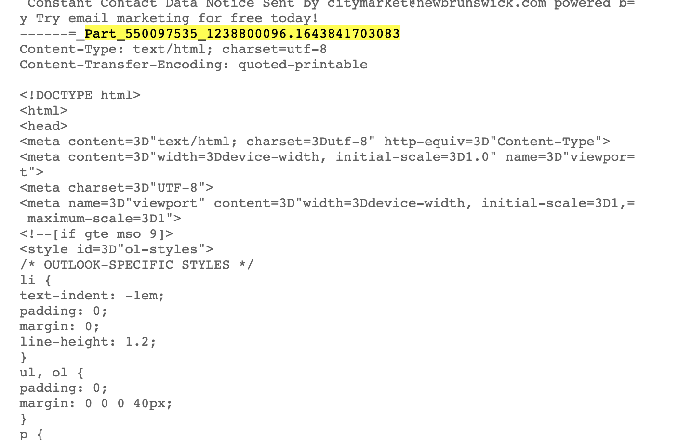

Slide 23
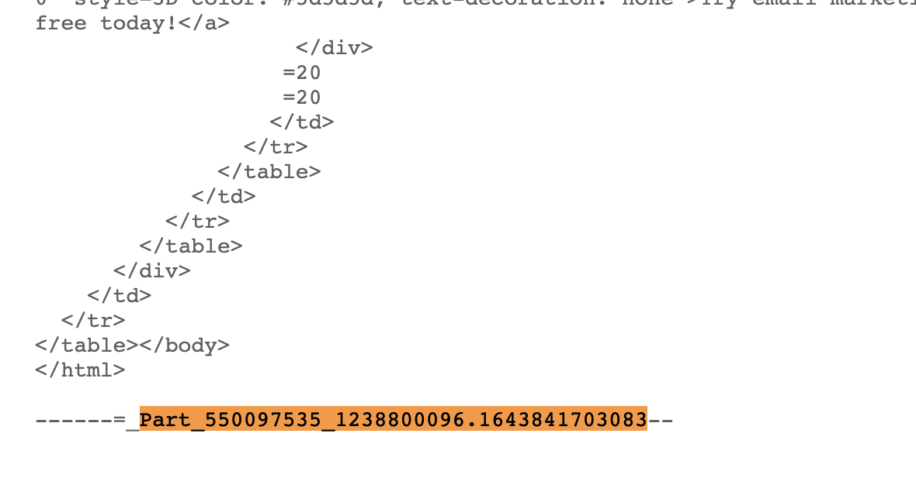

Slide 24
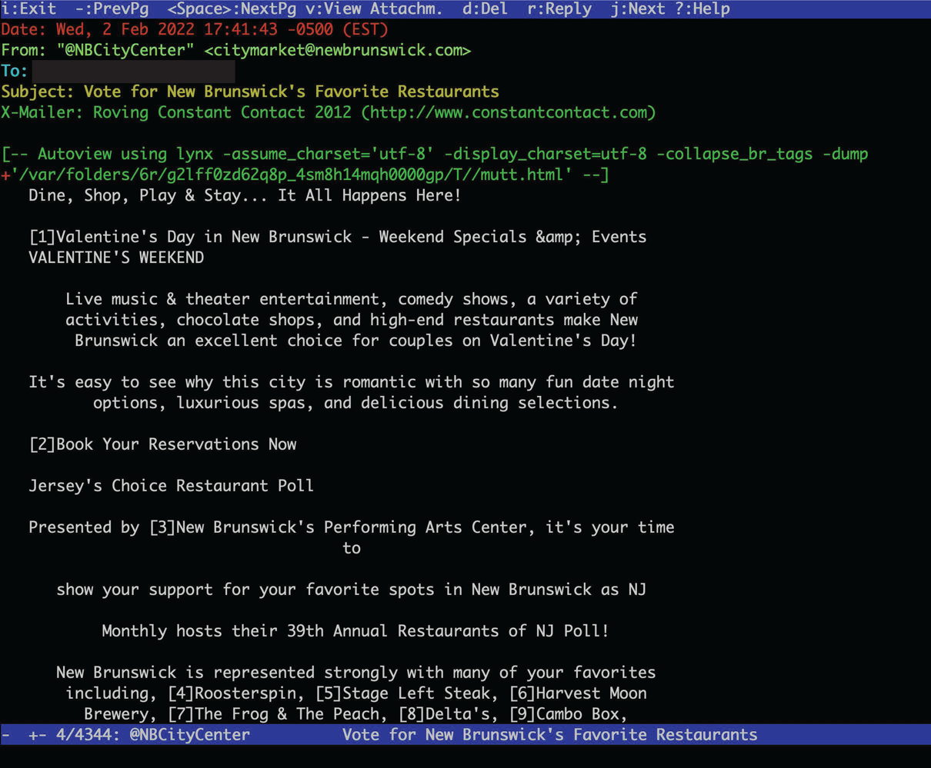

Slide 25
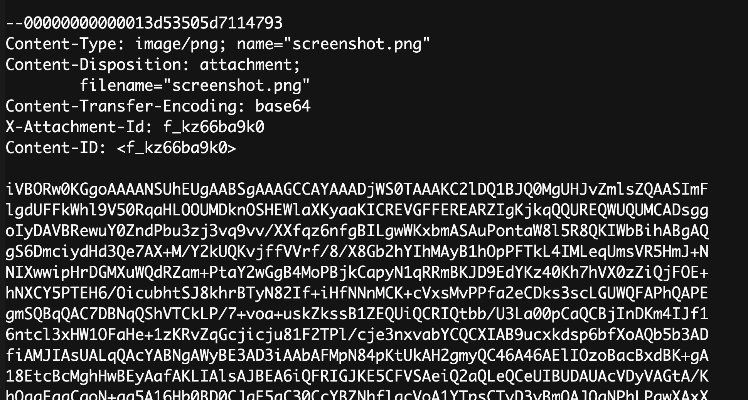

Slide 26
Mail Access Protocols

Slide 27
Mail access protocols
POP3 or IMAP4
SMTP
SMTP
access
protocol
user
agent
user
agent
Bob
Alice
sender’s mail
server
receiver’s mail
server
SMTP: delivery/storage to receiver’s server. Focused on push
Mail access protocol: retrieval from server
  POP: Post Office Protocol [RFC 1939]
    Client connects to POP3 server on TCP port 110
  IMAP: Internet Mail Access Protocol [RFC 1730]
    Client connects to TCP port 143
  HTTP: gmail, outlook, etc.

Slide 28
POP vs IMAP
POP3
Stateless server
UA-heavy processing
UA retrieves email from server, then typically deleted from server
Latest changes are at the UA
Simple protocol (list, retr, del within a POP session)
IMAP4
Stateful server
UA and server processing
Server sees folders, etc. which are visible to UAs
Latest changes are at the server
Complex protocol
Heavily used: email sync across devices, reliable, …

Slide 29
What about web-based email?
Connect to mail servers via web browser
  Ex: gmail, scarletmail, etc.
Browsers speak HTTP
Email servers speak SMTP
Need to bridge these two

Slide 30
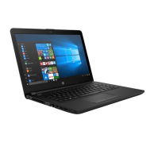

Web based email
Application process on the web server machine uses SMTP to push mail
HTTP
HTTP
Alice
alice@scarletmail.rutgers.edu
Bob
HTTP server
scarletmail.rutgers.edu
HTTP server
outlook.com
App process on the web server uses access protocol to pull email
May run on the same or different machines
(owned by your
webmail provider)
SMTP
Client/Server
aspmx4.googlemail.com
SMTP server
outlook-com.olc.protection.outlook.com
IMAP
Bob
bob@outlook.com
Internet
Alice’s mail provider’s server(s)
Bob’s mail provider’s server(s)

Slide 31
Comparing SMTP with HTTP
HTTP: pull
SMTP: push
both have ASCII command/response interaction, status codes
HTTP: each object encapsulated in its own response msg
SMTP: multiple objects sent in multipart msg
HTTP: can put non-ASCII data directly in response (dedicated entity body for binary data)
SMTP: need ASCII-based encoding (base64)

Slide 32
More themes from app-layer protocols
Keep it simple until you really need complexity
  Start with ASCII-based design; stateless servers. Then introduce:
  Cookies for HTTP state
  Stateful mail (IMAP, folders, etc.) for email organization
  Security extensions (e.g., TLS)
  Performance optimizations: persistence, caching, indirection, …
  Use headers as much as possible to non-intrusively evolve functionality
Partition functions based on what’s done best at the user (app) and protocol. Examples:
  Content rendering for users (browser, UA) separate from protocol operations (mail server)
  mail UA doesn’t need to be “always on” to send or receive email reliably. That’s the mail server’s job

