Slide 1

The Application Layer:
HTTP, SMTP
Lecture 5
http://www.cs.rutgers.edu/~sn624/352-S22
Srinivas Narayana

Slide 2




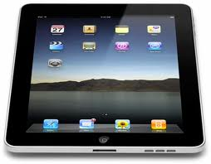
Quick recap of concepts
HyperText Transfer Protocol
(HTTP)
Domain Name System
128.45.10?.??
Application layer
URL: a resource or process
Distributed database of name to IP addr mappings.
mail.google.com/inbox
Entry types in the database:
resource records. A, NS, MX, AAAA
Host name
Path name
HTTP is a client/server application
Methods: GET/POST/…
Headers
User-agent/server/…
Response codes: 200, 404, etc.

Slide 3
This lecture: more about HTTP!
Persistent vs. Nonpersistent HTTP connections
Cookies (User-server state)
Web caches

Slide 4
HTTP Persistence

Slide 5
HTTP connections
Non-persistent HTTP
At most one object is sent over a TCP connection.
HTTP/1.0 uses nonpersistent HTTP
Persistent HTTP
Multiple objects can be sent over single TCP connection between client and server.
HTTP/1.1 uses persistent connections in default mode
TCP is a kind of reliable communication service provided by the transport layer. It requires some resources for the connection to be set up at the endpoints before data communication.

Slide 6
Non-persistent HTTP (HTTP/1.0)
1a. HTTP client initiates TCP connection to HTTP server
1b. HTTP server at host “accepts” connection, notifying client
Suppose user visits a page with text and 10 images.
2. HTTP client sends HTTP request message
3. HTTP server receives request message, replies with response message containing requested object
time

Slide 7
Non-persistent HTTP (HTTP/1.0)
4. HTTP server closes TCP connection.
5. HTTP client receives response message containing html file, displays html. Parsing html file, finds 10 referenced jpeg objects
Single connection per object
Useful at a time when web pages contained 1 object: the base HTML file.
time
6. Steps 1-5 repeated for each of 10 jpeg objects

Slide 8
How long does it take to transfer an object with non-persistent HTTP?
i.e.: before your browser can load the (entire) object?

Slide 9
Non-persistent HTTP transfer time
Total delay = propagation + queueing + transmission
Response time for user
  = total round-trip delay
  = sum of forward and backward total delays
Total round-trip delay for a “small” packet called a Round Trip Time (RTT)
  Round-trip delays with zero transmission delay
Assumptions:
  Small packets: TCP initiation packet, response, HTTP request are all small
  No processing delays at the server
  RTT stable over time
2RTT + file transmission time per object
initiate TCP
connection
RTT
request
file
File
transmission
time
for the
response
RTT
entire
file
received
time
time

Slide 10

Per-object overheads quickly add up
Modern web pages have 100s of objects in them.

Slide 11
Persistent HTTP (HTTP/1.1)
1a. HTTP client initiates TCP connection to HTTP server
1b. HTTP server at host “accepts” connection, notifying client
Suppose user visits a page with text and 10 images.
2. HTTP client sends HTTP request message
3. HTTP server receives request message, replies with response message containing requested object
Connection: keep-alive
HTTP header introduced in
HTTP/1.1
time

Slide 12
Persistent HTTP (HTTP/1.1)
4. HTTP server sends a response.
Server keeps the TCP connection alive.
5. HTTP client receives response message containing html file, displays html. Parsing html file, finds 10 referenced jpeg objects
time
The 10 objects can be requested over the same TCP connection.
i.e., save an RTT per object (otherwise spent opening a new TCP connection in HTTP/1.0)

Slide 13
Persistence vs. # of connections
Persistence is distinct from the number of concurrent connections made by a client
Your browser has the choice to open multiple connections to a server!
  Bounded by the HTTP specification to a small number (e.g., 5)
Further, a single connection can have multiple object (HTTP) requests in flight with persistent HTTP

Slide 14
Remembering Users
On the Web

Slide 15
HTTP: Remembering users
So far, HTTP mechanisms considered stateless
Each request processed independently at the server
The server maintains no memory about past client requests
However, state, i.e., memory, about the user at the server, is very useful!
User authentication (e.g., gmail)
Shopping carts (e.g., Amazon)
Video recommendations (e.g., Netflix)
Any user session state in general

Slide 16
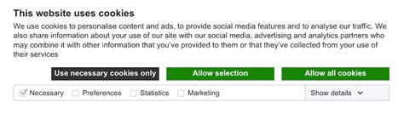
Familiar with these?

Slide 17
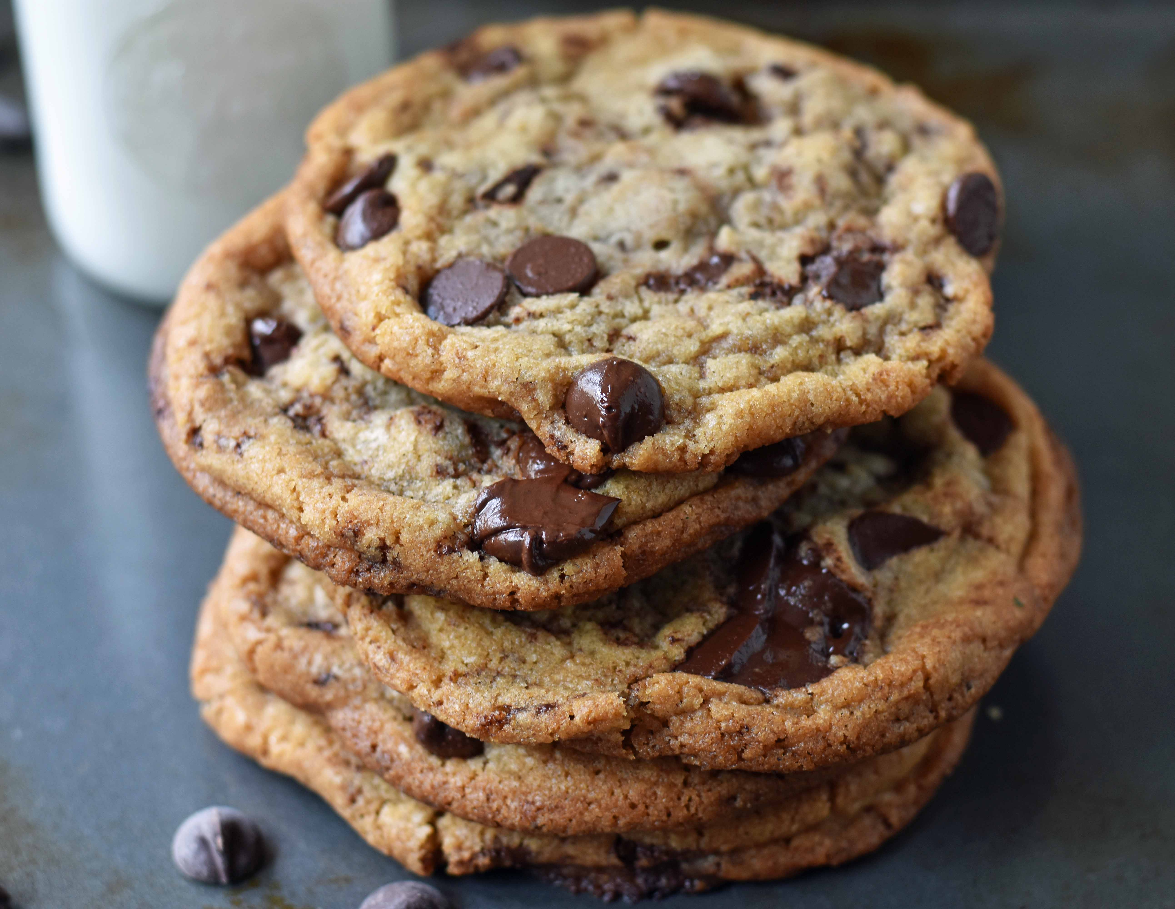
Cookies: Keeping user memory
client
server
Cookie is typically opaque to client.
Cookie file
http request msg + auth
server
creates ID
1678 for user
Netflix: 436
Amazon: 1678
http response +
Set-cookie: 1678
entry in backend
database
Cookie file
http request (no auth)
cookie: 1678
Netflix: 436
cookie-
specific
action
access
Amazon: 1678
Personalized http response
one week later:
access
Cookie file
http request (no auth)
cookie: 1678
cookie-
specific
action
Netflix: 436
Amazon: 1678
Personalized http response

Slide 18
How cookies work
Collaboration between client and server to track user state.
Four components:
cookie header line of HTTP response message
cookie header line in HTTP request message
cookie file kept on user endpoint, managed by user’s browser
back-end database maps cookie to user data at Web endpoint
Cookies come with an expiration date (yet another HTTP header!)

Slide 19
Cookies have many uses
The good: Awesome user-facing functionality
  Shopping carts, auth, … very challenging or impossible without it
The bad: Unnecessary recording of your activities on the site
  First-party cookies: performance statistics, user engagement, …
The ugly: Tracking your activities across the Internet
  Third-party cookies (played by ad and tracking networks) to track your activities across the Internet.
  Potentially personally identifiable information (PII)
  Ad networks target users with ads, may sell this info
  Scammers can target you too!

Slide 20

PSA: Cookies and Privacy
Disable and delete unnecessary cookies by default
Suggested privacy-conscious browsers, websites, tools:
DuckDuckGo (search)
Brave (browser)
AdBlock Plus (extension)
ToR (distract targeting)
… assuming it doesn’t break the functions of the site.
https://gdpr.eu/cookies/

Slide 21
Caching in HTTP

Slide 22
Web caches
Web caches: Machines that remember web responses for a network
Why cache web responses?
Reduce response time for client requests
Reduce traffic on an institution’s access link
Caches can be implemented in the form of a proxy server

Slide 23

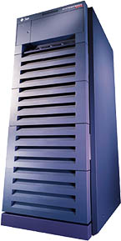
Web caching using a proxy server
You can configure a HTTP proxy on your laptop’s network settings.
If you do, your browser sends all HTTP requests to the proxy (cache).
Hit: cache returns object
Miss: obtain object from originating web server (origin server) and return to client
  Also cache the object locally
Clients
Return cached object!
Web Server
(also called origin server in this context)
GET foo.html
GET foo.html
The Internet
Proxy Server
Store foo.html
on receiving response

Slide 24
Caching in the HTTP protocol
Cache/Client
server
Conditional GET guarantees cache content is up-to-date while still saves traffic and response time whenever possible
Date in the cache’s request is the last time the server provided in its response header Last-Modified
HTTP request msg
If-modified-since: <date>
object
not
modified
X-Cache: HIT
HTTP response
HTTP/1.0
304 Not Modified
HTTP request msg
If-modified-since: <date>
object
modified
HTTP response
HTTP/1.0 200 OK
Last-modified: <date>
DATA DATA DATA

Slide 25
Content Distribution Networks (CDNs)
A global network of web caches
Provisioned by ISPs and network operators
Or content providers, like Netflix, Google, etc.
Uses (overlaps with uses of web caching in general)
Reduce traffic on a network’s Internet connection, e.g., Rutgers
Improve response time for users: CDN nodes are closer to most users than origin servers
Reduce bandwidth requirements on content provider
Reduce $$ to maintain origin servers

Slide 26
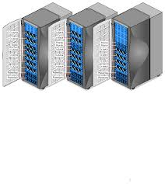
Without CDN
DOMAIN NAME | IP ADDRESS
www.yahoo.com | 98.138.253.109
cs.rutgers.edu | 128.6.4.2
www.google.com | 74.125.225.243
www.princeton.edu | 128.112.132.86
DNS
Clients distributed all over the world
Cluster of Rutgers CS origin servers (located in NJ, USA)
128.6.4.2
Problems:
Huge bandwidth requirements for Rutgers
Large propagation delays to reach users

Slide 27
Where the CDN comes in
Distribute content of the origin server over geographically distributed CDN servers
But how will users get to these CDN servers?
Use DNS!
  DNS provides an additional layer of indirection
  Instead of domain -> IP addr, use domain -> DNS server (NS record!)
The CDN runs its own DNS servers (CDN name servers) to perform this redirection
  Send users to the “closest” CDN web server for a given domain

Slide 28
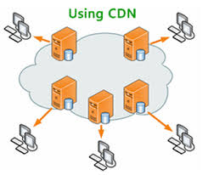
With CDN
DOMAIN NAME | IP ADDRESS
www.yahoo.com | 98.138.253.109
cs.rutgers.edu | 124.8.9.8 (NS record pointing to CDN name server)
www.google.com | 74.125.225.243
DNS reply
CDN Name Server (124.8.9.8)
NS record delegates the choice of IP address to the CDN name server.
Custom logic to map ONE domain name to one of many IP addresses!
DOMAIN NAME | IP ADDRESS
Cs.Rutgers.edu | 12.1.2.3
Cs.Rutgers.edu | 12.1.2.4
Cs.Rutgers.edu | 12.1.2.5
Cs.Rutgers.edu | 12.1.2.6
Popular CDNs:
CloudFlare
Akamai
Level3
…
12.1.2.3
CDN servers
12.1.2.4
12.1.2.6
12.1.2.5
128.6.4.2
Origin server
Most requests go to CDN servers (caches).
CDN servers may request object from origin
Few client requests go directly to origin server
Client

Slide 29
Summary of HTTP
Request/response protocol
ASCII-based human-readable message structures
Improve performance using connection persistence, caching, and CDN
Enhanced stateful functionality using cookies
Simple, highly-customizable protocol (just add headers)
Protocol that forms of the basis of the web we enjoy today!

Slide 31
Simple Mail Transfer Protocol

Slide 32
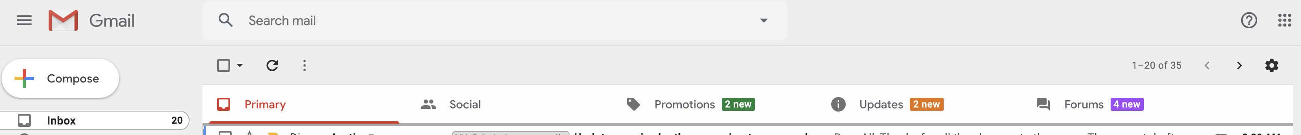
We’re all familiar with email.
How does it work?

Slide 33
Electronic Mail
outgoing
message queue
user mailbox
Three major components:
User agents
  a.k.a. “mail reader”
  e.g., Applemail, Outlook
  Web-based user agents (ex: gmail)
user
agent
mail
server
user
agent
SMTP
mail
server
user
agent
SMTP
SMTP
mail
server
user
agent
user
agent
user
agent

Slide 34
Electronic Mail: Mail servers
Mail Servers
Mailbox contains incoming messages for user
Message queue of outgoing (to be sent) mail messages
Sender’s mail server makes connection to Receiver’s mail server
  IP address, port 25
SMTP protocol: client/server protocol
Used to send messages
Client: sending user agent or sending mail server
server: receiving mail server
user
agent
mail
server
user
agent
SMTP
mail
server
user
agent
SMTP
SMTP
mail
server
user
agent
user
agent
user
agent

Slide 35
Scenario: Alice sends message to Bob
1) Alice (alice@rutgers.edu) uses UA to compose message to bob@nyu.edu
2) Alice’s UA sends message to her mail server; message placed in outgoing message queue
3) Client side of SMTP opens TCP connection with Bob’s mail server
4) SMTP client sends Alice’s message over the TCP connection
5) Bob’s mail server places the message in Bob’s incoming mailbox
6) Sometime later, Bob invokes his user agent to read message
1
mail
server
mail
server
user
agent
user
agent
Alice
2
Bob
3
4
6
5
A set of durable files on the machine. Persisted on disk.
Rutgers mail server
NYU mail server

Slide 36
Observations on these exchanges
Mail servers are useful “always on” endpoints
  Receiving the email on behalf of Bob, should Bob’s machine be turned off
  Retrying the delivery of the email to Bob on behalf of Alice, should Bob’s mail server be unavailable in the first attempt
The same machine can act as client or server based on context
  Rutgers’s mail server is the server when Alice sends the mail
  It is the client when it sends mail to Bob’s mail server
SMTP is push-based: info is pushed from client to server
  Contrast to HTTP or DNS where info is pulled from the server

Slide 39
Sample SMTP interaction
A small demo

Slide 40
Sample SMTP interaction
220 hill.com SMTP service ready
HELO town.com
250 hill.com Hello town.com, pleased to meet you
MAIL FROM: <jack@town.com>
250 <jack@town.com>… Sender ok
RCPT TO: <jill@hill.com>
250 <jill@hill.com>… Recipient ok
DATA
354 Enter mail, end with “.” on a line by itself
Jill, I’m not feeling up to hiking today. Will you please fetch me a pail of water?
.
250 message accepted
QUIT
221 hill.com closing connection

Slide 41
MAIL command response codes
220: Service ready
250: Request command complete
354: Start mail input
421: Service not available

Slide 42
Mail message (stored on server) format
SMTP: protocol for exchanging email msgs
RFC 822: standard for text message format:
header lines, e.g.,
  To:
  From:
  Subject:
  different from SMTP commands!
  (these would still be under “DATA”)
body
  the “message”, ASCII characters only
header
blank
line
body

Slide 43
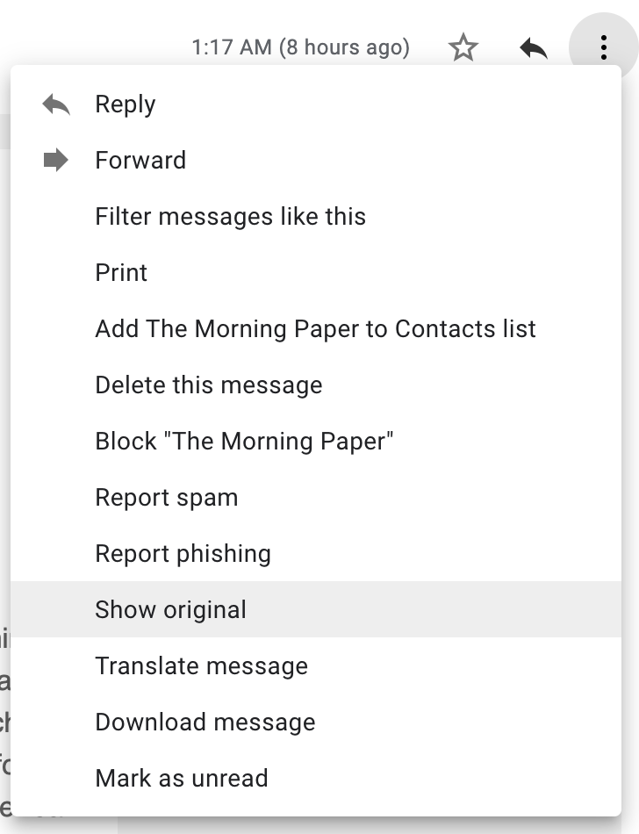
Message format: multimedia extensions
MIME: multimedia mail extension, RFC 2045, 2056
additional lines in msg header declare MIME content type
From: alice@crepes.fr
To: bob@hamburger.edu
Subject: Picture of yummy crepe.
MIME-Version: 1.0
Content-Transfer-Encoding: base64
Content-Type: image/jpeg
base64 encoded data .....
.........................
......base64 encoded data
MIME version
method used
to encode data
multimedia data
type, subtype,
parameter declaration
encoded data

Slide 44
CS 352
Mail: Access Protocols
CS 352, Lecture 5.2
http://www.cs.rutgers.edu/~sn624/352
Srinivas Narayana

Slide 45
Mail access protocols
POP3 or IMAP4
SMTP
SMTP
access
protocol
user
agent
user
agent
Bob
Alice
sender’s mail
server
receiver’s mail
server
SMTP: delivery/storage to receiver’s server
Mail access protocol: retrieval from server
  POP: Post Office Protocol [RFC 1939]
    Client connects to POP3 server on TCP port 110
  IMAP: Internet Mail Access Protocol [RFC 1730]
    Client connects to TCP port 143
  HTTP: gmail, outlook, etc.

Slide 46
POP vs IMAP
POP3
Stateless server
UA-heavy processing
UA retrieves email from server, then typically deleted from server
Latest changes are at the UA
Simple protocol (list, retr, del within a POP session)
IMAP4
Stateful server
UA and server processing
Server sees folders, etc. which are visible to UAs
Changes visible at the server
Complex protocol

Slide 47
What about web-based email?
Connect to mail servers via web browser
  Ex: gmail, outlook, etc.
Browsers speak HTTP
Email servers speak SMTP
Need a bridge to retrieve email using HTTP

Slide 48


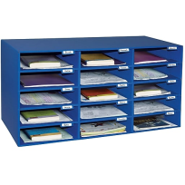
Web based email
HTTP
HTTP
HTTP server
HTTP
server
SMTP
Client
SMTP server
Internet

Slide 49
Comparing SMTP with HTTP
HTTP: pull
SMTP: push
both have ASCII command/response interaction, status codes
HTTP: each object encapsulated in its own response msg
SMTP: multiple objects sent in multipart msg
HTTP: can put non-ASCII data directly in response
SMTP: need ASCII-based encoding

Slide 50
More themes from app-layer protocols
Separation of concerns. Examples:
  Content rendering for users (browser, UA) separate from protocol operations (mail server)
  Reliable mail sending and receiving: mail UA doesn’t need to be “always on” to send or receive email reliably
In-band vs. out-of-band control:
  In-band: headers determine the actions of all the parties of the protocol
  There are protocols with out-of-band control, e.g., FTP
Keep it simple until you really need complexity
  ASCII-based design; stateless servers. Then introduce:
  Cookies for HTTP state
  IMAP for email organization
  Security extensions (e.g., TLS)
  Different methods to set up and use underlying connections (e.g., persistence)

