Slide 1

Link Layer: Multiple Access
CS 352, Lecture 15
http://www.cs.rutgers.edu/~sn624/352-S19
Srinivas Narayana
(heavily adapted from slides by Prof. Badri Nath and the textbook authors)

Slide 2
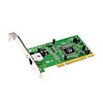
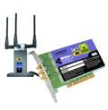

Where is the link layer implemented?
in each and every host
link layer implemented in “adapter” (aka network interface card NIC) or on a chip
  Ethernet card, 802.11 card; Ethernet chipset
  implements link, physical layer
Adapter attaches into host’s system buses (PCI)
Link layer: a combination of hardware, software, firmware
application
transport
network
link
cpu
memory
link
physical
host
bus
(e.g., PCI)
controller
physical
transmission
network adapter
card

Slide 3
Adapters communicating
datagram
datagram
controller
controller
sending host
receiving host
datagram
frame
sending side:
  encapsulates datagram in frame
  adds reliability/error checking bits
receiving side
  Check for errors
  extracts datagram, passes to upper layer at receiving side (usually: link layer address must match)

Slide 4






Multiple access
two types of “links”:
point-to-point
  PPP for dial-up access
  point-to-point link between Ethernet switch, host
broadcast (shared wire or medium)
  old-fashioned Ethernet
  802.11 wireless LAN
shared wire (e.g.,
cabled Ethernet)
shared RF
(e.g., 802.11 WiFi)
shared RF
(satellite)
humans at a
cocktail party
(shared air, acoustical)

Slide 5
Multiple access protocols
single shared broadcast channel
two or more simultaneous transmissions by nodes: interference
  collision if node receives two or more signals at the same time
multiple access protocol
distributed algorithm that determines how nodes share channel, i.e., determine when node can transmit
communication about channel sharing must use channel itself!
  no out-of-band channel for coordination
Multiple access protocols part of Medium Access Control (MAC)

Slide 6
An ideal multiple access protocol
given: broadcast channel of rate R bps
Goals:
  1. when one node wants to transmit, it can send at rate R.
  2. when M nodes want to transmit, each can send at average rate R/M
  3. fully decentralized:
    no special node to coordinate transmissions
    no synchronization of clocks, slots
  4. simple

Slide 7
MAC protocols: Taxonomy
three broad classes:
channel partitioning
  divide channel into smaller “pieces” (time slots, frequency, code)
  allocate piece to node for exclusive use
random access
  channel not divided, allow collisions
  “recover” from collisions
“taking turns”
  nodes take turns, but nodes with more to send can take more or longer turns

Slide 8
(1) Channel partitioning MAC protocols: TDMA
TDMA: time division multiple access
access to channel in "rounds"
each station gets fixed length slot (length = packet transmission time) in each round
unused slots go idle
example: 6-station LAN, 1,3,4 have packets to send, slots 2,5,6 idle
6-slot
frame
6-slot
frame
1
3
4
1
3
4

Slide 9
Channel partitioning MAC protocols: FDMA
FDMA: frequency division multiple access
channel spectrum divided into frequency bands
each station assigned fixed frequency band
unused transmission time in frequency bands go idle
example: 6-station LAN, 1,3,4 have packet to send, frequency bands 2,5,6 idle
time
frequency bands
FDM cable

Slide 10
(2) Random access protocols
when node has packet to send
  transmit at full channel data rate R.
  no a priori coordination among nodes
Collision possible when two or more transmitting nodes choose to send simultaneously
A random access MAC protocol specifies:
  how to detect collisions
  how to recover from collisions (e.g., via delayed retransmissions)
examples of random access MAC protocols:
  slotted ALOHA, ALOHA
  CSMA, CSMA/CD, CSMA/CA

Slide 11

Slotted ALOHA
assumptions:
all frames same size
time divided into equal size slots (time to transmit 1 frame)
nodes start to transmit only slot beginning
nodes are synchronized
if 2 or more nodes transmit in slot, all nodes detect collision
operation:
when node obtains fresh frame, transmits in next slot
  if no collision: node can send new frame in next slot
  if collision: node retransmits frame in each subsequent slot with prob. p until success

Slide 12
Slotted ALOHA
node 1
1
1
1
1
node 2
2
2
2
node 3
3
3
3
C
I
C
S
I
C
I
S
S
Pros:
single active node can continuously transmit at full rate of channel
highly decentralized: only slots in nodes need to be in sync
simple
Cons:
collisions, wasting slots
idle slots
nodes may be able to detect collision in less than time to transmit packet
clock synchronization

Slide 13
Slotted ALOHA: efficiency
efficiency: long-run
fraction of successful slots
(many nodes, all with many frames to send)
max efficiency: find p* that maximizes
Np(1-p)^{N-1}
for many nodes, take limit of Np*(1-p*)^{N-1} as N goes to infinity, gives:
max efficiency = 1/e = .37
suppose: N nodes with many frames to send, each transmits in slot with probability p
prob that given node has success in a slot = p(1-p)^{N-1}
prob that any node has a success = Np(1-p)^{N-1}
at best: channel
used for useful
transmissions 37%
of time!
!

Slide 14
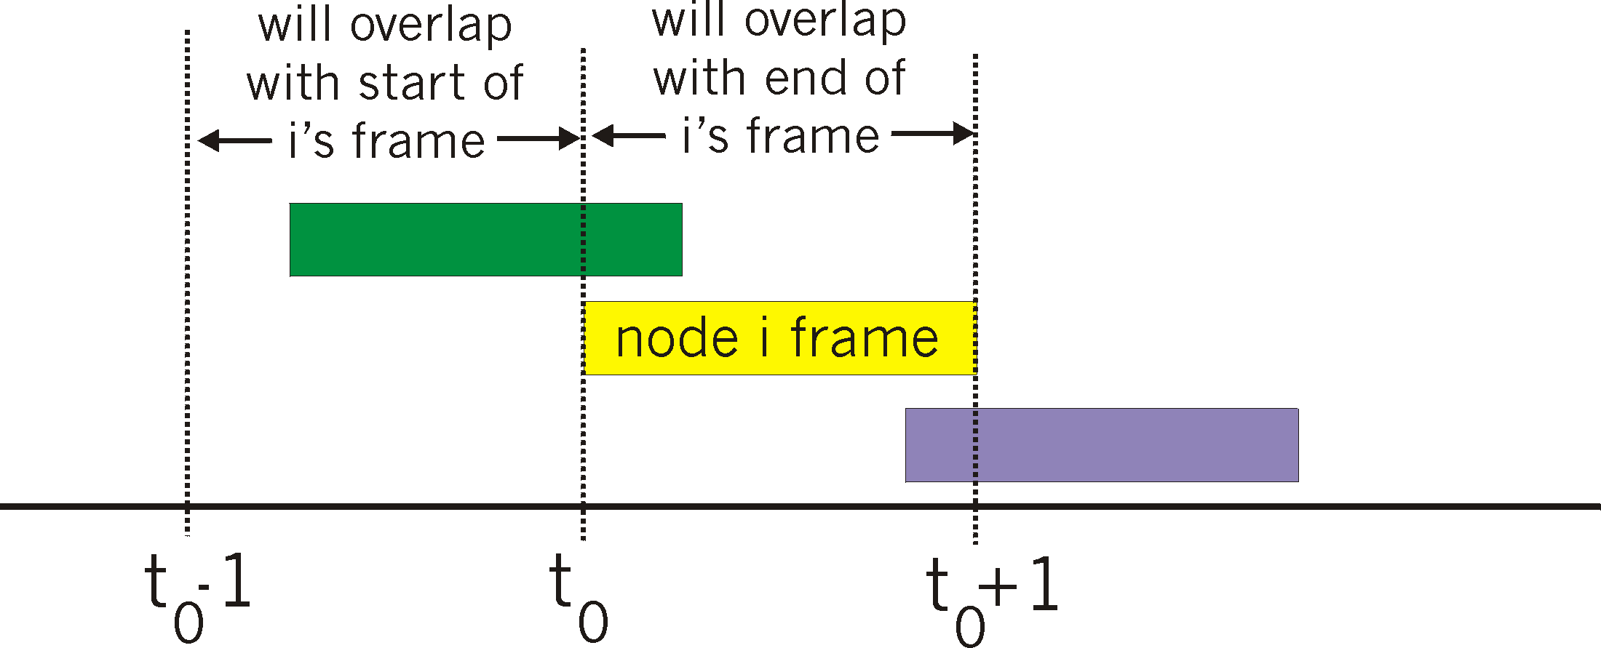
Pure (unslotted) ALOHA
unslotted Aloha: simpler, no synchronization
when frame first arrives
  transmit immediately
collision probability increases:
  frame sent at t₀ collides with other frames sent in [t₀-1,t₀+1]

Slide 15
Pure ALOHA efficiency
P(success by given node) = P(node transmits) .
P(no other node transmits in [t₀-1,t₀] .
P(no other node transmits in [t₀-1,t₀]
= p . (1-p)^{N-1 .} (1-p)^{N-1}
= p . (1-p)^{2(N-1)}
… choosing optimum p and then letting n
= 1/(2e) = .18
Worse than slotted Aloha!

Slide 16
Are there better strategies to transmit rather than independently and randomly?

Slide 17
CSMA (carrier sense multiple access)
CSMA: listen before transmit:
if channel sensed idle: transmit entire frame
if channel sensed busy, defer transmission
human analogy: don’t interrupt others!

Slide 18
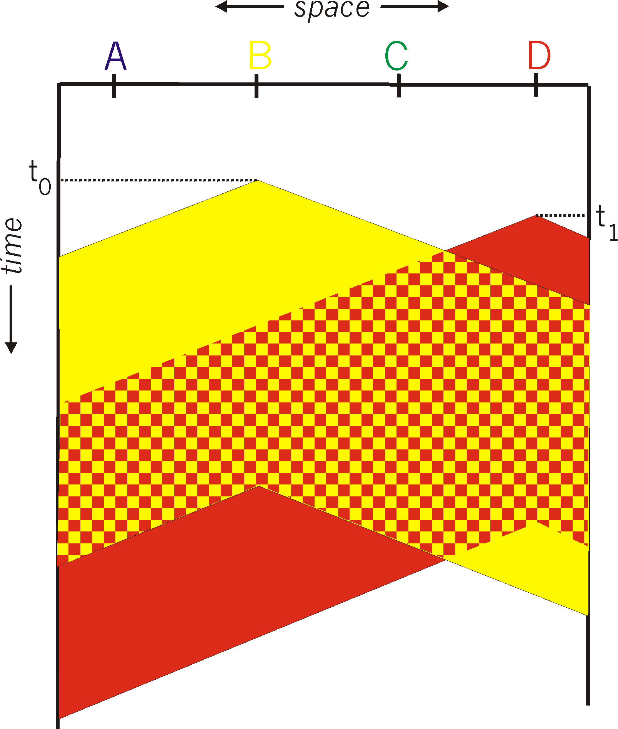
CSMA collisions
spatial layout of nodes
collisions can still occur: propagation delay means two nodes may not hear each other’s transmission
collision: entire packet transmission time wasted
  distance & propagation delay play role in in determining collision probability

Slide 19
CSMA/CD (collision detection)
CSMA/CD: carrier sensing, deferral as in CSMA
  collisions detected within short time
  colliding transmissions aborted, reducing channel wastage
collision detection:
  easy in wired LANs: measure signal strengths, compare transmitted, received signals
  difficult in wireless LANs: received signal strength overwhelmed by local transmission strength
human analogy: the polite conversationalist

Slide 20
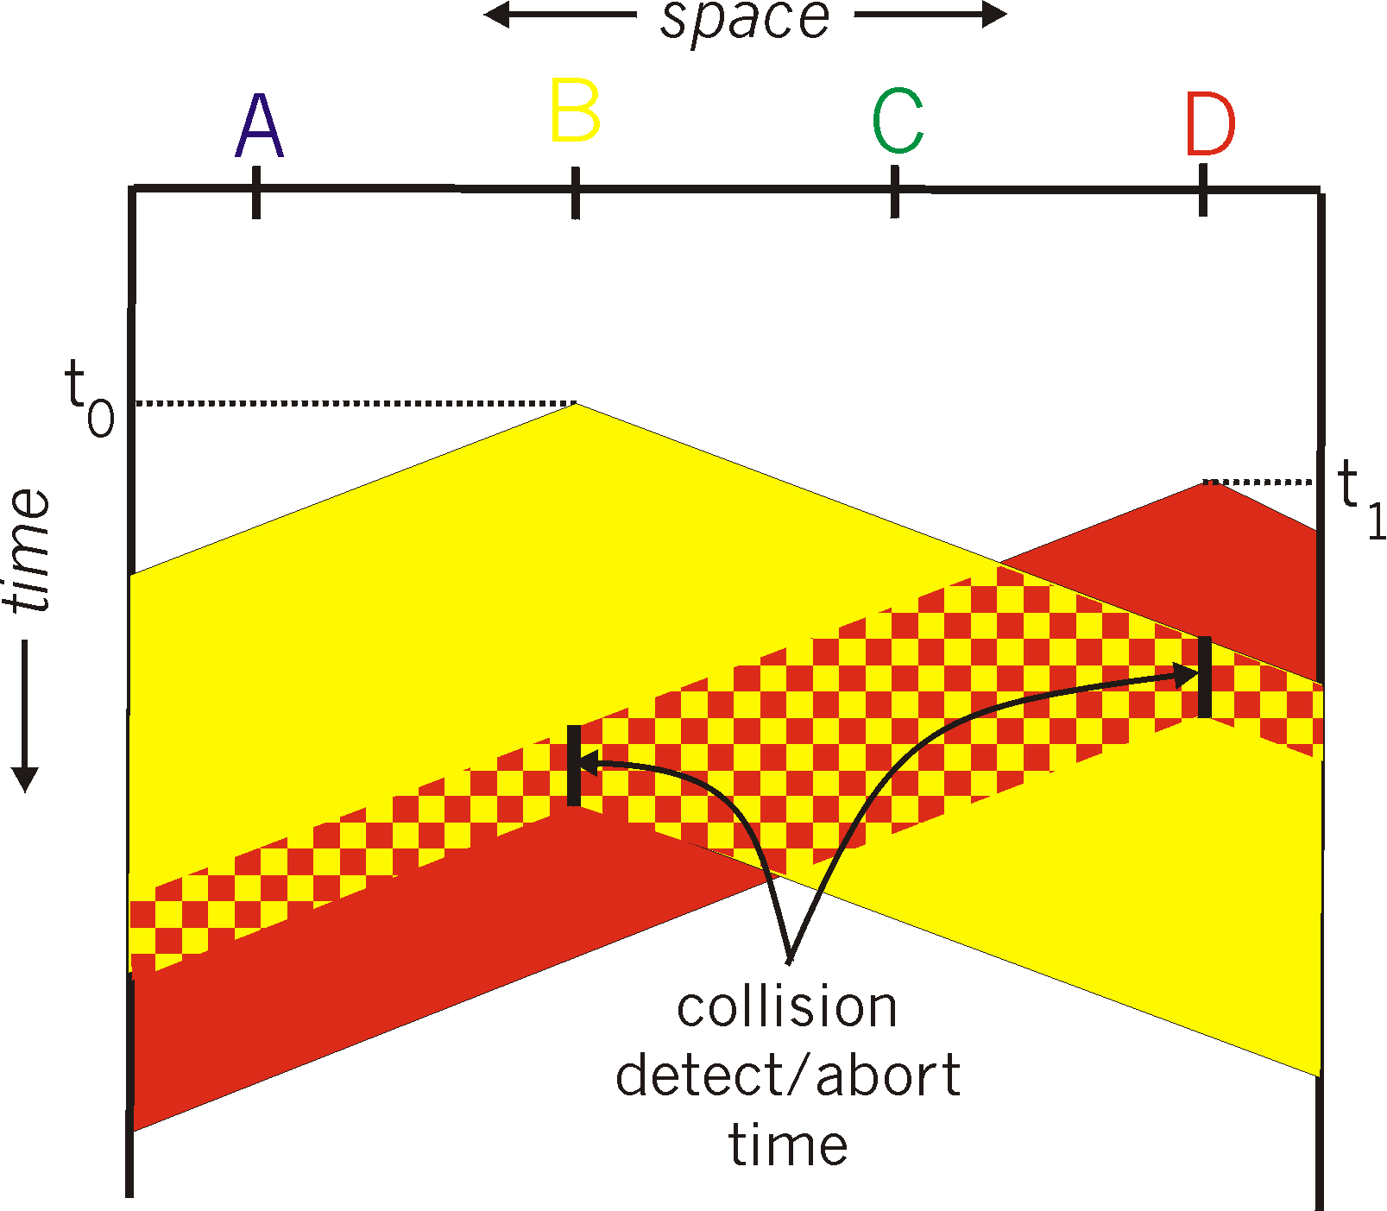
CSMA/CD (collision detection)
spatial layout of nodes

Slide 21
Ethernet CSMA/CD algorithm
1. NIC receives datagram from network layer, creates frame
2. If NIC senses channel idle, starts frame transmission. If NIC senses channel busy, waits until channel idle, then transmits.
3. If NIC transmits entire frame without detecting another transmission, NIC is done with frame !
4. If NIC detects another transmission while transmitting, aborts and sends jam signal
How long should the NIC wait to retransmit after aborting due to a collision?

Slide 22
Ethernet CSMA/CD algorithm
1. NIC receives datagram from network layer, creates frame
2. If NIC senses channel idle, starts frame transmission. If NIC senses channel busy, waits until channel idle, then transmits.
3. If NIC transmits entire frame without detecting another transmission, NIC is done with frame !
4. If NIC detects another transmission while transmitting, aborts and sends jam signal
5. After aborting, NIC enters binary (exponential) backoff:
  after mth collision, NIC chooses K at random from {0,1,2, …, 2^{m}-1}. NIC waits K·512 bit times, returns to Step 2
  longer backoff interval with more collisions

Slide 23
CSMA/CD efficiency
T_{prop} = max prop delay between 2 nodes in LAN
t_{trans} = time to transmit max-size frame
efficiency goes to 1
  as t_{prop} goes to 0
  as t_{trans} goes to infinity
better performance than ALOHA: and simple, cheap, decentralized!

Slide 24
(3) “Taking turns” MAC protocols
channel partitioning MAC protocols:
  share channel efficiently and fairly at high load
  inefficient at low load: delay in channel access, 1/N bandwidth allocated even if only 1 active node!
random access MAC protocols
  efficient at low load: single node can fully utilize channel
  high load: collision overhead
“taking turns” protocols
  look for best of both worlds!

Slide 25
“Taking turns” MAC protocols
polling:
orchestrator node “invites” sender nodes to transmit in turn
typically used with simple sender devices
concerns:
  polling overhead
  latency
  single point of failure (orchestrator)
data
poll
orchestrator
data
senders

Slide 26
“Taking turns” MAC protocols
token passing:
control token passed from one node to next sequentially.
token message
concerns:
  latency
  single point of failure (node holding the token)
T
(nothing
to send)
T
data

Slide 27
Summary of multiple access protocols
channel partitioning
  Time Division, Frequency Division
  Code (next lectures)
random access
  ALOHA, Slotted ALOHA, CSMA, CSMA/CD
  carrier sensing: easy in some technologies (wire), hard in others (wireless)
  CSMA/CD used in Ethernet
  CSMA/CA used in 802.11
taking turns
  polling from central site, token passing
  Bluetooth, FDDI, token ring

