Slide 1

The Application Layer:
Sockets, DNS
CS 352, Lecture 3
http://www.cs.rutgers.edu/~sn624/352-S19
Srinivas Narayana

Slide 2
App-layer protocol
Types of messages exchanged,
  e.g., request, response
Message format:
  Syntax :what fields in messages & how fields are delineated
  Semantics: meaning of information in fields
Rules for when and how processes send & respond to messages
Public-domain protocols:
defined in RFCs
allows for interoperability
e.g., HTTP, SMTP
Proprietary protocols:
e.g., Skype, Microsoft Exchange

Slide 3



Application “addresses”
We usually think of an application executing on a single host.
However, applications can reside on, say, 2 different hosts connected by a network
In order to communicate, need to identify the communicating parties
Telephone network: phone number (10 digits)
Computer network: IP address
  IPv4 (32 bits) 128.6.24.78
  IPv6 (128 bits) 2001:4000:A000:C000:6000:B001:412A:8000
Suppose there is more than one networked program executing on a host
  In addition to host address, we need one more address
  “Which Program to talk to?”
Another identity for an application: port #
Host / house (IP address)
App / person (port #)

Slide 4

IP address & port number
Host
Host
process
socket
P4
process
process
P1
socket
socket
P2
Host
Internet
process
A socket is the door between
OS/network and the application/process
socket
P3

Slide 5
A network connection is a 4-tuple
Host: IP address B
Host:: IP address A
process
socket
process
process
socket
socket
Host: IP address C
Internet
process
socket
Connection := (IP_{S}, Port_{S}, IP_{D}, Port_{D})

Slide 6
Recall: Services provided by lower layers
Host A
Host B
Application
Layer
Application Protocol
Application
Layer
Transport
Layer
Transport Protocol
Transport
Layer
Network
Layer
Network
Layer
Network
Layer
Network
Layer
H-to-N
Layer
H-to-N
Layer
H-to-N
Layer
H-to-N
Layer
Router
Router

Slide 7
Client-server architecture
client
Server:
  always-on host
  permanent IP address
  server farms (“data centers”) for scaling
Clients:
  communicate with server
  may be intermittently connected
  may have dynamic IP addresses
  do not communicate directly with each other
server
client

Slide 8
Peer-to-peer (P2P) architecture
peer
Peers:
  Intermittently connected hosts
  Directly talking to each other
Little to no reliance on always-up servers
  Examples: BitTorrent, Skype
Today, many applications use a hybrid model
  Example: Skype “supernodes”
peer

Slide 9
Domain Name System (DNS)
“You have my name. Can you lookup my number?”

Slide 10
Domain Name System (DNS)
Problem statement:
  Average brain can easily remember 7 digits for a few names
  On average, IP addresses have 12 digits
  We need an easier way to remember IP addresses
Solution:
  Use alphanumeric names to refer to hosts
  Just as a contacts or telephone directory (white pages)
  Add a service (called DNS) to map between alphanumeric host names and binary IP addresses
  We call this Address Resolution

Slide 11
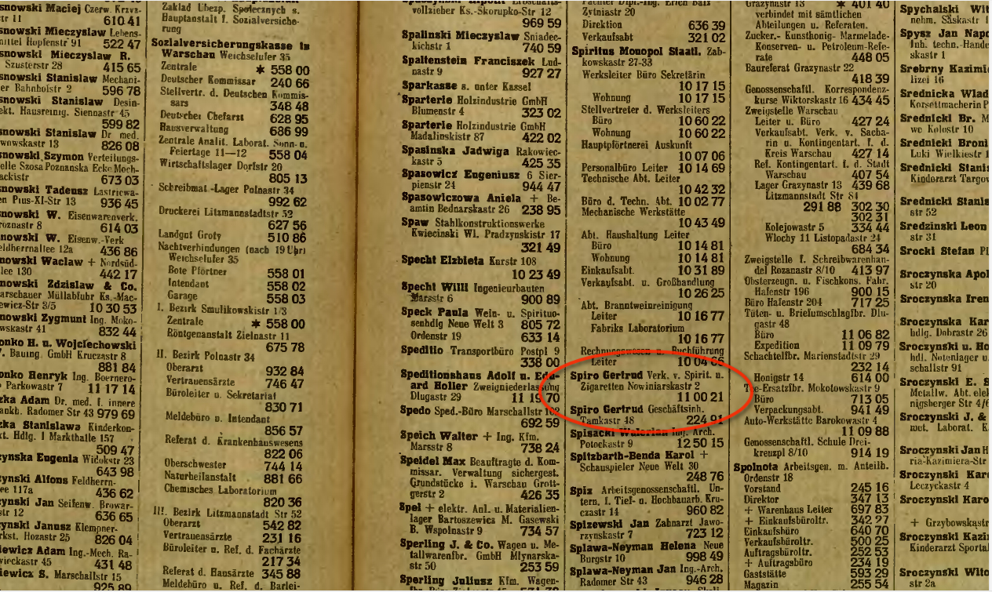
Simple DNS
Idea (1): What if every host has a local directory?
/etc/hosts.txt
  How things worked in the early days of the Internet!
What if hosts moved around? How do you keep this up to date?

Slide 12
Simple DNS
DOMAIN NAME | IP ADDRESS
www.yahoo.com | 98.138.253.109
cs.rutgers.edu | 128.6.4.2
www.google.com | 74.125.225.243
www.princeton.edu | 128.112.132.86
<Client IP, CPort, DNS server IP, 53>
QUERY | STD QUERY | cs.rutgers.edu
<DNS server, 53, Client IP, Cport>
RESPONSE | STD QUERY | 128.6.4.2
Idea (2): Implement a server that looks up a table
  Simple, but does not scale
Every new host needs to be entered in this table
Performance?
Failure?

Slide 13
DNS design
A centralized DNS design (ex: single server) is problematic.
single point of failure
traffic volume
distant centralized database
security
maintenance
It doesn’t scale to the requirements of the Internet.

Slide 14
Distributed and hierarchical database
Root DNS Servers
com DNS servers
org DNS servers
edu DNS servers
google.com
DNS servers
wnyc.org
DNS servers
rutgers.edu
DNS servers
umass.edu
DNS servers
amazon.com
DNS servers
cs.rutgers.edu
DNS server
RFC 1034

Slide 15
DNS protocol
Client and Server
Client connects to Port 53
DNS server address should be known
  Either manually configured or automatically (more on this to come…)
Two types of messages
  Queries
  Responses
Type of Query (OPCODE) methods
  Standard query (0x0)
    Request domain name for a given IP address
  Updates (0x5)
    Provide a binding of IP address to domain name
Each type has a common message format that follows the header

Slide 16
DNS Protocol
When client wants to know an IP address for a host name
  Client sends a DNS query to the “local” name server in its network
  If name server contains the mapping, it returns the IP address to the client
  Otherwise, the name server forwards the request to the root name server
  The request works its way down the tree toward the host until it reaches a name server with the correct mapping

Slide 17
Example
root DNS server
2
Host at cis.poly.edu wants IP address for gaia.cs.umass.edu
Local DNS server
Root DNS server
TLD DNS server
Authoritative DNS server
3
.edu DNS server
4
5
local DNS server
dns.poly.edu
7
6
1
8
umass.edu DNS server
dns.umass.edu
requesting host
cis.poly.edu
gaia.cs.umass.edu

Slide 18
Query type
root DNS server
2
Iterated query:
Contacted server replies with name of server to contact
“I don’t know this name, but ask this server”
3
.edu DNS server
4
5
local DNS server
dns.poly.edu
7
6
1
8
umass.edu DNS server
dns.umass.edu
requesting host
cis.poly.edu
gaia.cs.umass.edu

Slide 19
Query type
root DNS server
Recursive query:
Puts burden of name resolution on the contacted name server
Problem: think about the root DNS server.
Must it answer every DNS query?
2
3
7
6
.edu DNS server
local DNS server
dns.poly.edu
5
4
1
8
umass.edu DNS server
dns.umass.edu
requesting host
cis.poly.edu
gaia.cs.umass.edu

Slide 20
DNS caching and updating records
Once (any) name server learns a name to IP address mapping, it caches the mapping
  Cache entries timeout (disappear) after some time
  TLD servers typically cached in local name servers
  In practice, root name servers aren’t visited often

Slide 21
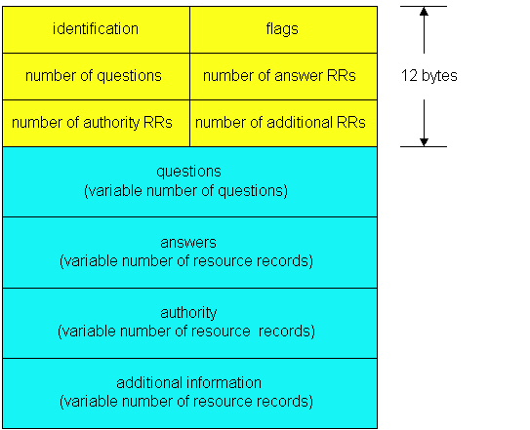
DNS protocol messages
DNS protocol : query and reply messages, both with same message format
QR
Opcode
Message header
QR = 0 for Query, 1 for response
Opcode= 0 standard
identification: 16 bit # for query, reply to query uses same #
flags:
  Authoritative answer
  recursion desired
  recursion available
  reply is authoritative

Slide 22
DNS protocol, messages
QR
OPCODE
Name, type fields
for a query
RRs in response
to query
records for
authoritative servers
Information about nameserver
additional “helpful”
info that may be used

Slide 23
DNS records
DNS: distributed db storing resource records (RR)
RR format: (name, type, class, ttl, addr)
Type=A
  name is hostname
  value is IP address
Type=CNAME
  name is alias name for some “canonical” (the real) name
  www.ibm.com is really
  servereast.backup2.ibm.com
  value is canonical name
Type=AAAA
  name is hostname
  value is IPv6 address
Type=NS
  name is domain (e.g. foo.com)
  value is hostname of authoritative name server for this domain
Type=MX
  value is name of mailserver associated with name

Slide 24
DNS Record example
NAME | Design.cs.rutgers.edu
TYPE | A
CLASS | IN
TTL | 1 day(86400)
ADDRESS | 192.26.92.30
RRs in response
to query
records for
authoritative servers
Information about nameserver
NAME | Cs.rutgers.edu
TYPE | NS
CLASS | IN
TTL | 1 day(86400)
NSDNAME | Ns-lcsr.rutgers.edu

Slide 25
DNS summary
DNS service:
Hostname to IP address translation
Host aliasing
  Canonical and alias names
Mail server aliasing
Load distribution
  Replicated Web servers: set of IP addresses for one canonical name
Caching
Hierarchical structure for scaling
Multiple layers of indirection

Slide 26
Bootstrapping DNS
How does a host contact the name server if all it has is the name and no IP address?
IP address of at least 1 nameserver must be given a priori
    or with another protocol (DHCP, bootp)
  File /etc/resolv.conf in unix
  Start -> settings-> control panel-> network ->TCP/IP -> properties in windows

Slide 27
Themes
Request/response nature of these protocols
How Messages are structured
  HTTP, SMTP, FTP - simple ASCII protocols
Caching
Name Lookup
  Division of concerns (e.g. zones)
  Hierarchy structure

