Slide 1

Debugging; Routing
Lecture 23
http://www.cs.rutgers.edu/~sn624/352-F24
Srinivas Narayana

Slide 2

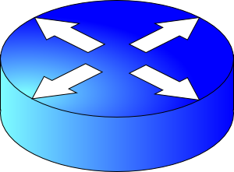


The network layer enables reachability.
We’ll see protocols that solve subproblems.
How does an endpoint get an address?
How does an endpoint talk to another outside its network?
Debugging?
ICMP
Routing protocols
OSPF, RIP, BGP
DHCP
How does an endpoint talk to another within the same network?
ARP
Gateways
NAT

Slide 3
Review: Internet Control Message Protocol (ICMP)
A protocol for troubleshooting and diagnostics
Works over IP: unreliable delivery of packets
Some functions of ICMP:
  Determine reachability (ping) and provide unreachability errors
  Specify that packets have been in the network for too long (traceroute)
ICMP header
Message type, Code, Checksum,
ICMP data
IP header

Slide 4
Ping
Uses ICMP echo request (type=8, code=0) and reply (type=0, code=0)
Source sends ICMP echo request message to dst address
Destination network stack replies with an ICMP echo reply message
Source can calculate round trip time (RTT) of packets
If no echo reply comes back, then the destination is unreachable
Don’t need to have a server program running on the other side
  In general, the remote endpoint can be completely outside your control

Slide 5
Ping
A
R1
R2
R3
B
Echo
request
Time
Ping time
Echo reply

Slide 6
Traceroute
A tool that can record the router-level path taken by packets
A clever use of the IP time-to-live (TTL) field
In general, when a router receives an IP packet, it decrements the TTL field on the packet
  A failsafe mechanism to ensure packets don’t keep taking up network resources for too long
If a router receives a packet with TTL=0, it sends an ICMP time exceeded message (type=11, code=0) to the source endpoint

Slide 7
Traceroute
Traceroute sends multiple packets to a destination endpoint
But it progressively increases the TTL on those packets: 1, 2, ...
Every time a time exceeded message is received, record the router’s IP address
Process repeated until the destination endpoint is reached
If the packet reaches the destination endpoint (i.e.: TTL is high enough), then the endpoint sends a port unreachable message (type=3, code=3)

Slide 8
Traceroute
A
R1
R2
R3
B
TTL=1, dest = B, dstport = invalid
Time
Time exceeded
Source: R1
TTL = 2
Similarly, capture IP addresses of routers at distance 3, 4, …
TE(R2)
Port un- reachable
Source: B
Have full router-level path until destination

Slide 9
Summary of ICMP
A protocol for network diagnostics and troubleshooting
Two useful tools: ping and traceroute
Ping: test connectivity to a machine totally outside your control
  Use ICMP echo request and reply
Traceroute: determine router-level path to a remote endpoint
  A smart use of the TTL field in the IP header

Slide 10


The network layer enables reachability.
Every protocol below solves a sub-problem.
Net layer
How does an endpoint get an address?
Debugging
ICMP
How does an endpoint talk to another outside its network?
DHCP
ping
traceroute
Routing protocols
OSPF, RIP, BGP
How does an endpoint talk to another within the same network?
ARP
Gateways
NAT
IPv6

Slide 11
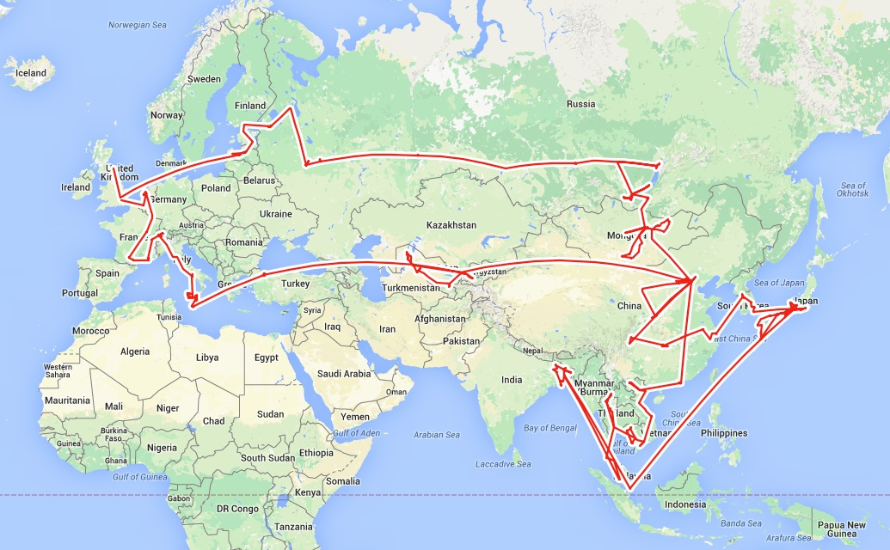
Routing is a fundamental problem in networking.
How would one design a “Google Maps”
to navigate the Internet?

Slide 12
Goals of Routing Protocols #1
Determine good paths from source to destination
“Good” = least cost
  Least propagation delay
  Least cost per unit bandwidth (e.g., $ per Gbit/s)
  Least congested (workload-driven)
“Path” = a sequence of router ports (links)

Slide 13


Goals of Routing Protocols #2
Make networks resilient to failures
Routers & links can fail without taking down the entire network
Entire subsets can be unreachable; rest still reachable
Hence, the protocol must be distributed

Slide 14




Per-router control plane
Distributed control plane: Components in every router interact with other components to produce a routing outcome.
Routing
Algorithm
control
plane
data
plane
Routing protocol
Data plane
per-packet processing, moving packet from input port to output port
Q1. What info exchanged?
0111
1
3
2
values in arriving
packet header,
i.e, destination IP address
Q2. What computation?

Slide 15
The graph abstraction
Routing algorithms work over an abstract representation of a network: the graph abstraction
Each router is a node in a graph
Each link is an edge in the graph
Edges have weights (also called link metrics). Set by netadmin
Ex: Rutgers campus
u: Computer Science
v: School of Engineering
…
5
v
3
w
2
5
u
2
1
z
3
1
2
x
y
1

Slide 16
The graph abstraction
Routing algorithms work over an abstract representation of a network: the graph abstraction
G = (N, E)
N = {u, v, w, x, y, z}
E = { (u,v), (u,x), (v,x), (v,w), (x,w), (x,y), (w,y), (w,z), (y,z) }
Ex: Rutgers campus
u: Computer Science
v: School of Engineering
…
5
v
3
w
2
5
u
2
1
z
3
1
2
x
y
1

Slide 17
The graph abstraction
5
Cost of an edge: c(x, y)
  Examples: c(u, v) = 2, c(u, w) = 5
Cost of a path = sum of edge costs
  c(path x → w → y → z) = 3 + 1 + 2 = 6
Outcome of routing: each node should determine the least cost path to every other node
Q1: What information should nodes exchange with each other to enable this computation?
Q2: What algorithm should each node run to compute the least cost path to every node?
v
3
w
2
5
u
2
1
z
3
1
2
x
y
1

Slide 18
Coming up next
Routing protocols
Link state
protocols
Distance vector protocols
Each router has complete information of the graph
Messages exchanged by flooding all over the network
Communication expensive, but complete
Each router only maintains distances & next hop to others
Messages are exchanged only between neighbors
Communication cheap, but incomplete

Slide 19
Link State Protocols

Slide 20
Link state protocol
Each router knows the state of all the links and routers in the network
Every router performs an independent computation on globally shared knowledge of network’s complete graph representation
Routing protocols
Link state
protocols
Distance vector protocols

Slide 21
Q1: Information exchange
Link state flooding: the process by which neighborhood information of each network router is transmitted to all other routers
Each router sends a link state advertisement (LSA) to each of its neighbors
LSA contains the router ID, the IP prefix owned by the router, the router’s neighbors, and link cost to those neighbors
Upon receiving an LSA, a router forwards it to each of its neighbors: flooding
5
v
3
w
2
5
u
2
1
z
3
1
2
x
y
1

Slide 22
Q1: Information exchange
Eventually, the entire network receives LSAs originated by each router
LSAs put into a link state database
LSAs occur periodically and whenever the graph changes
  Example: if a link fails
  Example: if a new link or router is added
The routing algorithm running at each router can use the entire network’s graph to compute least cost paths
5
v
3
w
2
5
u
2
1
z
3
1
2
x
y
1

Slide 23
Q2: The algorithm
Dijkstra’s algorithm
Given a network graph, the algorithm computes the least cost paths from one node (source) to all other nodes
This can then be used to compute the forwarding table at that node
Iterative algorithm: maintain estimates of least costs to reach every other node. After k iterations, each node definitively knows the least cost path to k destinations
Notation:
c(x,y): link cost from node x to y; = ∞ if not direct neighbors
D(v): current estimate of cost of path from source to destination v
p(v): (predecessor node) the last node before v on the path from source to v
N': set of nodes whose least cost path is definitively known

Slide 24
Dijsktra’s Algorithm
1 Initialization:
2 N' = {u}
3 for all nodes v
4 if v adjacent to u
5 then D(v) = c(u,v)
6 else D(v) = ∞
7
8 Loop
9 find w not in N' such that D(w) is a minimum
10 add w to N'
11 update D(v) for all v adjacent to w and not in N' :
12 D(v) = min( D(v), D(w) + c(w,v) )
13 /* new cost to v is either old cost to v or known
14 shortest path cost to w plus cost from w to v */
15 until all nodes in N'
Initial estimates of distances are just the link costs of neighbors.
Least cost node among all estimates. This cost cannot decrease further.
Relaxation

Slide 25
Visualization
min cost in N \ N’
N \ N’
Nodes with estimated least path costs, not definitively known to be smallest possible
N’
nodes whose least cost paths from u are definitively known
W should move to N’.
w
c(w, v)
D(w)
v
Relaxation: for each v in N \ N’, is the cost of the path via w smaller than known least cost path to v?
If so, update D(v)
Predecessor of v is w.
D(v)
v’
u
v’’
Cost of path via w: D(w) + c(w,v)
Cost of known best path: D(v)

Slide 26
Dijkstra’s algorithm: example
Step
0
1
2
3
4
5
N'
u
ux
uxy
uxyv
uxyvw
uxyvwz
D(v),p(v)
2,u
2,u
2,u
D(w),p(w)
5,u
4,x
3,y
3,y
D(x),p(x)
1,u
D(y),p(y)
∞
2,x
D(z),p(z)
∞
∞
4,y
4,y
4,y
5
v
3
w
2
5
u
2
1
z
3
1
2
x
y
1

Slide 27
Constructing the forwarding table
To find the router port to use for a given destination (router), find the predecessor of the node iteratively until reaching an immediate neighbor of the source u
The port connecting u to this neighbor is the output port for this destination

Slide 28
Constructing the forwarding table
5
Suppose we want forwarding entry for z.
v
3
w
2
5
u
2
1
z
3
1
2
x
y
1
D(v),p(v)
2,u
D(w),p(w)
3,y
D(x),p(x)
1,u
D(y),p(y)
2,x
D(z),p(z)
4,y
z: p(z) = y
y: p(y) = x
x: p(x) = u
x is an immediate
neighbor of u
Forwarding table at u:
destination
link
z
(u,x)

Slide 29
Summary of link state protocols
Each router announces link state to the entire network using flooding
Each node independently computes least cost paths to every other node using the full network graph
Dijkstra’s algorithm can efficiently compute these best paths
  Easy to populate the forwarding table from predecessor information computed during the algorithm

