Slide 1
Network Layer: Addressing
Lecture 20
http://www.cs.rutgers.edu/~sn624/352-F24
Srinivas Narayana

Slide 2
Software/hardware organization at hosts
Application: useful user-level functions
Communication functions broken up and “stacked”
Transport: provide guarantees to apps
Each layer depends on the one below it.
Each layer supports the one above it.
The interfaces between layers are well-defined and standardized.
Network: best-effort global pkt delivery
Link: best-effort local pkt delivery

Slide 3
Network
Application
HTTPS
FTP
HTTP
SMTP
DNS
Transport
TCP
UDP
Net layer
Network
IP
Host-to-Net
X.25
…
802.11
ATM

Slide 4
The network layer
Endpoint
Main function: Move data from sending to receiving endpoint
on sending endpoint: encapsulate transport segments into datagrams
on receiving endpoint: deliver datagrams to transport layer
The network layer also runs in every router
Implication: Often challenging to evolve network layer
Routers examine headers on all packets passing through them
Process
Network Layer
Process
Endpoint

Slide 5
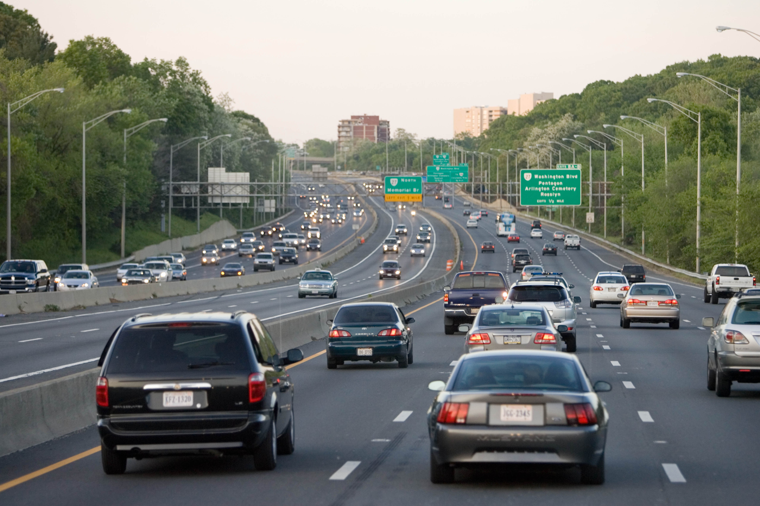
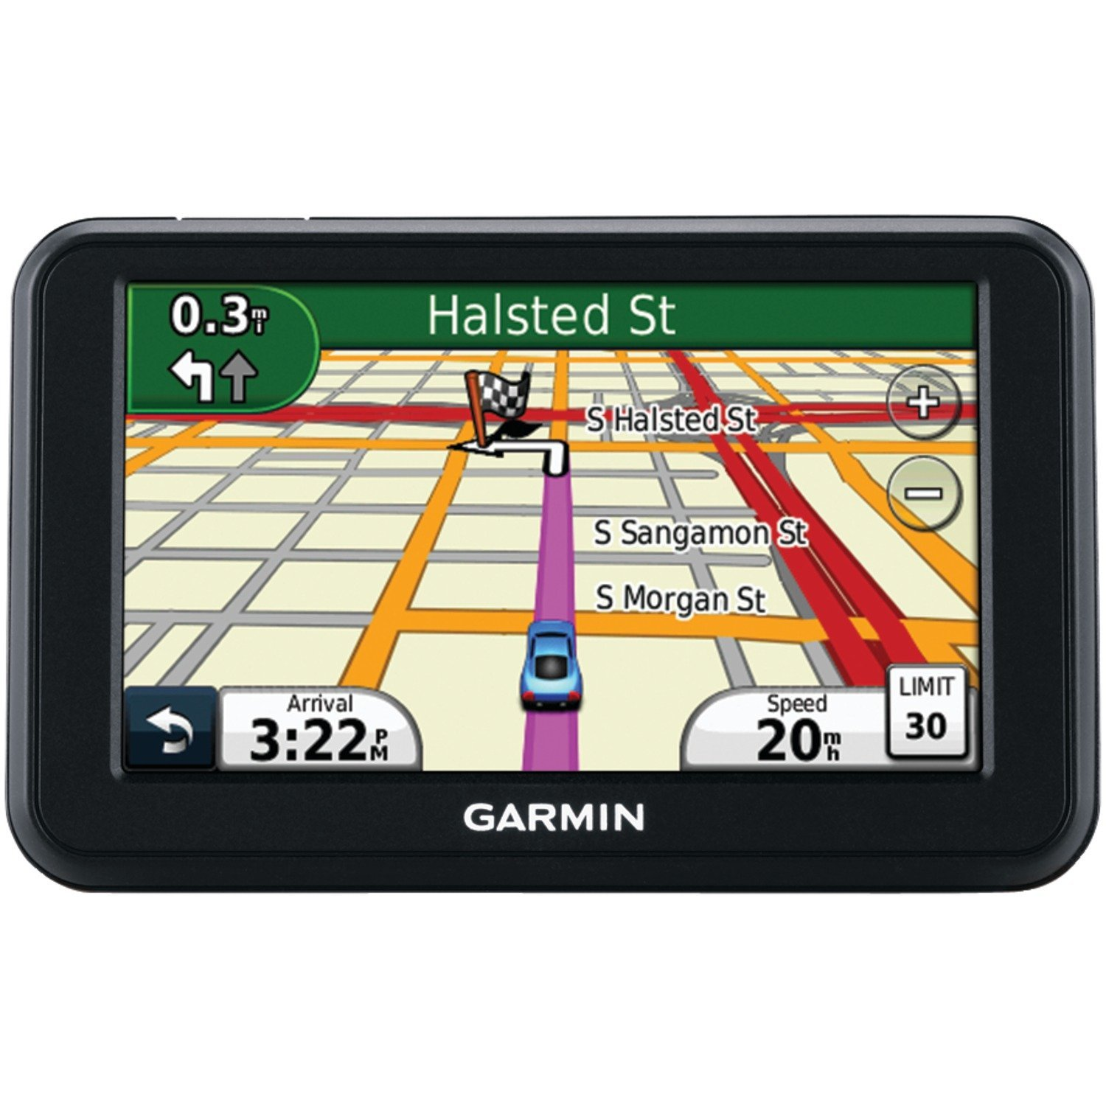
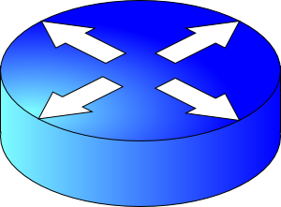
Two key network-layer functions
Forwarding: move packets from router’s input to appropriate router output
Routing: determine route taken by packets from source to destination
routing algorithms
The network layer solves the routing problem.
Analogy: taking a road trip
Forwarding: process of getting through single interchange
Routing: process of planning trip from source to destination
network
layer
runs
everywhere

Slide 6
Data plane and Control Plane
Data plane = Forwarding
local, per-router function
determines how datagram arriving on router input port is forwarded to router output port
Control plane = Routing
network-wide logic
determines how datagram is routed along end-to-end path from source to destination endpoint
two control-plane approaches:
Distributed routing algorithm running on each router
Centralized routing algorithm running on a (logically) centralized server
values in arriving
packet header
0111
1
3
2

Slide 7
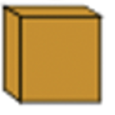
This lecture: Addresses in the Internet
I need to send B something.
Sure, what’s B’s address?
A
B
Endpoints
Endpoints
Network layer

Slide 8
Internet Addressing

Slide 9
The Internet needs addresses
Addresses are a precursor to communication.
Allow endpoints to locate each other
Internet addresses are neither endpoint names nor identify them
Addresses help routers determine how to move a packet
Like street address for the postal system
Network layer addresses are designed to help routers perform the forwarding and routing functions efficiently
Specifically, we’ll look at Internet Protocol (IP) addresses.
Most popular: IP version 4 or IPv4. (later: IPv6)

Slide 10
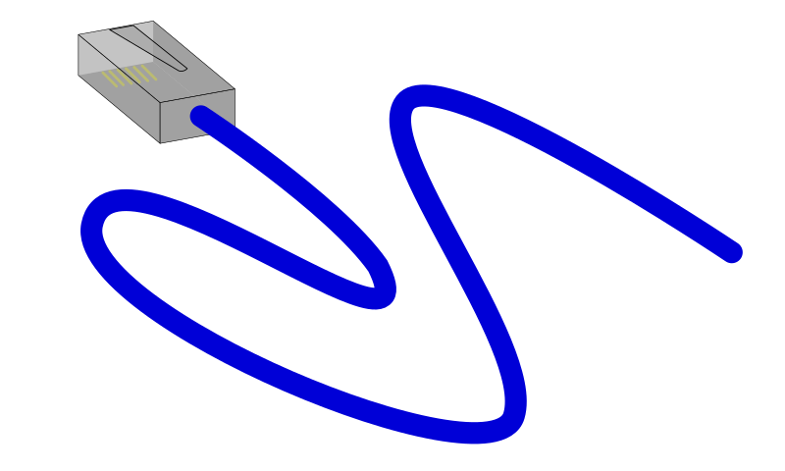
IPv4 Addresses
32 bits long
Identifier for a network interface
An IP address corresponds to the point of attachment of an endpoint to the network.
An IP address is NOT an identifier for the endpoint
Changes when endpoint moves
IPv4 dotted quad notation: each byte is written in decimal in MSB order, separated by dots. Example:
10000000 11000011 00000001 01010000
128
.
195
.
1
.
80

Slide 11
Grouping IP addresses by prefixes
IP addresses can be grouped based on a shared prefix of a specified length
Example: consider two IP addresses:
128.95.1.80 and 128.95.1.4
The addresses share a prefix of (bit) length 24: 128.95.1
The addresses have different suffixes of (bit) length 8
IP addresses: prefix corresponds to the network component and the suffix to an endpoint (host) component of the address

Slide 12
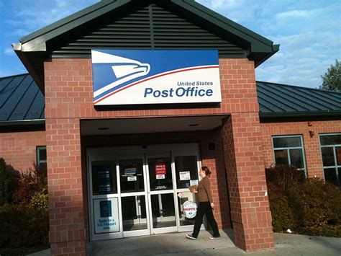
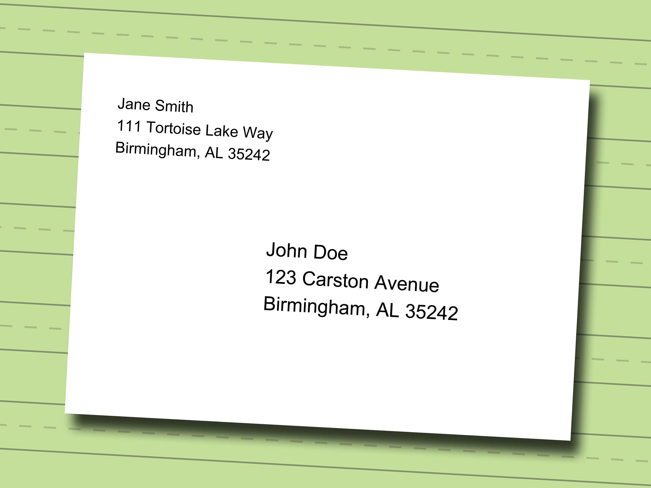
IP addresses use hierarchy to scale routing
IP addresses of endpoint interfaces in a network (e.g., Rutgers Busch campus) share a prefix of some length
Each interface/endpoint has a different suffix, and hence a different 32-bit IP address
Using prefixes reduces the amount of information needed to forward packets over the Internet
IP prefixes are like zip codes: routers don’t need to store info for each endpoint, just each prefix
Prefixes allow IP addresses to move from one network to another (more on this later)
NJ

Slide 13
IP addresses use hierarchy to scale routing
Postal envelopes should show clearly delineated zip codes.
Q: How to identify the prefix from a 32-bit IP address?
Two methods:
Old: Classful addressing. IP address itself is formatted to denote the IP prefix
New: Classless addressing (also called classless inter-domain routing, or CIDR).
Each router independently identifies prefix from IP
NJ

Slide 14
Classless IPv4 addressing (CIDR)

Slide 15
Classless IPv4 addressing
Also called classless inter-domain routing (CIDR)
Key idea: Network component of the address (ie: prefix) can have any length (usually from 8—32)
Address format: a.b.c.d/x, where x is the prefix length
Customary to use 0s for all suffix bits
network
part
host
part
11001000 00010111 00010000 00000000
200.23.16.0/23

Slide 16
CIDR
https://www.internetsociety.org/resources/deploy360/2015/short-guide-ip-addressing/
An ISP can obtain a block of addresses and partition this further to its customers
Say an ISP has 200.8.0.0/16 address (65K addresses).
The ISP has customer who needs only 64 addresses starting from 200.8.4.128
Then that block can be specified as 200.8.4.128/26
200.8.4.128/26 is “inside” 200.8.0.0/16
200.8.0.0/16
200.8.0.0
200.8.0.1
200.8.4.128/26
…
200.8.1.0
200.8.1.1
…
200.8.255.255

Slide 17
Netmask (or subnet mask)
An alternative to denote the IP prefix length of an organization
32 bits: a 1-bit denotes a prefix bit position. 0 denotes host bit.
network
part
host
part
11001000 00010111 00010000 00000000
200.23.16.0/23
network part of mask
host part of mask
11111111 11111111 11111110 00000000
Netmask: 255.255.254.0

Slide 18
Detecting addresses from same network
Given IP addresses A and B, and netmask M.
1. Compute logical AND (A & M).
2. Compute logical AND (B & M).
3. If (A & M) == (B & M) then A and B are
on the same network.
Ex: A = 165.230.82.52, B = 165.230.24.93, M = 255.255.128.0
A and B are in the same network according to the netmask
A & M == B & M == 165.230.0.0

Slide 19
Finding your own IP address(es)
The old way (still works today on Mac and Linux):
ifconfig –a
The new way using “iproute2” tools on Linux:
ip link
ip addr
What else do you see in these outputs?

