Slide 1

Congestion Control
Lecture 17
http://www.cs.rutgers.edu/~sn624/352-F24
Srinivas Narayana

Slide 2
How much data to keep in flight?
= window size
Proportional to throughput
SEQ 0
SEQ 1
SEQ 2
Stop and Wait
SEQ 3
SEQ 0
RTT
ACK 1
ACK 2
ACK 3
ACK 4
RTT
ACK
SEQ 1
Pipelined Reliability
RTO
Retransmit

Slide 3



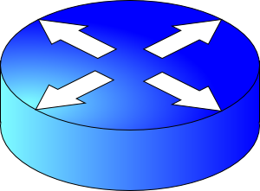
sender
Multiple locations for bottlenecks
application
process
recv()
Congestion Control
TCP socket
receiver buffers
Flow Control
What’s the bottleneck? How to adapt how much data to keep in flight?
TCP
code
from sender
Packet loss
Packet delays
receiver
It is difficult to know where the bottleneck link is
It is difficult to know how many other endpoints are using that link
Endpoints may join and leave at any time
Network paths may change over time, leading to different bottleneck links (with different link rates) over time

Slide 4
How to share a network, with so many unknowns?

Slide 5
The approach that the Internet takes is to use a distributed algorithm to converge to an efficient and fair outcome.

Slide 6
The approach that the Internet takes is to use a distributed algorithm to converge to an efficient and fair outcome.
No one can centrally view or control all the endpoints and bottlenecks in the Internet.
Every endpoint must try to reach a globally good outcome by itself: i.e., in a distributed fashion.
This also puts a lot of trust in endpoints.

Slide 7
The approach that the Internet takes is to use a distributed algorithm to converge to an efficient and fair outcome.
If there is spare capacity in the bottleneck link, the endpoints should use it.

Slide 8
The approach that the Internet takes is to use a distributed algorithm to converge to an efficient and fair outcome.
If there are N endpoints sharing a bottleneck link, they should be able to get equitable shares of the link’s capacity.
For example: 1/N’th of the link capacity.

Slide 9
Flow Control vs. Congestion Control
Avoid overwhelming the receiving application
Sender is managing the receiver’s socket buffer
Avoid overwhelming the bottleneck network link
Sender is managing the bottleneck link capacity and bottleneck router buffers

Slide 10
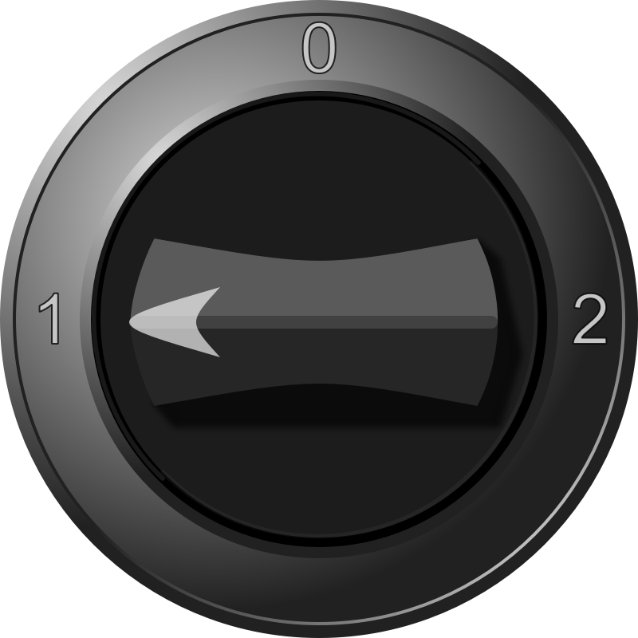


The approach that the Internet takes is to use a distributed algorithm to converge to an efficient and fair outcome.
C
H
How to achieve this?
Approach: sense and react
Example: showering: Want “just right” water
Use a feedback loop with signals and knobs

Slide 11
Signals and Knobs in Congestion Control
Signals
  Packets being ACK’ed
  Packets being dropped (e.g. RTO fires)
  Packets being delayed (RTT)
  Rate of incoming ACKs
Knobs
  What can you change to “probe” the available bottleneck capacity?
    Window size
  Suppose the receiver socket buffer size is unbounded
    Congestion window: window size used for congestion control
  Increase window/sending rate: e.g., add x or multiply by a factor of x
  Decrease window/sending rate: e.g., subtract x or reduce by a factor of x
Implicit feedback signals measured directly at sender.
(There are also explicit signals that the network might provide.)

Slide 12
Sense and react, sure…but how?
H
Where do you want to be?
  The steady state
How do you get there?
  Congestion control algorithms
Sense accurately & react accordingly
C

Slide 13
The Steady State
Efficiency for a single TCP connection

Slide 14

What does efficiency look like?
Suppose we want to achieve an efficient outcome for one TCP connection by observing network signals from the endpoint
Q: How should the endpoint behave at steady state?
Challenge: bottleneck link is remotely located

Slide 15
Steady state: Ideal goal
High sending rate: Use the full capacity of the bottleneck link
Low delay: Minimize the overall delay of packets to get to the receiver
  Overall delay = propagation + queueing + transmission
  Assume propagation and transmission components fixed
“Low delay” reduces to low queueing delay
i.e., don’t push so much data into the network that packets have to wait in queues
Key question: When to send the next packet?

Slide 16
When to send the next packet?
T
Fast link
Bottleneck link
1. Send packet burst (as allowed by window)
Inter-packet delay T
2. Receive data packet
5. Send data packet on ACK
Data
Sender
T
T
Receiver
T
4. Receive ACK
3. Send ACK
ACKs

Slide 17
Rationale
When the sender receives an ACK, that’s a signal that the previous packet has left the bottleneck link (and the rest of the network)
Hence, it must be safe to send another packet without congesting the bottleneck link
Such transmissions are said to follow packet conservation
ACK clocking: “Clock” of ACKs governs packet transmissions

Slide 18
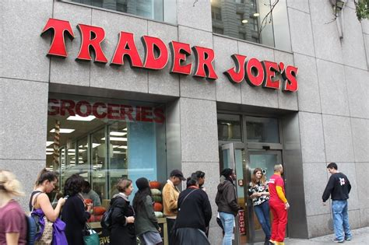
ACK clocking: analogy
How to avoid crowding a grocery store?
Strategy: Send the next waiting customer exactly when a customer exits the store
However, this strategy alone can lead to inefficient use of resources…

Slide 19
ACK clocking alone can be inefficient
Sender pushing data slowly
T
Large delay T
Send data packet on ACK
Data
Sender
T
T
Receiver
T
ACKs

Slide 20
ACK clocking alone can be inefficient
Sender pushing data slowly
T
Large delay T
Send data packet on ACK
Data
Sender
Receiver
The sending rate should be high enough to “fill up” the link
Analogy: a grocery store with only 1 customer in entire store
If the store isn’t “full”, you’re using store space inefficiently

Slide 21
Steady State of Congestion Control
Send at the highest rate possible (to fully use the link)
while being ACK-clocked (to avoid congesting the pipe)
So, how to get to steady state?

Slide 22
Finding the Right Congestion Window

Slide 23
Let’s play a game
Suppose I’m thinking of a number (positive integer). You need to guess the number I have in mind.
Each time you guess, I will tell you whether your number is smaller or larger than (or the same as) the one I’m thinking of
My number can be very large or small
How would you go about guessing the number?

Slide 24
Finding the right congestion window
TCP congestion control algorithms solve a similar problem!
There is an unknown bottleneck link rate that the sender must match
If sender sends more than the bottleneck link rate:
  packet loss, delays, etc.
If sender sends less than the bottleneck link rate:
  all packets get through; successful ACKs

Slide 25
Quickly finding a rate: TCP slow start
L
N
T
Payload
Initially cwnd = 1 MSS
  MSS is “maximum segment size”
Upon receiving an ACK of each MSS, increase the cwnd by 1 MSS
Effectively, double cwnd every RTT
Initial rate is slow but ramps up exponentially fast
On loss (RTO), restart from cwnd := 1 MSS
Host A
Host B
MSS
one segment
RTT
two segments
four segments
time

Slide 26
Behavior of slow start
Assume bottleneck link (rate) can change any time. Hence, keep repeating the process from the start.
Packet drops/
RTO
Congestion Window
Slow start
Slow start
Slow start
1 MSS
Time

Slide 27
Slow start has problems
Congestion window increases too rapidly
  Example: suppose the “right” window size cwnd is 17
  cwnd would go from 16 to 32 and then dropping down to 1
  Result: massive packet drops
Congestion window decreases too rapidly
  Suppose the right cwnd is 31, and there is a loss when cwnd is 32
  Slow start will resume all the way back from cwnd 1
  Result: unnecessarily low throughput
Instead, perform finer adjustments of cwnd based on signals

Slide 28
Use slow start mainly at the beginning
You might accelerate your car a lot when you start, but you want to make only small adjustments after.
  Want a smooth ride, not a jerky one
Slow start is a good algorithm to get close to the bottleneck link rate when there is little info available about the bottleneck, e.g., the beginning of a connection
Once close enough to the bottleneck link rate, use a different set of strategies to perform smaller adjustments to the congestion window
  Called TCP congestion avoidance

