Slide 1
The Web (part 2)
Lecture 7
http://www.cs.rutgers.edu/~sn624/352-F24
Srinivas Narayana

Slide 2
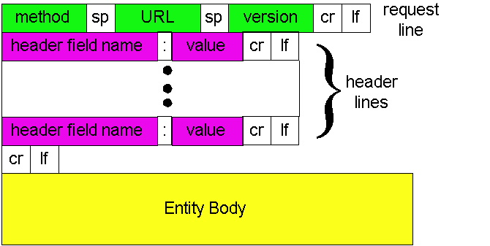
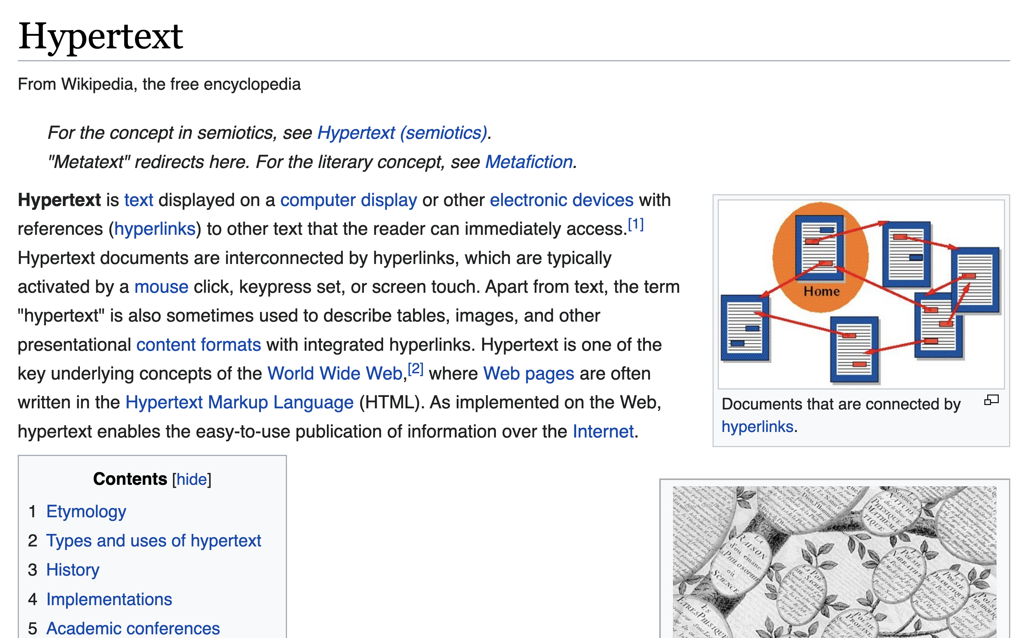
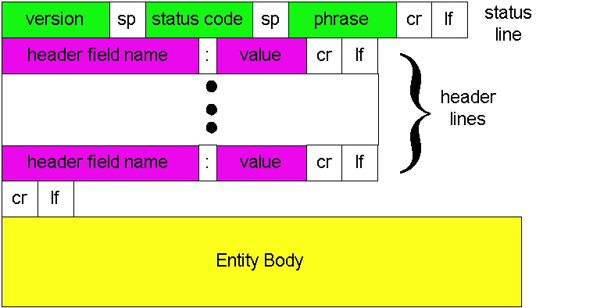
Review of concepts
Request
GET, POST, …
HyperText Transfer Protocol (HTTP)
200 OK, 301 Moved, etc.
Response
Client-Server Protocol
time
clientIP, clientPort, serverIP, 80
requests
responses

Slide 3
HTTP Persistence

Slide 4
Two types of HTTP connectivity
Non-persistent HTTP
At most one object is sent over a TCP connection.
HTTP/1.0 uses non-persistent connections
Persistent HTTP
Multiple objects can be sent over single TCP connection between client and server.
HTTP/1.1 uses persistent connections in default mode
TCP is a reliable communication protocol provided by the transport layer. It requires setting up some resources (e.g., memory regions) for the connection to be set up at the endpoints before data communication.

Slide 5
Non-persistent HTTP (HTTP/1.0)
1a. HTTP client initiates TCP connection to HTTP server
1b. HTTP server at host “accepts” connection, notifying client
Suppose a user visits a page with text and 10 embedded images.
2. HTTP client sends HTTP request message
3. HTTP server receives request message, replies with response message containing requested object
time

Slide 6
Non-persistent HTTP (HTTP/1.0)
4. HTTP server closes TCP connection.
5. HTTP client receives response message containing HTML file, displays HTML. Parsing HTML file, finds 10 referenced image objects
Single connection per object
Useful at a time when web pages contained 1 object: the base HTML file.
time
6. Steps 1-5 repeated for each of 10 image objects

Slide 7
How long does it take to download an entire web page with non-persistent HTTP?
i.e.: before your browser can load the (entire) web page?

Slide 8
Non-persistent HTTP user response time
Total delay = propagation + queueing + transmission
Response time for the user
= sum of forward and backward total delays
Round-Trip Time (RTT): total forward + backward delay for a “small” packet
Zero transmission delay
Assumptions:
TCP initiation packet, response, HTTP requests are all “small” packets
No processing delays at the server
RTT is stable over time
(2RTT + file transmission time) * #objects
initiate TCP
connection
RTT
request
file
File
transmission
time
for the
response
RTT
entire
file
received
time
time

Slide 9
Per-object overheads quickly add up
Modern web pages have 100s of objects in them.
Objects (e.g. images) may not be small.

Slide 10
Persistent HTTP (HTTP/1.1)
1a. HTTP client initiates TCP connection to HTTP server
1b. HTTP server at host “accepts” connection, notifying client
Suppose user visits a page with text and 10 images.
2. HTTP client sends HTTP request message
3. HTTP server receives request message, replies with response message containing requested object
Connection: keep-alive
HTTP header introduced in
HTTP/1.1
time

Slide 11
Persistent HTTP (HTTP/1.1)
4. HTTP server sends a response.
Server keeps the TCP connection alive.
5. HTTP client receives response message containing HTML file, displays HTML. Parsing HTML file, finds 10 referenced image objects
time
The 10 objects can be requested over the same TCP connection.
i.e., save an RTT per object (otherwise spent opening a new TCP connection in HTTP/1.0)

Slide 12
Persistent HTTP user response time
Assume requests made one at a time (separate RTT per req)
RTT + (RTT + file transmission time) * #objects
Pipelining: send more than one HTTP request at a time
Extreme case: all requests in one (small) packet
2RTT + (file transmission time) * #objects
In practice, dependencies between objects
Compare with non-persistent:
(2RTT + file transmission time) * #objects
Persistence (& pipelining) can save significant time, especially on high-RTT connections
Other advantages of persistence: CPU savings, reduced network congestion, less memory (fewer connections)

Slide 13
Persistence vs. # of connections
Persistence is distinct from the number of concurrent connections made by a client
Your browser has the choice to open multiple connections to a server
HTTP spec suggests to limit this to a small number (2)
Further, a single connection can have multiple HTTP requests in flight (pipelining) with persistent HTTP

Slide 14
Remembering Users On the Web

Slide 15
HTTP: Remembering users
So far, HTTP mechanisms considered stateless
Each request processed independently at the server
The server maintains no memory about past client requests
However, state, i.e., memory, about the user at the server, is very useful!
User authentication (e.g., gmail)
Shopping carts (e.g., Amazon)
Video recommendations (e.g., Netflix)
Any user session state in general

Slide 16
Familiar with these?

Slide 17
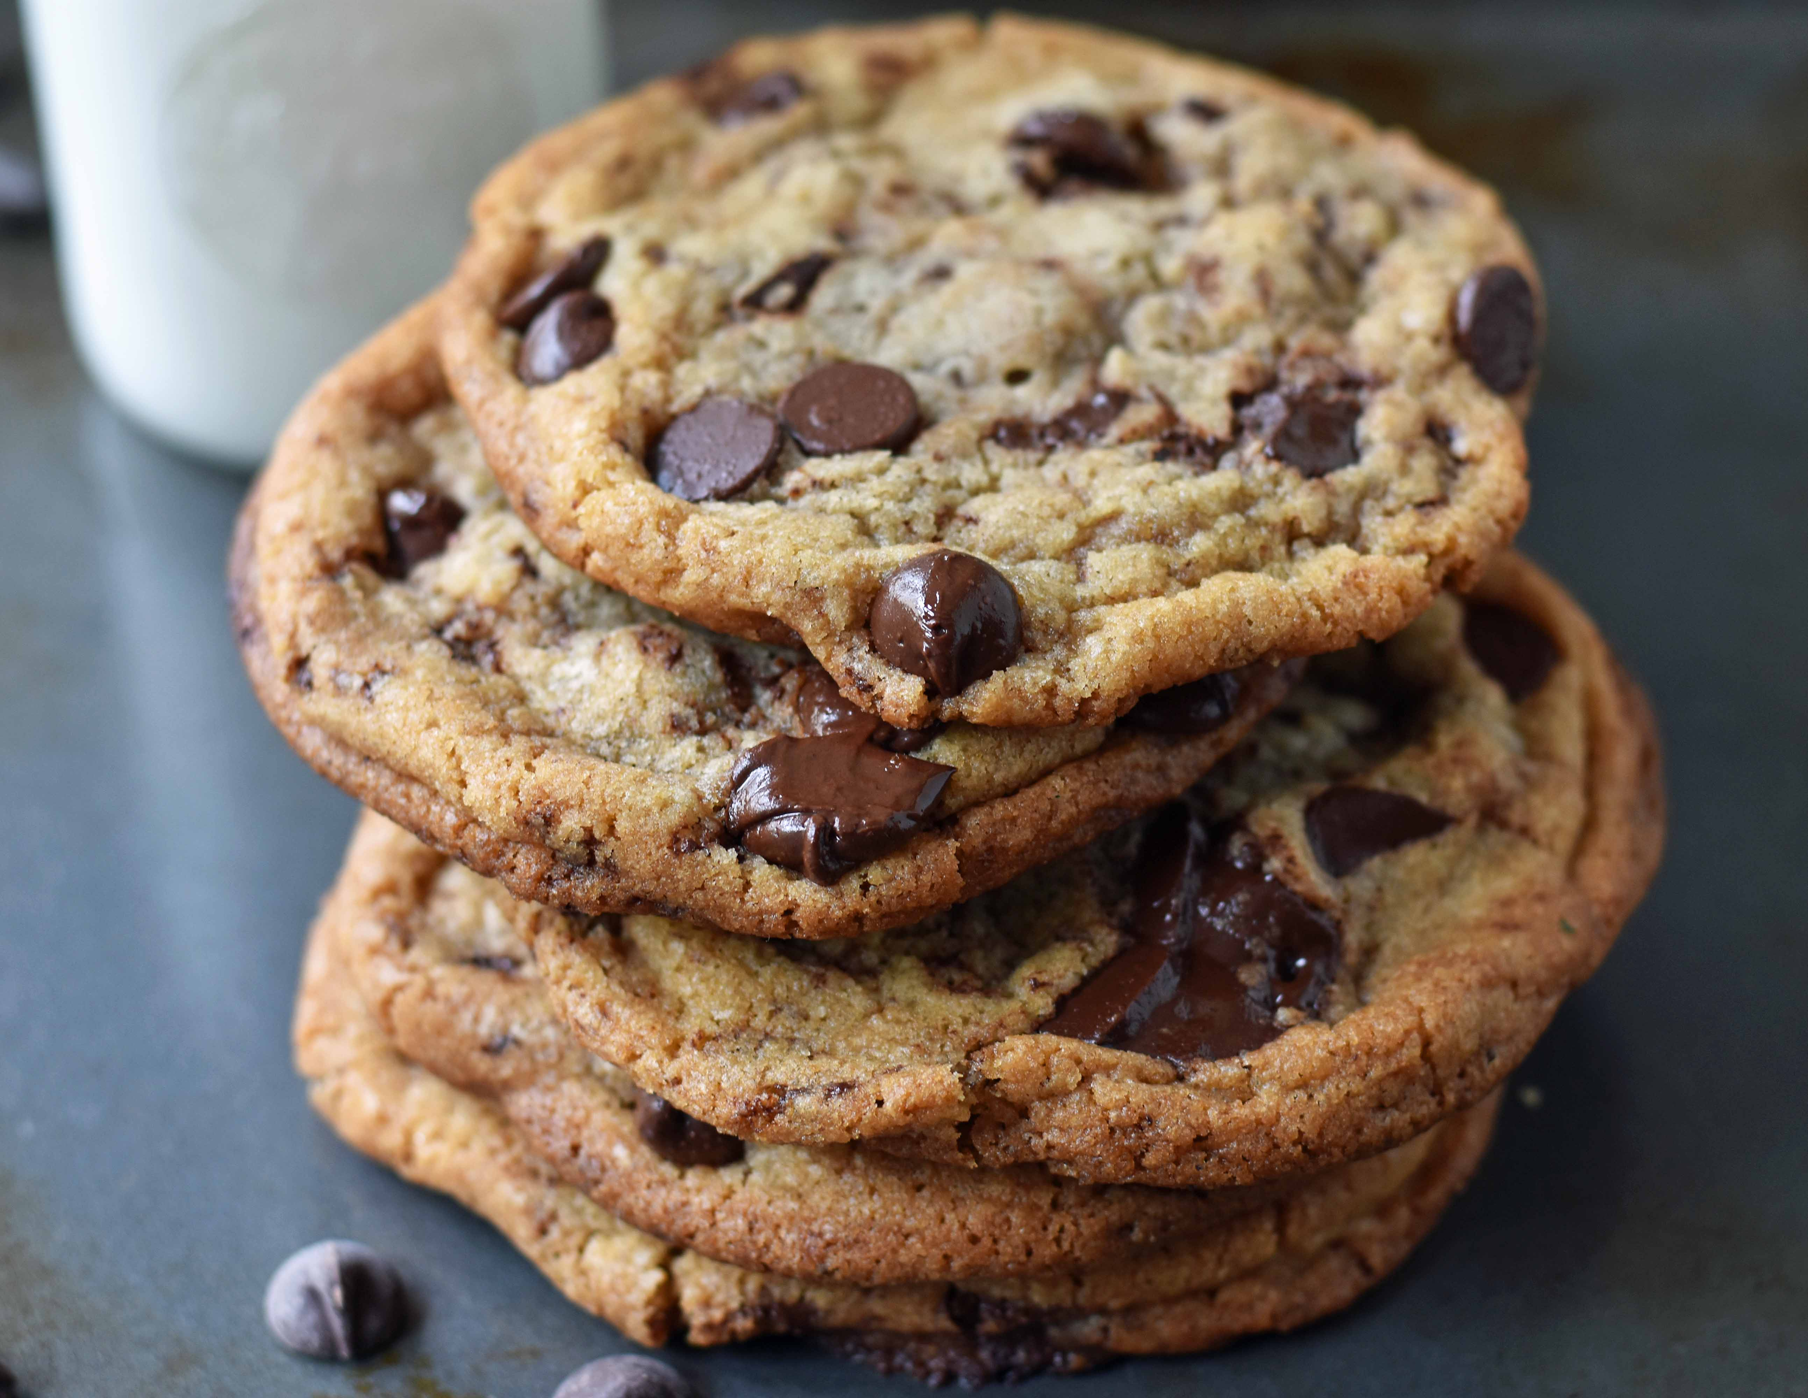
Cookies: Keeping user memory
client
server
Cookie is typically opaque to client.
Cookie file
http request msg + auth
server
creates ID
1678 for user
Netflix: 436
Amazon: 1678
http response +
Set-cookie: 1678
entry in backend
database
Cookie file
http request (no auth)
cookie: 1678
Netflix: 436
cookie-
specific
action
access
Amazon: 1678
Personalized http response
one week later:
access
Cookie file
http request (no auth)
cookie: 1678
cookie-
specific
action
Netflix: 436
Amazon: 1678
Personalized http response

