Slide 1
The Web (HTTP)
Lecture 6
http://www.cs.rutgers.edu/~sn624/352-F24
Srinivas Narayana

Slide 2
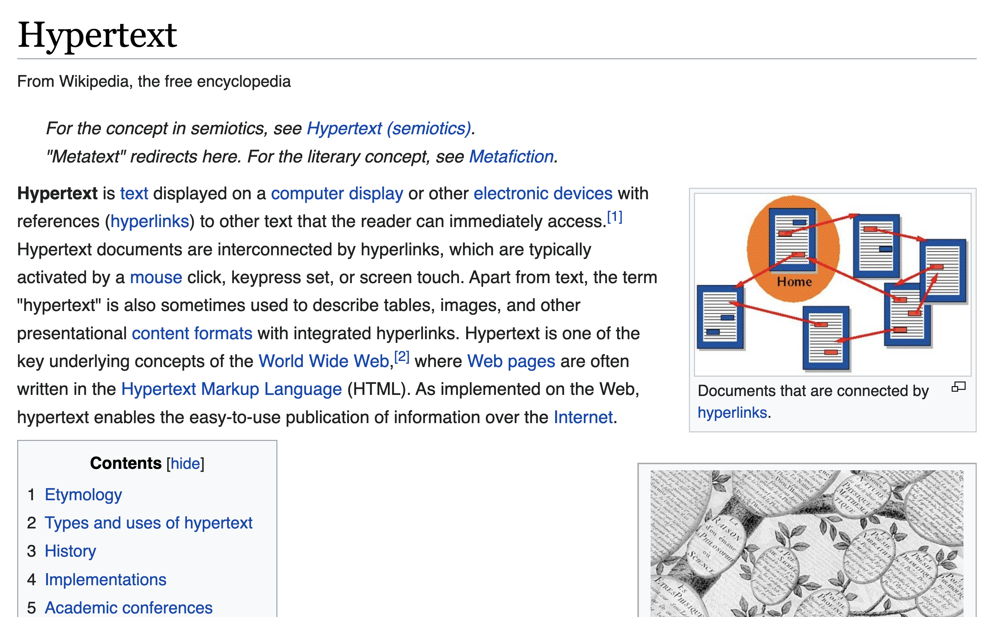
Web and HTTP: Terms
HTTP stands for “HyperText Transfer Protocol”
A web page consists of many objects
Object can be HTML file, JPEG image, video stream chunk, audio file,…
Web page consists of base HTML-file which embeds several objects
Each object is addressable by a uniform resource locator (URL)
sometimes also referred to as uniform resource identifier (URI)
Example URL:
www.cs.rutgers.edu/~sn624/index.html
Domain/host name
path

Slide 3
HTTP Protocol

Slide 4
Client server protocol
Hostname | IP address
Cs.Rutgers.edu | 10.0.1.2
DNS
I want to browse cs.rutgers.edu
Host name
Server IP Address
HTTP application typically associated with port 80
clientIP, clientPort, server IP Address, 80
HTTP request
HTTP response
HTTP messages

Slide 5
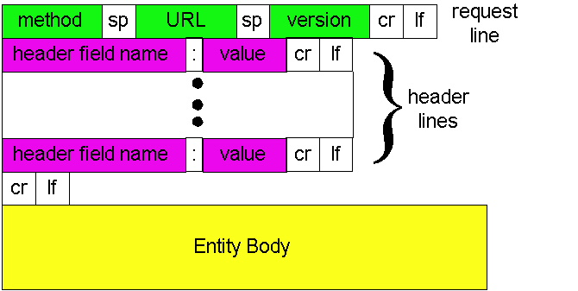
HTTP Request: Message Format
Type of request
Object/process
requested
Protocol version
Parameters influencing
the request
Data needed to fulfill request
http://www.w3.org/Protocols/rfc2616/rfc2616-sec14.html#sec14

Slide 6
HTTP messages: request message
ASCII (human-readable format)
request line
(GET, POST,
HEAD commands)
GET /352/syllabus.html HTTP/1.1
Host: www.cs.rutgers.edu
User-agent: Mozilla/4.0
Connection: close
Accept-language:en
(extra carriage return, line feed)
Header lines
Carriage return,
line feed
indicates end
of header

Slide 7
The URL
Universal Resource Locator: a way to name objects on server
But can also name an application process on the server!
Examples:
Data storage from data entered in web forms
Login pages
Web carts
Providing almost any service requires data handling by running code at the server
Not just rendering “static” resources

Slide 8
HTTP method types
GET
Get the resource specified in the requested URL (could be a process)
POST
Send entities (specified in the entity body) to a data-handling process at the requested URL
HEAD
Asks server to leave requested object out of response, but send the rest of the response
Useful for debugging
PUT
Update a resource at the requested URL with the new entity specified in the entity body
DELETE
Deletes file specified in the URL
and other methods
https://httpwg.org/specs/rfc9110.html#method.definitions

Slide 9
Uploading form input: GET and POST
POST method:
Web page often includes form input
Input is uploaded to server in entity body
Posted content not visible in the URL
Free form content (ex: images) can be posted since entity body interpreted as data bytes
GET method:
Entity body is empty
Input is uploaded in URL field of request line
URL must contain a restricted set of characters
Example:
http://site.com/form?first=jane&last=austen

Slide 10
Difference between POST and PUT
POST: the URL of the request identifies the resource that processes the entity body
PUT: the URL of the request identifies the resource that is contained in the entity body
https://tools.ietf.org/html/rfc2616

Slide 11
Difference between HEAD and GET
GET: return the requested resource in the entity body of the response along with response headers (we’ll see these shortly)
HEAD: return all the response headers in the GET response, but without the resource in the entity body
https://tools.ietf.org/html/rfc2616

Slide 12
Observing HTTP GET and POST

Slide 13
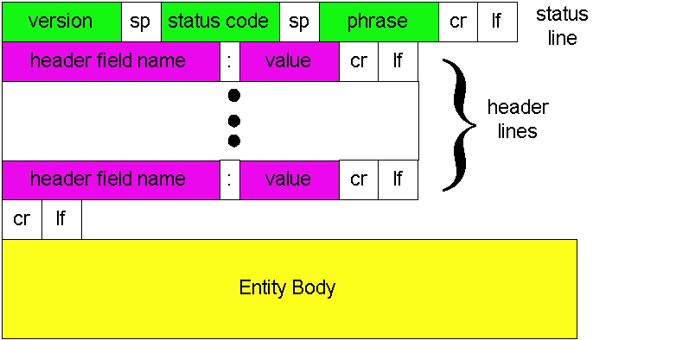
HTTP Response: General format
Unlike HTTP request, No method name
HTTP protocol version
used by server
Was request successful?
(or error condition)
Returned object data

Slide 14
HTTP message: response message
status line
(protocol
status code
status phrase)
HTTP/1.1 200 OK
Connection: close
Date: Thu, 06 Aug 1998 12:00:15 GMT
Server: Apache/1.3.0 (Unix)
Last-Modified: Mon, 22 Jun 1998 …...
Content-Length: 6821
Content-Type: text/html
data data data data data ...
response
header
lines
data, e.g., requested
HTML file in entity body

Slide 15
HTTP response status codes
In first line in server->client response message.
A few sample codes:
200 OK
request succeeded, requested object later in this message
301 Moved Permanently
requested object moved, new location specified later in this message (Location:)
403 Forbidden
Insufficient permissions to access the resource
404 Not Found
requested document not found on this server
505 HTTP Version Not Supported

Slide 16
Observing HTTP behaviors
wget google.com (or) curl google.com
telnet example.com 80
GET / HTTP/1.1
Host: example.com
(followed by two enter’s)
Exercise: try
telnet google.com 80
telnet web.mit.edu 80

