Slide 1

Domain Name System
Lecture 4
http://www.cs.rutgers.edu/~sn624/352-F24
Srinivas Narayana

Slide 2

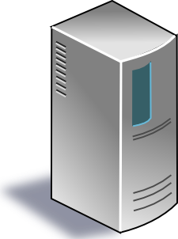

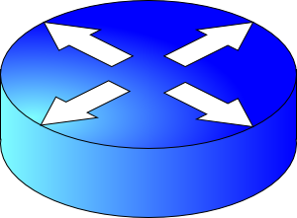

Review
Connection 4-tuple
IP_{A}
IP_{B}
port_{A}
port_{B}
Application process
Application process
Propagation
bind(IP_{B}, port_{B})
listen()
accept()
recv(data)
Transmission
connect(IP_{B}, port_{B})
send(data)
Bandwidth
Queueing
User space
Socket
Socket
Kernel space
OS network stack layers
OS network stack layers
Internet

Slide 3
Common Architectures of Applications

Slide 4
Client-server architecture
client
Server:
  Always-on endpoint
  Provides a “service” to the world
  Typically, a permanent IP address
  Hosted in clusters to scale to many users
Clients:
  A “customer” of the service
  Maybe intermittently connected
  May have dynamic IP addresses
  Typically, do not communicate directly with other clients
The web and most mobile apps use a client-server architecture
server
client

Slide 5
Peer-to-peer (P2P) architecture
peer
Peers:
  Intermittently connected hosts
  Directly talking to each other
Little to no reliance on always-up servers
  Examples: BitTorrent
Today, many applications use a hybrid model: servers to set up connectivity, communicate directly afterward
  Example: (webRTC) Google meet
peer

Slide 6
Going forward: A few app-layer protocols
Domain Name System
The web
Streaming video

Slide 7
Domain Name System

Slide 8
Domain Name System (DNS)
Problem: Humans cannot remember Internet (IP) addresses
  The average human brain can remember 7 digits for a few names
  On average, IP addresses have 12 digits
Solution: Use human-friendly names to refer to endpoints
  Alphanumeric names (e.g. www.cs.rutgers.edu)
  Called host names or domain names
A new problem! We need a directory (address book) to translate human-friendly names to IPs

Slide 9
You have a name. Can you lookup an address?

Slide 10

Directories
Directories map a name to an address
We call this process Address Resolution
Simplistic designs
  Central directory
  Ask everyone (flooding)
  Tell everyone (e.g., push to a file like /etc/hosts)
Scalable distributed designs
  Hierarchical namespace (e.g., Domain Name System (DNS))
  Flat namespace (e.g., Distributed Hash Table)

Slide 11
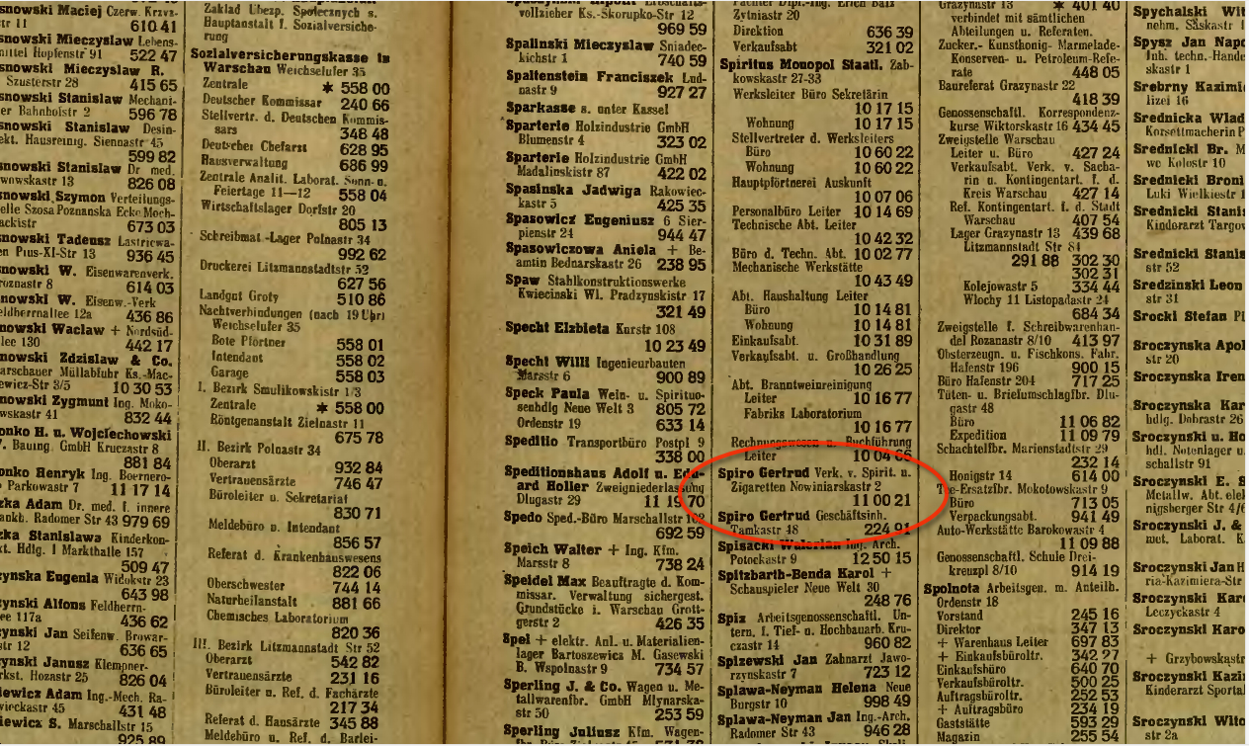
Simple DNS (“tell everyone”)
What if every endpoint has a local directory?
/etc/hosts.txt: how DNS worked in the early days of the Internet
Q: What if endpoints changed addresses? How do you keep this up to date?

Slide 12
Simple DNS
DOMAIN NAME | IP ADDRESS
spotify.com | 98.138.253.109
cs.rutgers.edu | 128.6.4.2
www.google.com | 74.125.225.243
www.princeton.edu | 128.112.132.86
<Client IP, CPort, DNS server IP, 53>
Name server
QUERY cs.rutgers.edu
<DNS server, 53, Client IP, Cport>
RESPONSE 128.6.4.2
Pre-designated DNS server port: 53
Key idea: Implement a server that looks up a table.
Would this work?
  Every new (changed) host needs to be entered in this table
  Performance: can the server serve billions of Internet users
  Failure: what if the server or the database crashes?
  How to secure this server?

Slide 13
Ideas to make DNS work for the Internet
Idea #1. Hierarchy
  Organize names hierarchically so we can divide the work of resolution
  Internet: some names under “.com”, others with “.org”, “.edu”, …
  Called top-level domains (TLD)
  TLDs may contain sub-domains, sub-sub-domains, …
  Lowest level: fully qualified domain name (e.g. people.cs.rutgers.edu)
Idea #2. Distribution
  Each node in the hierarchy served separately (name servers)
  Lowest level: Manage changes in IP addresses of endpoints
    Authoritative name server

Slide 14
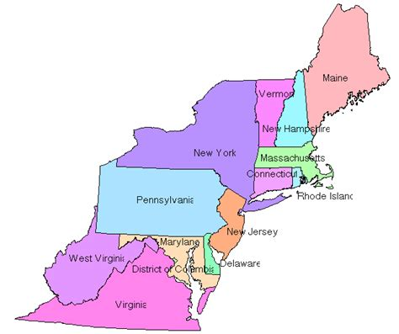
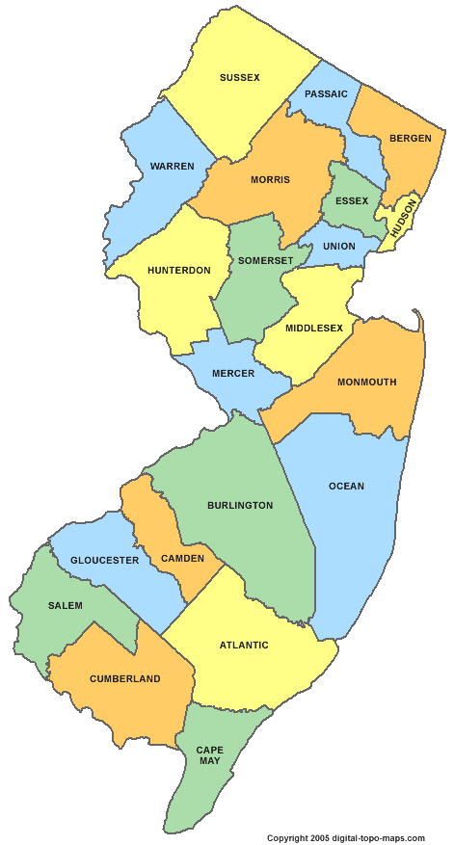

Distributed and Hierarchical database
Root DNS Servers
Top-level domain (TLD) servers
com DNS servers
org DNS servers
edu DNS servers
google.com
DNS servers
wnyc.org
DNS servers
rutgers.edu
DNS servers
umass.edu
DNS servers
amazon.com
DNS servers
cs.rutgers.edu
DNS server
Authoritative name server
RFC 1034
Hierarchy
Replication

Slide 15
DNS Protocol
Client-server application
Client connects to (known) port 53 on server
For now, assume the DNS server IP is known
Two types of messages
  Queries
  Responses
Type of Query (OPCODE)
  Standard query (0x0)
    e.g., Request IP address for a given domain name
  Updates (0x5)
    Provide a binding of IP address to domain name

Slide 16
DNS in action
dig <domain-name>
dig +trace <domain-name>
dig @<dns-server> <domain-name>
Don’t just watch; try it!

Slide 17
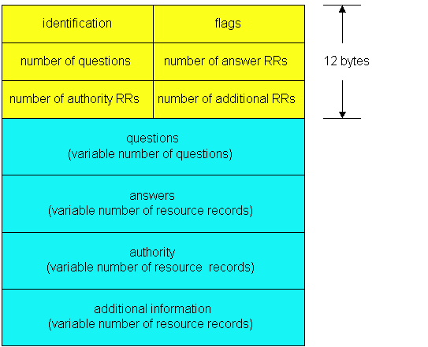
DNS protocol: Message format
DNS protocol : query and reply messages, both with same message format
QR
Opcode
Message header
QR = 0 for Query, 1 for response
Opcode= 0 standard
identification: 16 bit # for query, reply to query uses same #
flags:
  Authoritative answer
  recursion desired
  recursion available
  reply is authoritative

Slide 18
DNS protocol: Message format
QR
OPCODE
Name, class, type fields
for a query
Resource records in response to query
records for
authoritative servers
additional helpful
info that relates to the query
(but not the answer)

Slide 19
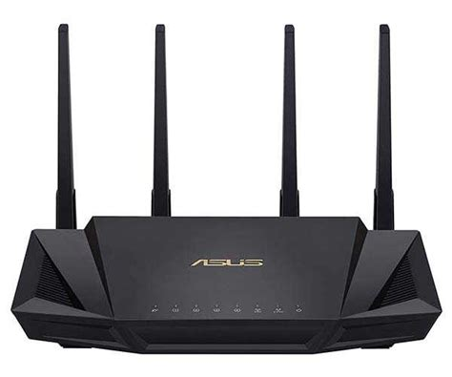
DNS Protocol: Actions
When client wants to know an IP address for a host name
  Client sends a DNS query to the “local” name server in its network
  If name server contains the mapping, it returns the IP address to the client
  Otherwise, the name server forwards the request to the root name server
  The request works its way down the DNS hierarchy until it reaches a name server with a mapping for the requested name

Slide 20
Example
root DNS server
2
Host at cs.rutgers.edu wants IP address for gaia.cs.umass.edu
Local DNS server
Root DNS server
TLD DNS server
Authoritative DNS server
3
.edu DNS server
4
5
local DNS server
dns.rutgers.edu
7
6
1
8
umass.edu DNS server
dns.umass.edu
requesting host
cs.rutgers.edu
gaia.cs.umass.edu

Slide 21
Query type
root DNS server
2
Iterative query
Contacted server replies with name of server to contact
“I don’t know this name, but ask this other server”
Queries 2,4,6 are iterative from point of view of the local DNS server
3
.edu DNS server
4
5
local DNS server
dns.rutgers.edu
7
6
1
8
umass.edu DNS server
dns.umass.edu
requesting host
cs.rutgers.edu
gaia.cs.umass.edu

