Slide 1

CS 352
Network: Addressing
Lecture 19
http://www.cs.rutgers.edu/~sn624/352-F22
Srinivas Narayana

Slide 2


Network
Application
HTTPS
FTP
HTTP
SMTP
DNS
Transport
TCP
UDP
Net layer
Network
IP
Host-to-Net
X.25
…
802.11
ATM

Slide 3




The network layer
Endpoint
Main function: Move data from sending to receiving endpoint
on sending endpoint: encapsulate transport segments into datagrams
on receiving endpoint: deliver datagrams to transport layer
The network layer also runs in every router
  Very challenging to evolve the network layer
Routers examine headers on all passing through them
Process
Network Layer
Process
Endpoint

Slide 4

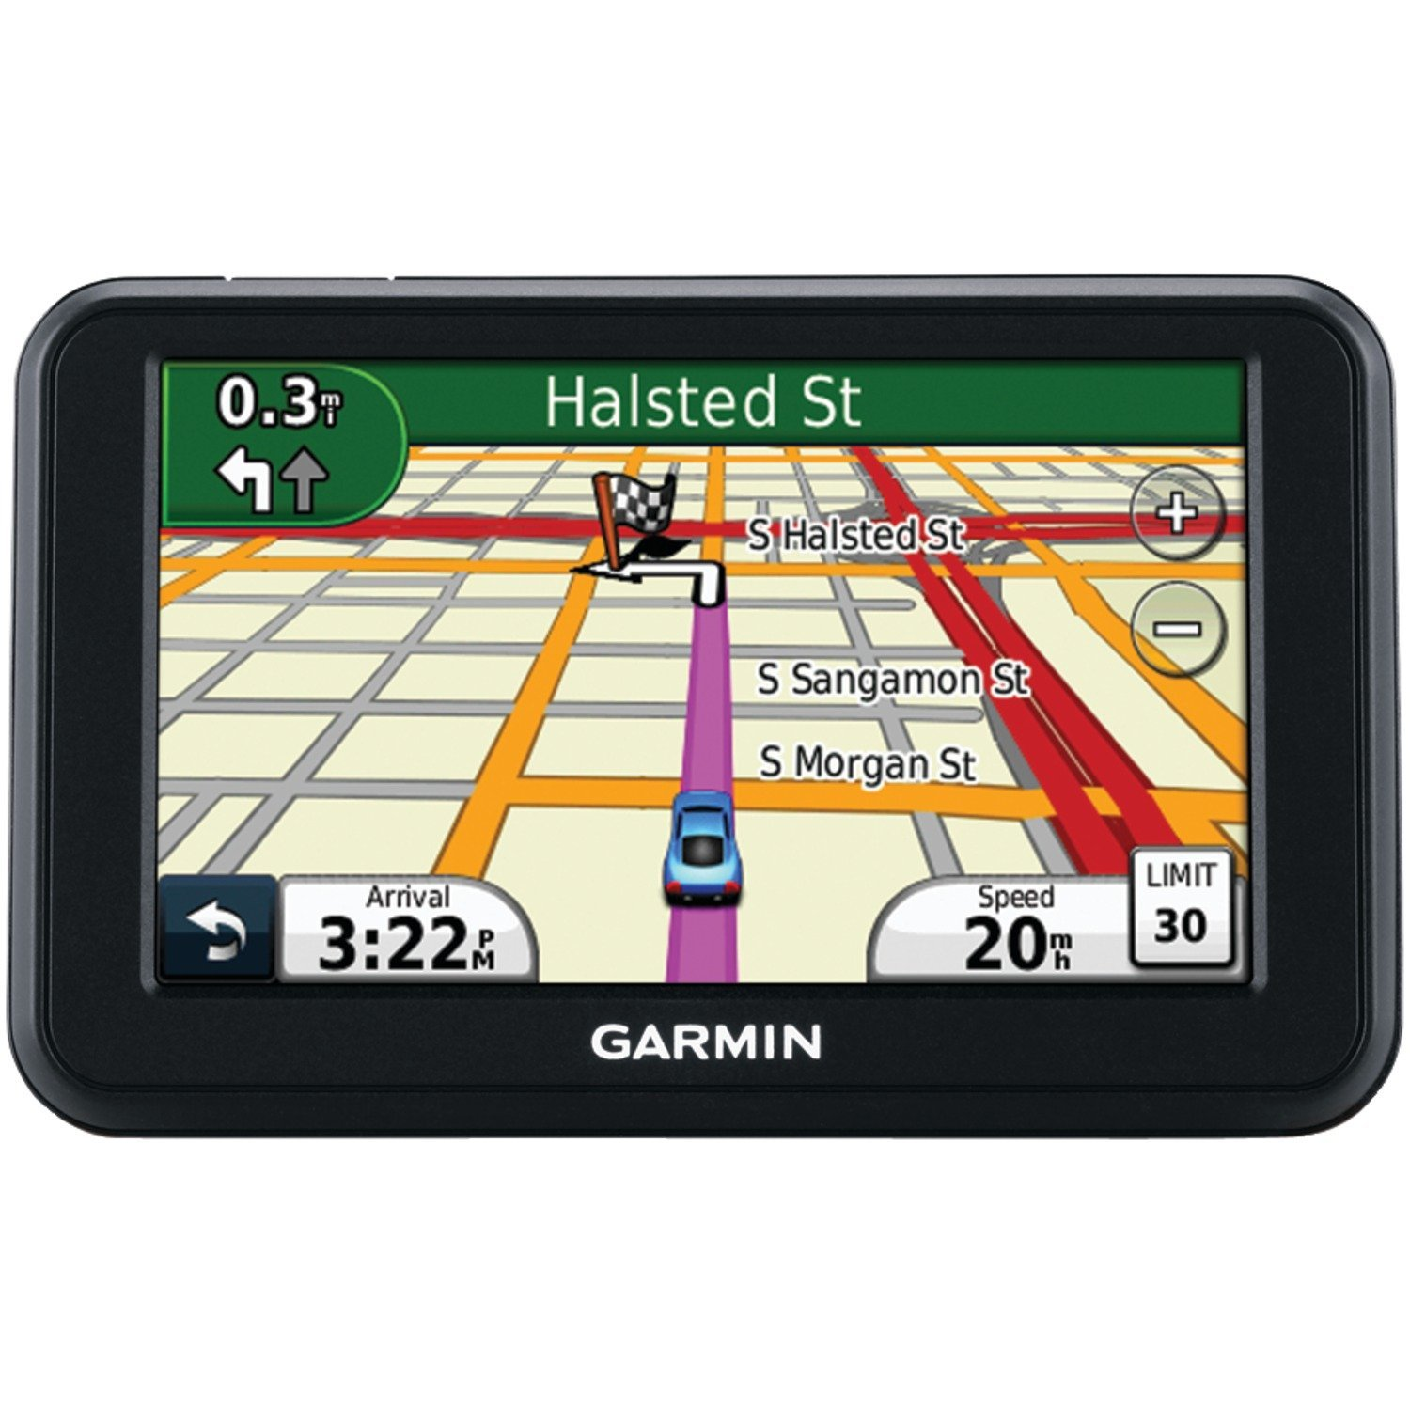

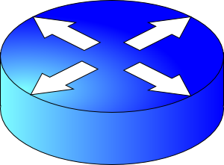
Two key network-layer functions
Forwarding: move packets from router’s input to appropriate router output
Routing: determine route taken by packets from source to destination
  routing algorithms
The network layer solves the routing problem.
Analogy: taking a road trip
Forwarding: process of getting through single interchange
Routing: process of planning trip from source to destination
network
layer
runs
everywhere

Slide 5
Data plane and Control Plane
Data plane = Forwarding
local, per-router function
determines how datagram arriving on router input port is forwarded to router output port
Control plane = Routing
network-wide logic
determines how datagram is routed along end-to-end path from source to destination endpoint
two control-plane approaches:
  Distributed routing algorithm running on each router
  Centralized routing algorithm running on a (logically) centralized server
values in arriving
packet header
0111
1
3
2

Slide 6

This lecture: Addresses in the Internet
I need to send B something.
Sure, what’s B’s address?
A
B
Endpoints
Endpoints
Network layer

Slide 7
Internet Addressing

Slide 8
The Internet needs addresses
Addresses are a precursor to communication.
  Allow endpoints to locate each other
Internet addresses are neither endpoint names nor identify them
Addresses help routers determine how to move a packet
  Like street address for the postal system
Network layer addresses are designed to help routers perform the forwarding and routing functions efficiently
  Specifically, we’ll look at Internet Protocol (IP) addresses.
  Most popular: IP version 4 or IPv4. (later: IPv6)

Slide 9

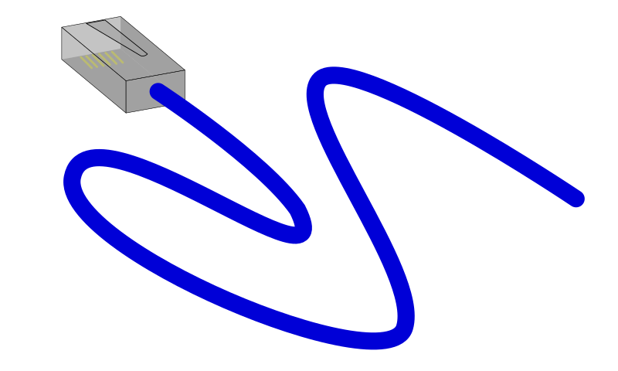

IPv4 Addresses
32 bits long
Identifier for a network interface
An IP address corresponds to the point of attachment of an endpoint to the network.
An IP address is NOT an identifier for the endpoint
  Changes when endpoint moves
Dotted quad notation: each byte is written in decimal in MSB order, separated by dots. Example:
10000000 11000011 00000001 01010000
128
.
195
.
1
.
80

Slide 10
Grouping IP addresses by prefixes
IP addresses can be grouped based on a shared prefix of a specified length
Example: consider two IP addresses:
  128.95.1.80 and 128.95.1.4
  The addresses share a prefix of (bit) length 24: 128.95.1
  The addresses have different suffixes of (bit) length 8
IP addresses: prefix corresponds to the network component and the suffix to an endpoint (host) component of the address

Slide 11
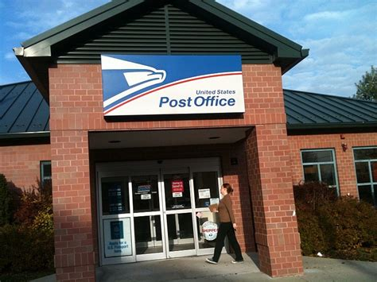
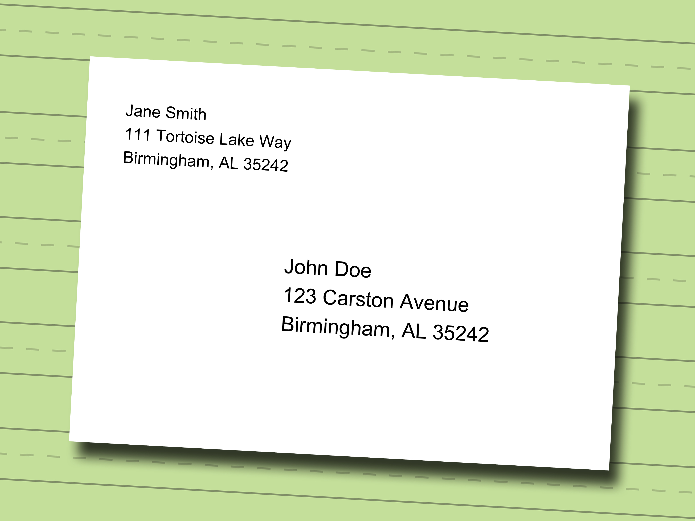
IP addresses use hierarchy to scale routing
IP addresses of endpoint interfaces in a network (e.g., Rutgers Busch campus) share a prefix of some length
Each interface/endpoint has a different suffix, and hence a different 32-bit IP address
Using prefixes reduces the amount of information needed to forward packets over the Internet
IP prefixes are like zip codes: routers don’t need to store info for each endpoint, just each prefix
Prefixes also allow IP addresses to be delegated from one network to another (more on this later)
NJ

Slide 12
IP addresses use hierarchy to scale routing
Postal envelopes should show clearly delineated zip codes.
Q: How to identify the prefix from a 32-bit IP address?
  Two methods:
Old: Classful addressing. IP address itself is formatted to denote the IP prefix
New: Classless addressing (also called classless inter-domain routing, or CIDR).
  Each router independently identifies prefix from IP
NJ

Slide 13
Classless IPv4 addressing (CIDR)

Slide 14
Classless IPv4 addressing
Also called classless inter-domain routing (CIDR)
Key idea: Network component of the address (ie: prefix) can have any length (usually from 8—32)
Address format: a.b.c.d/x, where x is the prefix length
  Customary to use 0s for all suffix bits
network
part
host
part
11001000 00010111 00010000 00000000
200.23.16.0/23

Slide 15
CIDR
https://www.internetsociety.org/resources/deploy360/2015/short-guide-ip-addressing/
An ISP can obtain a block of addresses and partition this further to its customers
Say an ISP has 200.8.0.0/16 address (65K addresses).
The ISP has customer who needs only 64 addresses starting from 200.8.4.128
Then that block can be specified as 200.8.4.128/26
200.8.4.128/26 is “inside” 200.8.0.0/16
200.8.0.0/16
200.8.0.0
200.8.0.1
200.8.4.128/26
…
200.8.1.0
200.8.1.1
…
200.8.255.255

Slide 16
Netmask (or subnet mask)
An alternative to denote the IP prefix length of an organization
32 bits: a 1-bit denotes a prefix bit position. 0 denotes host bit.
network
part
host
part
11001000 00010111 00010000 00000000
200.23.16.0/23
network part of mask
host part of mask
11111111 11111111 11111110 00000000
Netmask: 255.255.254.0

Slide 17
Detecting addresses from same network
Given IP addresses A and B, and netmask M.
1. Compute logical AND (A & M).
2. Compute logical AND (B & M).
3. If (A & M) == (B & M) then A and B are
on the same network.
Ex: A = 165.230.82.52, B = 165.230.24.93, M = 255.255.128.0
A and B are in the same network according to the netmask
A & M == B & M == 165.230.0.0

Slide 18
Finding your own IP address(es)
The old way (still works today on Mac and Linux):
  ifconfig –a
The new way using “iproute2” tools on Linux:
  ip link
  ip addr
What else do you see in these outputs?

Slide 19
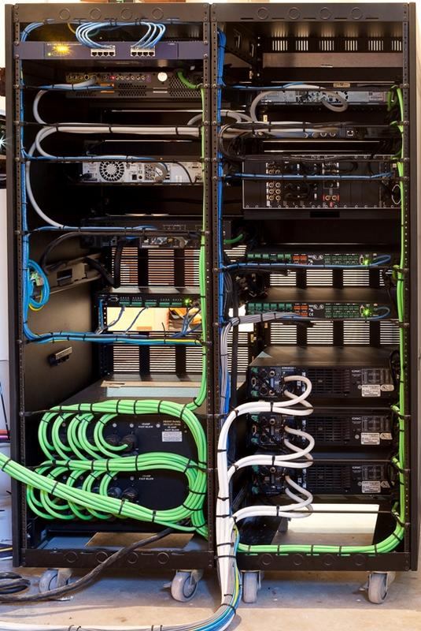
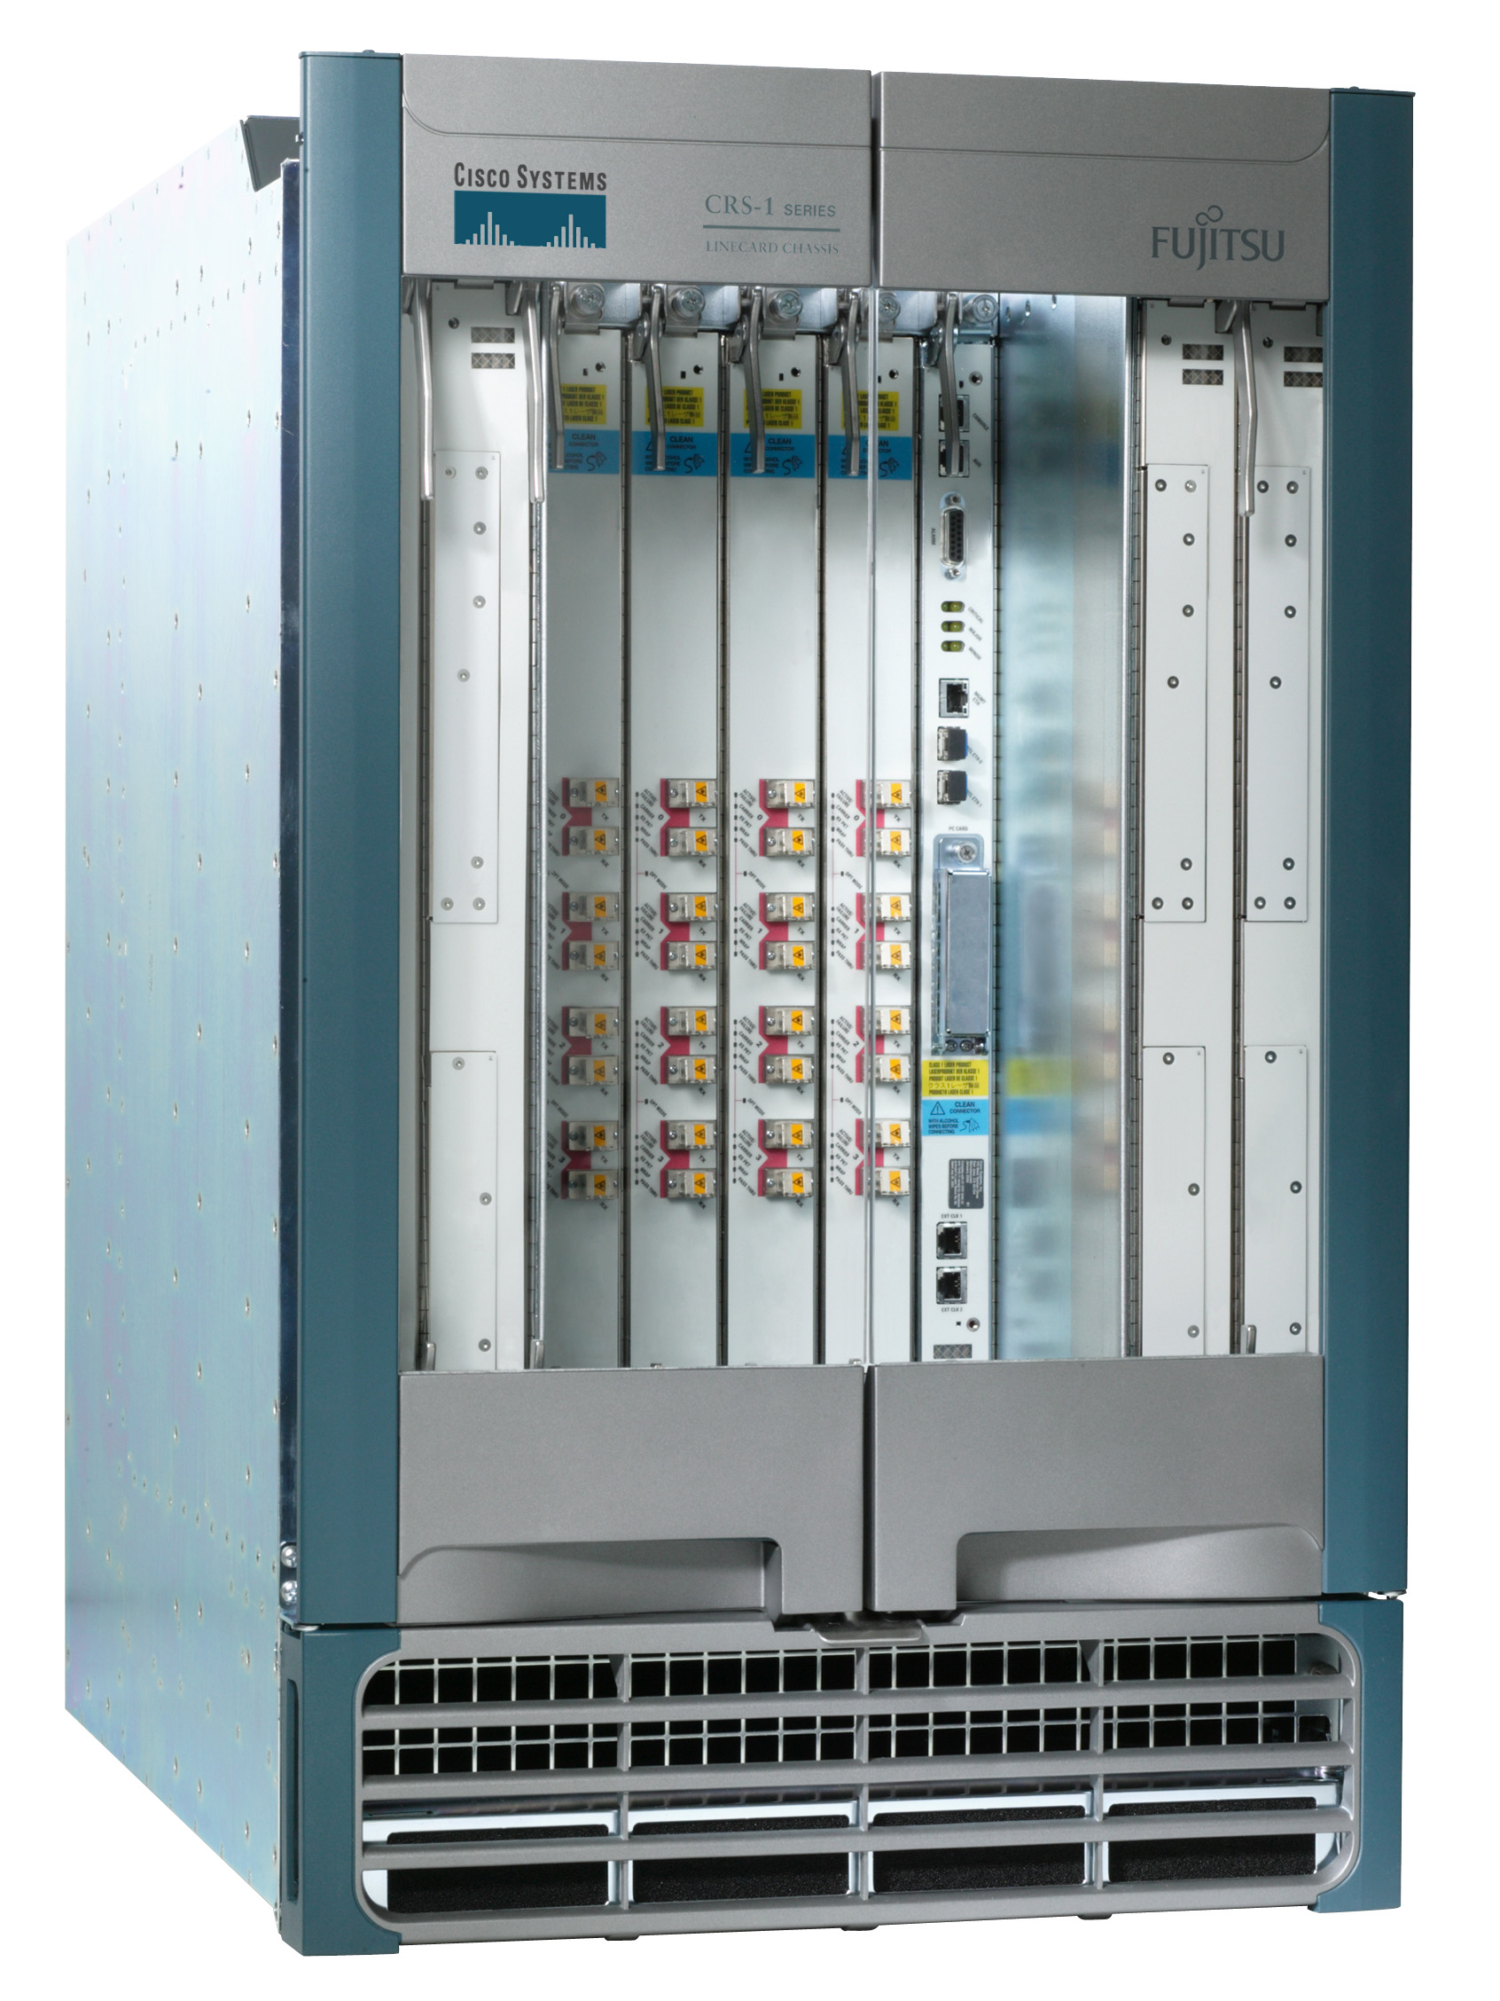
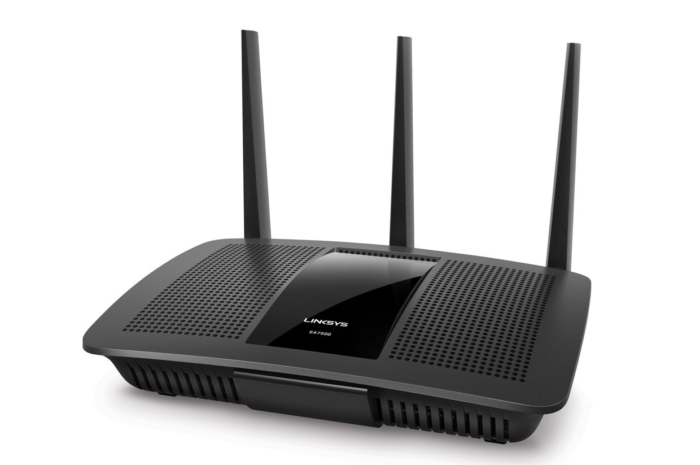
Next we’ll talk about routers
Access routers
Core router
Data center top-of-rack switch

Slide 20
What’s inside a router?

Slide 21
Router architecture overview
Review: assuming distributed routing, routing function: decide which ports packets need to exit
route
processor
Control plane
Data plane
Review: Forwarding function: move packets from one input port to another.
high-speed
switching
fabric
router input ports
router output ports

Slide 22
Different and evolving designs
There are different kinds of routers, with their own designs
  Access routers (e.g., home WiFi), chassis/core routers, top-of-rack switches
Router designs have also evolved significantly over time
For simplicity and concreteness, we will learn about one high-speed router design from the early 2000s.
Called the MGR (multi-gigabit router). It could support an aggregate rate of 50 Gbit/s (1 G = 10⁹)
  Today’s single-chip routers can support aggregate rates of ~10 Tbit/s (1 T = 10¹²)

Slide 23
Input port functions
Input port
Output port
Input port
Switching fabric
Output port
Line termination: receives physical (analog) signals and turns them into digital signals
Rate of link connecting to a single port termed line speed or line rate (modern routers: 100+ Gbit/s)
Link layer: performs medium access control functions (e.g., Ethernet)
…
…
Input port
Output port
Per-output
Queues
Line
Term
Link
Layer
/ MAC
(receive)
Route
lookup
switching
fabric

Slide 24
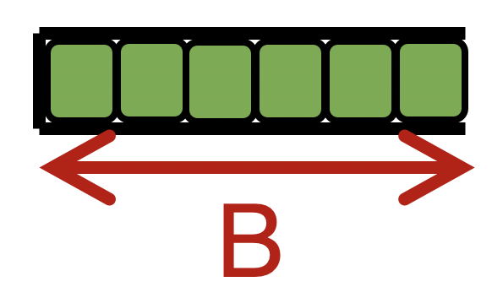

Input port functions
Input port
Output port
Input port
Switching fabric
Output port
Route lookup: high-speed lookup of which output port the packet is destined to
Goal: must complete this processing at the line rate
Queueing: packets may wait in per-output-port queues if packets are arriving too fast for the switching fabric to send them to the output port
…
…
Input port
Output port
Per-output
Queues
Line
Term
Link
Layer
/ MAC
(receive)
Route
lookup
switching
fabric

Slide 25

Route lookups
Route
lookup
Per-output
Queues
Line
Term
Link
Layer
Packet forwarding in the Internet is based on the destination IP address on the packet.
Example: if dst IP on packet is 65.45.145.34, it matches the forwarding table prefix 65.0.0.0/8.
The packet is forwarded out port 3.
Example 2: what about dst IP 128.9.5.6?
Parse
Transport
Extract destination IP address
Network
Link layer
Route Lookup Data Structure
Outgoing Port
Forwarding Table
Dst-network
Port
65.0.0.0/8
3
128.9.0.0/16
1
149.12.0.0/19
7

Slide 26
Route lookups
Route
lookup
Per-output
Queues
Line
Term
Link
Layer
Number of entries in the forwarding table matters.
Fitting into router memory
Designing hardware and software for fast lookups
Parse
Transport
Extract destination IP address
Network
Link layer
Route Lookup Data Structure
Outgoing Port
Forwarding Table
Dst-network
Port
65.0.0.0/8
3
128.9.0.0/16
1
149.12.0.0/19
7

Slide 27
Route lookups
Route
lookup
Per-output
Queues
Line
Term
Link
Layer
Recall: IP addresses can be aggregated based on shared prefixes.
The number of table entries in a router is proportional to the number of prefixes, NOT the number of endpoints.
Today: ~ 1 million prefixes.
Parse
Transport
Extract destination IP address
Network
Link layer
Route Lookup Data Structure
Outgoing Port
Forwarding Table
Dst-network
Port
65.0.0.0/8
3
128.9.0.0/16
1
149.12.0.0/19
7

Slide 28
Route lookups
Route
lookup
Per-output
Queues
Line
Term
Link
Layer
Destination-IP-based forwarding has consequences.
Forwarding behavior is independent of the source: legitimate source vs. malicious attack traffic
Forwarding behavior is independent of the application: web traffic vs. file download vs. video
IP-based packet processing is “baked into” router hardware: evolving the IP protocol faces tall deployment hurdles
Parse
Transport
Extract destination IP address
Network
Link layer
Route Lookup Data Structure
Outgoing Port
Forwarding Table
Dst-network
Port
65.0.0.0/8
3
128.9.0.0/16
1
149.12.0.0/19
7

Slide 29
Output port functions
Input port
Output port
Input port
Switching fabric
Output port
Components in reverse order of those in the input port
This is where most routers have the bulk of their packet buffers
  Recall discussions regarding router buffers from transport
MGR uses per-port output buffers, but modern routers have shared memory buffers
  More efficient use of memory under varying demands
…
…
Input port
Output port
Queues
Link
Layer
/ MAC
(transmit)
Line
Termination
Switching
fabric
To output link

Slide 30
Output port functions
Input port
Output port
Input port
Switching fabric
Output port
Two important policy decisions
Scheduling: which among the waiting packets gets to be transmitted out the link?
  Ex: First-In-First-Out (FIFO)
Buffer management: which among the packets arriving from the fabric get space in the packet buffer?
  Ex: Tail drop: later packets dropped first
…
…
Input port
Output port
Queues
Link
Layer
/ MAC
(transmit)
Line
Termination
Switching
fabric
To output link

Slide 31
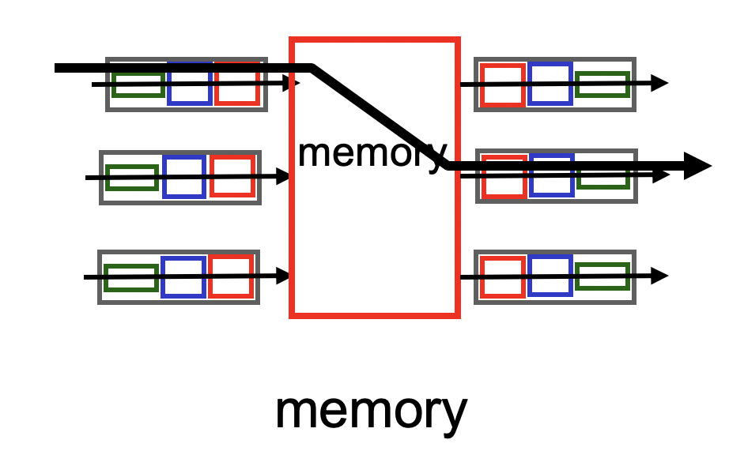
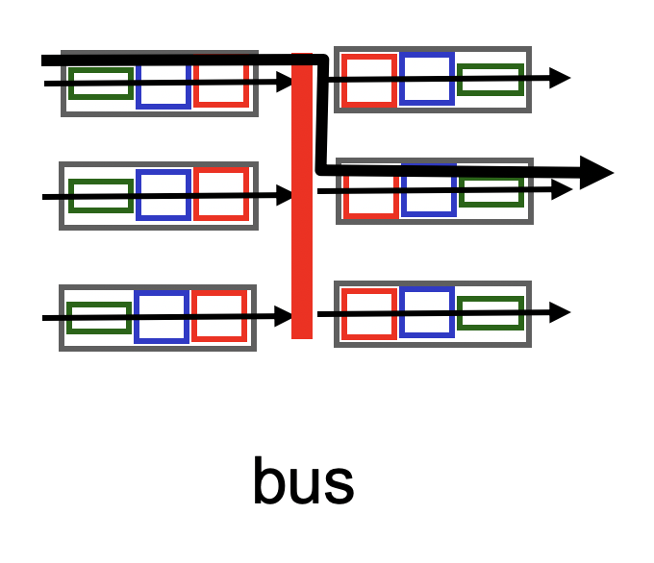
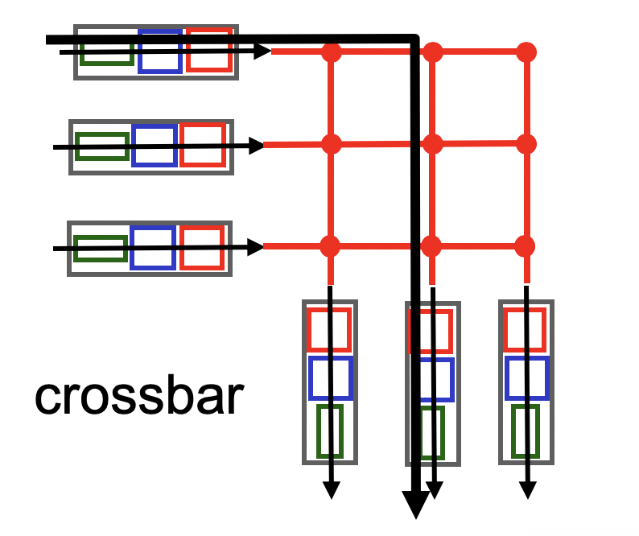
Fabrics: Types
Input port
Output port
Input port
Switching fabric
Output port
…
…
Fabric goal: Ferry as many packets as possible from input to output ports as quickly as possible.
Input port
Output port
Input port writes packets into shared memory.
Output port reads the packet when output link ready to transmit.
Single shared channel to move data from input to output port.
Easy to build buses; technology is quite mature.
Each input port has a physical data path to every output port.
Switch at the cross-over points turns on to connect pairs of ports.

Slide 32
Fabrics: Types
Input port
Output port
Input port
Switching fabric
Output port
…
…
Input port
Output port
Crossbars can get expensive as the number of ports grows (N² connections for N ports)
MGR uses a crossbar and schedules (in,out) port pairs.
Modern high-speed routers use highly optimized shared-memory-based interconnects.

Slide 33

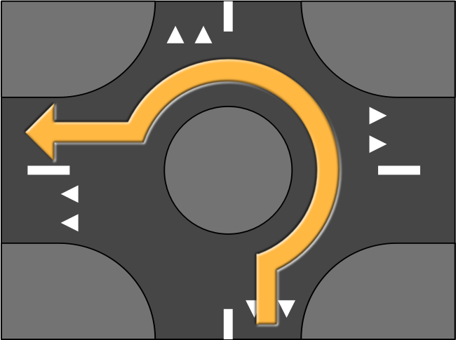



Nonblocking fabrics
Input port
Output port
Input port
Switching fabric
Output port
…
…
Input port
Output port
High-speed switching fabrics designed to be nonblocking:
  If an output port is “available”, an input port can always transmit to it without being blocked by the switching fabric itself
  Nontrivial to achieve
Crossbars are nonblocking by design
Shared memory can be designed to be nonblocking if the memory access is fast enough

Slide 34
Nonblocking fabrics
Input port
Output port
Input port
Switching fabric
Output port
…
…
Input port
Output port
With a nonblocking fabric, queues aren’t formed due to the switching fabric.
  With a nonblocking fabric, there are no queues due to inefficiencies at the input port or the switching fabric
Queues only form due to contention for the output port
  Fundamental, unavoidable, given the route

Slide 35
Nonblocking fabrics
Input port
Output port
Input port
Switching fabric
Output port
…
…
Input port
Output port
With a nonblocking fabric, queues aren’t formed due to the switching fabric.
  With a nonblocking fabric, there are no queues due to inefficiencies at the input port or the switching fabric
Queues only form due to contention for the output port
  Fundamental, unavoidable, given the route
Typically, these queues form on the output side
  But can also “backpressure” to the input side if there is high contention for the output port
  i.e.: can’t move pkts to output Qs since buffers full, so buffer @ input

Slide 36
Control (plane) processor
A general-purpose processor that “programs” the data plane:
  Forwarding table
  Scheduling and buffer management policy
Implements the routing algorithm by processing routing protocol messages
  Mechanism by which routers collectively solve the Internet routing problem
  More on this soon.
Control Processor
Input port
Output port
Input port
Switching fabric
Output port
…
…
Input port
Output port

Slide 37

Router design: the bigger picture
Control plane
Traditional distributed routing: per route-change processing
(~ a few tens of seconds)
Routing
Algorithm
control
plane
data
plane
Data plane
per-packet processing
(~ tens of nanoseconds)
0111
1
3
2
values in arriving
packet header, i.e, destination IP address

Slide 38
Longest Prefix Matching

Slide 39
Review: Route lookup
Table lookup matches a packet against an IP prefix
  Ex: 65.12.45.2 matches 65.0.0.0/8
Prefixes are allocated to organizations by Internet registries
But organizations can reallocate a subset of their IP address allocation to other orgs
Parse
Transport
Extract destination IP address
Network
Link layer
Route Lookup Data Structure
Outgoing Port
Forwarding Table
Dst-network
Port
65.0.0.0/8
3
128.9.0.0/16
1
149.12.0.0/19
7

Slide 40
Example of IP block reallocation
Dst IP Prefix | Output port
65.0.0.0/8 | 3
128.9.0.0/16 | 1
… | …
200.23.16.0/20 | 7 (towards A)
Suppose ISP A reallocates a part of its IP block to orgs 1… 8
ISP A owns the IP block 200.23.16.0/20.
Organization 1
200.23.16.0/23
Organization 2
200.23.18.0/23
[BGP] Send me pkts destined to
200.23.16.0/20
Organization 3
200.23.20.0/23
.
ISP A
.
.
.
.
Internet
.
Organization 8
200.23.30.0/23
There is an announcement mechanism (BGP) by which ISP A can inform the rest of the Internet about the prefixes it owns.
It is enough to announce a coarse-grained prefix 200.23.16.0/20 rather than 8 separate sub-prefixes.
Route Aggregation
Save forwarding table memory
Fewer routing protocol msgs

Slide 41
Example of IP block reallocation
Dst IP Prefix | Output port
65.0.0.0/8 | 3
128.9.0.0/16 | 1
… | …
200.23.16.0/20 | 7 (towards A)
Suppose ISP A reallocates a part of its IP block to orgs 1… 8
ISP A owns the IP block 200.23.16.0/20.
Organization 1
200.23.16.0/23
Organization 2
200.23.18.0/23
[BGP] Send me pkts destined to
200.23.16.0/20
Organization 3
200.23.20.0/23
.
ISP A
.
.
.
.
Internet
.
Organization 8
200.23.30.0/23
Now suppose one of these organizations adds another ISP for its Internet service and prefers using the new ISP.
Note: it’s possible for the organization to retain its assigned IP block.

Slide 42
Example of IP block reallocation
Dst IP Prefix | Output port
65.0.0.0/8 | 3
128.9.0.0/16 | 1
… | …
200.23.16.0/20 | 7 (towards A)
Suppose ISP A reallocates a part of its IP block to orgs 1… 8
ISP A owns the IP block 200.23.16.0/20.
Organization 1
200.23.16.0/23
Organization 2
200.23.18.0/23
[BGP] Send me pkts destined to
200.23.16.0/20
Organization 3
200.23.20.0/23
.
ISP A
.
.
.
.
Internet
.
Organization 8
200.23.30.0/23
[BGP] Announce 200.23.18.0/23
(besides other IP prefixes)
ISP B
Organization 2
200.23.18.0/23

Slide 43
Example of IP block reallocation
Dst IP Prefix | Output port
65.0.0.0/8 | 3
128.9.0.0/16 | 1
200.23.18.0/23 | 4 (towards B)
200.23.16.0/20 | 7 (towards A)
Suppose ISP A reallocates a part of its IP block to orgs 1… 8
ISP A owns the IP block 200.23.16.0/20.
Organization 1
200.23.16.0/23
Organization 2
200.23.18.0/23
[BGP] Send me pkts destined to
200.23.16.0/20
Organization 3
200.23.20.0/23
.
ISP A
.
.
.
.
Internet
.
Organization 8
200.23.30.0/23
[BGP] Announce 200.23.18.0/23
(besides other IP prefixes)
ISP B
Organization 2
200.23.18.0/23

Slide 44
A closer look at the forwarding table
200.23.18.0/23 is inside 200.23.16.0/20
A packet with destination IP address 200.23.18.xx is in both prefixes
  i.e., both entries match
Q: How should the router choose to forward the packet?
  The org prefers B, so should choose B
Dst IP Prefix | Output port
65.0.0.0/8 | 3
128.9.0.0/16 | 1
200.23.18.0/23 | 4 (towards B)
200.23.16.0/20 | 7 (towards A)
200.23.16.0/20

Slide 45
Longest Prefix Matching (LPM)
Use the longest matching prefix, i.e., the most specific route, among all prefixes that match the packet.
Policy borne out of the Internet’s IP allocation model: prefixes and sub-prefixes are handed out
Internet routers use longest prefix matching.
  Very interesting algorithmic problems
  Challenges in designing efficient software and hardware data structures
Dst IP Prefix | Output port
65.0.0.0/8 | 3
128.9.0.0/16 | 1
200.23.18.0/23 | 4 (towards B)
200.23.16.0/20 | 7 (towards A)
200.23.16.0/20

Slide 46
Internet routers perform longest-prefix matching on destination IP addresses of packets.

Slide 47
Why is LPM prevalent?
Verizon
Agg. route
Rutgers
AT&T
Specific route
(longer prefix)
An ISP (e.g., Verizon) has allocated a sub-prefix (or “subnet”) of a larger prefix that the ISP owns to an organization (e.g., Rutgers)
Further, the ISP announces the aggregated prefix to the Internet to save on number of forwarding table memory and number of announcements
The organization (e.g., Rutgers) is reachable over multiple paths (e.g., through another ISP like AT&T)
The organization has a preference to use one path over another, and expresses this by announcing the longer (more specific) prefix
Routers in the Internet must route based on the longer prefix

