Slide 1
CS314 – Section 5
Recitation 2
Long Zhao (lz311@rutgers.edu)
Regular Expressions
DFA, NFA
Homework 1
Slides available at http://www.ilab.rutgers.edu/~lz311/

Slide 2
Regular expressions
Token: shortest string of characters with individual meaning. E.g. keywords, identifier, constant, operator, …
Language has few to hundreds of tokens.
C language: keyword (int, float, return), identifier (var1, func), constant (0x01, 0.01), operator (+, -, …)
Regular expression: a pattern used to specify a set of strings required for a particular purpose.

Slide 3
Regular expressions
(From Scott book) A regular expression is one of
1. A character
2. The empty string, denoted ϵ
3. Two regular expressions next to each other, meaning any string generated by the first one followed by (concatenated with) any string generated by the second one
4. Two regular expressions separated by a vertical bar ( | ), meaning any string generated by the first one or any string generated by the second one
5. A regular expression followed by a Kleene star, meaning the concatenation of zero or more strings generated by the expression in front of the star

Slide 4
Regex exercises
Find regex representing the language
Language | Regex
{0}
{0,1}
{0,01}
{0, ϵ}{001}
{1}*{10}
{10,11,1100}*

Slide 5
Regex exercises
Find regex representing the language
Language | Regex
{0} | 0
{0,1} | 0|1
{0,01} | 0|01
{0, ϵ}{001} | (0|ϵ)001
{1}*{10} | 1*10
{10,11,1100}* | (10|11|1100)*

Slide 6
Regex exercises
Construct a regular expression for binary numbers of length two.
Construct a regular expression for binary numbers with even length.
Find regular expressions over {0, 1} that determine the language which consists of all strings with even number of 1s.

Slide 7
Regex exercises
Construct a regular expression for binary numbers of length two.
(0|1)(0|1)
or
(00|01|10|11)

Slide 8
Regex exercises
Construct a regular expression for binary numbers with even length.
((0|1)(0|1))*
or
(00|01|10|11) *

Slide 9
Regex exercises
What would be the regular expression corresponding to the language which consists of all strings of 0s and 1s that have odd length?

Slide 10
Regex exercises
What would be the regular expression corresponding to the language which consists of all strings of 0s and 1s that have odd length?
Based on the previous example, we can add only 1 digit to the front or the end of the string. Thus, the regular expression can be (0|1)(00|01|10|11)* or (00|01|10|11)*(0|1).

Slide 11
Regex exercises
Find regular expressions over {0, 1} that determine the language which consists of all strings with even number of 1s.
(0*10*10*)*

Slide 12
Regex exercises
Find regular expressions over {0, 1} that determine the language which consists of all strings with odd number of 0s.

Slide 13
Regex exercises
Find regular expressions over {0, 1} that determine the language which consists of all strings with odd number of 0s.
(1*01*)(1*01*01*)*

Slide 14
Regex exercises
Construct a regular expression for integers (e.g., 0, 42, -137, etc.).
Construct a regular expression for floating point numbers that don’t use scientific notation (e.g., 3.5, 0.2, -47.3).
Construct a regular expression for all strings of a’s that have at least 3 a’s. Is there more than one way to write this?

Slide 15
Regex exercises
Construct a regular expression for integers (e.g., 0, 42, -137, etc.).
0|(-|ϵ)(1-9)(0-9)*

Slide 16
Regex exercises
Construct a regular expression for floating point numbers that don’t use scientific notation (e.g., 3.5, 0.2, -47.3).
(-|ϵ)0|(1-9)(0-9)*.(0-9)+ (-0.0 is allowed in this regex)

Slide 17
Regex exercises
Construct a regular expression for all strings of a’s that have at least 3 a’s. Is there more than one way to write this?
(a*)aaa
(a+)aa

Slide 18
Finite-State Automaton
S1
0
0
S0
S3
1
1
S2

Slide 19
Finite-State Automaton
A Finite-State Automaton is a quadruple:
<S, s, F, T>
S is a set of states, e.g., {S0,S1,S2,S3}
s is the start state, e.g., S0
F is a set of final states, e.g., {S3}
T is a set of labeled transitions, of the form (state, input) => state

Slide 20
DFA & NFA
DFA - Determistic Finite Automaton: At most one transition for a state and an input symbol. (Recognizers should be a DFA.)
NFA - Nondeterministic Finite Automaton: More than one transition possible for a state and an input symbol.

Slide 21
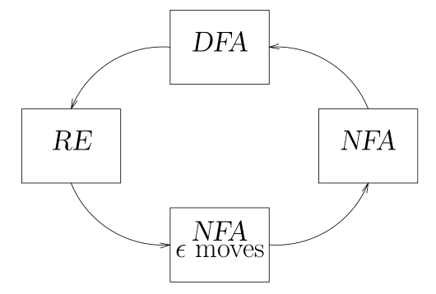
Constructing a DFA from a RE
Regular Expression (RE) →NFA with ϵ moves
NFA with ϵ moves to NFA
NFA→DFA

Slide 22
NFA with ϵ moves (5 rules)
A
A
ϵ
ϵ
ϵ
AB
A
B

Slide 23
NFA with ϵ moves (5 rules)
A
ϵ
ϵ
A|B
ϵ
B
ϵ
ϵ
ϵ
A
ϵ
A*
ϵ

Slide 24
NFA with ϵ moves (Examples)
(A|B)C
A
ϵ
ϵ
ϵ
C
ϵ
B
ϵ

Slide 25
NFA with ϵ moves (Examples)
A|BC
A
ϵ
ϵ
B
ϵ
C
ϵ
ϵ

Slide 26
NFA with ϵ moves (Examples)
((A|B)C)*
ϵ
A
ϵ
ϵ
ϵ
ϵ
C
ϵ
ϵ
B
ϵ
ϵ

Slide 27
DFA (Examples)
A
A
ϵ
AB
A
B

Slide 28
DFA (Examples)
A
A|B
B
A+
A
A*
A
A

