Slide 1
Economics and Computation
Lirong Xia

Slide 2
This Course
Economics: decision making by multiple actors, each with individual preferences, capabilities, and information, and motivated to act in regard to these preferences.
Computer science: study of representation and processing of information for the purpose of specific calculation tasks.
Breadth over depth

Slide 3
Mostly a math course
a.k.a. doing a mini PhD with Lirong
Learn in classes
Find a research topic (by yourself)
Read papers, identify research problems
Work them out
Present your findings and progresses
Write a paper

Slide 4
Policies and Suggestions
Grading
70% project&presentations + 30% in-class polls (correctness does not matter)
Up to 2 students per group
Proposal (must discuss with Lirong)
Presentations (2-3 times)
Final report
Questions are very welcome
If you don’t ask me, I may ask you (random quiz)

Slide 5


Tragedy of the commons: Braess’ Paradox
2000 travelers from 1 to 4
Centralized goal: minimize max delay
1000 1→ 2→4; 1000 1→ 3→4;
minimax delay: 35min
No one wants to deviate
$$\frac{x}{100}$$
2
25min
1
4
$$\frac{x}{100}$$
25min
3

Slide 6
Tragedy of the commons: Braess’ Paradox
2000 travelers from 1 to 4
Centralized goal: minimize max delay
1000 1→ 2→4; 1000 1→ 3→4;
minimax delay: 35min
$$\frac{x}{100}$$
2
25min
1
0min
4
$$\frac{x}{100}$$
25min
3

Slide 7
Tragedy of the commons: Braess’ Paradox
2000 travelers from 1 to 4
No one wants 1→ 3→4
1→ 2→3→4 is always better
No one wants 1→ 2→4
1→ 2→3→4 is always better
Everyone goes 1→ 2→3→4, delay is 40min each
Paradox: worse than the system without 2→3
More in the “game theory” class
$$\frac{x}{100}$$
2
25min
1
0min
4
$$\frac{x}{100}$$
25min
3

Slide 8
Goal of the course
How to analyze the outcome?
Social choice, game theory
How to incentivize people?
Mechanism design
Economics + Computation
Incentives + computational thinking

Slide 9
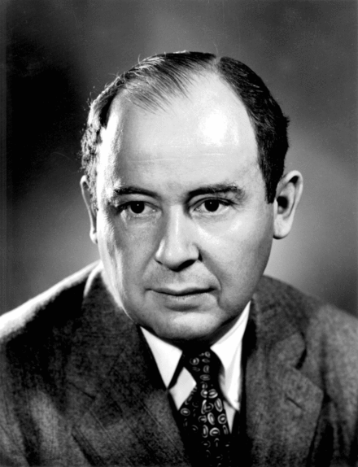
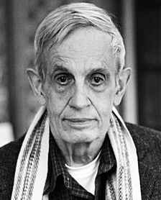
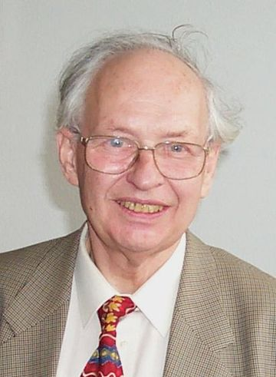
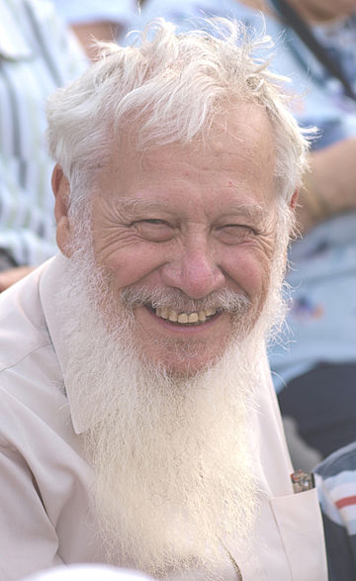
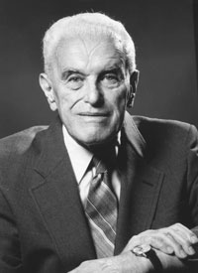
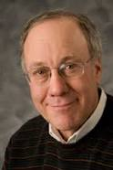
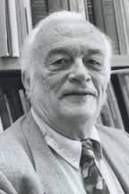
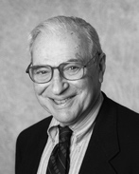
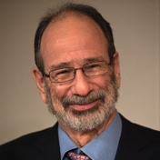
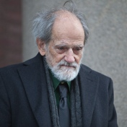
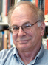
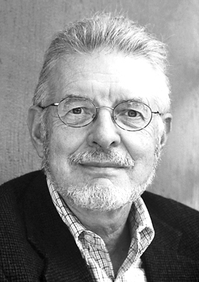
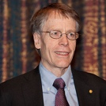
Brief schedule
(Algorithmic) Game theory
Auctions
Mechanism design
(Computational) Social choice
Wisdom of the crowd
Preference modeling
Bitcoin and blockchain
Von Neumann
Nash
Selten
Aumann
Harsanyi
Myerson
Vickrey
Arrow
Roth
Shapley
Kahneman
McFadden
Hansen

Slide 10
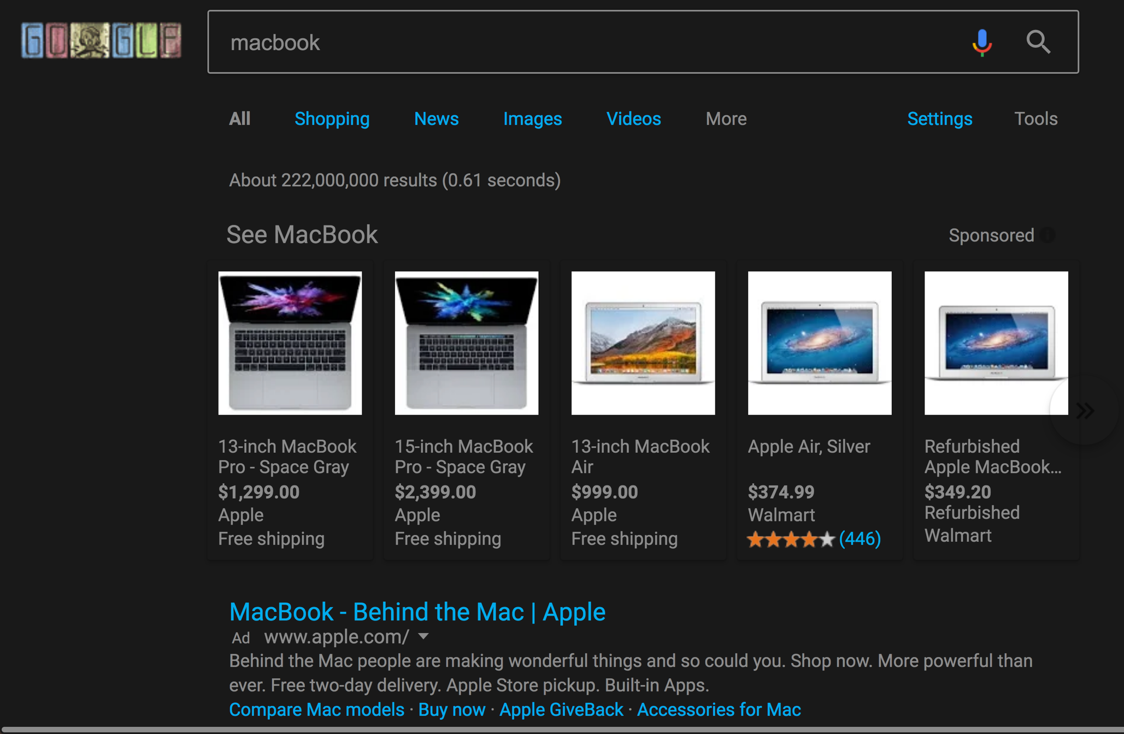

Example: Auctions
2nd price auction
highest bid wins
charged the 2nd highest price
more in the “auctions” and “mechanism design” class

Slide 11



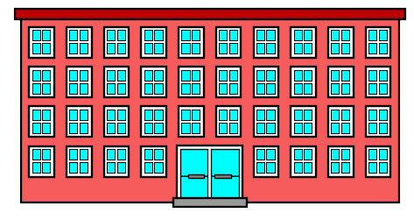
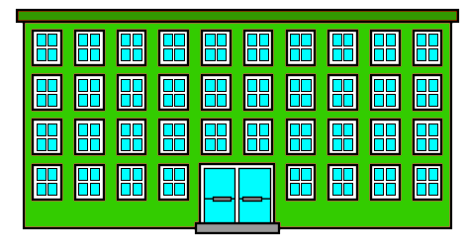
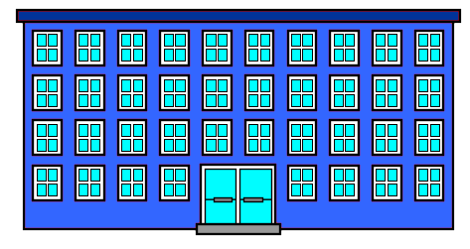
Example: School choice
> >
> >
Kyle
> >
> >
Stan
> >
> >
Eric

Slide 12

Example: Resource allocation
1
2
3
4
5
6
> > > > >
1
6
2
3
5
4
> > > > >
6
5
4
3
2
1
> > > > >

Slide 13
Sequential allocation
O
=
1
2
3
4
5
6
Kyle
> > > > >
>
1
6
2
3
5
4
> > > > >
Stan
>
6
5
4
3
2
1
> > > > >
Eric
Step 1 | Step 2 | Step 3 | Step 4 | Step 5 | Step 6
1
6
5
4
2
3

Slide 14
Is it a good mechanism?
Sounds good
Efficient: if we have different preferences, then we will all (almost) get what we want
Fair: (1st pick, last pick), (2nd pick, 2nd to last pick)…
How can we formalize these ideas?
more in “matching and resource allocation”

Slide 15
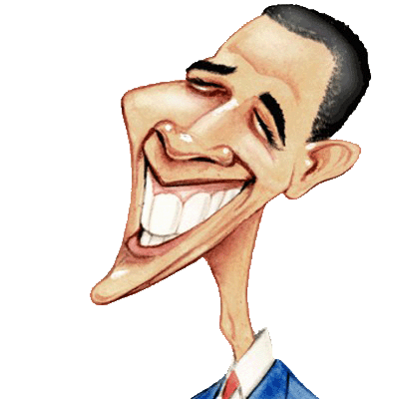
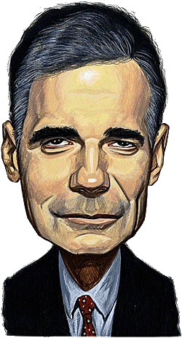
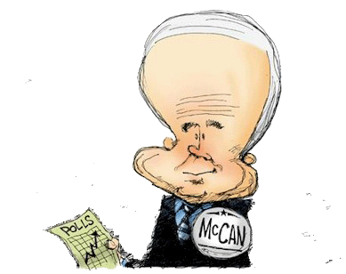

Example 3: Political elections
> >
Alice
> >
Bob
> >
Carol

Slide 16
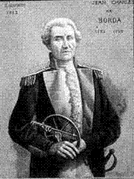
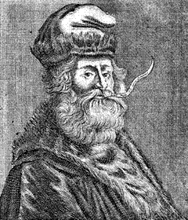
The Borda voting rule
BORDA
LULL
Input: profile of rankings over alternatives
Output: a single winner
For each vote R, the alternative ranked in the i-th position gets m-i points
The alternative with most total points is the winner
Use some tie-breaking mechanism whenever there is a tie

Slide 17
Example of Borda
> >
Alice
Borda
> >
Bob
> >
Carol
Total scores
: 1+1+1=3
: 0+0+2=2
: 2+2+0=4

Slide 18
Other voting rules?
Many other voting rules beyond Borda will be discussed in the social choice class
Which one is the best?
Hard to compare.
Criteria will be discussed in the social choice class

Slide 19




Example: Crowdsourcing
.
.
.
.
.
.
.
.
.
.
.
.
.
.
>
.
>
.
.
.
.
.
.
.
.
.
.
.
.
.
a
b
c
a
>
b
b
>
a
…
b
>
c
Turker 1
Turker 2
Turker n

Slide 20
Optimal way to make a decision
How can we make an optimal decision by aggregating noisy answers from strategic agents?
more in “Wisdom of the crowd”

