Slide 1


Overlap Set Similarity Join with Theoretical Guarantee
Dong Deng, Yufei Tao, Guoliang Li

Slide 2
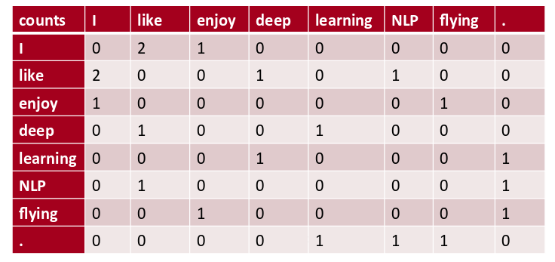
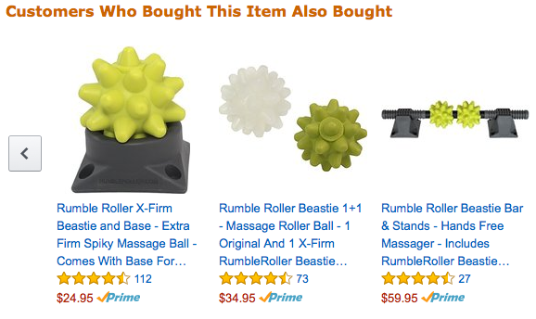
Overlap Set Similarity Join Examples
Find all the user pairs sharing at least c friends
Find all the word pairs co-occurrent in at least c documents
Find all the item pairs co-purchased in at least c transactions

Slide 3
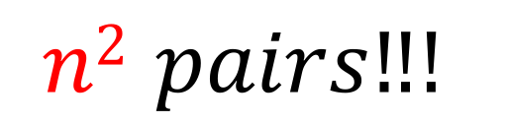
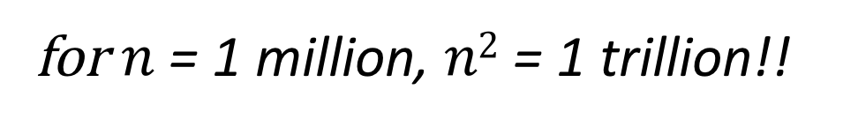
Challenge
$$n2 pairs‼!$$
for $n$ = 1 million, $n2$ = 1 trillion!!

Slide 4
Many Applications
Data Mining and Data Management
  Data Integration
  Data Cleaning
  Frequent Pattern Mining
  Recommendation
Machine Learning
  Large Entries Retrieval on Matrix Productions
  Non-negative Matrix Factorization
  Singular Value Decomposition
  Word Embedding
  Scene Reconstruction

Slide 5
Overlap Set Similarity Join
Input:
  (i) a collection of sets; (ii) a constant threshold c
Output:
  all set pairs with overlap size no smaller than c
Contribution:
first sub-quadratic algorithm
whenever possible
Bag-of-Words:
{9th, Street, WI}
R₁ = {e₁, e₂, e₃}
R₂ = {e₁, e₃, e₄, e₇}
R₃ = {e₂, e₄, e₅, e₆}
R₄ = {e₂, e₄, e₅, e₆, e₈, e₉, e₁₀, e₁₁}
R₅ = {e₂, e₇, e₈, e₉, e₁₀, e₁₁, e₁₂, e₁₃, e₁₄}
|R₁∩R₂| ≥ c
|R₃∩R₄| ≥ c
|R₄∩R₅| ≥ c
(R₁ , R₂ )
(R₃ , R₄ )
(R₄ , R₅ )
Keywords:
{4b2b, house, garage}
…
threshold c=2
any data type that can be abstracted as sets
Input
Output

Slide 6
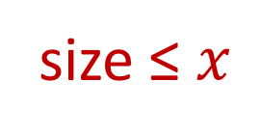
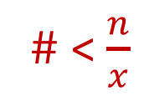
Size-Aware Algorithm
threshold c = 2
R₁ = {e₁, e₂, e₃}
R₂ = {e₁, e₃, e₄, e₇}
R₃ = {e₂, e₄, e₅, e₆}
R₁ = {e₁, e₂, e₃}
R₂ = {e₁, e₃, e₄, e₇}
R₃ = {e₂, e₄, e₅, e₆}
e₁e₂ e₁e₃ e₂e₃
Small
e₁e₃ e₁e₄ e₁e₇ e₃e₄ e₃e₇ e₄e₇
e₂e₄ e₂e₅ e₂e₆ e₄e₅ e₄e₆ e₅e₆
size ≤ $x$
(R₁ , R₂)
x
Output all set pairs sharing a common subset of size c
(R₄ , R₃)
R₁ = {e₁, e₂, e₃}
R₂ = {e₁, e₃, e₄, e₇}
R₃ = {e₂, e₄, e₅, e₆}
R₄ = {e₂, e₄, e₅, e₆, e₈, e₉, e₁₀, e₁₁}
R₅ = {e₂, e₇, e₈, e₉, e₁₀, e₁₁, e₁₂, e₁₃, e₁₄}
(R₄ , R₅)
# < $\frac{n}{x}$
R₄ = {e₂, e₄, e₅, e₆, e₈, e₉, e₁₀, e₁₁}
R₅ = {e₂, e₇, e₈, e₉, e₁₀, e₁₁, e₁₂, e₁₃, e₁₄}
Hash Table
Large
where n is the total size of all sets
Build a hash table for each large set, probe it with every other set to get all the results

Slide 7
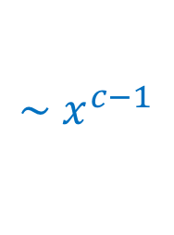

Size Boundary Selection
small sets
$$\sim x^{c−1}$$
goes up smoothly first, and then rapidly
c: threshold
x: size boundary
time cost
$$\sim \frac{1}{x}$$
goes down rapidly first, and then smoothly
large sets
size boundary x
Increase x little by little:
Benefit: the decrease of the time spend on large sets
Cost: the increase of the time spend on small sets

Slide 8
Skip Unique c-subsets (i.e., subset of size c)
Observation 1: Unique c-subsets cannot generate any result and we can skip them

Slide 9
Skip Redundant c-subsets
Observation 2: Redundant c-subsets only generate duplicate results and we can skip them

Slide 10
Experiments
C++, Ubuntu Server, Single Thread, CPU E5-2620 2.10 GHz

Slide 11
Evaluating the Size Boundary Selection
  first goes down rapidly and then goes down smoothly
  first goes up smoothly and then goes up rapidly

Slide 12
Evaluating the Size Boundary Selection
  the boundaries we selected has roughly the same performance than that of the optimal one

Slide 13
Evaluating the Heap-based Methods
  reduced the # of enumerated c-subsets by up to 4 orders

Slide 14
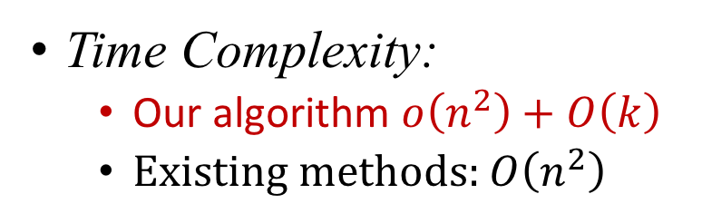
Comparing with Existing Methods - Scalability
Practical Performance
Time Complexity:
  Our algorithm $o\left(n^{2}\right)+O\left(k\right)$
  Existing methods: $O\left(n^{2}\right)$
  DBLP (c=6)
6.6 hrs
x 9.82 times
n: input size
k: output size
4.5 hrs
x 13.27 times
2.3 hrs
x 9.15 times
1.3 hrs
x 11.68 times
9 mins
x 5.34 times
Our algorithm
when dataset size increases by 3 times

Slide 15
Comparing with Existing Methods - Thresholds
  DBLP (1 million sets)
  Address (1 million sets)
  improves by up to 1 order
  even if all sets have the same size

Slide 16
Conclusion
Overlap set similarity join
The first sub-quadratic algorithm whenever that is possible
Practical size boundary selection method
Heap-based methods to skip many unnecessary c-subsets
Support both self-join and two-relation-join

Slide 17

Thanks!
Q&A

