Slide 1
LCJoin: Set Containment Join via List Crosscutting
Dong Deng, Chengcheng Yang, Shuo Shang,
Fan Zhu, Li Liu, Ling Shao
Inception Institute of Artificial Intelligence

Slide 2
Contents
Set Containment Join
Existing Solutions
LCJoin
Experimental Results
Conclusion

Slide 3
Problem Definition
Set Containment Join
Find All Pairs Such That $R⊆S$
$${(R}_{1}, S_{3}), (R_{3}, S_{1})$$
Rid | $$ℝ$$
$$R_{1}$$ | $$\{e_{1},e_{2},e_{3},e_{4}\}$$
$$R_{2}$$ | $$\{e_{2},e_{3},e_{5}\}$$
$$R_{3}$$ | $$\{e_{1},e_{2},e_{5},e_{6}\}$$
Sid | $$𝕊$$
$$S_{1}$$ | $$\{e_{1},e_{2},e_{4},e_{5},e_{6}\}$$
$$S_{2}$$ | $$\{e_{2},e_{4},e_{5}\}$$
$$S_{3}$$ | $$\{e_{1},e_{2},e_{3},e_{4},e_{6}\}$$
Job Advertisements
Job Seeker
Publish/Subscribe

Slide 4
Existing Solutions
Set Containment Join (SCJ)
SCJ
Union-Oriented
Method
Intersection-Oriented
Method
Basic Idea
1
1
Generate Signature $sig(R)/sig(S)$ for Each Set in $ℝ$ and $𝕊$
Build an Inverted Index for $𝕊$
2
Generate Candidate Pairs (R, S) Where $sig(R)⊆sig(S)$
2
For Each R in $ℝ$, Intersect all Inverted Lists Corresponding to Elements in R
3
Verify Candidates

Slide 5
Motivation
Union-Oriented Methods
Existing Solutions
Example: 4-bit Signatures for R and S. To set a bit, i mod 4 for each $e_{i}$
Rid | $$ℝ$$
$$R_{1}$$ | $$\{e_{1},e_{2},e_{3},e_{4}\}$$
$$R_{2}$$ | $$\{e_{2},e_{3},e_{5}\}$$
$$R_{3}$$ | $$\{e_{1},e_{2},e_{5},e_{6}\}$$
Sig
$$1111$$
$$0111$$
0110
Sid | $$𝕊$$
$$S_{1}$$ | $$\{e_{1},e_{2},e_{4},e_{5},e_{6}\}$$
$$S_{2}$$ | $$\{e_{2},e_{4},e_{5}\}$$
$$S_{3}$$ | $$\{e_{1},e_{2},e_{3},e_{4},e_{6}\}$$
Sig
$$1110$$
$$1110$$
$$1111$$
Verification Result: ($R_{1},S_{3}$)
Candidates: ($R_{1},S_{3}$), ($R_{2},S_{3}$), ($R_{3},S_{3}$)
Enumerate & Lookup
Signature Size?
Large Signature Size High Enumeration Cost
Small Signature Size Many Candidates. High Verification Cost

Slide 6
Existing Solutions
Intersection-Oriented Methods
Rid | $$ℝ$$
$$R_{1}$$ | $$\{e_{1},e_{2},e_{3},e_{4}\}$$
$$R_{2}$$ | $$\{e_{2},e_{3},e_{5}\}$$
$$R_{3}$$ | $$\{e_{1},e_{2},e_{5},e_{6}\}$$
Sid | $$𝕊$$
$$S_{1}$$ | $$\{e_{1},e_{2},e_{4},e_{5},e_{6}\}$$
$$S_{2}$$ | $$\{e_{2},e_{4},e_{5}\}$$
$$S_{3}$$ | $$\{e_{1},e_{2},e_{3},e_{4},e_{6}\}$$
Build Inverted Index
Result of $R_{1}=I_{S}(e_{1})∩I_{S}(e_{2})∩I_{S}(e_{3})$ $∩I_{S}\left(e_{4}\right)=S_{3}$
$I_{S}(e_{1})$:
$S_{1}$, $S_{3}$
$I_{S}(e_{2})$:
$S_{1}$, $S_{2}$, $S_{3}$
Result of $R_{2}= ∅$
$I_{S}(e_{3})$:
$$S_{3}$$
Result of $R_{3}=S_{1}$
$I_{S}(e_{4})$:
$$S_{1}\text{, }S_{2}\text{, }S_{3}$$
Verification Free
$I_{S}(e_{5})$:
$$S_{1}\text{, }S_{2}$$
$I_{S}(e_{6})$:
$$S_{1}\text{, }S_{3}$$

Slide 7
LCJoin
List Cross-Cutting Based Set Containment Join
$$R$$
$e_{1}， e_{2}$， $e_{3}$， $e_{4}$
$$R$$
$e_{1}， e_{2}$， $e_{3}$， $e_{4}$
$$Ι_{s}(e_{1})$$
$$Ι_{s}(e_{2})$$
$$Ι_{s}(e_{3})$$
$$Ι_{s}(e_{4})$$
$$Ι_{s}(e_{1})$$
$$Ι_{s}(e_{2})$$
$$Ι_{s}(e_{3})$$
$$Ι_{s}(e_{4})$$
$$s_{1}$$
$$s_{2}$$
$$s_{3}$$
$$s_{7}$$
$$s_{3}$$
$$s_{4}$$
$$s_{5}$$
$$s_{6}$$
$$s_{7}$$
$$s_{1}$$
$$s_{2}$$
$$s_{3}$$
$$s_{5}$$
$$s_{6}$$
$$s_{7}$$
$$s_{1}$$
$$s_{3}$$
$$s_{4}$$
$$s_{5}$$
$$s_{6}$$
$$s_{1}$$
$$s_{2}$$
$$s_{3}$$
$$s_{7}$$
$$s_{3}$$
$$s_{4}$$
$$s_{5}$$
$$s_{6}$$
$$s_{7}$$
$$s_{1}$$
$$s_{2}$$
$$s_{3}$$
$$s_{5}$$
$$s_{6}$$
$$s_{7}$$
$$s_{1}$$
$$s_{3}$$
$$s_{4}$$
$$s_{5}$$
$$s_{6}$$
Rip-Cutting
Cross-Cutting
$$I_{S}(A)$$
$$I_{S}(A)$$
GAP
$$I_{S}(B)$$
$$I_{S}(B)$$
GAP
GAP

Slide 8
LCJoin
List Cross-Cutting Based Set Containment Join
Example
$$Ι_{s}(e_{1})$$
$s_{1}$ $s_{10}$ $s_{13}$ $s_{14}$ $s_{18}$ $s_{25}$ $s_{27}$ $s_{30}$
$$Ι_{s}(e_{2})$$
$s_{1}$ $s_{13}$ $s_{17}$ $s_{20}$ $s_{21}$ $s_{23}$ $s_{25}$
$$Ι_{s}(e_{3})$$
$s_{7}$ $s_{12}$ $s_{13}$ $s_{16}$ $s_{26}$ $s_{29}$
$$Ι_{s}(e_{4})$$
$s_{1}$ $s_{3}$ $s_{13}$ $s_{15}$ $s_{19}$
MaxSid

Slide 9
LCJoin
List Cross-Cutting Based Set Containment Join
Early Termination
$$Ι_{s}(e_{1})$$
$s_{1}$ $s_{10}$ $s_{13}$ $s_{14}$ $s_{18}$ $s_{25}$ $s_{27}$ $s_{30}$
$$Ι_{s}(e_{2})$$
$s_{1}$ $s_{13}$ $s_{17}$ $s_{20}$ $s_{21}$ $s_{23}$ $s_{25}$
$$Ι_{s}(e_{3})$$
$s_{7}$ $s_{12}$ $s_{13}$ $s_{16}$ $s_{26}$ $s_{29}$
$$Ι_{s}(e_{4})$$
$s_{1}$ $s_{3}$ $s_{13}$ $s_{15}$ $s_{19}$
MaxSid

Slide 10
LCJoin
List Cross-Cutting Based Set Containment Join
Two Optimizations
Design a prefix-tree-based method to share the computation between sets in $ℝ$
Partition the data to further improve efficiency

Slide 11
LCJoin
Prefix-Tree Based Method
PostOrder-Traverse
root
$$I(e_{1})$$
$$I(e_{2})$$
$$I(e_{3})$$
$$NextMax =S_{7}$$
$S_{3}$ exists on the nodes from root to leaf $R_{1}$.
result pair $(R_{1},S_{3})$
$$MaxSid =S_{3}$$
$$RidList =R_{1}$$
$${ e}_{1}$$
$$S1$$
$$S2$$
$$S3$$
$$S7$$
$$S_{3}$$
$$S_{4}$$
$$S_{5}$$
$$S_{6}$$
$$S_{7}$$
$$S_{1}$$
$$S_{2}$$
$$S_{3}$$
$$S_{5}$$
$$S_{6}$$
$$S_{7}$$
$$NextMax =S_{4}$$
$$MaxSid =S_{3}$$
$$RidList =R_{1}$$
$${ e}_{2}$$
$$NextMax =S_{4}$$
$$NextMax =S_{5}$$
$$I(e_{4})$$
$$I(e_{5})$$
$$I(e_{6})$$
$${ e}_{5}$$
$${ e}_{3}$$
$$MaxSid =S_{3}$$
$$RidList =φ$$
$$MaxSid =S_{3}$$
$$RidList =R_{1}$$
$$S_{1}$$
$$S_{3}$$
$$S_{4}$$
$$S_{5}$$
$$S_{6}$$
$$S1$$
$$S2$$
$$S4$$
$$S5$$
$$S1$$
$$S_{3}$$
$$S_{4}$$
$$S_{5}$$
$$S_{6}$$
$$S_{7}$$
$$NextMax =S_{4}$$
$${ e}_{6}$$
$${ e}_{4}$$
$$NextMax =S_{4}$$
$$MaxSid =S_{3}$$
$$RidList =R_{2}$$
$$MaxSid =S_{3}$$
$$RidList =R_{1}$$
$$R2$$
$$R1$$
use the max NextMax on the path from root to leaf as the next MaxSid

Slide 12
SAL-Hashing
LCJoin
Data Partition
$$root$$
$$I(e_{1})$$
$$I(e_{2})$$
$$I(e_{3})$$
$$I(e_{2})$$
$$I(e_{3})$$
$$S1$$
$$S2$$
$$S3$$
$$S7$$
$$S_{3}$$
$$S_{4}$$
$$S_{5}$$
$$S_{6}$$
$$S_{7}$$
$$S_{1}$$
$$S_{2}$$
$$S_{3}$$
$$S_{5}$$
$$S_{6}$$
$$S_{7}$$
$${ e}_{1}$$
$${ e}_{2}$$
$$S_{3}$$
$$S_{7}$$
$$S_{1}$$
$$S_{2}$$
$$S_{3}$$
$$S_{7}$$
Use $S_{1}, S_{2}, S_{3}, S_{7}$
$${ e}_{2}$$
$${ e}_{3}$$
$$I(e_{4})$$
$$I(e_{5})$$
$$I(e_{6})$$
Build Local Inverted Index
$$S_{1}$$
$$S_{3}$$
$$S1$$
$$S2$$
$$S1$$
$$S_{3}$$
$$S_{7}$$
$$I(e_{4})$$
$$I(e_{5})$$
$$I(e_{6})$$
$${ e}_{5}$$
$${ e}_{3}$$
$${ e}_{5}$$
$$S_{1}$$
$$S_{3}$$
$$S_{4}$$
$$S_{5}$$
$$S_{6}$$
$$S1$$
$$S2$$
$$S4$$
$$S5$$
$$S1$$
$$S_{3}$$
$$S_{4}$$
$$S_{5}$$
$$S_{6}$$
$$S_{7}$$
Shorter Inverted Lists
$${ e}_{6}$$
$${ e}_{4}$$
$$R3$$
$$R2$$
$$R1$$

Slide 13
SAL-Hashing
LCJoin
Data Partition
$$root$$
Cost
Benefit
$$I(e_{1})$$
$$I(e_{2})$$
$$I(e_{3})$$
Build Local Inverted Index
Shorter Inverted List for Each Node on This Partition
$$S1$$
$$S2$$
$$S3$$
$$S7$$
$$S_{3}$$
$$S_{4}$$
$$S_{5}$$
$$S_{6}$$
$$S_{7}$$
$$S_{1}$$
$$S_{2}$$
$$S_{3}$$
$$S_{5}$$
$$S_{6}$$
$$S_{7}$$
$${ e}_{1}$$
$${ e}_{2}$$
$${ e}_{2}$$
$${ e}_{3}$$
$$I(e_{4})$$
$$I(e_{5})$$
$$I(e_{6})$$
$${ e}_{5}$$
$${ e}_{3}$$
$${ e}_{5}$$
$$S_{1}$$
$$S_{3}$$
$$S_{4}$$
$$S_{5}$$
$$S_{6}$$
$$S1$$
$$S2$$
$$S4$$
$$S5$$
$$S1$$
$$S_{3}$$
$$S_{4}$$
$$S_{5}$$
$$S_{6}$$
$$S_{7}$$
Build Local Inverted Index
$${ e}_{6}$$
$${ e}_{4}$$
$$R3$$
Use Original Built Inverted Index
$$R2$$
$$R1$$

Slide 14
Experimental Results
Experimental Setup
Ubuntu 16.04
Intel Xeon Gold-6148 Processor
64G DRAM
Characteristics of Our Datasets
Dataset | # of Sets | Min/Max/Avg Size | # of Elements | Z-Value
FLICKR | 3,546,729 | 1 / 1230 / 5.4 | 618,971 | 0.63
AOL | 36,389,577 | 1 / 125 / 2.5 | 3,849,556 | 0.68
ORKUT | 15,301,901 | 2 / 9120 / 7 | 2,322,299 | 0.13
TWITTER | 28,819,434 | 2 / 4998 / 9 | 13,096,918 | 0.3

Slide 15
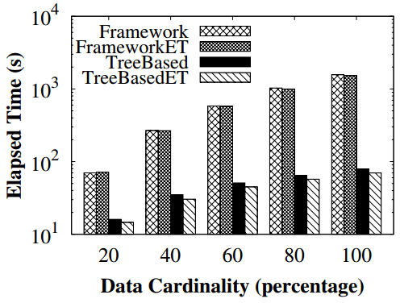
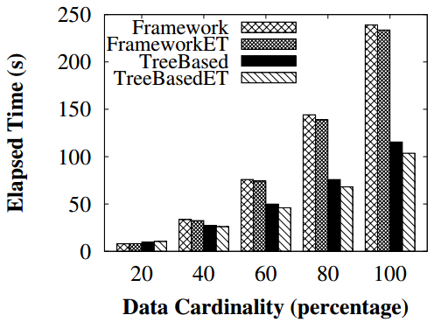
Experimental Results
Evaluation of the tree-based methods
FLICKR
AOL
TWITTER
Tree Based Method Can Share Computations in Common Prefixes of Sets in $ℝ$

Slide 16
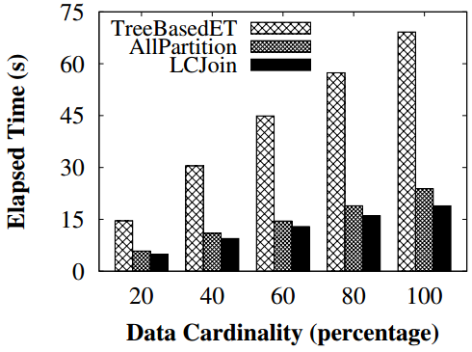
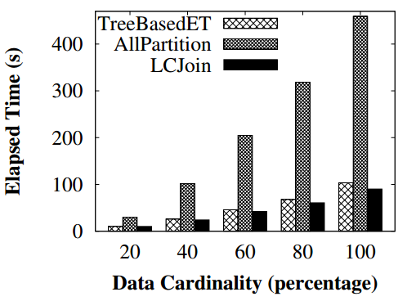
Experimental Results
Evaluation of data partition methods
AOL
AOL
TWITTER
Dynamic Partition achieved the best performance

Slide 17
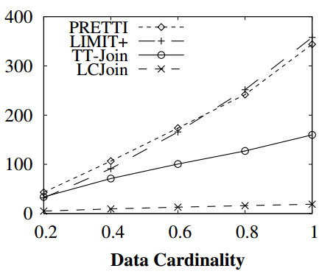
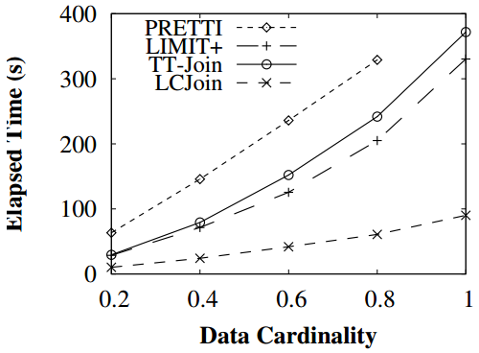
Experimental Results
Comparing with State-of-the-Art
$$≥4×$$
$$≥10×$$
AOL
TWITTER
LCJoin Outperforms the State-of-the-Art Method by Up to $10×$

Slide 18
Conclusion
A cross-cutting based list intersection method, which can skip many irrelevant entries.
A
A prefix tree on $ℝ$to share the computation across sets.
B
LCJoin
Data partitions to further improve the efficiency and scalability.
C
D
Experimenting to demonstrate the superiority of LCJoin

Slide 19
Q&A

