Slide 1






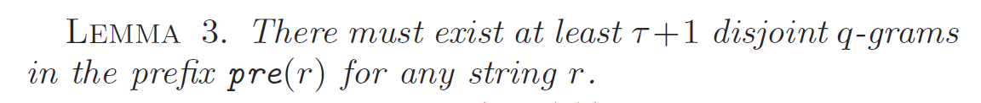
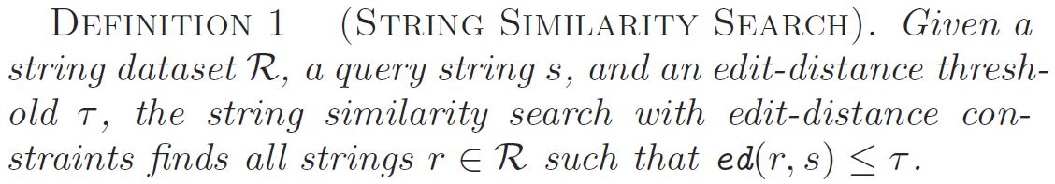
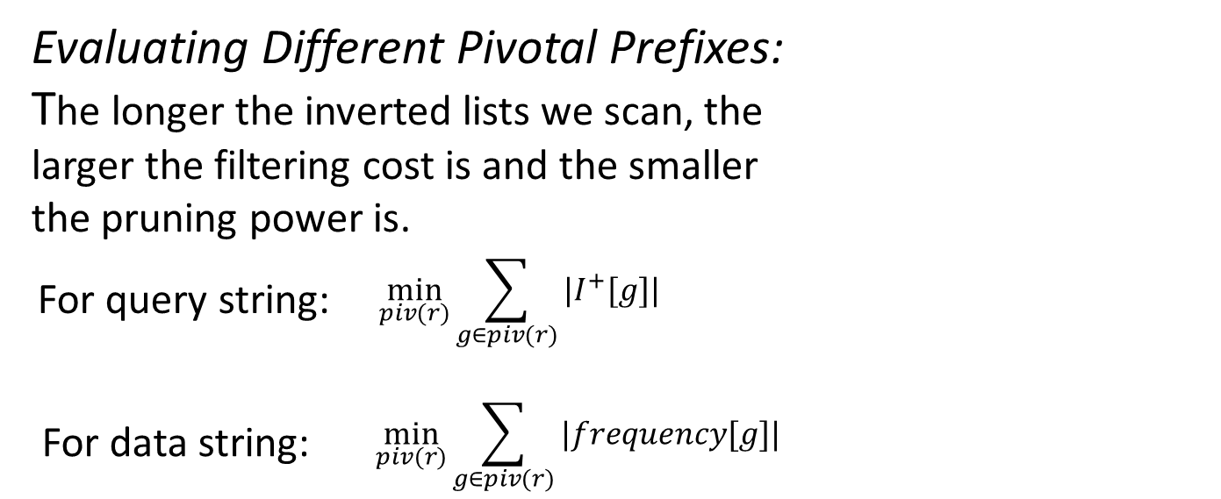
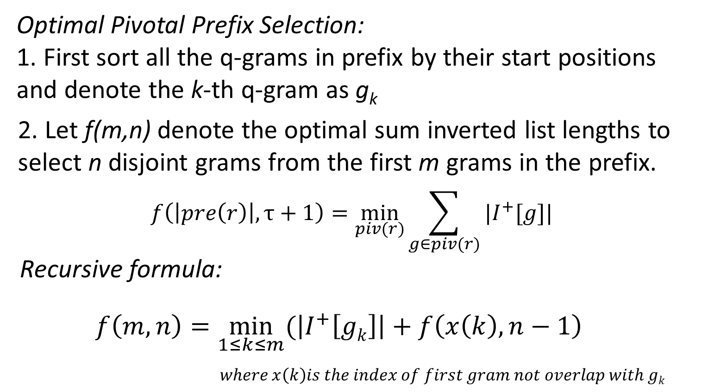
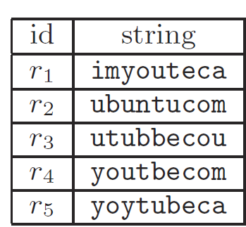
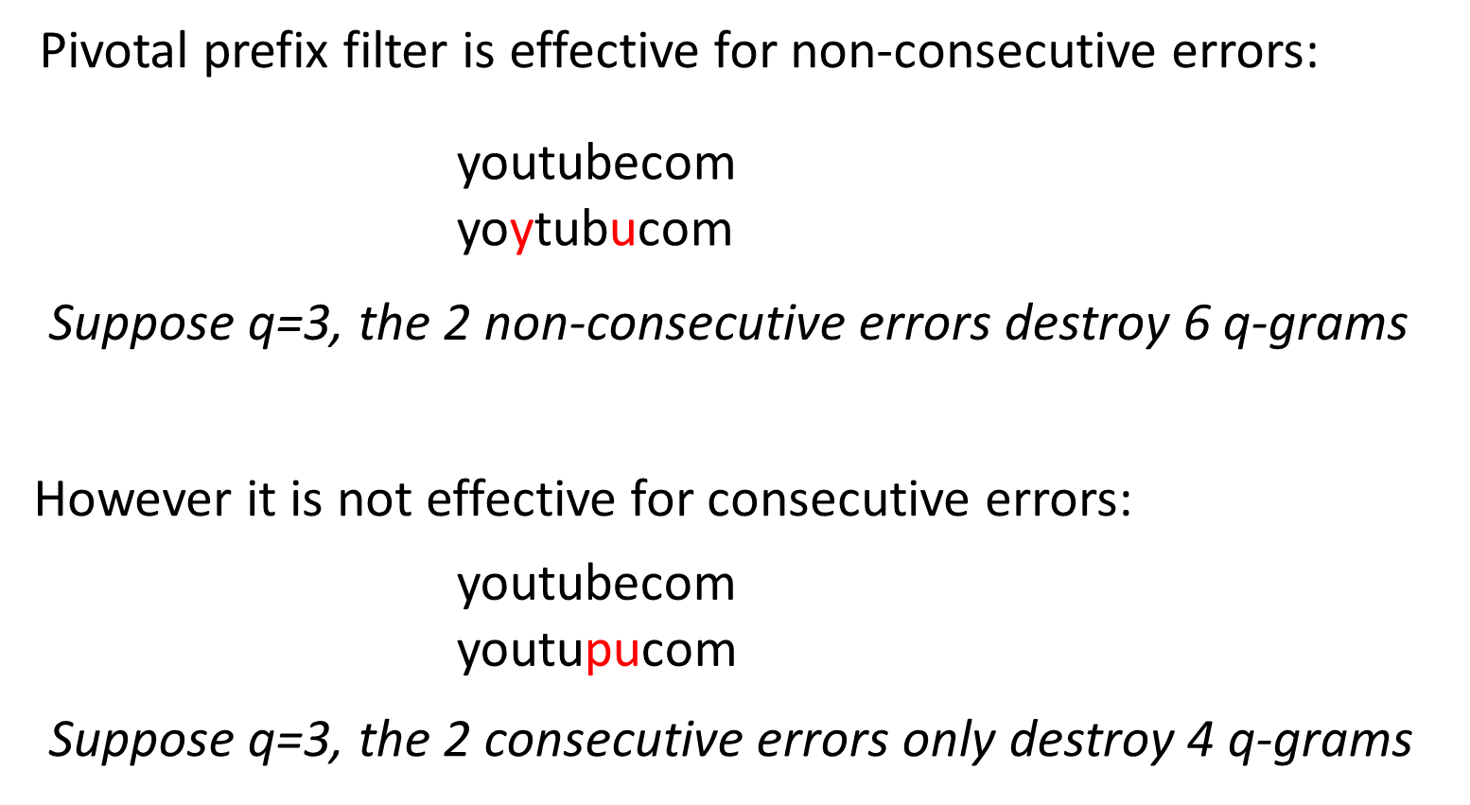
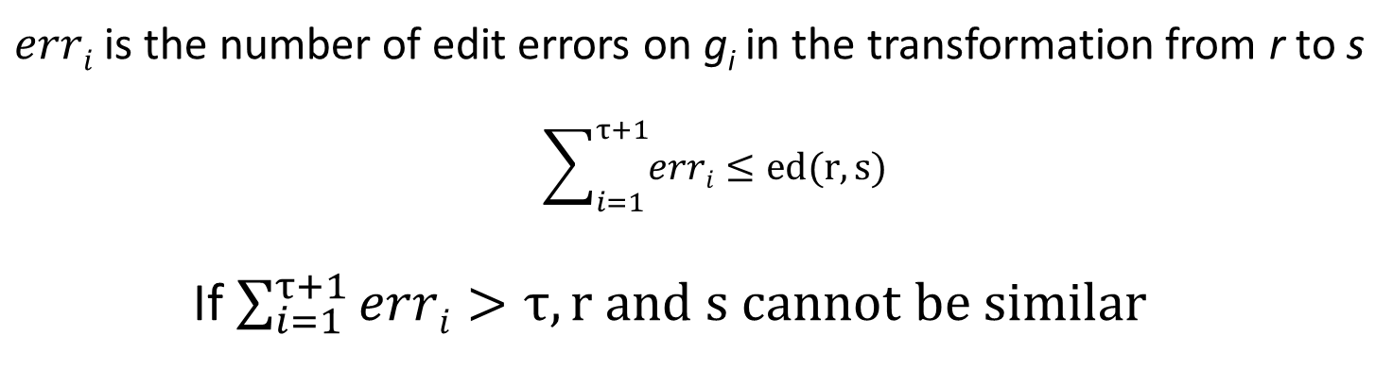
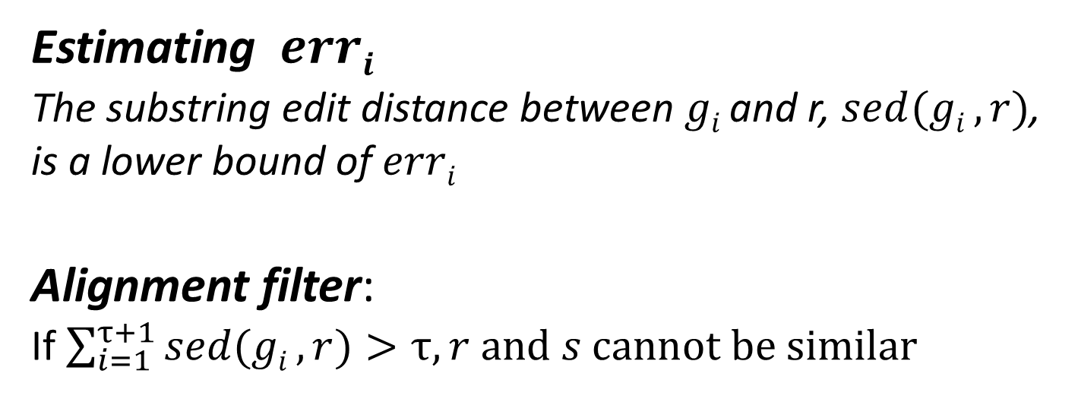
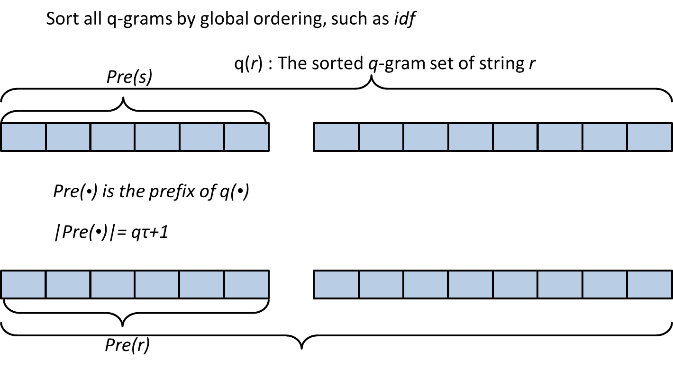
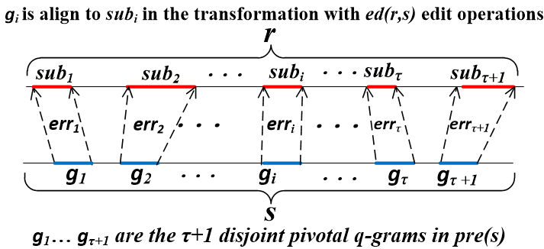
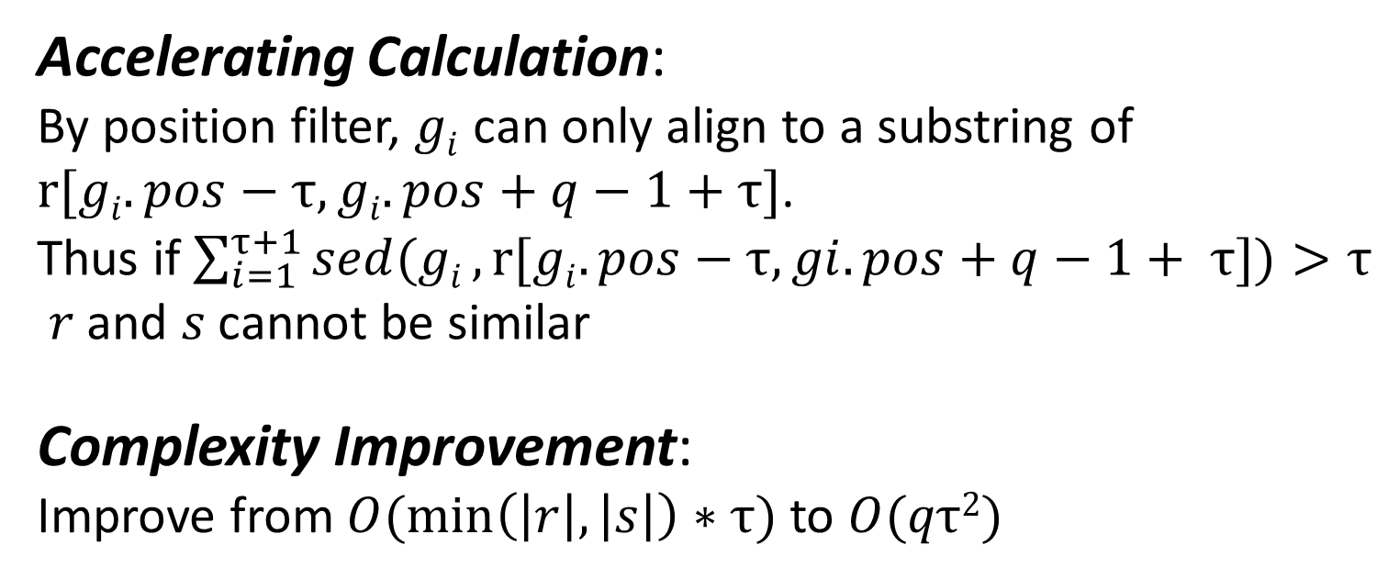
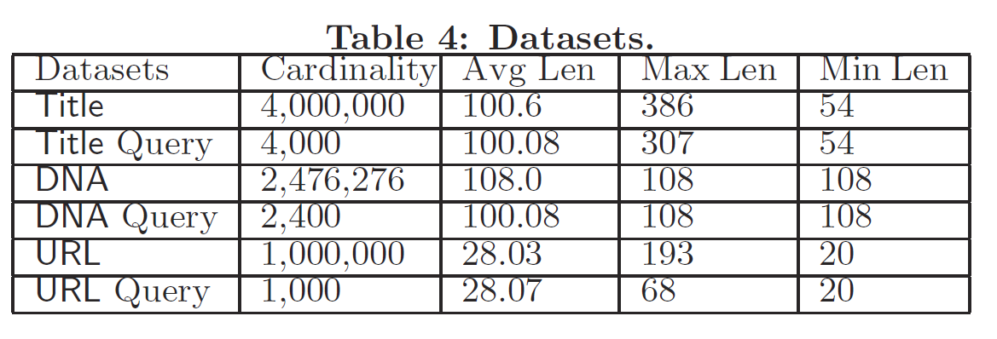
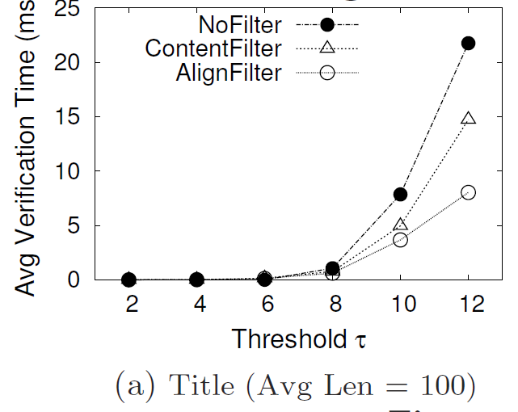
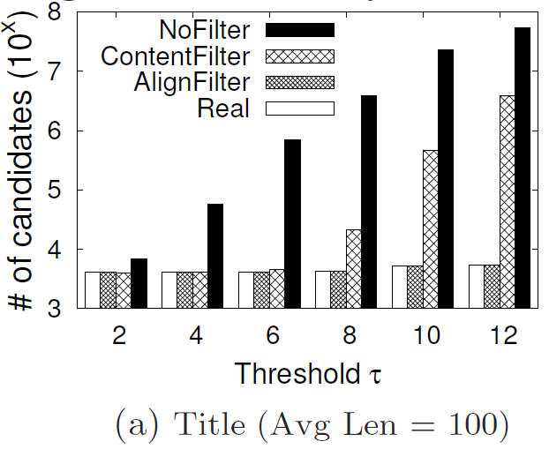
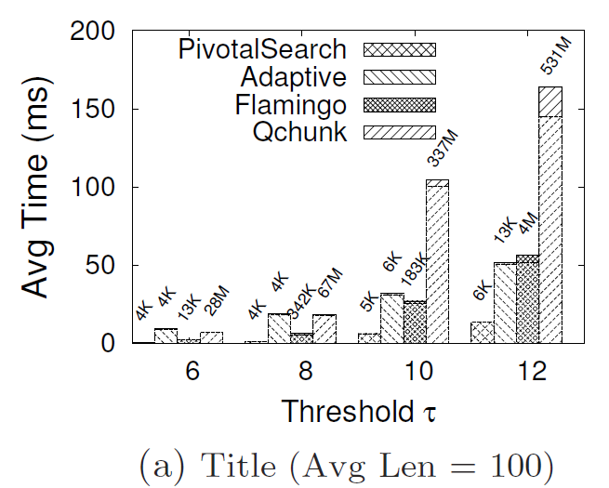
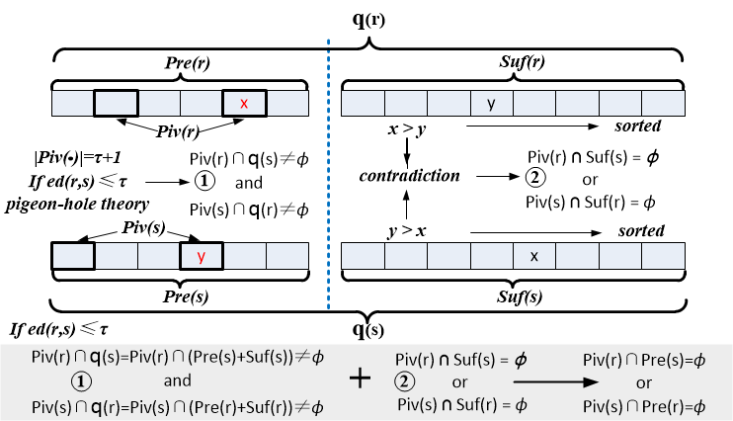
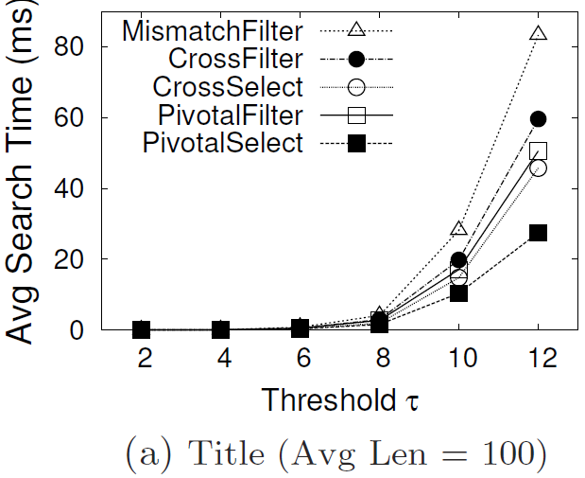
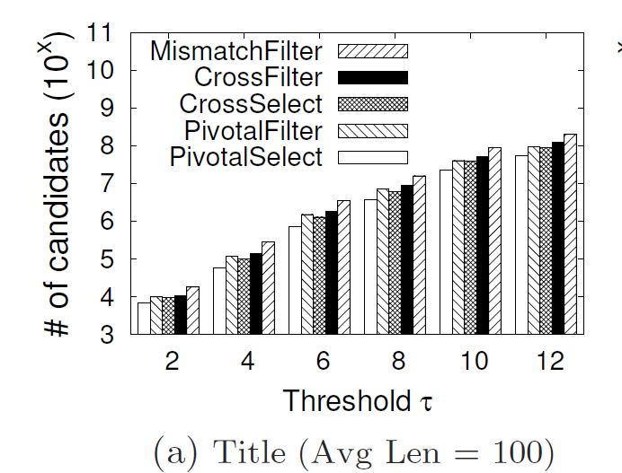
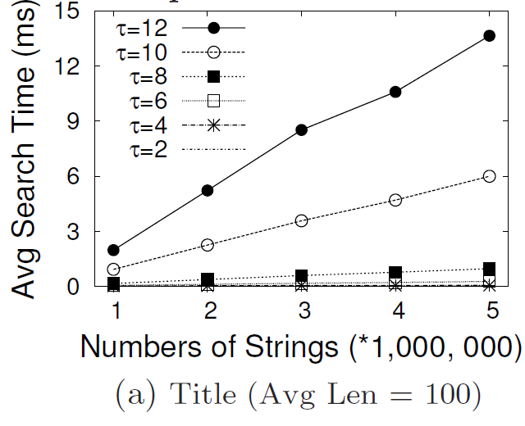
The Similarity Search Algorithm
Indexing:
1. Fix the global gram order
2. Build inverted indexes for prefixes and pivotal prefixes
Querying:
1. Generate prefix and pivotal prefix for the query string
2. Probe the prefix index with the pivotal prefix of the query
3. Probe the pivotal prefix index with the prefix of the query
4. Verify the candidates
Global gram order
im | my | te | bu | un | nt | uc | bb | tb | oy | yt | ca | om | yo | ou | ut | ub | co | tu | be | ec
1 | 1 | 1 | 1 | 1 | 1 | 1 | 1 | 1 | 1 | 1 | 2 | 2 | 3 | 3 | 3 | 3 | 3 | 3 | 3 | 4
A Pivotal Prefix Based Filtering Algorithm
for String Similarity Search
Dong Deng, Guoliang Li, Jianhua Feng
Department of Computer Science, Tsinghua University, Beijing, China
Problem Definition
Edit Distance:
The minimum number of edit operations(insertion/deletion/substitution) needed to transform one string to another string.
For example: ED(youtbe, yotde) = 2
To supporting dynamic thresholds we maintain the incremental inverted indexes
youtbe
delete u
Pivotal Prefix Selection
yotbe
substitute b with d
Existence of Pivotal Prefix:
yotde
Query string
s = “yotubecom”
and τ = 2
Application:
Data cleaning & Data integration
Spell Checking
Copy Detection
Entity Linking
Macromolecules Sequence Alignment
….
string dataset R
ed(s, r₄) <= 2
output <s, r₄> as a result
Alignment Filter
q-gram and Existing Filter
Edit Distance
q-gram:
A q-gram of a string is its substring with length q.
For example, the 2-gram set of string s is q(s)= “youtbecom”
youtbecom
youtdecom
yo
yo
ou
ou
ut
ut
tb
td
be
de
ec
ec
co
co
om
om
Experiments
τ edit operations destroy at most qτ
q-grams. ➔
Count Filter:
If ED(r,s) ≤ τ, |q(r) ∩ q(s)|≥ max(|q(r)|, |q(s)|) − qτ
Prefix Filter:
  If ED(r,s) ≤ τ, pre(r) ∩ pre(s) ≠ ϕ
Settings:
C++, g++ 4.8.2 with -O3 flags
64bit Ubuntu Server 12.04 LTS version
Intel Xeon E5-2650 2.00GHz processor and 16GB memory.
Pivotal Prefix Filter
Evaluating Alignment Filter
Comparison with State-of-the-art
Evaluating Pivotal Prefix Filter
Scalability
http://dbgroup.cs.tsinghua.edu.cn/dd/pivotal.html
Copyright © 2014, Database Research Group, Tsinghua University

