Slide 1
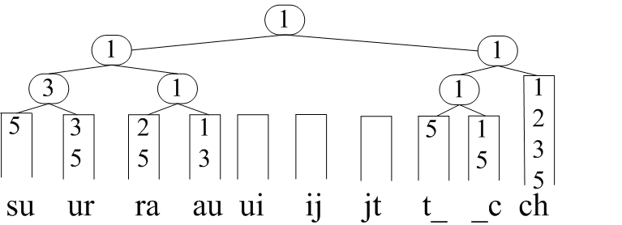
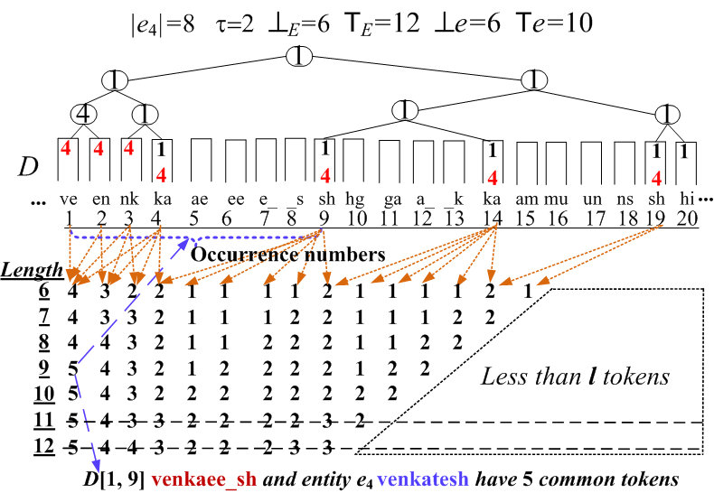
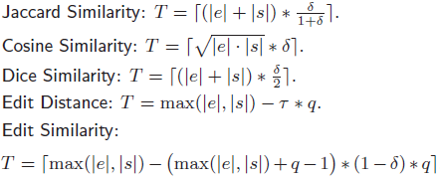
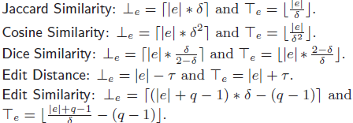
Heap-based Filtering Algorithms
Inverted Index Structure
Faerie: Efficient Filtering Algorithms for Approximate Dictionary-based Entity Extraction
Inverted index for entities:
(1) tokens or q-grams;
(2 ) ids of entities that
contain them
Guoliang Li, Dong Deng, Jianhua Feng
Department of Computer Science, Tsinghua University, Beijing, China
Entity Extraction
Approximate Entity Extraction
Multi-heap-based method:
1: Build an inverted index for all entities.
2: Construct a heap for each substring in D.
3: Count the occurrence number of the top
entity on the heap. Then adjust the heap,
add the next entity to the heap and repeat.
4: Verify the candidates.
T=tau*q=3*2=6
P_{e}
3<6 2<6 3<6 6>=6 it’s candidate
1, 1, 1, 2, 2, 3, 3, 3, 5, 5, 5, 5, 5, 5
A Document
An Efficient Filter for Approximate Membership Checking. Venkaee shga Kamunshik kabarati, Dong Xin, Surauijt ChadhuriSIGMOD
#1: Data in real world is dirty
ed: minimum # of single-character transformations
Surauijt Chadhuri
Surajit Chaudhuri
A Valid Substring
surauijt_ch
ed=3
Single-heap-based method:
1: Build an inverted index for all entities.
2: Construct a single heap for the document.
3: Adjust the heap, using a set of arrays to
count the occurrence number of each
entity in each valid substring.
4: Verify the candidates.
A Dictionary of Entities
1 Dong Xin 2 Surajit Chaudhuri
#2: Improve extraction quality
#3: Many real applications
Information retrieval
Molecular biology
Bioinformatics
Natural language processing
Entity Extraction
Locate entities from the document
e.g., Dong Xin
Improving The Single-heap-based Method
Problem Definition
Lazy-Count: Use Tl instead of T, which only depends on |e| and the threshold. We can use it on single-heap-based method to do pruning.
Given a dictionary of entities E = {e₁, e₂, . . . , e_{n}}, a document D, a similarity function, and a threshold, it finds all “similar” pairs <s, e_{i}> with respect to the given function and threshold, where s is a substring of D and e_{i} ∈ E.
Bucket-Count: We can divide the elements in Pe into two buckets and utilize lazy-count pruning if their position difference is larger than Te –Tl.
Batch-Count: If Tl≤ |Pe[i···j]| ≤ e and ⊥e≤ |D[p_{i}···p_{j}]| ≤ e, Pe[i···j] is a candidate window. A valid substring must contain a candidate window if it’s similar to e.
Entities
Document
Finding Candidate Windows Efficiently
ID | Entities | Length
1 | kaushik ch | 10
2 | chakrabarti | 11
3 | chaudhuri | 8
4 | venkatesh | 8
5 | surajit ch | 9
an efficient filter for approximate membership checking. venkaee shga kamunshik kabarati, dong xin, surauijt chadhurisigmod.
Binary Shift: We can do a binary search to find the first possible candidate window after the current window
Binary Span: We can do a binary search between j and i+e–1 and directly span to the last window.
An example result with ed threshold 1
<chaudhuri, chadhuri>
Experiments
Implemented in C++; Ubuntu: Intel Core 2 X5450 3.00GHz CPU and 4 GB RAM.
Unified Framework
Transform different similarities
to the overlap similarity (|e∩s|).
If e and s are similar, then |e∩s|
>=T, where T is different from
different similarity functions.
Datasetss
single-heap vs multi-heap
Scalability
Valid substring: ⊥_{e} ≤|s|≤ T_{e}
Compared with NGPP
Compared with ISH (Jaccard Similarity/Edit Similarity)
If s is similar to e, # of tokens
in s should be in [⊥_{e}, T_{e}]
http://dbgroup.cs.tsinghua.edu.cn/faerie
Copyright © 2011, Database Research Group, Tsinghua University

