Slide 1
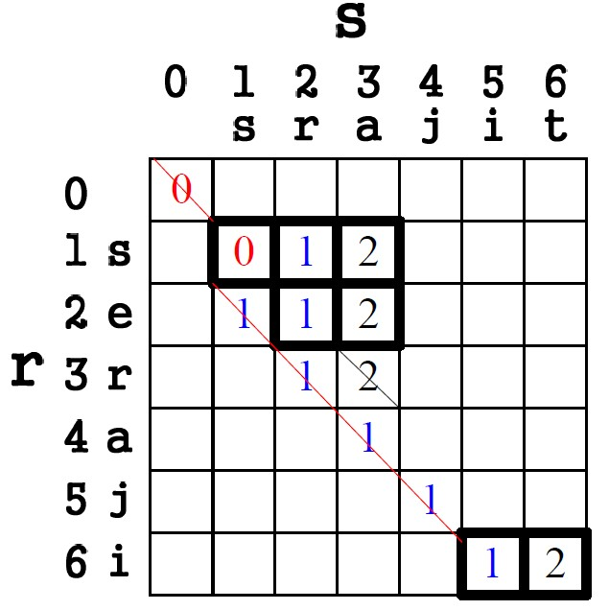
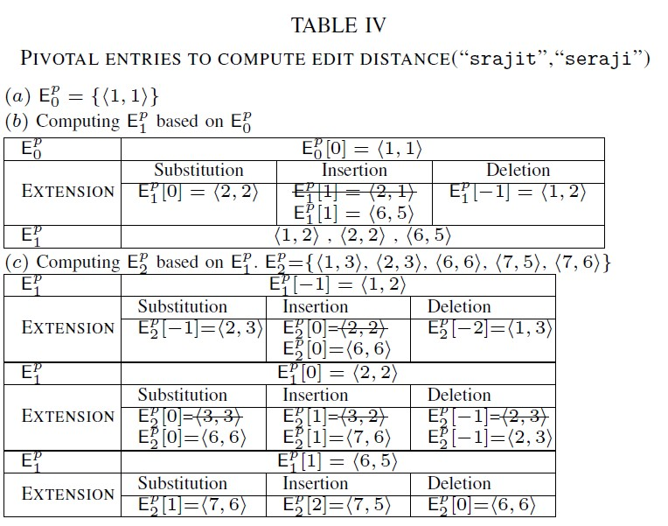
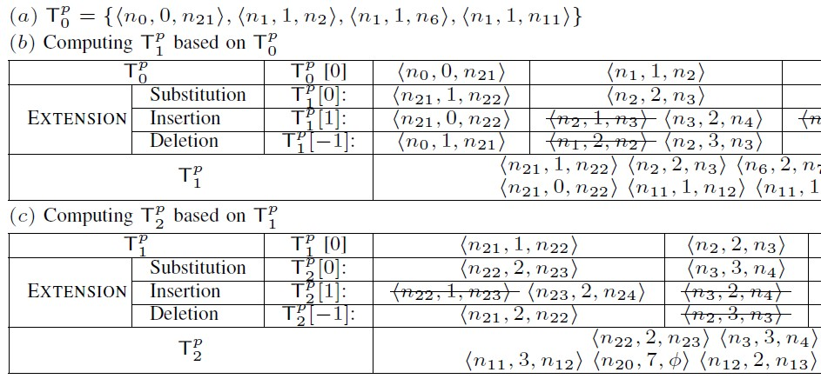
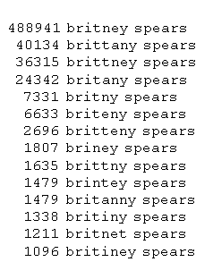
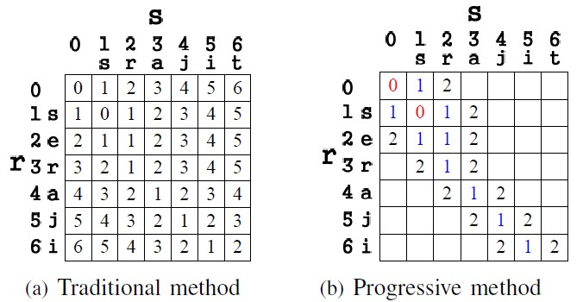
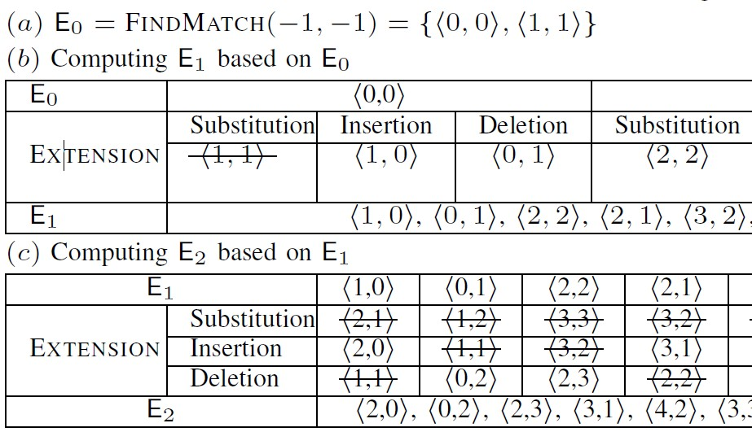
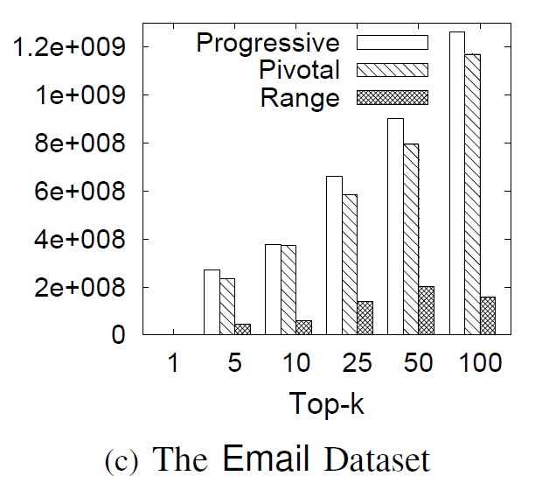
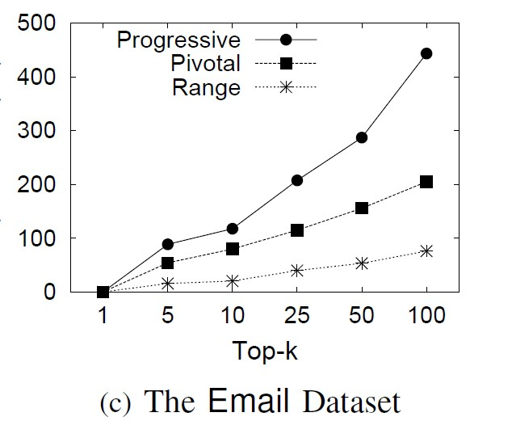
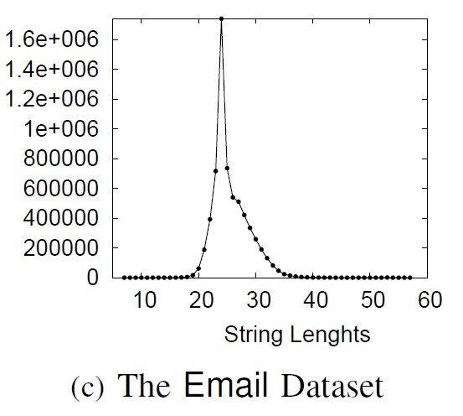
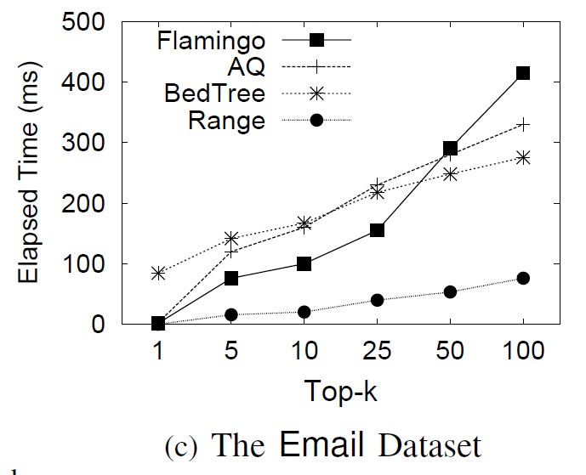
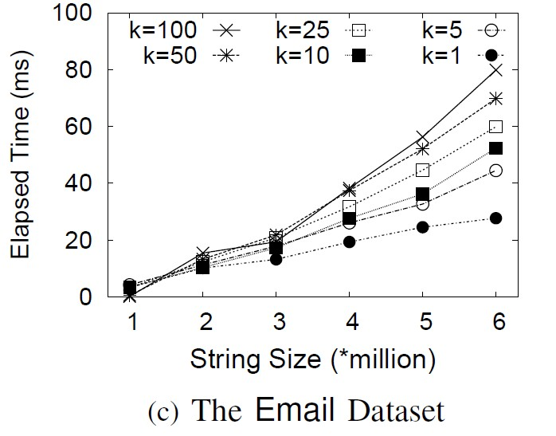
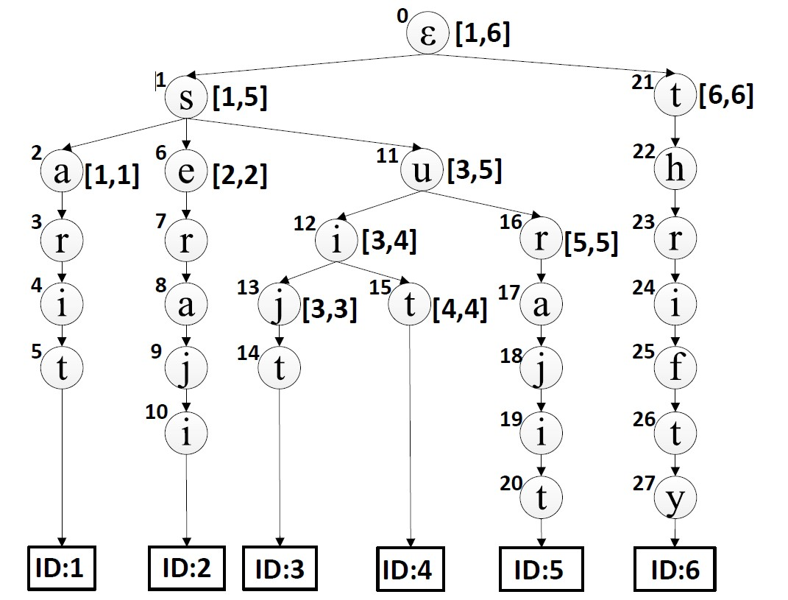
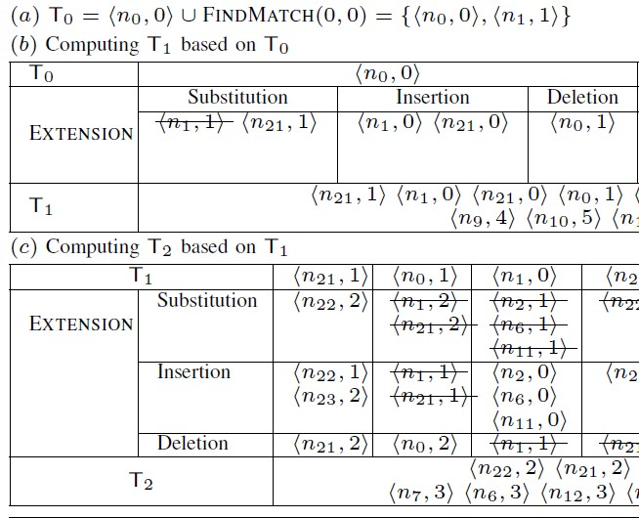
Pivotal Entry-based Method
Definition(Pivotal Entry): An entry ⟨i, j⟩ in Ex is called
a pivotal entry, if D[i + 1][j + 1] > D[i][j].
Top-k String Similarity Search with Edit-Distance Constraint
Dong Deng$, Guoliang Li$, Jianhua Feng$, Wen-Syan Li^
$Department of Computer Science, Tsinghua University, Beijing, China
^SAP Labs, Shanghai, Beijing
Motivation
Top-k String Similarity Search
#1: Data in real world is dirty
Edit Distance: minimum # of single character transformations
e.g. ED(srajit, seraji) = 2
Definition (Pivotal Triple):Given an entry ⟨n, j⟩, one of n’s children n_{c}, and a query q, triple ⟨n, j,
n_{c}⟩ is called a pivotal triple, if ED(n_{c},q[1, j+ 1]) >ED(n, q[1, j]).
The user doesn’t know the exact spelling!
#2: Hard to define a threshold
#3: Many real applications
Information retrieval
Molecular biology
Bioinformatics
Data Quality, Data Cleaning
Find movies with a star “similar to” Schwarrzenger
Star | Title | Year | Genre
Keanu Reeves | The Matrix | 1999 | Sci-Fi
Samuel Jackson | Iron man | 2008 | Sci-Fi
Schwarzenegger | The Terminator | 1984 | Sci-Fi
Samuel Jackson | The man | 2006 | Crime
Problem Definition
Range-based Method
Top-k String Similarity Search: Given a string set S and a query string q, top-k string similarity search returns a string set R ⊆ S such that |R|=k and for any string r∈ R and s∈ S − R, ED(r, q) ≤ ED(s, q).
Definition 4 (Pivotal Quadruple): A quadruple ⟨[l, u], d, j⟩ is a pivotal quadruple,
if it satisfies (1) ⟨l, u⟩ is a sub-range of a d-th level node’s range;
(2) for any string s with ID in [l, u], ED(s[1, d+1], q[1, j+1])>ED(s[1, d], q[1, j]);
(3) strings with ID l − 1 or u + 1 do not satisfy conditions (1) or (2).
the top-3 similar strings of srajit
Progressive Framework
Experiments
implemented in C++, Ubuntu: Intel Xero X5670 2.5GHz CPU and 4 GB memory
Datasets
Traditional Method: Dynamic Programming
D_{i,0} = i, D_{0,j} = j,
Progressive Method: Smallest Cell First
Two Operations: Find Match / Extend
Number of calculated entries
Running Time of Each Methods
Insertion
Deletion
Match/Subsitition
D_{i,j} = min{D_{i-1, j} + 1, D_{i, j-1} + 1, D_{i-1, j-1} + 0/1}
A trie for strings in table 1
Top-3 Query: srajit
Email Dataset
(n_{i} j)
i-th node of trie;
j-th character of Q
Length Distribution
State-of-the-art methods
Scalibility
Tx: node and char with ED=x
http://dbgroup.cs.tsinghua.edu.cn/dd/projects/topksearch
Copyright © 2013, Database Research Group, Tsinghua University

