Slide 1
An Efficient Trie-based Method for Approximate Entity Extraction with Edit-Distance Constraints
Dong Deng (Tsinghua, China)
Guoliang Li (Tsinghua, China)
Jianhua Feng (Tsinghua, China)
Notes:
Good afternoon ladies and gentlemen. Thank you for this opportunity to talk to you today.
My name is Dong Deng and I am from Tsinghua University, Beijing, China.
I am going to present a method for approximate entity extraction.

Slide 2
Outline
Motivation
Problem Formulation
Trie-based Framework
Trie-based Algorithms
Optimizing Partition Scheme
Experiment
Conclusion
Notes:
Here is the outline of today’s presentation.
I’ll give the motivation of our project first .

Slide 3
Named Entity Recognition
Dictionary-based Entity Extraction
Dictionary of Entities
Documents
1 Sir Isaac Newton was an English physicist, mathematician, astronomer, natural philosopher, alchemist, and theologian and one of the most influential men in human history. His Philosophiæ Naturalis Principia Mathematica, published in 1687, is by itself considered to be among the most influential books in the history of science, laying the groundwork for most of classical mechanics.
2 Sigmund Freud was an Austrian psychiatrist who founded the psychoanalytic school of psychology. Freud is best known for his theories of the unconscious mind and the defense mechanism of repression and for creating the clinical practice of psychoanalysis for curing psychopathology through dialogue between a patient and a psychoanalyst.
Isaac Newton Sigmund Freud English Austrian physicist mathematician astronomer philosopher alchemist theologian psychiatrist economist historian sociologist ...
Notes:
Let’s begin with the concept of dictionary-based named entity recognition.
Dictionary-based Named Entity recognition, also known as Dictionary-based entity extraction is an important operation in information extraction, which identifies substrings from a document that match the predefined entities in a given dictionary.
Here is an example: The left part is a dictionary of entities and the right part contains two documents. Dictionary based entity extraction will locates Isaac Newton from document one and sigmund freud from document two., which are all included in the dictionary.

Slide 4
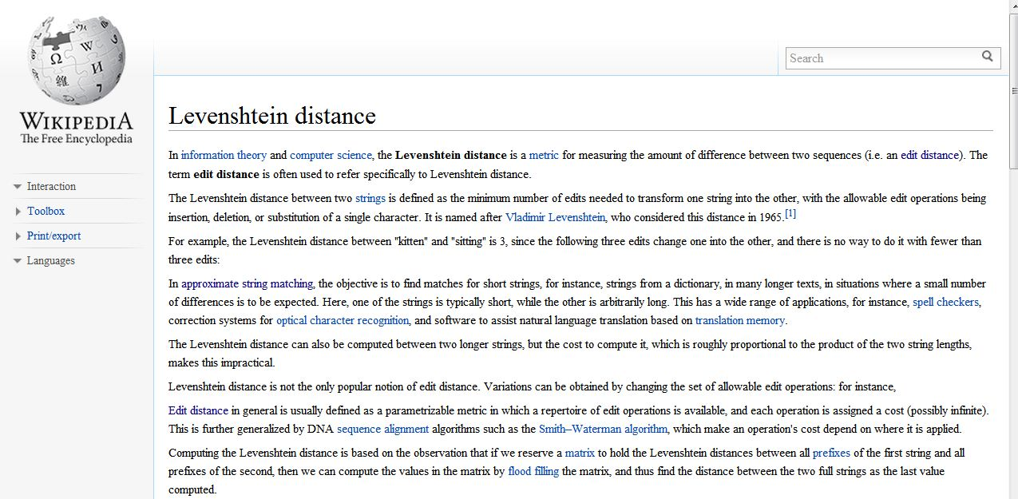
Automatically add the links
Wikipedia
http://en.wikipedia.org/wiki/Levenshtein_distance
Notes:
This problem has a lot of applications.
For example it can help to add links on wikipedia documents automatically.
In this situation, the dictionary of entities is the set of all entries in wikipedia. When someone edit or submit a new document, dictionary-based entity extraction can identify substrings from the document which match some entries in the dictionary and automatically add link on these substring which pointer to the respective entries.

Slide 5
Real-world Data is Rather Dirty！☹
DBLP Complete Search
Typo in “author”
Typo in “title”
Argyrios Zymnis
Argyris Zymnis
relaxed
related
Notes:
However, data in real word is very dirty.
Here we can see that there contains typos in the author field and title field in DBLP data.
We also may have orthographical or typographical errors in both document and dictionary.

Slide 6
Approximate Entity Extraction
Approximate dictionary-based entity extraction finds all substrings from the document that approximately match the predefined entities.
For example:
Sigmund Freund was an Austrian psychiatrest who founded the psychoanalytic school of psychology. Freud is best known for his theories of the unconscious mind and the defense mechanism of repression and for creating the clinical practice of psychoanalysis for curing psychopathology through dialogue between a patient and a psychoanalayst.
Documents
Dictionary of Entities
Isaac Newton
Sigmund Freud
physicist
astronomer
alchemist
theologian
economist
sociologist ...
Notes:
To solve this problem, we propose to solve the approximate entity extraction problem.
Approximate dictionary-based entity extraction finds all substrings from the document that approximately match the predefined entities.
Here is a simple example: Notice that there is a typo in the substring sigmund freund above the red line in the document, although the substring is not exactly match any entity in dictionary, approximate entity extraction will still locate it from the document as show in the slide.

Slide 7
Outline
Motivation
Problem Formulation
Trie-based Framework
Trie-based Algorithms
Optimizing Partition Scheme
Experiment
Conclusion
Notes:
Next we will formulate our problem and give some preliminary knowledge.

Slide 8
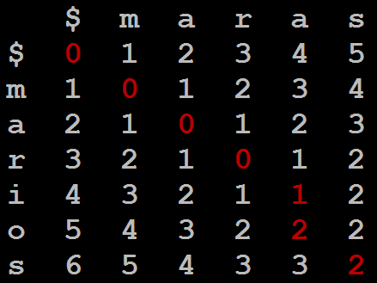
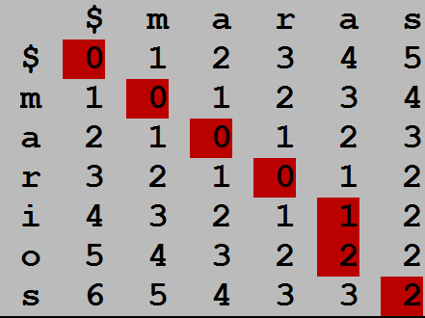
Edit Distance
ED(r, s): The minimum number of single-character edit operations(insertion/deletion/substitution) to transform r to s.
For example: ED(marios, maras) = 2
D_{i,0} = i, D_{0,j} = j,
D_{i,j} = min{D_{i-1, j} + 1, D_{i, j-1} + 1,
D_{i-1, j-1} + t_{i, j}},
0 if a_{i} = b_{j}
1 if a_{i} ≠ b_{j}.
Substitute a->i
Insert o
where t_{i, j} =
ED(r, s)
Notes:
To tolerate inconsistencies between substrings and entities we use edit distance to quantify the similarity between two strings.
The edit distance between two strings is the minimum number of single-character edit operations (i.e., insertion, deletion, and substitution) needed to transform one string to another. For example, the edit distance between marios and maras is 2.
There is a dynamic way to calculate the edit distance of two strings. The recursive formula is listed in the left and the matrix to record the status D[i][j] is listed in the right.
From the slide we can see that to transform maras to marios, we only need a substitution and a insertion. Thus the edit distance between them is 2.
Edit Distance has a lot of interested features. One of them is that the edit distance between two string will definitely larger than their length difference.

Slide 9
Problem Formulation
Approximate Entity Extraction: Given a dictionary of entities E = {e₁, e₂, . . . , e_{n}}, a document D, and a predefined edit distance threshold τ, approximate entity extraction finds all “similar” pairs <s, e_{i}> such that ED(s, ei) ≤ τ, where s is a substring of D and ei∈ E.
Notes:
Here is our problem formulation and below is an example which will go through all this slides.
Approximate Entity Extraction takes a dictionary, a document and an edit distance threshold as input, and outputs all similar pairs between substring and entity.
In the example, we have a dictionary E with 5 entities, each attached with an ID on the left side. And we have a document D on the right side.
Suppose the edit-distance threshold τ = 2. the highlighted pair is an example answers.

Slide 10
State-of-the-art Methods
Shortage:
Large Index Size
Need to Tune Parameters
Inefficient for large threshold
 | NGPP | Faerie
Inverted Index | Prefix of 1-variant family | q-grams
Filtering Condition | a substring matches with the prefix of 1-variant of partition | Overlap must be larger than a threshold
Notes:
Two state of art methods Faerie [17] and NGPP [19] have been proposed to address this problem.
The basic idea of NGPP is that: first partitions entities into different partitions, and guarantees that an entity and a substring are similar if they have two similar partitions with edit distance no larger than 1.
faerie proposed a unified framework to support various similar functions, an entity and a substring are similar if their overlap similarity is larger than a threshold.
however they both have some limitations. Firstly, they need to tune parameters to achieve a high performance, which is a tedious and troublesome process.
Secondly, faerie used gram-based index structures and NGPP indexed all 1-variant of partitions. Both of them involve large index size.
Last, then are inefficient for large edit distance threshold.

Slide 11
Outline
Motivation
Problem Formulation
Trie-based Framework
Trie-based Algorithms
Optimizing Partition Scheme
Experiment
Conclusion
Notes:
Next I will introduce our trie-based framework.

Slide 12
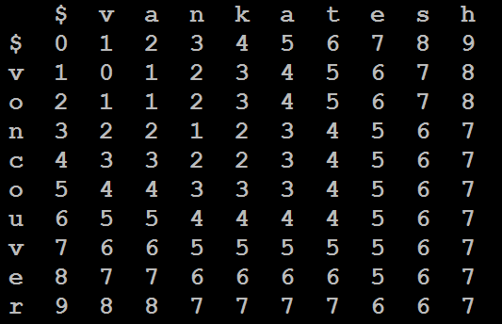
Observation
Set τ=2 entity:vankatesh
substring: voncouver
Split the entity into τ+1=3 segments
A substring in document
Notes:
If we have an entity vankatesh and a substring in the document voncouver, and edit distance threshold tau is two. We split the entity vankatesh into three segments “van” “kate” “esh”. We can see that none of the three segments appear the substring.
Here we have an entity vankate on the upper side and a substring voncouver on the left side. If we split the entity into three segments, van, kat and esh, as we can see here, non

Slide 13
Observation
Set τ=2 entity:vankatesh
substring: voncouver
>= 1
edit operations
>= 1
edit operations
>= 1
edit operations
>= τ + 1 = 3
edit operations
NOT SIMILAR
Notes:
Then we find that the entity and the substring cannot be similar. This is because it will need at least one edit operation to make a segment exactly match with a part of the substring and thus will need at least three edit operations to transform the entire entity to the substring, which is larger than the edit distance threshold.
In general, we can proof that given an entity e with τ + 1 segments and a substring s, if s is similar to e within threshold τ , e must contain a substring which is exactly a segment of e.

Slide 14
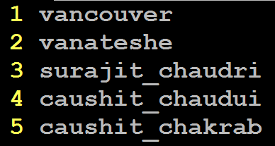
Trie-based Framework
Step1: Partition entities into segments using even partition scheme.
Notes:
Trie-based framework has three steps.
The first step is to partition all the entities into tau plus one segments. There could be many strategies to partition the entity into τ + 1 segments. Here we using even partition scheme and we will discuss how to select the best partition strategy later.
Even partition scheme means that the tau plus one segments have equal length.
Here is an example, we split all entities into three segments with equal length.

Slide 15
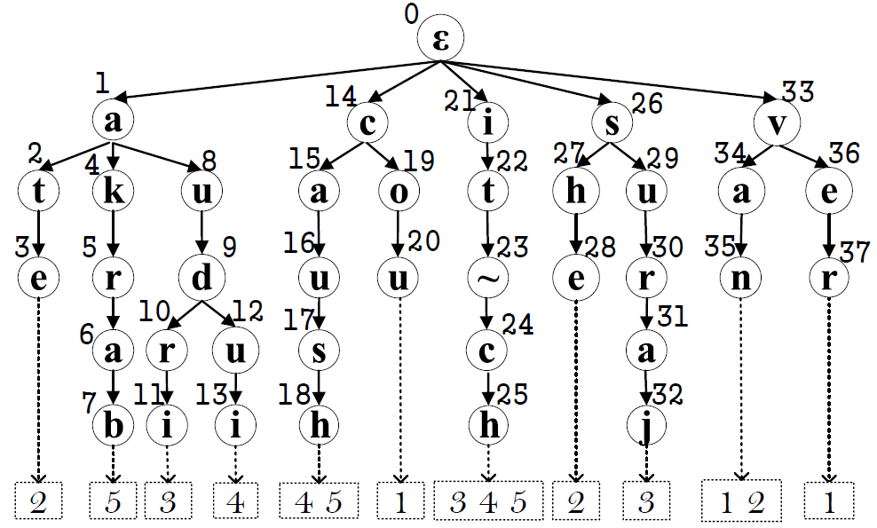
Trie-based Framework
Step2: Index the segments using a trie structure
Notes:
Next we use a trie structure to index all the segments.
Each segment corresponds to a unique path from the root of the trie to a leaf node. For simplicity, a node is mentioned interchangeably with its corresponding string. Each leaf node has an inverted list of IDs of entities that contain the corresponding segment.

Slide 16
Trie-based Framework
Step3: From the document, identify substring which is similar to an entity in the dictionary using the trie structure.
Baseline: Trie-search Method
Notes:
Last we need to locate substring which is similar to an entity in the dictionary using the trie structure.
To achieve this we propose a trie-search method.

Slide 17
Trie-search Method
3.1 Enumerate all valid substrings.
if L_{min} - τ = 9-2=7 L_{max} + τ = 15+2=17
kaushit chekrabarti, surajit chaudhuri, vankatesh ganti,
Len = 7
Notes:
We first enumerate all valid substrings.
If the minimum and maximum length of the valid substring is seven and seventeen respectively, then all substrings with length between seven and seventeen should be enumberated as show in here.
We first enumerate substring with length seven.

Slide 18
Trie-search Method
3.1 Enumerate all valid substrings.
if L_{min} - τ = 9-2=7 L_{max} + τ = 15+2=17
kaushit chekrabarti, surajit chaudhuri, vankatesh ganti,
Len = 8
Notes:
Then enumerate substring with length eight

Slide 19
Trie-search Method
3.1 Enumerate all valid substrings.
if L_{min} - τ = 9-2=7 L_{max} + τ = 15+2=17
kaushit chekrabarti, surajit chaudhuri, vankatesh ganti,
Len = 17
Notes:
We continue this procedure until we enumerate substring with length seventeen

Slide 20
Trie-search Method
3.2 Find each suffix of every substring in the trie structure to check if it can reach the leaf.
chaudhuri
Pruned
Notes:
Then for each of the enumerated substring, we should check if there is any part of the substring is exactly a segment of any entity.
To improve the performance, we check if each suffix of every substring in the trie structure.
For each suffix of substring s, we find the suffix in the trie structure. If we reach a leaf node, s has a substring corresponding to the leaf node. We retrieve the entities in the inverted list, which may be similar to substring s.

Slide 21
Trie-search Method
3.2 Find each suffix of every substring in the trie structure to check if it can reach the leaf.
urajit chaud
Candidate of
entity 3,4,5
Notes:
Here is another enumerated substring, surajit chaud.

Slide 22
Trie-search Method
3.3 Verify the candidate pairs
ED(surajit chaudri, urajit chaud)=3
ED(caushit chaudui , urajit chaud)=7
ED(caushit chakrab, surajit chaud)=10
Notes:
At last we will verify all the candidate pairs using standard edit distance calculation method and get the final answers.

Slide 23
Trie-search Method
Shortage
Huge Number of candidate pairs:
<surajit_chaudhuri, surajit_chaudri>
< urajit_chaudhuri, surajit_chaudri>
<surajit_chaudhur , surajit_chaudri>
…...
Notes:
However many substrings share common segments. For example, consider the three valid substrings on the left side. They share a common segment “it ch”. TRIE-SEARCH will search“it ch” multiple times and access the entities in the inverted list of “it ch” repeatedly and generate huge number of candidate pairs. Thus TRIE-SEARCH involves duplicated computations.

Slide 24
Outline
Motivation
Problem Formulation
Trie-based Framework
Trie-based Algorithms
Optimizing Partition Scheme
Experiment
Conclusion
Notes:
To avoid the duplicated computations, we propose an efficient trie-based algorithm

Slide 25
Trie-based Algorithm
Step3: From the document, find the matched segments from the trie structure.
To avoid duplicate computation, we do not enumerate all valid substrings.
Trie-based Algorithm
Notes:
To avoid the duplicated computations on the shared segment across different substrings, we propose a trie based algorithm. For each segment shared by multiple substrings, we only access the inverted list of the segmsent once.
To achieve this goal, trie-basd method developed two operations, search and extension Instead of enumerate all valid substrings .

Slide 26
Trie-based Algorithm
3.1 Search: Search matched segments.
Document:
kaushit chekrabarti, surajit chaudhuri, vankatesh ganti,
Notes:
The search operation will search each suffix of the document and check whether it can reach a leaf node.
Here is an example:
We have a trie in the middle part and a document on the bottom.
Search operation runs like this, as we can see here, the search operation finally find a leaf node “it_ch”.

Slide 27
Trie-based Algorithm
3.2 Extend the matched segments to find similar pairs.
D: kaushit chekrabarti, surajit chaudhuri, vankatesh ganti,
e₃: surajit chaudri
e₄: caushit chaudui
e₅: caushit chakrab
Notes:
For each leaf node found in the search operation, which corresponding to a segment, the entities in the inverted list also contain the segment. thus they may be similar to the substrings that contain the segment. The extension operation will extend.

Slide 28
 | k | a | u | s | h | i | t | _ | c | h | e | k | r | a | b | a | r
s | 5 | 4 | 4 | 4 | 5 | 5
u | 5 | 4 | 3 | 4 | 4 | 4
r | 4 | 4 | 3 | 3 | 3 | 3
a | 4 | 3 | 3 | 2 | 2 | 2
j | 5 | 4 | 3 | 2 | 1 | 1
i | 5 | 4 | 3 | 2 | 1 | 0
t
_
c
h
a
u
d
r
i
All Larger
Than Two,
Terminate!
e₃
No Need to Compute This Range
Notes:
To avoid the duplicated computations on the shared segment
across different substrings

Slide 29
 | k | a | u | s | h | i | t | _ | c | h | e | k | r | a | b | a | r
c | 1 | 1 | 2 | 3 | 4 | 5
a | 1 | 0 | 1 | 2 | 3 | 4
u | 2 | 1 | 0 | 1 | 2 | 3
s | 3 | 2 | 1 | 0 | 1 | 2
h | 4 | 3 | 2 | 1 | 0 | 1
i | 5 | 4 | 3 | 2 | 1 | 0
t
_
c
h |  |  |  |  |  |  |  |  |  | 0 | 1 | 2 | 3 | 4 | 5 | 6 | 7
a |  |  |  |  |  |  |  |  |  | 1 | 1 | 2 | 3 | 3 | 4 | 5 | 6
u |  |  |  |  |  |  |  |  |  | 2 | 2 | 2 | 3 | 4 | 4 | 5 | 6
d |  |  |  |  |  |  |  |  |  | 3 | 3 | 3 | 3 | 4 | 5 | 5 | 6
u |  |  |  |  |  |  |  |  |  | 4 | 4 | 4 | 4 | 4 | 5 | 6 | 6
i |  |  |  |  |  |  |  |  |  | 5 | 5 | 5 | 5 | 5 | 5 | 6 | 7
Not Larger
Than Two,
Extend The
Right Part!
e₄
No Need to Compute This Range
All Larger
Than Two,
Prune!
Notes:
To avoid the duplicated computations on the shared segment
across different substrings

Slide 30
 | k | a | u | s | h | i | t | _ | c | h | e | k | r | a | b | a | r
c | 1 | 1 | 2 | 3 | 4 | 5
a | 1 | 0 | 1 | 2 | 3 | 4
u | 2 | 1 | 0 | 1 | 2 | 3
s | 3 | 2 | 1 | 0 | 1 | 2
h | 4 | 3 | 2 | 1 | 0 | 1
i | 5 | 4 | 3 | 2 | 1 | 0
t
_
c
h |  |  |  |  |  |  |  |  |  | 0 | 1 | 2 | 3 | 4 | 5 | 6 | 7
a |  |  |  |  |  |  |  |  |  | 1 | 1 | 2 | 3 | 3 | 4 | 5 | 6
k |  |  |  |  |  |  |  |  |  | 2 | 2 | 1 | 2 | 3 | 4 | 5 | 6
r |  |  |  |  |  |  |  |  |  | 3 | 3 | 2 | 1 | 2 | 3 | 4 | 5
a |  |  |  |  |  |  |  |  |  | 4 | 4 | 3 | 2 | 1 | 2 | 3 | 4
b |  |  |  |  |  |  |  |  |  | 5 | 5 | 4 | 3 | 2 | 1 | 2 | 3
Same as the
left part of e₄
Share Prefix!
Not Larger
Than Two,
Extend The
Right Part!
e₅
No Need to Compute This Range
Share Prefix!
Not Larger
Than Two,
Get
Candidates!
Notes:
To avoid the duplicated computations on the shared segment
across different substrings

Slide 31
Trie-based Algorithm
3.2 Extend the matched segments to find similar pairs.
it_ch
ush 2
aush 1
kaush 1
2 ekra
1 ekrab
2 ekraba
Notes:
To avoid the duplicated computations on the shared segment
across different substrings

Slide 32
Trie-based Algorithm
3.2 Extend the matched segments to find similar pairs.
We get two results pairs:
<caushit chakrab, aushit_chekrab> <caushit chakrab, kaushit_chekrab>
Notes:
To avoid the duplicated computations on the shared segment
across different substrings

Slide 33
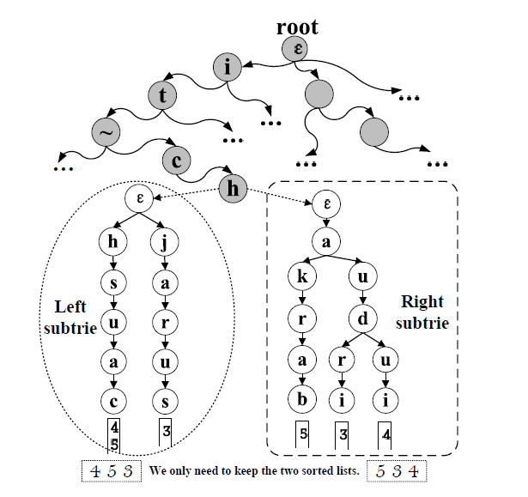
Trie-based Algorithm
Two-level Trie
Notes:
To avoid the duplicated computations on the shared segment
across different substrings

Slide 34
Outline
Motivation
Problem Formulation
Trie-based Framework
Trie-based Algorithms
Optimizing Partition Scheme
Experiment
Conclusion
Notes:
Next let’s discuss how to optimize partition scheme.

Slide 35
Observation
Even Partition:
vanateshe
van
ate
she
Notes:
We have an observation that different partition strategies will involve different number of extension operation.
For example, consider entity e2 = “vanateshe”. The even partition has three segments “van”, “ate”, “she”.

Slide 36
Observation
Even Partition:
vanateshe
Extend 5 times.
C=5
van
ate
she
an efficient filter for approximate membershep
checking. kaushit chekrabarti, surajit chaudhuri, vankatesh ganti, dong xin. vancouver, canada. sigmod 2008.
Notes:
The occurrence number of them are respectively 2, 2 and 1. In the EXTENSION operation, vankatesh will be considered five times.

Slide 37
Observation
Uneven Partition:
vanateshe
vana
tes
he
Notes:
But if we partition vankatesh into another three segments,“vana”, “tes”,“he”

Slide 38
Observation
Uneven Partition:
vanateshe
Extend 2 times.
C=2
vana
tes
he
an efficient filter for approximate membershep
checking. kaushit chekrabarti, surajit chaudhuri, vankatesh ganti, dong xin. vancouver, canada. sigmod 2008.
Notes:
Then the three segments respectively appear 0, 1 and 1 times in the document. Thus we only extend vankatesh twice in total.
So we want to select a best partition scheme with minimum extension operation.

Slide 39
Optimization Objectiveness
Entity: c₁ c₂ c₃ c₄ … … c_{m-2} c_{m-1} c_{m}
Segments:
g₁
g₂
… …
g_{τ}
g_{τ+1}
Appear Time:
Wg₁
Wg₂
Wg_{τ}
Wg_{τ+1}
Extension:
C= $\sum_{i=1}^{τ+1}{Wgi}$
Document
Optimization Objectiveness: C=M[τ+1][m].
M[i][j]: the minimum total appear times of the i segments generated by c₁c₂ … c_{j-1}c_{j}.
Notes:
Next we analysis the extension operation needed using a particular partition stratigy.
Here we have an entity and split it into tau plus one segments. Then the extension operation needed for this partition strategy is the sum of the appearance times of these tau plus one segments as show in the slide, which is also the optimize object of our problem.

Slide 40
Dynamic Programming
If the start position of last partition is p,
Then:
$$\text{C}\text{=}\text{M}\text{[}\text{τ}\text{+1][}\text{m}\text{]=}\text{M}\text{[}\text{τ}\text{][}\text{p}\text{−1]+}\text{W}c_{p}…c_{m}$$
Iterative we have
Notes:
we can devise a dynamic-programming algorithm to solve this problem.
The basic idea is to consider the last segment. Suppose the last segment has been partitioned, then we need to partition the other part into τ segments. This is a sub problem. Thus we can devise a dynamic-programming algorithm.
The recursive formula is listed below, Next we will need to determining the appearance times of a string in the document.

Slide 41
Determining Wg
Build A Suffix Trie.
The segment g
The number of subtrie leaf nodes
= The occurrence time in document = Wg
Notes:
To efficiently determining the appearance times of a segment, we can build a suffix trie over the document. For each trie node, the string from the root to the node corresponds to a possible segment, and the number of its leaf descendants is exactly its occurrence number in the document
In this way, we can easily determining the occurrence number of a segment using the trie structure.

Slide 42
Pruning
Even VS. Dict+Doc Method
Even involves larger candidate set
Dict+Doc counts the indexing time
Make indexing more efficient
Using Segment Length to Do Pruning.
Using Even-Partition Weight as An Upper Bound.
Adding Extra Pointers On Suffix Trie.
Notes:
if we use the document to determinate weights, the time of constructing suffix trie and partitioning the entities should be included in the running time for online extraction.
to accelerate partitioning entities we have developed several pruning technologies, but I will not go into the details. Please refer our paper.

Slide 43
Outline
Motivation
Problem Formulation
Trie-based Framework
Trie-based Algorithms
Optimizing Partition Scheme
Experiment
Conclusion

Slide 44
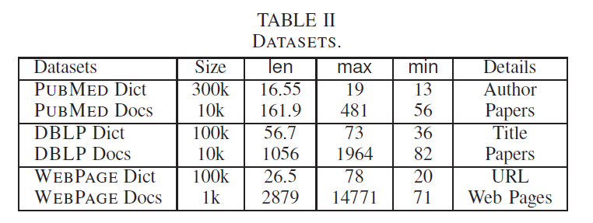
Experiment Setup
Three real Data sets
Existing algorithms
NGPP (downloaded from its hompage)
Faerie (we implemented)
Notes:
We used three real datasets, DBLP∗∗, PUBMED††, and Wiki
WEBPAGE‡‡.

Slide 45
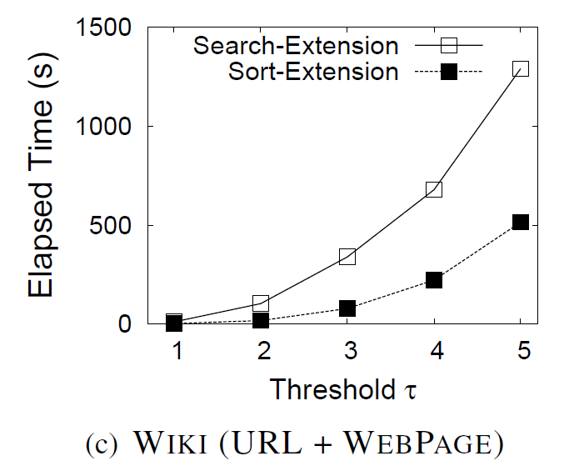
Search-Extension VS Sort-Extension
Notes:
SORT-EXTENSION was about 3-4 times faster than SEARCH-EXTENSION. This is because SORT-EXTENSION shares the computation on the common prefixes for different entities.

Slide 46
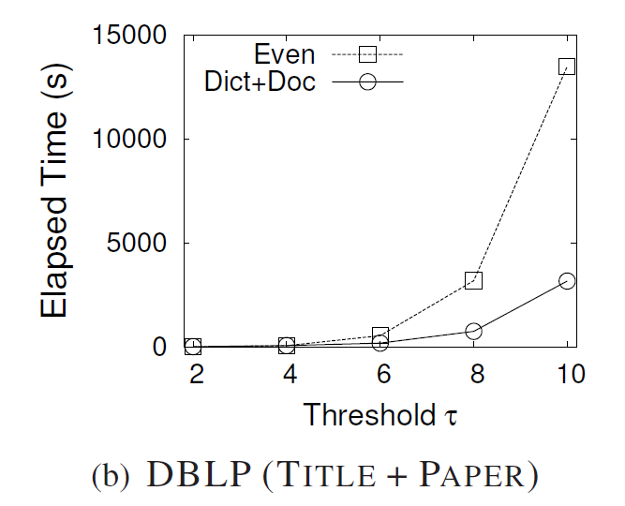
Partition : Even vs Dict+Doc
Notes:
EVEN partition method may involve large numbers of candidates for large thresholds and thus may lead to low performance.

Slide 47
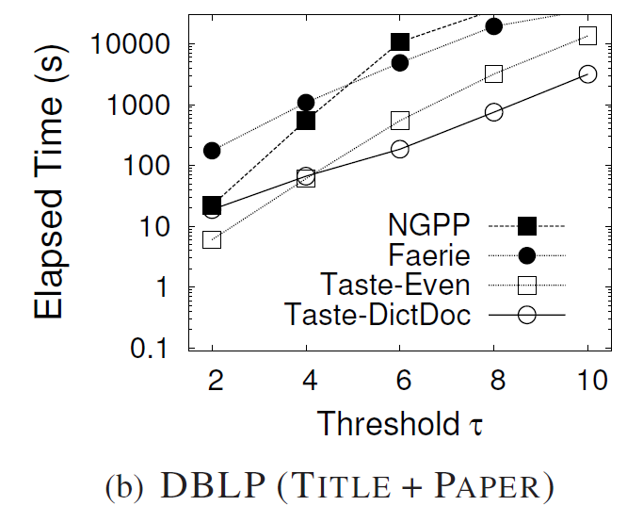
Comparison with State-of-the-art Methods
Faerie VS NGPP
Notes:
We see that our methods outperforms Faerie and NGPP, especially for large thresholds

Slide 48
Scalability with Dictionary Sizes
Notes:
Here we test the scalability of our method, we observe that our method scaled well as the dictionary size increased.

Slide 49
Outline
Motivation
Problem Formulation
Trie-based Framework
Trie-based Algorithms
Optimizing Partition Scheme
Experiment
Conclusion

Slide 50
Conclusion
Approximate entity extraction
A trie-based framework
A trie-based algorithm method
Selecting high-quality partition scheme
Notes:
In this talk we discuss the approximate entity extraction problem.
We propose a trie-base framework to solve this problem.
We develop an efficient extension-based framework to find similar pairs by extending the matching segments.
we study how to select the best partition strategy to improve the performance.

Slide 51
Thanks!
Q&A
http://dbgroup.cs.tsinghua.edu.cn/dd/projects/taste/
Notes:
Thank you very much! Welcome to our website for more information.

