Slide 1
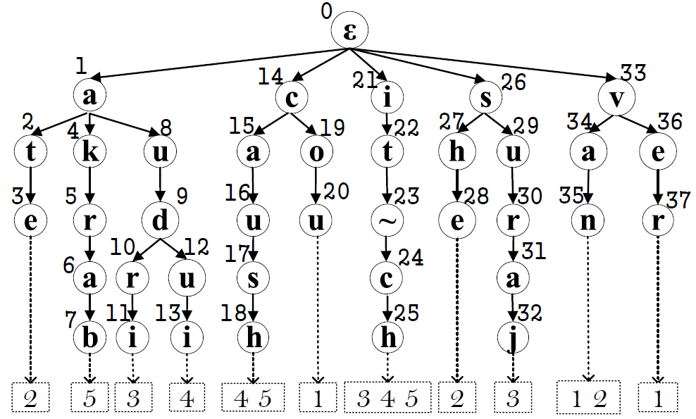
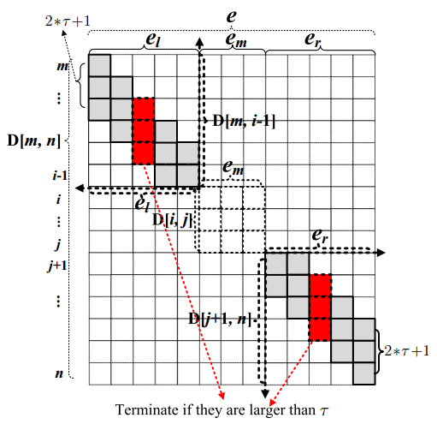
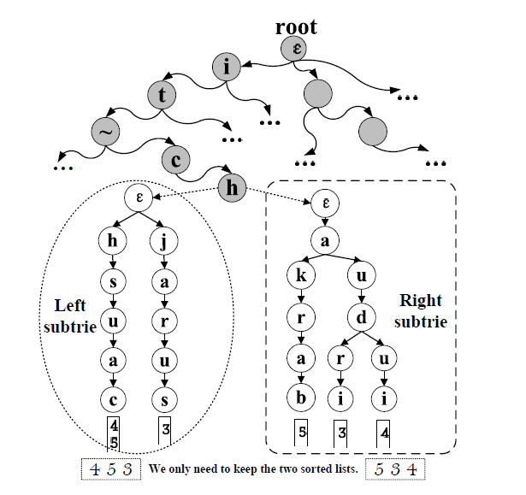
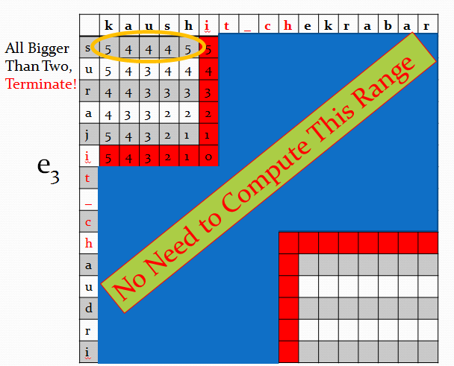
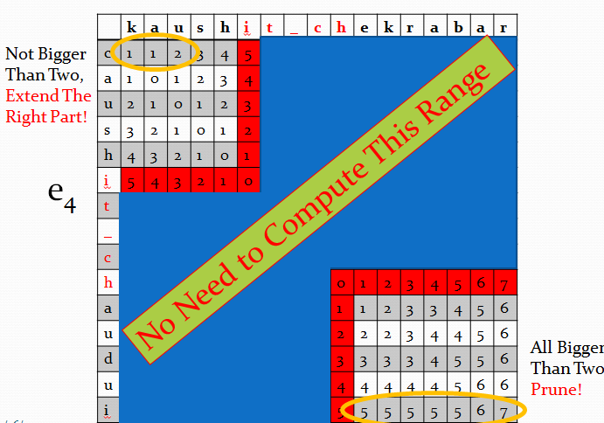
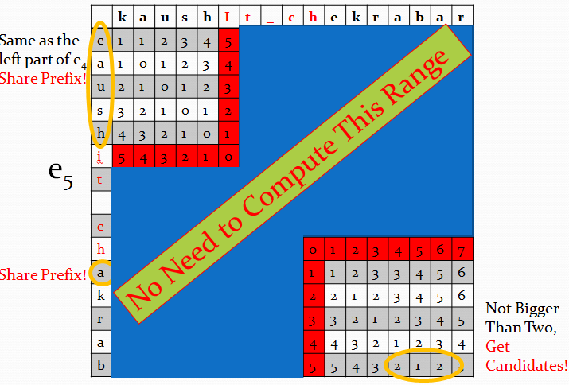
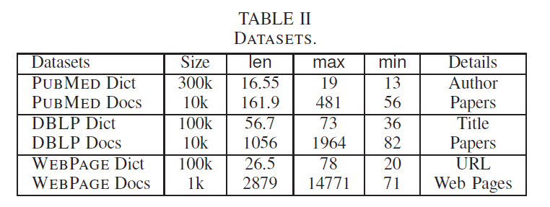
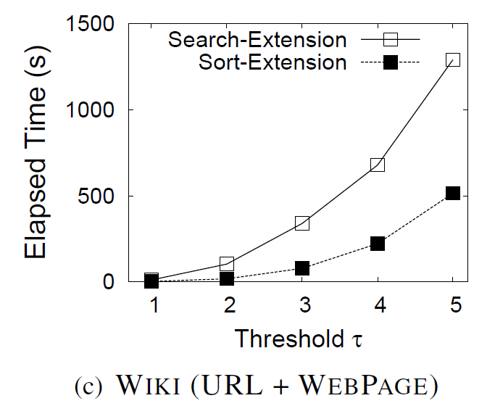
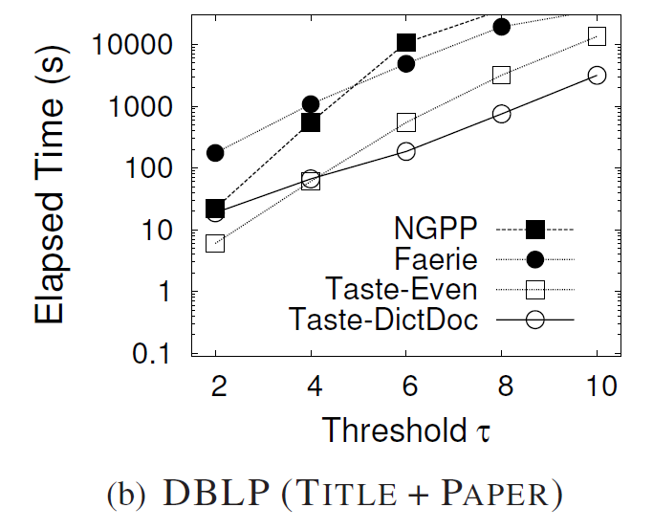
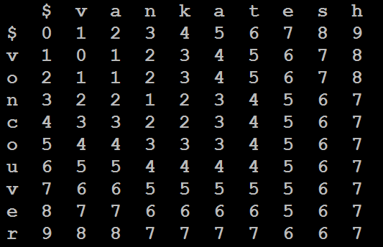
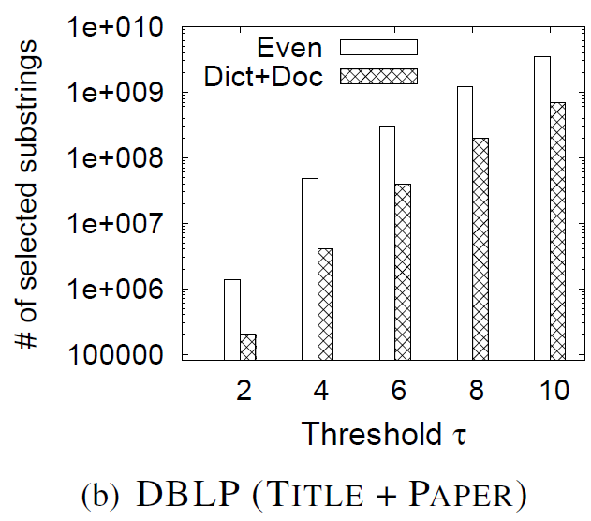
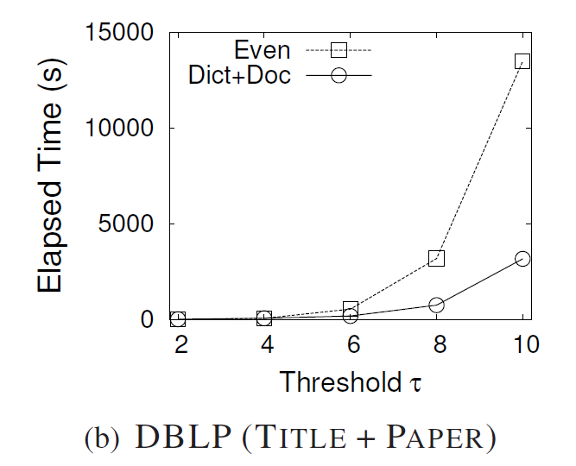
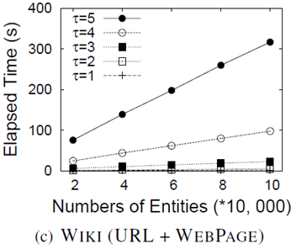
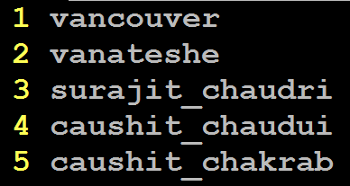
Trie-based Algorithms
Search-Extension Method
An Efficient Trie-based Method for Approximate Entity Extraction with Edit-Distance Constraints
1&2.the same with trie-search method[fig1&2]
3.1 Search: check whether each substring of the document is a trie leaf node.
3.2 Extension: Extend the matched segments to find similar pairs. [Fig 3]
Dong Deng, Guoliang Li, Jianhua Feng
Department of Computer Science, Tsinghua University, Beijing, China
Entity Extraction
Approximate Entity Extraction
Fig 2: Trie Structure
Sort-Extension Method
A Document
An Efficient Filter for Approximate Membership Checking. Venkaee shga Kamunshik kabarati, Dong Xin, Surauijt ChadhuriSIGMOD
#1: Data in real world is dirty
1.Sort the inverted list in leaf node
2.Share the computation of the longest common prefix while extending the matched segment.
ed: minimum # of single-character transformations
Surauijt Chadhuri
Surajit Chaudhuri
ed=3
Fig 4.2 Example 2
Fig 3 Extension
Fig 4.1 Example 1
Fig 4.3 Example 3
A Dictionary of Entities
1 Dong Xin 2 Surajit Chaudhuri
#2: Improve extraction quality
#3: Many real applications
Information retrieval
Molecular biology
Bioinformatics
Natural language processing
Entity Extraction
Locate entities from the document
e.g., Dong Xin
Optimizing Partition Scheme
vanateshe
vanateshe
Observation: Different partition scheme generates different candidate set with different size.
Problem Definition
Optimize Object: C=M[τ+1][m].
M[i][j]: the minimum total partition
weight to partition string c₁c₂ … c_{j-1}c_{j}
into i segments.
Given a dictionary of entities E = {e₁, e₂, . . . , e_{n}}, a document D, and a predefined edit distance threshold τ, approximate entity extraction finds all “similar” pairs <s, e_{i}> such that ED(s, e_{i}) ≤ τ, where s is a substring of D and e_{i}∈ E.
van
ate
she
vana
tes
he
Will Extend 5 times
Will Extend 2 times
Entity: c₁ c₂ c₃ c₄ … … c_{m-2} c_{m-1} c_{m}
Segments:
g₁
g₂
… …
g_{τ}
g_{τ+1}
Appear Time:
Wg₁
Wg₂
Wg_{τ}
Wg_{τ+1}
Entities
Document
Document
Dynamic Programming, the recursive formula:
Partition Scheme: Even VS. Dict+Doc
ID | Entities | Length
1 | vancouver | 10
2 | vanateshe | 11
3 | surajit_chaudri | 8
4 | caushit_chaudu | 8
5 | caushit_chakra | 9
an efﬁcient ﬁlter for approximate
membershep checking. kaushit chekrabarti, surajit chaudhuri, vankatesh ganti, dong xin. vancouver, canada. sigmod 2008.
1.Even scheme involves large candidate set size.
2.Dict+Doc scheme counts the indexing time in.
Accelerate Partition Scheme Selection:
1. Using segment length to do pruning.
2. Using even-scheme weight as upper bound.
3. Adding extra pointers on suffix trie.
Weight: build a suffix trie to determining Wc_{i} …c_{j}
An example result with ed threshold 2
<surajit_chaudri, surajit_chaudhuri>
Experiments
implemented in C++, Ubuntu: Intel Core E5420 2.5GHz CPU and 4 GB memory
Trie-based Framework
Datasets
Given an entity e with τ + 1 segments and
a substring s, if s is similar to e within
threshold τ , s must contain a substring
which is exactly a segment of e.
>= 1
edit operation
>= 1
edit operation
>= 1
edit operation
Search-Extension VS. Sort-Extension
Taste vs. Faerie & NGPP
>= τ + 1 = 3
edit operation
NOT SIMILAR
Trie-search:
Even vs. Dict+Doc:
Even vs. Dict+Doc:
1.partition the entities into segments [fig1]
2.index the segments using trie structure [fig2]
3.from the document, find the matched segments by enumerate all substrings.
Candidate Number
Elapsed Time
Scalibility
http://dbgroup.cs.tsinghua.edu.cn/dd/projects/taste
Fig 1: Partition
Copyright © 2012, Database Research Group, Tsinghua University

