Slide 1

Text In Pygame

Slide 2
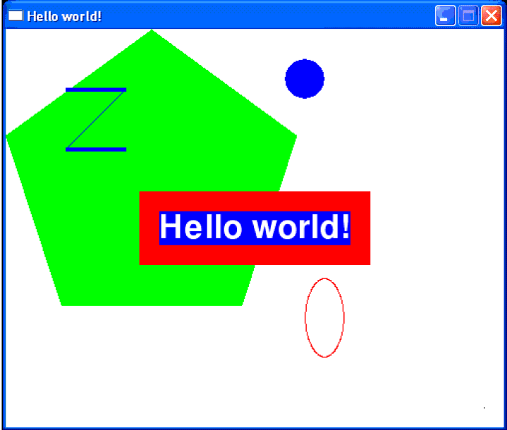
Displaying Text

Slide 3
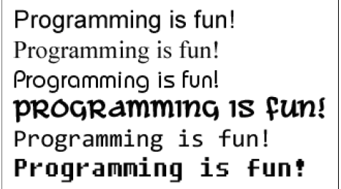
Fonts
A font is a complete set of letters, numbers, symbols, and characters of a single style. Here is an example of the same sentence printed in different fonts:

Slide 4
Set Up Fonts
We create a pygame.font.Font object (which we will just call Font objects for short) by calling the pygame.font.SysFont() function.
The first parameter is the name of the font, but we will pass the None value to use the default system font.
The second parameter will be the size of the font. In this example, we want the font size to be 48 points.

Slide 5

The Render Method
The Font object that we have stored in the basicFont variable has a method called render().
This method will create a Surface object with the text drawn on it.
The first parameter to render() is the string of the text to draw.
The second parameter is a boolean for whether or not we want anti-aliasing.

Slide 6
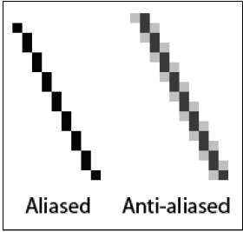
Anti-Aliasing
Anti-aliasing is a technique for making a
drawing look less blocky.
Anti-aliasing can make your text and lines look blurry but smoother.
It takes a little more computation time to do anti-aliasing, so although the graphics may look better, your program may run slower (but only just a little).

Slide 7
The Render Method
The 3rd parameter is the color of the text.
The 4th parameter is the color of the background.
The second line creates a rectangle around the text.

Slide 8
Attributes
The pygame.Rect data type (which we will just call Rect for short) makes working with rectangle-shaped things easy. Use your chart!

Slide 9
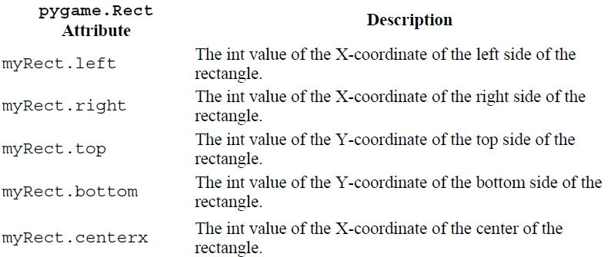
Attributes

Slide 10
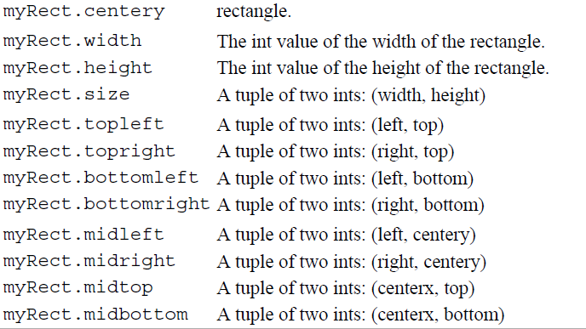
Attributes

Slide 11

Blit the Text Onto the Surface
The blit() method will draw the contents of one Surface object onto another Surface object.
This will draw the "Hello world!" text (which was drawn on the
Surface object stored in the text variable) and draws it to the Surface object stored in the windowSurface variable.
Remember that the text object had the "Hello world!" text drawn on it.

Slide 12
Displaying Text

