Slide 1
Sprites (Images) and
Sounds

Slide 2
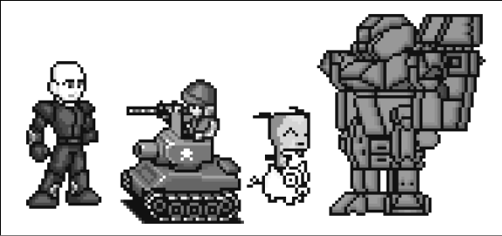
What are Sprites?
A sprite is a name for a single two-dimensional image that is used as part of the graphics on the screen. Here is an example:

Slide 3
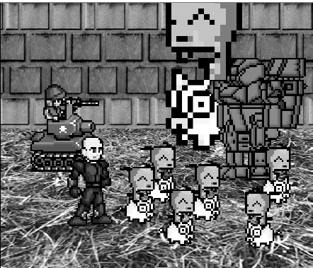
Sprites
This is an example of sprites being used in a complete scene.
The sprite images are drawn on top of the background.
Notice that we can flip the sprite image horizontally so that the sprites are facing the other way.
We can draw the same sprite image multiple times on the same window. We can also resize the sprites to be larger or smaller than the original sprite image.
The background image can also be considered one large sprite.

Slide 4
Images and Sound Files
Sprites are stored in image files on your computer. There are several different image formats that Pygame can use:
BMP
PNG
JPG (and JPEG)
GIF.
You can download images from your web browser or create your own using MS Paint or Photoshop.
Remember that the The sound file formats are
MID
WAV
MP3.

Slide 5
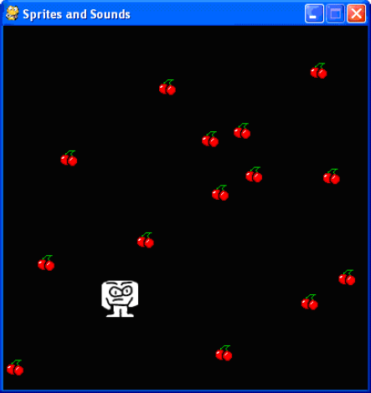
Sprites and Sound Program
This program is the same as the Keyboard and Mouse Input program.
However, in this program we will use sprites instead of plain looking squares. We will use a sprite of a little man instead of the white player square, and a sprite of cherries instead of the green food squares.
We also play background music and a sound effect when the player sprite eats one of the cherry sprites.

Slide 6
Sprites and Sound Program
Most of the code in this program was explained in the previous game, so we will only focus on the parts that add sprites and sound.
We are going to use 3 different variables to represent the player, unlike the previous programs that just used one.
The player variable will store a Rect object that keeps track of where and how big the player is.
The player variable doesn't contain the player's image, just the player's size and location.
At the beginning of the program, the top left corner of the player will be located at (300, 100) and the player will have a height and width of 40 pixels to start.

Slide 7
Sprites and Sound Program
The playerImage will be the 2nd variable to represent the player.
The pygame.image.load() function is passed a string of the filename of the image to load.
The return value of pygame.image.load() is a Surface object that has the image in the image file drawn on its surface. We store this Surface object inside of playerImage.

Slide 8
pygame.transform.scale() Function
The pygame.transform.scale() function can shrink or enlarge a sprite.
The first argument is a pygame.Surface object with the image drawn on it (playerImage).
The second argument is a tuple for the new width and height of the image in the first argument.
The function returns a pygame.Surface object with the image drawn at a new size.
We will store the stretched image in the playerStretchedImage variable (3rd player variable).

Slide 9
pygame.transform.scale() Function
On line 21, we call pygame.image.load() again to create a Surface object with the cherry image drawn on it.
Be sure that you have the player.png and cherry.png file in the same directory as the spritesAndSounds.py file.
The Surface objects that are stored in playerImage and foodImage are the same as the Surface object we use for the window.
In our game, we will blit these surfaces onto the window's surface to create the window that the user sees.

Slide 10
Setting up the Music and Sounds
Next we need to load the sound files. There are two modules for sound in Pygame.
The pygame.mixer module is responsible for playing short sound effects during the game.
The pygame.mixer.music module is used for playing background music.

Slide 11
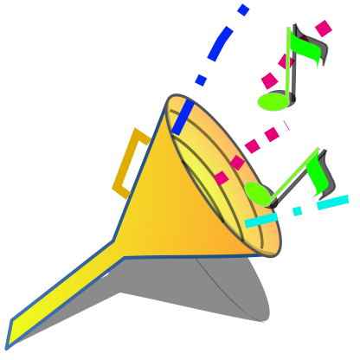
Setting up the Music and Sounds
We will call the pygame.mixer.Sound() constructor function to create a pygame.mixer.Sound object (which we will simply call a Sound object).
This object has a play() method that when called will play the sound effect.
On line 39 we load the background music by calling pygame.mixer.music.load().

Slide 12
Setting up the Music and Sounds
Finally, we have a simple boolean variable named musicPlaying that will tell our program if it should play the background music and sound effects or not.
It is nice to give the player the option to run the program without the sound playing.

Slide 13
Toggling the Sound On and Off
We will check if the user has pressed the M key. The M key will turn the background music on or off.
If musicPlaying is set to True, then that means the background music is currently playing and we should stop the music by calling pygame.mixer.music.stop().
If musicPlaying is set to False, then that means the background music is not currently playing and should be started by calling pygame.mixer.music.play().

Slide 14
Toggling the Sound On and Off
Finally, no matter what, we want to toggle the value in musicPlaying.
Toggling a boolean value means we set it to the opposite of its current value. False if it is True or True if it is currently False.
Think of toggling as what happens when you flip a light switch on or off.
Toggling the value in musicPlaying will ensure that the next time the user presses the M key, it will do the opposite of what it did before.

Slide 15
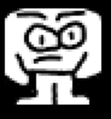
Drawing the Player on the Window
Remember that the value stored in playerStretchedImage is a Surface object.
"Blitting" is the process of drawing the contents of one Surface object to another Surface object.
In this case, we want to draw the sprite of the player onto the window's Surface object.
The second parameter to the blit() method is the Rect object that keeps track of the position of the player in the window.

Slide 16
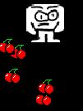
Checking if the Player has Collided with the Cherries
This code is similar to the code in the previous programs. But here we are adding a couple of new lines.
We want to call the play() method on the Sound object stored in the pickUpSound variable. But we only want to do this if musicPlaying is set to True (which tells us that the sound turned on).

Slide 17
Checking if the Player has Collided with the Cherries
When the player eats one of the cherries, we are going to enlarge the size of the player by two pixels in height and width.
On line 116, we create a new Rect object to store in the player variable which will have the same sizes as the old Rect object stored in player. Except the width and height of the new Rect object will be 2 pixels larger.

Slide 18
Checking if the Player has Collided with the Cherries
The Rect object that represents the position and size of the player is changed in size, so we need to create a new stretched image (to match the new size) by calling pygame.transform.scale().
Be sure to pass the original Surface object in playerImage and not playerStretchedImage. Stretching an image often distorts it a little. If we keep restretching a stretched image over and over, the distortions add up quickly.

Slide 19
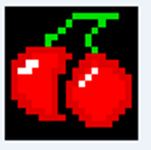
Drawing the Cherries on the Window
In our previous programs, we called the pygame.draw.rect() function to draw a green square for each Rect object stored in the foods list. However, in this program we want to draw the cherry sprites instead.

Slide 20
Drawing the Cherries on the Window
We will call the blit() method and pass the Surface object stored in foodImage. (This is the surface that has the image of cherries drawn on it.)
We only use the food variable (which contains each of the Rect objects in foods on each iteration through the for loop) to tell the blit() method where to draw the foodImage.

Slide 21
What is Next?
The Games:
Dodger
Wormy &
Flappy Bird

Slide 22
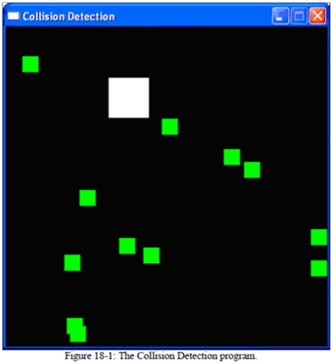
SpritesAndSound.py Lab
Type in and test the animation.
Experiment and make changes in the code so that you can understand what is going on and why.
Change the Sprites & Sounds
You will be working in groups to explain the code to the rest of the class.

