Slide 1
Keyboard Input

Slide 2
KeyboardInput.py
This program looks identical to the collision detection program
earlier in this chapter. But in this program, the bouncer only moves
around when we hold down keys on the keyboard.

Slide 3
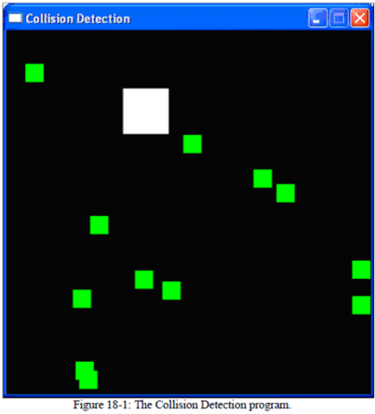
Keyboard Input
The "W" key moves the bouncer up.
The "A" key moves the bouncer to the left
The "D" key moves the bouncer to the right.
The "S" key moves the bouncer down.
The user can also use the keyboard's arrow keys.
We can also click anywhere in the GUI window and create new food objects at the coordinates where we clicked.
In addition, the ESC key will quit the program and the "X“ key will teleport the bouncer to a random place on the screen.

Slide 4
Same as Collision Detection

Slide 5
Same as Collision Detection

Slide 6
Setting up Window and data structures
We are going to use 4 different boolean variables to keep track of which of the arrow keys are being held down.
For example, the left arrow key will set the moveLeft variable to True. When the key is released, we will set the moveLeft variable back to False.
The "W" key (moveUp variable), the "S" key (moveDown), and the "D" key (moveRight) are set in a similar way.

Slide 7
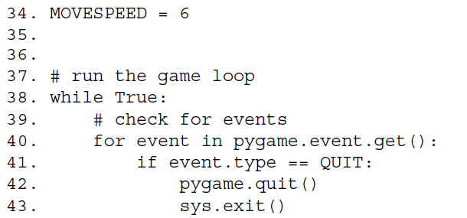
Same as Collision Detection
Lines 34 to 43 are identical to code in the previous Pygame programs. These lines handle the start of the game loop and handling what to do when the user wants to quit the program.

Slide 8
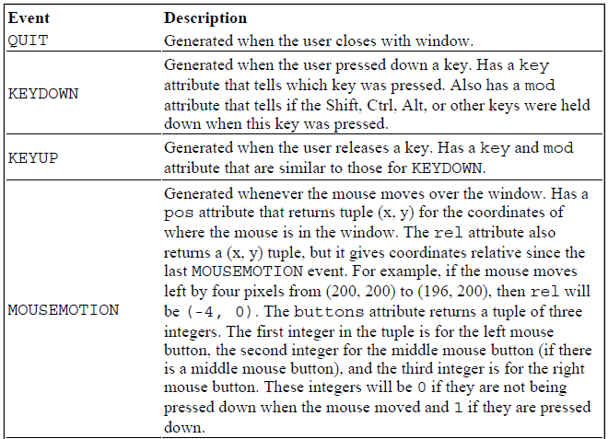
Events
We have seen the QUIT event being handled in our code. Below is a brief list of other events that could be returned by pygame.event.get()

Slide 9
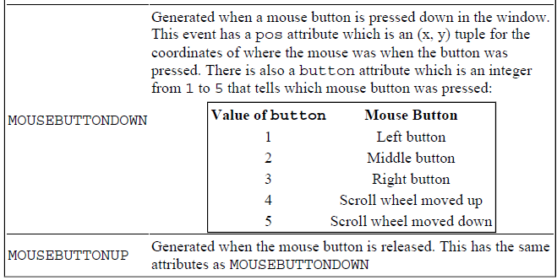
Events

Slide 10
Events
If the event type is KEYDOWN, then the event object will have a key attribute that will tell us which key was pressed down.

Slide 11
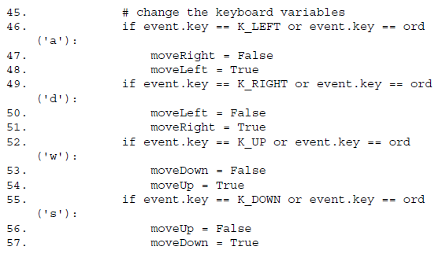
Events
On line 46, we can compare this value to K_LEFT, which represents the left arrow key on the keyboard. We will do this for each of the arrow keys: K_LEFT, K_RIGHT, K_UP, K_DOWN.
When one of these keys is pressed down, we will set the corresponding movement variable to True, and opposite to False.

Slide 12
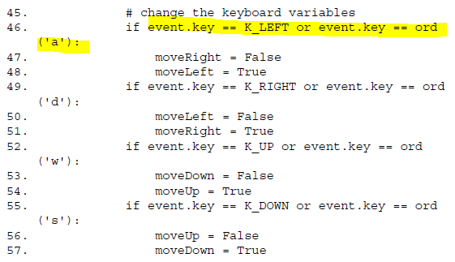
Events
You may notice that on line 46, event.key can either be equal to K_LEFT or ord('a'). The value in event.key is set to the integer ASCII value of the key that was pressed on the keyboard. (There is no ASCII value for the arrow keys, which is why we use the constant K_LEFT.) You can use the ord() function to get the ASCII value of any single character to compare it with event.key.

Slide 13
Handling the KEYUP Event
When the user releases the key that they are holding down, a KEYUP event is generated.
If the key that the user released was the Esc key, then we want to terminate the program.
Remember, in Pygame you must call the pygame.quit() function before calling the sys.exit() function. We want to do this when the user releases the Esc key, not when they first Esc key down.

Slide 14
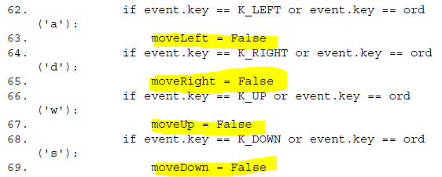
Handling the KEYUP Event
Lines 62 to 69 will set a movement variable to False if that direction's key was let go.

Slide 15
Teleporting the Player
If the user released one of the keys that moves the player, then we want to set the movement variable that corresponds with the key to False. This will tell the later parts of our program to no longer move the player's square on the screen.
We will also add teleportation to our game. If the user presses the "X" key, then we will set the position of the user's square to a random place on the window.
This will give the user the ability to teleport around the window by pushing the "X" key (though they can't control where they will teleport: it's completely random).

Slide 16
Handling the MOUSEBUTTONUP Event
Mouse input is handled by events just like keyboard input is.
The MOUSEBUTTONUP event occurs when the user clicks a mouse button somewhere in our window, and releases the mouse button.
The pos attribute in the Event object is set to a tuple of two integers for the XY coordinates.
On line 75, the X-coordinate is stored in event.pos[0] and the Ycoordinate is stored in event.pos[1].
We will create a new Rect object to represent a new food and place it where the MOUSEBUTTONUP event occurred. By adding a new Rect object to the foods list, a new food square will be displayed on the screen.

Slide 17
Moving the Bouncer Around the Screen
We have set the movement variables (moveDown, moveUp, moveLeft, and moveRight) to True or False depending on what keys the user has pressed.
Now we will actually move the player's square (which is represented by the pygame.Rect object stored in player) around by adjusting the XY coordinates of player.
If moveDown is set to True (and the bottom of the player's square is not below the bottom edge of the window), then we move the player's square down by adding MOVESPEED to the player's current top attribute. We do the same thing for the other three directions as well.

Slide 18
The Colliderect() Method
In our previous Collision Detection program, we had our own function to check if one rectangle had collided with another.
That function was included in this so that we could understand how the code behind collision detection works.
In this program, we can use the collision detection function that comes with Pygame. The colliderect() method for pygame.Rect objects is passed another pygame.Rect object as an argument and returns True if the 2 rectangles collide and False if they do not.
This is the exact same behavior as the doRectsOverlap() function in our previous Collision Detection program.

Slide 19
The Rest of the Program
The rest of the code is similar to the code in the Input program is similar to the Collision Detection program:
Draw the food squares and the player squares to the windowSurface surface.
Occasionally add a new food square at a random location to the foods list.
Check if the player square has collided with any of the food squares.
Call mainClock.tick(40) to make the program run at an appropriate speed.

Slide 20
What is Next?
Sprites and Sound

Slide 21
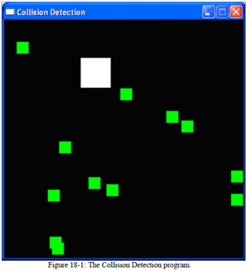
KeyboardInput.py Lab
Type in and test the animation.
Experiment and make changes in the code so that you can understand what is going on and why.
You will be working in groups to explain the code to the rest of the class.

