Slide 1

Animations

Slide 2
Animations
Now that we know how to get the Pygame framework to draw to the screen, let’s learn how to make animated pictures.
A game with only still, unmoving images would be fairly dull.
Sales of the game “Look At This Rock” have been disappointing.
Animated images are the result of drawing an image on the screen, then a split second later drawing a slightly different image on the screen.

Slide 3
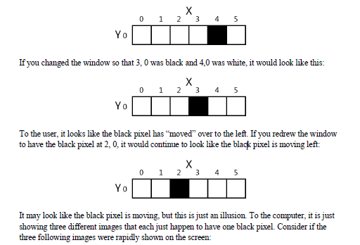
Animation
Imagine the program’s window was 6 pixels wide and 1 pixel tall, with all the pixels white except for a black pixel at 4, 0. It would look like this:

Slide 4
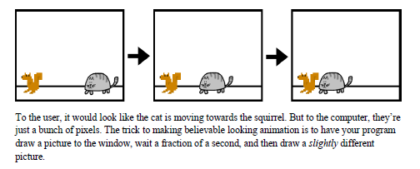
Animation

Slide 5
Our First Animation Program
We will save it as catanimation.py
You will need to have the image file cat.png to be in the same folder as catanimation.py

Slide 6
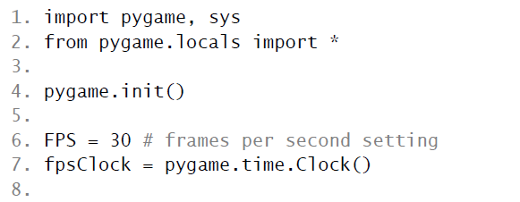
Catanimation.py
The frame rate or refresh rate is the number of pictures that the
program draws per second, and is measured in FPS or frames per second.
(On computer monitors, the common name for FPS is hertz.
Many monitors have a frame rate of 60 hertz, or 60 frames per second.)
A low frame rate in video games can make the game look choppy or
jumpy.
If the program has too much code to run to draw to the screen frequently
enough, then the FPS goes down.
The games we will cover won’t have this as an issue.

Slide 7
Pygame.time.clock()
A pygame.time.Clock object can help us make sure our program runs at a certain maximum FPS.
This Clock object will ensure that our game programs don’t run too fast by putting in small pauses on each iteration of the game loop.
If we didn’t have these pauses, our game program would run as fast as the computer could run it. This is often too fast for the player, and as computers get faster they would run the game faster too.

Slide 8
Pygame.time.clock()
A call to the tick() method of a Clock object in the game loop can make sure the game runs at the same speed no matter how fast of a computer it runs on.
The Clock object is created on line 7 of the catanimation.py program.

Slide 9
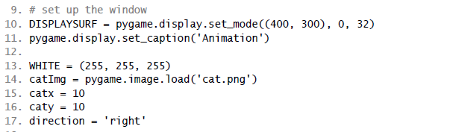
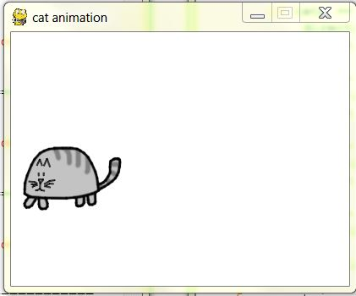
Catanimation.py

Slide 10
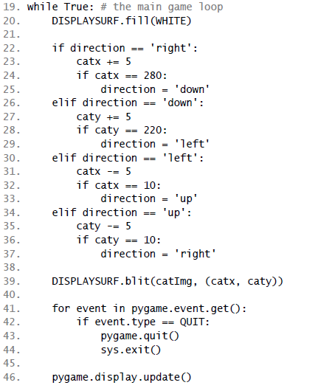
Catanimation.py

Slide 11
47. fpsClock.tick(FPS)
The Clock object’s tick() method should be called at the very end of the game loop, after the call to pygame.display.update().
The length of the pause is calculated based on how long it has been since the previous call to tick(), which would have taken place at the end of the previous iteration of the game loop. (The first time the tick() method is called, it doesn’t pause at all.)

Slide 12
7. fpsClock = pygame.time.Clock()
In this program, it is run on line 47 as the last instruction in the game loop.
All you need to know is that you should call the tick() method once per iteration through the game loop at the end of the loop. Usually this is right after the call to pygame.display.update().

Slide 13
FPS
Try modifying the FPS constant variable to run the same program at different frame rates.
Setting it to a lower value would make the program run slower.
Setting it to a higher value would make the program run faster.

Slide 14
Blitting
The image of the cat was stored in a file named cat.png. To load this file’s image, the string 'cat.png' is passed to the pygame.image.load() function.
The pygame.image.load() function call will return a Surface object that has the image drawn on it.
This Surface object will be a separate Surface object from the display Surface object, so we must blit (that is, copy) the image’s Surface object to the display Surface object.

Slide 15
Blitting
Blitting is drawing the contents of one Surface onto another. It is done with the blit() Surface object method.
If you get an error message like “pygame.error: Couldn't open cat.png” when calling pygame.image.load(), then make sure the cat.png file is in the same folder as the catanimation.py file before you run the program.

Slide 16
Blitting
Line 39 of the animation program uses the blit() method to copy catImg to DISPLAYSURF.
There are two parameters for blit().
The first is the source Surface object, which is what will be copied onto the DISPLAYSURF Surface object.
The second parameter is a two-integer tuple for the X and Y values of the topleft corner where the image should be blitted to.

Slide 17
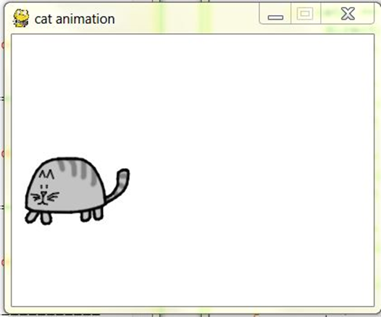
Catanimation.py
The rest of the game loop is just changing the catx, caty, and direction variables so that the cat moves around the window.
There is also a call to pygame.event.get() to handle the QUIT event.

Slide 18

Catanimation.py Lab
Type in and test the animation.
Change the speed
Make the cat move in the opposite direction
Change the cat to another image.

Slide 19
What is Next?
Sound

