Slide 1

Sound and more
Animations

Slide 2
Playing Sounds are important in Gaming
The Sound effects are good to play when the player takes damage, slashes a sword, or collects a coin.
Games are better if they have background music (to set the tone) playing regardless of what was going on in the game.

Slide 3
How do we add Sounds?
Pygame can only load one music file to play in the background at a time.
To load a background music file, call the pygame.mixer.music.load() function and pass it a string argument of the sound file to load.
This file can be WAV, MP3, or MIDI format.

Slide 4
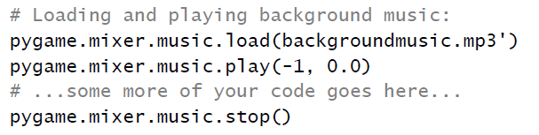
How do we add Sounds?

Slide 5
How do we add Sounds?
To begin playing the loaded sound file as the background music, call the pygame.mixer.music.play(-1, 0.0) function.
The -1 argument makes the background music forever loop when it reaches the end of the sound file. If you set it to an integer 0 or larger, then the music will only loop that number of times instead of looping forever.
The 0.0 means to start playing the sound file from the beginning. If you pass a larger integer or float, the music will begin playing that many seconds into the sound file. For example, if you pass 13.5 for the second parameter, the sound file will begin playing at the point 13.5 seconds in from the beginning.

Slide 6
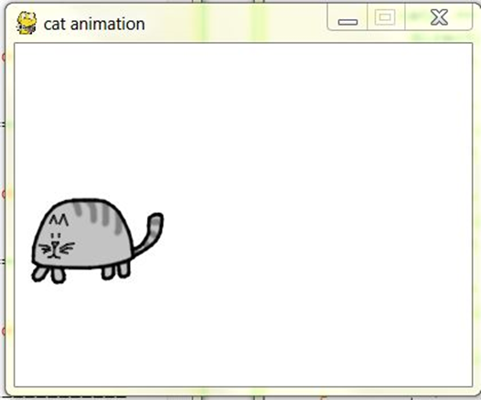

Catanimation.py Lab
Experiment with different sounds in your Catanimation.py program.
Try adding sound bits as well as background music.

Slide 7
What is Next?
More Animations

Slide 8
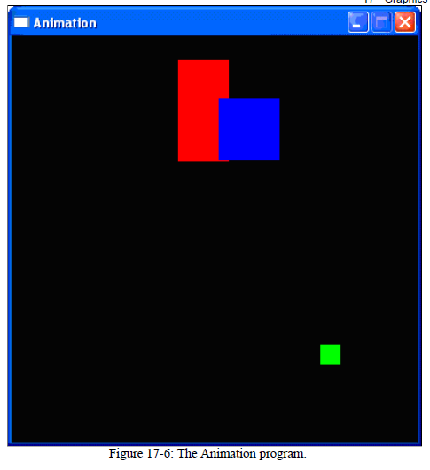
Animation.py

Slide 9
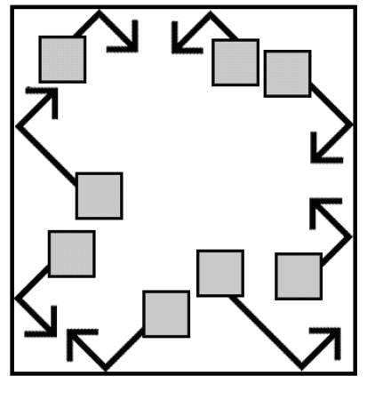
Animation.py
In this program we have several different blocks bouncing off of the edges of the window.
The blocks are different colors and sizes and move only in diagonal directions.

Slide 10
Animation.py
In order to animate the blocks (that is, make them look like they are moving) we will move the blocks a few pixels over on each iteration through the game loop.

Slide 11

How the Animation Program works
In this program, we will have three different colored blocks moving around and bouncing off the walls.
In order to do this, we need to first consider exactly how we want the blocks to move.

Slide 12

Moving and Bouncing the Blocks
Each block will move in one of four diagonal directions:
Down and left
Down and right
Up and left
Up and right.
When the block hits the side of the window, we want it to "bounce" off the wall and move in a new diagonal direction. The blocks will bounce as shown in the picture.

Slide 13
Moving and Bouncing the Blocks
The new direction that a block moves after it bounces depends on two things:
Which direction it was moving before the bounce
Which wall it bounced off

Slide 14
Moving and Bouncing the Blocks
There are a total of eight possible ways a block can bounce - two different ways for each of the four walls.
For example, if a block is moving down and right, and then bounces off of the bottom edge of the window, we want the block's new direction to be up and right.

Slide 15
Moving and Bouncing the Blocks
We can represent the blocks with a Rect object to represent:
The position and size of the block
A tuple of three ints to represent the color of the block
An integer to represent which of the four diagonal directions the block is currently moving.

Slide 16
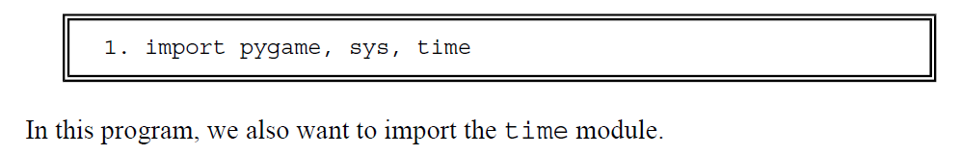
Animation.py

Slide 17
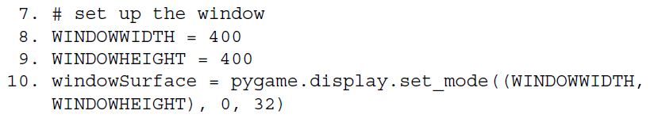
Animation.py
In this program the size of the window's width and height is used for more than just the call to set_mode().
We will use constant variables to make the program more readable. Remember, readability is for the benefit of the programmer, not the computer.
If we ever want to change the size of the window, we only have to change lines 8 and 9.

Slide 18
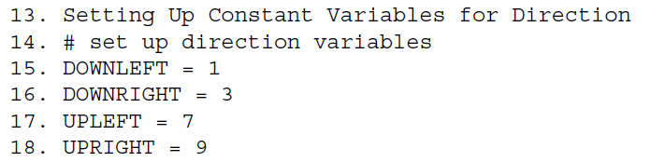
Animation.py
We will use the keys on the number pad of the keyboard to remind us which belongs to which direction.
1 is down and left
3 is down and right
7 is up and left
9 is up and right.
However, it may be hard to remember this, so instead we will use constant variables instead of these integer values.

Slide 19

Animation.py
We will use a constant variable to determine how fast the blocks should move.
A value of 4 means that each block will move 4 pixels on each iteration through the game loop.

Slide 20
Setting up the Blocks
We will set up a dictionary to be the data structure that represents each block.
The dictionary will have the keys of:
'rect' (with a Rect object for a value)
'color' (with a tuple of 3 ints for value)
'dir' (with one of our direction constant variables for a value).

Slide 21

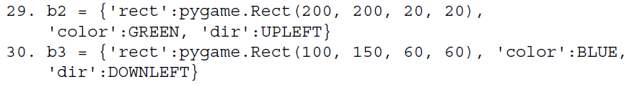

Setting up the Blocks
We will store these data structures in variables b1, b2, and b3
On line 31 we put all of these data structures in a list, and store the list in a variable named blocks.
blocks[0] is the dictionary b1

Slide 22
The Game Loop
Inside the game loop, we want to:
Move all of the blocks around the screen in the direction that they are going.
Bounce the block if they have hit a wall.
Draw all of the blocks to the windowSurface .
Call pygame.display.update() to draw the surface to the screen.
Call pygame.event.get() to check for QUIT event.

Slide 23
The Game Loop
Before we draw any of the blocks on the windowSurface surface, we want to fill the entire surface with black so that anything we previously drew on the surface is covered.
Once we have blacked out the entire surface, we can redraw the blocks.

Slide 24

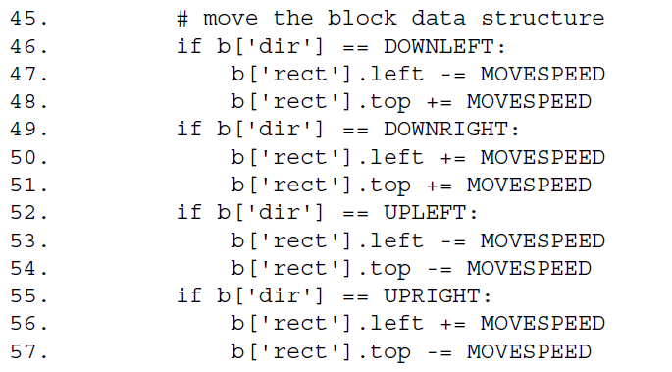
Moving Each Block
We want to update the position of each block, so we must loop through the blocks list and perform the same code on each block's data structure. Inside the loop, we will refer to the current block as b so it will be easy to type.

Slide 25
Moving Each Block
So if the direction of the block is either DOWNLEFT or DOWNRIGHT, we want to increase the top attribute.
If the direction is UPLEFT or UPRIGHT, we want to decrease the top attribute.
If the direction of the block is DOWNRIGHT or UPRIGHT, we want to increase the left attribute.
If the direction is DOWNLEFT or UPLEFT, we want to decrease the left attribute.

Slide 26
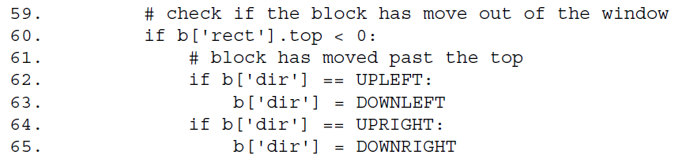
Checking If The Block Has Bounced
After we have moved the block, we want to check if the block has gone past the edge of the window.
If it has, we want to "bounce" the block, which in the code means set a new value for the block's 'dir' key.
When the direction is set, the block will move in the new direction on the next iteration of the game loop.

Slide 27
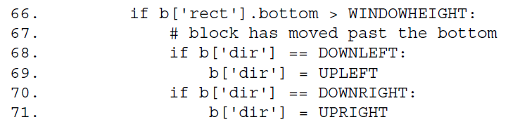
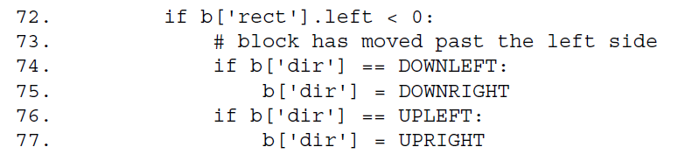
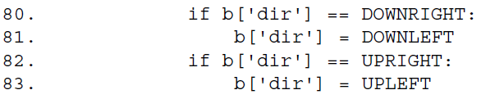
Checking If The Block Has Bounced
We need to make this check for each of the 4 edges of the window.

Slide 28

Drawing the Blocks in the Window
Now that we have moved the block (and set a new direction if the block has bounced off the window's edges), we want to draw it on the windowSurface surface. We can draw this using the pygame.draw.rect() function.
This is the last line of the for loop.
We want to run the moving, bouncing, and drawing code on each of the blocks stored in the blocks list, which is why we loop through each of them.
Also, if we wanted to add new blocks or remove blocks from our program, we only have to modify the blocks list and the rest of the code still works.

Slide 29
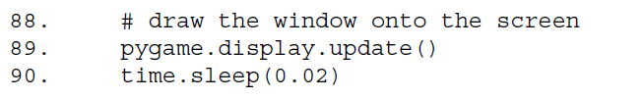
Drawing the Window on the Screen
The call to the time.sleep() function is there because the computer can move, bounce, and draw the blocks so fast that if the program ran at full speed, all the blocks would just look like a blur.
This call to time.sleep() will stop the program for 20 milliseconds. There are 1000 milliseconds in a second, so 0.001 seconds equals 1millisecond and 0.02 equals 20 milliseconds.

Slide 30
What is Next?
Collision Detection

Slide 31
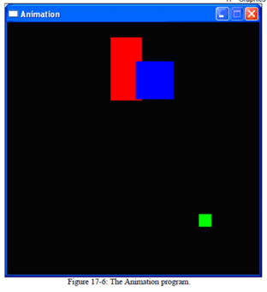
Animation.py Lab
Type in and test the animation.
Comment line 90 and see how fast it goes. Then change time to 1.0. What happens?
Comment “fill(black)” to see trail of rectangles
Add at least 2 more different
rectangles.

