Slide 1

Pixels, Colors and Shapes

Slide 2
Pixel Coordinates
The window that the “Hello World” program created was just composed of little square dots on your screen called pixels.
Each pixel starts off as black but can be set to a different color. Imagine that instead of a Surface object that is 400 pixels wide and 300 pixels tall, we just had a Surface object that was 8 pixels by 8 pixels. If that tiny 8x8 Surface was enlarged so that each pixel looks like a square in a grid, then a good representation of it could look something like this:

Slide 3
Pixel Coordinates
If you’ve taken a math class and learned about Cartesian Coordinates, you might notice that the Y-axis starts at 0 at the top and then increases going down, rather than increasing as it goes up. This is just how Cartesian Coordinates work in Pygame (and almost every programming language).
Each column of the X-axis and each row of the Y-axis will have an “address” that is an integer from 0 to 7 so that we can locate any pixel by specifying the X and Y axis integers.
For example, in the above 8x8 image, we can see that the pixels at the XY coordinates (4, 0), (2, 2), (0, 5), and (5, 6) have been painted black, the pixel at (2, 4) has been painted gray, while all the other pixels are painted white. XY coordinates are also called points.

Slide 4
Functions Vs. Methods
import whammy
fizzy() // function call
egg = Wombat() // Constructor function -returns
an object
egg.blahblah() // method call
(associated w/ object)
whammy.spam() // function – see import

Slide 5
A Bit about Surface Objects
Surface objects are objects that represent a rectangular 2D image.
The pixels of the Surface object can be changed by calling the Pygame drawing functions (more on these later…) and then displayed on the screen.
The window border, title bar, and buttons are not part of the display Surface object.

Slide 6
A Bit about Surface Objects
The Surface object returned by pygame.display.set_mode() is called the
display Surface.
Anything that is drawn on the display Surface object will be displayed on the window when the pygame.display.update() function is called.
It is a lot faster to draw on a Surface object (which only exists in the computer’s memory) than it is to draw a Surface object to the computer screen. Computer memory is much faster to change than pixels on a monitor.

Slide 7
A Bit about Surface Objects
Often your program will draw several different things to a Surface object.
Once you are done drawing everything on the display Surface object for this iteration of the game loop (called a frame), it can be drawn to the screen.
The computer can draw frames very quickly, and our programs will often run around 30 frames per second (that is, 30 FPS). This is called the “frame rate”

Slide 8
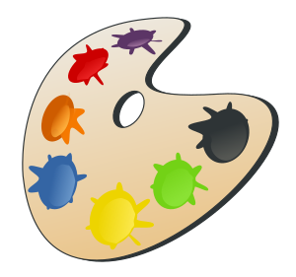
Colors

Slide 9
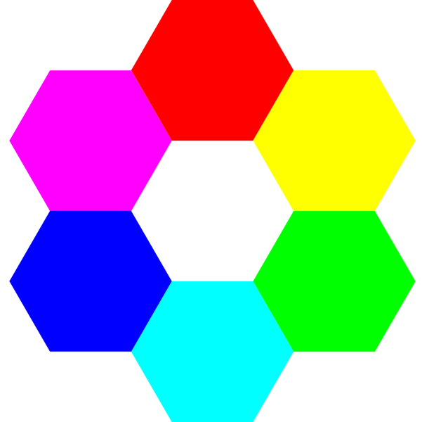
How is the Color of a PIXEL recorded?
It is represented using the RGB (Red, Green, Blue) color model.
In Python, we use tuples of 3 integers to represent the values of red, green, and blue each range from 0 to 255.
256 x 256 x 256 =
16,777,216 COLORS!
Error if <0 or >255

Slide 10
Color PIXELS
Combining color is not the same as mixing paint to make a color.
You can make yellow by combining red and green!
The computer uses light to display color, not paint.
SEE CD for example!

Slide 11
Color PIXELS
What RGB values do you think represents black? (?,?,?)
What RGB values do you think represents white? (?,?,?)
Only 16,777,214 colors Left!

Slide 12
Color - Opacity
The RGB model sometimes includes an alpha value as well that indicates how transparent or opaque the color is. A color that is transparent will let you see some of the color beneath it.
Think OPACITY in Alice
Alpha value of 0 - completely transparent
Alpha value of 255 – not transparent

Slide 13
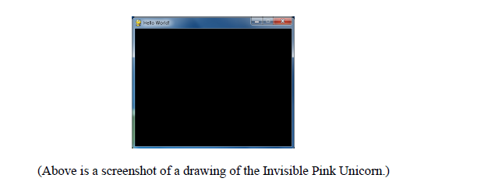
Color - Opacity

Slide 14
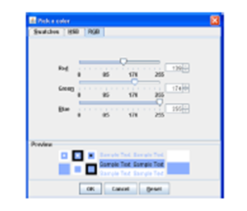
Color Exercise
Time to explore some colors!
Follow the handout and explore COlOR_CHOOSER!

Slide 15
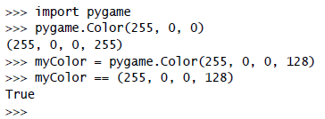
Color Objects
One way to create a color is as a pygame.Color object. You can create Color objects by calling the pygame.Color() constructor function and passing either three or four integers. You can store this Color object in variables just like you can store tuples in variables.

Slide 16
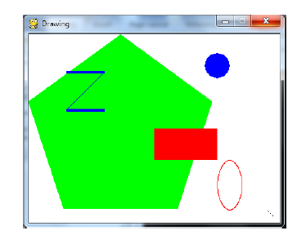
Drawing Shapes

Slide 17
Rectangle Objects
Pygame has two ways to represent rectangular areas (just like there are two ways to represent colors). The first is a tuple of four integers:
1. The X coordinate of the top left corner.
2. The Y coordinate of the top left corner.
3. The width (in pixels) of the rectangle.
4. Then height (in pixels) of the rectangle.

Slide 18
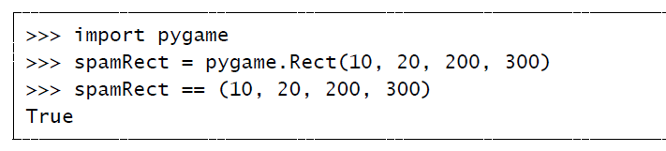
Rectangle Objects
The second way is as a pygame.Rect object, which we will call Rect objects for short. For example, the code below creates a Rect object with a top left corner at (10, 20) that is 200 pixels wide and 300 pixels tall:

Slide 19
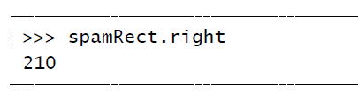
Rectangle Objects
The handy thing about this is that the Rect object automatically calculates the coordinates for other features of the rectangle.
For example, if you need to know the X coordinate of the right edge of the pygame.Rect object we stored in the spamRect variable, you can just access the Rect object’s right attribute:

Slide 20
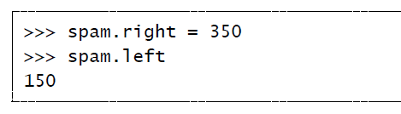
Rectangle Objects
The Pygame code for the Rect object automatically calculated that if the left edge is at the X coordinate 10 and the rectangle is 200 pixels wide, then the right edge must be at the X coordinate 210.
If you reassign the right attribute, all the other attributes are automatically recalculated:

Slide 21
Attributes that Pygame.Rect objects Provide

Slide 22
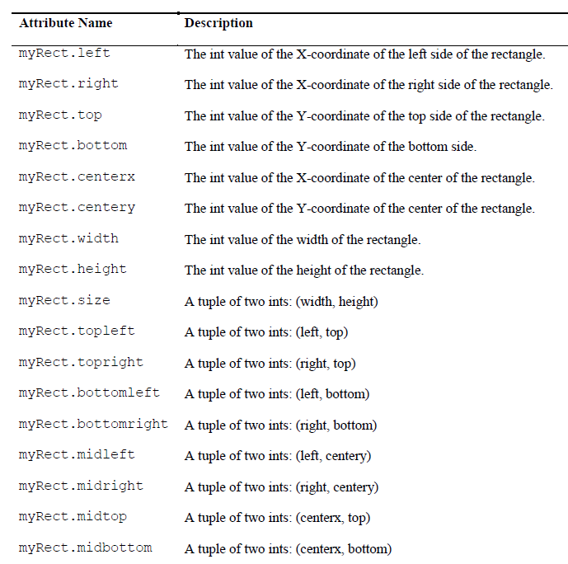
Rectangle Objects

Slide 23
Primitive Drawing Functions

Slide 24
Drawing Primitives
Pygame provides several different functions for drawing different shapes onto a surface object. These shapes such as:
Rectangles
Circles
Ellipses
Lines
Individual pixels
are called drawing primitives.

Slide 25
Our First Drawing Program

Slide 26

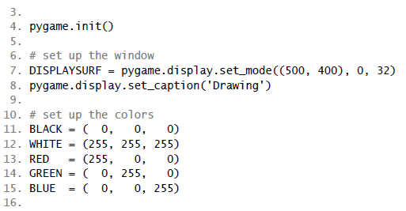
Drawing.py

Slide 27
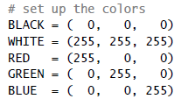
Drawing.py
Notice how we make constant variables for each of the colors?
Doing this makes our code more readable.
GREEN in the source code is easier to understand than (0, 255, 0) !

Slide 28
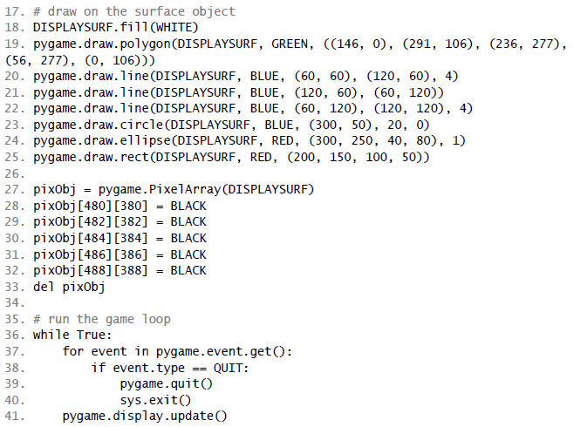

Drawing.py

Slide 29
Drawing.py
The drawing functions are named after the shapes they draw.
The parameters you pass these functions tell them:
  Which Surface object to draw on
  Where to draw the shape (and what size)
  What color to use
  And how wide to make the lines.

Slide 30
Drawing Functions
Please refer to handout to see a list of the functions in more detail.

Slide 31
Pixel Array Objects
Unfortunately, there isn’t a single function you can call that will set a single pixel to a color (unless you call pygame.draw.line() with the same start and end point).
The Pygame framework needs to run some code behind the scenes before and after drawing to a Surface object.
If it had to do this for every single pixel you wanted to set, your program would run much slower. (Almost 2 to 3 times slower).

Slide 32
Pixel Array Objects
Instead, you should create a
pygame.PixelArray object
(we’ll call them PixelArray objects for short) of a Surface object and then set individual pixels.
Creating a PixelArray object of a Surface object will “lock” the Surface object.
While a Surface object is locked, the drawing functions can still be called on it, but it cannot have images like PNG or JPG images drawn on it.

Slide 33
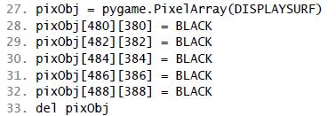
Pixel Array Objects
The PixelArray object that is returned from pygame.PixelArray() can have individual pixels set by accessing them with two indexes.
For example, line 28’s pixObj[480][380] = BLACK will set the pixel at X coordinate 480 and Y coordinate 380 to be black.

Slide 34
Pixel Array Objects
To tell Pygame that you are finished drawing individual pixels, delete the PixelArray object with a del statement. See line 33
Deleting the PixelArray object will “unlock” the Surface object so that you can once again draw images on it.
If you forget to delete the PixelArray object, the next time you try to blit (that is, draw) an image to the Surface, you will get an ERROR.

Slide 35
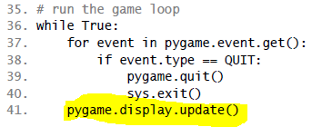
Pygame.display. Update() function
After you are done calling the drawing functions to make the display Surface object look the way you want, you must call pygame.display.update() to make the display Surface actually appear on the user’s monitor.

Slide 36

Pygame.display. Update() function
The one thing that you must remember is that pygame.display.update() will only make the display Surface (that is, the Surface object that was returned from the call to pygame.display.set_mode()) appear on the screen.
If you want the images on other Surface objects to appear on the screen, you must “blit” them (that is, copy them) to the display Surface object with the blit() method. We will discuss this later…

Slide 37
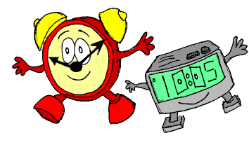
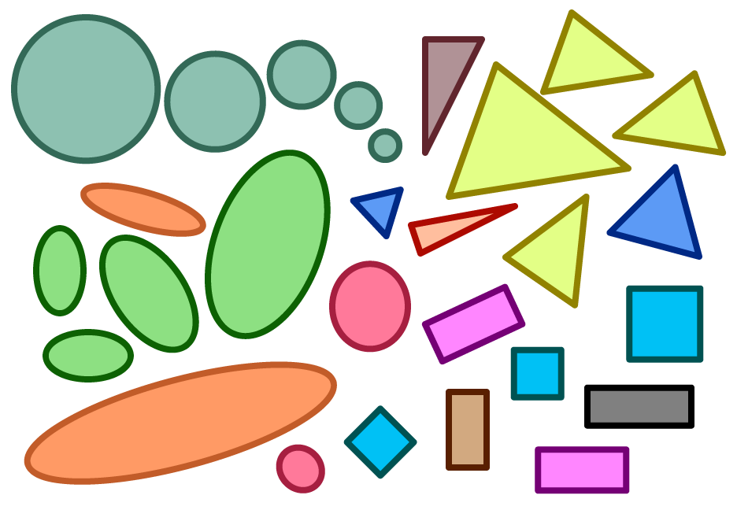
PROJECT TIME!!!!
Use your new found knowledge of shapes to create your own works of art!
Be creative, you can create houses, snowmen, landscapes and MORE!

Slide 38
What is Next?
Animations
Animations

