Slide 1

PYGAME

Slide 2
Pygame Basics
Just like how Python comes with several modules that provide additional functions for your programs (like math and random), the Pygame framework includes several modules with functions for:
  drawing graphics
  playing sounds
  handling mouse input
  And more!

Slide 3
Some Pygames

Slide 4
GUI vs. CLI
The Python programs that you can write with Python’s built-in functions only deal with text through the print() and input() functions.
Your program can display text on the screen and let the user type in text from the keyboard. This type of program has a command line interface, or CLI (which is pronounced like the first part of “climb” and rhymes with “sky”).

Slide 5
GUI vs. CLI
These programs are somewhat limited because they can’t display graphics, have colors, or use the mouse.
These CLI programs only get input from the keyboard with the input() function and even then user must press Enter before the program can respond to the input.
This means real-time (that is, continuing to run code without waiting for the user) action games are impossible to make.

Slide 6
GUI vs. CLI
Pygame provides functions for creating programs with a graphical user interface, or GUI (pronounced, “gooey”).
Programs with a graphics-based GUIs can show a window with images and colors.

Slide 7
Hello World
Our first program using Pygame will be a small program that makes a window that says
“Hello World!” appear on the screen.

Slide 8
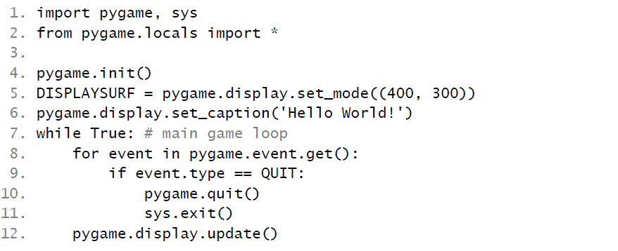
Hello World
Create a script called blankpygame.py
Type in the following program (do not include numbers or the periods at the beginning of the line – they are just for reference.)

Slide 9
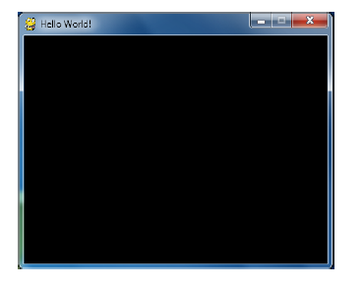
Hello World
When you run this program, a black window like this will appear:
Yay! We’ve just made
The world’s most boring video game!

Slide 10
Hello World
It’s just a blank window with “Hello World!” at the top of the window (in what is called the window’s title bar, which holds the caption text).
But creating a window is the first step to making graphical games. When you click on the X button in the corner of the window, the program will end and the window will disappear.

Slide 11

Hello World – A Closer Look
The first few lines of code are lines that will begin almost every program you write that uses Pygame.
Line 1 is a simple import statement that imports the pygame and sys modules so that our program can use the functions in them.
All of the Pygame functions dealing with graphics, sound, and other features that Pygame provides are in the pygame module.

Slide 12
Hello World
We can’t use the input() or print() functions in a Pygame GUI. We will learn more about input and output in Pygame later.
Let’s take a closer look to the “Hello World” program!

Slide 13
Hello World – A Closer Look
Line 2 is also an import statement. It uses the form modulename import * format.
Normally if you want to call a function that is in a module, you must use the modulename.functionname() format after importing the module.
However, with from modulename import *, you can skip the modulename. portion and simply use functionname() (just like Python’s built-in functions).

Slide 14

Hello World – A Closer Look
Line 4 is the pygame.init() function call, which always needs to be called after importing the pygame module and before calling any other Pygame function.
You don’t need to know what this function does, you just need to know that it needs to be called first in order for many Pygame functions to work.
If you ever see an error message like
pygame.error: font not initialized,
check to see if you forgot to call pygame.init() at the start of your program.

Slide 15
Hello World – A Closer Look
Line 5 is a call to the pygame.display.set_mode() function, which returns the pygame.Surface object for the window. More on surface objects later…
Notice that we pass a tuple value of two integers to the function: (400, 300). This tuple tells the set_mode() function how wide and how high to make the window in pixels. (400, 300) will make a window with a width of 400 pixels and height of 300 pixels.
NOTE: An error will occur if it is not a tuple.

Slide 16
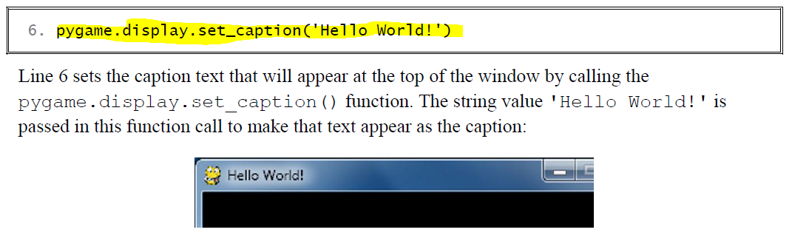
Hello World – A Closer Look

Slide 17

Hello World – A Closer Look - Game States
Most of the games we will be looking at have these while True loops in them along with a comment calling it the “main game loop”. A game loop (also called a main loop) is a loop where the code does three things:
1. Handles events.
2. Updates the game state.
3. Draws the game state to the screen.

Slide 18
The Game State
The game state is simply a way of referring to a set of values for all the variables in a game program. In many games, the game state includes the values in the variables that tracks the player’s health and position, the health and position of any enemies, which marks have been made on a board, the score, or whose turn it is.
Whenever something happens like the player taking damage (which lowers their health value), or an enemy moves somewhere, or something happens in the game world we say that the game state has changed.

Slide 19
The Game State
If you’ve ever played a game that lets you save, the “save state” is the game state at the point that you’ve saved it. In most games, pausing the game will prevent the game state from changing.

Slide 20
The Game State
Since the game state is usually updated in response to events (such as mouse clicks or keyboard presses) or the passage of time, the game loop is constantly checking and re-checking many times a second for any new events that have happened. This is usually called event handling.

Slide 21

Hello World – The QUIT Event
Event objects have a member variable (also called attributes or properties – remember ALICE?) named type which tells us what kind of event the object represents.
Line 9 checks if the Event object’s type is equal to the constant QUIT. Remember that since we used the from pygame.locals import * form of the import statement, we only have to type QUIT instead of pygame.locals.QUIT.

Slide 22
Hello World – A Closer Look
Line 12 calls the pygame.display.update() function, which draws the Surface object returned by pygame.display.set_mode() to the screen (remember we stored this object in the DISPLAYSURF variable).
Since the Surface object hasn’t changed, the same black image is redrawn to the screen each time pygame.display.update() is called.

Slide 23
Hello World – That is IT!
That is the entire program!
After line 12 is done, the infinite while loop starts again from the beginning.
This program does nothing besides make a black window appear on the screen, constantly check for a QUIT event, and then redraws the unchanged black window to the screen over and over again.

Slide 24
What is Next?
Let’s learn how to make interesting things appear on this window instead of just blackness by learning about :
Pixels
Surface objects
Color objects
Rect objects
Pygame drawing functions.

